Slide 1







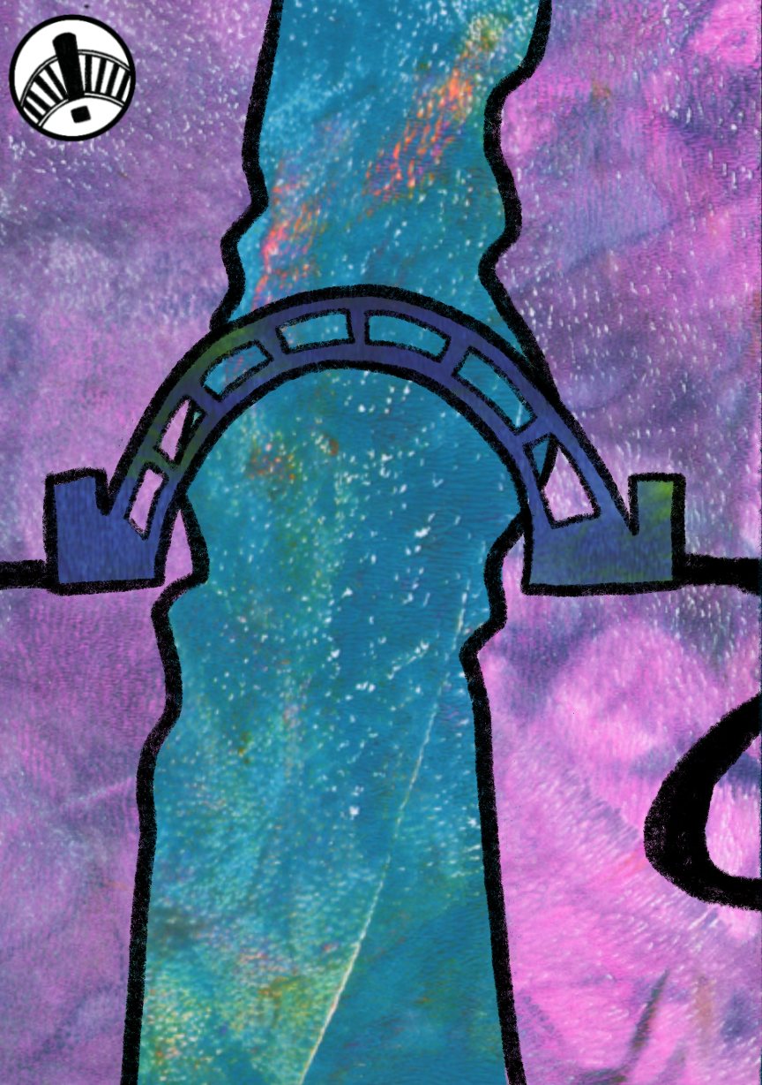
Game-Changer Strategies in Interdisciplinary Collaboration: Creative ways to bring supportive understanding to research environments
Dr Charlotte George
University of Oxford
Dr Inna Yaneva-Toraman
University of Edinburgh
i.yaneva-toraman@ed.ac.uk
charlotte.george@imm.ox.ac.uk

Slide 2






Researchers face interdisciplinary barriers across whole ecosystem
www.x-net.bio
Teams
Departments
Institutes
Funders
Publishers
Communities
Local
Global
“People can be supportive in principle but dismissive in details”​
Anonymous interdisciplinary researcher
Notes:
As Cristina’s just highlighted the X-NET project surfaced numerous barriers to interdisciplpinary research embedded throughout the academic system from local to the global level, but fundamentally what underlies it all is a widespread misunderstanding about how to work with others outside narrow, and much of this is in the small detail of how teams function

Slide 3


Need for developing collaborative capacity
www.x-net.bio
Public and Patients
Industry
“If researchers are not working together, it creates reputational damage and creates mistrust”​
“Around 50% of researchers are not ‘naturally’ collaborative ”​
“Need for more holistic training of PhD and post-docs, moving towards team working rather than an individualistic training focus”
“Leave ego at the door”​
“academia is so close and people have only ever seen one way of working”
60% agreed a career in interdisciplinary research is harder
70% agreed working in an interdisciplinary team is harder
“It is very valuable to industry when academia produces interdisciplinarians with the skills and experiences required to work in and lead multidisciplinary agile teams”
HxC Researcher Survey 2025
XNET – Industry Cross-disciplinary training needs workshop
Notes:
This was really highlighted by the work X-NET did with patients and the public who expect researchers to be working together and the consequenses of not doing this well resulting in reputational damage and mistrust and then by industry who told us in no uncertain terms that collaboration and team working are not natural skills for many, it’s incredibly valuable for them researchers to have these skills and we need to be better at enabling collaborative training particularly at early career points were the focus is often on being a individual PhD

Slide 4









Opportunities to influence collaborative capacity in the research project lifecycle
Pre-collaboration
Network building
Initial team recruitment
proposal design
and applying for funding
Building research team
Conducting research
Reporting
outputs
Notes:
Multiple opportunities to improve collaborative capacity of researchers along the project lifescycle - today in this talk we will talk about activities from two MRC biomedical leadership awards HxC and INTEGRATE that were spun put of the XNET project and GRID INFRAME

Slide 5

Opportunities to influence collaborative capacity in the research project lifecycle
Pre-collaboration
Network building
Initial team recruitment,
proposal design
and applying for funding
Building research team
Conducting research
Reporting
outputs
Interdisciplinary
peer-mentoring
Mapping of Good Practices
Interdisciplinary support & team working
Hackathons
GRID Game
Code of Conduct Toolkit
Training Videos
INTEGRATE & HxC are Part of the MRC-funded Biomedical Data Science Leadership Awards
Notes:
From INTRAGE I’m sharing findings from initatives Peer-mentoring and hackatons targeting the pre-project collaboration and network building and Inna will be sharing insights from the HxC and GRID/INFrame project aimed at improving the collaboration of assembled teams.

Slide 6
UK Survey: Majority of interdisciplinary biomedical data science researchers want better connections and opportunities for development
Percentage of respondents (out of 69) interested in:
Professional skills and career development workshops
77% (53)
Connecting with researchers from adjacent field at similar career stage through peer mentoring
68% (47)
>80% would like a stronger peer support network with mathematical or computational colleagues
72% think a code of conduct would be useful in future collaborative projects
Industry secondments
51% (35)
Hackathons
51% (35)
Traditional career mentoring
41% (28)
Number of respondents
INTEGRATE: Survey March 2026 (Preliminary results)

Slide 7



Bytes and Bench Peer Mentoring
Mentoring programme that brings together post-doctoral researchers from computational and laboratory-based disciplines
Aims:
Reach siloed post-doctoral researchers and build connections
Improve interdisciplinary communication
Promote knowledge and skills exchange across disciplines
Recruitment
and Baseline survey
Opening workshop
End
Workshop
Final Survey
Mid-scheme Workshop
Scheme running
Evaluation
Jan 26
Mar
Oct
Dec/Jan
Post-doctoral researchers from different backgrounds in groups of 3
UK-Wide
Fully online
Meet monthly 5-6 times
over 6 months

Slide 8

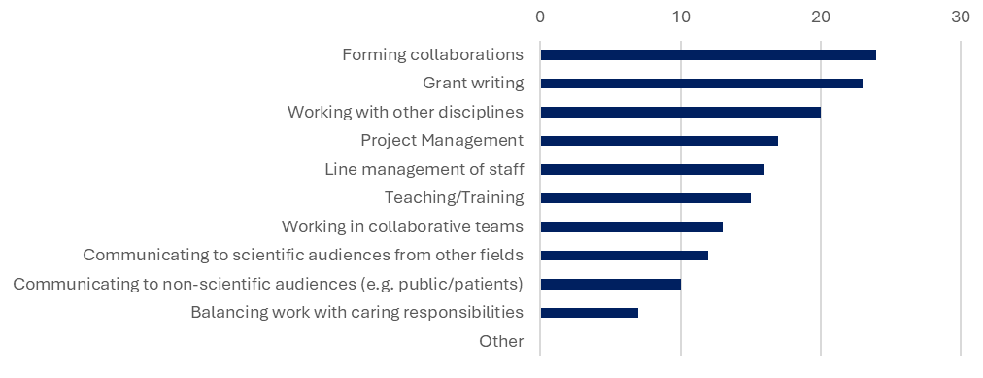
Bytes and Bench Peer Mentoring
What do you want to discuss as part of this programme?
Recruitment Jan 2026 UK biomedical data science networks, MRC investments & Social Media
High demand – 52 post-docs applied, 30 accepted
Participant Motivation
“I’d also like a supportive space to ask "basic" questions in both directions”
Mentoring Package
Ethics, recruitment, code of conduct workshop materials, available at:
https://osf.io/2vg38/overview
Happy to share resources and welcome feedback to make as useful as posible across diverse settings
Integrate@imm.ox.ac.uk

Slide 9
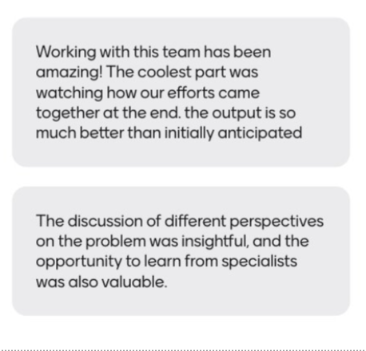
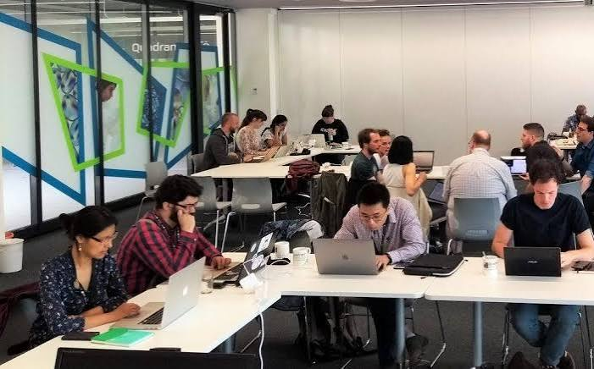
Hackathon learnings
2-5 day (24 total work time) event bringing reseachers and professionals from different disciplines and sectors together in small teams
5 small teams 'compete' to solve a problem given certain data
Mixed disciplines, ability, career stages, sectors
Sharing of good practices and understanding of different fields
Technical and communication skills gained
High time and preparation but high reward
  "Really enjoying the atmosphere - collaboration and team work is really good" ​
  "it's intimidating talking to other researchers - nice to have a task to focus on and help break down the barriers"
  "Made connections, I'll keep in contact with to ask for advice"
Need for good scene-setting, pre-training and codes of conduct to set tone of good behaviors

Slide 10




HxC – Healthier Science through Collaboration
GRID
Aim 3: Compose research culture guidelines that facilitate equitable, respectful, and effective interdisciplinary teams.
GRID – Games for Research and Interdisciplinary Dialogue
Aims 1&2: Identify the challenges to interdisciplinary collaboration and design an open access boardgame to foster better interdisciplinary dialogue.

Slide 11
GRID
Evidence
Insights
Action
Community-wide survey of interdisciplinary researchers
Co-design workshops
Real-life examples of interdisciplinary research challenges - including team dynamics, disciplinary hierarchies, lack of recognition, and communication
Real-life examples of good practices to mitigate these issues
Training and guidance needed in shared decision making, roles and responsibilities, code of conduct and more
Evidence of how these tools support teams must be collected by testing within teams
Trust and team-building is often established in informal settings
Yet teams are under time and resource constraints
Developed evidence-based guidance and training materials
Tools and training should be easy, quick, and practical

Slide 12

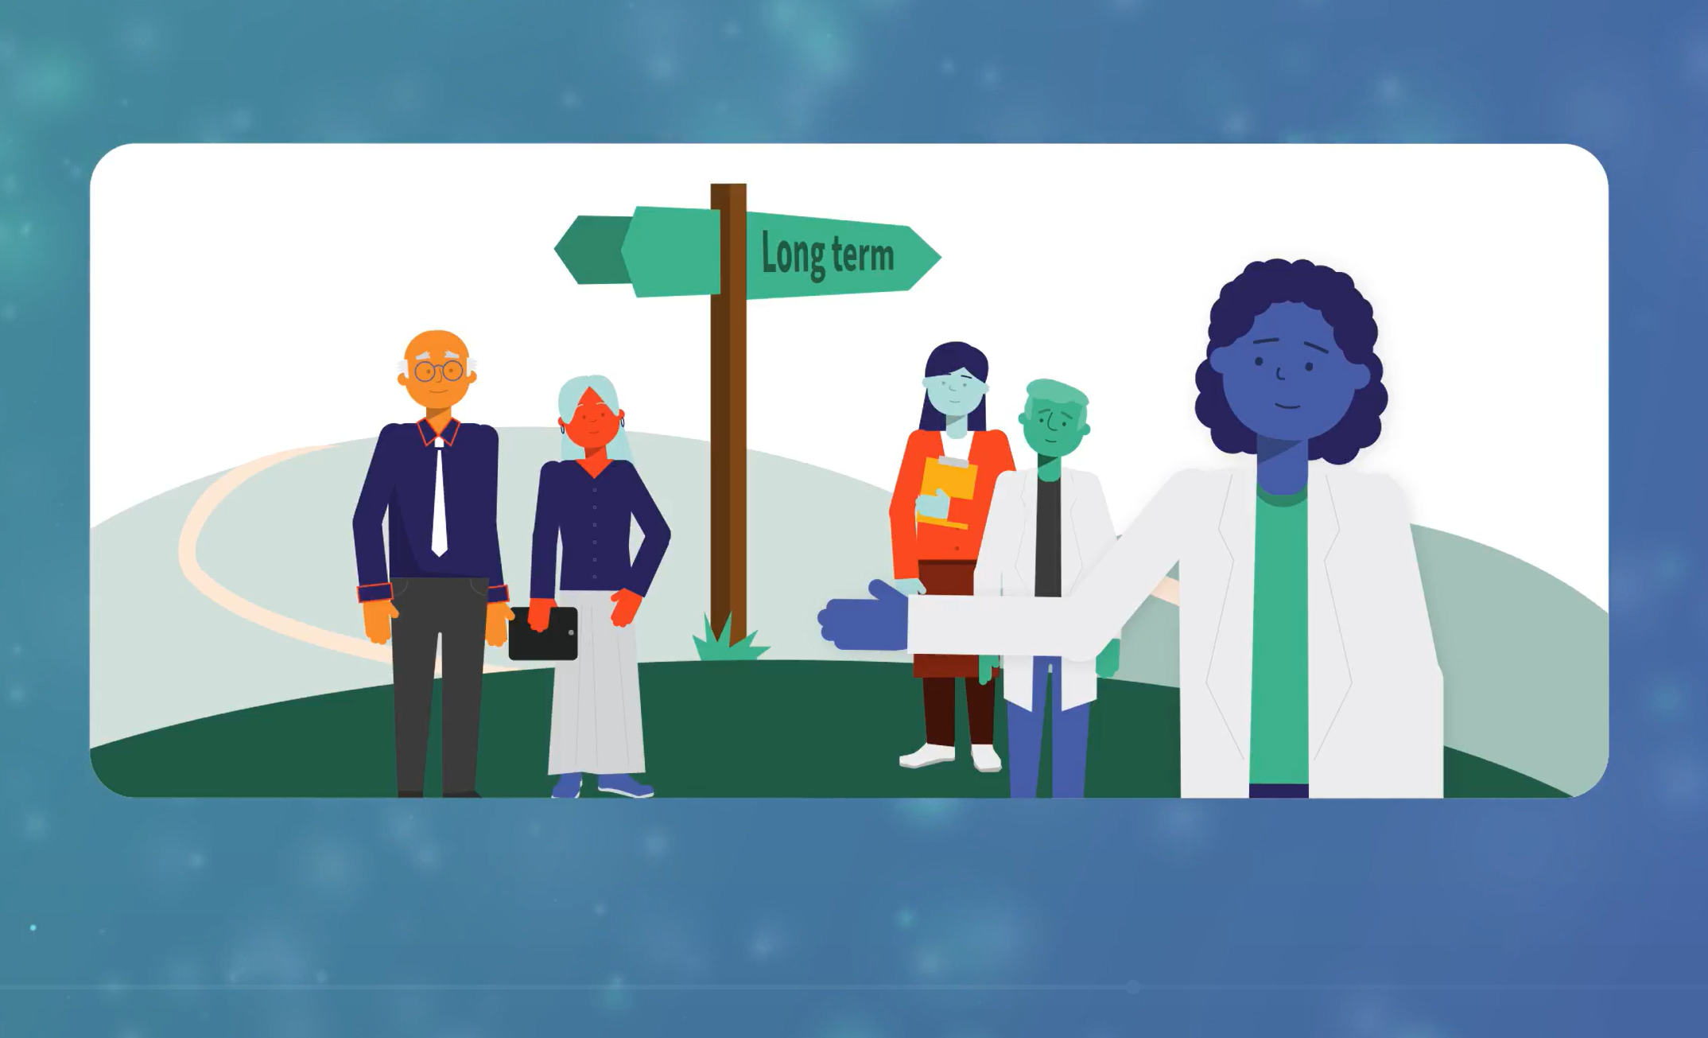
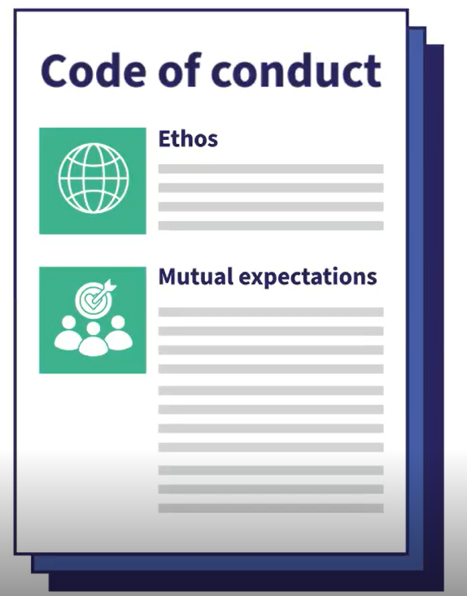
Code of Conduct Toolkit
Code of Conduct Toolkit
Co-developed with our advisory groups
For anyone working in an interdisciplinary setting
Draft their own Code of Conduct by following activities
No single CoC, but depending on team needs
Self-guided use by teams of 3-20 people
Takes time to complete – a message about the importance of IDR in itself
Emphasis: Not a one-off document

Slide 13


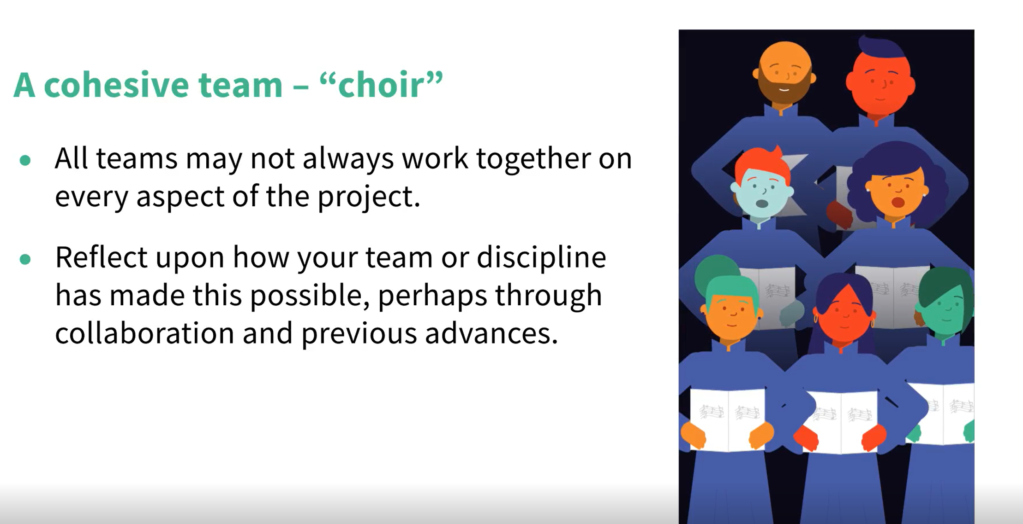
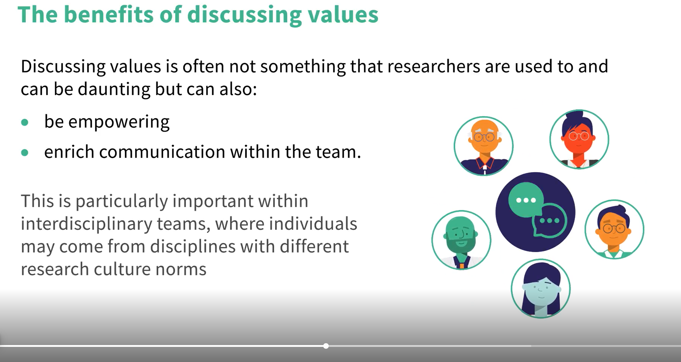
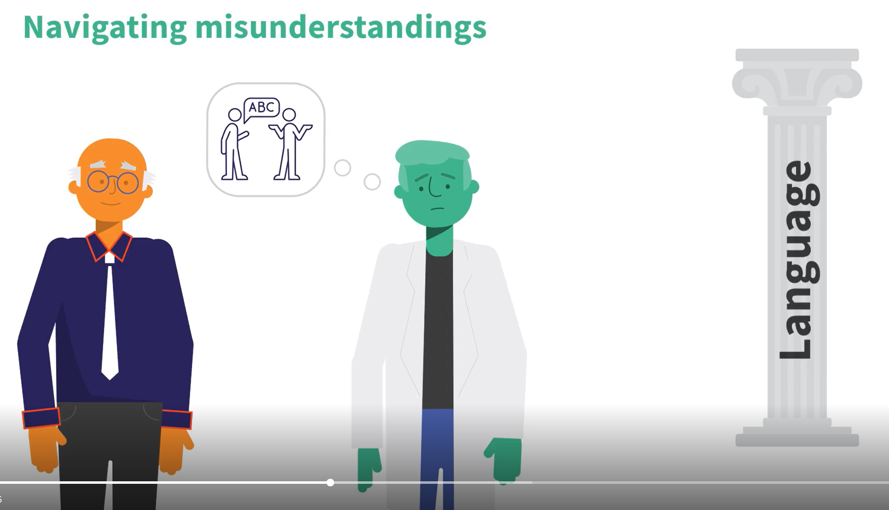
Bitesize Video Series
11 short videos on Interdisciplinary Research Culture
HDR UK Futures Learning Platform
Continuing Professional Development (CPD) Accredited
3-8 minutes (each)
Learning evaluation (Quiz)
Encourages reflection and practical application
1 hour of self-paced learning

Slide 14


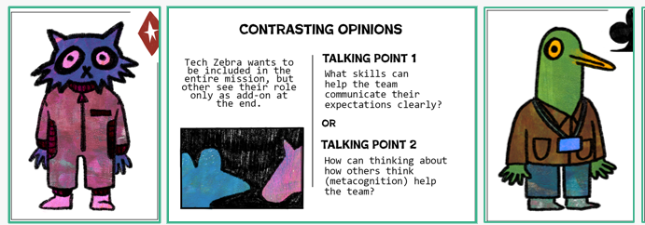
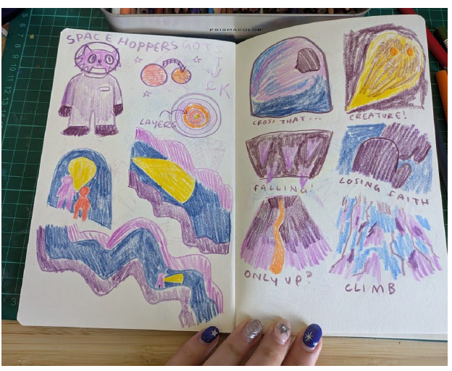
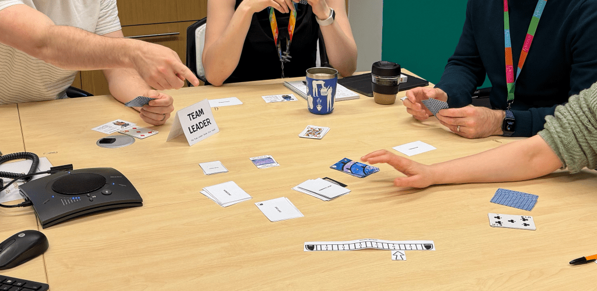
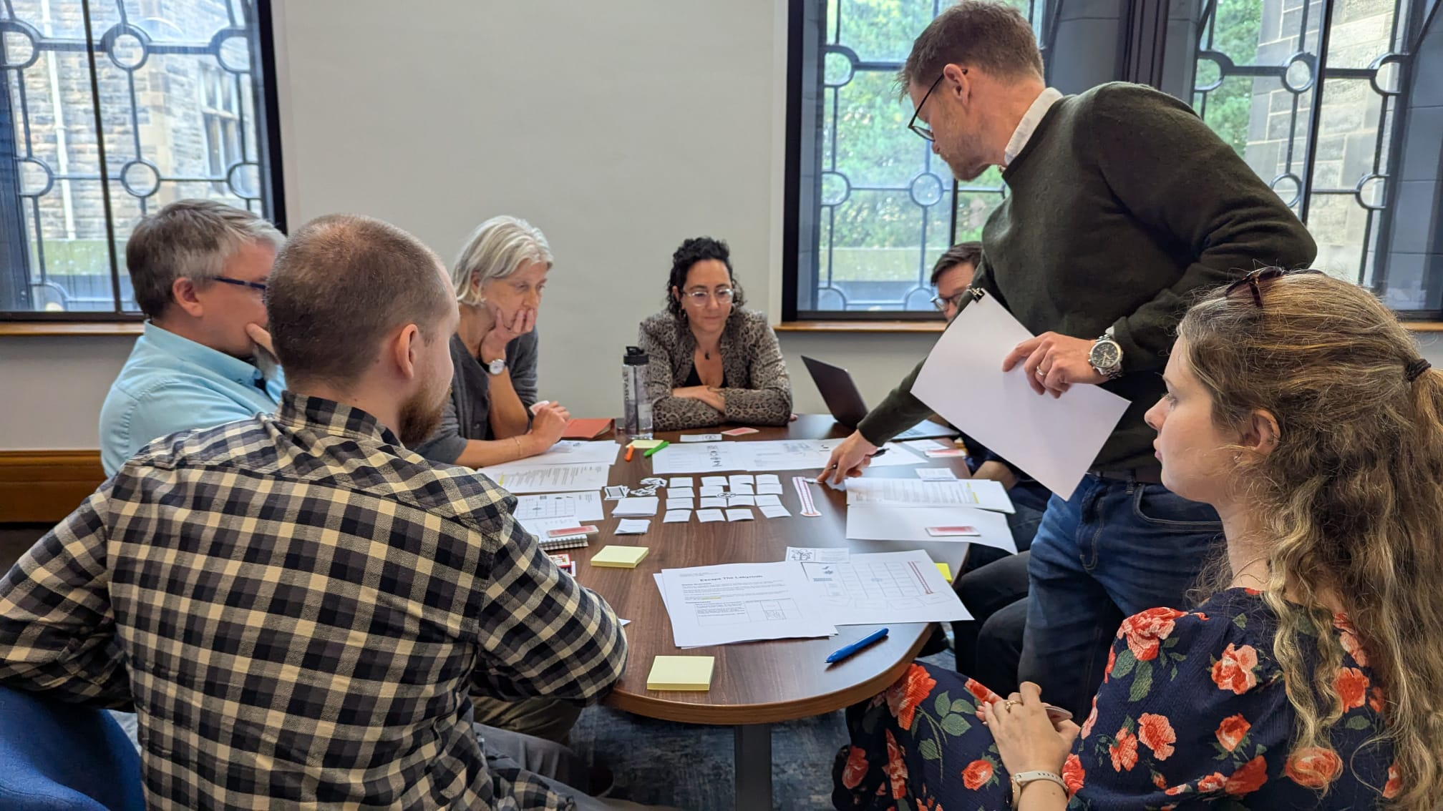
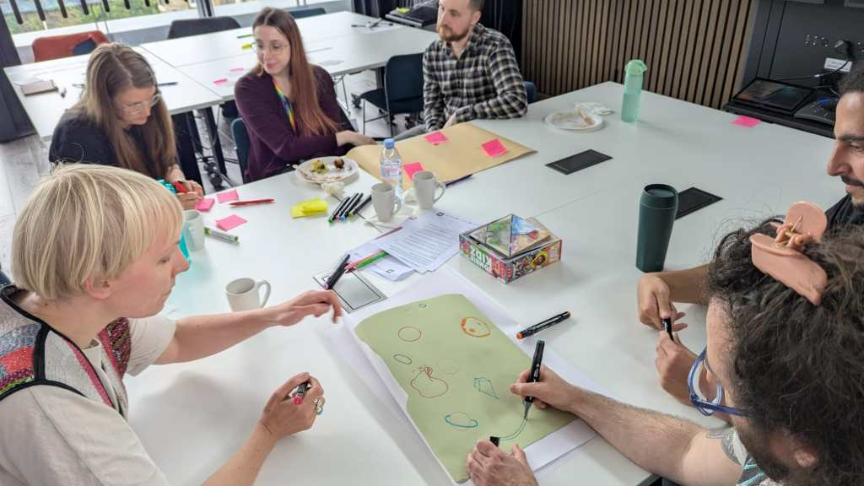
GRID Boardgame
InFrame - GRID (Games for Research and Interdisciplinary Dialogue)
Testing within HxC Intervention phase
Co-designed board game with Interdisciplinary teams
Aim of the game: to tackle real-world challenges by improving communication and team-building
Playful learning – to learn about each other talk about difficult issues

Slide 15

HxC - Aim 4: Prototype and test draft guidelines across HDR UK and UK DRI.
GRID – Aims 4&5:
Test the game’s effectiveness in team building, communication, and recognizing distinct disciplinary contributions
Give voice to diverse perspectives and experiences of interdisciplinary research in a gamified environment that facilitates easier rapport building and dialogue
  Test the training and tools
  4 intervention and 4 non-intervention (control) teams ; GRID – additional 2 teams
  Recruitment – HDR UK, UK DRI, UoEdinburgh, UoGlasgow
  Team composition – primarily Biomedical sciences and STEM subjects
Play the GRID Boardgame
Code of Conduct Toolkit Activities
Individual Online Training (self-passed)

Slide 16
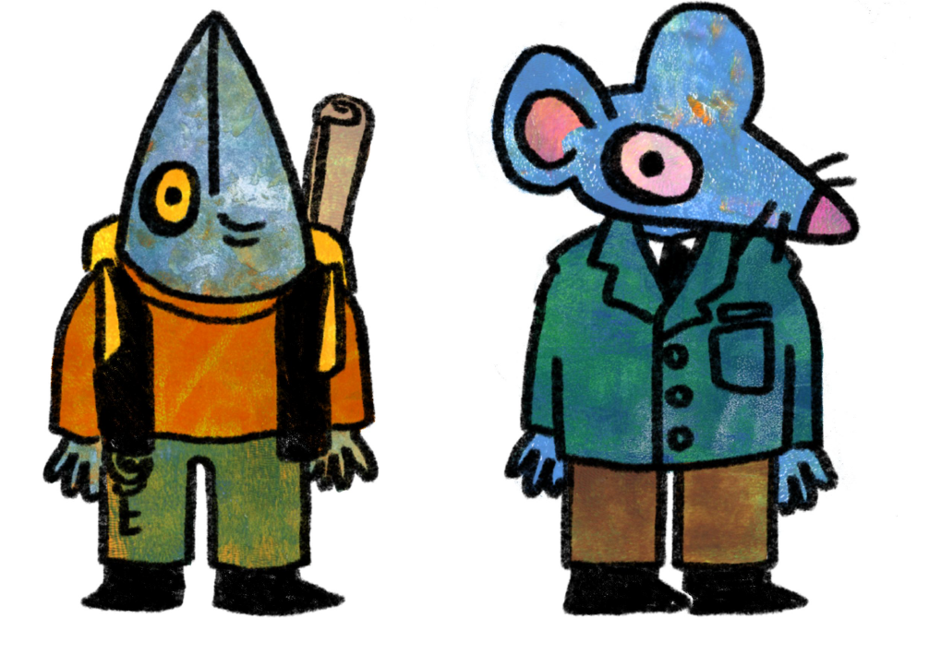
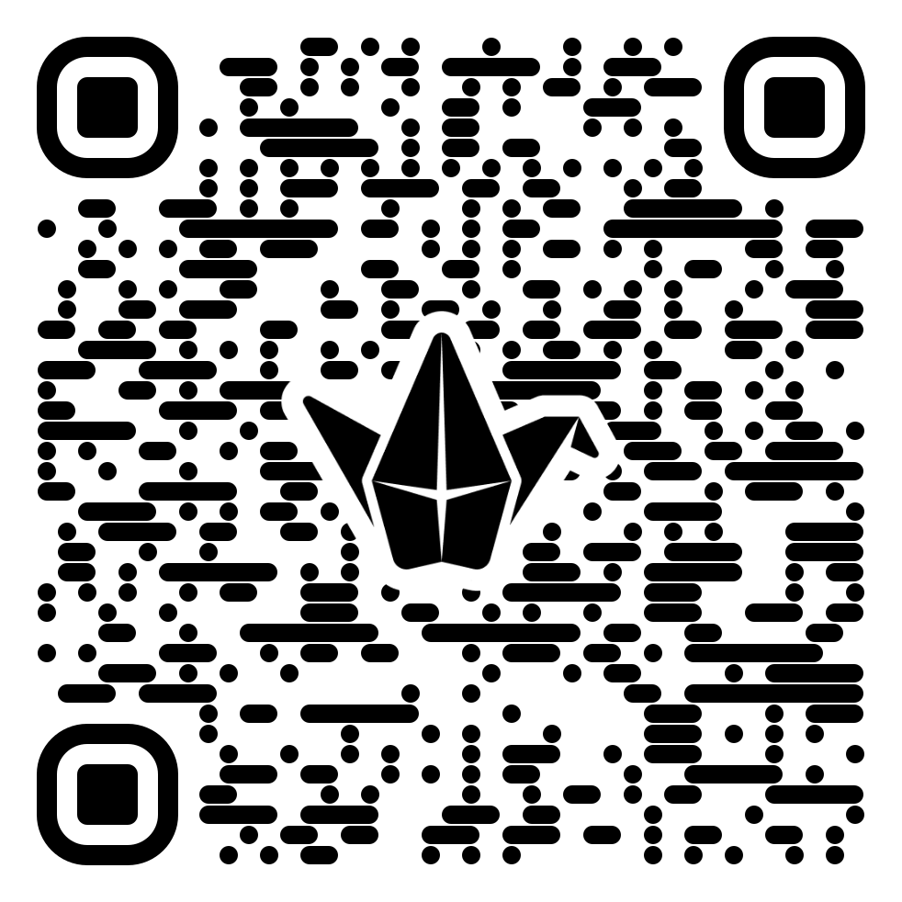
Game Taster
In-Person Interactive Option
Online Individual
Padlet Discussion
Groups of 4
Each person - Take the cards from the same suit (hearts, spades, diamonds, clubs)
One person – Also takes the challenge card
At start – read the challenge and play it out

Slide 17
RULES for groups
A =1 J = 11 Q = 12 K = 13
CAN discuss general strategy
CAN’T say what cards you have and their values
CAN’T say the card value you are going to play
CAN’T discuss or reveal specific card values
Allowed: "I can play the lower number cards" or "I can play even cards"
Forbidden: "I have a 4" or "My highest card is a Jack."

Slide 18
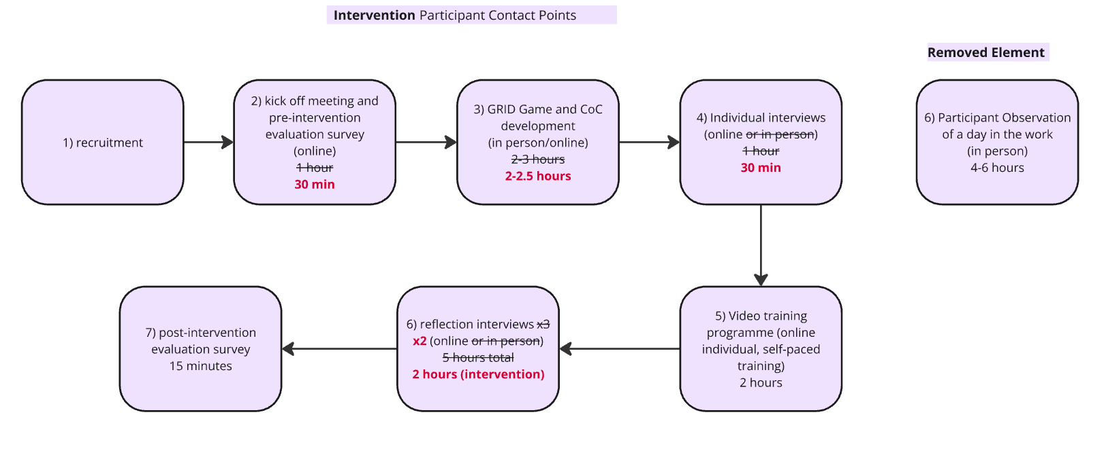
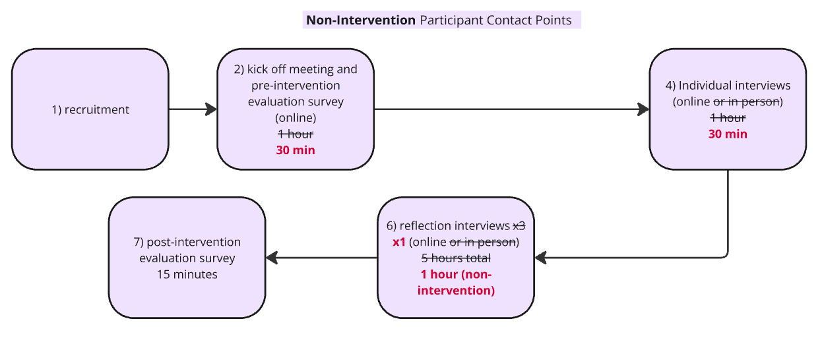
Evaluation Methodology - Challenges and Adaptations
Game survey
Reduced overall time commitment incl. removal of planned in-person element (shadowing).
All components offered in a fully virtual format.
Clearer communication of expectations around time and participation.

Slide 19
Reflection on Tools, workshop and/or game
Activities improved understanding of colleagues: “it helps you understand how your colleagues think.”
Workshop/game reflections: “a lot of fun… a very good activity.”
Participants valued that activities were:
    Short
    Easy to understand
    Quick to engage with
    Low preparation
Many felt activities would: “definitely help team dynamics” if completed by most of the team.
Completion in their own time or team meetings was minimal.
Leadership was seen as important to drive interest in training and activities: “the group leader actually does care about the group as people… not just science.”

Slide 20
Driving system level change
Maximising Interdisciplinary research and collaboration requires active intervention
Collaborative skills development needed for all involved in the research environment not just interdisciplinary researchers
Champion the importance of how teams work, alongside what they deliver
Embed research culture as a core element of your teams (broader inclusion beyond research delivery)
Incentivise leaders’ responsibility to build healthy research environment and teams
Call for Action: Interdisciplinary research culture needs active skills development and practice
Notes:
For PIs

Slide 21



Thank you
Hollydawn Murray
Chris Ponting
Ava Khamseh
Amonida Zadissa
Jane Hillston
GRID
Rachel Porteous
Agnessa Spanellis
Frank Siedlok
Gabrielle Blackbell
James Buckley
Mollie MacGregor
Supported by
Chris Ponting
Cristina Martin
David Sims
Matt Elliot
Paul Davies
Mike Morgan
Ralitsa Madsen
Desiree Tennant
Dmitry Finkelberg
Ava Khamseh
David Sims
Rachel Etherington
Tanita Casci
David Gavaghan
Sarah Cadman
Colin Mclean
Matt Elliot
Paul Davies
All the researchers, research professionals, leaders from higher education, research institutes, funders and industry without whom this work would not be possible

