Slide 1


ARMA 2026
First Timers Session

Slide 2


Session overview
Welcome and introductions
Harrogate Convention Centre facilities
Conference app
Sessions and socials
Getting to know others
#ARMA2026
Notes:
Kate

Slide 3
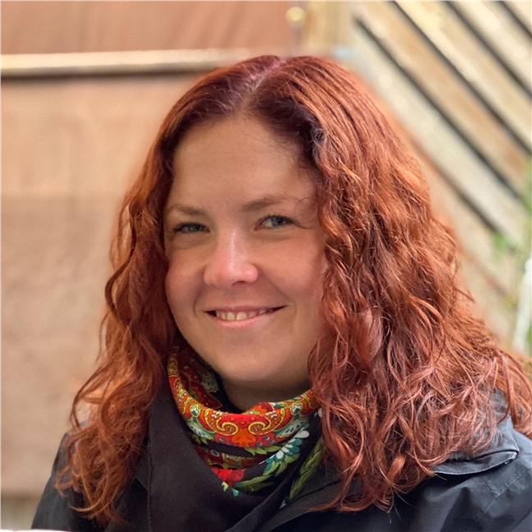
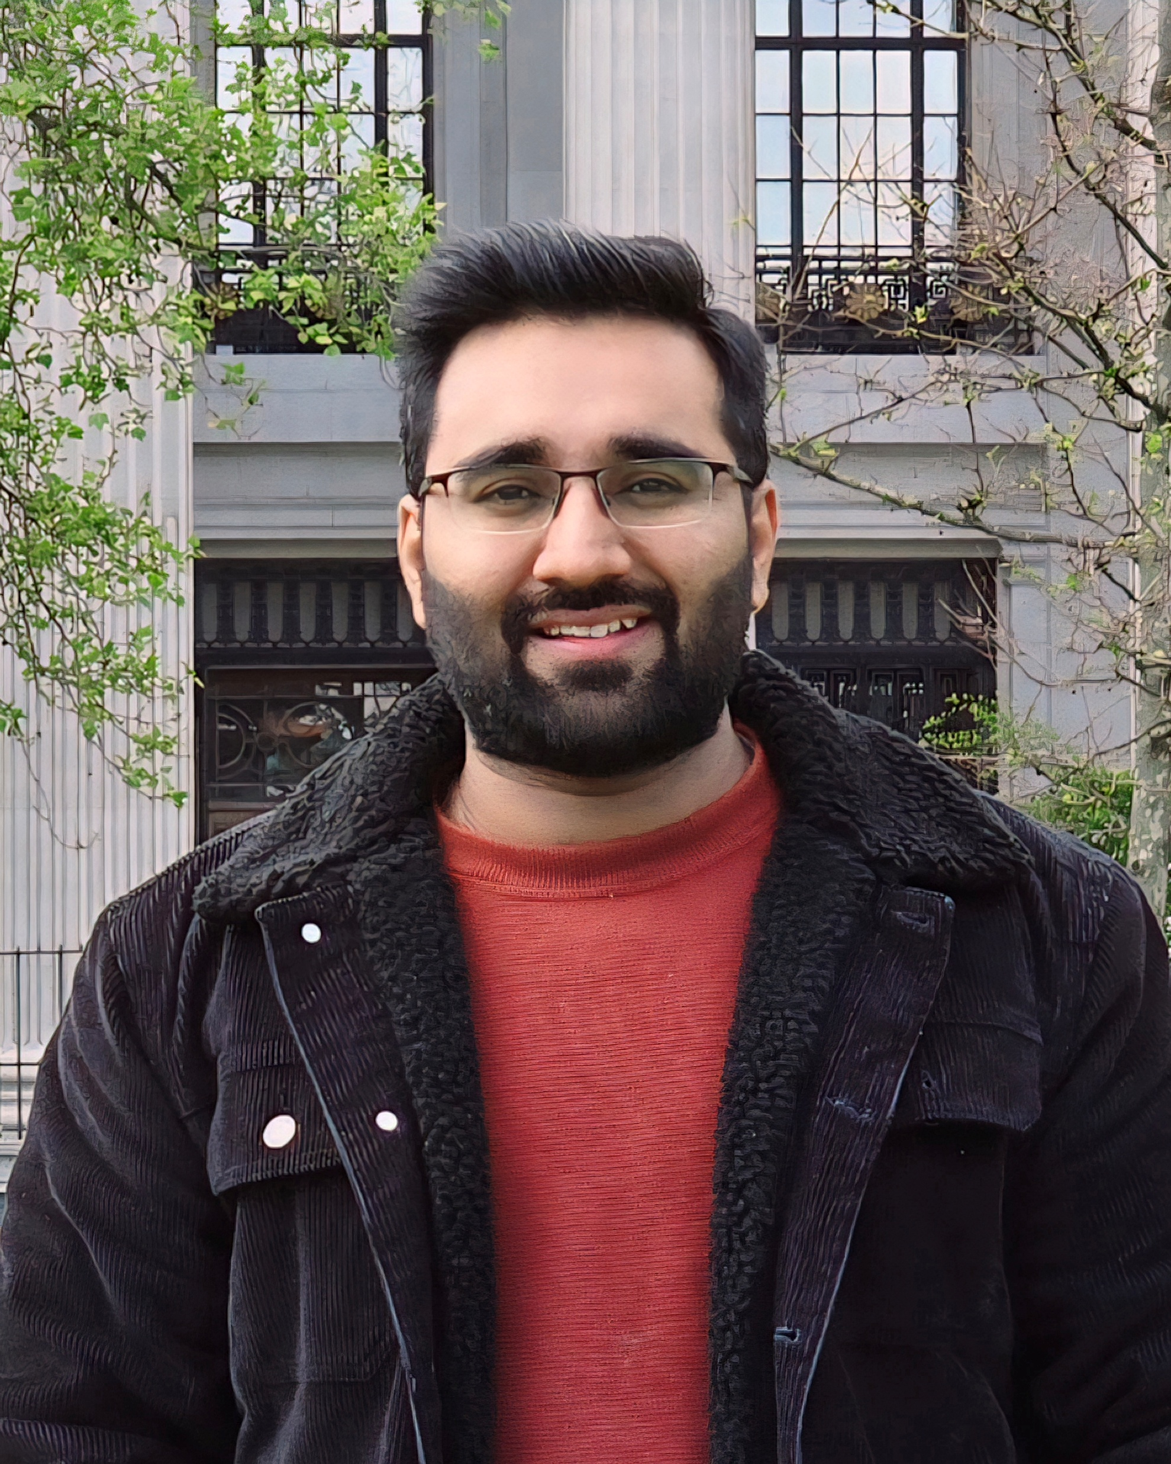
Introductions
Kate Ludlow
Zain Ul Abidin
#ARMA2026
Notes:
All

Slide 4
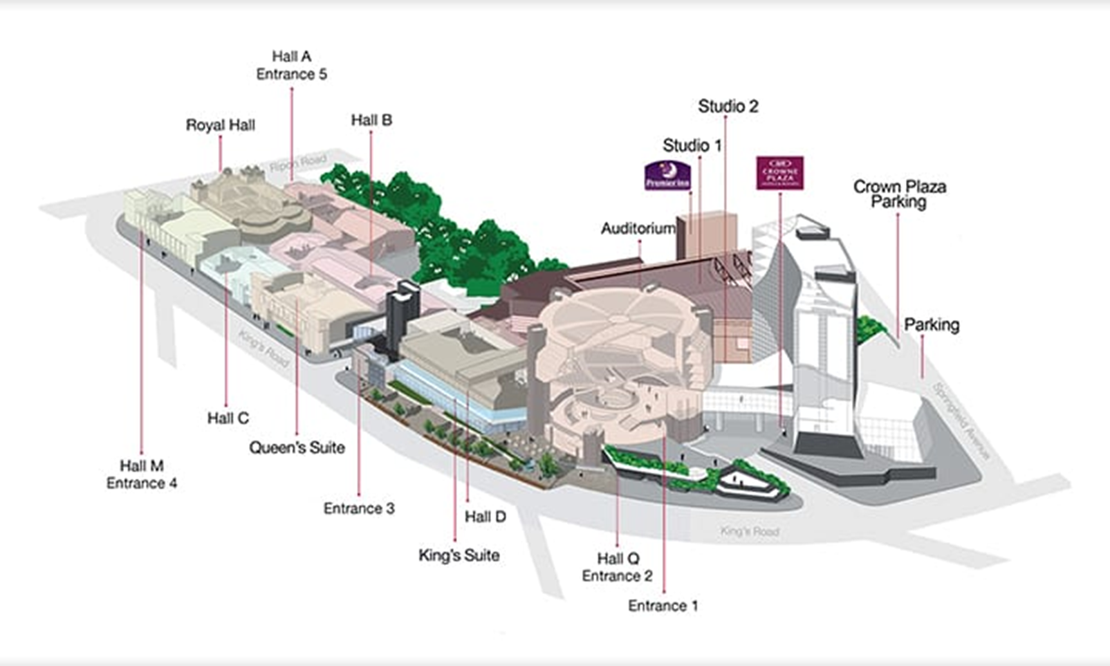
Harrogate Convention Centre
#ARMA2026
Notes:
Zain

Slide 5
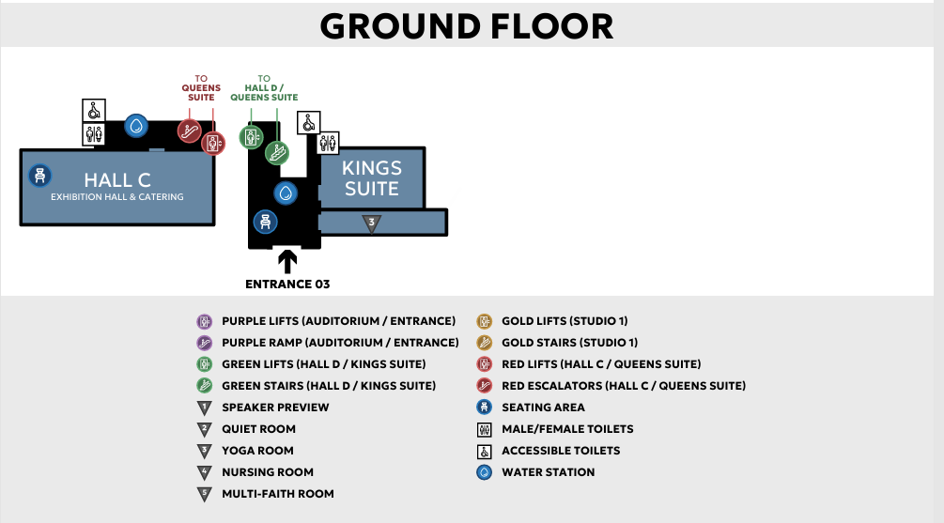
Harrogate Convention Centre
#ARMA2026
Notes:
Zain

Slide 6
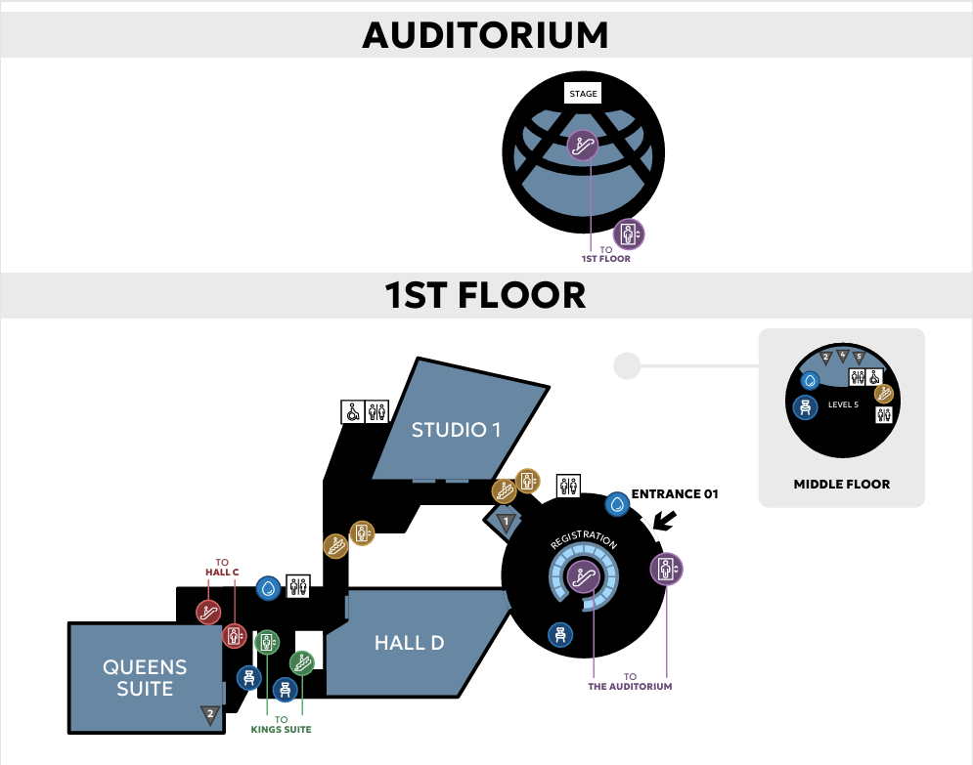
Harrogate Convention Centre
#ARMA2026
Notes:
Zain

Slide 7
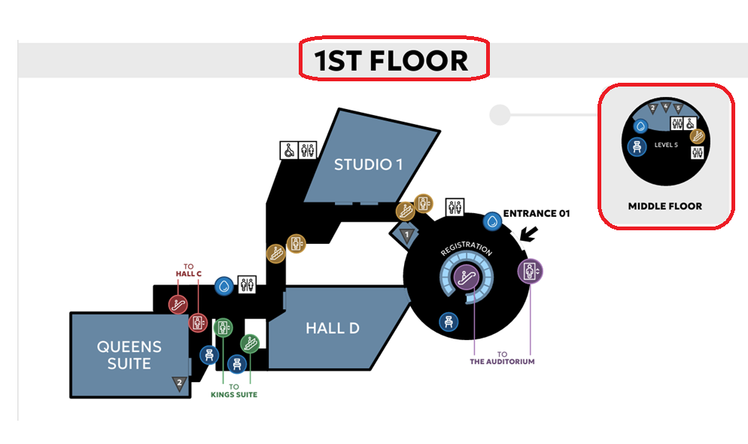
Harrogate Convention Centre
On the first floor you will find the Multi-faith, nursing and quiet room
#ARMA2026
Notes:
Zain

Slide 8
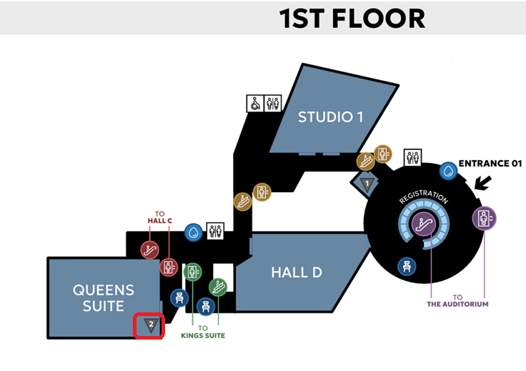
Harrogate Convention Centre
There is a second (smaller) quiet room in next to the Queen’s Suite session rooms
#ARMA2026
Notes:
Zain

Slide 9


ARMA Programme/App
Android:
Latest programme can be found online here: https://www.armaconference.com/programme
ARMA 2026 App – download via the QR Code. The ARMA 2026 mobile app will be the main source of all the information you need for the conference. We encourage you to download it and familiarise yourself with it before travelling to the venue.
App Features:
Meeting Hub - View the list of attendees*, request connections and set up meetings with other delegates, speakers and sponsors.
Programme - View the full interactive programme by day - includes session details, keynote speakers, as well as oral presentations and abstracts. You can also take notes in the app and export them later.
Apple:
*You will be able to update your contact details and app visibility in the "Privacy & Settings" tab of the app. Remember you will need to check your settings to allow visibility if you want to share your contact details with anyone via the app/QR code scanning. Please note, you will not see yourself in the list of attendees in the Meeting Hub.
#ARMA2026
Notes:
Alice

Slide 10
ARMA App
Android:
My Agenda - Build your own personalised agenda by adding sessions you don't want to miss. Please note you will need to be logged into the app to create a personalised agenda.
Speakers - See the full list of keynote speakers and oral presenters.
Abstracts - View all the oral and poster abstracts.
Partners/Exhibitors - See the full list of our partners and exhibitors. You can view their materials and connect with them in the app if you miss them in person.
Apple:
#ARMA2026
Notes:
Alice

Slide 11
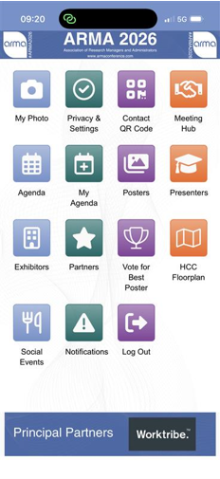
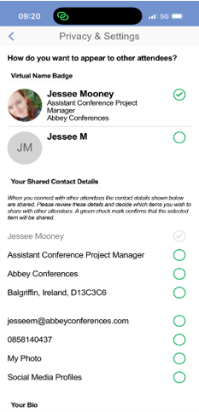
Statement Conference App
#ARMA2026
Notes:
Alice

Slide 12
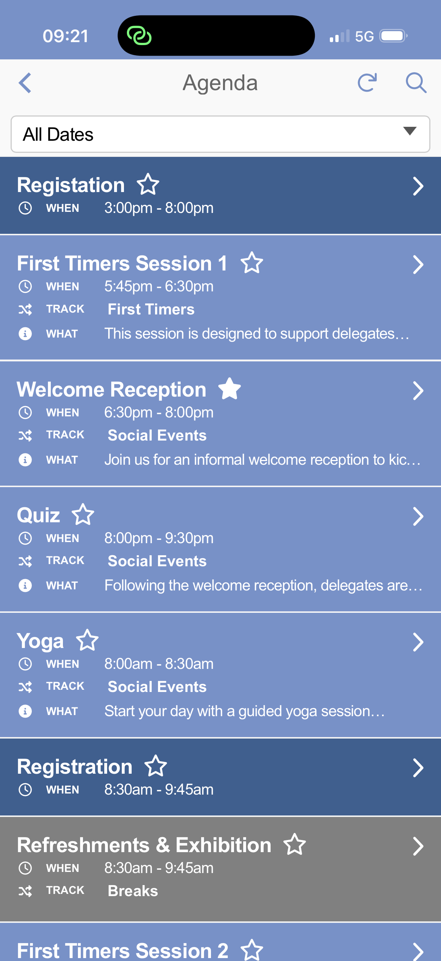
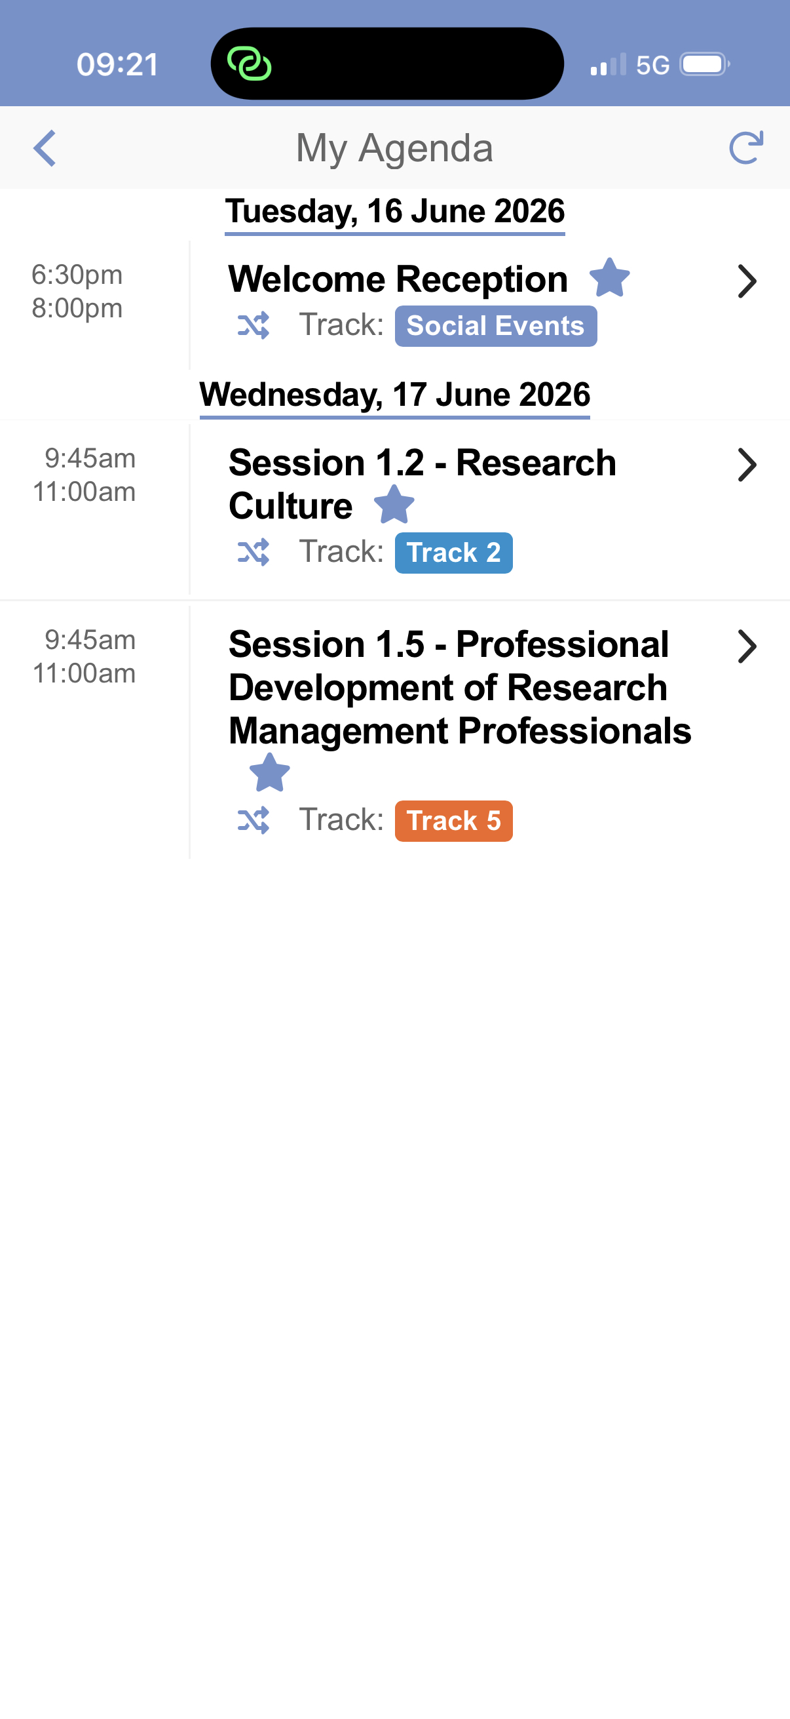
#ARMA2026
Notes:
Alice

Slide 13
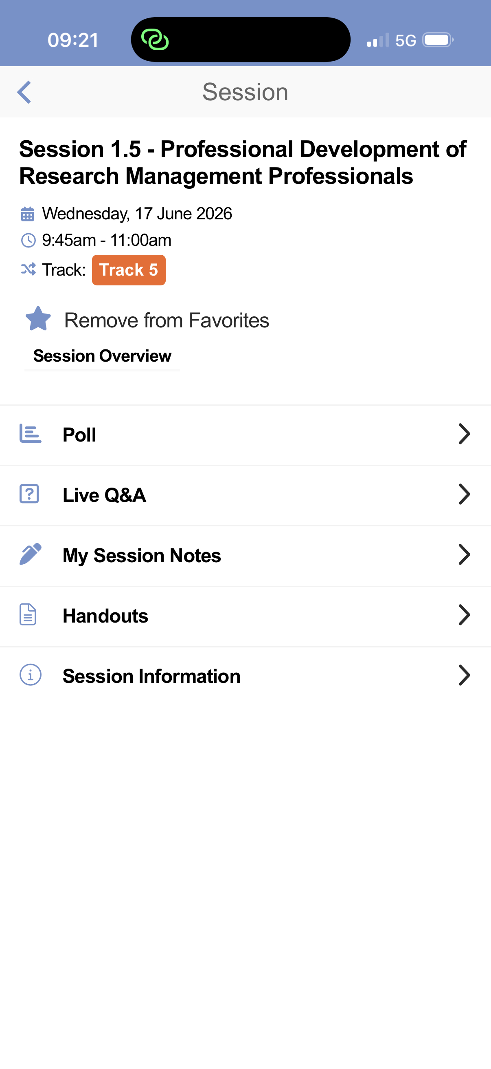
#ARMA2026
Notes:
Alice

Slide 14
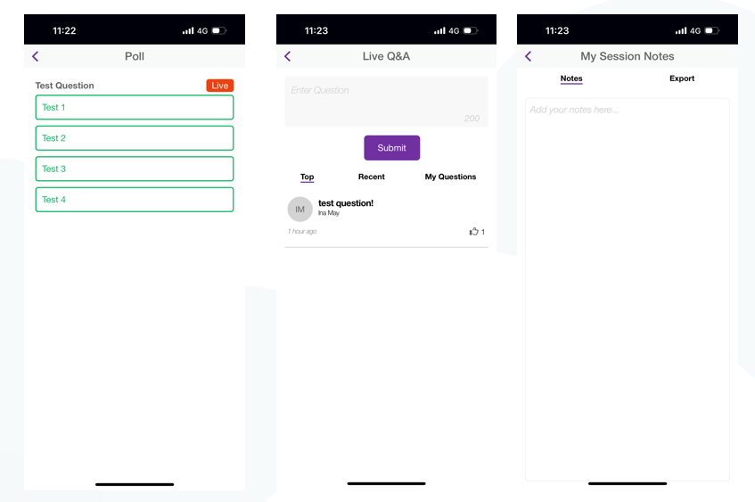
#ARMA2026
Notes:
Alice

Slide 15
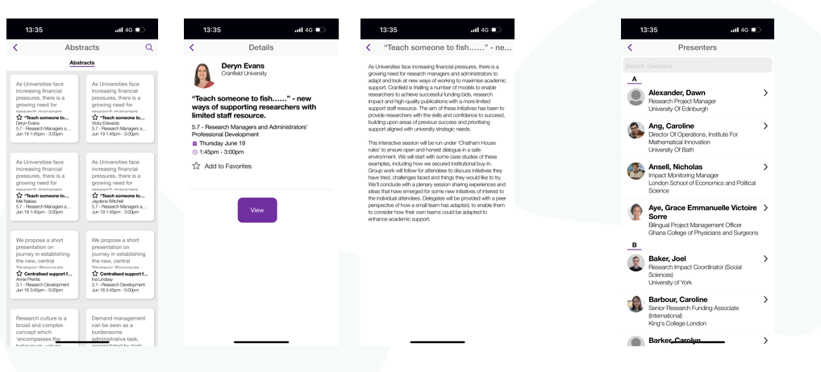
#ARMA2026
Notes:
Alice

Slide 16
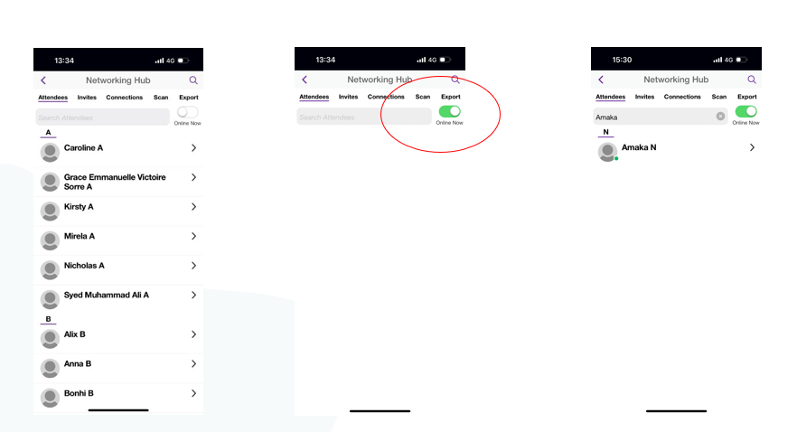
#ARMA2026
Notes:
Alice

Slide 17
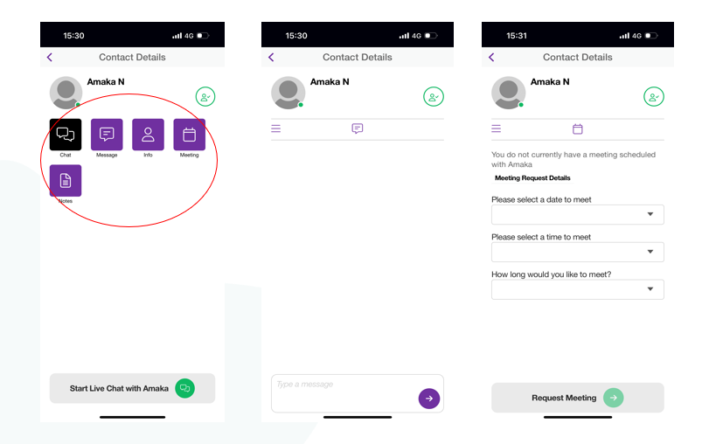
#ARMA2026
Notes:
Alice

Slide 18
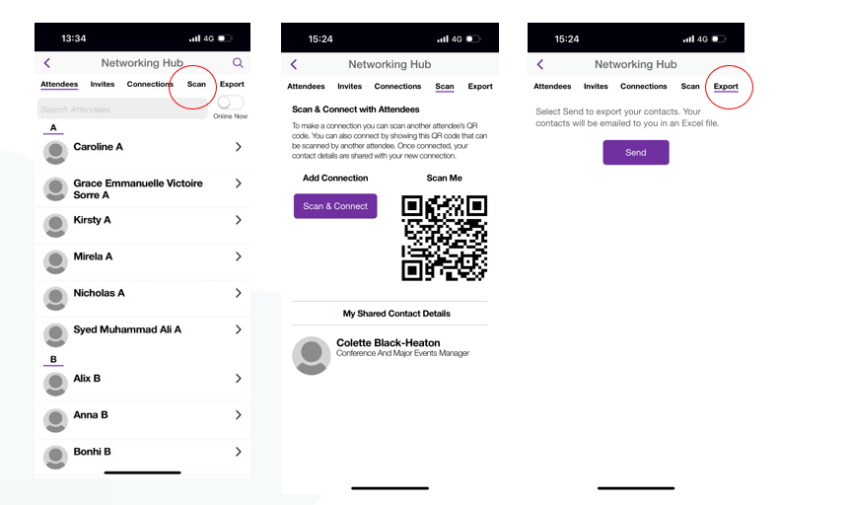
#ARMA2026
Notes:
Alice

Slide 19
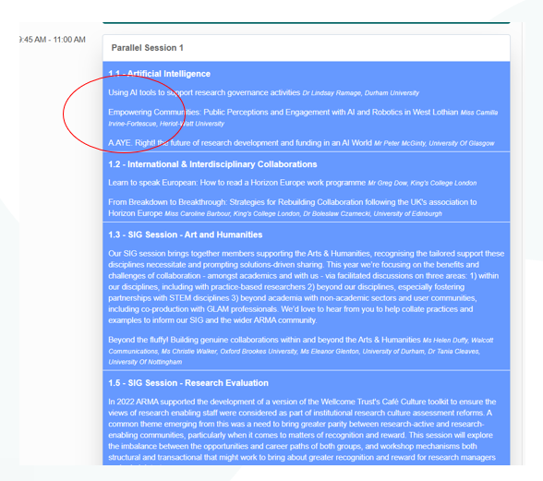
Session overview
#ARMA2026
Notes:
Kate

Slide 20
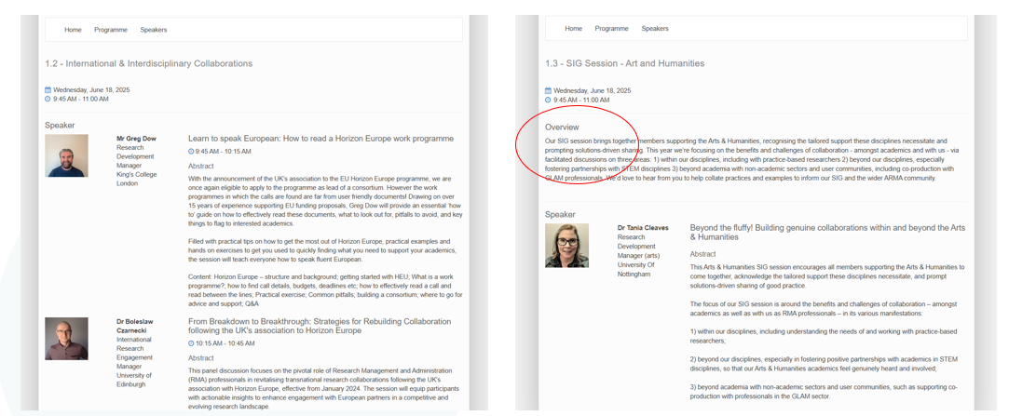
Session overview
#ARMA2026
Notes:
Kate

Slide 21
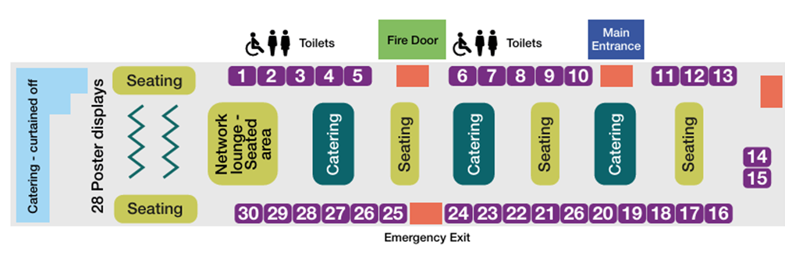
ARMA 2026 Exhibition
Break and lunchtimes – all catering will be serviced in Hall C. You can meet all our sponsors & exhibitors.
You can also view the poster presentations here.
#ARMA2026
Notes:
Kate

Slide 22
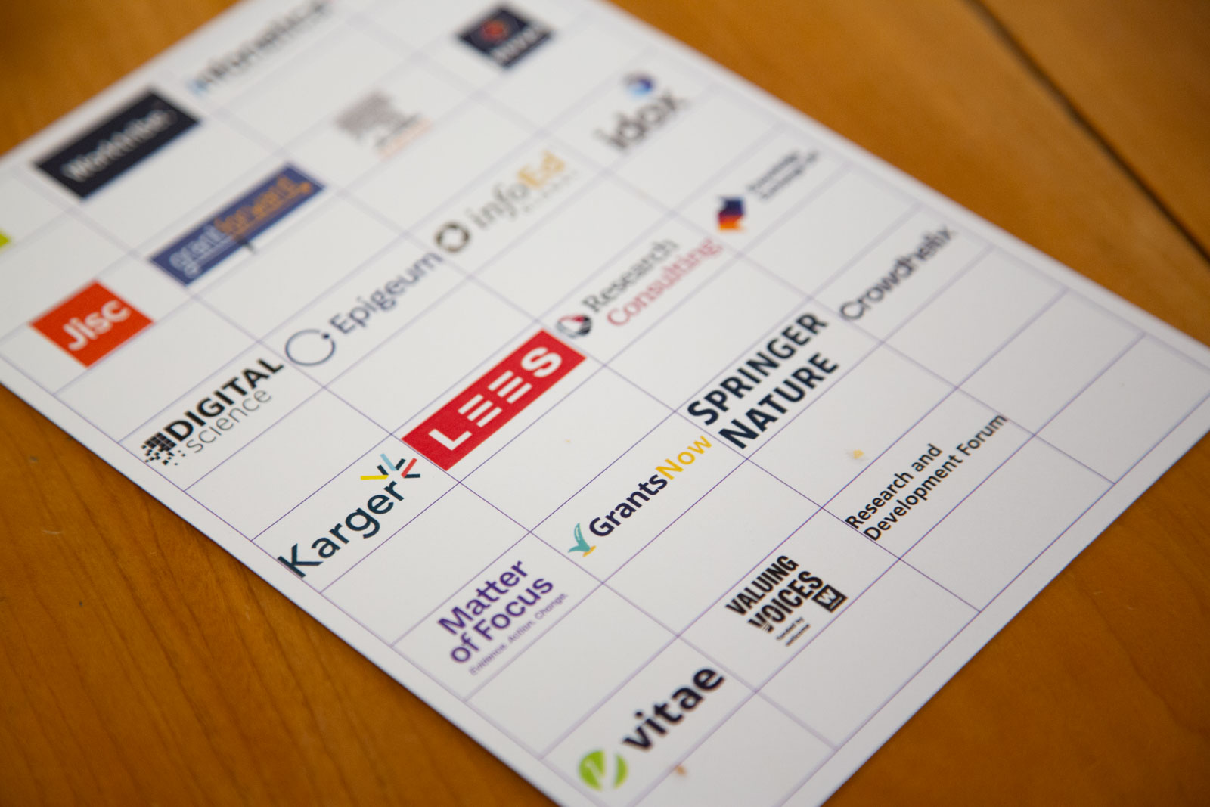
ARMA 2026 Exhibitor Passport
Together with your badge, all delegates will be issued an Exhibitor Passport
Collect a stamp at each corresponding booth, once your passport is complete return to the ARMA booth where you’ll be entered into the prize draw!
The winner will be announced during the second plenary session on Thursday.
#ARMA2026
Notes:
Kate

Slide 23
Social Events
Tuesday 16 June
Welcome Reception, 18:30 – 20:00 HCC, Hall D
Join us for an informal welcome reception to kick off the conference. Network with fellow delegates and exhibitors while enjoying light refreshments in a relaxed setting.
Quiz Night, 20:00 – 22:30
Following the welcome reception, delegates are invited to take part in a quiz at an external venue. This is a fun and informal opportunity to continue networking and unwind after the first day of the conference. See registration desk to register.
#ARMA2026
Notes:
Kate

Slide 24
Social Events
Wednesday 17 June
Morning Yoga, 08:00 – 08:30, First Floor Foyer (Conservatory) HCC
Start your day with a guided yoga session designed to energise and refresh. See registration desk to register.
Gala Dinner and Awards Ceremony, 18:45 – 00:00, HCC Studio 1
The Gala Dinner is a highlight of the conference social programme, bringing delegates together for a memorable evening of dining, celebration and connection.
The evening will also feature the Conference Awards Ceremony, recognising and celebrating excellence, innovation and achievement across the research management community.
This is a ticketed event and is not included in the conference registration fee. Delegates wishing to attend will need to purchase a ticket in advance. See registration desk to register.
#ARMA2026
Notes:
Kate

Slide 25
Social Events
Thursday 18 June
Morning Yoga, 08:00 – 08:30, First Floor Foyer (Conservatory)
A second opportunity to enjoy a calming yoga session before the conference day begins. See registration desk to register
#ARMA2026
Notes:
Kate

Slide 26
Recommendations
Session recommendations
Plugged In or Playing Catch Up: How do other always seem to know? Session 1.5, Queen’s Suite 2
AI in Research Funding: Practice, Policy and Responsible Use. Session 4.4, Queen’s Suite 1
#ARMA2026
Notes:
All

Slide 27
ARMA SIGs
https://arma.ac.uk/special-interest-groups/
Arts & Humanities
Audit & Compliance
Ethics & Governance
EU & International
Global Majority
Meta Research
Open Research
Post Award
Postgraduate Research
Research Contracts
Research Development
Research Evaluation
Research Excellence Framework (REF)
Research Impact
Research & Innovation Culture
Research Information & Systems
Trusted Research and Safer Partnerships
#ARMA2026
Notes:
Zain

Slide 28
ARMA 2026
Code of Conduct
The code of conduct is to protect all attendees of ARMA 2026. The full code of conduct will be shared on the conference website but as a general overview;
Unacceptable behaviour includes: intimidation, harassing, abusive, discriminatory, derogatory or demeaning conduct by any attendees of ARMA 2026.
Harrassment includes: offensive verbal comments related to gender, sexual orientation, race, religion, disability, inappropropriate use of nudity and/or sexual images in public spaces (including presentations slides), deliberate intimidation, stalking or following, harassing photography or recording, sustained disruption of talks or events, inappropriate contact or unwelcome sexual attention.
Wearing clothing that is potentially offensive
#ARMA2026
Notes:
Zain

Slide 29
Group discussion
Suggested prompts
What are you hoping to get out of the conference?
What’s your favourite thing about your role?
Have you been to Yorkshire before?
If you could wake up tomorrow with one new non-physical skill or talent (e.g. perfect recall, incredible intuition, knowing every language) what would it be and how would you use it?
#ARMA2026
Notes:
Alice

Slide 30

Thank you
Any questions?
Notes:
Kate

