Slide 1

Annual General Meeting
18 June 2026
Please make sure you have signed in

Slide 2

Lorna Wilson
Chair

Slide 3

Agenda
Welcome and apologies​
Minutes of the previous meeting, and matters arising ​
The Year Past​
The Treasurer​’s Report and presentation of annual accounts
Board Appointments
Any Other Business

Slide 4
Welcome and Apologies
Minutes of the Previous
Meeting and any matters arising – 19 June 2025

Slide 5

The Year Past
2024/25

Slide 6


Slide 7


Chair’s Reflection
​

Slide 8

Strategic Priorities
Professionalising Research Management
Connecting for Impact
Leading our Sector
Enabling our Ambition

Slide 9
Member-led

Slide 10
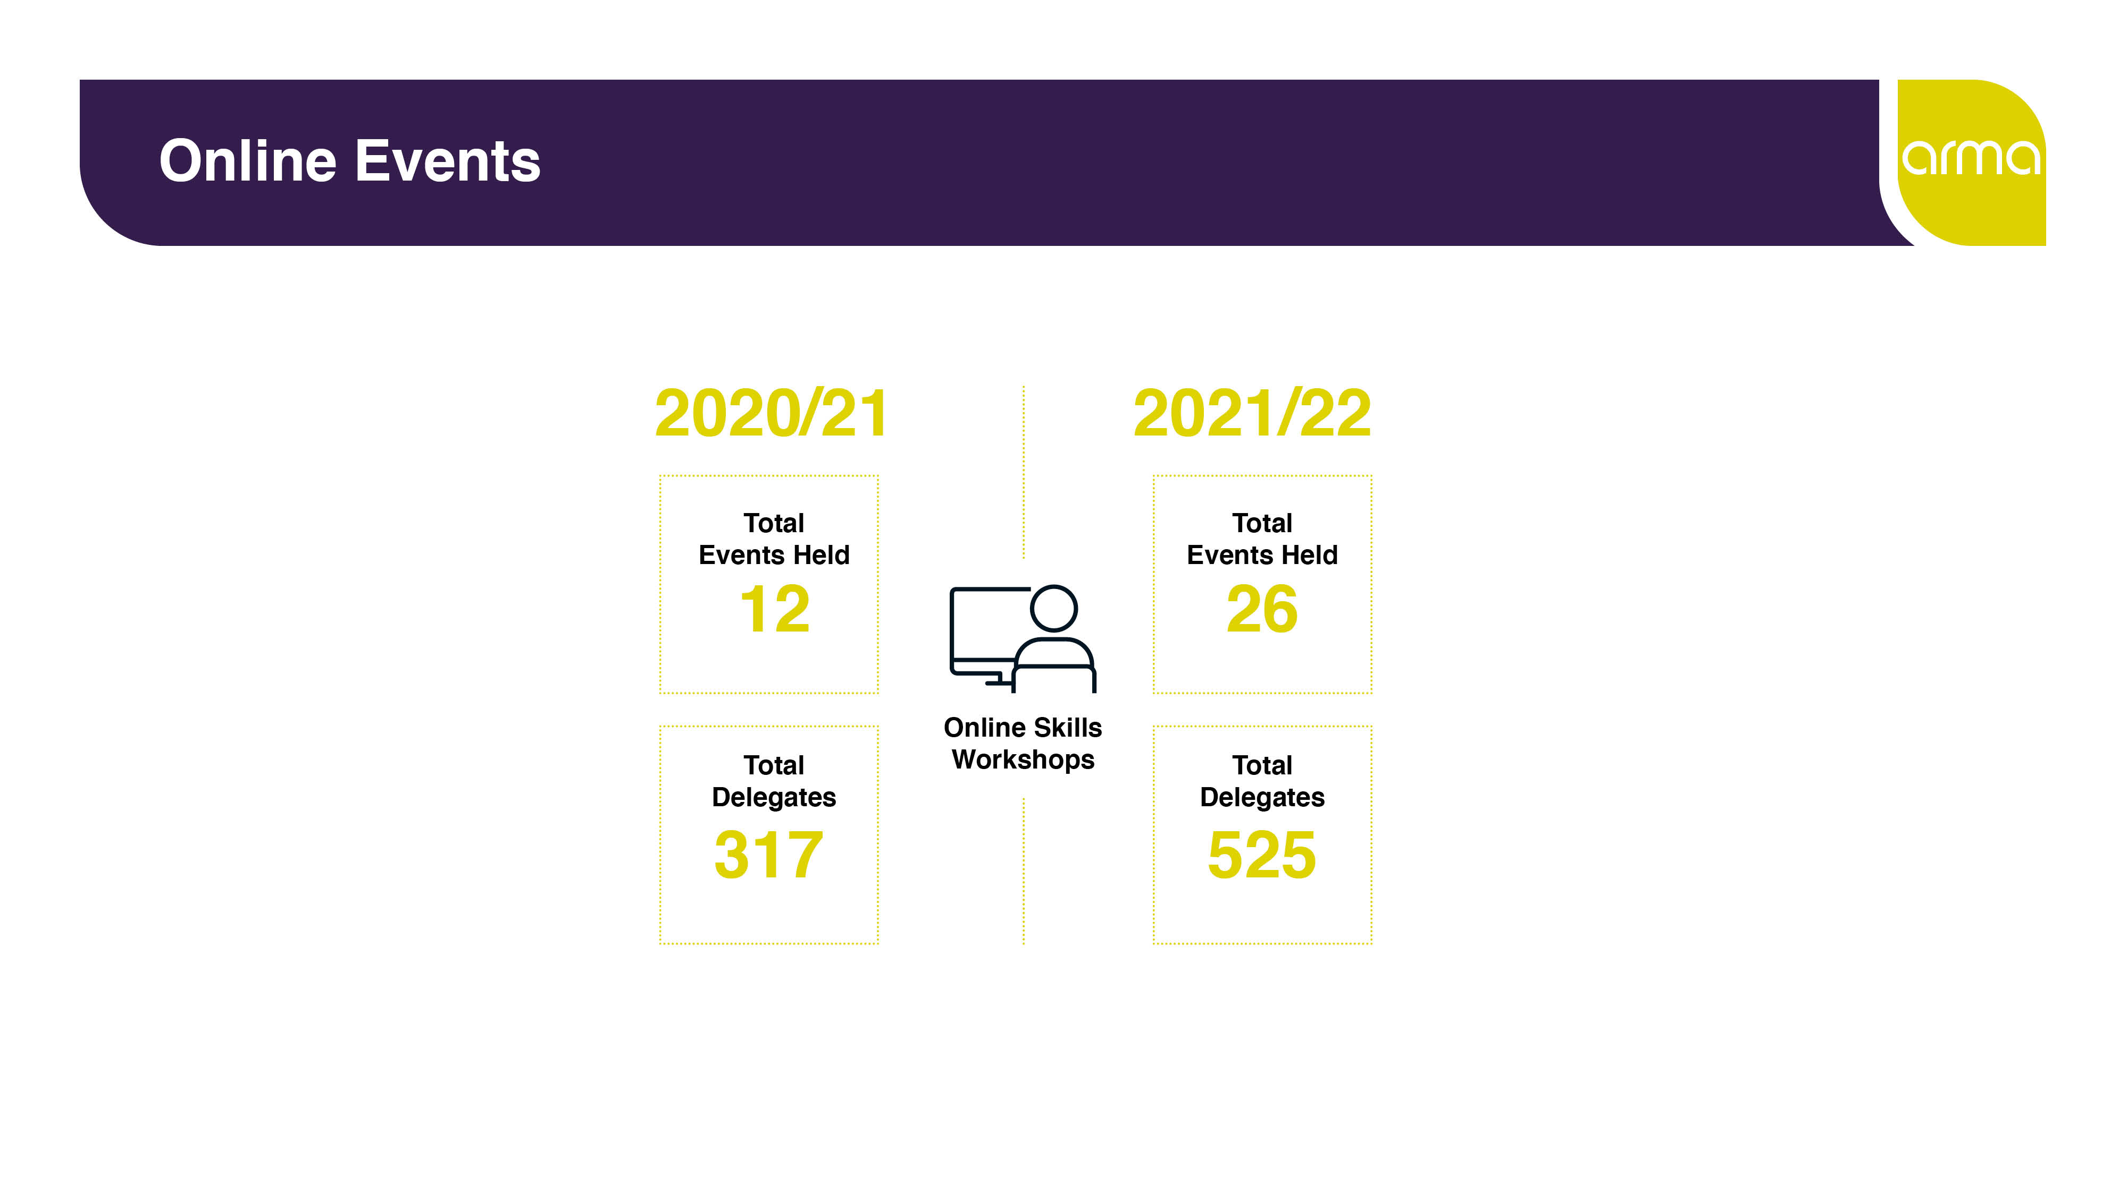
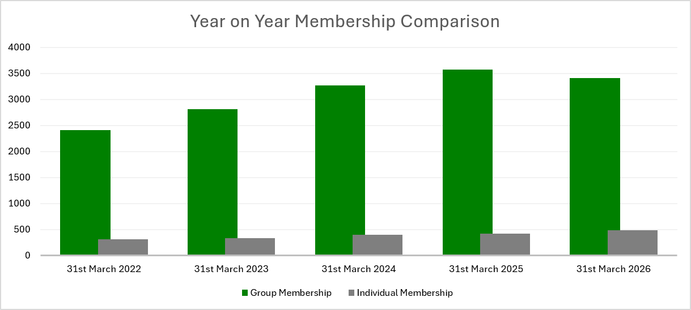
Our Members
On 31 March 2026 we had 3901 members
92% of our members are from UK HEIs
88% joined through group memberships
49% of organisations with group memberships also had representation on the Research Leaders Forum (75/154)
Non-HEI members come from a mix of funders, charities & not-for-profits, research institutes, NHS Bodies, consultancies and statutory bodies
Notes:
91% of our members are from UK HEIs (2024 – 94%; 2023 – 92%)
89% joined through group memberships (91% in 2024; 91% in 2023)
55% of organisations with group memberships also had representation on the Director’s Forum (47% in 2024 - 70/149; 38% in 2023 - 58/153)

Slide 11
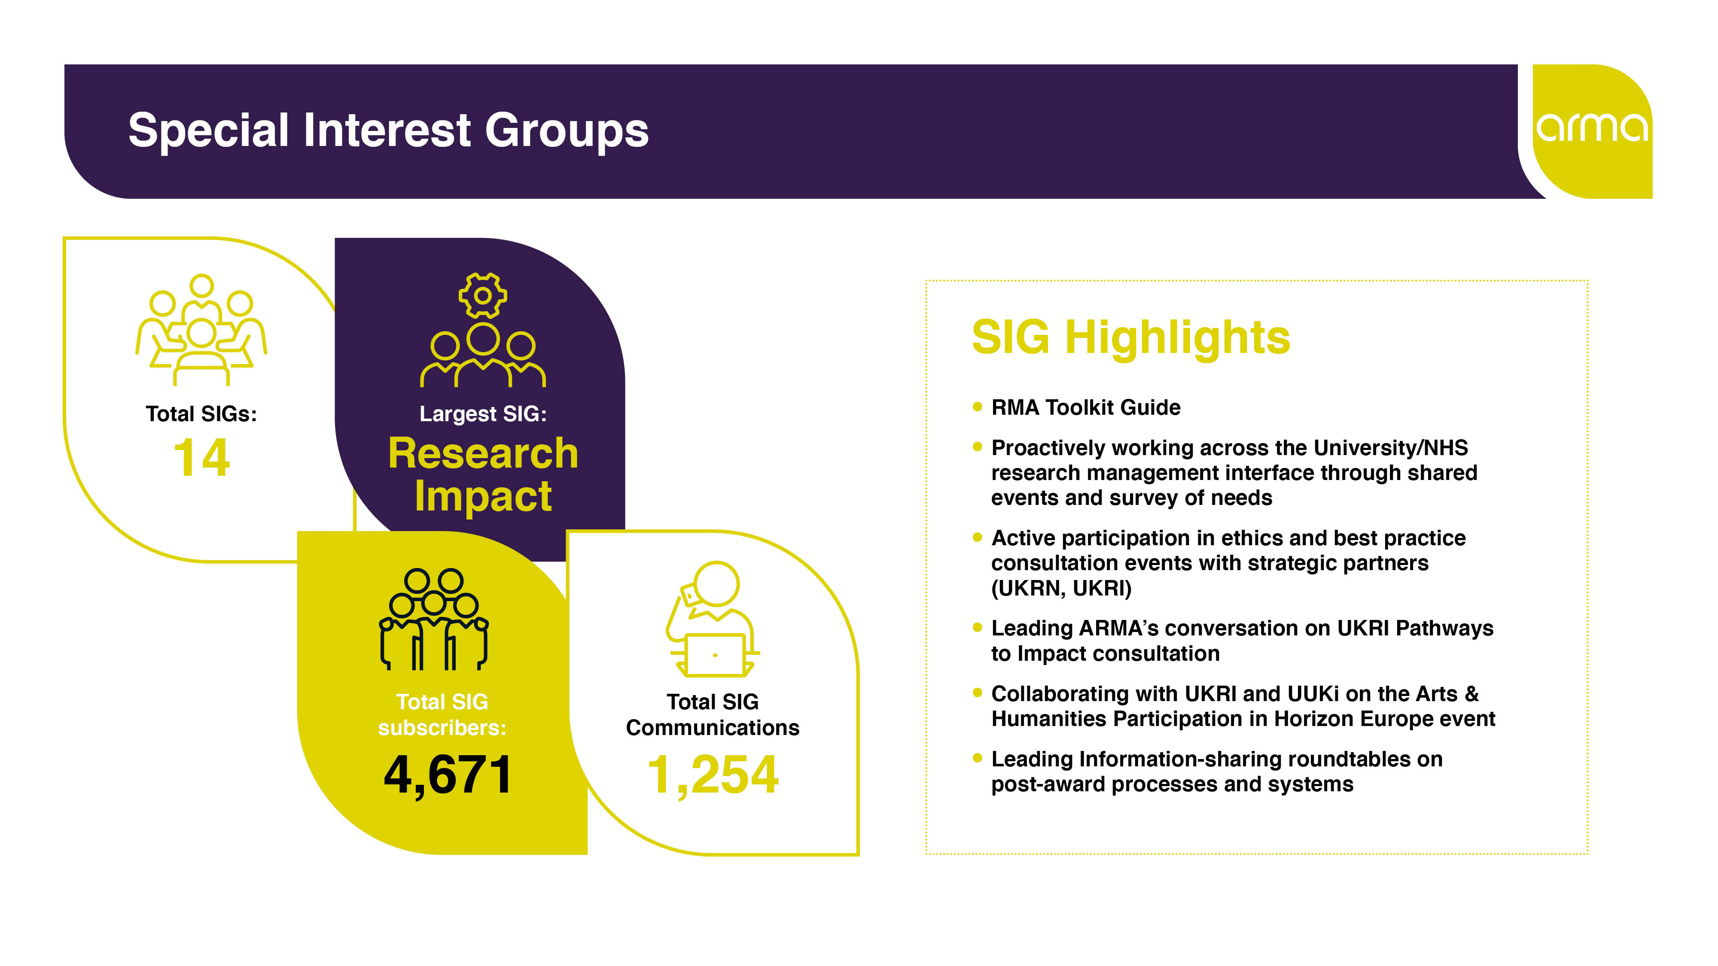
New ARMA Events
In 2022, ARMA Member Engagement Committee commissioned a review of existing special interest groups (SIGs) to understand how they operate, potential needs and support, relevance and gaps for new SIGs. The review will be completed in 2023.
SIGs
  2021/2022 14 SIGs, Largest: Impact; Total SIG Subscribers: 4,671; Total SIG Communications: 1,254
  2022/2023 13 SIGs (M&H SIG closed); Largest: Impact; Total SIG Subscribers: 4684; Total SIG Communications: 795
In response to members’ needs and priorities, ARMA held new member events throughout the year.
A few examples:
Two Research Leaders Forum (formerly Director Forum) events attracted 93 delegates over the two sessions
The ARMA REF Forum had 65 in-person and 376 online registrations
Concordat for the Environmental Sustainability of Research and Innovation Practice webinar attracted 169 registrations

Slide 12








9
1274

Slide 13
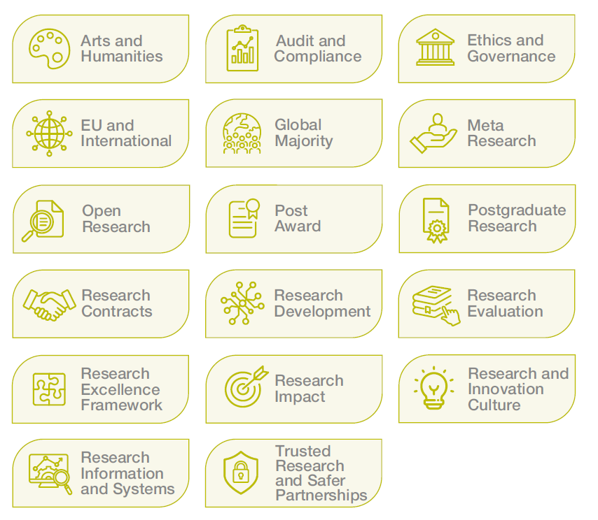
In 2022, ARMA Member Engagement Committee commissioned a review of existing special interest groups (SIGs) to understand how they operate, potential needs and support, relevance and gaps for new SIGs. The review will be completed in 2023
  2021/2022 14 SIGs, Largest: Impact; Total SIG Subscribers: 4,671; Total SIG Communications: 1,254
  2022/2023 13 SIGs (M&H SIG closed); Largest: Impact; Total SIG Subscribers: 4684; Total SIG Communications: 795
In 2025/26:
Two new SIGs were launched.
We ran 77 SIG events with 6122 registered attendees
This included five in-person SIG events, funded by the ARMA SIG Innovation Fund
We have a total of 66 SIG Champions
Notes:
ARMA currently has 15 SIGs, with 4909 subscribers to their mailing lists.
SIG Champions Forum took place in Manchester to share best practice

Slide 14
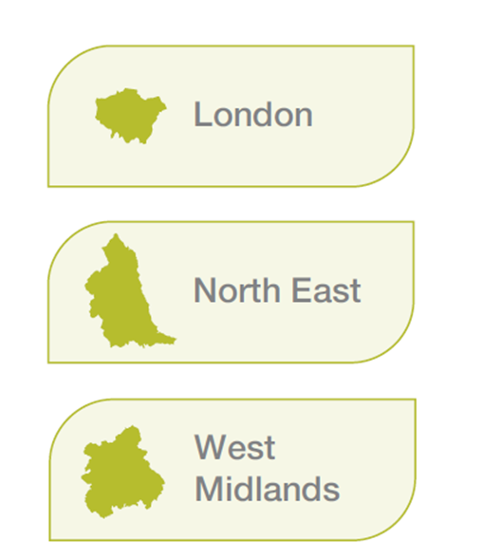
Regional Groups Pilot
In 2022, ARMA Member Engagement Committee commissioned a review of existing special interest groups (SIGs) to understand how they operate, potential needs and support, relevance and gaps for new SIGs. The review will be completed in 2023.
SIGs
  2021/2022 14 SIGs, Largest: Impact; Total SIG Subscribers: 4,671; Total SIG Communications: 1,254
  2022/2023 13 SIGs (M&H SIG closed); Largest: Impact; Total SIG Subscribers: 4684; Total SIG Communications: 795
In response to member needs, we launched the regional groups pilot programme with three inaugural groups – London, North East and West Midlands.
Following the pilot, the programme will be expanded to include additional regions, enabling even more members to benefit from locally rooted and professionally enriching communities.

Slide 15
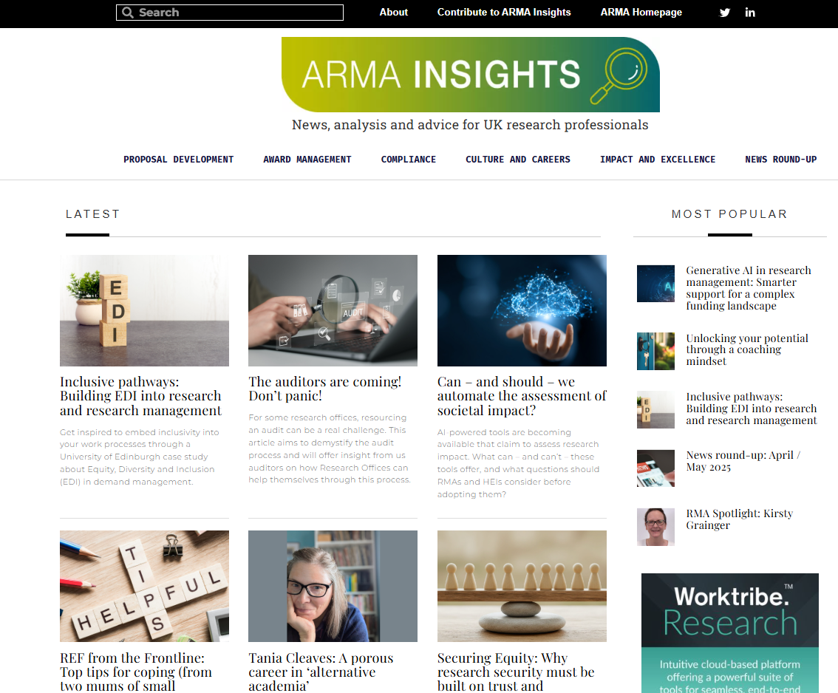

ARMA Insights
ARMA Insights
In 2025/26, 31 articles were published, which collectively received 6,574 views.
As of 31 March 2026, ARMA Insights has had 22,289 views.

Slide 16
ARMA Insights
Artificial Intelligence Working Group
The Artificial Intelligence (AI) Working Group has been established by the Member Engagement Committee (MEC) to enhance ARMA’s knowledge and understanding of AI as it relates to research management.
The objective of the working group is to provide informed recommendations on ARMA’s future direction and activity in relation to artificial intelligence, and to strengthen ARMA’s ability to support, inform and represent the research management profession in this rapidly evolving area.
The working group will share its findings and provide recommendations to MEC in 2027.

Slide 17
ARMA Insights
Research Culture Survey
The second Research Culture Survey was launched in February 2026, attracting 469 responses.
The survey was developed in collaboration with the Research & Innovation Culture SIG Champions, who will share early insights at their conference session.
A report on research culture will be developed for the research management community and published later in 2026.

Slide 18

ARMA Awards
The award categories:
- ARMA Volunteer of the Year
- Collaboration in Research Management
- Innovation in Research Management
- Research Culture in Research Management
- Research Management Team of the Year
- Outstanding Contribution to Research Management
31 nominations were received with 14 selected
for the shortlist
Winners were announced at the Awards
Ceremony which took place during the ARMA 2026 gala dinner

Slide 19
ARMA Representing You!
International Network of Research Management Societies (INORMs)
DSIT Research Security Independent Advisory Board
CO-PRO Inquiry Panel member
DSIT Horizon Europe Participation Systems Group
Higher Education Security Forum
DSIT Bureaucracy Review and Reform Implementation Network
British Academy/Vitae Researchers at Risk Steering Board
UUK/Jisc research licensing strategy group
TRAC Development Group
UKRI Research Organisation Consultation Group
NHS R&D Forum
International Professional Recognition Council Member
International Advisory Group on Research into RMAs
RM Roadmap Ambassador for UK
And many more!

Slide 20
Bold

Slide 21
We are Bold
We are a key partner in delivering the £4.5m Research England funded “Research Professional Futures”
We have directly fed into the UK Government’s new Research Security Strategy and are part of a small group helping to design the new Research Security Fund
We have been working with Research England who have funded us to deliver work on “Financial Sustainability of Research” with the sector
We continue to champion our profession and the expertise we offer, including through increased opportunities such as contributing to funding panels

Slide 22
Inclusive

Slide 23
We are Inclusive
ARMA’s EDI Advisory Group has been used as a sounding board in the development of new and refreshed policies, such as our refreshed expenses policy
Inclusive recruitment practices continue
Conference registration and support to attend bursaries offered
Mixed delivery of T&D events to increase accessibility, recognising members are keen to get back together in person
Pilot regional groups created to foster local connections
The Exec Office took part in Cognitive Inclusion training and updated ARMA’s trainer good practice guidance, slide sets and included the topic in the train the trainer programme

Slide 24
Collaborative

Slide 25
We are Collaborative
We continue to cultivate partnerships with key sector bodies particularly in raising the importance of the RMA community and our voice being represented in sector discussions
  The PRISM Network, HERSA, BUFDG, RLUK, JISC, etc
  Key Funders (particularly DSIT and UKRI)
  Sector Bodies such as UUK
We continue to work collaboratively with our sister associations around the world, including:
  ARMA lead for the UK on the RM Roadmap initiative (led by EARMA)
We continue to work with other sector partners to deliver our mission and offer benefits to our members
  Knowledge Exchange UK – joint Directors Forum being discussed for Autumn 2026

Slide 26
Professional

Slide 27
We are Professional
Investment in our IT infrastructure
  We have procured a supplier to work with us on the installation of a completely new IT system and completed a thorough 'Discovery' phase to fully understand our CRM requirements
  A new Learning Management System has been fully implemented for our qualifications programme with all students and assessors fully utilising it
We expanded our support to Senior Leaders by launching our Research Leaders Forum and rolling out new training and development opportunities such as the successfully group coaching Mastermind programme
As part of our commitment to continuous improvement we have reviewed our qualifications programme to ensure it continues to meet the needs of the sector and is aligned with the updated Professional Development Framework. The newly refreshed programme has launched and will start in Autumn 2026
In 2022, ARMA Member Engagement Committee commissioned a review of existing special interest groups (SIGs) to understand how they operate, potential needs and support, relevance and gaps for new SIGs. The review will be completed in 2023.
SIGs
  2021/2022 14 SIGs, Largest: Impact; Total SIG Subscribers: 4,671; Total SIG Communications: 1,254
  2022/2023 13 SIGs (M&H SIG closed); Largest: Impact; Total SIG Subscribers: 4684; Total SIG Communications: 795

Slide 28
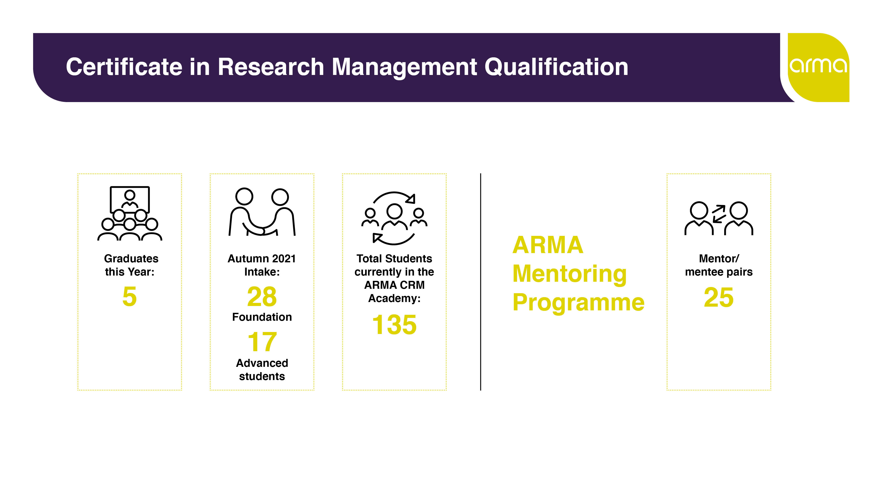
2024/25
6
18
48
171
28
We have established a Qualifications Working Group to ensure our qualification programmes continue to equip our students with the skills they need to be successful in their careers.

Slide 29
Training & Development Events
During 25/26 based on member insights, we introduced a number of brand-new training sessions. This included:
Learning from European Counterparts: Strategies for Successful Horizon Europe Bids
Horizon Europe Post-Award Financial Management
Building Confidence in Research Integrity
Introduction to the Challenge of Effective Research Governance
27 T&D Events
537 participants
5 Face to Face events in cities across the UK, including Edinburgh, Manchester, London, York and Leeds
96% of attendees rated our training good or excellent
Notes:
In 2022/23, we had 500 participants attend our events.

Slide 30
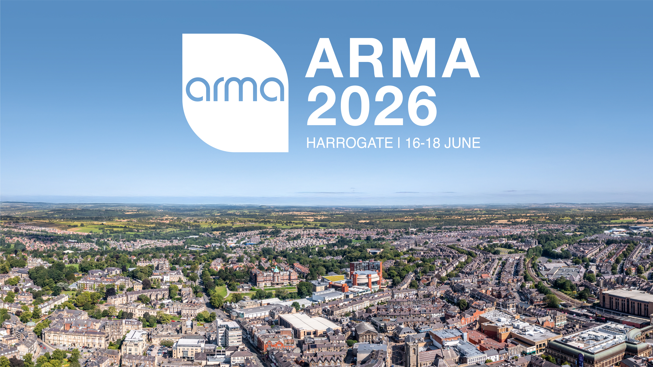
Conference
In 2022, ARMA Member Engagement Committee commissioned a review of existing special interest groups (SIGs) to understand how they operate, potential needs and support, relevance and gaps for new SIGs. The review will be completed in 2023.
SIGs
  2021/2022 14 SIGs, Largest: Impact; Total SIG Subscribers: 4,671; Total SIG Communications: 1,254
  2022/2023 13 SIGs (M&H SIG closed); Largest: Impact; Total SIG Subscribers: 4684; Total SIG Communications: 795
ARMA 2026 attracted strong interest from delegates and sponsors
ARMA 2027 venue secured, and location will be announced during closing session of ARMA 2026

Slide 31
Ushma Gudka
Treasurer

Slide 32
Treasurer’s Report

Slide 33
Financial Highlights 2025/26
Surplus of £63.5k compared to a planned budget deficit of £137.7k
We achieved overall 90% of our income target and expenditure was 77%
Strong performance in Conference £483.4k, Membership £407.2k and T&D £99.6k
Projects and Professional Qualifications were behind budget
Expenditure £322.8k under budget, reflecting IT Refresh delays and adjustment of activity and strong cost control
Strong cash position of £717k
Notes:
2023/24 figures for comparison
Operating surplus of £72.7k before tax compared with projected budget deficit of £76k.
Membership fees and Training & Development income substantially ahead of budget, by £36.3k and £42.7k respectively.
Expenditure £150.5k under budget
Strong cash position of £481.4k

Slide 34
What We Delivered in 2025/26
Strategic priority to improve our IT to improve access/facilities for our members
  Provisional Budget line of £100k included for IT refresh project ONGOING
  Learning Management System ACHIEVED
Delivery Officer – ACHIEVED
Improving for our members
  Professional Development Framework ACHIEVED
  Qualifications refresh ONGOING - DELIVERY FOR 2026 START

Slide 35

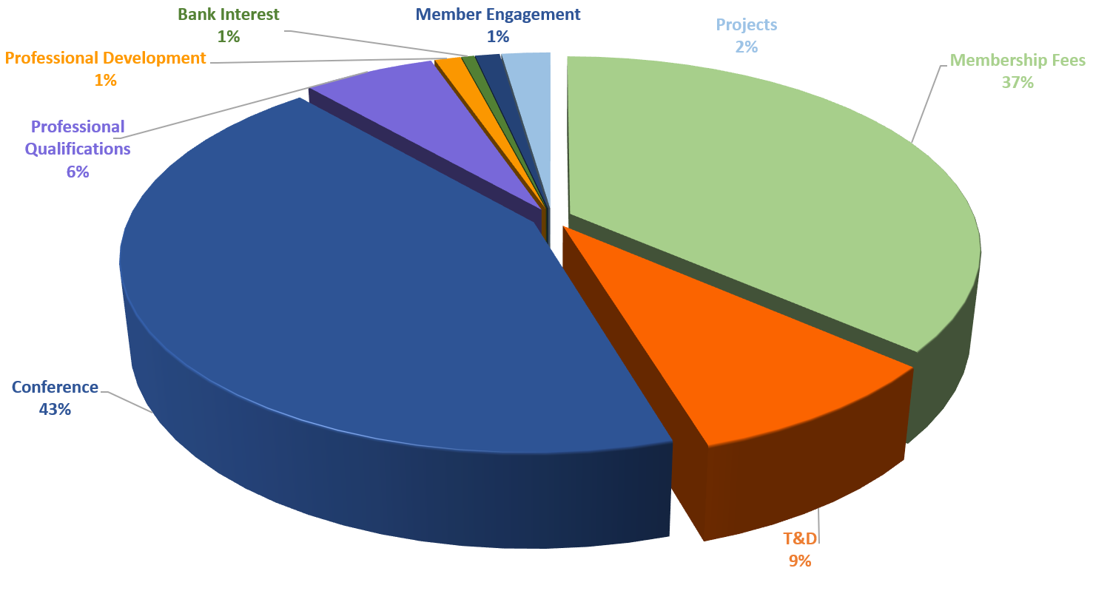
Where ARMA funding came from last year

Slide 36
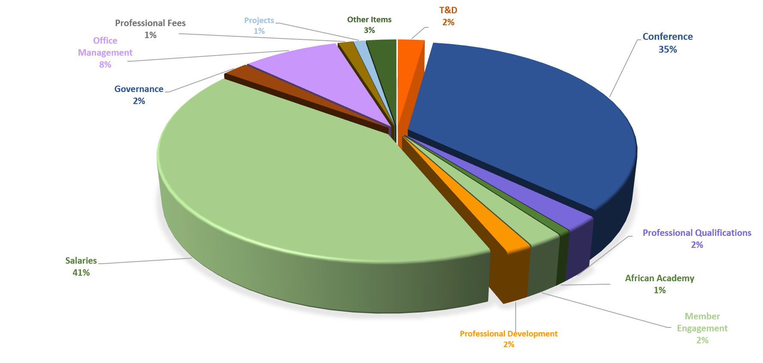
…and how we spent it
Notes:
Updated for 23/24

Slide 37
Budget 2026/27
Investing in our future
An ambitious but realistic budget to support our members whilst recognising the sector challenges
Income target to remain at £1.24m
A small increase in Membership fees and our T&D but our face-to-face T&D and Professional qualifications remain the same for 2026/27
Conference income mirrors last year's success; No adjustments to both T&D and Project income

Slide 38
Investing for the Future
2026/27
Strategic priority to improve our IT to improve access/facilities for our members
  Budget line of £90k included for IT refresh project for 25/26
  Final part of Qualifications refresh
Risk profiling
  F&GC/Board are very mindful of the current sector challenges and while ARMA remains ambitious for our future, we have also considered mitigation scenarios to ensure future sustainability of ARMA

Slide 39
Approval of the Annual Accounts 2025/26

Slide 40

Thank you

Slide 41
Sophie Collet - Deputy Chair

Slide 42
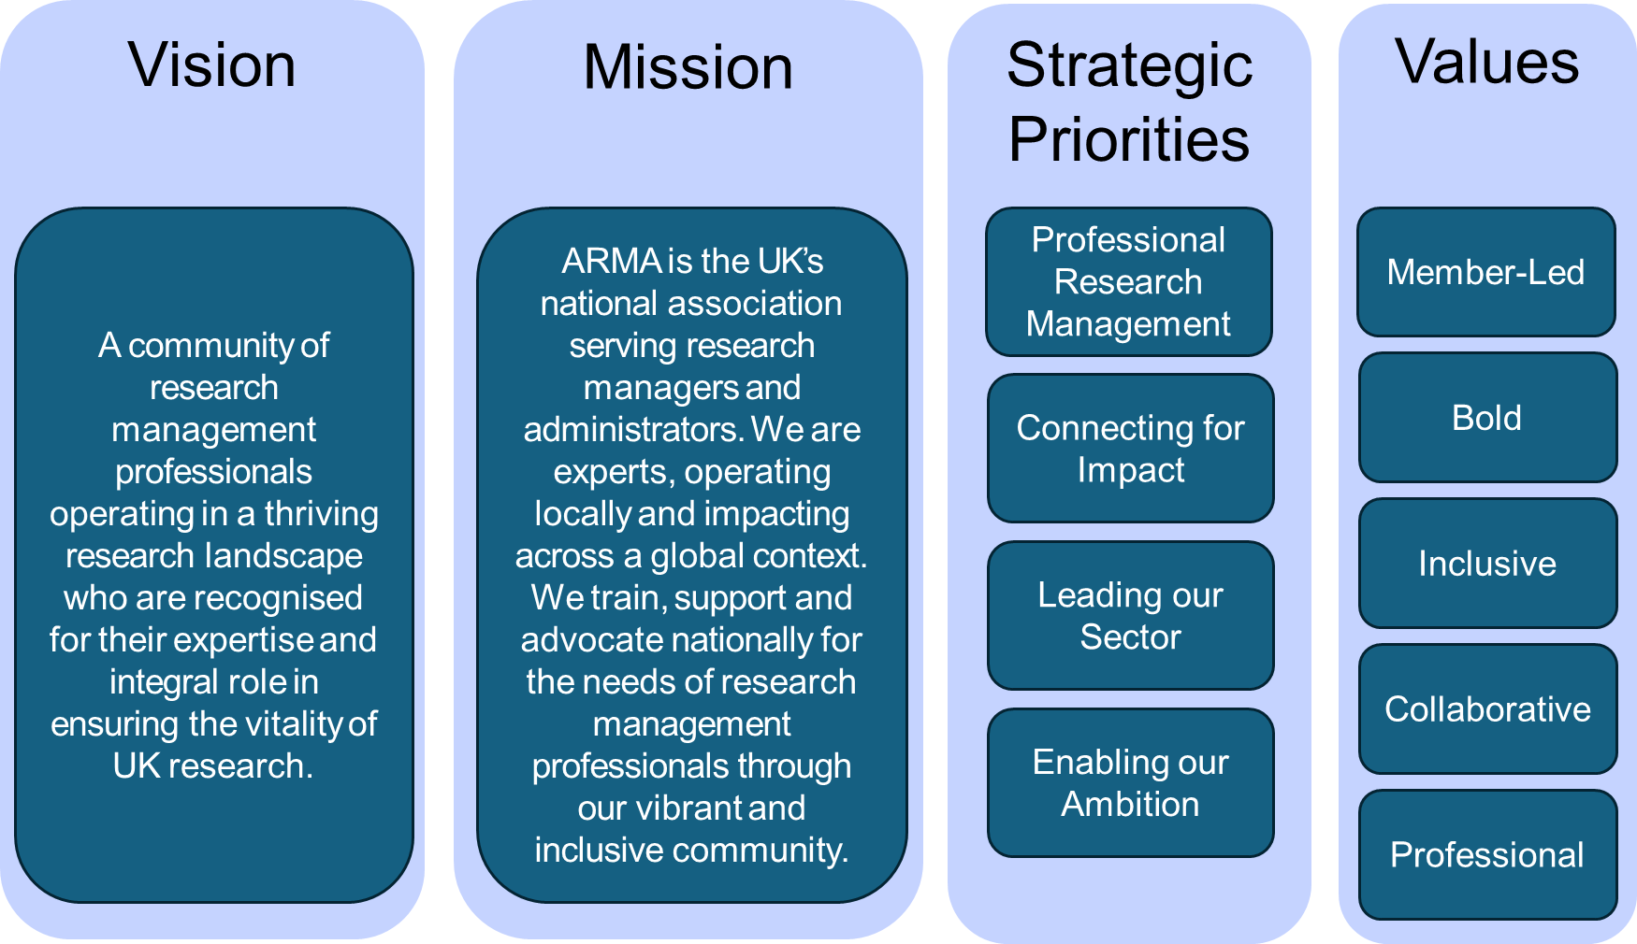
Strategic Planning
…bringing our vision, mission and priorities to life, while identifying clear actions to be carried out in accordance with ARMA’s values.

Slide 43
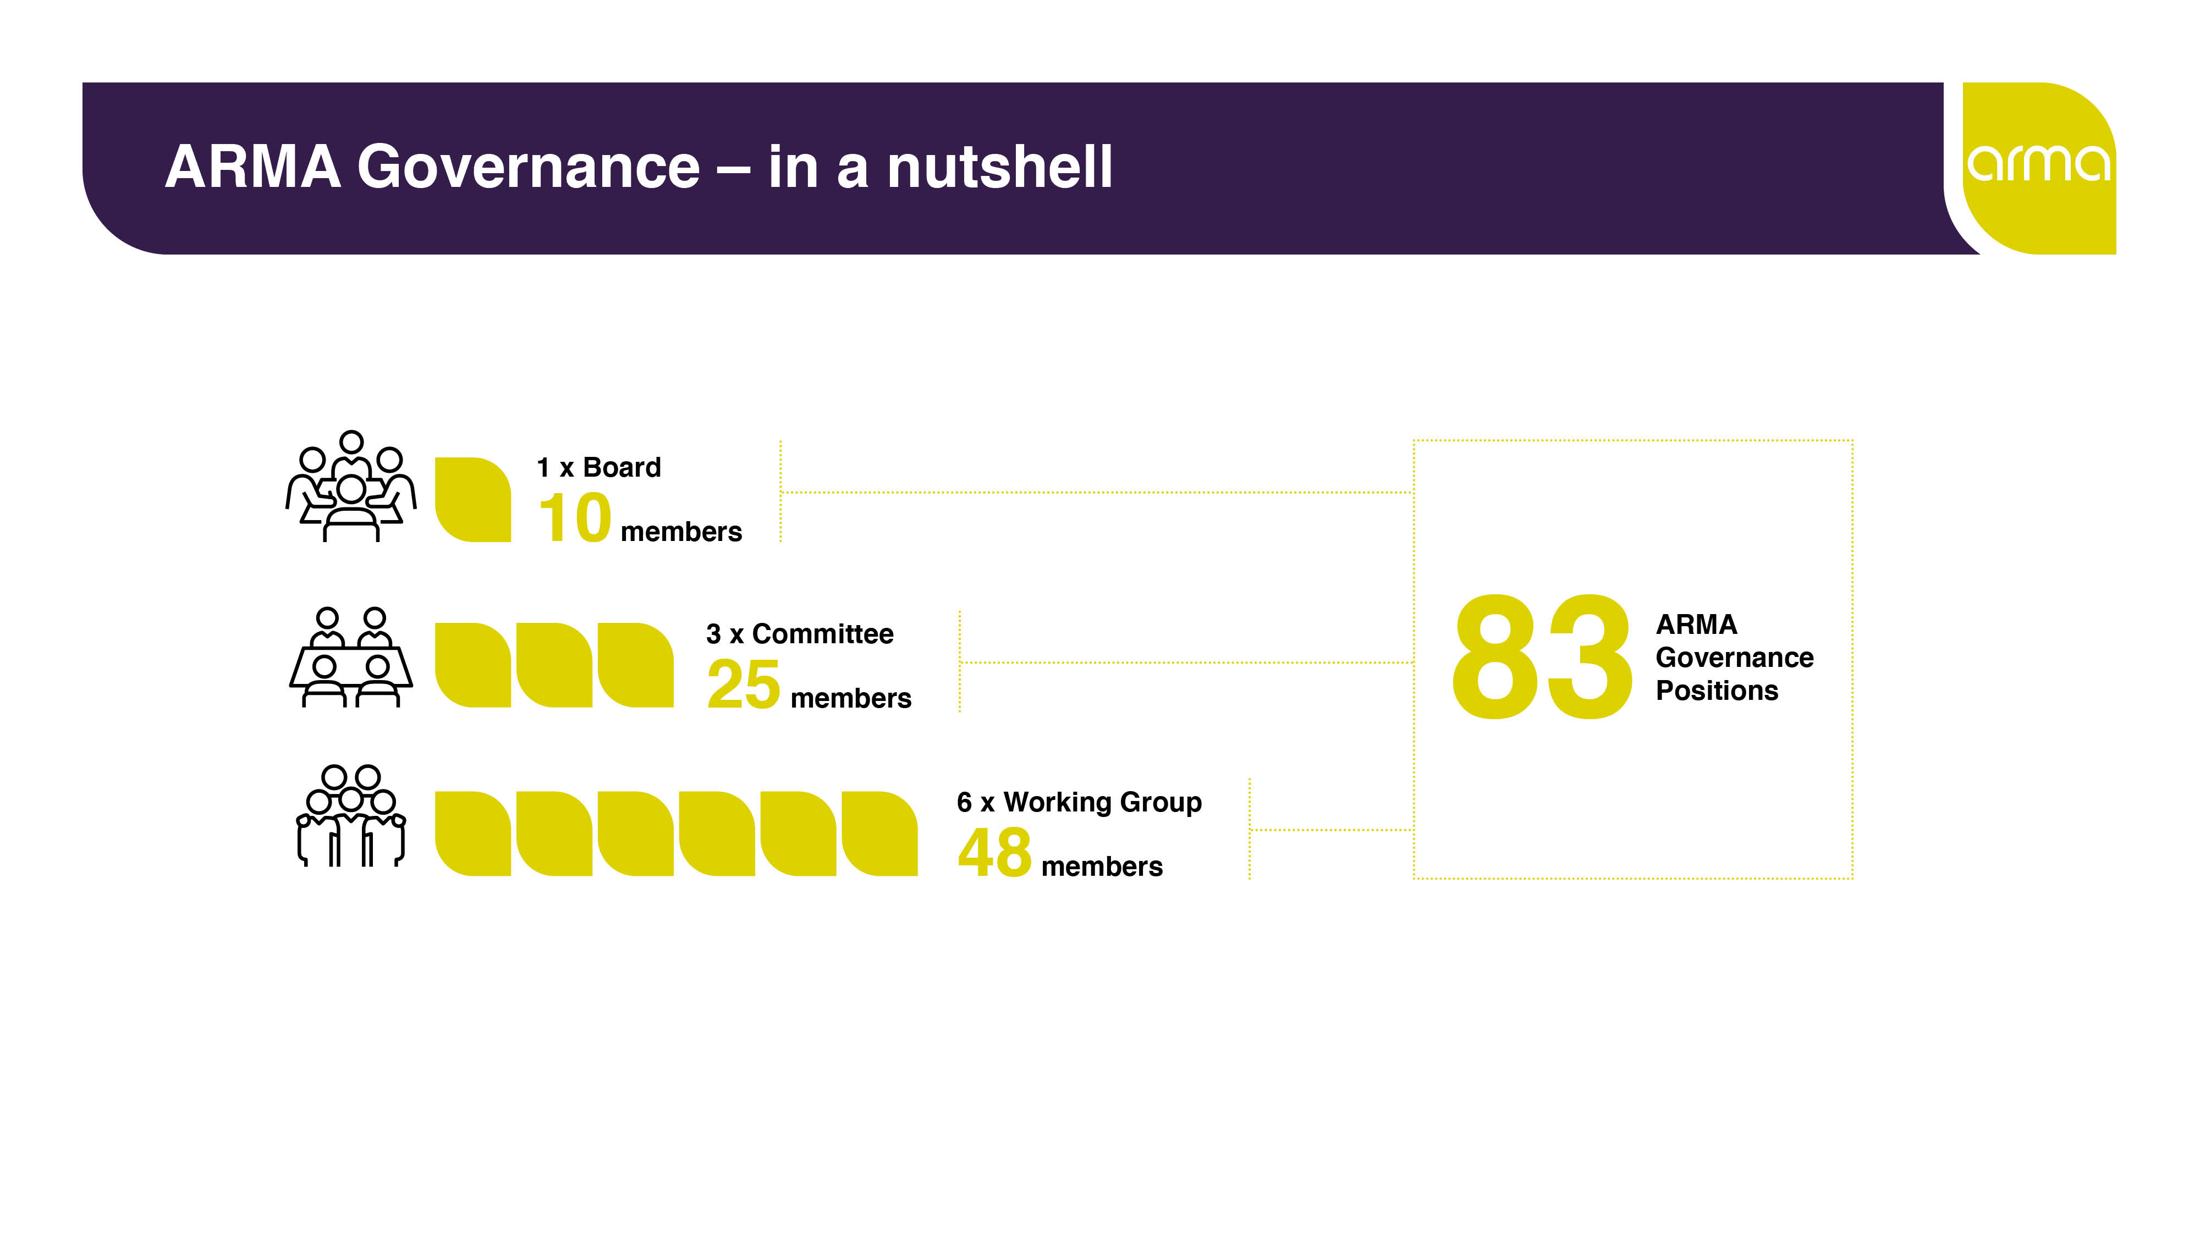

92
61
Notes:
Updated for 2024

Slide 44

The work of the EDI Advisory Group
Membership includes ARMA Deputy Chair (Group Chair), up to seven member representatives, a Global Majority SIG co-Chair and the ARMA CEO
Established in 2019 to act in an advisory capacity, reporting to the ARMA Board
EDIAG has advised the Conference WG on conference planning, reviewed ARMA policies e.g. the Expenses Policy, and is considering how to select meaningful measures for EDI in the context of ARMA Strategy delivery

Slide 45
Governance Review
ARMA commissioned PARN to undertake a Governance Review
Interviews were conducted with Board members and senior Exec Office staff
A focus group was held to gather the views of volunteers
The review indicated that ARMA is “a well-run, values-led organisation with a strong volunteer ethos”
No fundamental weaknesses in governance were identified
The recommendations of the review will be considered by the ARMA Board and an implementation plan created

Slide 46
Alasdair Cameron -CEO

Slide 47
Board Appointments

Slide 48

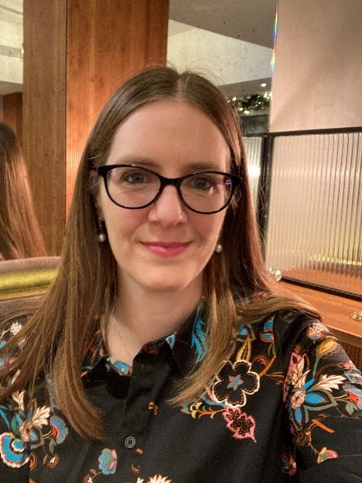
Board Appointments
Members are invited to endorse the re-appointment of:
Jo Lakey
Director
(Aug 2026-Jul 2029)

Slide 49
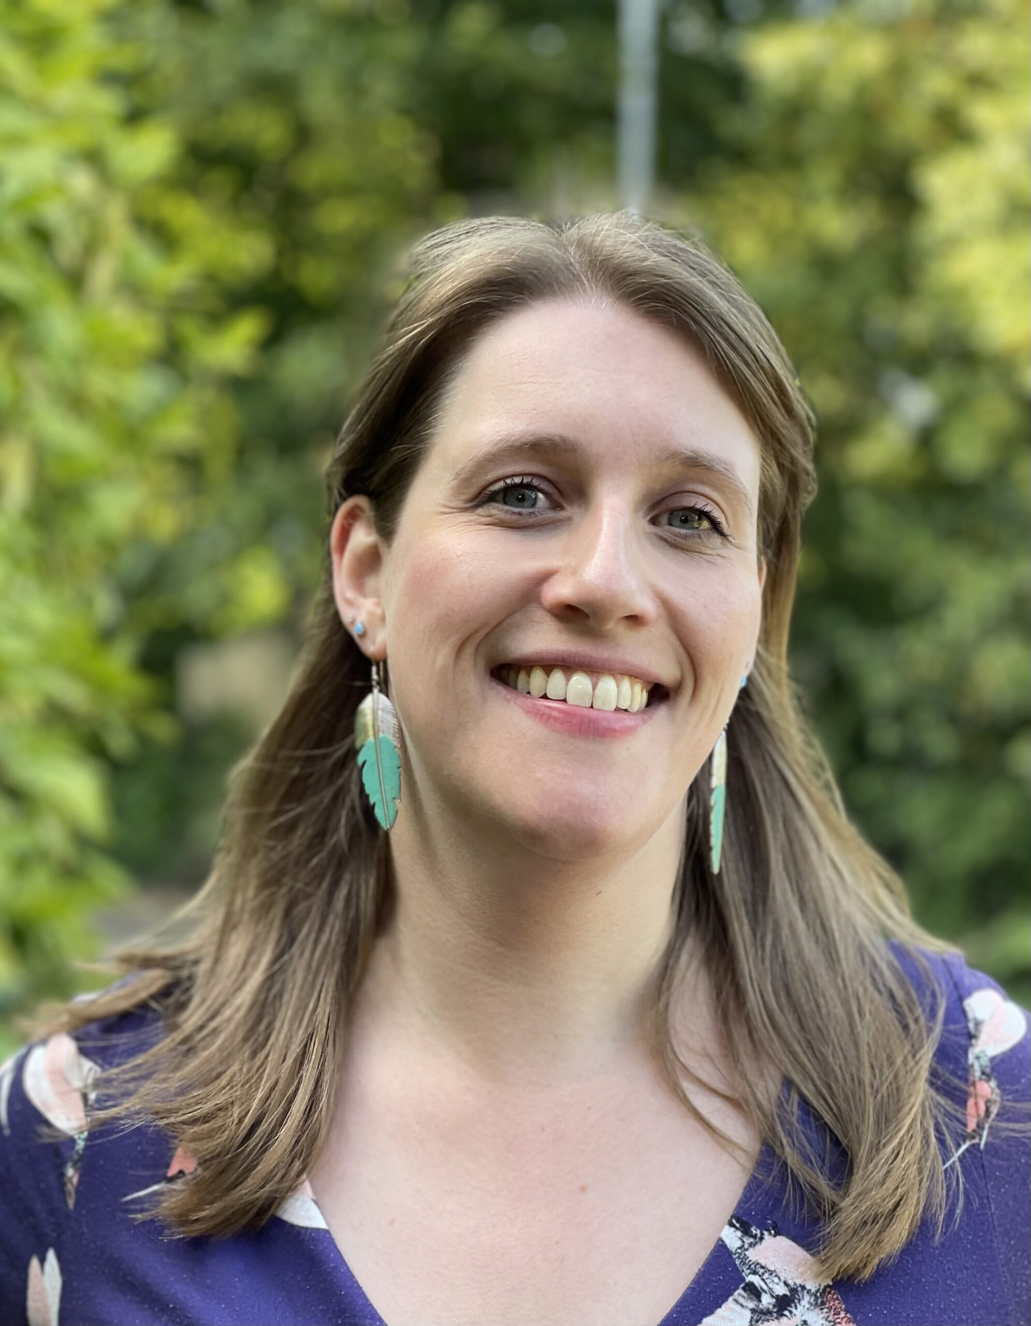
Board Appointments
Members are invited to endorse the re-appointment of:
Alison Lloyd
Director
(Aug 2026-Jul 2029)

Slide 50
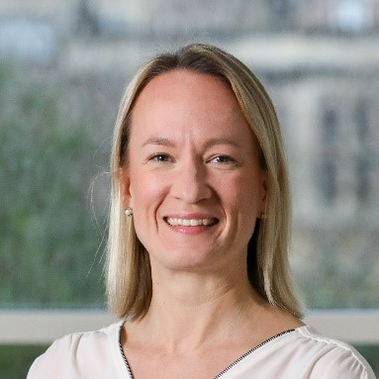
Board Appointments
Members are invited to endorse the re-appointment of:
Sophie Collet
Deputy Chair
(Aug 2027-Jul 2030)

Slide 51
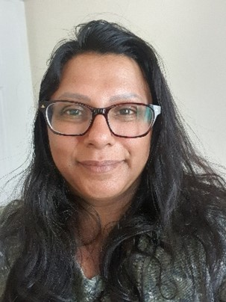
Board Appointments
Members are invited to endorse the re-appointment of:
Ushma Gudka
Treasurer
(Aug 2027-Jul 2030)

Slide 52
Thank you

Slide 53
Lorna Wilson
Chair

Slide 54

Closing Remarks
A HUGE thank you to all of our phenomenal volunteers and members.

Slide 55
Any other business
Questions

Slide 56
Final reflections from ARMA’s outgoing Chair

Slide 57
Close of meeting

Slide 58
Thank you for attending!

