Slide 1


Local Dynamism meets Institutional Direction:
How do we change research culture together?
Andrew Moss, Research Culture Manager, Durham University
Amy Mayfield, Research Culture Manager, Lancaster University
Mary Muers, Research Environment Programmes Lead, University of Oxford
Nicola Simcock, Research Culture Manager, Newcastle University
Notes:
3 MIN INTRODUCTION
Thank you for having us…..
My name is NS I’m the RCM at Newcastle Uni and I will be presenting today alongside my colleagues AM, AM and MM – all of whom, like me work in large research-intensive universities and we all work on changing or sustaining the culture for research. With 4 presenters our talk today is going to be slick, and we are going to address Local dynamism meets institutional direction – how do we change research culture together.

Slide 2


To what extent are institutional research culture strategies reflective of local research environments and communities?
Not reflective
Reflective of limited groups or environments
Moderately reflective
Very reflective
#ARMA2026
Notes:
To start: Audience participation –Hands up
Starting with a big question, unfortunately we don’t have the time to unpack every element of this question and so we are looking for your gut reaction to this “To what extent are institutional research culture strategies (and that is whatever an institutional research strategy means to you, perhaps at your own institution, or perhaps elsewhere) reflective of local research environments and communities? (and again, whatever local research environments and research communities means to you).
There are 4 options from Not reflective, reflective od limited groups, moderately reflective to very reflective
If you are able, please raise your hand if you think institutional RC strategies are not very reflective of local research environments…..
Comment…
Next raise you hand….
We have started with this question to give an indication about where the people might think that RC work and RC change might sit in an institution.

Slide 3
The Research Culture Challenge
Institutions have a responsibility to create and sustain positive research culture(s)
However, institutional responsibility creates an unintended consequence:
The perception that the institution ‘owns’ the research culture and becomes solely responsible for changing it
#ARMA2026
Notes:
Institutions have a responsibility to create and sustain positive research culture(s) and working at the institutional level provides an opportunity to grapple with the big structural issues like processes and systems, to see the big picture and try and make changes that will impact the community as whole rather than pockets within. Myself and my co-presenters have all working as part of an institutional RC Team or as institutional RC individual and we acknowledge the benefits provided in being able to bring awareness of the some of the big institutional and sectoral issues.
The institution has a huge impact on the research culture, and its role should not be minimised, but institutional responsibility can lead to an unintended consequence that can have a negative impact: that the RC is owned by the institution, and perhaps therefore the Research Culture Team, and that it is our responsibility to change it.
While we each represent a large universities, this can be a problem at all scales and what we want to share today is an overview of how all 4 intuitions have independently started to pivot our work to address this problem.
While recognise the power and the importance of institutional level work (which each of our institutions are maintaining) we shifting our focus to the local level to engage and empower local groups to take on some of this ownership for RC.

Slide 4
Local Dynamism meets Institutional Direction
Shared aims:
Supporting local units to reflect on their research culture activities
Providing clarity for local units on scope
Improving sharing amongst local units
Identifying shared needs and gaps across units
Strengthening 'strategic' thinking on research environment in local units
#ARMA2026
Notes:
For our 4 institutions this has come after years of institutional level work, and while we have each made a lot of progress in that time, we have all recognised that the work needs to change to be more impactful.
We’ve each approached this using slightly different methods, but we are all aiming for very similar outcomes.
For instance, we are all keen to support units to reflect on their RC and RC activities, get those groups engaged in this work in a meaningful and rekevant way
Provide clarity – RC is big and it means very different things to different people – what’s in and what’s out?
Improve sharing – so important, I think we have all recognised that there is so much innovative and inspiring activity happening out there, but finding it, narrating it and sharing it is challenging.
Working with multiple local units identifies needs and gaps across the institution, probably better than something like A RC Survey ever could
This feeds into strategic thinking – where do we realistically need to go based on the reality of where out units are right now?
So now I will hand over to my co-presents to take you through 3 different mechanisms you might be interested in using to achieve these aims, starting with Mary to talk about the approach at Oxford.
and we hoping to share that work so any of those of you starting to recognise the same challenge in your own settings might benefit in learning the approaches we are trialling.

Slide 5
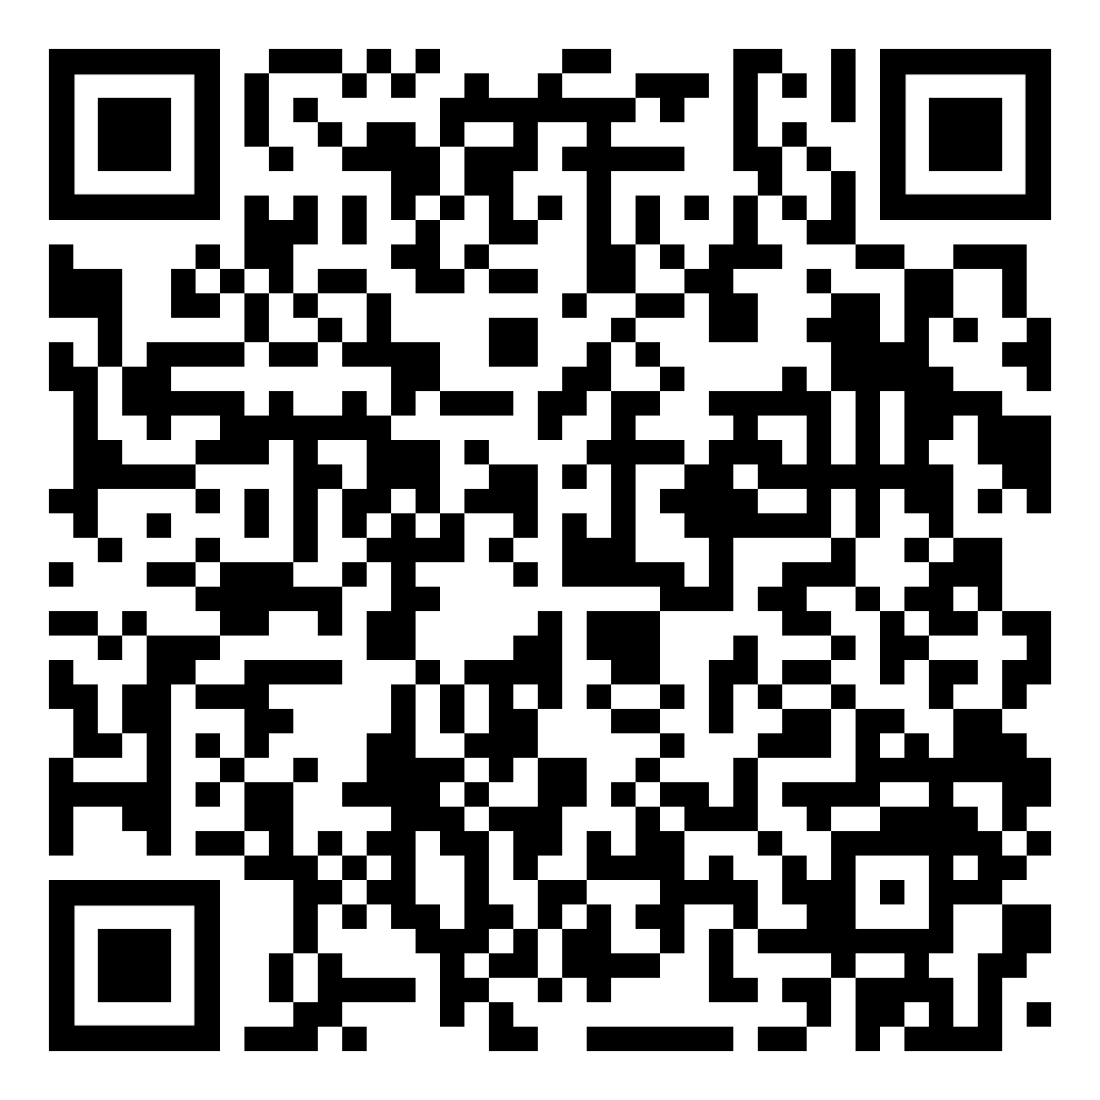
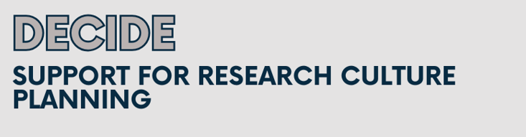
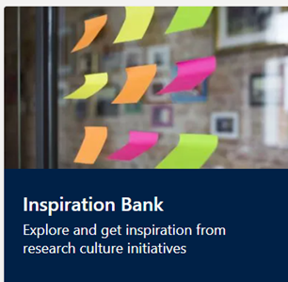
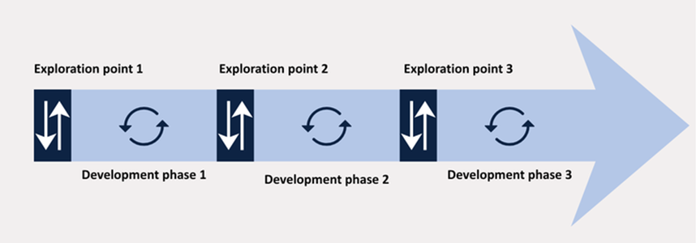
Oxford
Research Culture Toolkit
Template and facilitated conversations with departments
•Structured by 14 research culture topics; • questions to reflect on; • case studies
Baseline practices / policies
How is your department enhancing this area of research culture?
What challenges have you identified, and what support is needed for improvement?
Inspiration Bank to share good practice throughout departments
Resources Library points to existing resource throughout the University
DECIDE Tool to guide strategic planning
#ARMA2026
Notes:
3 MINUTES
At the University of Oxford we identified those needs that Nicola has just outlined. Across a very large and devolved institution, we knew there was a wealth of creative and thoughtful activity supporting positive research cultures, as well as variability in experiences and awareness. The Research Culture Toolkit is designed as a process of working with departments - or other organisational units - to support structured self-reflection and sharing, and to raise the quality and rigour and efficiency of activities that strengthen our research environment.
The overall process is that we have a framework of 14 topics: these are organised by Oxford's three interconnected research culture priorities on research practice, careers and valuing diverse contributions. This framework gives the scope. Then there is a Template with a section for each topic and questions to reflect on; this is done both through facilitated conversations with a small number of people from each department, and independently by the dept. -- this process is called an Exploration point, and we repeat it at intervals of at least a year to encourage reflection on progress or barriers to progress.
Tools that sit alongside include the Inspiration Bank - bite-size case studies and examples of activities for each topic, to try to avoid each department reinventing wheels all over the place. Plus the resources library.
We have recently added the DECIDE guide which is a simple acronym to support strategic planning of research culture related activities.
The Toolkit process was initially piloted and iterated in 8 departments in summer 2024 and then used university-wide in early 2025. we used findings from that exercise to identify areas for coordinated action as well as local context-specific issues. We go back to the departments to see what has changed over the course of the past ~18 months.
Why is this important?
What have we learnt?
If you would like to find out more, please do take a look at a short report that describes the Toolkit.

Slide 6
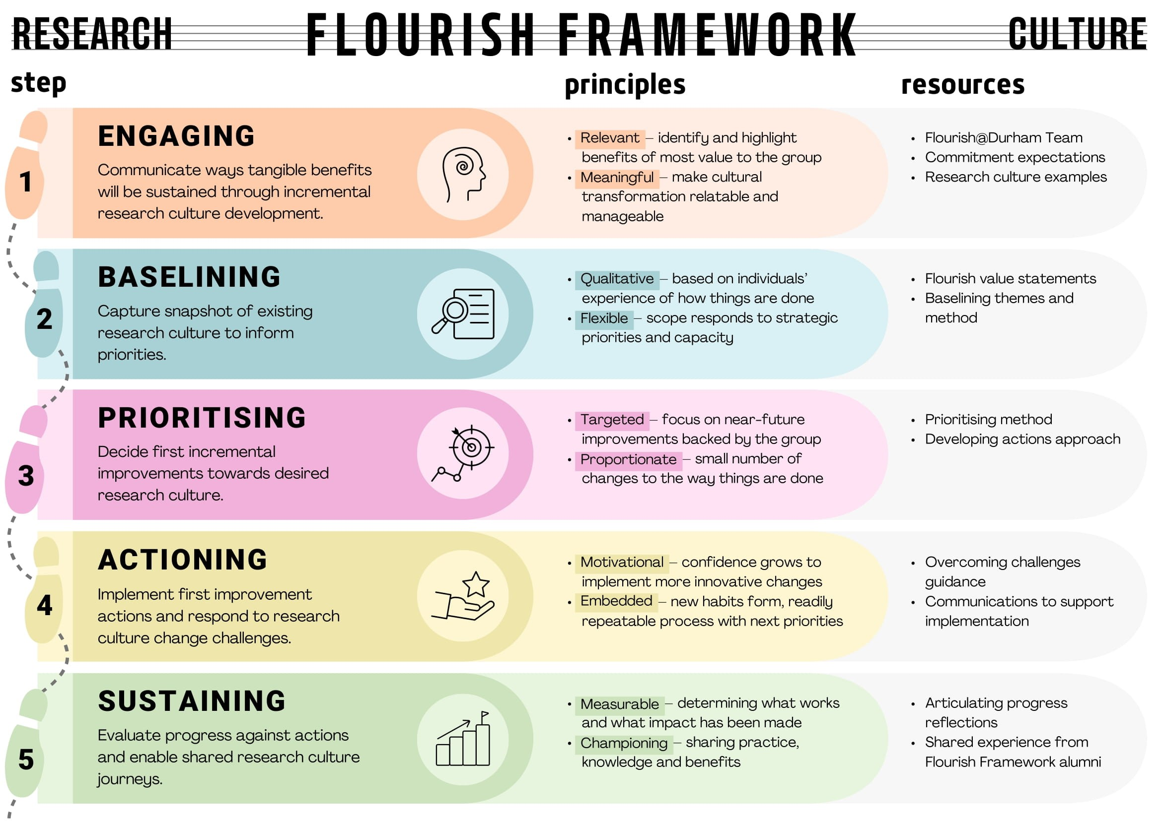
Durham
#ARMA2026
Notes:
3 MINUTES – Qual Survey – showcase the principles – mention Sabina – incremental and logical change – relationship building -
•A 5-step framework that invites academic departments and university research institutes to consider the prevailing research culture of their environment and to take steps to develop a positive research culture.
•Empower individuals and teams to take ownership of their research culture and create solutions that are relatable and manageable
•Be supported in undertaking incremental steps toward your desired research culture.
•Designed to be adaptable to the research culture journey of each unit and is intended to enable proportionate and targeted improvement.
•Based on Flourish at Durham values that have emerged in consultation with staff – Research Leadership, Career Development, Behaviours, Processes and Structures, Visibility and Recognition
1.Engaging – Approach to the Department to undertake the Framework
2.Baseline – Qualitative survey sent to members of the Department to understanding the behaviours, expectations and norms of the culture of the department
3.Prioritising – 3-hour creative facilitation session that reflects on the current reality through baseline responses and considers the research culture vision for 2030
4.Actioning – Within the prioritising session, create actions and activities that are proportionate and sustainable for the Department to undertake within reasonable timelines
5.Sustaining – The term after, the RC team work with the Department on sustaining actions and implementation

Slide 7
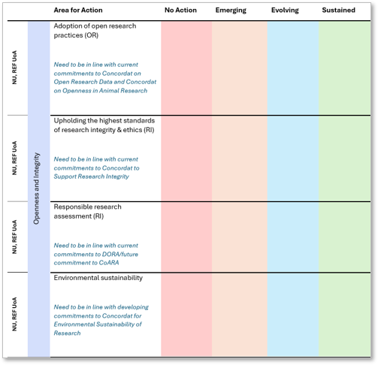
Newcastle and Lancaster
Research Culture Maturity Framework
‘Areas for Action’ under sub-themes of respective action plans
Measured progress - Embryonic, Emerging, Evolving, Embedded
Pilot groups recruited
Flexible approach, each unit engaging differently… including digitally (in development)
Local and (cumulatively) institutional areas of priority
Join us: https://doi.org/10.25405/data.ncl.32587923
Research Culture Uncovered podcast episode 152
#ARMA2026
Notes:
The maturity framework explores the progress made locally on research culture initiatives. It was developed at Newcastle, loosely based on the National Centre for Co-ordinating Public Engagement (NCCPE) framework and measures progress from the extent to which an area of research culture is considered embryonic all the way through to embedded with emerging and evolving in between.
Nicola kindly shared the template and thought behind the creation of this at Newcastle, at an N8 Research Culture and Evaluation meeting. At Lancaster we were also exploring how we best measure progress against our Research-excellence Culture Action Plan (ReCAP) and so recognizing an opportunity I reached out to Nicola!
In each of our institutional maturity frameworks, statements were created for each of the action areas within our respective research culture action plans. These exemplified the characteristics of the environment and typical practices that you might expect to see at each level.
So, an example from our version of the Lancaster maturity framework within the theme of Recognising and Rewarding our Research Community and specific action area of Celebrate and Reward Success:
At the Embryonic stage – The unit recognises the significance of supporting researchers in celebrating successes and repurposing 'failure' but has yet to take substantial action. Achievements are not routinely communicated or shared across the unit.
All the way through to what the Embedded stage looks like where - 'Failure' is viewed as a learning opportunity and individuals actively supported in re-framing and re-submitting applications, papers, grants etc. Initiatives that celebrate good research culture practice and research culture leadership are recognised and rewarded in workload models, promotions and awards.
The way in which we’ve deployed the maturity framework in both our institutions has largely been led by the unit (be that a school, department, research or researcher group). What we have both reflected on is creating the opportunities for as many as want to, to engage and ensuring their voices are valued and recognized in the process.
For instance, at Lancaster we received feedback from one unit that rather than having a session at a Research Away Day (which had been a popular choice initially), we would get better engagement from PGRs by holding a dedicated separate session with them. Another felt that better engagement would arise from a digital version of the framework. The framework was designed for collective group thinking on printed physical versions and consideration of the statements progressively laid out alongside each other. So, I was very fortunate to our Research Culture Evaluator who considered the need to align the outcomes of both formats but also the need for it to be accessible on a screen of any size... and was able to re-design and re-formulate it into a version which appears to work well and is currently being tested with a couple of departments.
The selections made are really useful for the unit's to reflect on their progress in different areas as perceived by their colleagues and what they may wish to focus on moving forward. What's been particularly helpful are any examples or rationalisations that have been provided as to why colleagues made the selections they did, giving a sense of what might be shareable good practice or reportable in an SPRE statement for instance. Cumulatively it's also providing a sense of what institutional areas of focus might be in our respective action plans, if a number of departments are reporting they feel activity is embryonic in particular areas and explore what more we can do to support and strengthen them.
We’ve presented our findings as a bit of a double-act in a few places now - I know some colleagues will have heard us talk about this at the Research Culture and Innovation SIG evaluation event recently and we have also recorded an episode of the Research Culture Uncovered podcast with the wonderful Emily Ennis. There is a link there to a repository at Newcastle so you can access the content, along with the guide for use and the equality analysis.
3 MINUTES

Slide 8
Shared Findings
Research culture must be locally owned and context-specific *
Structured reflection and dialogue are valuable
Inclusivity and participation are central
Recognition and celebration matter
Leadership, support structures, and coordination are important enablers
#ARMA2026
Notes:
1. Research culture must be locally owned and context-specific *
Effective research culture work requires local autonomy, contextual adaptation, and departmental ownership.
2. Structured reflection and dialogue are valuable
Structured opportunities and space for collective reflection help departments identify priorities, challenges, and strengths.
3. Inclusivity and participation are central
Positive research culture depends on inclusive participation and attention to groups whose experiences may otherwise be less visible.
4. Recognition and celebration matter
Recognition of contributions, achievements, and good practice strengthens engagement and culture.
5. Leadership, support structures, and coordination are important enablers
*This very much aligns with the first point - we need departments to be empowered to strengthen culture at local level and in a way that works in their context – so they need coordination, structures, systems, recognition and leadership etc.

Slide 9
Conclusion
Four approaches from four institutions - similar approaches to enable research culture progress at a local level
Combining institutional structures and processes with locally-led initiatives, boosting engagement and sharing good practice to embed change
Enabled by institutional strategies and dedicated culture teams, included trust and relationship-building and project delivery.
A problem shared is a problem solved… local dynamism meets institutional direction to enable research culture progress
#ARMA2026

Slide 10
Thank you and please contact us
Andrew Moss, a.d.moss@durham.ac.uk
Amy Mayfield, a.gibbons1@lancaster.ac.uk
Mary Muers, mary.muers@admin.ox.ac.uk
Nicola Simcock, Nicola.Simcock@ncl.ac.uk
#ARMA2026

Slide 11

Thank you
Any questions?

