Slide 1



10 Tips for Building Inclusive and Resilient Teams: Lessons in Culture-First Leadership
Emily Johnson, PhD
Eva Caamaño Gutiérrez, PhD
computational-biology-facility-livuni
cbf.liverpool.ac.uk
www
Notes:
Hi everyone, we’ve got some really exciting, and really big talks in this session so I’m going to try to mix things up by talking about something a little smaller and more personal in scope, but hopefully something where the key messages will resonate with all of you. So, onto my title ’10 tips for building inclusive and resilient teams: lessons in culture-first leadership.

Slide 2
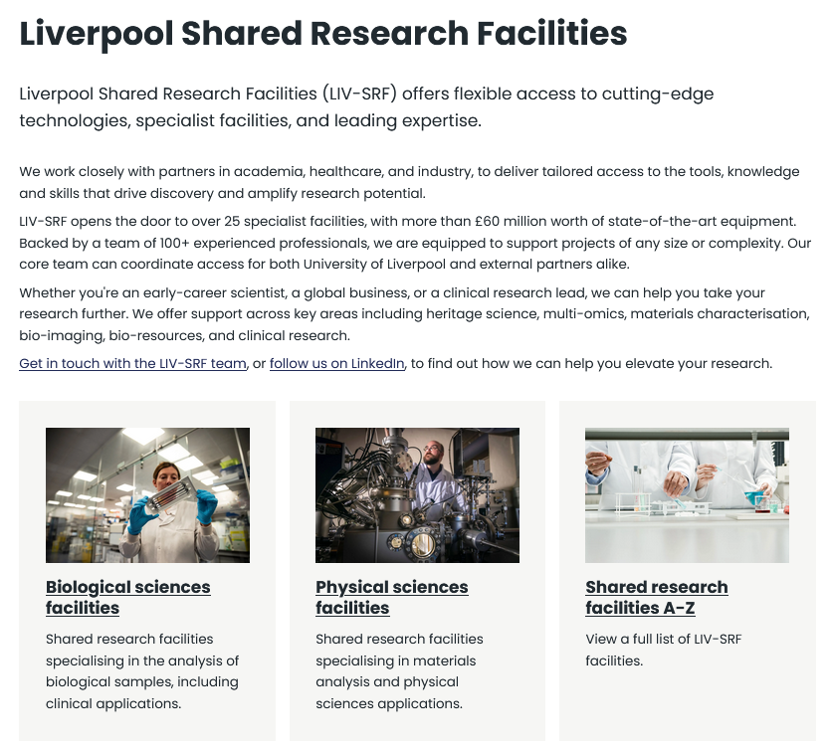







Computational Biology Facility at Liverpool
A snapshot of our activities from 2024-2025…
193 users
63 grant applications
28 different entities
49 co-authored papers
1,590 attendees to our courses +outreach
Contributed to securing £8.4M
In grant funding
CBF@liverpool.ac.uk
Emily.johnson@liverpool.ac.uk
https://www.liverpool.ac.uk/research/facilities/shared-research-facilities/
Notes:
But before talking about what worked for our team, I’d first like to introduce the team!

Slide 3
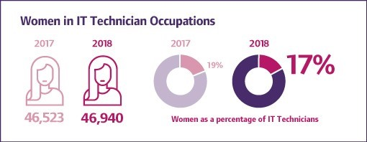
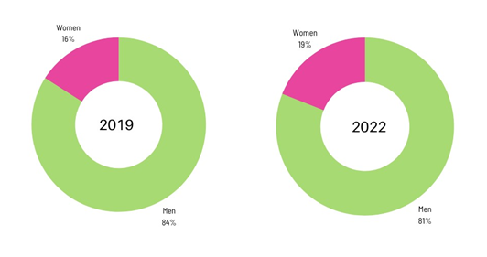
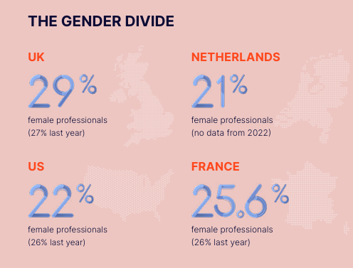
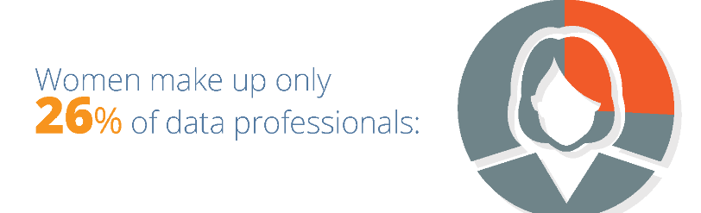
What’s it like to work as a data scientist…?
Notes:
Well mostly, it’s great, I love my job and I love the work we do… but there is one little problem with it…..

Slide 4



2016
2022
2026
Notes:
In 2016 the picture was worse than average. One woman in the whole team being treated as the defacto notekeeper and admin. 2022 was when a shift finally started to happen. That original woman became a manager, still the lone woman in the team. And then you can see the green figure, that was me! I was assessed by a take home task before interview. After that there was a bit of a cascade, and you can see

Slide 5
What changed…?
Notes:
I would love to be able to give you some hard and fast rules that could change any team’s culture overnight but a lot of these changes were slow, or small, gradually building up into something more…

Slide 6
1. Align your actions to your values
No matter how uncomfortable

Slide 7
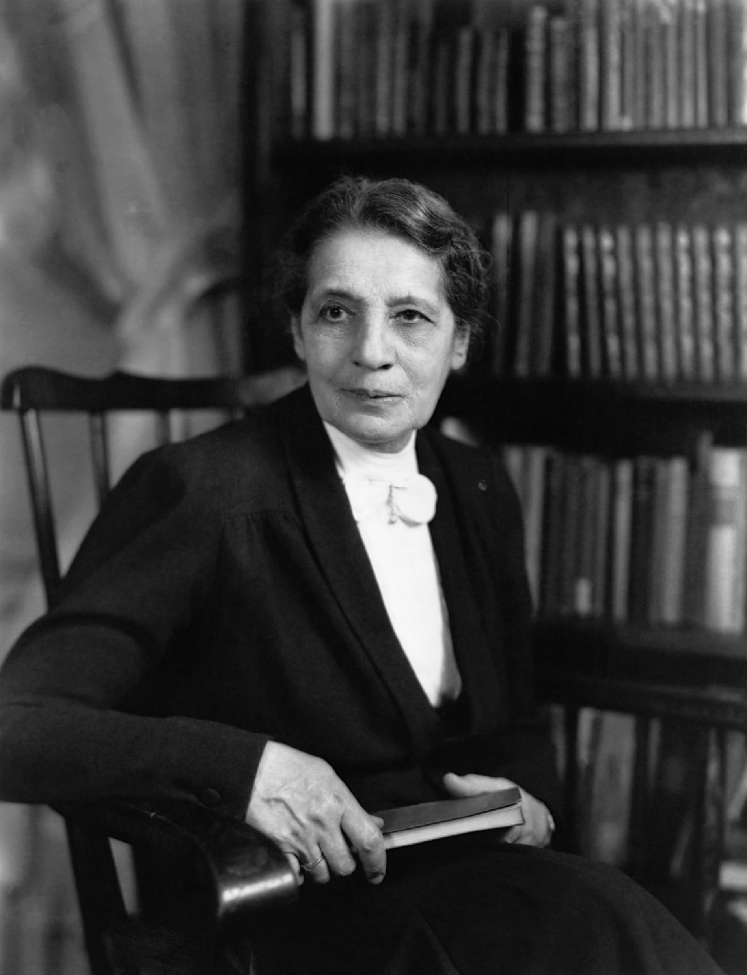
Name it when you see it:
“as [name] said earlier…”
In written outputs be deliberate about citation and authorship order.
Be the champion you wish you’d had or
carry the torch…
Notes:
Do any of you know who this woman on the left is? If I said her name ‘Lise Meitner’ ‘Leez Meitnuh’ would you recognise it?
‘In 1945, Otto Hahn received the Nobel Prize in Chemistry for discovering nuclear fission. His colleague of many years, the physicist Lise Meitner, got nothing - even though her knowledge and her work were essential for the award-winning discovery. ‘
https://www.lostwomenofscience.org/news-events/the-matilda-effect-how-women-are-becoming-invisible-in-science
https://www.ebsco.com/research-starters/womens-studies-and-feminism/matilda-effect

Slide 8
2. Nurture 2-way honest interactions
Trust is the way to excellence

Slide 9
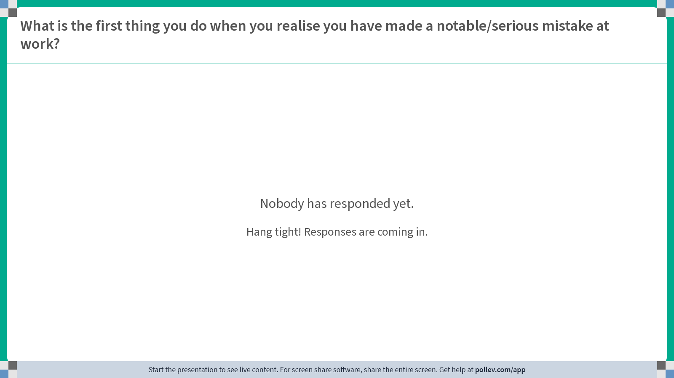
Notes:
Poll Title: Do not modify the notes in this section to avoid tampering with the Poll Everywhere activity.
More info at polleverywhere.com/support
What is the first thing you do when you realise you have made a serious mistake at work?
https://www.polleverywhere.com/free_text_polls/A2YHNflnkeZcWxpDpvoMK

Slide 10
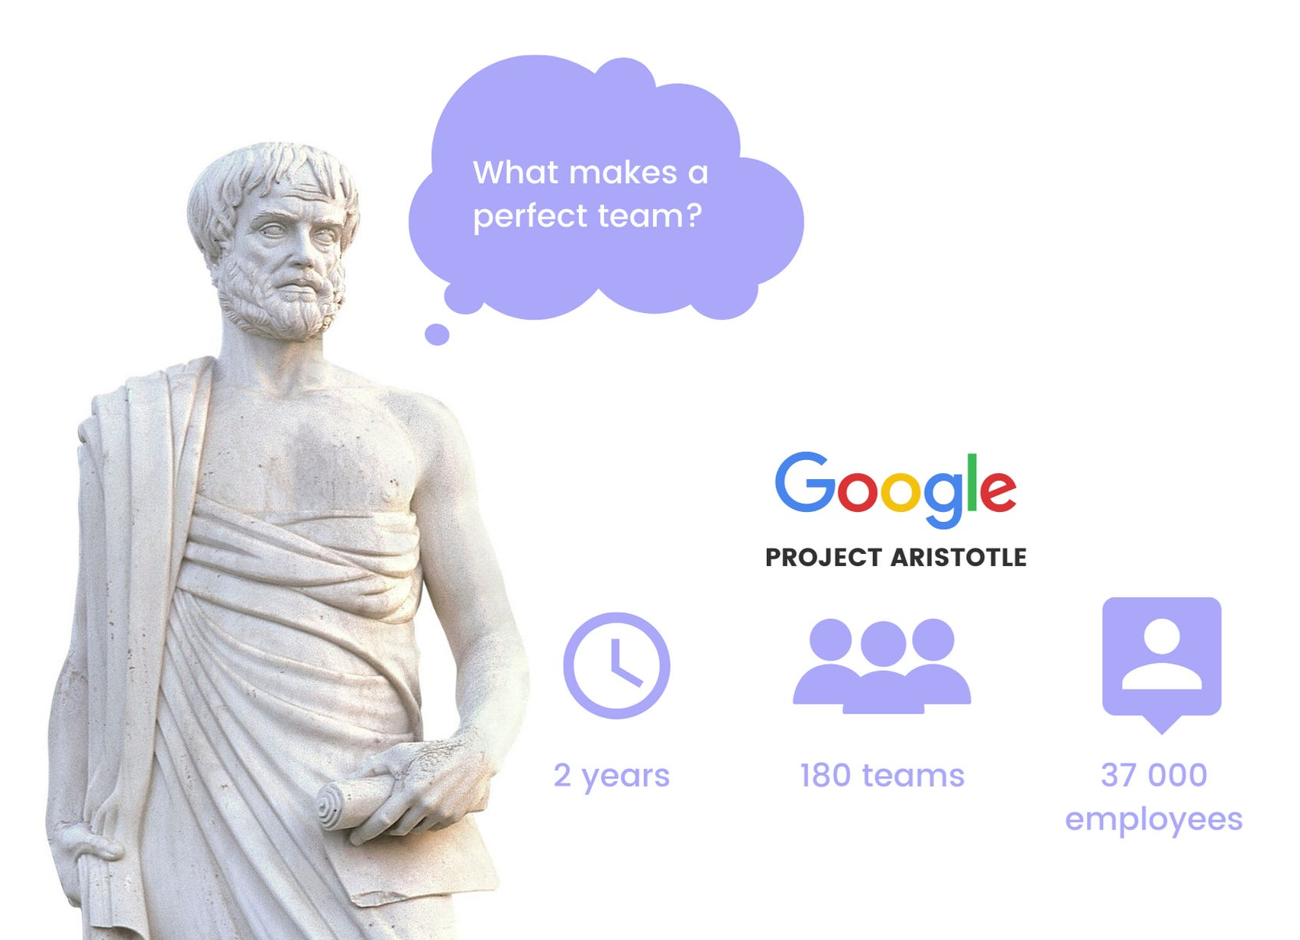
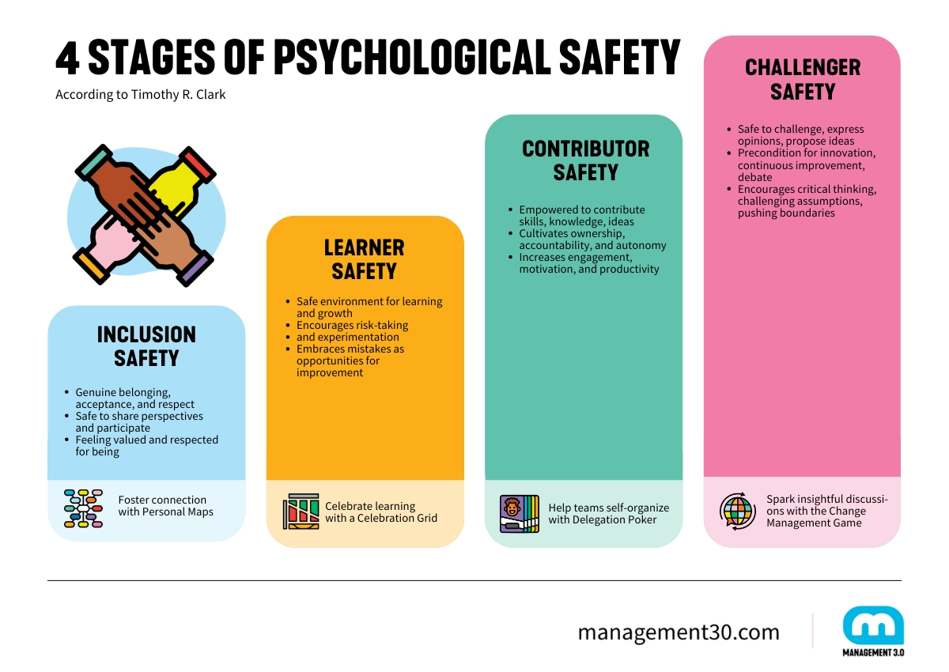
Nurture 2-way honest interactions
PSYCHOLOGICAL SAFETY
“Psychological safety refers to the sense of security that allows people to express their ideas, admit mistakes, and ask questions without fear of embarrassment or punishment.”
Notes:
Between 2012 and 2014, Google conducted a research initiative called Project Aristotle, the goal was to find what makes teams effective…
The researchers analysed over 250 attributes across roughly 180 teams, examining everything from personality traits and skill levels to experience and leadership style. The single strongest factor behind high-performing teams was something suprising: psychological safety.
https://www.leaderfactor.com/learn/project-aristotle-psychological-safety
https://medium.com/@satoshihgsn/the-hidden-power-of-psychological-safety-what-googles-project-aristotle-revealed-about-4263e2a8d829

Slide 11
3. Know what’s going on and let the team know too
Share with all members but in a time effective way

Slide 12
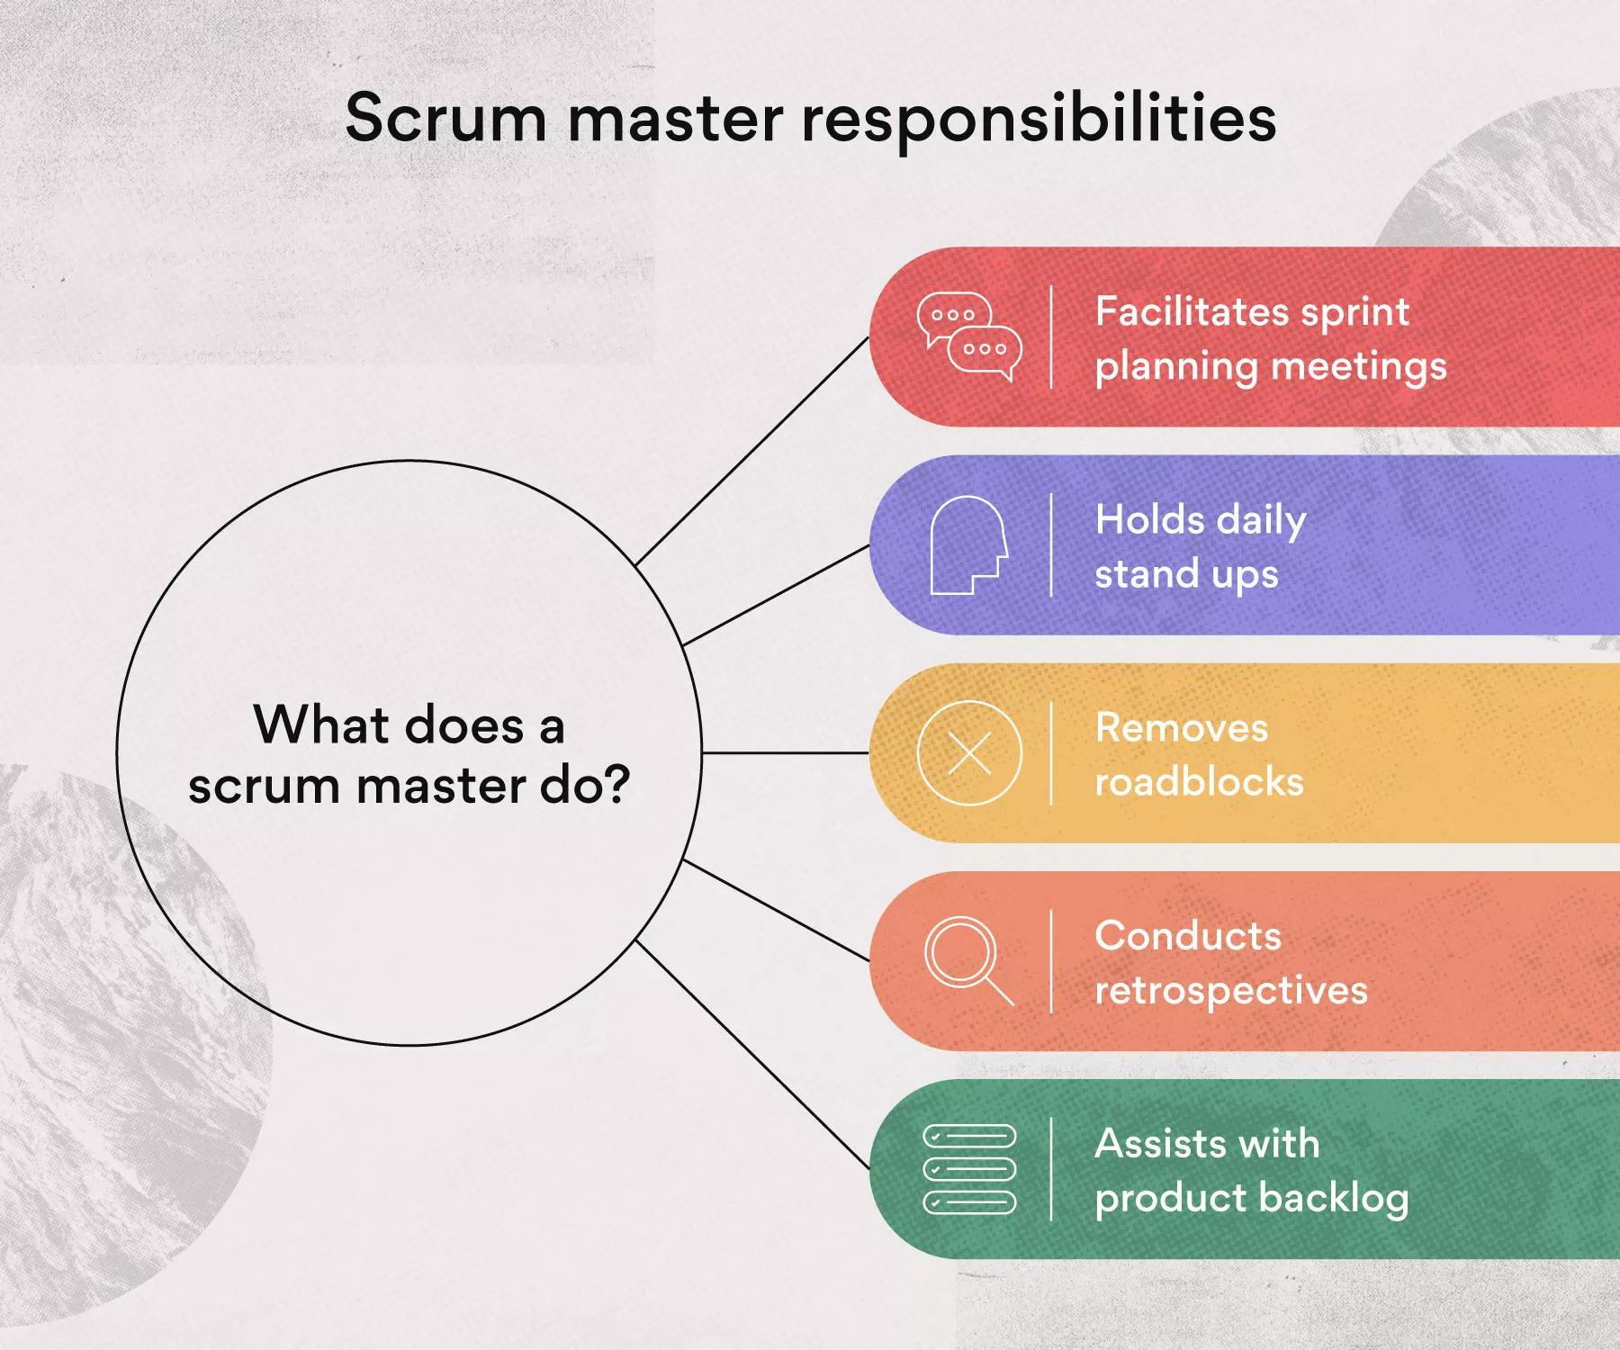
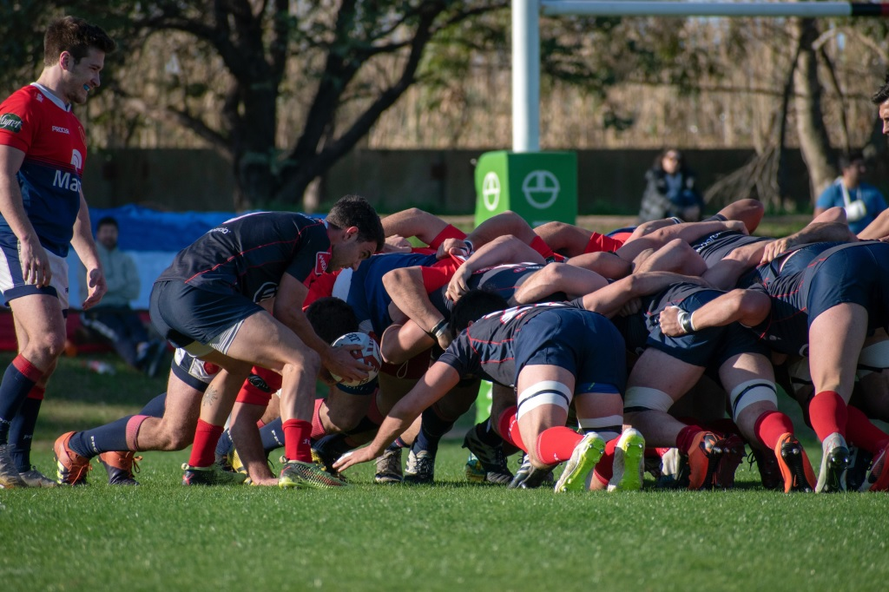
The power of a pseudo-scrum…
Meet once a week for an hour
Each member of the team gives an update on what they’ve been working on
If routine, try to keep it brief, if non-routine:
  Troubleshoot and brainstorm problems
  Share difficulties
  Share wins!
Not to publicly interrogate people on how they’re using/managing their time – if there are concerns these are private discussions
Leadership/management all participate too!
Notes:
How we’ve adapted it…
Feed into the idea of psychological safety again here with the last points…

Slide 13
4. Embrace change
Stagnancy kills

Slide 14
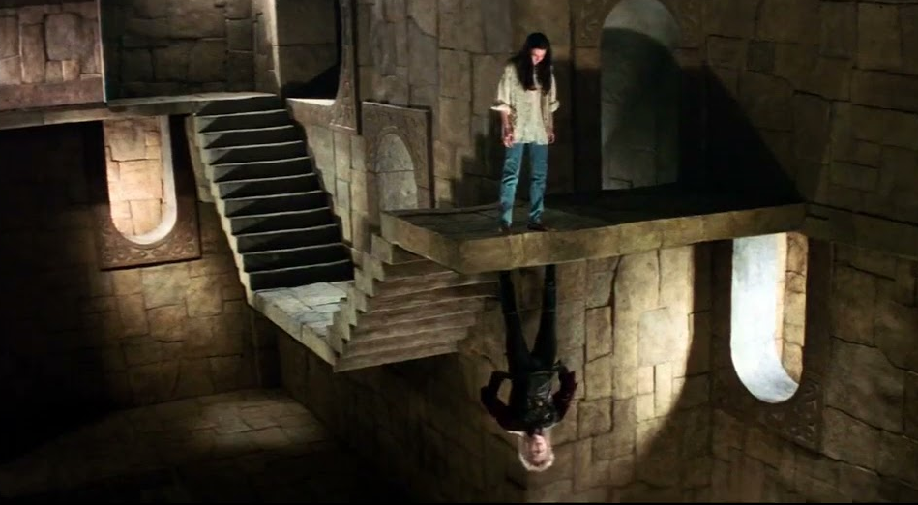

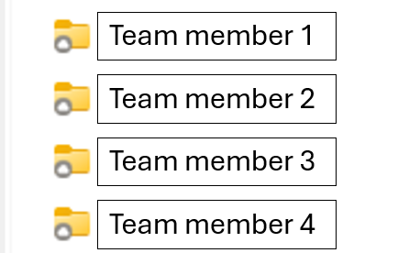
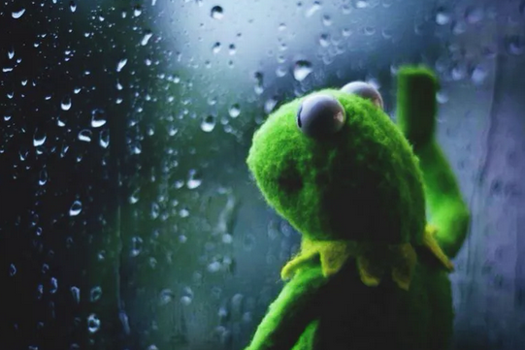

‘This is how we’ve always done things…’
Notes:
Explain how scripts were shared (or mostly not shared) early on and reluctance to get people on board for new ways of approaching things – despite how difficult it made onboarding new staff!

Slide 15
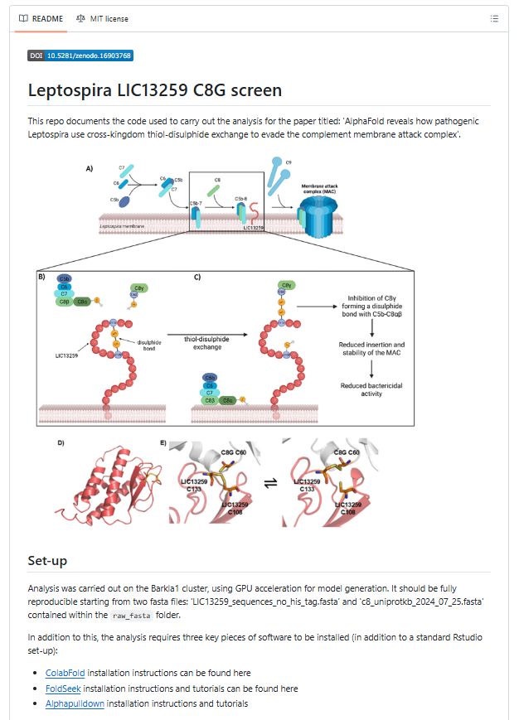
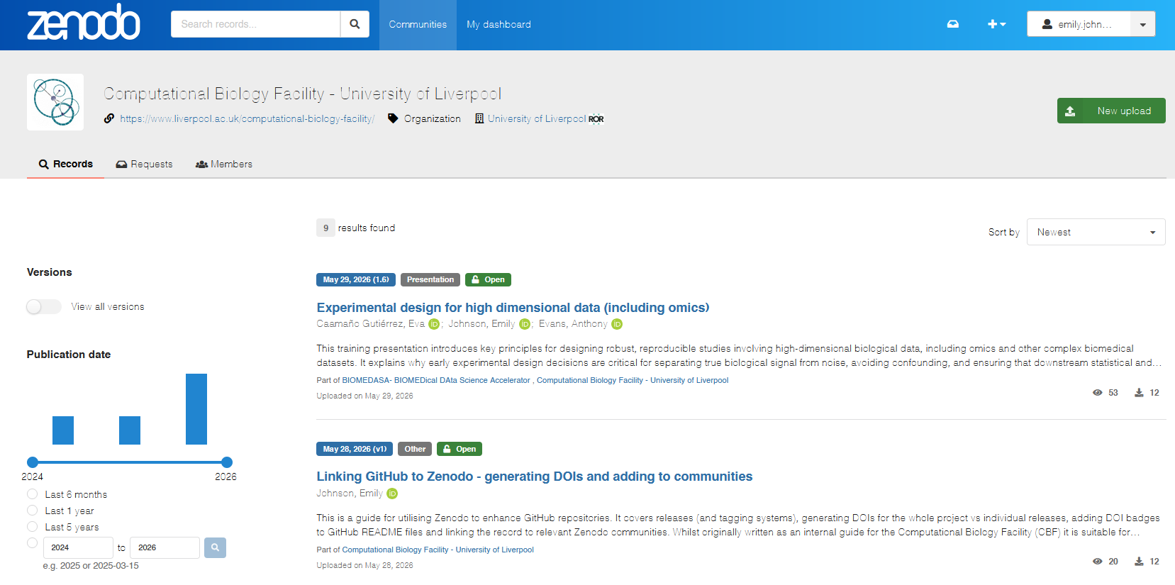
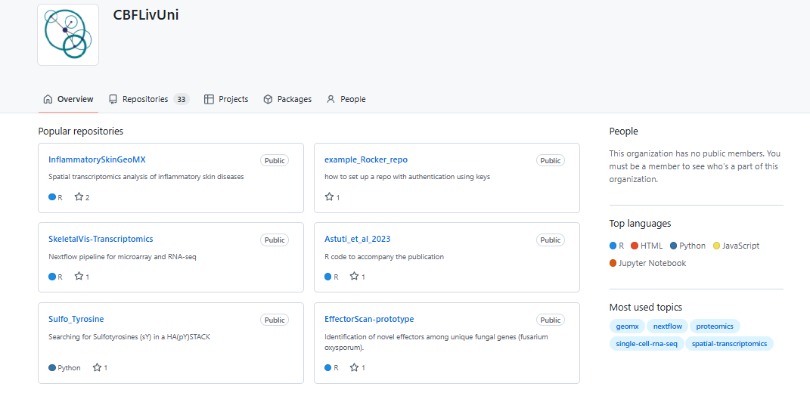

‘This is how we’ve always done things…’
Notes:
How we finally switched to GitHub, a few of us used it diligently, engaged in peer-peer mentorship and group working together to increase uptake. How we started training staff new and old. How it didn’t stop there and how we’re approaching new and better ways to share data publicly now.

Slide 16
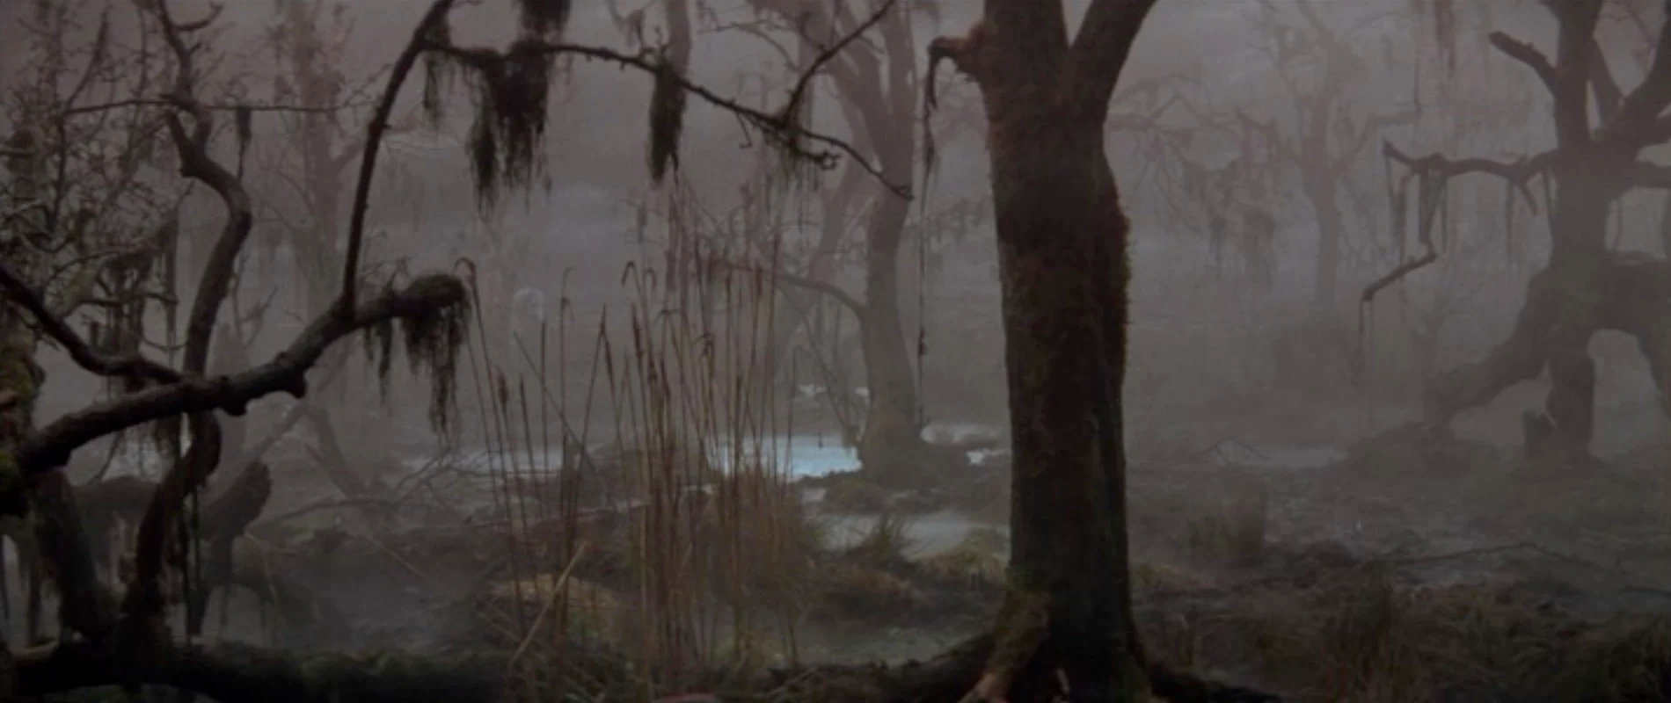
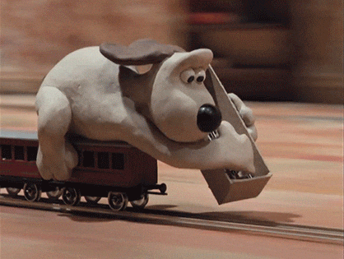
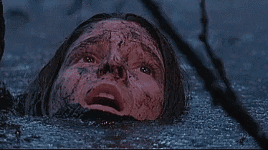
‘This is how we’ve always done things…’
Notes:
A point that even if continuous building/keeping up can feel hard it’s worth it in the long run to avoid being mired down…
(Note to self: figure out how to crop never ending story gif to remove the puppet… maybe…..)

Slide 17
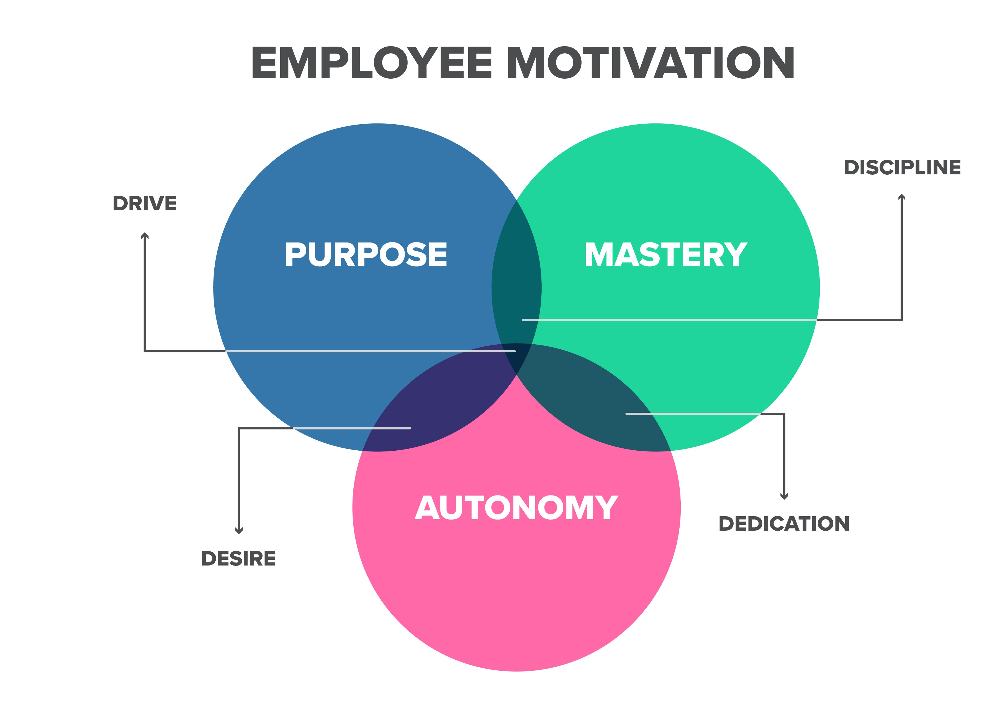
Gamify, 2019
Notes:
Introduce Pink’s framework here and how it feeds into the next three points…
It’s a model of intrinsic motivation from the book ‘Drive’ which argues for any cognitively demanding task you need more than simple financial incentives…

Slide 18
5. Development is the master investment for mastery

Slide 19

Importance of keeping up
Environment and Culture - Excellent research requires a supportive and inclusive research culture
Employment - Researchers are recruited, employed and managed under conditions that recognise and value their contributions
Professional and Career Development - Professional and career development are integral to enabling researchers to develop their full potential
At the CBF we have 10 days of development time per year…

Slide 20


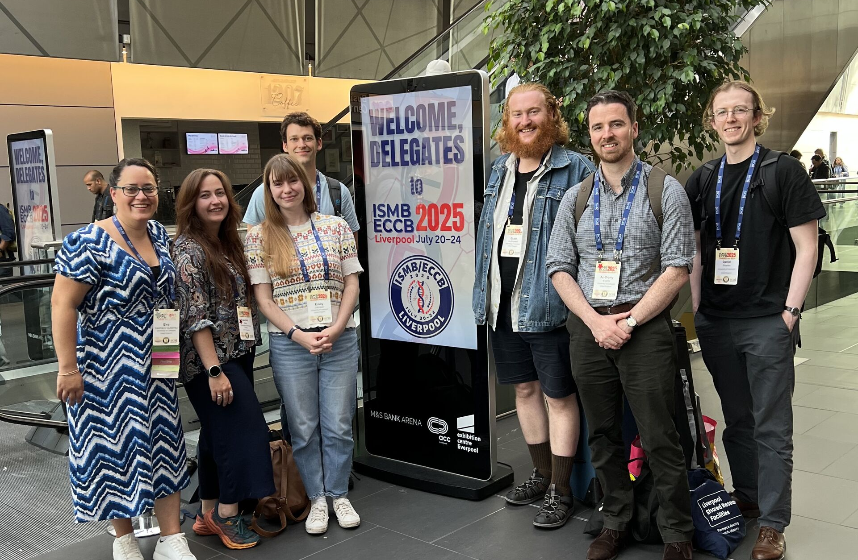


Importance of keeping up
Experimental design
Data sharing (FAIR)
Safe use of AI (WIP)

Slide 21
6. Purpose is the best intrinsic motivator
Let people be involved in what they are building

Slide 22

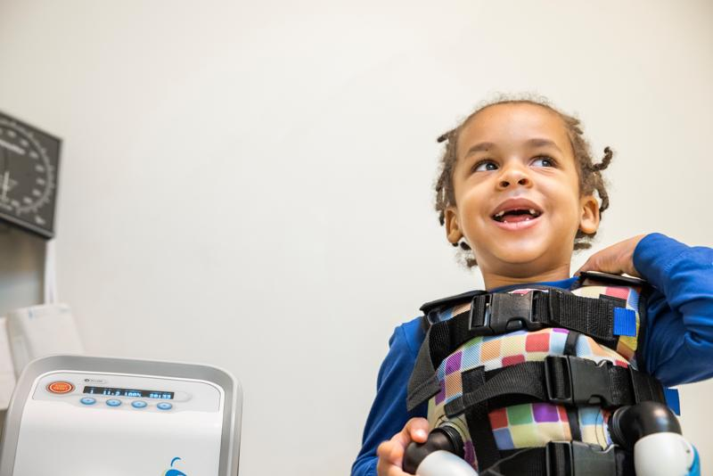
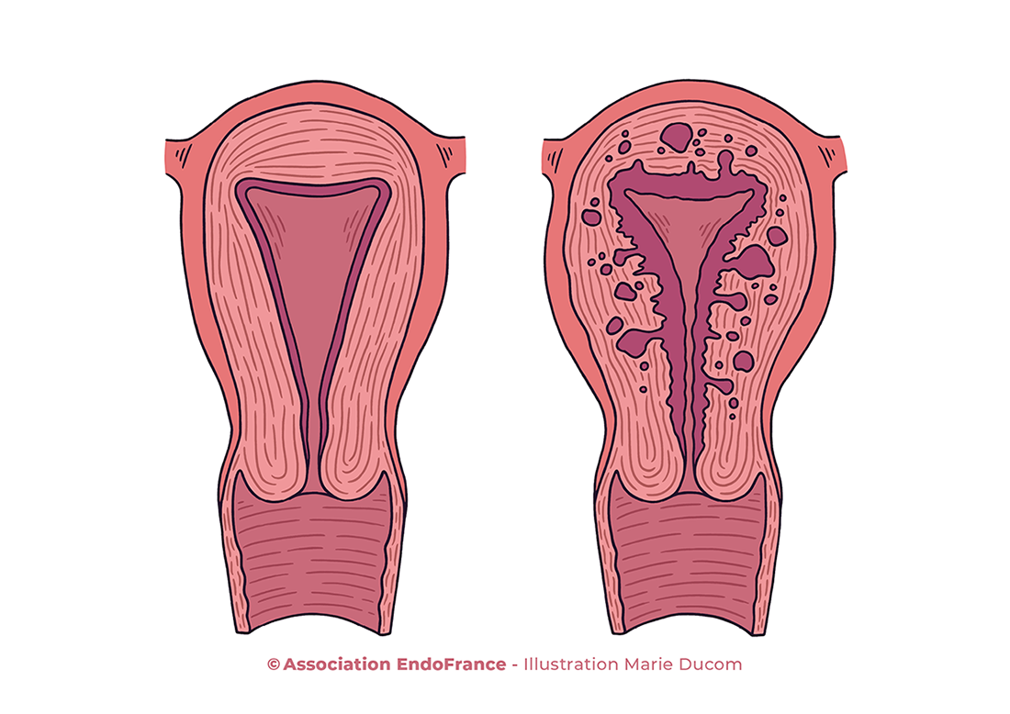
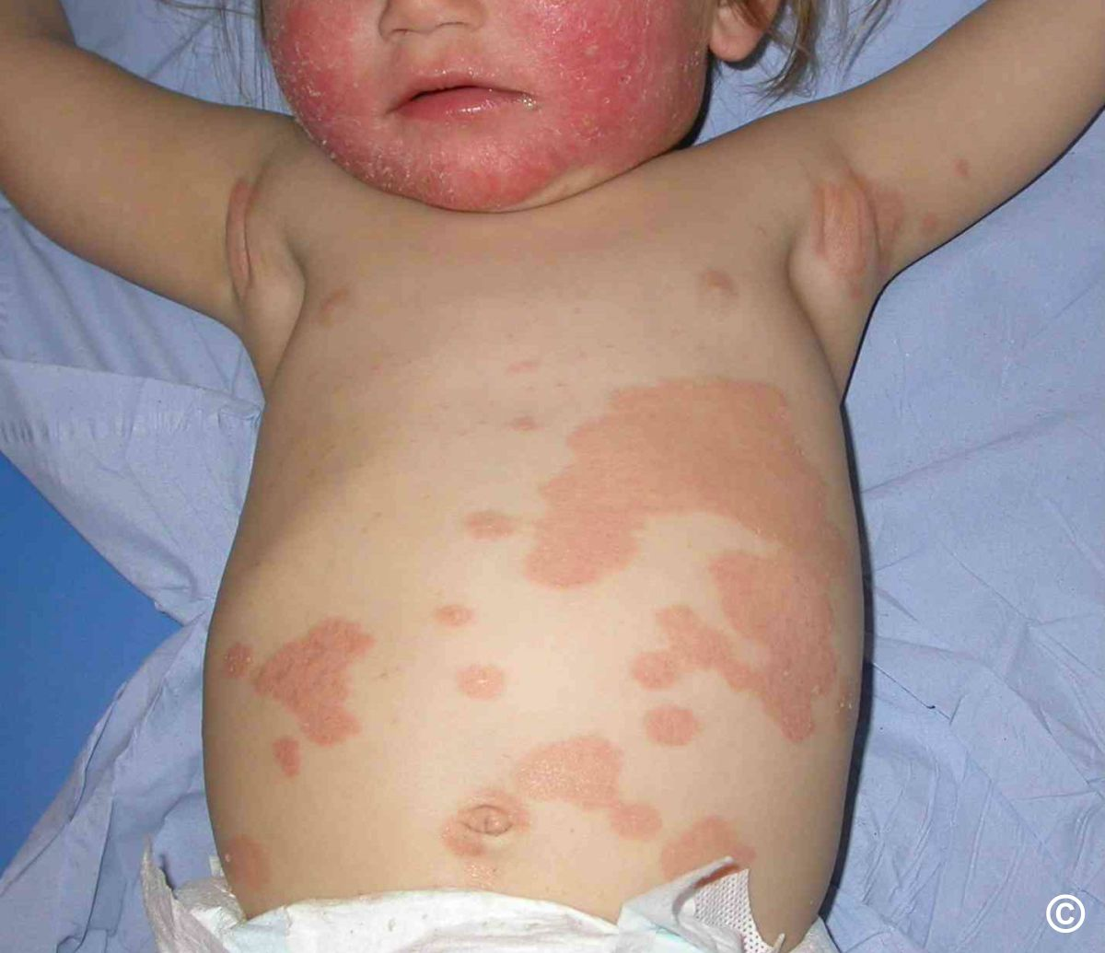


Let people be involved in what they are building
“ENHANCE” work package

Slide 23
7. Promote ownership and autonomy
Notes:
https://www.researchgate.net/publication/382067762_MICROMANAGEMENT_A_COMPREHENSIVE_ANALYSIS
https://www.researchgate.net/publication/384443720_Micromanagement_on_Employee_Performance_A_Killer_or_Motivator
Decided to opt for FWA angle but micromanagement would be another possible one to address…

Slide 24
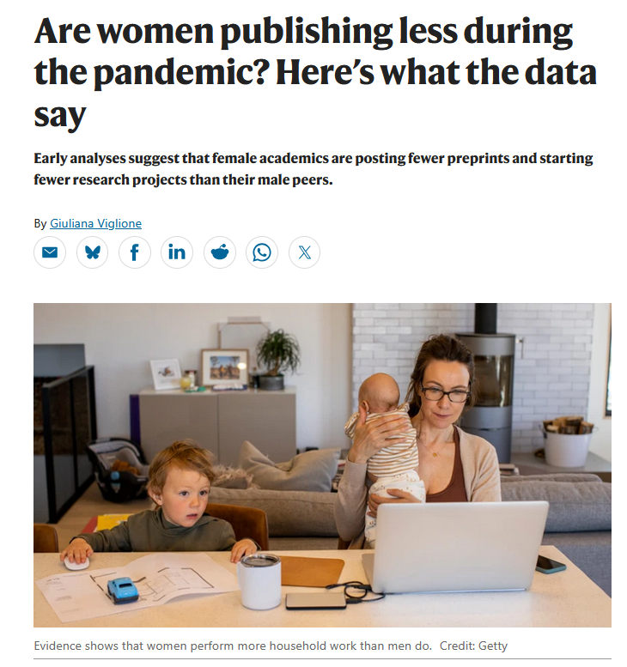
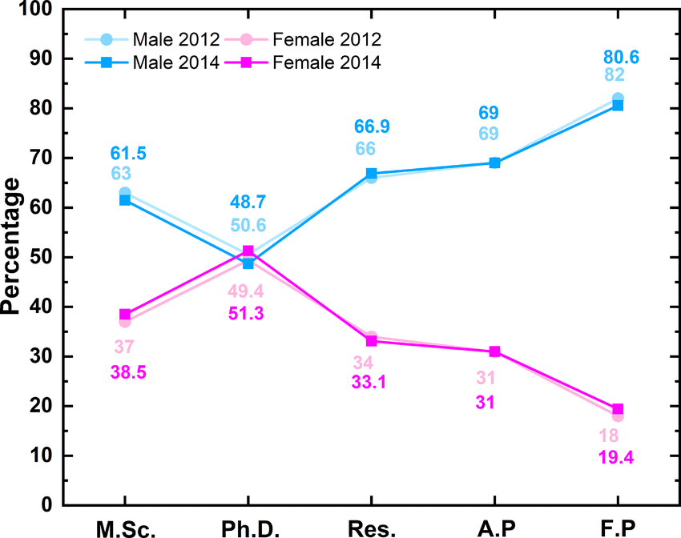
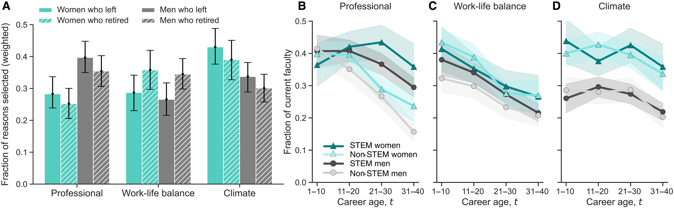
Power to choose how to work
Science Advances, 2023
Advances in Geosciences, 2020
Notes:
https://www.nature.com/articles/d41586-020-01294-9
https://www.researchgate.net/publication/343501382_Women_in_geosciences_within_the_Italian_University_system_in_the_last_20_years

Slide 25

“Offering flexibility as an option for all employees, regardless of gender or parental status, ensures equity and maintains team morale.”
Notes:
https://www.womentech.net/
‘To ensure flexible hours genuinely improve retention, companies must implement policies thoughtfully to avoid the "flexibility stigma." For instance, if flexibility is only ever utilized by women—or if those who work flexibly are perceived as less committed to career advancement—it can inadvertently create a disadvantage. Offering flexibility as an option for all employees, regardless of gender or parental status, ensures equity and maintains team morale.’
https://www.nature.com/articles/s41586-024-07500-2
‘We also found that the 395 managers in the experiment revised their surveyed views about the effect of hybrid working on productivity, from a perceived negative effect (−2.6% on average) before the experiment to a perceived positive one (+1.0%) after the experiment. These results indicate that a hybrid schedule with two days a week working from home does not damage performance.’
https://pmc.ncbi.nlm.nih.gov/articles/PMC11254825/

Slide 26


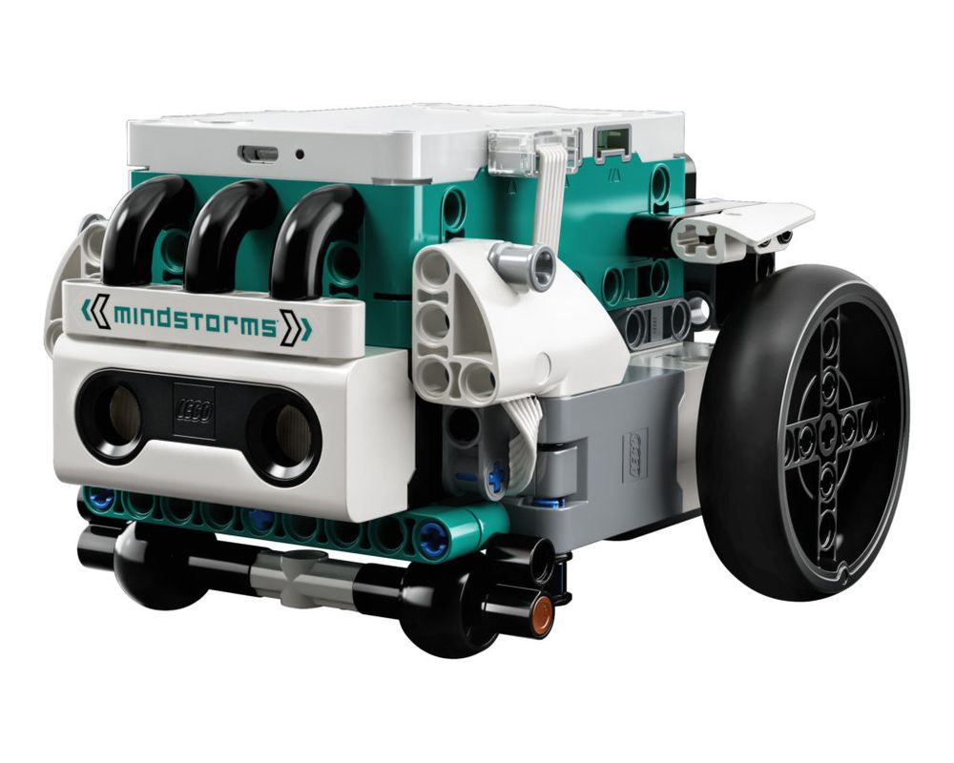

Elevating and investing in ideas
2024
“INSPIRE” work package
2022
Notes:
Narrative of Eva asking me what I was interested in during our early one on ones, mentioning outreach, her suggesting I apply for a grant… importantly, as the lead!
This leading to us purposing equipment and piloting an outreach program, which then became an entire pillar in a successfully funded MRC bid, leading to the project ‘BIOMEDASA’.

Slide 27
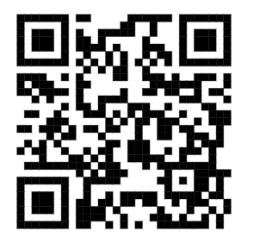
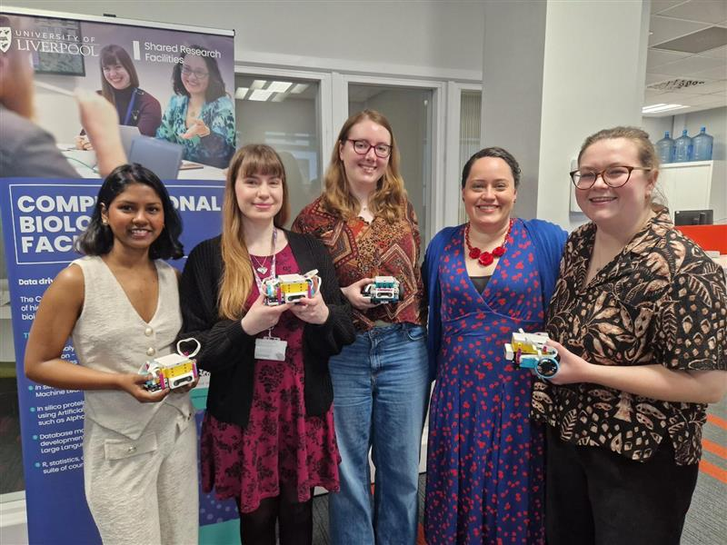
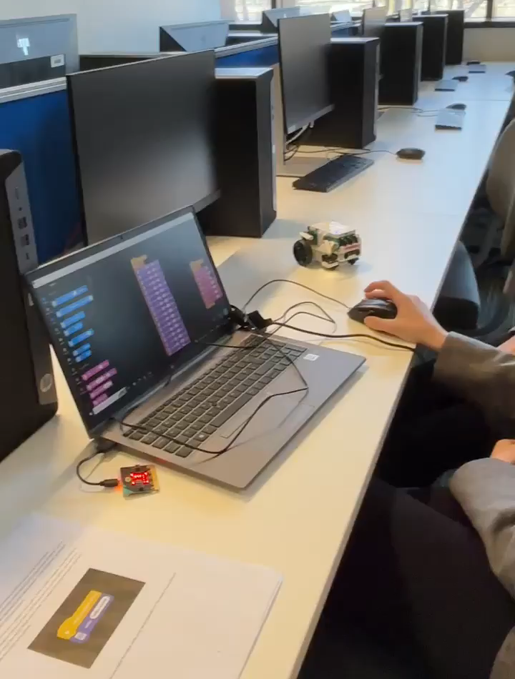
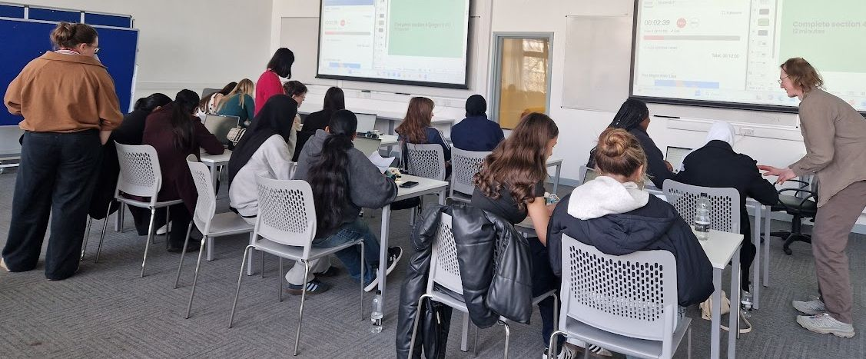
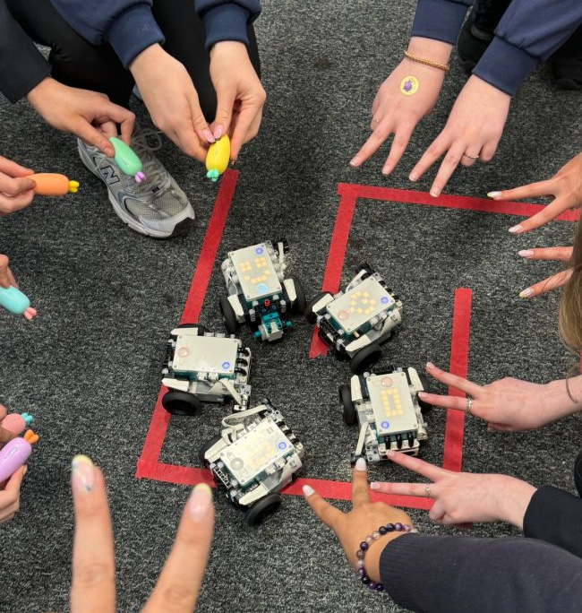
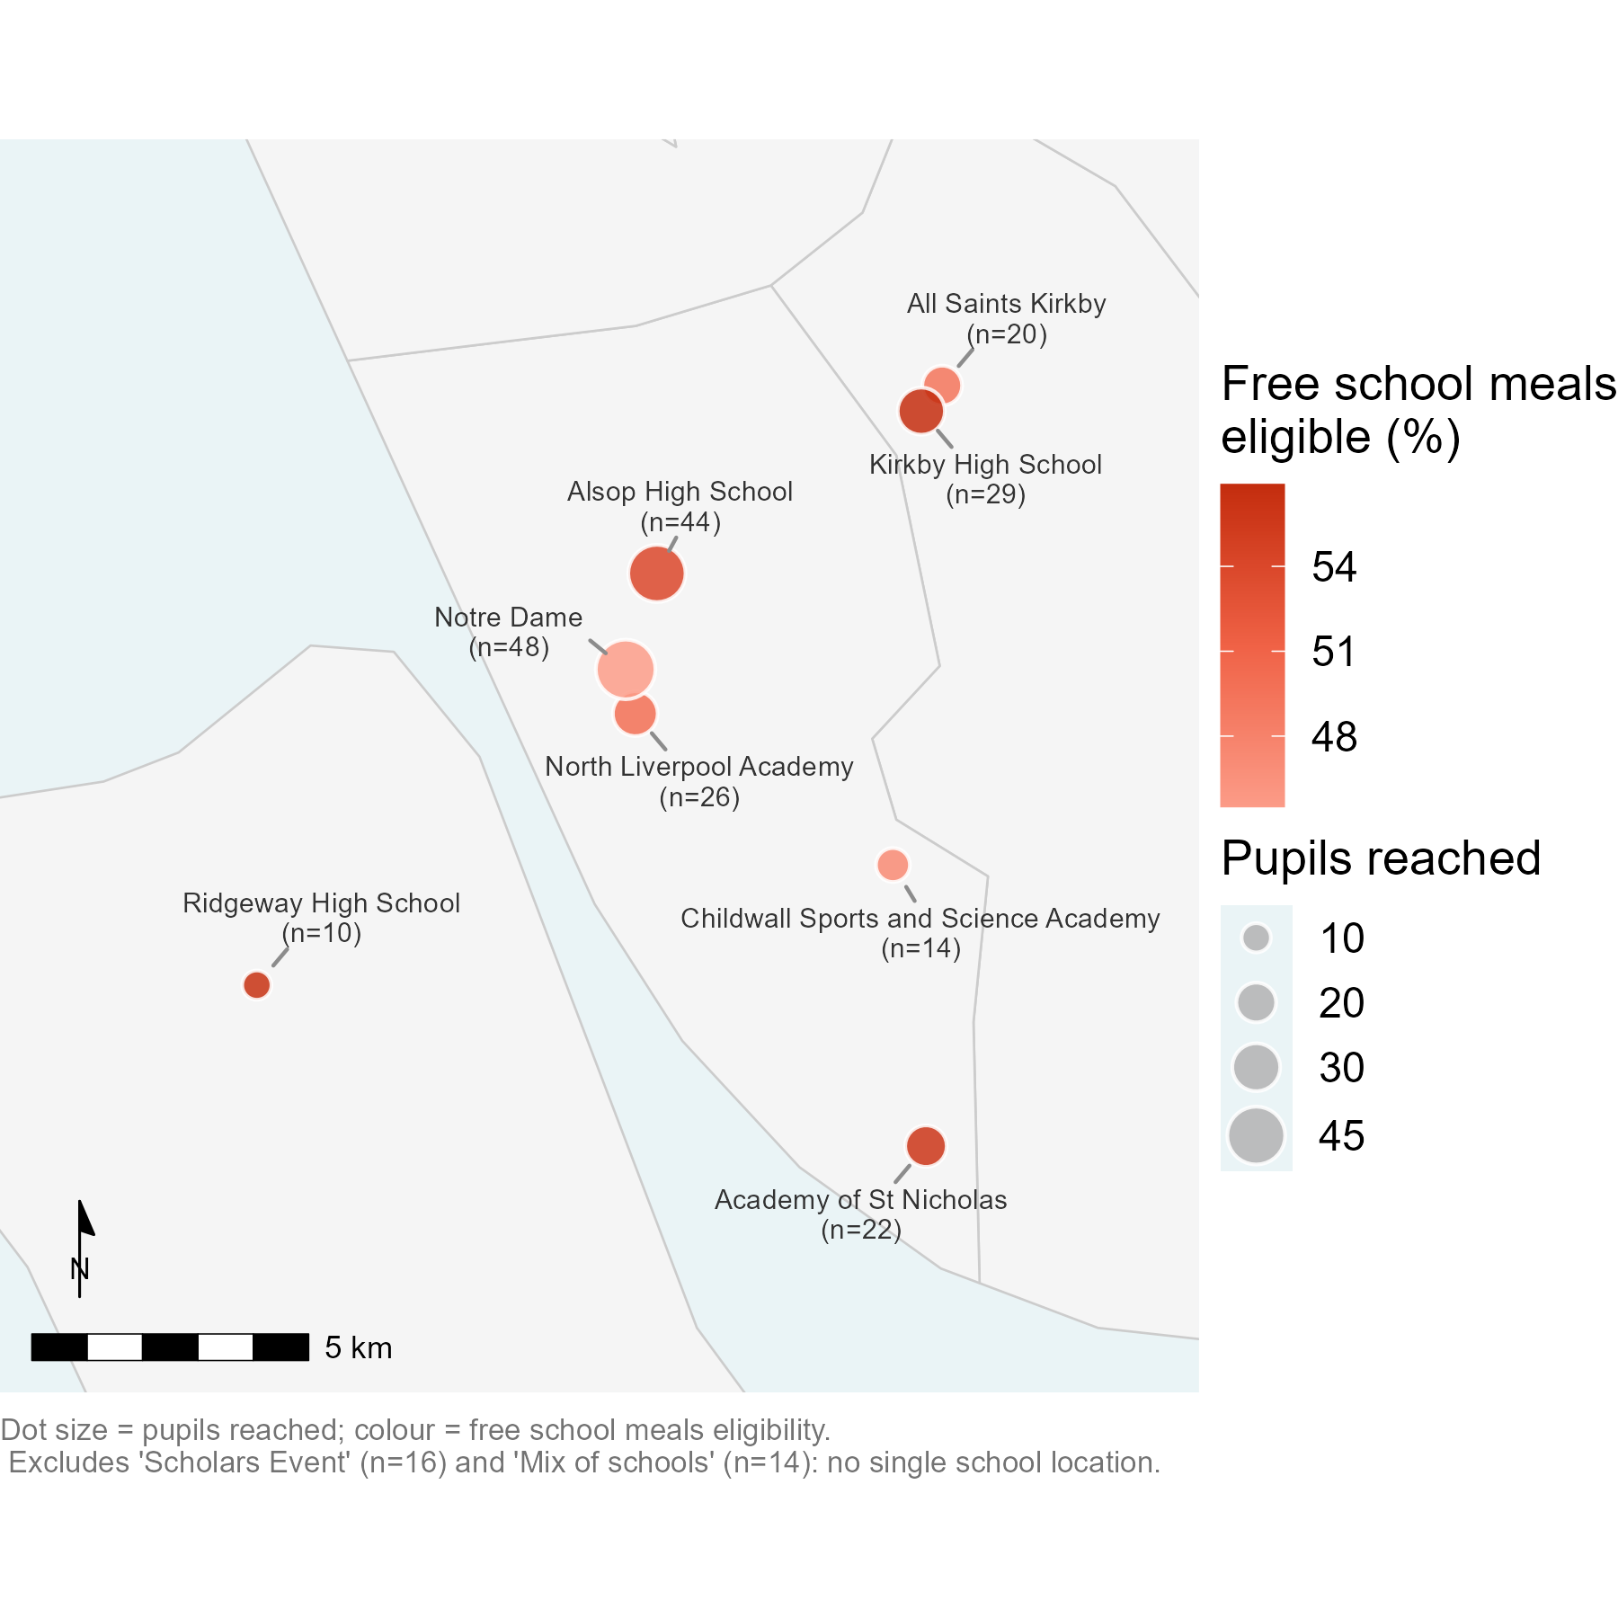
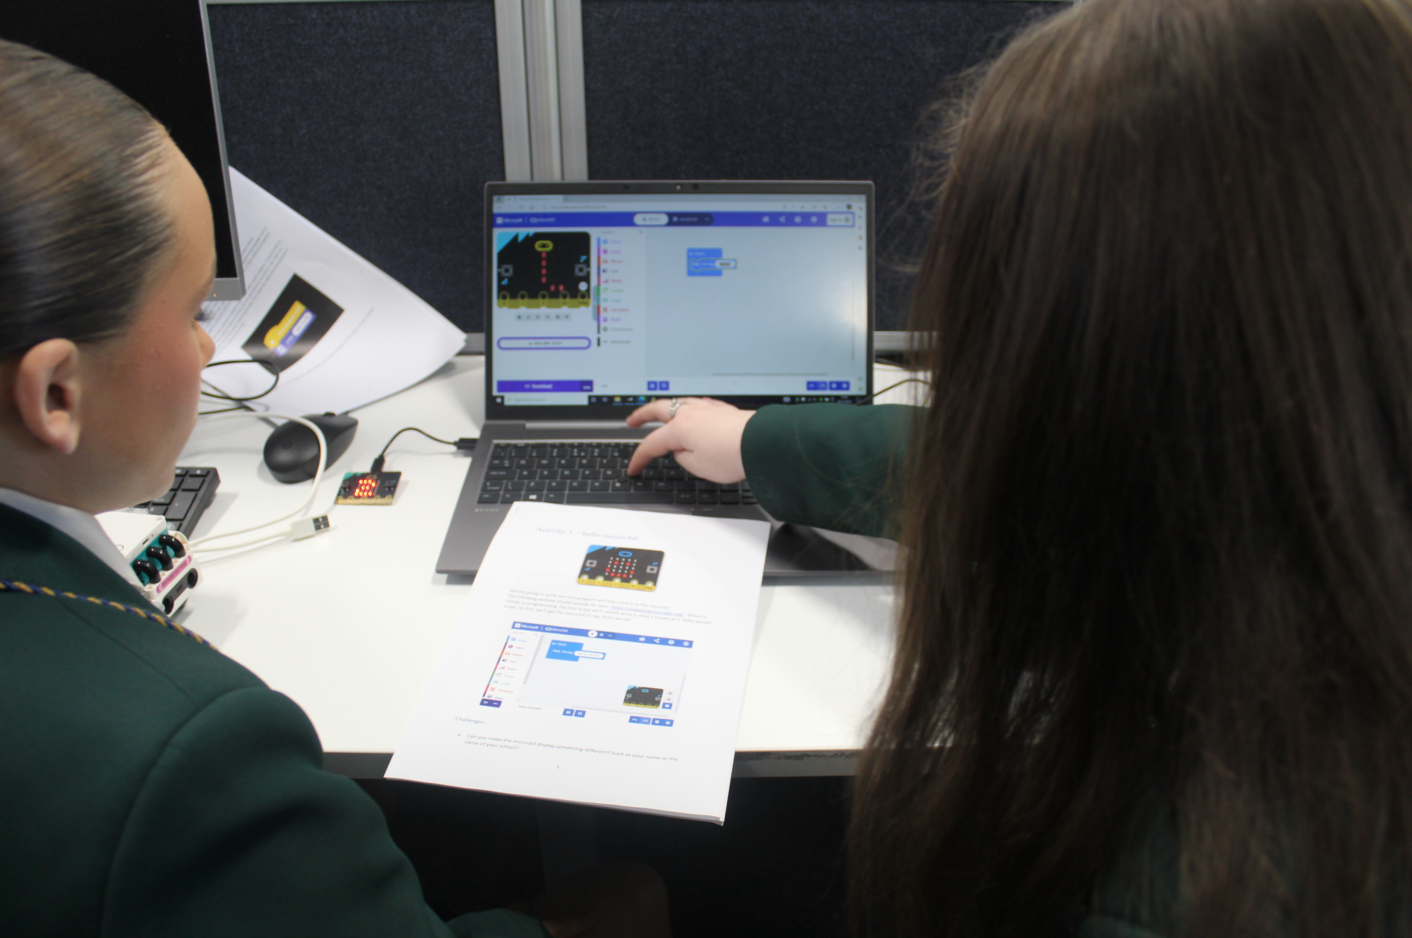
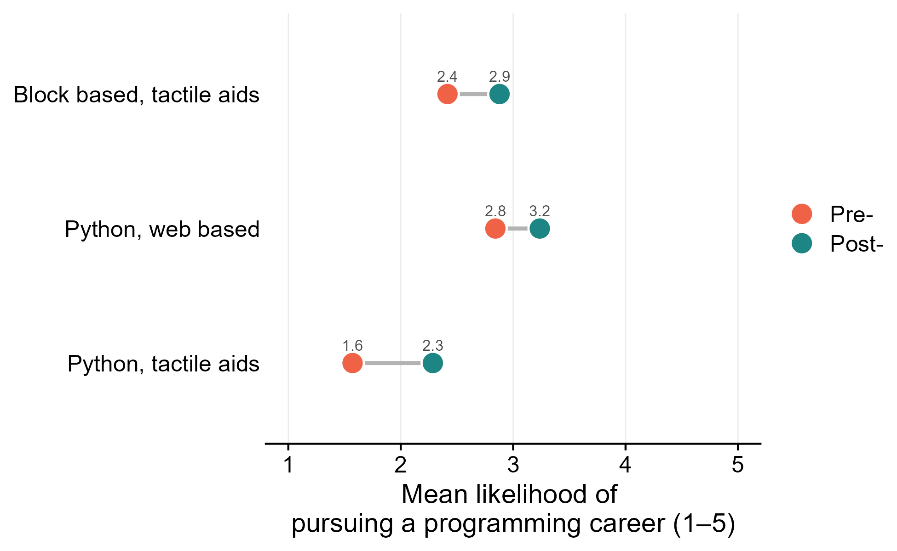
Elevating and investing in ideas
Access our materials here!
Notes:
The program has since grown and expanded, with us enhancing our suite of available materials and reaching different schools across Liverpool and the surrounding areas, with even more events planned this year, all because a junior member of the team was encouraged to pursue her passions….
Note to self: add some photos…

Slide 28
8. Celebrate each other
Often, as a team…

Slide 29
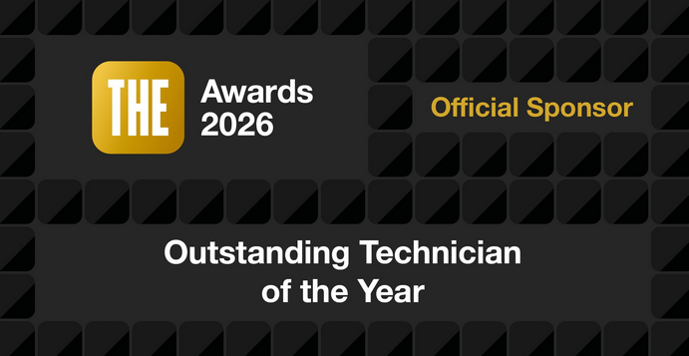

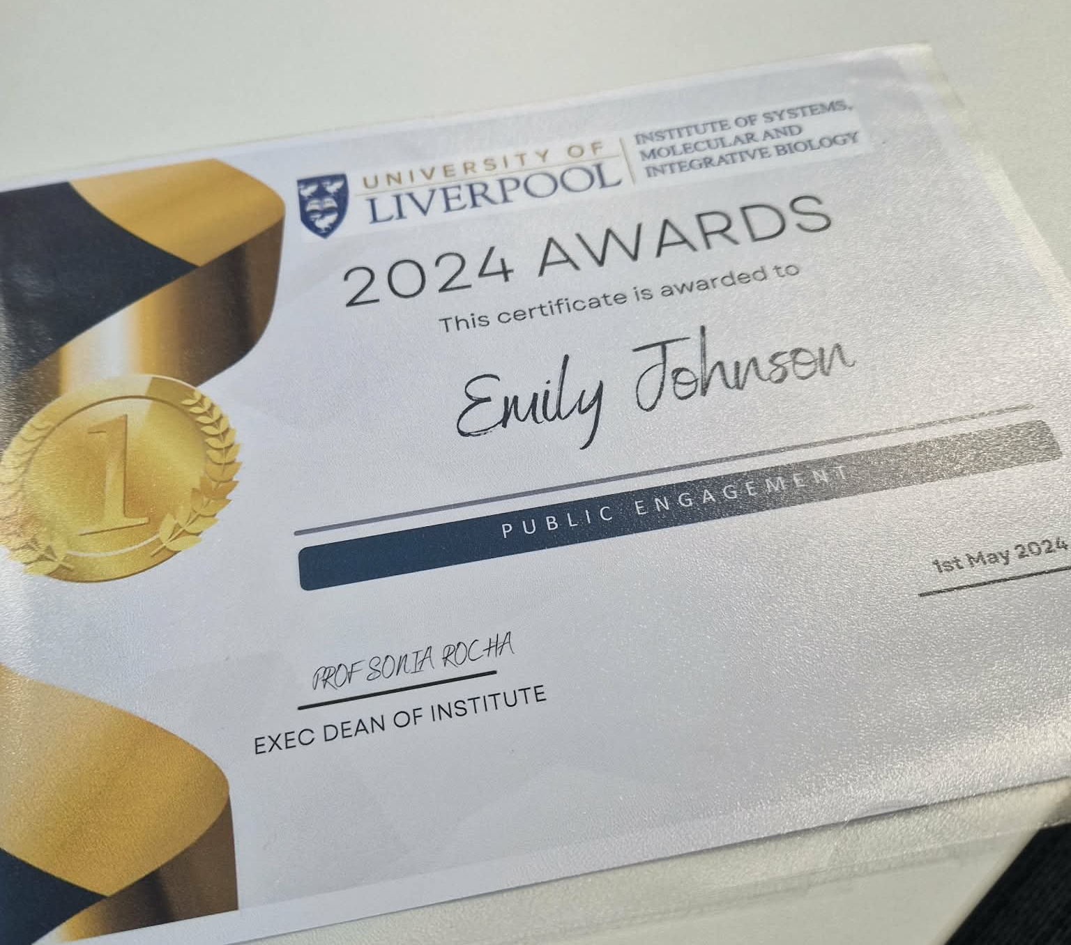
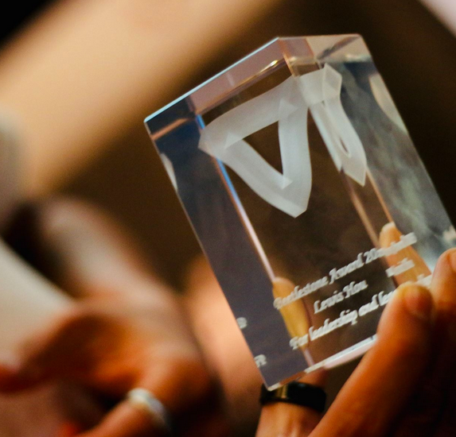


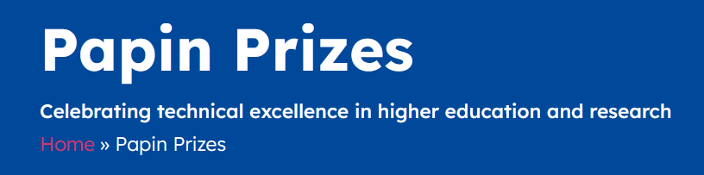
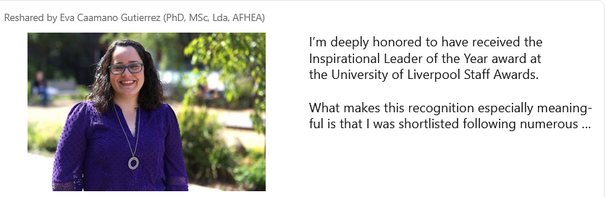
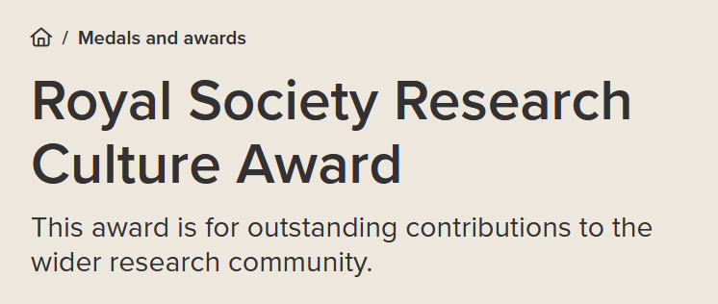

Find ways to celebrate each other…
Notes:
Highlight our tendency to highlight/celebrate eachother’s achievements and nominate staff for awards, highlight the team coming together for Eva’s nomination (as a surprise).

Slide 30
9. Socialise
Give the time for your team to do so on working hours

Slide 31
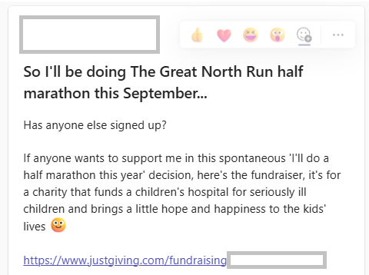
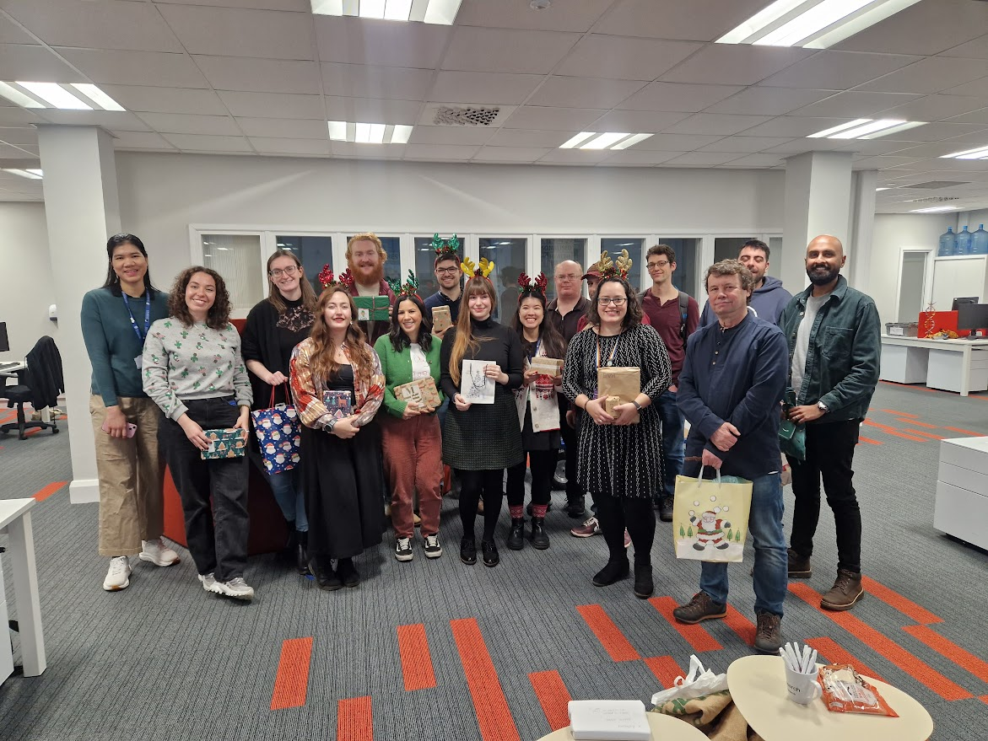
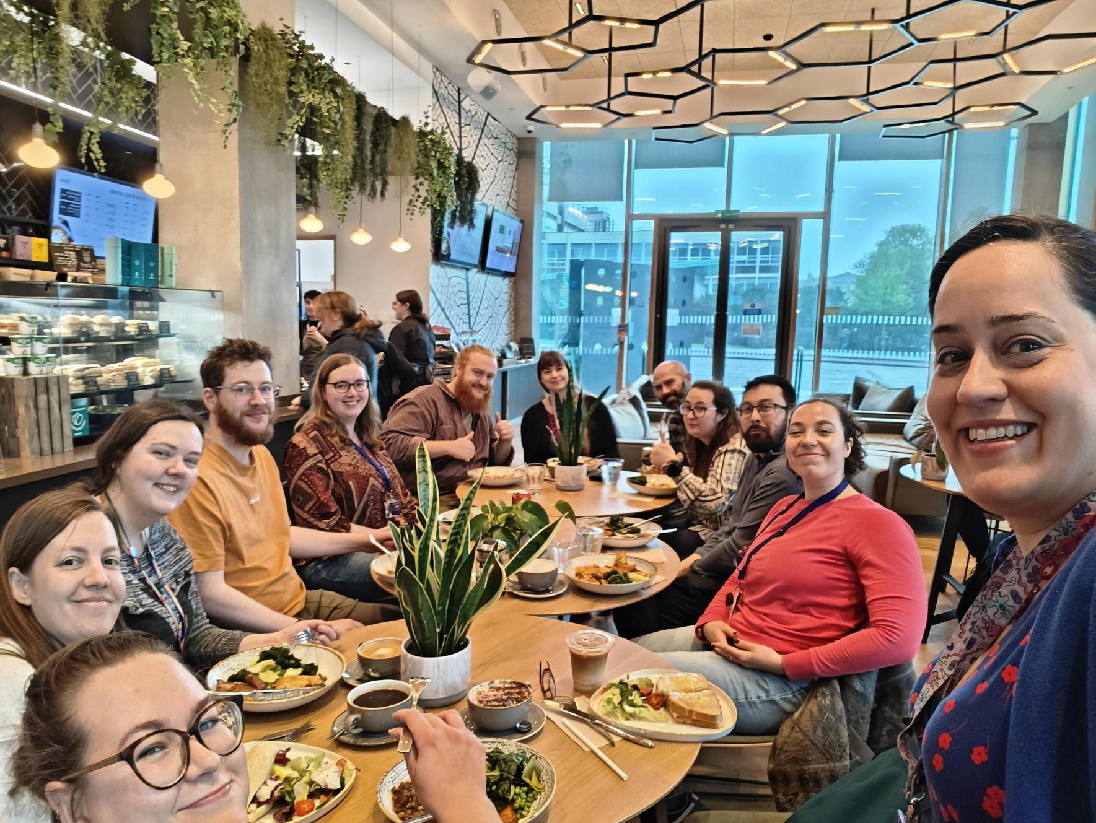

Build connections – not just at the pub!
Notes:
Mention the power of one person acting as a catalyst – Lauren came in every day when she started, this made other people more willing to come in too. Now we have a regular habit of coming in on Fridays without this having to be enforced by management.

Slide 32
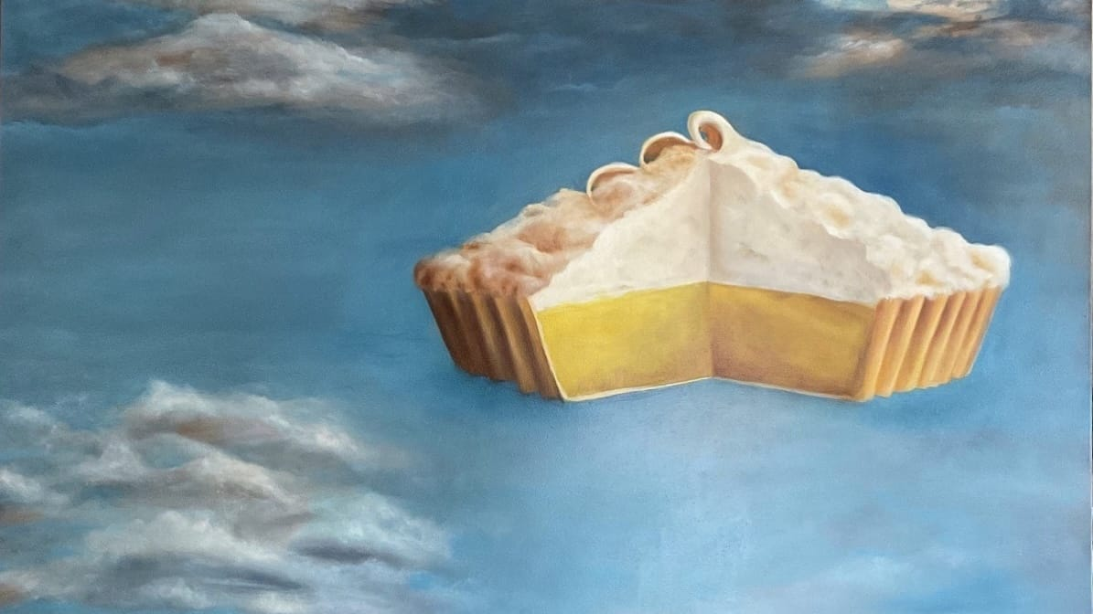
Notes:
At this point you might be thinking, this is all a bit ‘pie in the sky’ or over-idealised, or this is just one team trying to generalise their success story…
However, most of these changes were team driven, not upper management, it was often the most junior members being given the confidence to enact change. Often it started with one person thinking ‘I can show up here’ or ‘make a difference here’ and those small changes compounding over time. You could be that person in your team. And that brings me onto the final tip…

Slide 33
10. Underesourced? Know what is your #1 priority: your people

Slide 34
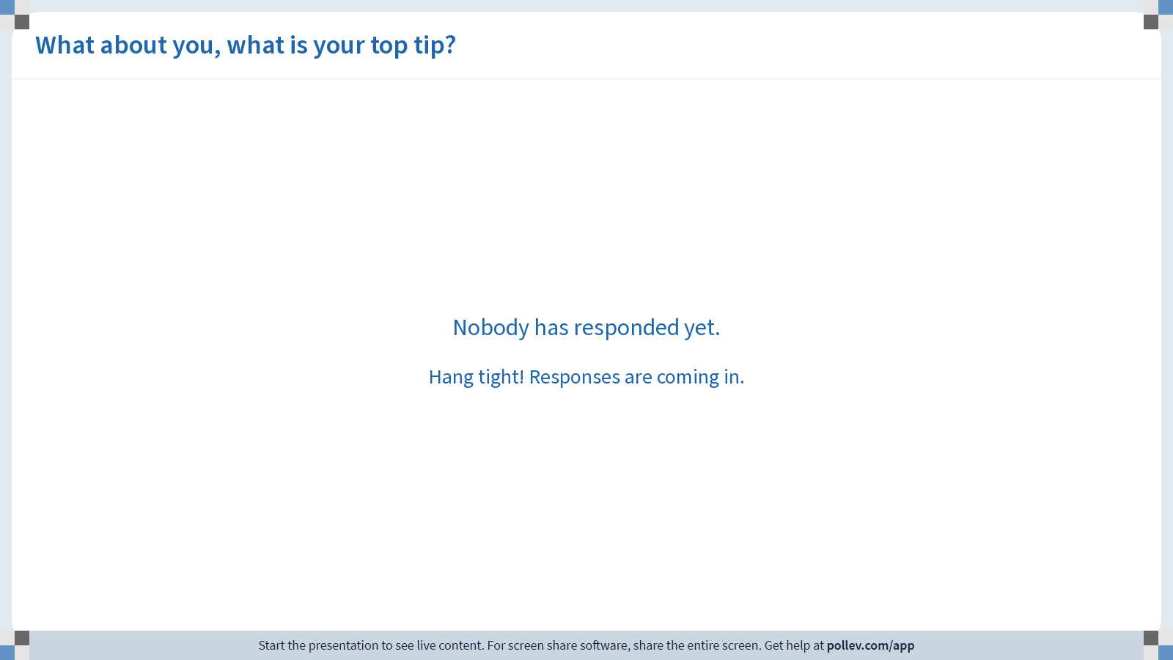
Notes:
Poll Title: Do not modify the notes in this section to avoid tampering with the Poll Everywhere activity.
More info at polleverywhere.com/support
What about you, what is your top tip?
https://www.polleverywhere.com/discourses/gzmWXfgx1OHKFb1Ely4Oo

Slide 35
What about you? What is your number 1 tip?
Find me afterwards to let me know!

Slide 36

Thank you! Any questions…?
Contact
www
cbf.liverpool.ac.uk
CBF@liverpool.ac.uk
Emily.johnson@liverpool.ac.uk
computational-biology-facility-livuni
emily-jane-johnson-
Notes:
I’d like to thank you for your time and attention. If we have time for questions I’ll take them now, otherwise please find me after this session.

