Slide 1
Leveraging Pracademic Expertise to Drive Research Impact
Alistair Quaile
Research Impact Manager

Slide 2
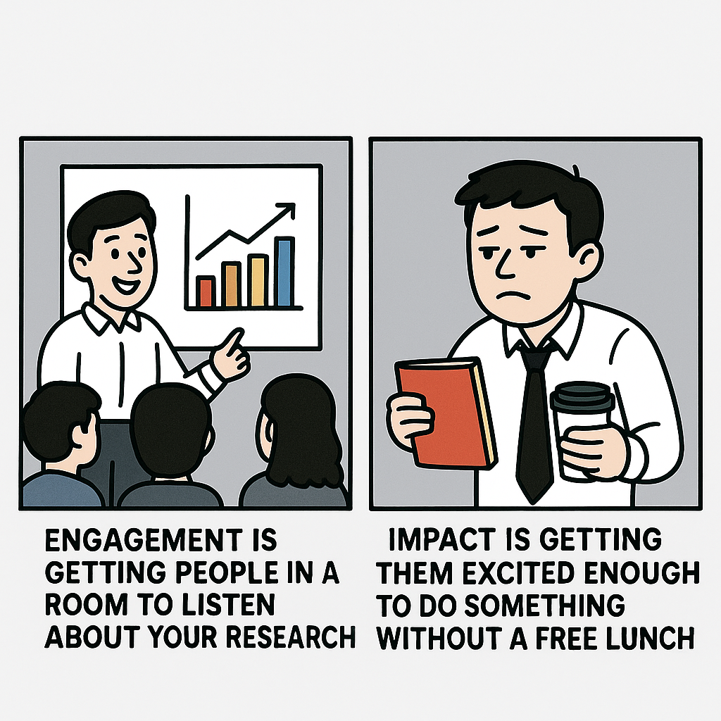
Engagement is easy, impact is hard
    The challenge: overcome persistent barriers to delivering societal impact
    The vision: create a role that can bridge research and practice

Slide 3

How do you solve a problem like impact?
Developed a fractional (0.15 FTE) Visiting Professor of Research Impact post
Aimed at leaders in business and policy who have expertise aligned with our research strengths
Appointed “pracademics” who sit at nexus between academia, business and wider society

Slide 4




What makes the model distinctive?
Not honorary roles
Embedded, relational, practical
Explicit remit to connect research
with policy, practice, and industry
Space to co-design impact with academics

Slide 5

Has it worked?
Since joining, they have:
Strengthened research collaborations
Mentored early career researchers
Facilitated cross-sector engagement
Supported academics in developing
impact case studies
Organised secondments in Government departments

Slide 6

Challenges and risks
Cultural resistance or scepticism toward pracademics
Difficulty capturing non-traditional metrics of influence
Need for more systematic recognition and pathways

Slide 7


What’s next?
“IF you want impact, you need knowledge.”
The Insights Fellowship (IF) is a policy-to-research programme enabling academic expertise to directly inform inclusive, place-based policymaking locally, regionally and nationally.

Slide 8

Key takeaways
Visiting Professors of Research Impact fill a structural gap
They can accelerate impact routes and enhance research quality
Culture change is slow but doable with the right architecture

Slide 9



Thank you
Let’s connect

