Slide 1


POST AWARD SIG:
Working Smarter, Not Harder: Practical Solutions for Post-Award Efficiency
Post Award SIG
Leila Cole, Durham University
Liam Rose, Imperial College London
Anish Kurien, University of Cumbria
Nicola Crawley, Wellcome Sanger Institute

Slide 2


Morning, how are you?
WHAT’S UNDERNEATH
Rising compliance and reporting
Funder demands up, capacity flat
Unclear guidance, more bureaucracy
Fewer resources, less room to be proactive
Gold-standard expectations on bronze-level resource
Cognitive load — holding it all at once
No silver bullet — just a few practical things that help, and a SIG that means we’re less alone with it.
#ARMA2026
Notes:
We often start meetings with an innocent "how are you?" — and I'm sure a lot of us reply "fine, busy," when underneath, what we're feeling is a sector that's overloaded.
And this isn't specific to post-award — I think we could ask any session running at this conference and get exactly the same answer.
For post-award, that's rising compliance, more reporting, funder demands climbing — and rarely the capacity to match. We're skilled specialists doing critical work, with less and less room to be proactive. This is sector-wide — not anyone's local failing.
And that's where a lot of us are: so much of it, it's hard to even know where to start.
So — we're not going to stand here and tell you the SIG can fix all of this. There's no silver bullet.
What we want to do this morning, with you, is share a few practical things that might help. Some are about how we work — are there tools or existing systems that can help us? — and some are about how we share the work across our teams, so it doesn't all sit with one person.
We want to use this like an in-person sharing of what works, so we're all a bit less alone with it.
Two quick things before we start. We'll use Menti throughout — so phones out; there's a space for questions as we go, and a few prompts from us to steer the session and the follow-up. And this is Chatham House — speak freely, nothing's attributed beyond this room.

Slide 3

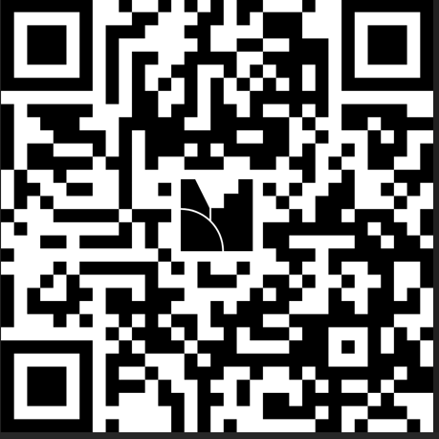
What is your biggest operational bottleneck right now?
Wordcloud
#ARMA2026
Notes:
‘What is your biggest operational bottleneck right now?’ - Menti word cloud - interaction with audience
Something like "okay we said phones out, we've got our first question for you.
Bridge
While you are doing that, don't worry this isn't going to be a training session and sorry we can't be magic.
We're not going to fix your workload in ten minutes. What we're going to do is show you a few things quickly — hopefully to give you an idea to take forward. Don't worry about copying anything down; you'll get the templates and notes afterwards, and we keep this going in the SIG.
Leila:
So — I've got the joy of kicking us off ;)
What can I actually do? I listen to my team tell me where things get stuck, where they're doing the same job twice — chasing across sections, checking again and again whether something's done. And I get frustrated we don't have the integrated systems or the IT resource to just fix it.
So I started asking: what can I do about it myself — with what we already have.

Slide 4
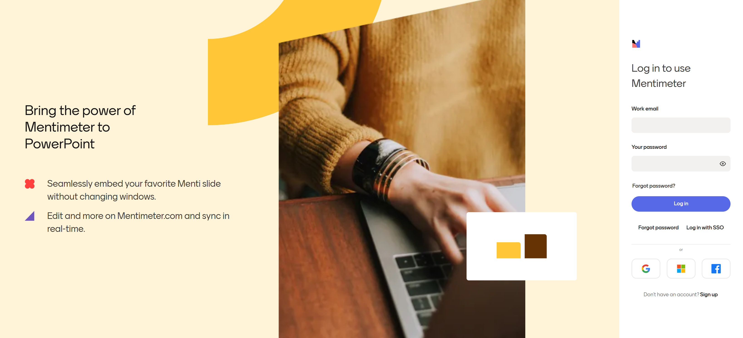
#ARMA2026
Notes:
‘What is your biggest operational bottleneck right now?’ - Menti word cloud - interaction with audience
Something like "okay we said phones out, we've got our first question for you.
Bridge
While you are doing that, don't worry this isn't going to be a training session and sorry we can't be magic.
We're not going to fix your workload in ten minutes. What we're going to do is show you a few things quickly — hopefully to give you an idea to take forward. Don't worry about copying anything down; you'll get the templates and notes afterwards, and we keep this going in the SIG.
Leila:
So — I've got the joy of kicking us off ;)
What can I actually do? I listen to my team tell me where things get stuck, where they're doing the same job twice — chasing across sections, checking again and again whether something's done. And I get frustrated we don't have the integrated systems or the IT resource to just fix it.
So I started asking: what can I do about it myself — with what we already have.

Slide 5
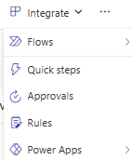
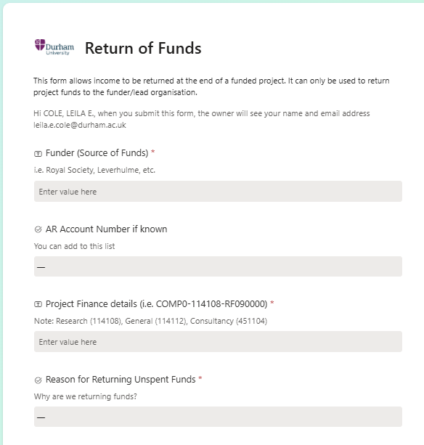
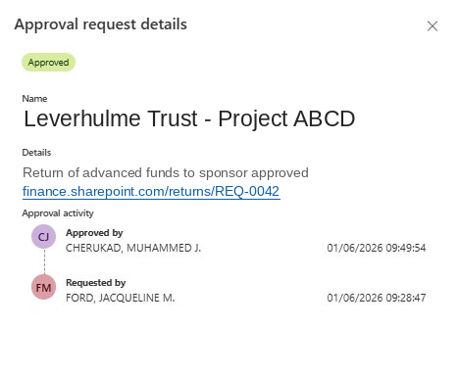
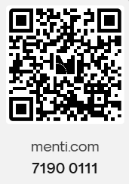
Approvals Without the Email Chase
SharePoint Lists – built in approval workflows
Q&A
#ARMA2026
Notes:
So — I've got the joy of kicking us off ;)
What can I actually do? I listen to my team tell me where things get stuck, where they're doing the same job twice — chasing across sections, checking again and again whether something's done. And I get frustrated we don't have the integrated systems or the IT resource to just fix it.
So I started asking: what can I do about it myself — with what we already have.
We've all got approvals flying around in email — chased, and a fortnight later nobody can find who said yes, or when. Inboxes lose things.
So here's the first thing I want to show you and it's the simplest one all morning: I didn't have to build anything. It was already there. You start with a list. See the buttons along the top? One just says Forms — press it, and you've got a tidy way in for people. And under Integrate, there's Approvals. Switch it on. That's it.
So instead of losing in email: the request comes in, the right person approves it right there in the list or via teams .. and SharePoint /Teams log the decision for you --> Who approved, and when. No chasing, no "did you ever sign that off?"
And notice — no Power Automate. We haven't actually built anything. That was all done with what we already have.
Then I started asking myself: what else can we do – and with a bit of help from your favorite AI to understand those irritating errors..

Slide 6
Transfer and transform data between teams
Skilled time on actions, not on reporting work done.
The team enters
One form with dropdowns
Department + HESA funder category
Worktribe ID 123456
Project Short Description
The flow translates
Maps Worktribe's codes to Oracle's
Claims the next free code — safely
Right prefix, cost centre, classification
Emails the requestor in under a minute
Logs in a list and excel for direct upload into ORACLE
Oracle receives
Data in an ORACLE upload file
Subcode RF032001
Cost centre + HESA classification
Five Oracle fields set automatically
One HESA pick → six Oracle values
THE HANDOVER File ready for finance → watches Oracle → requester told when live
#ARMA2026
Notes:
How many of us have systems that don't talk the same language — with no resource to fix it?
Our research system doesn't create projects in finance. We made it work — but only by good people spending a lot of time across multiple teams.
Same start as the last screen: a list and a form. Here's where it got to.
The team enter what they know — department, funder type, the project ID in a clean form. Power Automate does the rest.
I started with each piece, can I get a tool to do this manual process (convert worktribe department ID to ORACLE) tested with copilot or similar and then expaned. PowerAutomate and other tools now have an option for you to you describe it in plain words rather than code, and Copilot explains the errors.
It maps Worktribe's codes into Oracle's — picks the next free code, safely, in the right classification and section, so the reporting's right from day one, not unpicked at year-end. One funder pick fans out into all the Oracle fields. Code back in under a minute — so the project can start spending, and recruiting, sooner.
Then the handover. Finance get the file, in their format, in their own view — no re-keying. Each morning it tells them what's waiting. It watches Oracle, and the moment the code's live, it tells the requester. Nobody chases. Nobody reports back. Well — except the audit trail. I'm fond of a good audit.
There's a lot under this. But it's not where you start on a Monday. It started as a list and a form, and grew a piece at a time. No developer, no IT project, no budget. So don't start here — start with one thing that wastes your team's time, and build the first step. This is just what it can grow into. But not everything needs Lists and flows behind it — some of the best wins are just in your own inbox. Liam

Slide 7
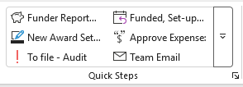


Outlook: Tiny Change, Large Impact
Microsoft Lists
Turn Emails into Tasks -Save incoming award notices directly to your list.
Audit Trail - Replace internal email chains with list commentary
Fewer Internal Emails- Use built-in comments to keep team updates in one clear place outside of inbox
Outlook Essentials
Quick steps – map repetitive replies, actions and filing.
Inbox Rules - Filing
Snooze/Flag - scheduling actionable items to resurface exactly when needed
#ARMA2026
Notes:
Quick Steps: Map repetitive replies, actions, and folder-filing tasks into single-click commands.
Inbox Rules: Route low-priority circular, internal system messages, and general mail to separate folders
Snooze & Flag: Master time-management by scheduling actionable items to resurface exactly when needed. Snooze brings it to the top of your inbox when everything else gets in the way
Shared mailbox.
Too many teams rely on shared mailboxes. If they can’t be removed optimise them.
Create templates for standarised replies. to ensure consistent, accurate answers for frequent funding or policy questions.
Flag important emails automatically (pin forward to manager, etc
Alerts - automatic reminders before major deadlines.
Lists
Convert incoming/outgoing Outlook award notices automatically into trackable list records.
Team Transparency Every team member sees all open and closed requests in one place.

Slide 8
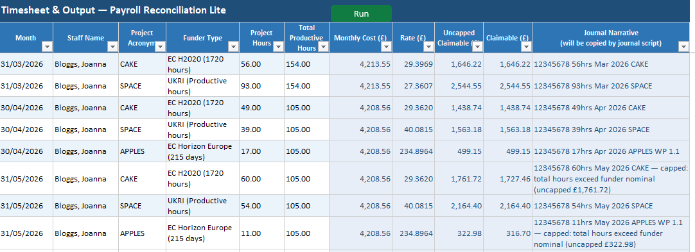
Timesheet-to-Payroll Reconciliation
Every funder counts time differently — 215 days, 1720 hours, productive hours. Then there's what the person actually cost the institution that month, and which parts of their pay are even eligible...
WHAT THIS HOLDS
Funder rules in one place — change them once
Eligibility rules for payroll elements
Your journal template + mappings
WHAT THIS DOES
Flags maybe-ineligible payroll entries — you decide
Maps each funder's basis onto the signed hours
Calculates both — uncapped, then capped to actual payroll
OUTPUTS
→ An auditable record
→ A journal to update the project ledger
The actual workbook — yours to download and adapt
#ARMA2026
Notes:
We all use Excel — but there are corners most of us never touch. So here we want to share a template. The actual template might not be of use to you — but it's an example of how Excel can support something we all do all the time.
Every funder counts time differently — productive hours, 215 days, 1720 hours — and on top of that you've got what the person actually cost that month, and which parts of their pay are even eligible.
Behind it sits one Reference tab — the funder rules, and which parts of pay are eligible and how the formulas treat them. The 'know-how' that usually lives in one person's head, written down once. And updatable.
A script checks each line of the payroll and flags anything that might be ineligible — or that it doesn't recognise — so you can make an informed call.
Then it sums the eligible payroll, applies the right basis for that funder, and works the claim out against the signed timesheet hours — showing both what the funder basis allows and the figure held to actual cost, so the choice is yours.
Out comes an auditable record, and a journal in our template, ready to paste.
It's not magic, and it's not the only way — but it took something fiddly and repetitive and made it quick and consistent. Not everyone uses it; Excel and ideas aren't magic.
And the rules behind it? They're the same for every one of us ..

Slide 9
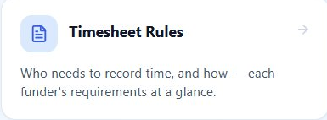
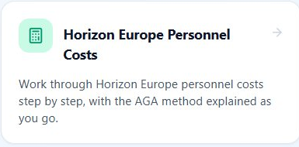

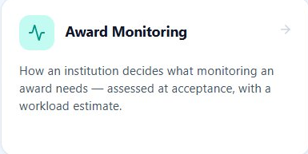
Built once, kept current — together
Shared across the sector
Funder rules don't change between institutions — yet every team works them out alone.
Institution-specific
How do others approach the same problem?
#ARMA2026
Notes:
…the same for every one of us. They're not secret, they're not ours — they're the funders' rules, published, identical for every institution in this room. So we've put them in one place.
That's what this is — the rules my spreadsheet runs on, sitting here for everyone, with calculators and wizards to walk you through them
Different problems all morning, same idea — approvals you can switch on, a bridge between two systems, Outlook doing more than we ask of it, a spreadsheet handling the fiddly maths. Using what we've already got. But every one started with one person, at one institution, working out a problem we probably all share — from scratch.
So, as we've said in the SIG, we want to share. We're joining it up with BUFDG's Research Finance Forum too, so it's not just one corner of the sector talking to itself. Open, free, no login — the templates live on the ARMA SIG page and in the conference app; the hub holds the rules and the guides behind them.
(bridge to Theme 2): Because none of this should sit with one person, working it out alone — which is exactly what Nicola and Anish are going to pick up next.

Slide 10
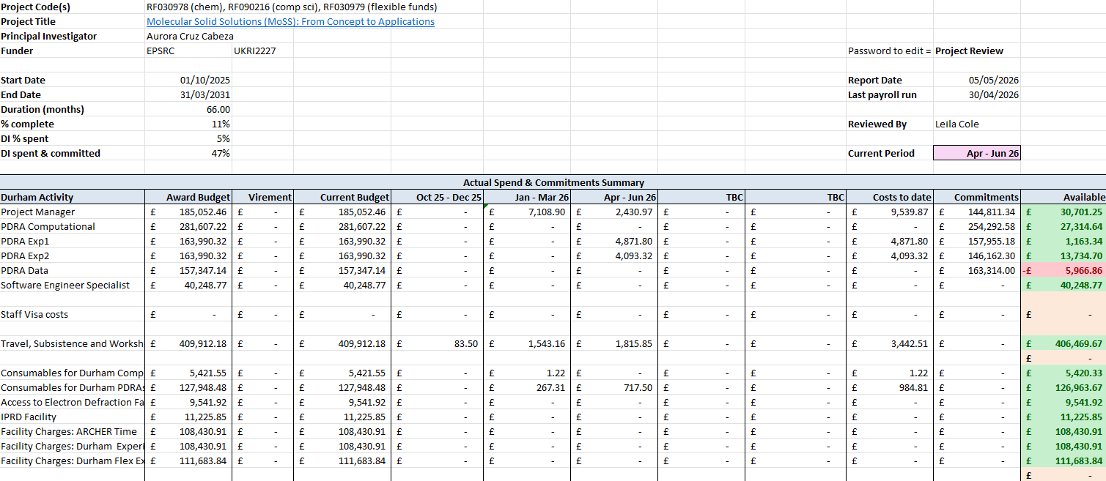
Project Health Check Workbook
Three pastes from finance → a one-page health check: budget vs actuals vs commitments vs available
#ARMA2026
Notes:
The second is a project health check, we all have versios of these. This is just one example with the review standard's written into it — what to check, what to flag, so it's not all held in one person's head.
Which is exactly where Nicola and Anish are taking us next.

Slide 11
Q&A
Theme One: Process & Workflow
Q&A
#ARMA2026
Notes:
Ask the presenters any questions

Slide 12
#ARMA2026
Notes:
‘What is your biggest operational bottleneck right now?’ - Menti word cloud - interaction with audience
Something like "okay we said phones out, we've got our first question for you.
Bridge
While you are doing that, don't worry this isn't going to be a training session and sorry we can't be magic.
We're not going to fix your workload in ten minutes. What we're going to do is show you a few things quickly — hopefully to give you an idea to take forward. Don't worry about copying anything down; you'll get the templates and notes afterwards, and we keep this going in the SIG.
Leila:
So — I've got the joy of kicking us off ;)
What can I actually do? I listen to my team tell me where things get stuck, where they're doing the same job twice — chasing across sections, checking again and again whether something's done. And I get frustrated we don't have the integrated systems or the IT resource to just fix it.
So I started asking: what can I do about it myself — with what we already have.

Slide 13

Turn & Talk
Reflecting on the bottlenecks highlighted in the poll; what approaches or solutions have you found effective in addressing these challenges at your Institution?
Live Feedback
Group discussion, feedback to room
#ARMA2026
Notes:
IF YOU DON’T HAVE ANY COMMENTS ON MENTI YOU CAN CLICK SUBMIT, AND THEN SKIP

Slide 14
#ARMA2026
Notes:
‘What is your biggest operational bottleneck right now?’ - Menti word cloud - interaction with audience
Something like "okay we said phones out, we've got our first question for you.
Bridge
While you are doing that, don't worry this isn't going to be a training session and sorry we can't be magic.
We're not going to fix your workload in ten minutes. What we're going to do is show you a few things quickly — hopefully to give you an idea to take forward. Don't worry about copying anything down; you'll get the templates and notes afterwards, and we keep this going in the SIG.
Leila:
So — I've got the joy of kicking us off ;)
What can I actually do? I listen to my team tell me where things get stuck, where they're doing the same job twice — chasing across sections, checking again and again whether something's done. And I get frustrated we don't have the integrated systems or the IT resource to just fix it.
So I started asking: what can I do about it myself — with what we already have.

Slide 15

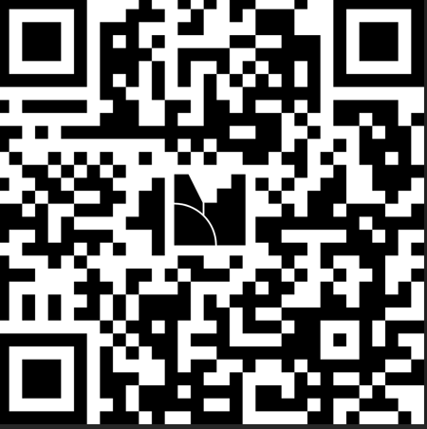
Discussion close out
  Which process or workflow change feels most viable for your team right now?
Live Feedback
#ARMA2026

Slide 16

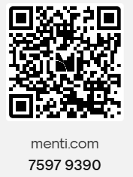
Shared Accountability & Knowledge Distribution
Operational Resilience
👥 Shared Accountability
📚 Knowledge Distribution
#ARMA2026

Slide 17
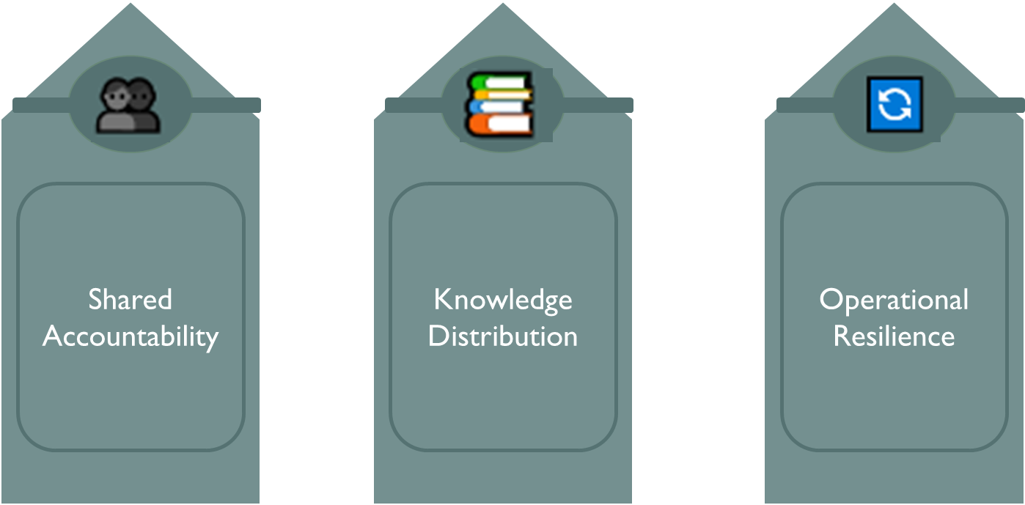
Shared Accountability & Knowledge Distribution
#ARMA2026

Slide 18
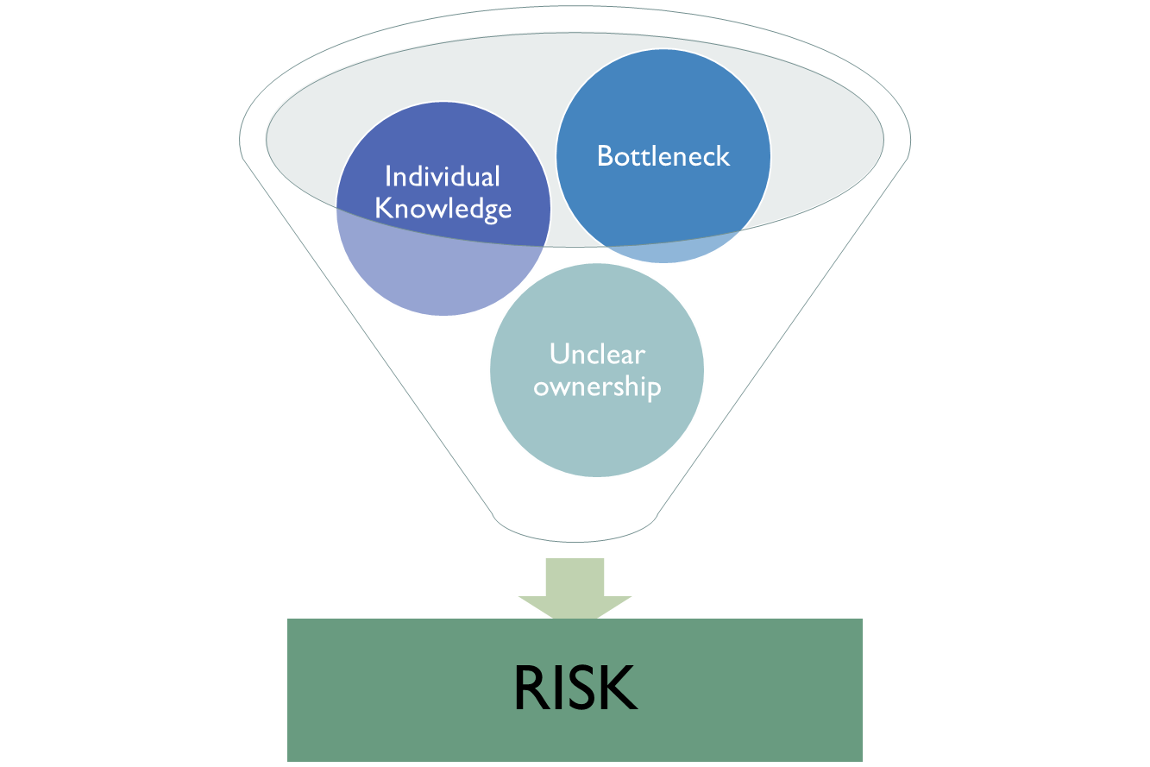
Shared Accountability & Knowledge Distribution
Challenges | Risks
Knowledge concentrated in small number of specialists | Delays and bottlenecks
Unclear ownership across processes | Reduced service continuity
Inconsistent handovers between teams | Inconsistent decision making
Over reliance on individuals, not processes | Increased cognitive load
 | Difficulty onboarding new staff
#ARMA2026
Notes:
Our second theme of the conference centres around Shared Accountability and Knowledge Distribution. As we've already discussed, post-award support is becoming increasingly complex. Teams are managing growing compliance requirements, funder expectations, reporting obligations, and stakeholder demands, often within the same resource constraints.
When capacity is stretched, it's natural for knowledge and responsibility to become concentrated in certain individuals. We all know the people in our organisations who are the "go-to" expert for a particular funder, system, contract type, or process. Their expertise is incredibly valuable, but it can also create risk if too much knowledge sits with one person or a small group.
The question for us is: how do we create more resilient ways of working without losing the specialist expertise that is so important to our success?

Slide 19
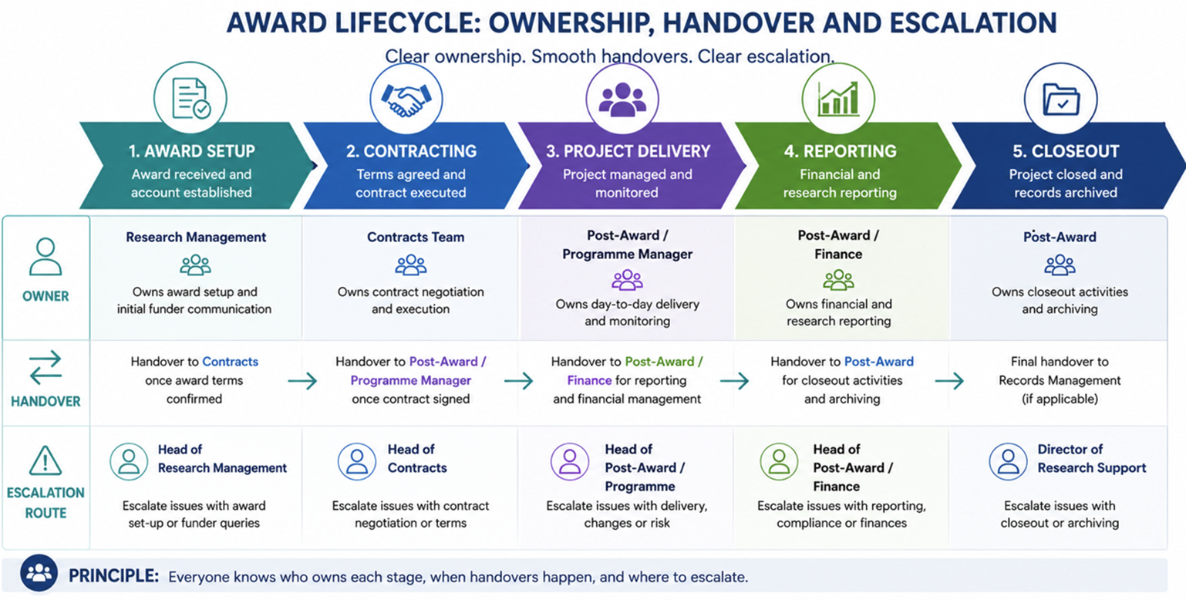
Shared Accountability starts with clear ownership
#ARMA2026
Notes:
One area to consider is shared accountability. In many Institutions, post-award delivery involves multiple teams – research management, contracts, finance, programme management, and operational support. Yet processes can become slowed down when responsibilities are unclear or when ownership changes hands multiple times.

Slide 20
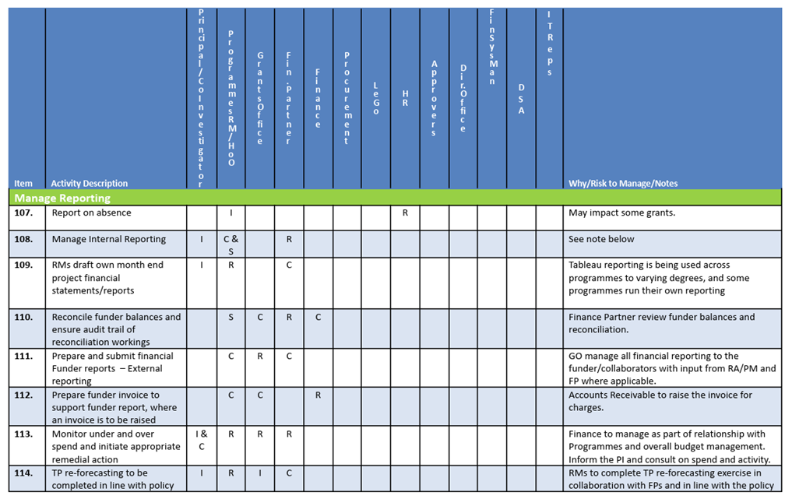
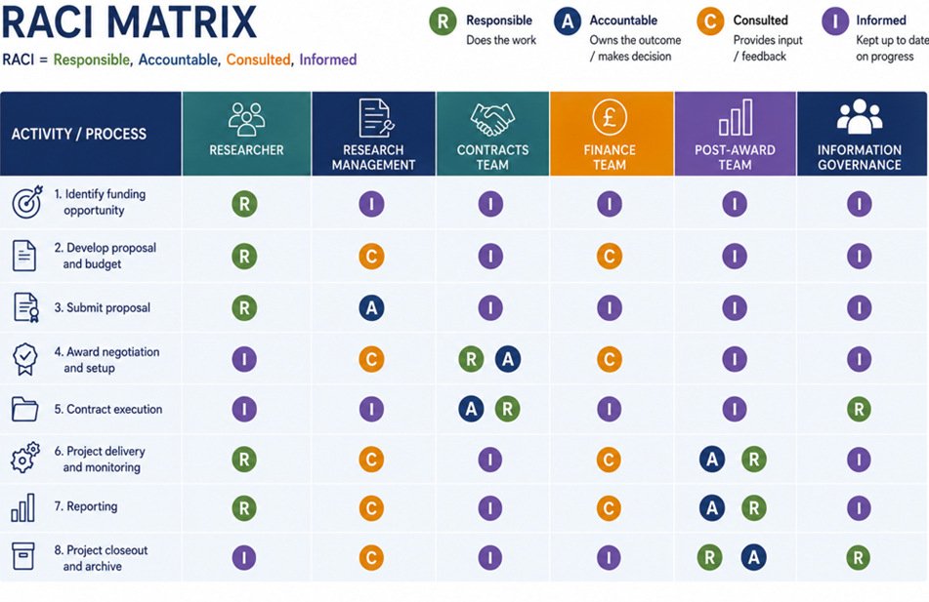
Defining Roles and Responsibilities
#ARMA2026
Notes:
Simple tools such as RACI models can help clarify who is responsible, accountable, consulted, and informed at different stages of the award lifecycle. Mapping processes from award notification through to project close can also help identify handover points, areas of duplication, and where escalation routes may not be clear.
The aim is not to create more bureaucracy, but to make it easier for teams to work together effectively and understand where their role begins and ends.
High leve of detail, or low detail depending on the requirements. Can have a RACI for a particular area of post award, breaking down the roles and responsibilities.

Slide 21
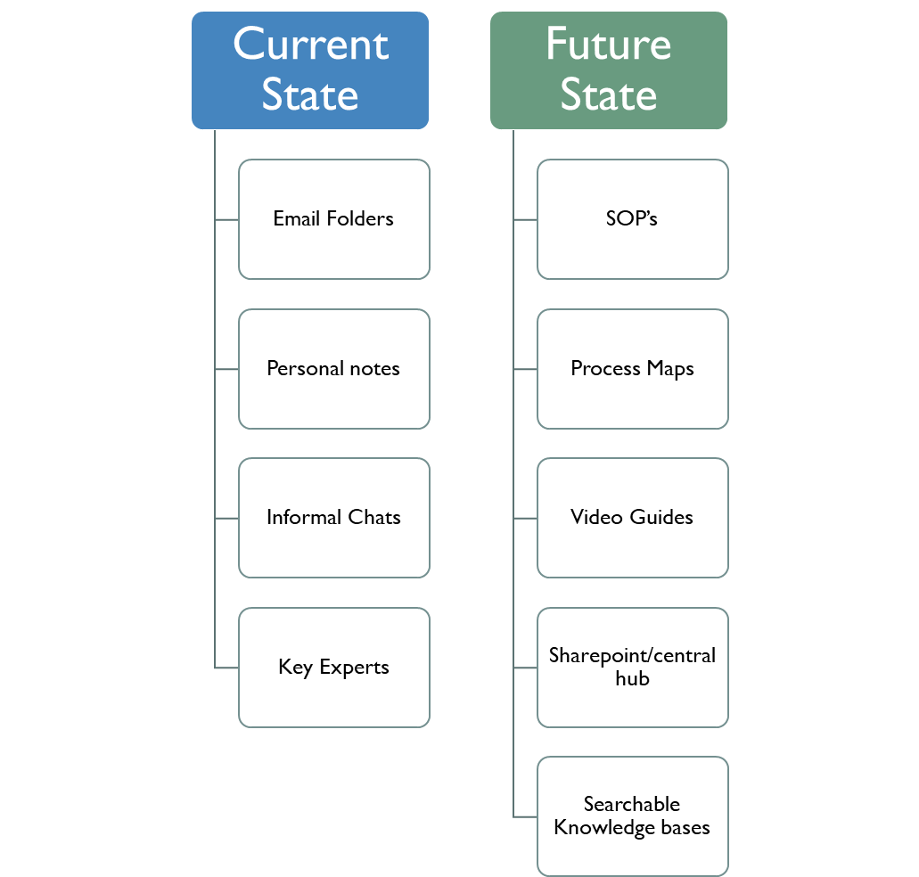
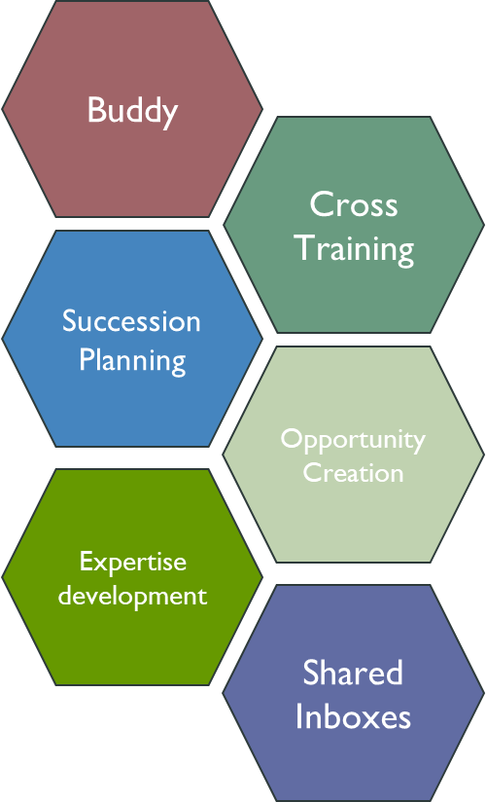
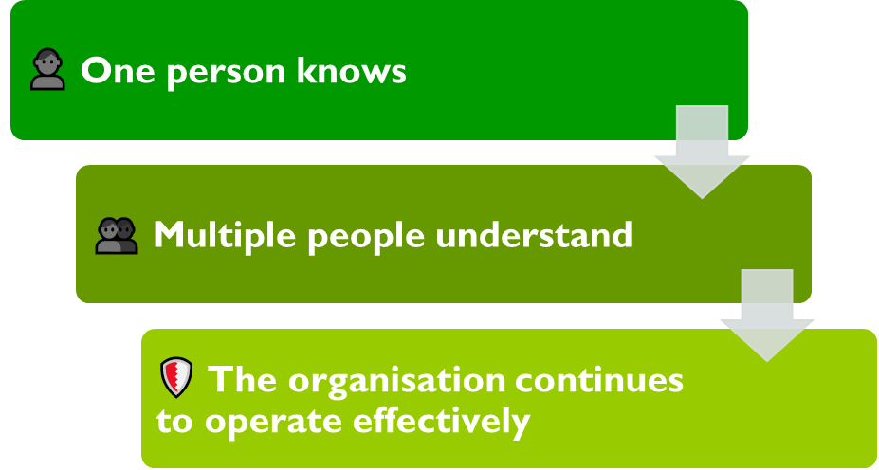
Organisational Memory
Moving away from single points of failure:
#ARMA2026
Notes:
Many of us have experienced situations where critical information exists in email folders, personal notes, or simply in someone's head. This can make onboarding difficult, create inconsistency, and increase pressure on individuals who become the sole source of knowledge.
Creating organisational memory is one way to address this challenge. This might include developing standard operating procedures, creating process maps, recording walkthrough videos, building SharePoint hubs, or maintaining searchable knowledge repositories. Importantly, knowledge capture should become part of business-as-usual activity rather than something we only think about when someone leaves. This is wht happens most often – then we realise we have a gap in our business process, with not a lot of time to fill that gap.
Some Institutions are even incorporating knowledge sharing and documentation into annual objectives, recognising that building Institutions capability is just as important as delivering day-to-day operational work.
This leads us to the concept of moving away from single points of failure.
If a key member of staff were unavailable tomorrow, would critical processes continue to function effectively? Could someone else step in and provide support? Would the information needed to continue the work be easy to find?
Thinking of how to build resilience to mitigate against the single points of failure risk: might involve buddy arrangements, cross-training, succession planning, shared inboxes, or creating opportunities for staff to develop expertise beyond their immediate role. These approaches help distribute knowledge more broadly across teams while also supporting professional development and collaboration.
Ultimately, shared accountability and knowledge distribution are not simply about reducing risk. They are about creating the capacity and resilience that allow post-award professionals to focus their expertise where it adds the greatest value.

Slide 22
Strengthen collaborative working across teams
Improve handover processes to increase efficiency
  Pre-Award to Post-Award Handover Form
  Pre-Award to Contracts Instruction Form
  Shared Contract Tracker Spreadsheet – visibility of grants in the pipeline
  Cohort kick-off meetings for PIs
  Joint training sessions to encourage greater cross-team collaboration
Establish functional working groups to drive process improvement and consistency
Promote a culture of collaboration, communication and shared ownership
  HR, Central Finance, Graduate School, Internal Comms, Ethics etc – Attend their team meetings!
#ARMA2026
Notes:
Another way of achieving shared accountability and knowledge distribution is by strengthening collaborative working across teams.
Team structures are going to be different depending on the type of institutions you are working at (Centralised, hybrid, devolved)
Improve handover processes to increase efficiency
Less emails and Meetings
Shared contracts tracker addressess issues with lack of visibility of grants in the pipeline for post-award staff
Cohort start-up meetings for PIs – Kick-off meeting checklists
Establish functional working groups to drive process improvement and consistency
Understanding costing implications across pre-and post-award
Streamline award setup processes.
Improve handovers between teams.
Review grant management systems and workflows.
Enhance reporting and management information.
Due Diligence
Trusted Research
Having good relationships with other teams – E.g. HR, Graduate School, Central Finance, Ethics and Governance etc

Slide 23
Developing skills across boundaries
Lack of understanding about the requirements and priorities of other teams
Increase operational resilience and capacity by broadening expertise
  Secondments/Shadowing
Skills sharing and knowledge exchange
  'Lunch and Learn' sessions led by different teams
  Helps create subject matter champions within teams
Establish functional working groups to drive process improvement and consistency
Create a skills matrix – who are the experts, where are the gaps?
Cross-boundary skills development is not about creating generalists
#ARMA2026
Notes:
Increase operational resilience and capacity by broadening expertise:
Post Award Managers undertaking short-term secondments within Contracts. Pre-Award to gain funder requirements
Training RDM and/or Post-Award Managers in research contract review so there is additional capacity during staff absence or periods of high demand.
Short-term secondments Pre-Award teams will increase understanding of funder requirements and improve understanding of the end-to-end grant lifecycle.
Shadowing Contracts colleagues to gain knowledge of research agreements, contract negotiation and key contractual risks.
Shadowing Finance colleagues to understand budgeting, forecasting, audits and financial reporting requirements.
Opportunities for Post-Award staff to support major bid development activities and gain experience of funder requirements before awards are secured.
Skills sharing and knowledge exchange
Regular "Lunch and Learn" sessions led by different teams (Contracts, Compliance (Trutsted Research, Export Controls), Research Development, Finance, Ethics, even IT).
Helps create subject matter champions
Establish functional working groups to drive process improvement and consistency (This is also useful for developing skills across teams)
Create a skills matrix – who are the experts, where are the gaps? – helps reduce single point of failure, identify training needs etc
Key Message - Cross-boundary skills development is not about creating generalists, but about building sufficient understanding and capability to improve collaboration, resilience and service continuity while retaining specialist expertise
Objective it not to create experts in everything, but to create confidence and understanding in the theme/area.

Slide 24
Q&A
Theme Two: Shared Accountability & Knowledge Distribution
Live Q&A
#ARMA2026
Notes:
Be honest: a bigger build, not everyone has the same tools — say it plainly. Honesty protects the credibility of everything before it.
Pain: the same questions arriving in the inbox, again and again. Connect back: the other tools bought back hours — this is what becomes possible with them.
The page shown is the SIG session page — built with and for the SIG, no login needed.

Slide 25
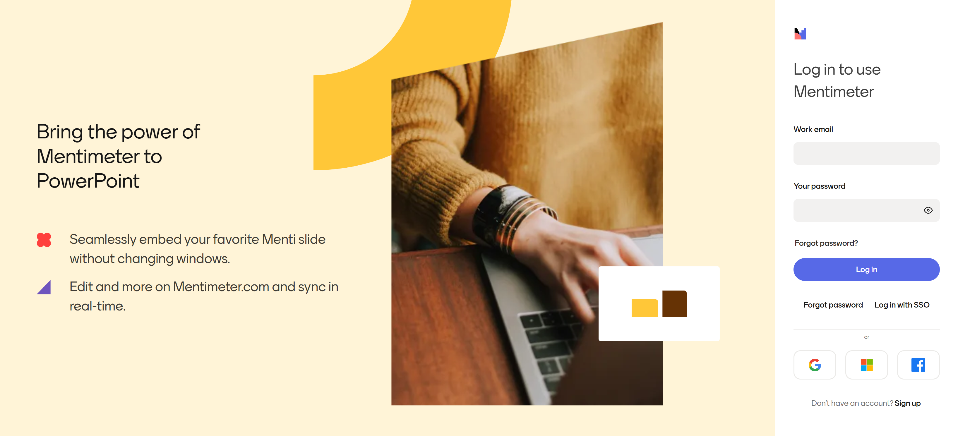
#ARMA2026
Notes:
‘What is your biggest operational bottleneck right now?’ - Menti word cloud - interaction with audience
Something like "okay we said phones out, we've got our first question for you.
Bridge
While you are doing that, don't worry this isn't going to be a training session and sorry we can't be magic.
We're not going to fix your workload in ten minutes. What we're going to do is show you a few things quickly — hopefully to give you an idea to take forward. Don't worry about copying anything down; you'll get the templates and notes afterwards, and we keep this going in the SIG.
Leila:
So — I've got the joy of kicking us off ;)
What can I actually do? I listen to my team tell me where things get stuck, where they're doing the same job twice — chasing across sections, checking again and again whether something's done. And I get frustrated we don't have the integrated systems or the IT resource to just fix it.
So I started asking: what can I do about it myself — with what we already have.

Slide 26

Turn & Talk
What is one thing your organisation has done to increase efficiency or to reduce reliance on individuals across post-award?
Live Feedback
Group discussion, feedback to room
#ARMA2026

Slide 27
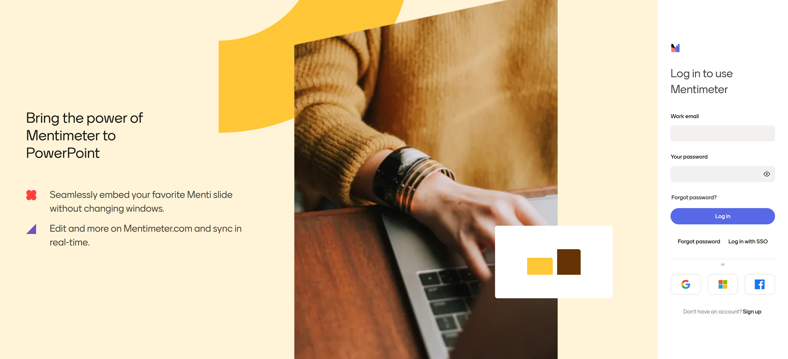
#ARMA2026
Notes:
‘What is your biggest operational bottleneck right now?’ - Menti word cloud - interaction with audience
Something like "okay we said phones out, we've got our first question for you.
Bridge
While you are doing that, don't worry this isn't going to be a training session and sorry we can't be magic.
We're not going to fix your workload in ten minutes. What we're going to do is show you a few things quickly — hopefully to give you an idea to take forward. Don't worry about copying anything down; you'll get the templates and notes afterwards, and we keep this going in the SIG.
Leila:
So — I've got the joy of kicking us off ;)
What can I actually do? I listen to my team tell me where things get stuck, where they're doing the same job twice — chasing across sections, checking again and again whether something's done. And I get frustrated we don't have the integrated systems or the IT resource to just fix it.
So I started asking: what can I do about it myself — with what we already have.

Slide 28

Thank you – Any further questions?
Live Feedback
Next SIG drop in:
15 July, 13:00 - 14:00 https://arma.ac.uk/product/arma-post-award-sig-drop-in-session-9/ [arma.ac.uk]
#ARMA2026
Notes:
Roving mics

Slide 29

Thank you
Any questions?

