Slide 1
Developing an interdisciplinary research ethics mechanism from scratch in the charitable sector
Aji Ceesay
Research Officer
Ross Goldstone
Senior Research Manager

Slide 2
Agenda
1. About the Health Foundation
2. Why research integrity is important for the Health Foundation
3. Setting up the research ethics process
Our learning from the process

Slide 3
About the Health Foundation
1

Slide 4





The Health Foundation
We are an independent charity which works to build a healthier UK. We aim to do this by:
Putting health and inequalities at the heart of decision making;
Shaping the future of the health and care system to ensure the best care for all;
Building new approaches to testing innovation that could transform health and care.
We do this in a number of ways, one of which is generating high-quality research and analysis to understand the big issues facing health and care, and potential solutions.

Slide 5
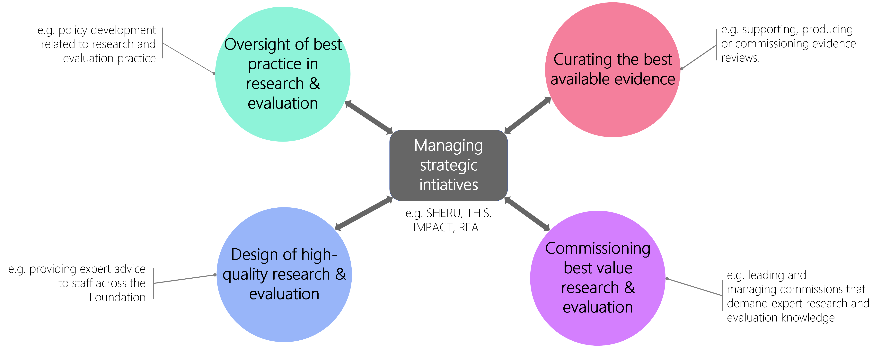
About the Research Team
Notes:
Notes
Research team is responsible for oversight of best practice in research and evaluation.
Includes leading the development and implementation of Foundation wide policies to research and evaluation practice. Research Integrity& Research Misconduct Policy.
Develop procedures to support good research conduct, e.g. Ethics review mechanism
Research team’s coordination with other teams at the Health Foundation.

Slide 6
Why research integrity matters at the Health Foundation
2

Slide 7
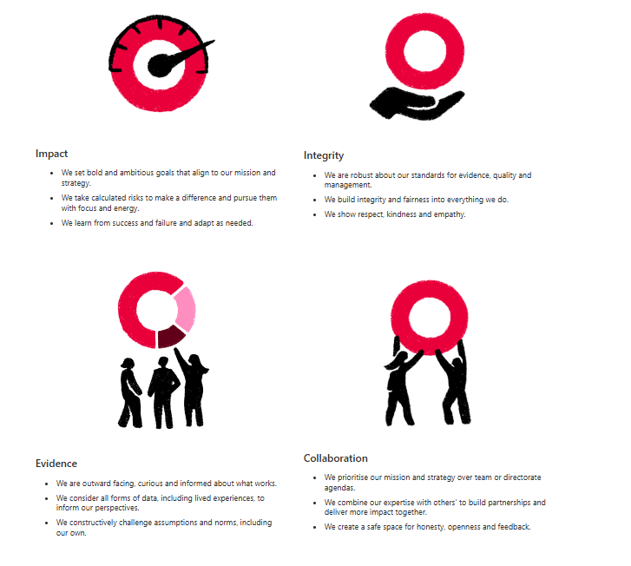
Research at the Health Foundation
Evidence underpins much of the work we do at the Health Foundation. We conduct and commission research to enable us to understand issues and test possible solutions using the highest quality research and analysis.
In order for our research to be trusted and authoritative, we must ensure that we align to best practice guidelines, notably the Concordat to Support Research Integrity and UK Policy for Health & Social Care Research.
Failing to do so poses significant reputational risk and is inconsistent with our values at the Health Foundation.

Slide 8
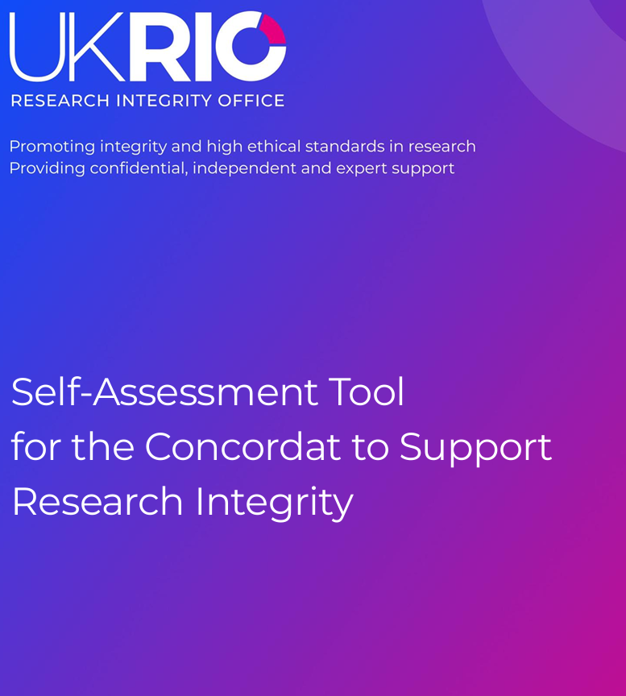
What did we set out to do?
Like most funding organisations outside of the University sector, we did not have an established research ethics process. Historically, this was done within the local teams undertaking research. This potentially creates inconsistencies and creates risk for the organisation.
This was highlighted to us through our use of the UK Research Integrity Office’s self-assessment tool.
This highlighted some opportunities to strengthen our research governance, most notably creating a research ethics review process.

Slide 9
What did we set out to do?
Aligned to best practice
Interdisciplinary
Working with UKRIO to seek feedback on our plans.
Relevant to research undertaken across our teams.
Proportionate
Efficient
The level of review required is aligned to potential risk.
The enables, not disrupts high-quality research.

Slide 10
Setting up the research ethics process
3

Slide 11
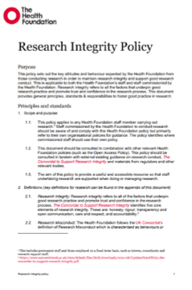
How did we do it?
Policy Development
A Research Integrity Policy was developed and approved, which created the justification, impetus and commitment to develop the research ethics process.
Staff Engagement
The ethics review process was codesigned with an Internal Stakeholder Group.
We completed a small-scale pilot of the new process with staff.
We attended team meetings, delivering a roadshow which created space for questions.
BAU Integration
We worked with those responsible for portfolio development and PMO documentation to insert the research ethics requirement into the Project Initiation Document (PID).
Guidance and resources are available to support staff.

Slide 12
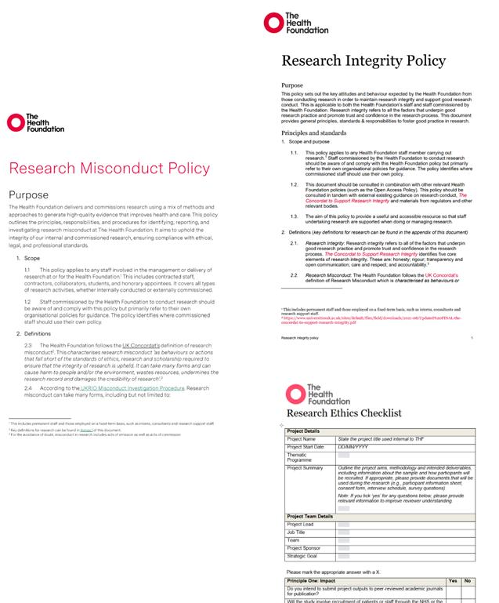
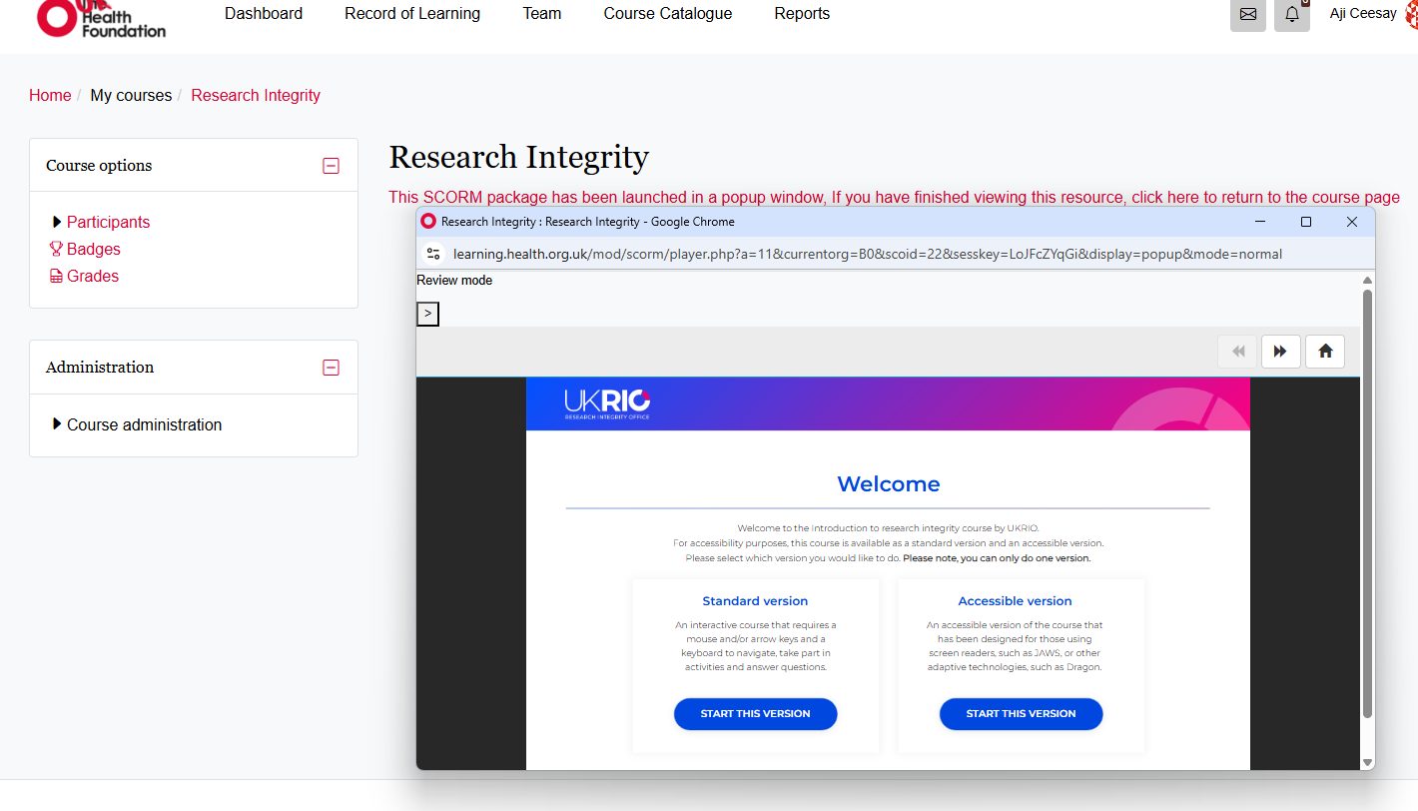
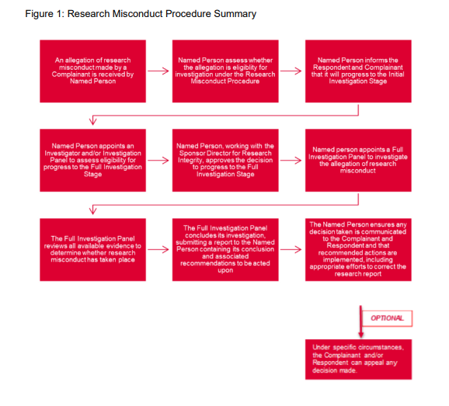
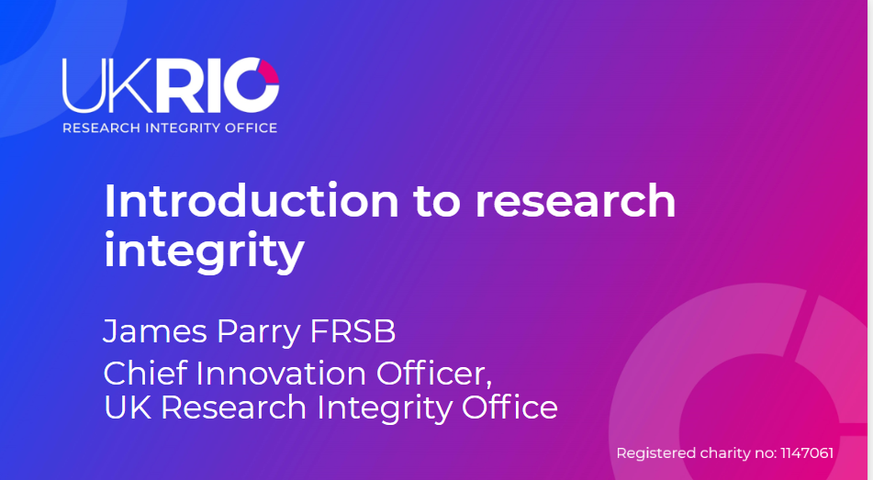
Resources we created to strengthen our policies, systems and culture to support our staff
The Health Foundation's
Research Ethics Champions

Slide 13
Ethics Review Process Tree – Simplified
Further review by Research Ethics Group required
Research Ethics Group provides feedback to integrate into research design for approval.
High / Moderate risk
ALL PROJECTS
Research Ethics Checklist Completed
Research Ethics Group:
A network of internal research ethics champions, who:
Are provided with bespoke training for their role as group members
Can provide informal research ethics support
Review research ethics checklists, where capacity allows
Review any high-risk research project a the Foundation
Low risk
No further review by Research Ethics Group required
Notes:
Comments:
Linking into wider processes (e.g., PID)
Could external use this process (if there is not a process available externally)?
Level of need for the Ethics Group
Where changes emerge (i.e., a significant change) will require further engagement
Alyssa – link-up to ensure connection to EDI.

Slide 14
Our learning from the process
4

Slide 15
Success Factors
External guidance & assurance from UKRIO
Strong senior leadership sponsorship
Proportionate processes aligned to organisational context
Address gaps where projects were not eligible for HRA review
Clear articulation of benefits to colleagues
Notes:
Clear articulation of benefits to colleagues:
- Alignment of best practice
- Enables publication and supports impact
- Protects researchers and participants
- Improves quality and credibility

Slide 16
Our Learning
Defining what ‘research’ is upfront is foundational
Proportionate systems work better than burdensome processes
Embedding into existing processes supports uptake
Culture change matters as much as policy
External expertise strengthens internal confidence

Slide 17


Thank you
Get in touch via email:
Aji Ceesay: aji.ceesay@health.org.uk
Ross Goldstone: ross.goldstone@health.org.uk
Or via LinkedIn:
Ross
Aji

