Slide 1


The Arts & Humanities, in solidarity: ‘specialised’ or galvanised?
Arts & Humanities Special Interest Group (SIG) session​
17 June 2026​
Notes:
Tania: Thank you all for coming today, it's so wonderful to see you here, in person, for this A&H SIG event.
You'll see that today's session theme is all about perceptions and realities of the Arts & Humanities (A&H) being under attack.
Aim of our 75-min session is to advocate (as ever) for the Arts and Humanities but also to support each other and have meaningful exchanges. We're in the same boat and consider our own voices equal to your own.
We encourage you to voice your opinions and stories, whether anonymously via Mentimeter, the Conf app's Q&A or verbally by raising your hand. We'll have time for small group discussion as well as whole group discussion, interspersed with some presentations that include provocations to you to consider.
This is a safe space, and we are operating under the rules of Chatham House.
0-5: Welcome (5min) - Tania
5-10: pulse check (5min) - Val
10-15: first presentation (5min) - Tania
15-35 first discussion (20min) - Paola
35-45 Positive stories (10min) - Val and one other?
45-55 Your positive stories from audience (10 mins) - Paola
55-70 Looking forward discussion (15 mins) - Tania
70-75: closing remarks: 5 mins - All

Slide 2


Rationale for today's session
The topic arrived a turning point for the sector and our SIG
Aim of the session is to create a safe space to share honest views and challenges
At the same time, we also want to make space for positive stories, actions and ideas, because:
We must strategically advocate for the Arts & Humanities, now more than ever – for the disciplines, for our academics, for ourselves
#ARMA2026
Notes:
Tania to present
We need to strategically advocate for A&H. Bring your stories of positive action, practical advice and championship from your organisations, e.g.: small, bottom-up initiatives or top-down institutional ones; lessons learned from other disciplines, the GLAM sector, creative practitioners and freelancers; and collaborative platforms like NCACE. We’ll showcase examples and seek your voices!

Slide 3
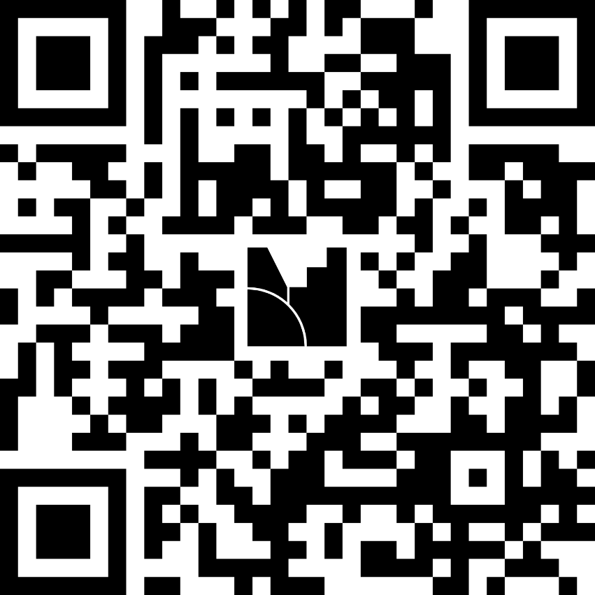
Pulse check: where are we at the moment?
CODE: 6153 8726
https://www.menti.com/al1uepqxwi5r
#ARMA2026
Notes:
Val

Slide 4
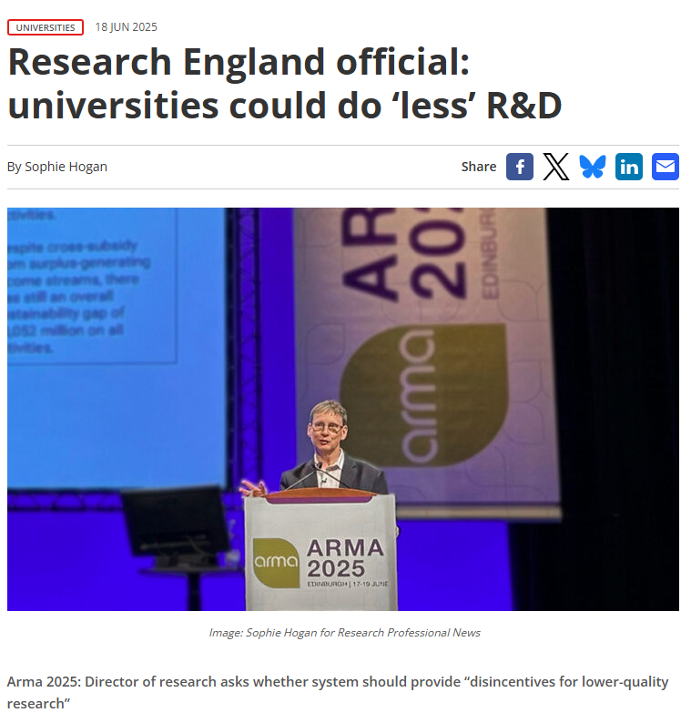
The current situation...
#ARMA2026
Notes:
Tania
You might recall, at last year's conference, a presentation by UKRI's Steven Hill that organisations ‘specialise’, i.e. 'do fewer things in research but do them really well' (https://www.timeshighereducation.com/news/ukri-chief-do-fewer-things-research-do-them-really-well).

Slide 5
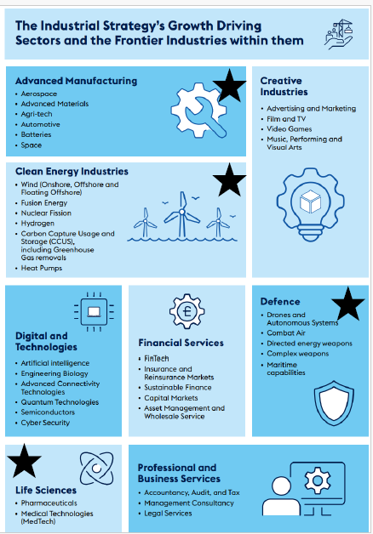
UKRI New Budget Model
Industrial Strategy Sectors
Advanced Manufacturing
Clean Growth and Energy
Creative [and cultural?] Industries
Defence & National Security
Engineering Biology
AI
Quantum Technologies
ACT, Semiconductors & Cybersecurity
Life Sciences
Professional, Business and Financial Services
#ARMA2026
Notes:
Tania
We are feeling that 'specialisation' as a kind of shrinking, constraining and money-driven conceptualisation of what the Arts and Humanities are 'for'. We held a drop-in a few months ago where we discussed the implications for A&H following UKRI's new budget model being announced

Slide 6
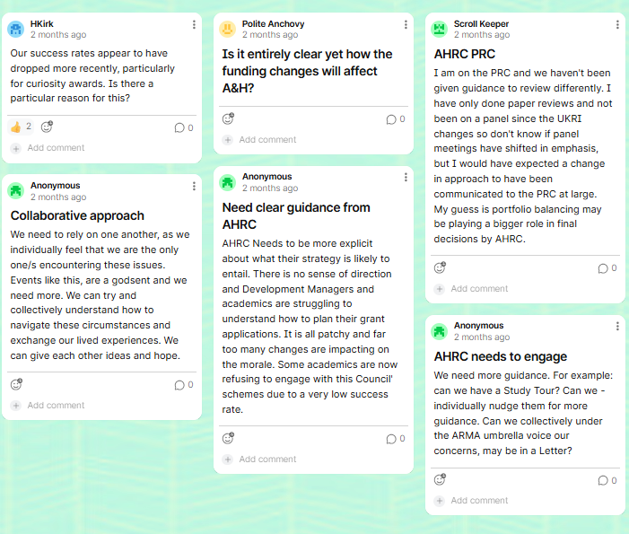
Our most recent SIG drop-in has started to unearth some views from our community...
https://padlet.com/ARMAuk/arma-arts-humanities-sig-drop-in-session-implications-of-ukr-5wn2ipbj3c5rzmnl ​
Notes:
Tania
We held a drop-in a few months ago where we discussed the implications for A&H following UKRI's new budget model being announced. We encourage you to view the Padlet: https://padlet.com/ARMAuk/arma-arts-humanities-sig-drop-in-session-implications-of-ukr-5wn2ipbj3c5rzmnl

Slide 7


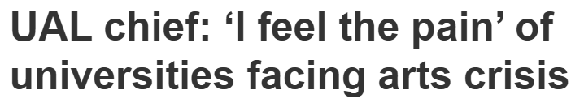
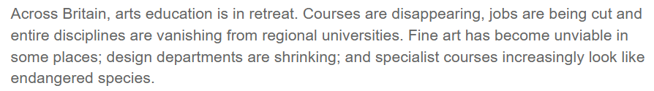
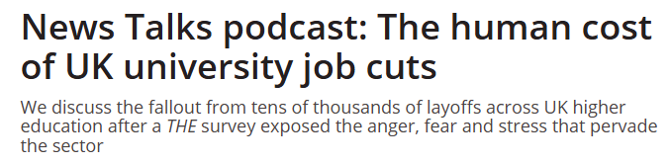
#ARMA2026
Notes:
Tania
This year in particular but for several years now, we are witnessing (and experiencing personally) departments being shutting down across the nation with upsetting job cuts and mass redundancies taking place; there are SHAPE disciplines, the British Academy has recognised for some time, which are ‘endangered’ with consequent ‘cold spots’ appearing that is disproportionately affecting different UK regions. This all makes for sobering reading and a demoralised daily work practice.
Research Professional article: https://www.researchprofessional.com/news-articles/article/1419221
THE podcast episode: https://www.timeshighereducation.com/opinion/news-talks-podcast-human-cost-uk-university-job-cuts?u%5B%E2%80%A6%5D=
British Academy mapping 'cold spots': https://www.thebritishacademy.ac.uk/policy-and-research/british-academy-shape-observatory/cold-spots-mapping-inequality-in-shape-provision/

Slide 8
Discussion:
What are the challenges that we, as an A&H community, are encountering...
at your institution?
for you, from a Professional Services point of view?
for your academics developing A&H-based research?
CODE: 6153 8726
https://www.menti.com/al1uepqxwi5r
#ARMA2026
Notes:
Paola to lead
What are the challenges that we – as an A&H community - are encountering?
How is the changing funding landscape already affecting A&H at your Institution?
What are the challenges that you are encountering from a Professional Services point of view?
What are the challenges that you are noticing the academics are encountering in developing A&H based research?
We'll allocate 10 minutes for you to discuss this informally in small groups, followed by 10minutes to discuss as a group and/or via Mentimeter

Slide 9
Uplifting stories from our community
Continuing AHRC champion, Prof Christopher Smith (blog: https://anatomiesofpower.wordpress.com/
RLUK-AHRC Research Catalyst Programme
Padlet from our drop-in session
Anonymous questionnaire to the SIG
Positive collaborations: National Centre for Academic and Cultural Exchange (NCACE)
#ARMA2026
Notes:
Paola to lead
What are the challenges that we – as an A&H community - are encountering?
How is the changing funding landscape already affecting A&H at your Institution?
What are the challenges that you are encountering from a Professional Services point of view?
What are the challenges that you are noticing the academics are encountering in developing A&H based research?
We'll allocate 10 minutes for you to discuss this informally in small groups, followed by 10minutes to discuss as a group and/or via Mentimeter

Slide 10
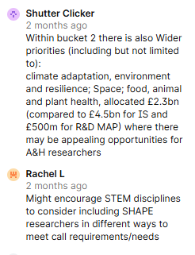
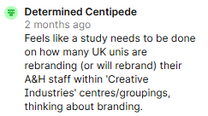
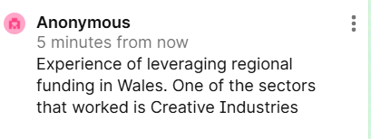
PADLET FROM OUR DROP-IN SESSION
#ARMA2026
Notes:
Val

Slide 11
We are building a narrative that the humanities are not a 'nice to have' bolt on to research in other areas, rather they are basis of all human inquiry. This has been as necessary for A&H colleagues as for those outside the disciplines. It has reinforced the sense of personal worth and elevated the discussion of the worth of the humanities within the institution.
I think this has been a success due to collaborative leadership - the Faculty lead has had a vision, articulated it and has brought colleagues with them. Even those who aren't fully 'sold' on the idea see the necessity of the championing the Humanities to various audiences for continued survival. Albeit that they might distance themselves from anything so practical!!
QUESTIONNNAIRE
4 responses
TOPICS:
  grant award
  grant submission
  institutional narratives
#ARMA2026
Notes:
Val

Slide 12

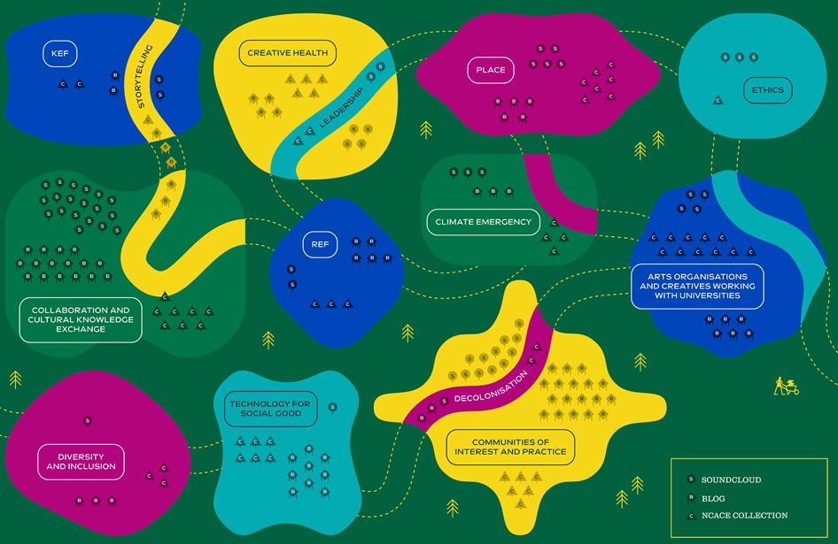
Positive collaborations:
Paola
NCACE: a collaborative advocacy platform
NCACE (National Centre for Academic and Cultural Exchange) is a UK-wide collaborative platform connecting Higher Education with the arts and cultural sectors to strengthen knowledge exchange, foster partnerships, and amplify the social, cultural, and environmental impact of Arts & Humanities research. Through its networks, events, publications, and collaborative labs, NCACE provides a vital infrastructure for advocacy, evidence-building, and cross-sector innovation—helping position Arts & Humanities as essential drivers of societal change.
Home - National Centre for Academic and Cultural Exchange
#ARMA2026
Notes:
Val

Slide 13

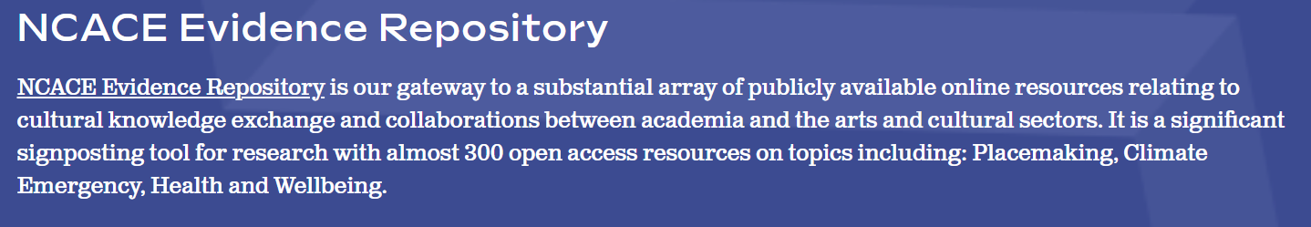
Paola
NCACE examples of activities include:
Ideas Pool & Micro-Commissions: bringing academics and arts practitioners together to seed new partnerships through small-scale, flexible funding. These “proof of concept” collaborations lower barriers to experimentation and relationship-building
Knowledge Impacts Network (KIN): a community of practice for knowledge exchange professionals, researchers, and cultural workers to share methods, challenges, and strategies for impact. This reflects NCACE’s commitment to peer learning and sector-wide capacity building.
Evidence Cafés: themed discussions on issues such as climate emergency, placemaking, arts and health, and creative communities—showing how Arts & Humanities contribute directly to contemporary societal challenges
Annual Policy Workshops: convening policymakers, academics, and cultural leaders around “grand challenge” themes like climate, health, and technology for social good, ensuring Arts & Humanities voices shape policy discourse.
#ARMA2026
Notes:
Val
We were kindly given loads of material from Mai Musie

Slide 14
YOUR STORIES
We need to strategically advocate for A&H.
Do you have any stories you'd be willing to share of positive action, practical advice and championship from your organisations, for instance:
small, bottom-up initiatives or top-down institutional ones
lessons learned from other disciplines, the GLAM sector, creative practitioners and freelancers?
We seek your voices!
#ARMA2026
Notes:
Paola to ask for further audience discussion (10min max)

Slide 15
LOOKING FORWARD
“The most common way people give up their power is by thinking they don't have any.” - Alice Walker
What's one thing you wish could change to help support our A&H disciplines and us as a community?
  What's one thing in our sector?
  What's one thing our A&H funders could do?
  What's one thing your institution could contribute?
  What's one thing you could do in your daily practice?
#ARMA2026
Notes:
Tania
In times of constraint, New Censorship Theory explains that people get creative, find loopholes, ways around barriers, invent new solutions; in other words, productive/generative
If you could ask funding bodies a specific question that could help both academics and professional services in addressing the sector's challenges, what would this question be?
What is the one thing you would like a funding body to know?
What is our responsibility as a community?
Being a trusted guide
Empathetic community
Agile

Slide 16
LOOKING FORWARD
“The most common way people give up their power is by thinking they don't have any.” - Alice Walker
CODE: 6153 8726
https://www.menti.com/al1uepqxwi5r
#ARMA2026
Notes:
Tania to lead

Slide 17

Thank you
Any questions?
Notes:
All

