Slide 1

Equipment Data Service
Balviar Notay
Product Manager
John Kaye
Head of product
Notes:
Thank you for taking the time to be on this webinar.
House Keeping
It will be recorded. Turn off videos if you don't want to appear in the recording. We will be making the video available for people after after the webinar as part of the webinar resources.
If you have any questions during the presentaiton – please put these in the chat and we'll deal with those at the end
We’ll also share relevent links in the chat and in webinar resources

Slide 2
How can you benefit from your organisation's research equipment data?
https://equipment.data.ac.uk/

Slide 3
Overview of session
Overview of the Equipment Data Service (5 min)
Breakout session (15min)
Feedback 10min
Objective
Explore how the service might support research managers

Slide 4
Equipment Data Service
  Data Management Platform
  Ingestion through file upload, API integration (Pure and Kit-Catalogue) or manual record creation
  Assign DOIs (equipment records only)
  API
About
Enables searching across all published UK research equipment databases through one aggregation portal
Current numbers:
  77 institutions
  22,248 records
  791 DOIs
UKRI compliance
Notes:
One of the major uses cases is having the ability to cite and track research equipment assets via DOIs.

Slide 5
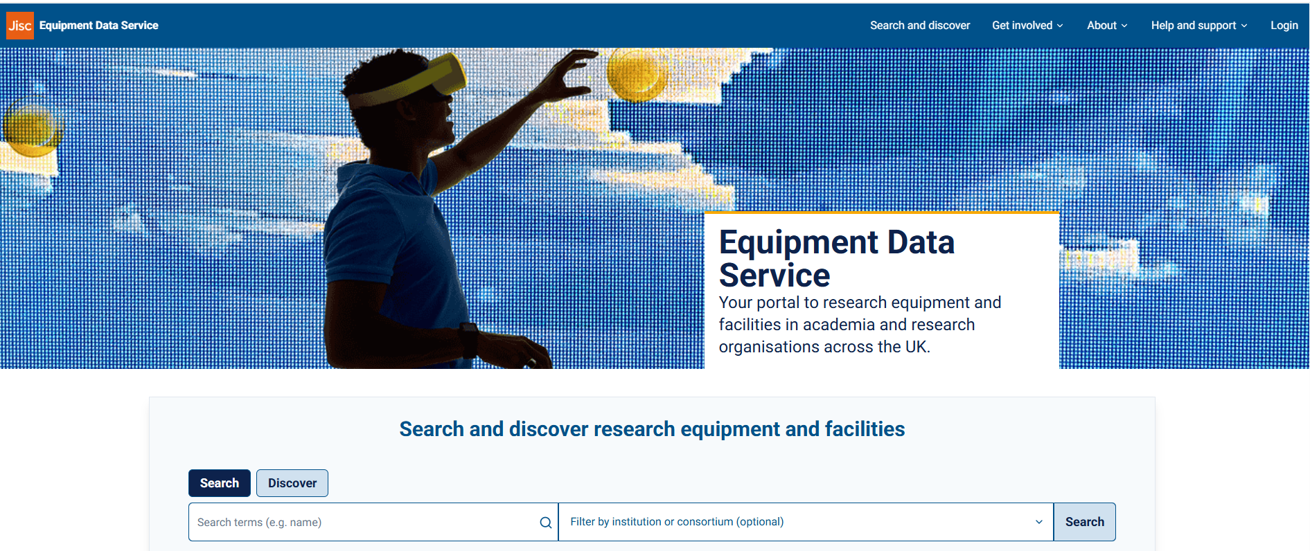
Updated website

Slide 6
Benefits
Impact evaluation | Assigning identifiers creates the link from equipment and facilities to research outputs, allowing evaluation of investments.
Reproducibility | Uniquely identifying resources used in research improves provenance and enables reproducibility.​
Market intelligence | A valuable, national dataset to inform investment decisions and identify opportunities to improve the procurement process.​
International best practice | Aligns with UKRI strategy for UK Research Data Alliance node and engagement with the wider persistent identifier landscape.​
Discovery, collaboration and sharing | Improved data quality, coverage and timeliness will increase discovery and collaboration through open API planned integrations with partners.
Improve data quality | Reduce the data collection burden on institutions with improved user experience, automation and interoperability.​
Credit for research support staff | Providing records of equipment through the international identifier systems allows for more, non-author, roles to be linked to research.
Notes:
---------------------------------------------------------
Assigning identifiers creates the link from equipment and facilities to research outputs, allowing evaluation of investments.
Uniquely identifying resources used in research improves provenance and enables reproducibility.​
Data about the lifecycle of equipment could create a valuable, national dataset that may inform investment decisions and identify opportunities to improve the procurement process.​
Aligns with UKRI strategy for UK Research Data Alliance node and engagement with the wider persistent identifier landscape.​
Improved data quality, coverage and timeliness will increase discovery and collaboration. The Service's open API and planned integrations with UKRI InfraPortal, NCUB Konfer and ITSS will surface connections between the equipment in more places. ​
Developing a new data management area and CRIS integrations aim to reduce the data collection burden on institutions by supporting institutions with improved user experience, automation and interoperability.​
Providing records of equipment through the international identifier systems allows for more, non-author, roles to be linked to research. For example, technicians can use these equipment records to populate their roles in ORCID profiles, which can then be linked to research outputs generated by the equipment. ​

Slide 7
Poll question
Awareness
Were you aware of the Jisc Equipment Data service before ARMA?
  Yes
  No

Slide 8
Poll question
Awareness
How involved are you in managing data relating to equipment?
  Involved
  Involved occasionally
  Not involved currently, but need to be
  Not involved

Slide 9
Discussion questions
How is your institution managing equipment data?
  Data sources/systems
  Teams/responsibilities
What are the opportunities, challenges and barriers?
How can/could the service help you collect the data you need?
What data would make a difference to you in meeting your priorities?
Use case: Support for procurement for research projects: what are the pain points? Could national market intelligence/equipment lifecycle data help these?

Slide 10
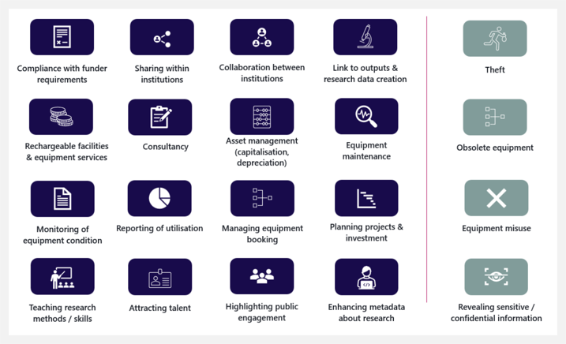
Use cases for equipment data
Notes:
In addition to complying with funder requirements to report equipment over the value of £138k (and therefore potentially to facilitate the sharing of that equipment between institutions), use cases for equipment data include:
• contextualising research outputs, linking equipment to publications & research data creation; • facilitating internal (as well as external) sharing of equipment within institutions, (including potentially sharing equipment below the £138k value threshold for compliance reporting); • income generation through facilities and equipment services and consultancy; • highlighting broader public engagement work and use of facilities by different types of external partners e.g. from industry, SMEs or public sector organisations; • helping to manage equipment – e.g. booking, maintenance, financial management as an asset (capitalisation, depreciation); • condition and use monitoring; • planning projects and investments; and • in some cases, as routes to attracting researchers keen to work with cutting edge technology in their field.
theft; • possible misuse of equipment; • revealing sensitive or confidential information (such as details relating to possible animal research activities); and • visibility of obsolete equipment. Mitigations already in place for these include suppressing records entirely, only making records visible to certain users (e.g. within the institution) or reducing the granularity of detail available about certain items (e.g. location information)

Slide 11
Equipment data opportunities based on market intelligence
The service could provide market intelligence data to support strategic procurement, financial efficiencies, inform place-based decisions, collaboration, better business intelligence and analytics for institutions and businesses. These ideas are still at an early stage and will require discovery to evaluate demand and whether there is a valid business case.
Area | Description | Benefits | How do we realise potential?
Support for national equipment procurement | Support the activities of purchasing consortium by providing evidence for creating of purchasing agreements/ frameworks for high volume/high value equipment Procurement services – purchasing body act on behalf of institution to buy research equipment | Financial efficiencies Reducing procurement timescales | Use equipment market intelligence to focus product discovery on high volume, high value equipment and assess demand from purchasing consortium, institutions and equipment suppliers.
Market intelligence for business and equipment suppliers | Market intelligence for equipment suppliers to generate customer leads. This may lead to some income generation | Market intelligence Financial sustainability | Product discovery to assess demand from equipment suppliers.
Intelligence for funders | The equipment data upgrade has made it possible to model the equipment lifecycle and identify when and where institutions might be purchasing equipment. This data has the potential to provide evidence to inform funding calls/policy decisions. | Evidence for funding/policy decisions | Develop service analytics around key policy areas e.g. place based, environmental, skills etc.

Slide 12
Poll question
I can see the need for a more coordinated procurement approach for research equipment
Agree
Disagree
No opinion

Slide 13
Thank you
John Kaye, Head of Product
john.kaye@jisc.ac.uk
Balviar Notay, Product Manger
balviar.notay@jisc.ac.uk

