Slide 1


What we learned from designing and evaluating a research culture leadership programme for research professionals at Cardiff University
Dr Mair Rigby
Nicola Edwards
Dr Charlotte Hennah

Slide 2

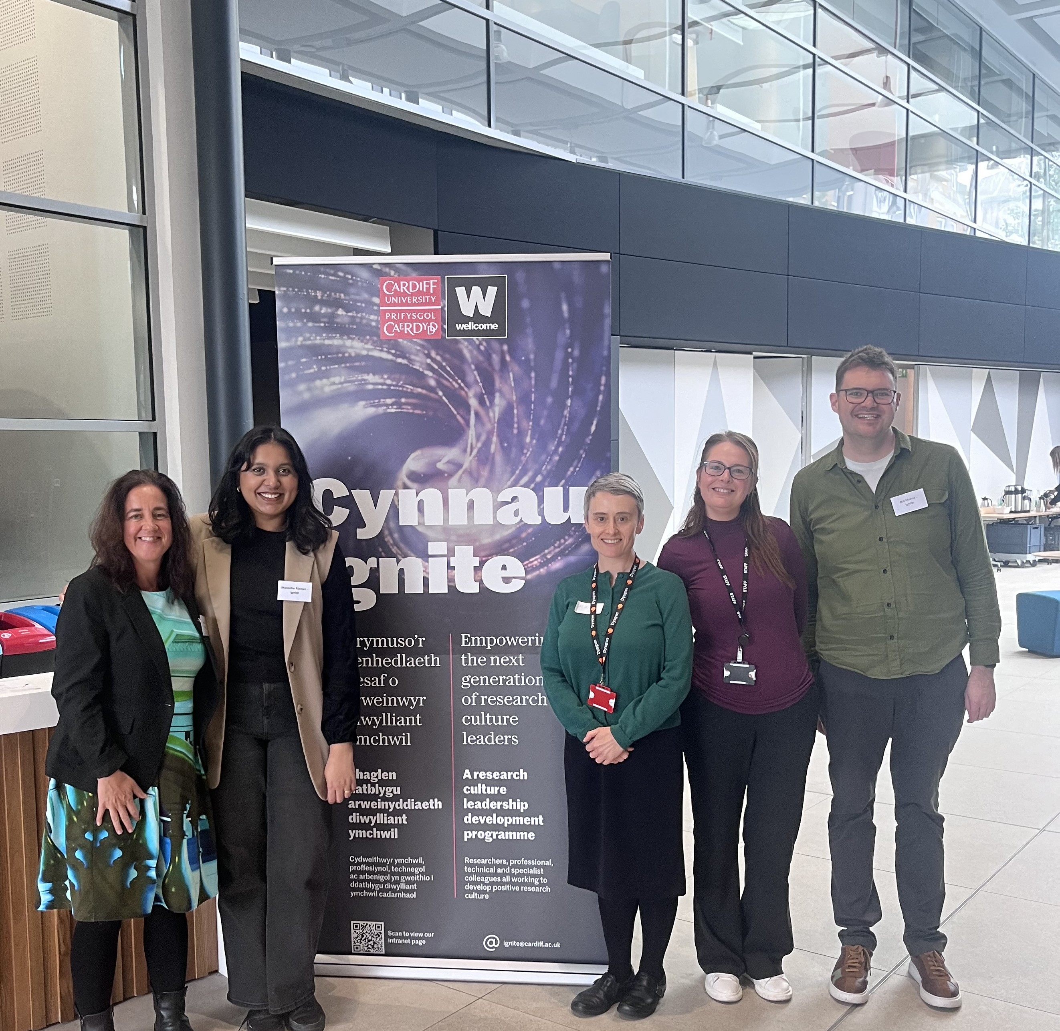

About the Project
Cynnau | Ignite
A two-year Wellcome funded project to pilot and evaluate a multi-stranded leadership development programme focused on empowering people to embody positive research culture values in their day-to-day research and research-support activity.
Key features
A cohort-based leadership development programme (academic researchers, PS, technical and specialist staff)
Small grant awards and funded group projects
In depth academic evaluation
#ARMA2026
Notes:
Mair – Very quick overview
Handover to Nic for the background thinking

Slide 3
Context
The thinking behind the Wellcome bid​
Cardiff’s inaugural research culture survey (2022) informed our bid to Wellcome
Starting point was belief that everyone in our research community creates culture through their collective behaviours
#ARMA2026
Notes:
Nic
Decided our goal should be to promote positive research culture practices through empowerment and leadership development
What? Committed to the individual participant feeling an advancement in their personal capacity
Who? Given our RC action plan was predominantly top down we wanted to foster bottom up change – so we recruited into the pilot members of the research community who might perceive themselves as less powerful:
Included running a cohort of technical, specialist and professional colleagues who enabled research (primarily middle management), Talk to you today.
We also had academic cohorts of Research-only and separately, Teaching and Research colleagues at lower grades.
How? Build community.
We wanted to encourage collaborative sense-making of the material amongst people with broadly similar lived experience at work.
Brought in academics and MPSS staff who exemplified positive cultural leadership (modelling good practice)
Co-investigative team was an equal balance between professional services and academic colleagues

Slide 4
Background
Promoting positive research culture practices through empowerment and leadership development
The intervention
What: a development programme that would benefit the individual
Who: those who might perceive themselves as less empowered and wanting to foster ground up change
How: a programme that would develop the community as well as the individual
#ARMA2026
Notes:
Nic
Mention James Vilares as the PS programme lead
Decided our goal should be to promote positive research culture practices through empowerment and leadership development
What? Committed to the individual participant feeling an advancement in their personal capacity
Who? Given our RC action plan was predominantly top down we wanted to foster bottom up change – so we recruited into the pilot members of the research community who might perceive themselves as less powerful:
Included running a cohort of technical, specialist and professional colleagues who enabled research (primarily middle management), Talk to you today. Grades 5 – 8
We also had academic cohorts of Research-only and separately, Teaching and Research colleagues at lower grades (grades 6 and 7)
Cohort – 5 (14%), 6 (47%), 7 (33%), 8 (2%)
How? Build community.
We wanted to encourage collaborative sense-making of the material amongst people with broadly similar lived experience at work.
Brought in academics and MPSS staff who exemplified positive cultural leadership (modelling good practice)
Co-investigative team was an equal balance between professional services and academic colleagues

Slide 5
Recruitment
Appetite for the intervention
We received 63 applications for this cohort, an oversubscription by 31.
Motivators for applying – Top 5 themes
Leadership development and confidence building
Understanding and shaping research culture
Building networks and breaking silos
Driving positive, inclusive environments
Career and professional growth
#ARMA2026
Notes:
Mair
Open to MPSS colleagues in toles that primarily support research activity
Majority of applications were from research professionals (officers and managers) staff – note lower engagement from technicians in particular. 47 people ultimately completed the programme on main and condensed programmes.
Themes from the ‘why are you applying?’ question
Strong appetite across the board, but strongest appetite from the PS (research professional) community (technicans less, but more opportunities from other sources)
Appetite related to there not being enough development opportunities of this kind for PS staff
Motivators for applying from EOIs – entry aligns closely with evaluation on exit
Clear appetite for Practical tools + peer learning + institutional impact

Slide 6
Delivery
Response to content
Four modules followed by funded group projects
Formative feedback
Valued time for self-reflection on how they contribute to research
Constructive to share experiences
Different experiences of office and lab-based colleagues need to be considered
Liked the facilitated activities
100% said they would recommend the workshops to a friend or colleague
96% attended all workshops
“Huge enthusiasm in the room … PS and technical staff seem to know a lot about research culture!”
#ARMA2026
Notes:
Mair

Slide 7
Funded projects
Projects were their response to the content
Visibility & Expertise
Directory of expertise
AI to grow open research culture
From silos to synergy (research culture challenges across academic and PS staff)
Culture & Working Environment
Better recruitment at Cardiff
Voice of PS staff on precarious contracts
Wellbeing for research culture
#ARMA2026
Notes:
Mair
Their response to the content – the projects they chose to do
Seeing opportunity to do things better and opportunity to give a platform to their experience and expertise
Evaluation tells us projects were important to the community – felt valued by having the funding to explore projects based on their expertise / things that are important to them
Visibility / Expertise / Culture and working environment
Handover to Charlotte

Slide 8
Leadership development was an effective and novel route into research culture training
Participants were drawn to a leadership development programme
They became increasingly interested in research culture throughout the programme
Research professionals were frustrated by a lack of leadership training opportunities, but when given the opportunity…
They were highly motivated and engaged in the programme
But perceived a lack of power to create change
#ARMA2026
Notes:
PSTS cohort consisted of Research Professionals? Technicians and Specialists. The following eval findings refer specifically to research professionals…
Our evaluation found viewing research culture through the lens of leadership development was a great way to boost engagement with research culture. All cohorts were initially drawn by the opportunity to take part in leadership development training, believing research culture was a novel idea. However, leadership development acted as the hook that encouraged participation and as the programme progressed, participants began to develop a stronger interest in research culture and its relevance to their own roles.
A theme that came through strongly during interviews was frustration at the lack of comparable training opportunities offered by the university for research professionals. It was clear that there is a prominent gap for staff in these roles. However, when they are given the opportunity to participate in Ignite, this cohort received the highest number of expressions of interest and were the most engaged cohort throughout both Ignite itself and our evaluation. However, they felt they lacked the power to create meaningful change.

Slide 9
Career pathway specific training was preferred, but cross-community networking matters
All participants valued having time and space for reflection
Career pathway specific training was relevant and useful
Training alongside others in similar roles created a safe space for discussion
Participants wanted more opportunities for cross-community networking
#ARMA2026
Notes:
Across all cohorts, participants particularly valued having dedicated time and space for reflection. This was seen as a critical benefit of the programme, allowing them to reflect on their roles, experiences, and professional development.
Ignite received mixed feedback from stakeholders about separating cohorts for delivery, however participants were strongly in favour of this approach and reported that the career pathway-specific training was relevant and useful. Research professionals in particular noted that being grouped with colleagues in similar roles helped create a safe environment for open and sometimes sensitive discussion of perceived hierarchical issues.
At the same time, participants across all cohorts would have welcomed more opportunities for cross-community networking. They felt this would have helped build a better understanding of each other’s roles and strengthened connections across the community.

Slide 10
What did research professionals take away?
They felt more empowered and confident in their leadership potential
Cynnau | Ignite:
Encouraged self-awareness and confidence
Promoted positive, inclusive and collegial practices at work
Did not lead to short-term change in research culture practices, but lay groundwork for long-term, sustainable change for individuals and Cardiff University
#ARMA2026
Notes:
At the start of the programme, the PSTS cohort reported feeling less empowered than other cohorts to influence research culture change. They described perceived hierarchical barriers and a sense of limited power to make change.
By the end of Ignite, this group reported a clear boost in empowerment and confident. Participants felt more aware of their own leadership potential, and better able to recognise the role they could play in shaping research culture. This was a distinctive impact for the PSTS cohort that was not seen in the same way across the other groups.
Ignite also encouraged greater self-awareness, reflection, and listening behaviours, both inside and outside work.
However, while participants described important individual-level changes, we did not see significant measurable changes in positive research culture practices over the evaluation period. This was aligned with participant expectations, as many emphasised that research culture change takes time, however many participants felt Ignite had the potential to lay the groundwork for long-term, sustainable culture change.

Slide 11
Evaluation Insights
There is an appetite for research culture training, particularly when presented alongside leadership development
Giving research professionals the opportunity to participate in leadership development programmes is highly beneficial and can generate interest in research culture
Tailoring delivery to career pathways is important, but so is networking
Research culture training programmes can be highly beneficial for individuals and organisations, but culture change takes time
#ARMA2026
Notes:
This work has led us to several broad insights relevant for future programmes like Ignite.
First, leadership development can be a highly effective way to engage colleagues with research culture. Presenting Ignite through the lens of leadership development helped attract participant applications and sustain engagement. Ignite also highlights the significant appetite for research culture training among HEI staff, particularly research professionals who would appreciate more training opportunities.
Second, delivering training that is specific to each career pathway is important because it boosts its relevance and usefulness. For research professionals in particular, training alongside their peers in similar roles helps create a feeling of psychological safety, but this should be balanced with opportunities for cross-community networking.
Third, programmes like Ignite can support meaningful individual-level change, boosting participants’ confidence, empowerment and awareness of their own leadership potential. However, wider culture change requires time, sustained support and organisational commitment, and is unlikely to be realised in short term programme evaluation.

Slide 12

Thank you
Any questions?
Contact: Vilares@Cardiff.ac.uk

