Slide 1



From Silos to Synergy
Lessons from EDI in Transforming Interdisciplinary Collaboration
Cristina Vazquez Martin
InFrame Project Coordinator
University of Glasgow

Slide 2


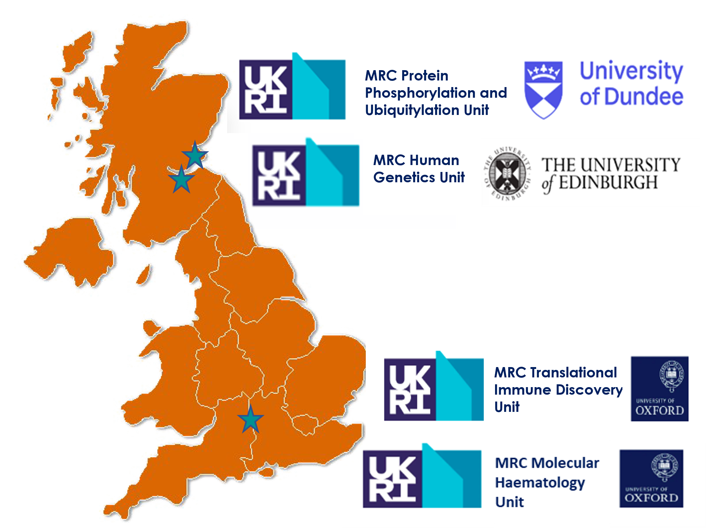
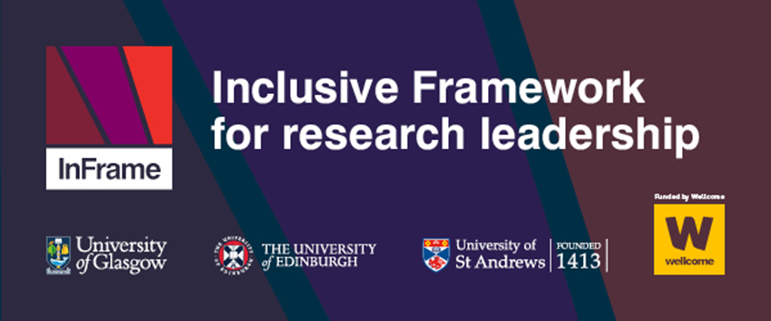
Grounding the Work
Interdisciplinary Research Network
Removing Barriers to Interdisciplinary Research (IDR)
Creating a Collegial Model of Leadership

Slide 3

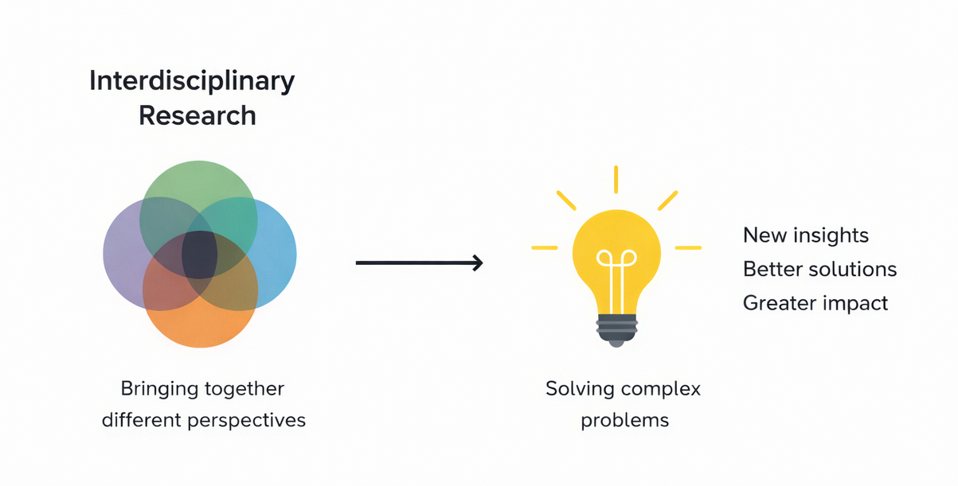
Why Interdisciplinary Research Matters
“Interdisciplinary research achieves outcomes
that cannot be achieved within a single discipline”
UK Research Excellence Framework (2021)
Different perspectives
Complex challenges

Slide 4
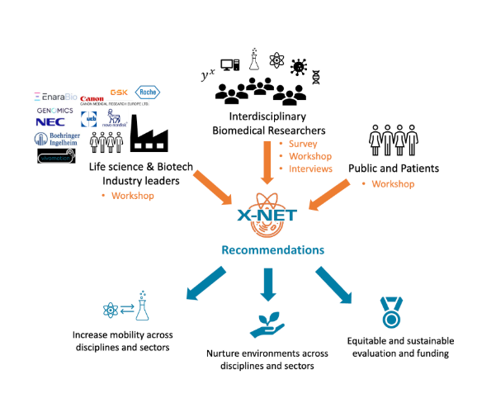
X-Net: Aims and Approach
Building a network of interdisciplinary researchers
Developing recommendations for funders and policymakers
www.x-net.bio

Slide 5
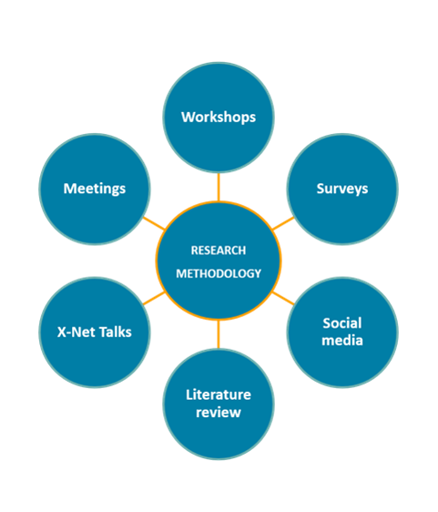
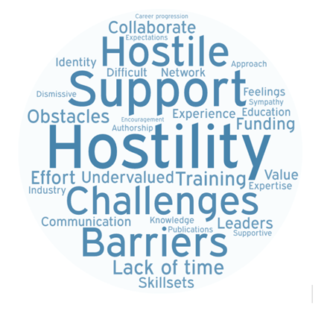
Our Research Approach
Over 60% of researchers reported negative experiences when working across disciplines (n=76)
www.x-net.bio

Slide 6
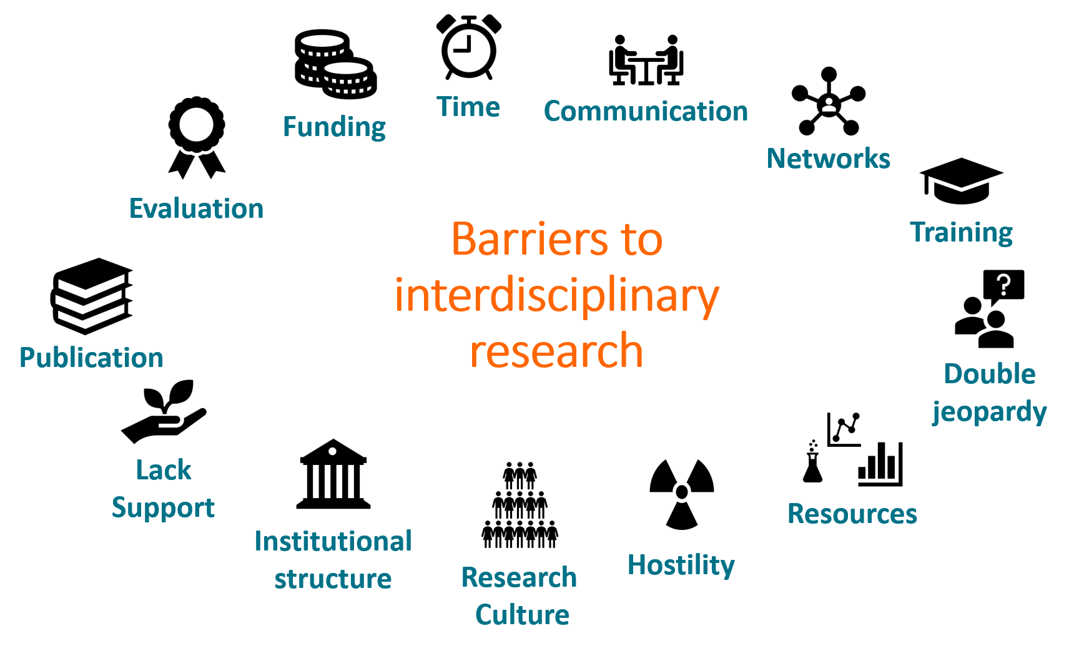
Challenges in Interdisciplinary Research
www.x-net.bio

Slide 7
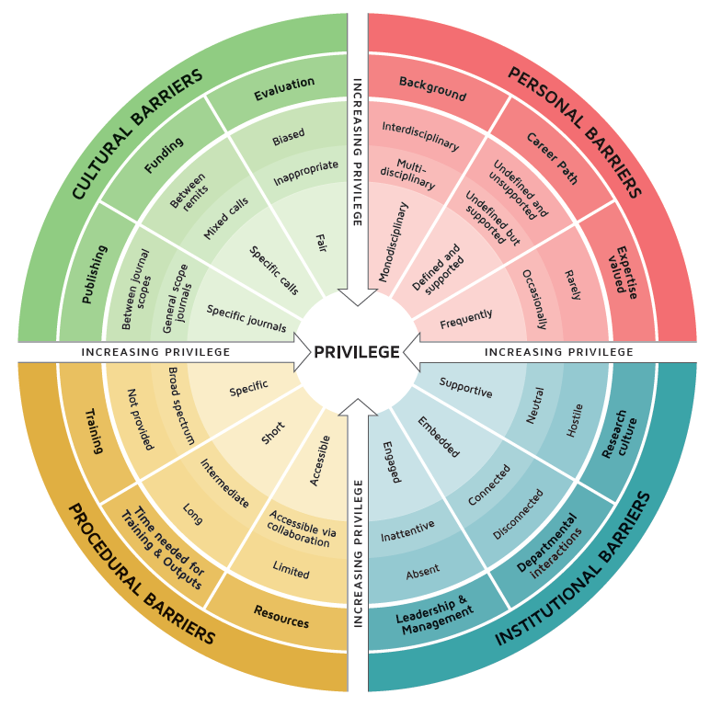
Interdisciplinary Research Wheel of Privilege
www.x-net.bio

Slide 8
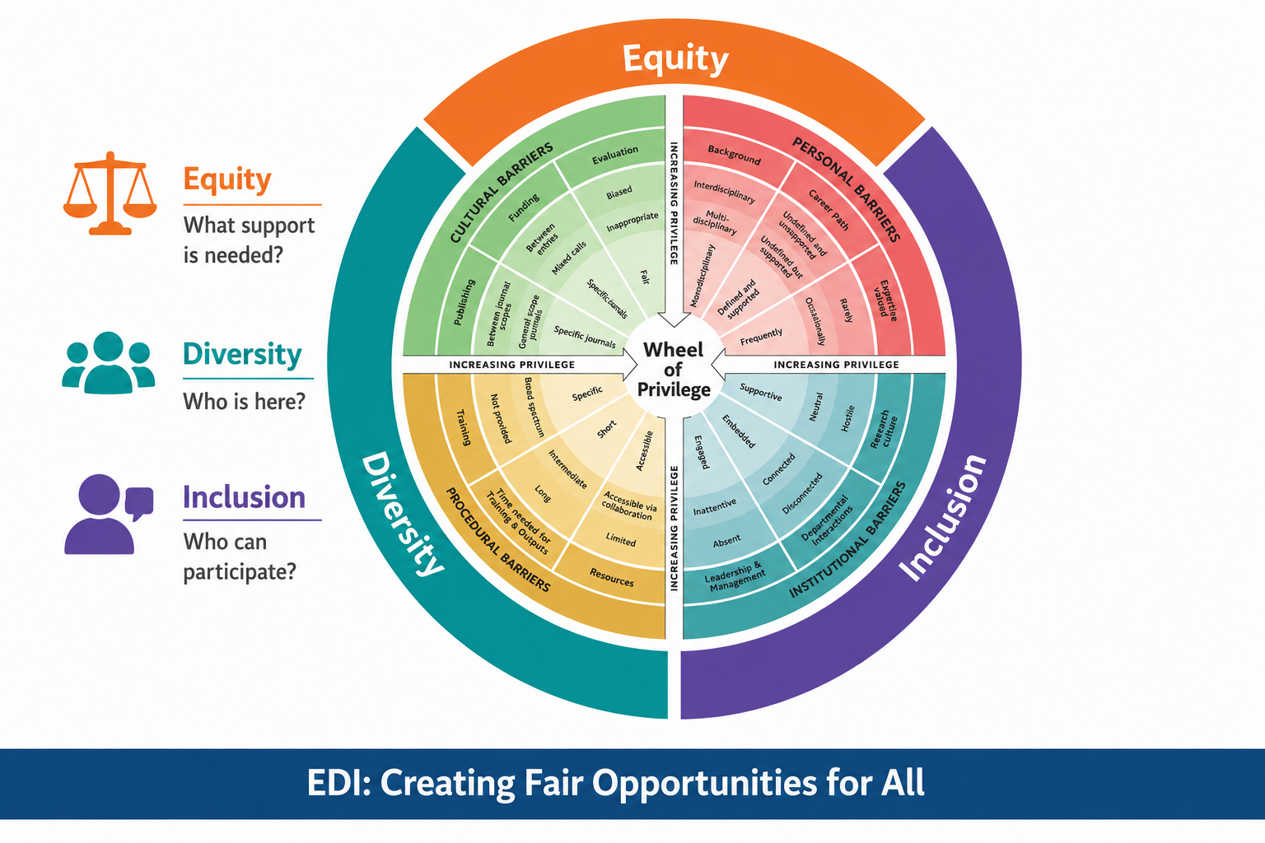
EDI (Equity, Diversity and Inclusion) as a condition for successful IDR
www.x-net.bio

Slide 9
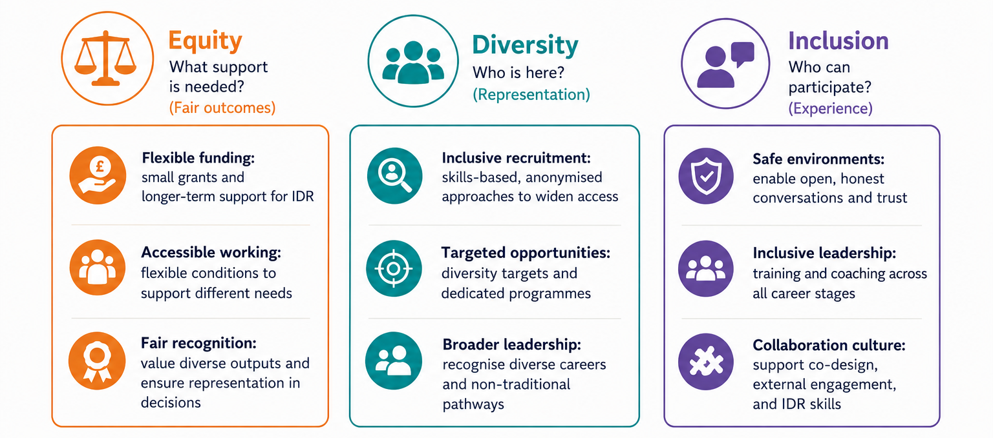
EDI in Practice, Enabling IDR
www.x-net.bio

Slide 10







InFrame, a New Model for Research Leadership
University of Edinburgh
University of St Andrews
University of Glasgow
www.inframeproject.org

Slide 11
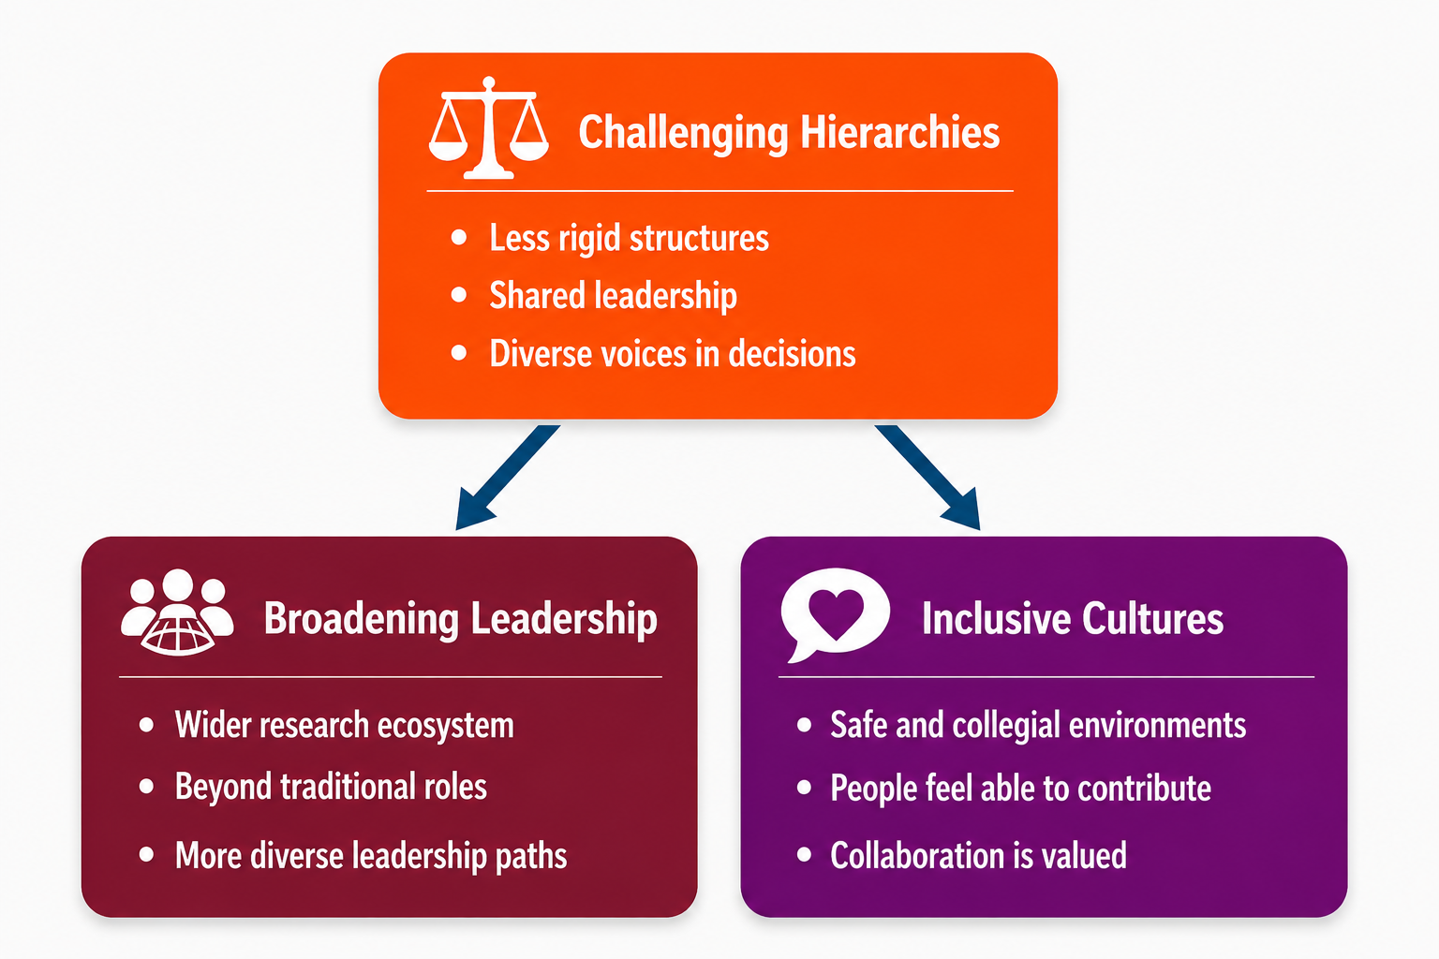
InFrame, a New Model for Research Leadership
www.inframeproject.org

Slide 12


Thank you
Find out more
X-Net and InFrame teams
Our collaborators, partners and research communities
Industry contributors, PPI groups, interdisciplinary researchers
Universities of Dundee, Oxford, Edinburgh, St Andrews and Glasgow
MRC and Wellcome
www.x-net.bio
    Thank you to everyone who contributed their time,
    insights, and care to this work
www.inframeproject.org

