Slide 1
HEALTHY IMPACT STRATEGY WORKBOOK
Dr Julie Bayley
Director of Research Impact and Culture & Associate Professor
Northeastern University London
julie.bayley@nulondon.ac.uk

Slide 2

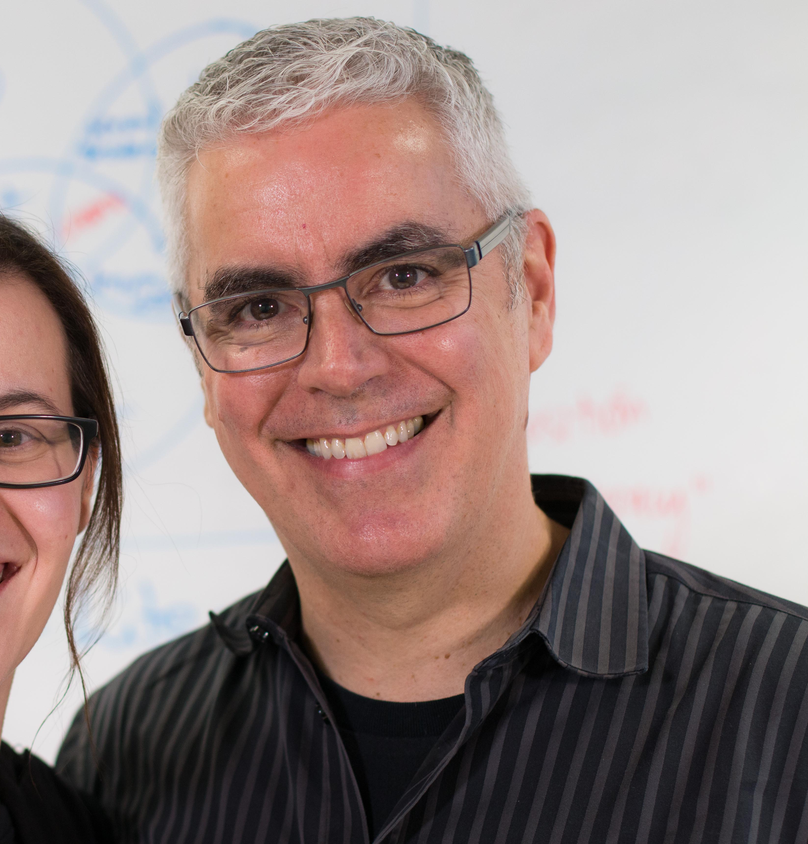
The Journey (so X-Factor, I know, I’m ashamed of me too)
Research -> societal benefit always around, but catapulted with weight into UK sector in REF2014
People tasked to do impact, not always with sufficient chance to understand how to deliver it or how it fitted with their work
  →Tensions, misunderstandings, myths, unreasonable expectations, feelings of failure
I’m here, but this is as much of my face as you need at 9.30 in the morning
Dr David Phipps, Director – Research Impact Canada

Slide 3

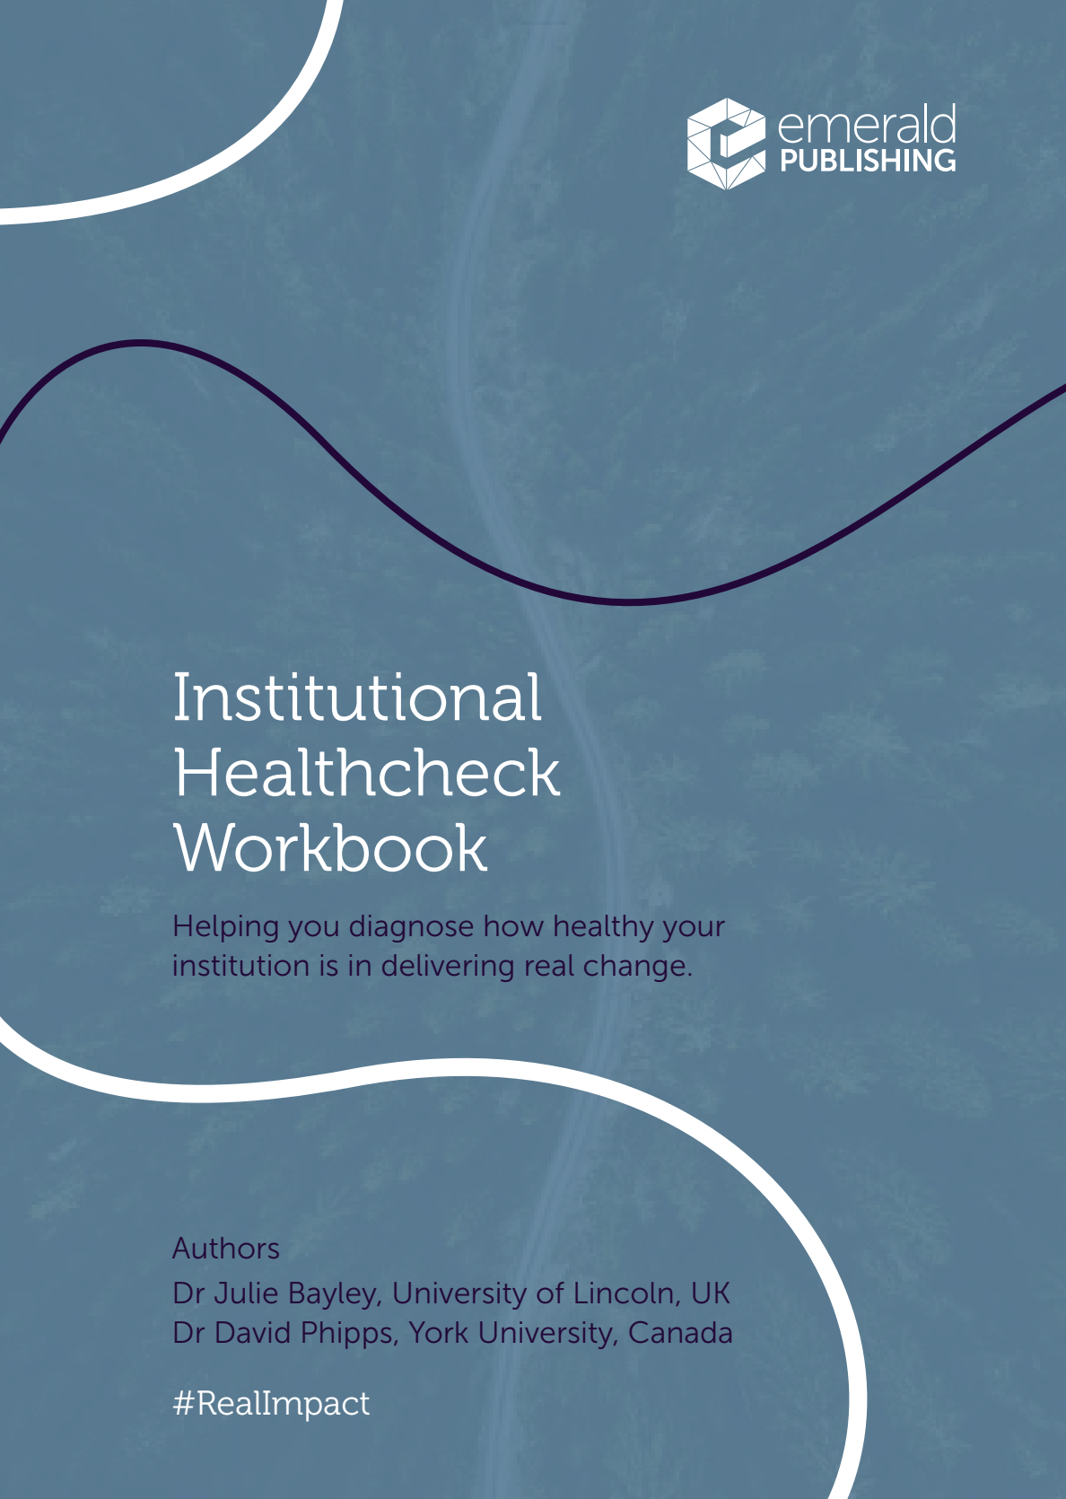

Individual level support not enough
Healthy institution: clarifies, creates, values, and supports the conditions needed to deliver impact, staff confident in impact
Unhealthy institution: expects but does not support impact, fragmented activities, blame culture, lack of staff confidence
Notes:
A healthy impact institution clarifies, creates, values, and supports the conditions needed to deliver research impact beyond academia. It recognises that impact requires sustained effort, investment in skills and capacity, strong external relationships and coordination, and establishes a positive supportive culture with impact-literate staff. An unhealthy impact institution expects impact without creating the capacity, skills, coordination, or strategic clarity needed to achieve meaningful change. It treats impact as an afterthought, disregards the need to build strong external relationships, and has a compartmentalised, fragmented, negative culture with staff unconfident about their contribution. In practice, healthy and unhealthy operate along a continuum, and an institution’s current footprint may reflect an early or emerging approach to impact, differing institutional priorities, or practical limitations in time, infrastructure, and resource.
An impact strategy sets the foundations for institutional efforts. At its best, a strategy provides a clear basis for healthy impact practice, signalling pursuit of meaningful benefits through shared and recognised action. At its worst, a poorly conceived strategy legitimates unhealthy practices, prioritising reputational gain over meaningful societal benefit and encouraging performative rather than purposeful activity. In doing so it can overlook the actual skills and capacity needed and weaken the conditions needed to deliver on goals.
Values are foundational, not tokenistic
Practicalities are recognized
Surfacing risks is welcomed not penalised

Slide 4
Amid many (and many competing) pressures, impact is often:
Tagged onto research strategies & research process
Set as ambition without attention to labour
Expressed as reputation & countable endpoints rather than societal change
Displaced by more urgent / ‘traditionally prestigious’ activities
Measured without recognition of individual contributions
Notes:
Tagged onto research strategies
Tagged on to the research process (‘later’)
Set as ambition without attention to labour, skills & capacity - unchanged even when staff are lost
Expressed as reputation rather than societal change Reduced to countable endpoints
Displaced by more urgent or traditionally prestigious activities
Measured without recognition of individual contributions

Slide 5

Efforts misalign without strategy
Activities scattered & people unclear on contribution
Pressure blurs good intent
People hold up intent at personal cost
Strategies can be “interestingly ambitious”
Magic beans
(Thanks ARMA SIG)

Slide 6
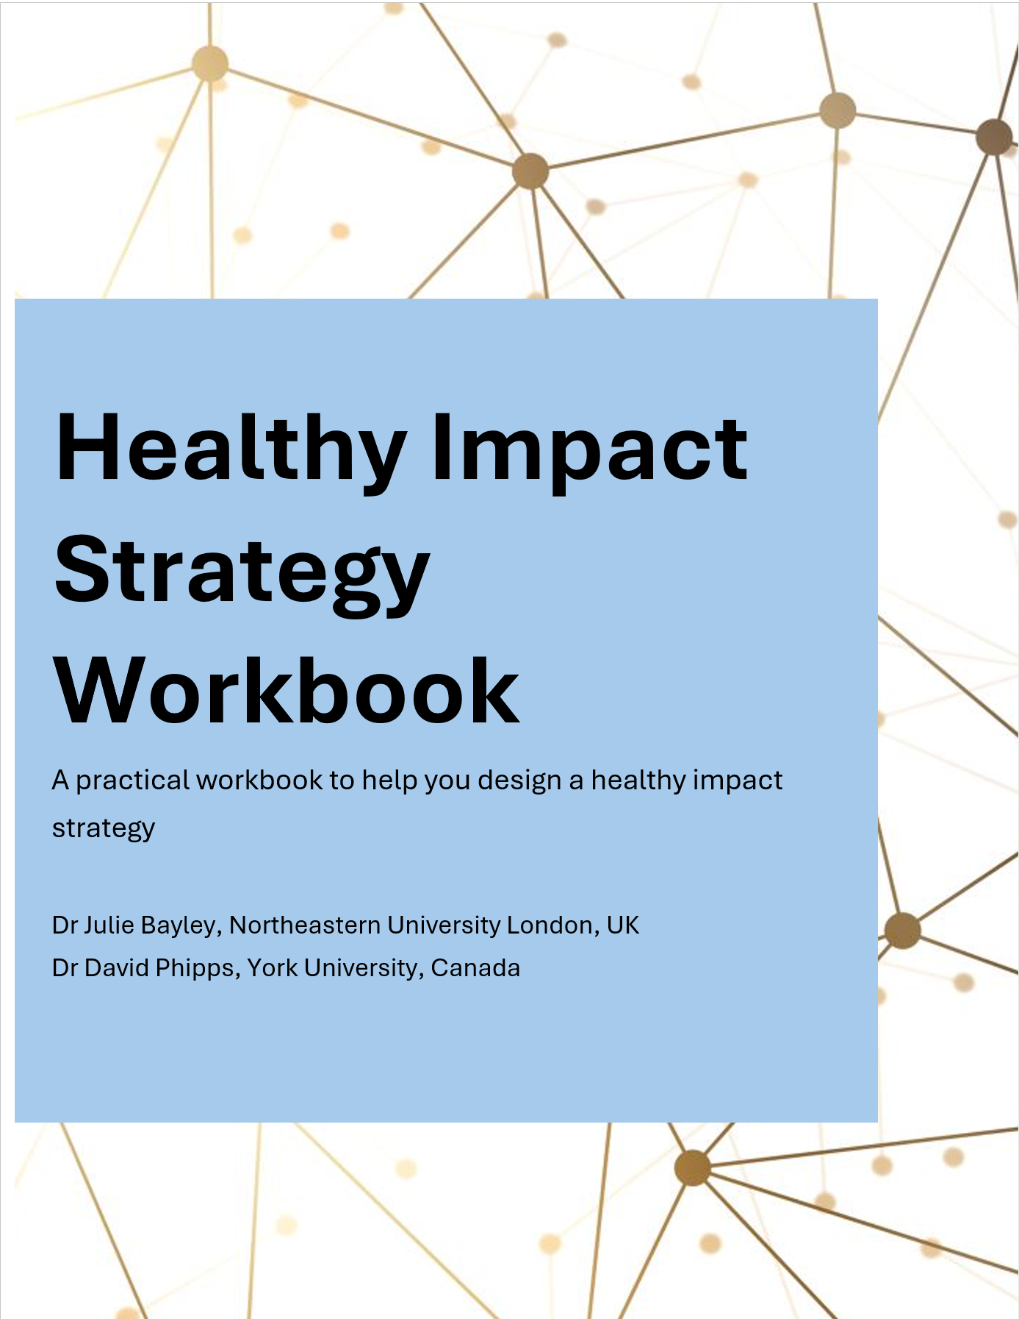
We need healthy strategic foundations
Set focus, scope and boundaries in a landscape of endless possibilities
Clear basis for healthy impact practice
Avoid legitimatising unhealthy practices
No one size fits all
Upcoming:
Implementation workbook
Ta daaaa!
Ta daaaa pending
Notes:
https://researchimpact.ca/resources/healthy-institutional-impact-strategy-workbook/

Slide 7

UPCOMING DISCUSSION
What needs clarifying strategically in your context?

Slide 8
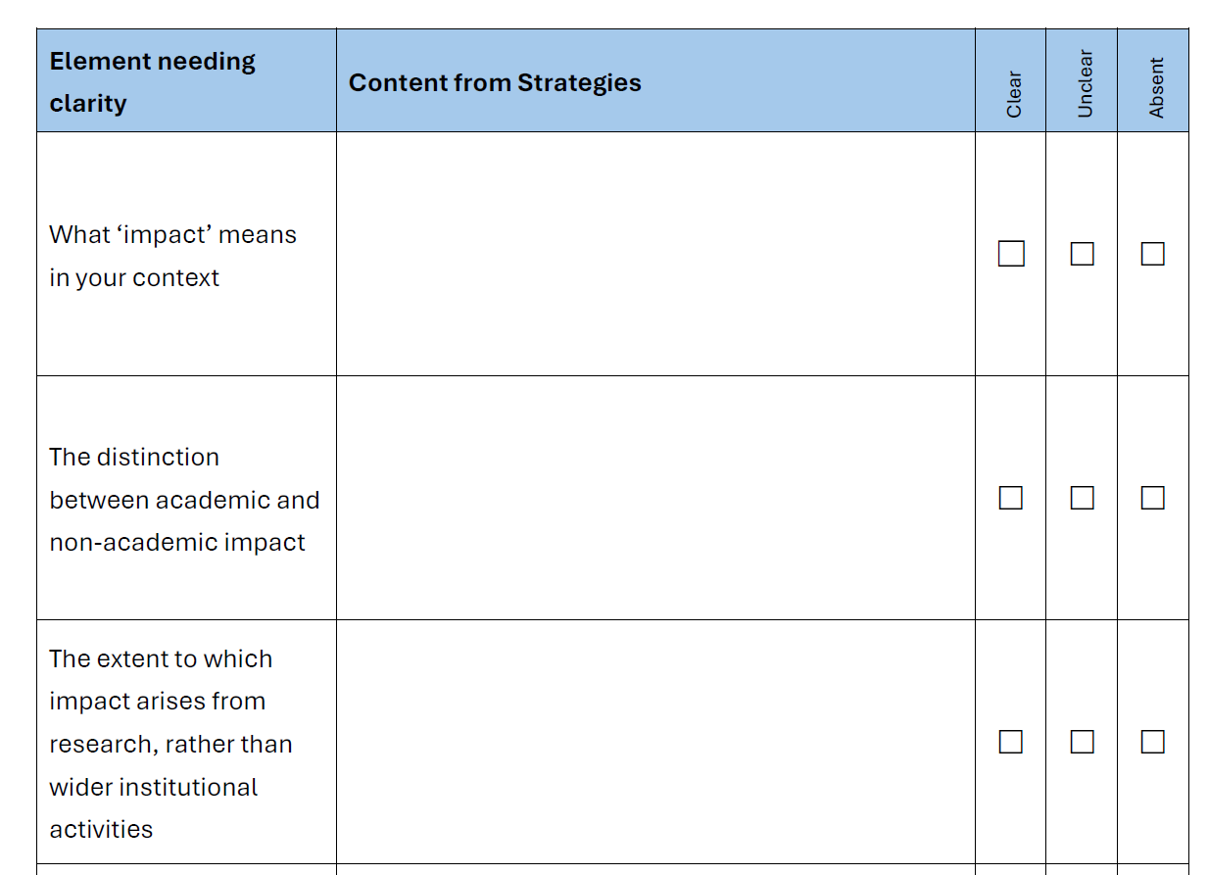
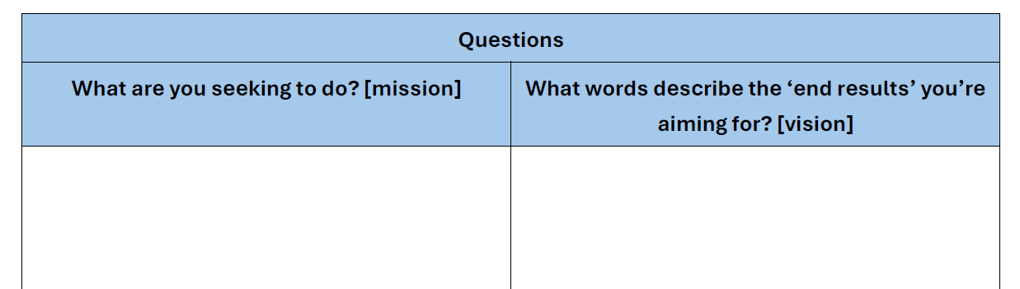
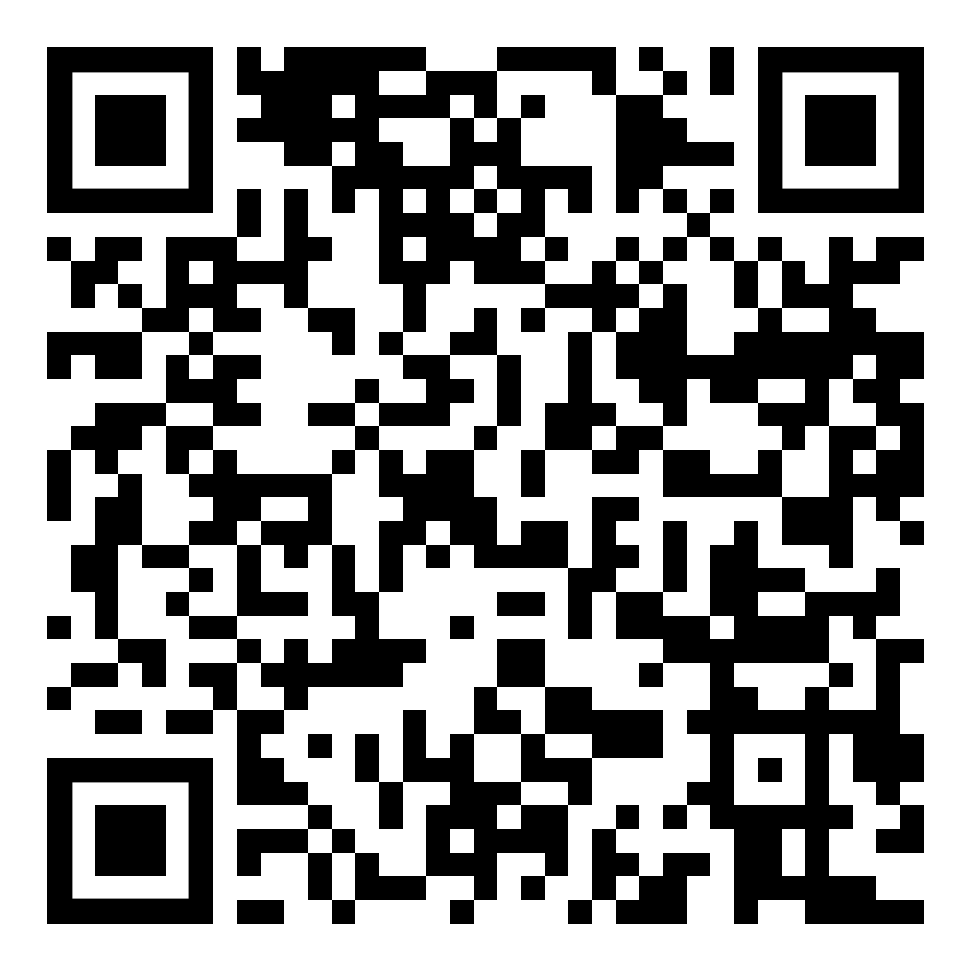
Healthy Institutional Impact Workbook
Flexible template
  Establish your starting point
  Step by step guide to build strategy
        Description + examples + questions + health warnings
  Blank Impact Strategy
Pdf and editable word
For anyone wanting to set a strategic approach
**Engage as widely as possible**
Available via Research Impact Canada
https://researchimpact.ca/resources/healthy-institutional-impact-strategy-workbook/

Slide 9
Scope: What and who it covers
Mission or vision: Your ambition
Values: Principles which guide your work
Approach: How impact will be delivered (high level)
Roles and responsibilities: Accountability (high level)
Strategic goals: Priorities
Measures of success: Demonstrating (and what counts as) achievement
Available via Research Impact Canada
https://researchimpact.ca/resources/healthy-institutional-impact-strategy-workbook/

Slide 10
Scope: What and who it covers
Mission or vision: Your ambition
Values: Principles which guide your work
Approach: How impact will be delivered (high level)
Roles and responsibilities: Accountability (high level)
Strategic goals: Priorities
Measures of success: Demonstrating (and what counts as) achievement
Available via Research Impact Canada
https://researchimpact.ca/resources/healthy-institutional-impact-strategy-workbook/

Slide 11
Scope
“This strategy covers non-academic impact arising from our research”
Parameters
Coverage of the strategy (who/what)
What impact means in this context
Clarifies the basis of the impact
Sets any boundaries and focus
Conflating academic influence with societal change may breed conflicting expectations or misdirected activity
What are the parameters needed for your strategy?
Available via Research Impact Canada
https://researchimpact.ca/resources/healthy-institutional-impact-strategy-workbook/

Slide 12
Mission or vision
“People able to live healthy, independent lives free from stigma, with fast and equitable access to health services, effective treatment and dignified care”
[vision]
Mission: what you are seeking to do and the meaningful contribution you aim to make
Vision: a clear picture of the future that the institution is striving to help create
For impact the mission and vision needed to extend beyond research outputs & into real-world change.
What are you seeking to do? [mission]
What are the ‘end results’ you’re aiming for? [vision]
Available via Research Impact Canada
https://researchimpact.ca/resources/healthy-institutional-impact-strategy-workbook/
Notes:
People able to live healthy, independent lives free from stigma, with fast and equitable access to mental health services, effective treatment and dignified care.

Slide 13
Values
Values:
Relational (e.g. coproduction)
Ethical (e.g. social justice)
Impact (e.g. sustainable change)
Learning (e.g. shared)
Research (e.g. interdisciplinary)
Principles shaping approaches, goals and decision making, e.g.:
  How you work with others
  Equality, diversion and inclusion
  Research diversity
  Environmental sustainability
May include the choice not to work with certain industries/sectors
Values need to be foundational and operationalised, not aspirational, tickbox or tokenistic.
What are values that not only guide you, but are the foundations of your approach?
Available via Research Impact Canada
https://researchimpact.ca/resources/healthy-institutional-impact-strategy-workbook/

Slide 14
Approach
Impact is primarily driven through industrial partnerships with our Research Institutes
High level statement of how impact will be delivered, e.g.
  Paths you want to prioritise (if any)
  Paths you welcome
  Paths you do not welcome (if any)
  What research and what personnel are prioritised (if any)
Resource limitations may create pressures on what gets prioritised.
Taking a strategic stance early on can help preserve approaches & manage tension.
How can you best characterise your approach to impact?
Available via Research Impact Canada
https://researchimpact.ca/resources/healthy-institutional-impact-strategy-workbook/

Slide 15
Roles and Responsibilities
This strategy is overseen by the Pro-Vice Chancellor for Research and Innovation.
High level responsibility
Clear accountability for direction, coordination & delivery
Clarifies oversight and governance.
May be a single individual or combination of roles & committees
Need to align responsibility with who has authority and understanding of the area
Who is responsible for impact in your context?
Who has overall responsibility?
Available via Research Impact Canada
https://researchimpact.ca/resources/healthy-institutional-impact-strategy-workbook/
Notes:
Supports continuity amid staff changes

Slide 16
Strategic goals
“Embed impact within institutional systems, structures and processes, ensuring impact is systematically integrated from the outset of all research”.
Clear priorities to move institution in the right direction
Enable and define meaningful progress
Set a basis for organising activities & monitoring
Temptation to frame goals around reputation rather than societal change.
What are your strategic goals? What major step changes do you want to achieve?
Available via Research Impact Canada
https://researchimpact.ca/resources/healthy-institutional-impact-strategy-workbook/

Slide 17
Measures of Success
“100% of research and research management staff are trained in impact, with annual cohorts for impact leadership”
How you’ll recognise – and what counts as - achievement
Qualitative and quantitative
Ensuring evaluation focuses on what matters not what’s easiest to measure.
Risk of seeking out what can be counted, rather than what counts. Need to avoid inappropriate endpoints, irresponsible use of metrics & conflating reputational markers with societal change
What are your markers of success?
Available via Research Impact Canada
https://researchimpact.ca/resources/healthy-institutional-impact-strategy-workbook/

Slide 18
DISCUSSION
What needs clarifying strategically in your context?
Scope (parameters)
Mission or vision (ambition)
Values (principles)
Approach (how)
Roles and responsibilities
Strategic goals (priorities)
Measures of success
Available via Research Impact Canada
https://researchimpact.ca/resources/healthy-institutional-impact-strategy-workbook/

Slide 19
Final thoughts and next steps
Healthy impact practice depends not simply on having a strategy but on the extent to which that strategy is meaningfully implemented and supported across the institution.
Next steps
Please use!
  Feedback – form available
Redeveloping with Emerald Publishing
Develop the Implementation plan
Available via Research Impact Canada
https://researchimpact.ca/resources/healthy-institutional-impact-strategy-workbook/

Slide 20
Thanks!
Questions?
Download the Workbook from Research Impact Canada (under Resources):
https://researchimpact.ca/resources/healthy-institutional-impact-strategy-workbook/
Email: Julie.bayley@nulondon.ac.uk

