Slide 1


Designing robust and purpose-led evaluation plans
A practical template for research managers
Dr bridget sealey, sealey associates ltd
Dr jenny spear, university of york

Slide 2
What we will talk about today
Principles for thinking through research impact evaluation (Bridget)
Delivering research impact evaluation in practice (Jenny)
Introducing an evaluation planning template (Bridget and Jenny)

Slide 3
Why bother?
Renewing or bidding for new funding
Research Excellence Framework
Reporting and accountability
Protecting activities and services
Learning and continuous improvement
Optimising investments/ prioritization
Ensuring equality, diversity and inclusion

Slide 4
The challenge
Where do we start?
What should we measure?
How do we choose methods?
How much is enough?
Where will I find the time?!
Who needs to be involved?

Slide 5
Two Key frameworks
Abudu et al (2022): clarity, indicators, methods, engagement, action and learning
Centre for cultural value (2021): beneficial, robust, people-centred, connected

Slide 6
A structured approach
Start with purpose
Set the stage for analysis
Align with context and audience
Use a theory of change or logic model to help you visualize and plan
Focus on outcomes and associated indicators
Choose proportionate methods that will actually help you answer the question!
Consider how you will share and embed the learning
Separate attribution from contribution

Slide 7
Method choices: benefits and trade offs
Interviews and focus groups
Deeper qualitative insights (useful for indicators like behaviour, organisational or social change)
Surveys
Useful for gathering quantitative data
Time efficient
Creative and collaborative methods
Ripple effects mapping
Theory of change workshops
Targeted
Participants often report benefit
Allows greater anonymity
Story telling using mixed media
Participants often report benefit
Useful when looking at larger groups
Participants can fit it in within their life
Can be a power leveller (with careful facilitation)
Trade off: Time consuming, interviewer bias
Trade off: Hidden nuances, no real-time clarification
Trade off: Logistical complications, facilitator dependent

Slide 8
Delivering research impact evaluation in practice
Dr jenny spear, university of york

Slide 9
Harmonised UKRI Impact Accelerator Account Evaluation (1)
Why were we evaluating?
What did success look like?
To assess and capture
Performance against programme objectives
How well organisational strategic priorities were being addressed
Opportunities for operational improvements
Programme successes - reporting and future funding
A report that
critically examined how the programme’s aim were being met
identified the benefits within and beyond the UoY
examined delivery processes and governance
provided recommendations for improvements
A suite of case studies
to demonstrate success and points of learning

Slide 10
Harmonised UKRI Impact Accelerator Account Evaluation (2)
What evidence?
Choosing methods
Extensive review of core documents to confirm original objectives and current organisational goals
UKRI IAA proposals, surveys & reports
Institutional Strategies & Policies
We only gathered new data where gaps existed
The evaluation process comprised:
1) a desk review of written information (e.g. applications, reports, policy reports, call guidance, publications, policy outputs); and
2) a set of semi-structured interviews with academic and research office staff and some external stakeholders - cognisant of EDI best practices

Slide 11
Harmonised UKRI Impact Accelerator Account Evaluation (3)
Timing & context
Reporting & use
Intended to support end of programme reporting and preparation for next tranche of funding
Planned activities sensitive to periods of heavy workload and pressures within the sector
Effective use of in person and online meetings
Hindsight……
Intended audience:
Impact fund managers
Internally distributed funding team
Research & innovation leadership (PS & academic)
Intended use:
Programme reporting
New funding application
Resource planning

Slide 12
Takeaways/ Lessons Learnt
The Representative Voice: Prioritising a truly representative cohort over just the "keen and eager" participants.
Data Maximisation: Recognising the immense value of existing data to save time and administrative effort.
Capturing Serendipity: Creating space within the evaluation to catch unexpected insights and opinions.
Adapting to Change: Acknowledging shifting priorities (leadership changes, sector stability) and documenting the "why" behind them.
External Value: Benefiting from the objective lens of an experienced, independent evaluation group.

Slide 13
Evaluation planning template

Slide 14
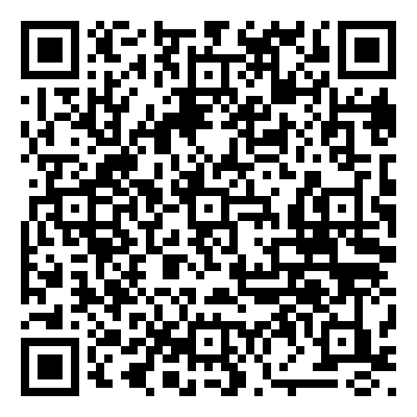
Evaluation planning template

Slide 15
Evaluation planning template
Why are you evaluating?
What does success look like?
What evidence would convince you?
Choosing methods
Timing and context
Reporting and use
TASK
Talk in threes about an evaluation you are planning or thinking about.
Share with each other the purpose for the evaluation and how what you have heard today might inform your plans. If you don’t have an evaluation planned, but might in future, how might this template support you?
And do raise your hand if you want us to come over and answer questions ☺

