Slide 1

From Horizon2020 to Horizon Europe: Lessons learnt so far in Financial Compliance and Audit
Jonathan Gray, LEES Accountants
Keri Dunning, University of Leeds

Slide 2


Introduction
Jonathan Gray FCCA - LEES Senior Grant Audit Manager
Specialist grant auditors
Offices in London, Norwich and the South of England
High profile client base with international coverage
50 staff including a dedicated grant audit team
Keri Dunning – Senior EU Post Award Research Administrator, University of Leeds
Central support team for all EC funded research
Supports University faculty offices and academic community
Worked on large portfolio of projects from FP6 through to current Horizon Europe programme (via UKRI)

Slide 3

Agenda
🔍 Horizon Europe audit requirements (highlighting differences from Horizon 2020)
⚠️ Common pitfalls for non-compliance & best practice
🤝 Challenges working across support functions
🛠️ Institutional tools and strategies in preparation for audit
💬 Q&A session
📊 SIG survey – ideas for future SIG activities

Slide 4
ARMA App
Answer our poll question!
  What’s your biggest financial compliance concern in EC-funded Horizon Europe?
Use the Q&A Function to add your own question

Slide 5
Key differences H2020 to Horizon Europe
Audit thresholds:
Horizon Europe
  End of grant – when all costs (including indirect costs) exceed €430,000.00
  Systems and Processes audit by EC threshold raised to €725 000.00 – invited by EC
Horizon:2020
  End of grant – when direct costs EC exceed €325,000.00
Additionally, European Commission can audit a project at any time during the project and up to 2 years after the final payment is released
European Court of Auditors can also audit the European Commission, via funding recipients, at any point up to 5 years after the final payment is released.

Slide 6
Key differences H2020 to Horizon Europe
Personnel calculations
  Audited based on one daily rate used per reporting period
  Calculation must be done for all staff regardless of % FTE – possibility that you may not be able to recover full cost for someone working 100% (due to how reporting period falls vs annual leave etc)
  Maximum declarable days = 215 days per year. Pro-rata for part time staff. Ensure you round up or down to nearest half day, for example 18 months reporting would total 322.5 days, 3 months reporting would total 54 days (53.75 rounded up)
  To calculate the day rate per person you use the following formula:
      [actual personnel costs during the months of the reporting period]
      Divided by
      [maximum declarable day equivalents]

Slide 7
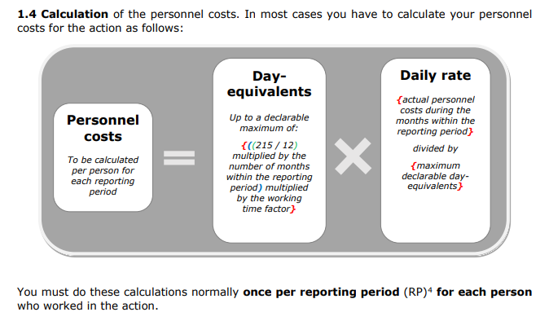
Key differences H2020 to Horizon Europe
Personnel calculations
  You then use this daily rate and the days recorded on the staff member’s timesheet/day declaration to calculate the cost to claim from the EC:

Slide 8
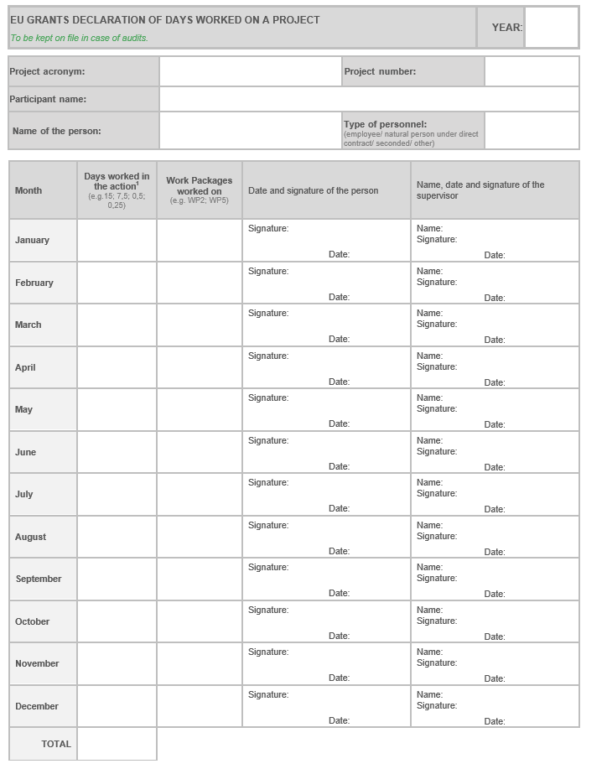
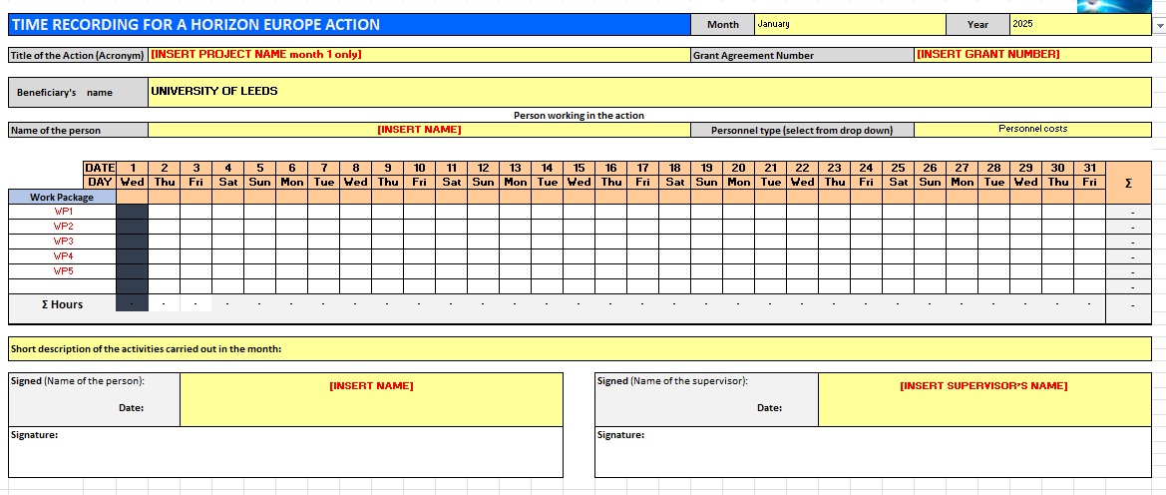
Key differences H2020 to Horizon Europe
Timesheets
  Can use a timesheet recording hours per day then converted into days for the purpose of the salary reconciliation
  [Or] can use a day declaration recording number of days worked per month

Slide 9
Converting hours into days
⏱️ Three permitted conversion methods
Method | How to calculate | When to use / Conditions
① Fixed conversion | 1 day = 8 hours | ✅ Suitable where there is no contractual daily reference or no standard annual productive hours. ✅ Simple default option. ✅ Must be applied consistently for the relevant staff category.
② Contract-based conversion | Average contractual hours per working day (e.g. 37.5 hrs/week ÷ 5 days = 7.5 hrs/day) | ✅ Based on the person's employment contract. ✅ Must be applied consistently.
③ Standard annual productive hours | Standard annual productive hours ÷ 215 (e.g. 1,600 ÷ 215 = 7.44 hrs/day) | ✅ Uses the organisation's usual standard annual productive hours. ✅ Standard productive hours must be at least 90% of the standard annual workable hours. ✅ Must be documented in the institution's normal practice and applied consistently. ❔Employment contract?

Slide 10
Personnel Costs - Rounding
  Time should be recorded accurately in hours (or the institution's normal unit of time). Rounding is applied only when declaring day-equivalents for the reporting period – not when recording time worked.
✔️ Correct Approach
✔️ Record actual time worked throughout the reporting period.
✔️ Convert total hours to day-equivalents
✔️ Round only the final total declared for the reporting period to the nearest half-day.
✔️ Retain the underlying detailed records to support the calculation in the event of an audit.
❌ Avoid
❌ Rounding individual daily time entries.
❌ Rounding each timesheet entry before summing.
❌ Applying repeated rounding throughout the reporting period, which can over- or under-state the total eligible time.

Slide 11

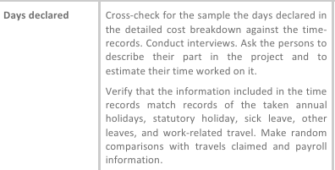
Key differences H2020 to Horizon Europe
Proof of payment for personnel information
  Need to provide payslips for at least 2 salary payments per person per year – new to HE but in line with EC audits
Annual leave declarations
  No longer a CFS requirement to cross check annual leave records to timesheets however it is still included in the indicative audit programme (used for EC audits)

Slide 12
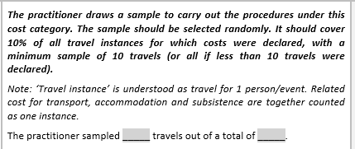
Key differences H2020 to Horizon Europe
Travel sample now selected ‘per travel instance’
  Travel instance = 1 person per event so need to categorise travel per person per trip to allow sample to be selected correctly. Increases evidence required as will need to evidence supporting the total cost of each trip

Slide 13
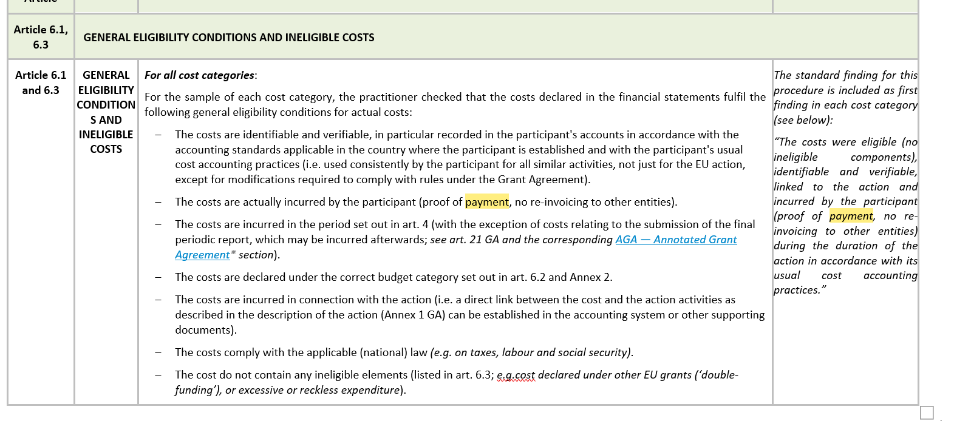
Key differences H2020 to Horizon Europe
Correct categorisation of Other goods, works and services
  Cost categories now presented separately on the financial statement (e.g. travel, equipment, other direct costs) and therefore needs categorising correctly so that audit sample is also correct – different requirements depending on cost type
Defrayal of all items sampled
  Similar to Innovate UK funding, we now need to provide proof of payment for all sampled costs

Slide 14
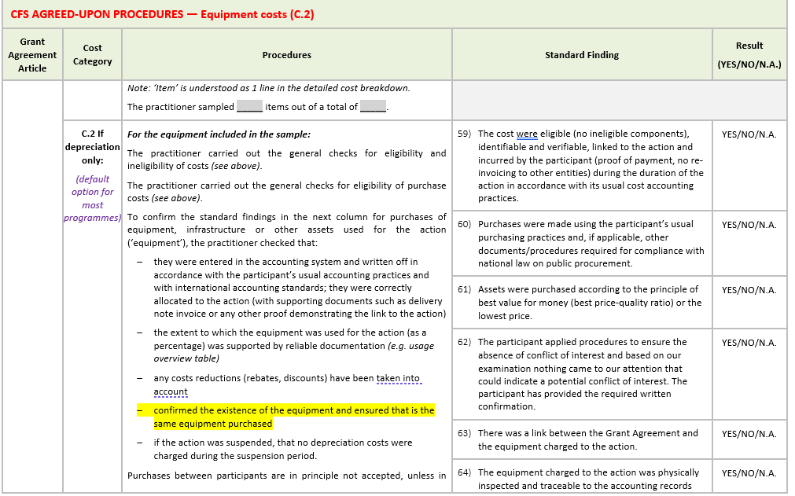
Key differences H2020 to Horizon Europe
Physical verification of equipment

Slide 15
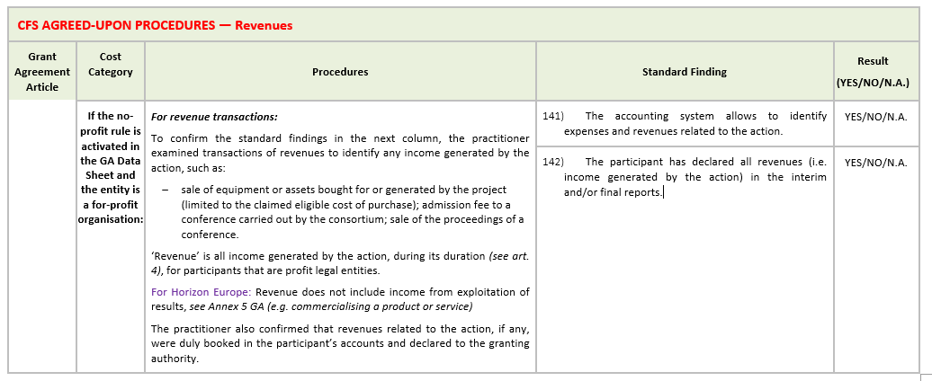
Key differences H2020 to Horizon Europe
Revenues verification
  Evidence confirming the project has not generated additional income during its duration (had to confirm this in FP7)

Slide 16


Common pitfalls for non-compliance
📄 Unsubstantiated direct costs
(missing documentation)
          Supporting receipts/invoices
          Internally invoiced goods e.g. facilities costs – need to evidence unit cost and usage as a direct cost – must also excluded from indirect costs calculation hence why categorisation is crucial
          IKAP – In Kind Against Payment
          Subcontracting – should have a formal contract in place (a purchase order alone is not a sufficient contract) and need to evidence works were carried out

Slide 17
Common pitfalls for non-compliance
4. 🕒 Personnel costs & timesheets
          Missing timesheets
          Timesheets not authorised
          Timesheets backdated
          Time recorded on non-working days (weekends, closure dates, annual leave)
          Calculation errors (just claim ledger – no calc)
          Project travel not recorded correctly on timesheets – can be checked to expenses/invoices at audit
3. 🧮 Reconciliation errors
          No basis of claim
          Incorrect classification
          Exchange rate

Slide 18
Common pitfalls for non-compliance
2. 🚫 Not following own policies (Procurement / Travel/Assets)
          Approvals for out of scope travel not obtained
          Costs approved that are not in line with policy
          Excessive travel costs
          Business vs economy travel
          Depreciation
          Procurement evidence missing – 3 quotes, tenders etc

Slide 19
Common pitfalls for non-compliance
1. 📌 Relevance to project
          Unjustified/unlinked costs
          Supporting evidence missing e.g. minutes of meeting, conference agendas etc.
          Difficult to link relevance to the project – networking, conferences where dissemination has not taken place, general project meetings, fieldwork

Slide 20
Challenges working across support functions
Departments involved in audit process:
  Finance/Research support offices – coordination/reporting/evidence gathering
  Academic (PI) – evidencing link to project, answering auditor’s queries
  HR – employment contracts
  Finance – expenses/invoicing
  Purchasing – Procurement
  Payroll – payroll evidence
  Treasury – income evidence
  Graduate office – provide agreements and payment evidence for project students
  Pre-award colleagues (addressing issues before they even happen!) e.g. IKAP (In-Kind Against Payment)

Slide 21
Challenges working across support functions
Best practice:
  Plan as far ahead as possible and agree deadlines – month end always problematic for payroll so request information ahead of known deadlines
  Audit process email template (recently introduced to send to PI’s ahead of audit)
  Pre-empt auditor queries e.g. procurement evidence for large value items, class of travel for expensive rail/flights
  Audit checklists for departments so requirements/expectations are clearly communicated

Slide 22
Institutional tools and strategies:
How do we reduce errors at audit?
Timesheets:
  Automated monthly reminders to complete timesheets
  Advance notice of audit so project team can finalise last month timesheets as soon as possible
  Fixed deadlines for submission of outstanding timesheets – costs excluded if deadlines not met
Interim reviews:
  Longer reporting periods for some Horizon Europe awards so introduce interim checks:
    Have we got all timesheets? Has anyone left the project earlier than expected?
    Are there any large items charged which we can start gathering evidence for? (more likely to be sampled at audit)
    Internally invoiced goods and services – is it eligible? Start requesting unit cost calculations and usage records
    Subcontracting – was it planned in the proposal? Have we got the procurement evidence?
    Is there any evidence we’d need at audit that is often hard to get hold of which could be gathered now e.g. purchase card receipts

Slide 23
Institutional tools and strategies:
How do we reduce errors at audit?
Guidance documents on SharePoint which can be shared with departments/PIs:
  Kick off meetings – guidance issued at project start to help prepare for eventual audit
  Timesheet guidance and templates
  Claims and audit checklists
  Interim reviews checklist
  Personnel costs calculator template
‘Problems’ checklist – link into other departments:
  Regular catch ups with Operations Manager (for example) to help escalate recurring issues
  Feedback following audit to Faculty Research Managers – ‘audit summary’

Slide 24
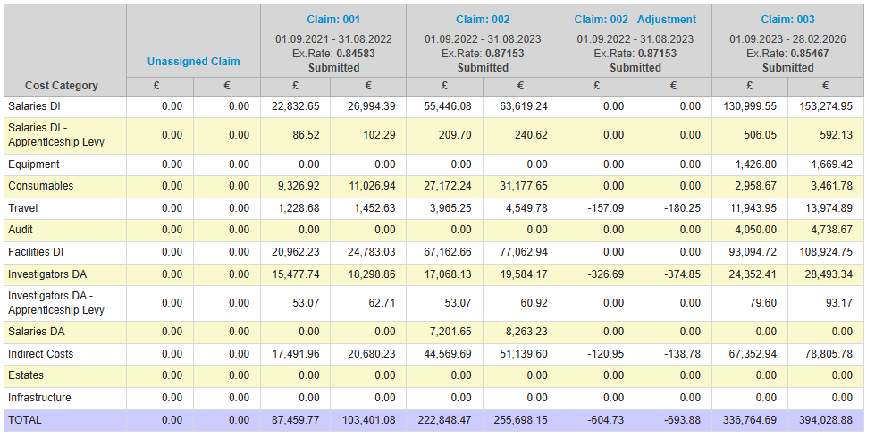
Institutional tools and strategies:
How do we reduce errors at audit?
Live claims tool to help update project throughout duration:

Slide 25
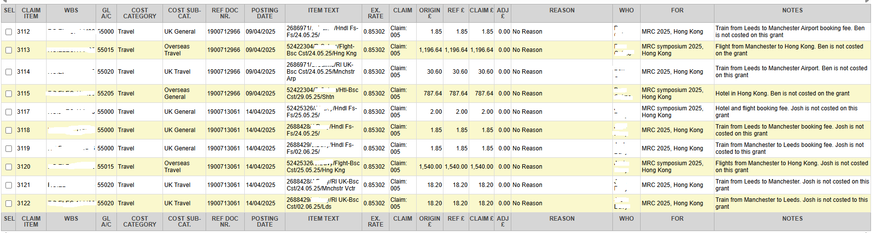
Institutional tools and strategies:
How do we reduce errors at audit?
Notes section to aid with categorising travel and ‘purpose of travel’:

Slide 26
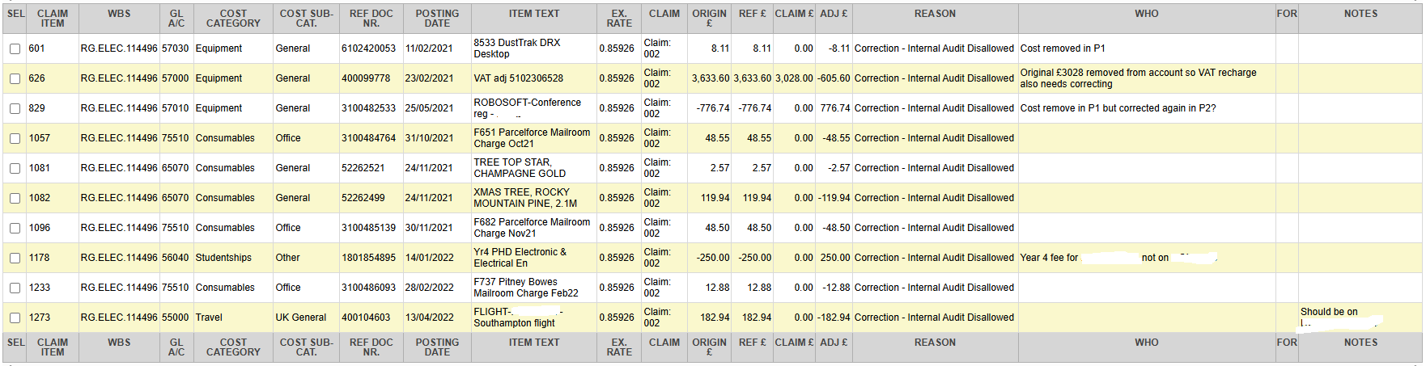
Institutional tools and strategies:
How do we reduce errors at audit?
Removal of ineligible costs prior to audit:

Slide 27

Audit and Compliance Special Interest Group
SIG Aims
  network locally and internationally
  share knowledge and best practice
  develop tools and knowledge base
  discuss current hot topics
  update members about changes
  provide training
  engage funders
Please complete our SIG activities survey!

Slide 28
Any questions?

Slide 29
Thank you!
Jonathan Gray j.gray@leesaccountants.co.uk
Keri Dunning k.l.dunning@leeds.ac.uk

