Slide 1



Reimagining research practices: towards a sustainable, ethical and inclusive future
Catriona Gold, Project Manager
Becky Gordon, Head of Research Quality and Policy

Slide 2

Three interlinking pillars
Sustainability: the sustainability of our evolving research practices
Ethics: the mitigations for ethical risks arising from reshaping research approaches
Inclusion: the enhancement of inclusion in our research community and practices

Slide 3
Three driving actions
Investigate internal and external current practices and innovative ideas
Reinvigorate and change our research culture by developing support mechanisms, new resources, university strategies and policies
Evaluate and communicate our activities, identifying best practice for sharing across the sector and optimising further development opportunities

Slide 4
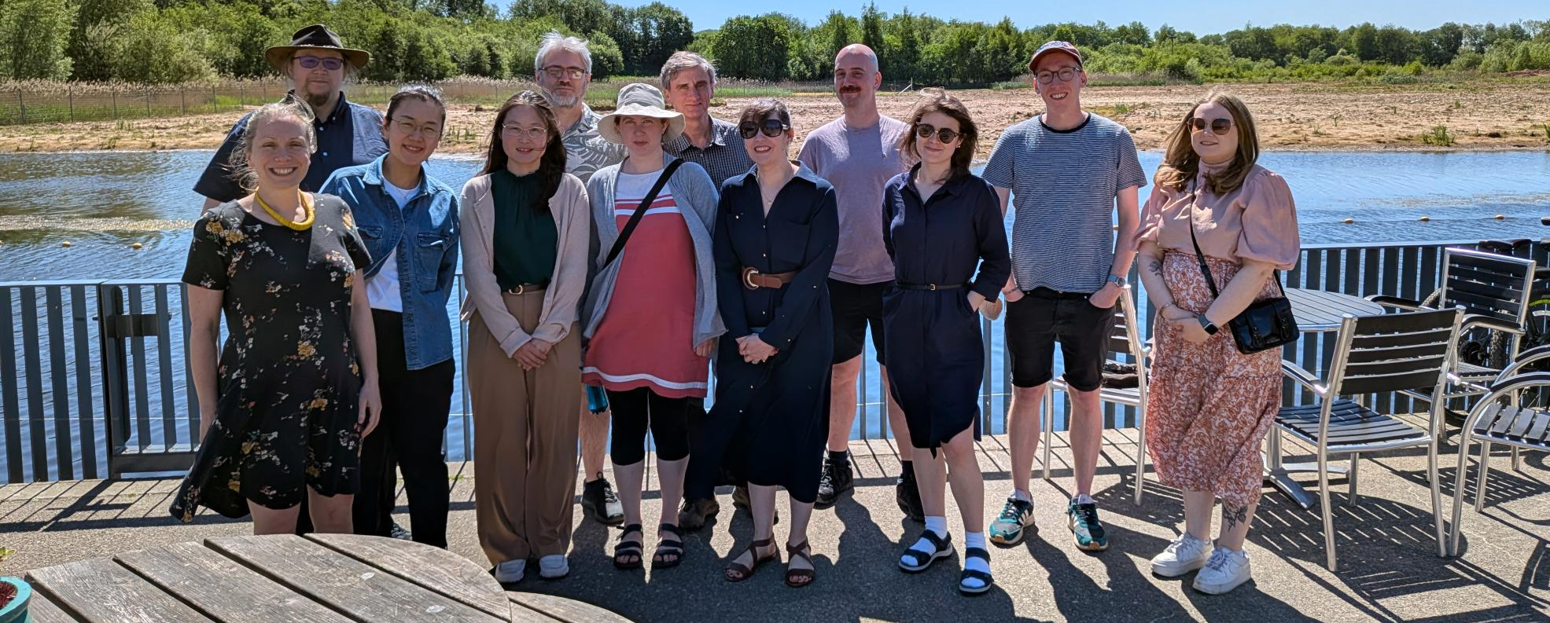
Team
PI: Rebecca Lingwood (Deputy Vice-Chancellor)
Co-Investigators: Professor Phil Barker (Lancaster Environment Centre), Professor Mark Levine, Drs Heather Shaw and Richard Philpot (Psychology), Dr Carlos Lopez-Galviz (LICA), Louise Zambianchi (Library), Becky Gordon (Research Services)
Researchers: 4 x PDRAs for sustainability, ethics, inclusivity and evaluation
Additional roles: Project Manager, 2 x Education Fellows, Senior Developer and Embedded Software Engineer

Slide 5
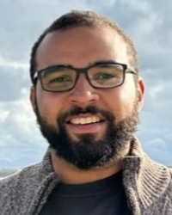
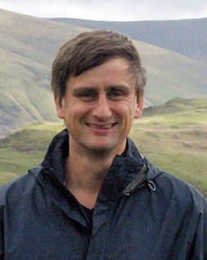

Sustainability
Exploring best practice in embedding sustainable research practices
International climate action symposium
Sustainability forums with researchers, technicans and PS
Interviews with university leadership re: sustainability goals
Corpus analysis of 91 UK HEI sustainability reports
Engagement at PS and academic conferences
Engagement with other HEIs

Slide 6
Sustainability - findings
In the UK, the Concordat for the Environmental Sustainability of Research and Innovation Practice provides a framework to identify needs of the university and researchers & centralise initiatives.
Digital infrastructure – especially AI - is often absent from sustainability conversations. When it is included, the emphasis is on it as a solution and not its environmental impacts.
We already have great efforts and ideas around sustainability; the barrier we encountered is how to connect and effectively communicate ideas that are spread throughout our institution.

Slide 7




Ethics
Researching barriers to ethical research in the digital age
Cuppa Conundrums – safe space to discuss ethics issues
‘Dataveillance’ workshops exploring digital surveillance issues
Podcast, guides and training for researchers on specific topics (including how to run sessions)

Slide 8

Ethics - findings
The cuppa conundrum structure allows for a safe and open space across various research practices
Discussion reduces binary thinking
Potential to engender a spirit of community in tackling ethical conundrums across disciplines and PS/academic staff
Scan QR to listen to our 'Cuppa Conundrums' podcast series!

Slide 9


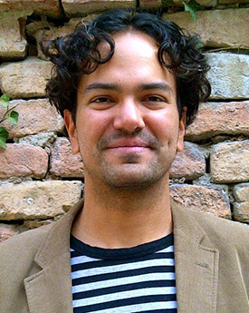


Inclusion
Understanding how to enhance inclusion
Focus groups and interviews with scholars doing community-based research
Exploring approaches to citizen science
Graphic novel about inclusion in community-based research
Community research toolkit

Slide 10
Inclusion - findings
Importance of inclusive research practices
Highlighting the need for inclusive research approaches
Ensuring representation and diversity in research
Interdisciplinary and participatory approaches
Holistic understanding of wicked problems
Collaborative, cross-disciplinary methods to address complex challenges
Engaging with creative and participatory methods (challenges: resource limitations and time constraints)

Slide 11
Inclusion - findings
Challenges Working with Communities
Institutional and systemic barriers (e.g., lack of understanding from funders and institutions on co-design and co-production process)
Building trust (e.g., time and effort required to establish trust, manage network, communicate with community members)
Identifying the right partner organisations
Opportunities in Community Research
Identifying appropriate research questions for meaningful engagement with communities
Creating spaces for dialogue; helping communities unpack and express their issues
Bringing lived experiences and insights from communities
Impacting current systems and policies

Slide 12
Inclusion - findings
Engaging with communities after the research project:
Developing further funding applications or training resources and organising sessions
Keeping communication channels with partners who might need advice or support
Connecting with other researchers and communities
Creating modules that allow students to work with communities on a smaller scale

Slide 13




Reinvigorate and change
Micro:bit device prototypes for community research
Policy language review – contributing to policy revision at LU
Revised sustainability strategy addressing research activities
Revised LU ethics policy
Ongoing cuppa conundrums
Training package for sustainability in research
Citizen science toolkit
Community research graphic novel

Slide 14


Evaluation
Assessing ideals (policies/statements) against reality
Survey to understand perceptions of research culture at LU
Wellcome evaluation & final report – in progress (watch this space!)

Slide 15
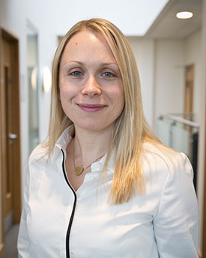

Communicating outcomes
Final project report
Launch events for deliverables
Intranet and website content
University/Faculty/Departmental meetings
Engagement with Wellcome community and N8+ group
Conferences
Academic publications

