Slide 1



Due Diligence in the Trusted Research Context
Mirna Dirghar &
Megan Wood-Smith

Slide 2


What is Trusted Research and why does it matter?
Aimed to Protect: Researchers Universities National Interests
Embedded in Funder requirements
Extends to collaborations, visitors, etc
Sets expectations to Manage:
Foreign interference Misuse of research Export Control National Security
Notes:
Megan –
Context:
UK universities operate in an increasingly open international research and teaching environment.
While international collaboration is encouraged by the UK Government, it also requires greater awareness of research security and compliance, as some academic knowledge and activities could be misused.
To address this, the UK government developed the Trusted Research guidance for UK HEIs, which aims to protect researchers, Universities, and national interests.
Developed with academia and jointly published by the National Protective Security Authority (NPSA) and the National Cyber Security Centre (NCSC), ​Trusted Research principles are embedded in UK funder requirements.
Originally research‑focused, the guidance now applies more broadly to collaborations, education partnerships, visitors, and related activities.
Trusted Research brings together multiple regimes including
Export Control regulations
NSIA
Sanctions and trade restrictions
Research integrity & security
UKRI funding conditions
and sets expectations for managing the associated risks which includes:
Foreign interference
Misuse of research
National security threats
In summary, Trusted Research enables safe and responsible international collaboration through risk management, not risk avoidance.

Slide 3
Due Diligence focuses on 3 core questions:
Who are we working with?
What is being shared/ transferred?
How could information or technology be misused or diverted?
Notes:
Within this context, due diligence focuses on three core questions:
Who are we working with?
What is being shared or transferred?
How could information or technology be misused or diverted?
Due diligence is proportionate, documented, and iterative.
Reassessment is needed where collaborations change, new partners or affiliates are added, IP transfer is proposed, data moves from published to unpublished, or deeper technical access is requested.

Slide 4
UoB’s Research Compliance
Approaches & Practices
Stage 1: Light touch Compliance Review
Stage 2: Full Compliance review
Meet with PI to run:
Complete any additional actions:
Export license application
Activity referred to Compliance Team
Researcher completes triage form
Due diligence
Initial screening to identify issues
NSIA assessment
NSIA notification
FIRS registration
Export control checks
Contractual mitigations
Trusted Research advice
Notes:
Alongside the Trusted Research agenda, our Research Compliance team advises on EC, NSIA, FIRS, and Subsidy Control.
We operate multiple compliance checkpoints throughout the project lifecycle and across Professional Services.
Activities are referred to us where there are:
International partners, funders, or affiliates OR
Dual‑use or emerging technologies (e.g. defence, aerospace, nuclear, AI, communications, semiconductors, space, advanced materials)
When an activity is referred to our team, the researcher completes a triage form, which outlines basic information about the activity.
From this, our Team conducts a light touch review.
This involves identifying relevant issues and conducting partner due diligence, which assesses the partner’s
Legal identity & ownership
Their country of incorporation and operation
Any links to defence, government, or civil‑military fusion
Determining if any sanctions or restrictions apply
Considering reputational risks and ethical concerns.
Where required, we conduct Stage 2 reviews, which includes:
Export control checks, classification & licensing.
NSIA screening to determine whether a notification or FIRS registration should be made
A subsidy control assessment
Crucially, we keep records of all assessments as the university is periodically audited.
We work with the contracts team to mitigate risk by:
Limiting agreements to UK entities only
Excluding affiliates where possible
Controlling onward sharing and re-export
Requiring compliance with export controls, sanctions, and national security laws
We also provide guidance and advice to support Trusted Research compliance.

Slide 5
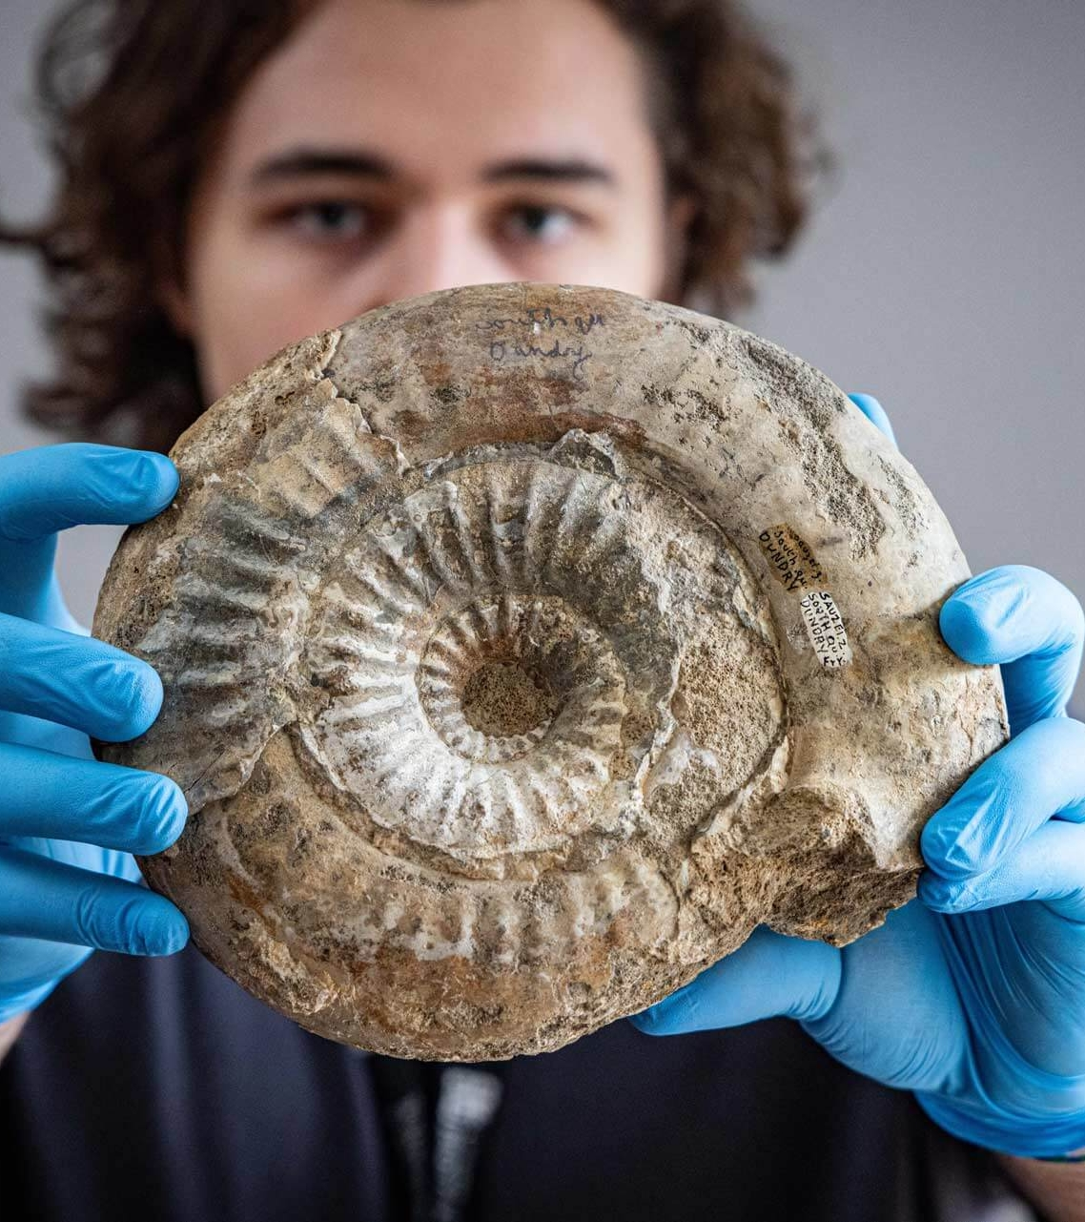
Trusted Research Evaluation Framework (TREF) Project
An institution wide approach to implementing TR principles
Engagement and input across all University activity
Project Board, Knowledge Management Group, and Working Group
Notes:
Alongside the day to day compliance advice that we give, we also manage two institution wide projects intended to embed research security and trusted research principles at Bristol. The first is our TREF project, utilising the National Protective Security Authority's TREF framework to identify where University activity can be more robust and secure.
This project has engagement and input across all university activity, not just research. This includes education, global engagement, cyber and information security, and campus security, among others. We have a Project Board comprising of senior leadership such as PVCs, the Chief Infosec Officer, the Director of Governance, a knowledge management group including our APVCs, Head of Schools, and other subject matter experts, and a working group comprising of Trusted Research subject matter experts, which includes me.

Slide 6
Assessment of Third Party Suitability Project
Due diligence of all third party entities
Creating a centralised repository
Aligning fragmented university due diligence processes
Notes:
As a workstream of the TREF project, we have the ATPS project, which focuses on streamlining the different due diligence frameworks at the University to ensure clear recordkeeping, remove duplication, address any risks early, and align risk appetites. At Bristol, we have several due diligence processes across research, philanthropy, procurement, education, careers, and student recruitment.
This project focuses on assessing risk at the earliest possible stage for high level legal, financial, or reputational concerns. These risks are rated using a Red Amber Green system, and managed by a governance group comprising of subject matter experts in finance and trusted research. These assessments are then visible for colleagues across the university to see.
Activity specific due diligence processes are then conducted by the specific SMEs in each team, focusing on their areas of expertise.

Slide 7

Lessons Learned
Key Challenges:
Building awareness, knowledge, and engagement
Nurturing a culture shift
What has worked:
Prioritising relationship building
Working closely with research administrators and professional services staff
Sector engagement
Notes:
Key Challenges:
Building awareness, knowledge, and engagement
Culture Shift required
Both are ongoing
What has worked:
Prioritising relationship-building through presentations and meetings; identify compliance “champions” throughout faculties and professional services
Being an approachable and supportive team, which focuses on enabling
We also encourage early contact with our team where there is any uncertainty
Working closely with Research administrators/professional services as they are the first line of defence, critical to:
Spotting risk indicators early
Asking the right questions and escalating appropriately
Embedding safeguards into contracts and processes
Sector engagement has been very helpful
Sharing knowledge, best practices and discussing challenges with peers via ARMA, HERSA

Slide 8
Mirna Dirghar &
mirna.dirghar@bristol.ac.uk
Megan Wood-Smith
megan.wood-smith@bristol.ac.uk

