Slide 1
Boosting engagement and impact: the role of small-scale university funding
18 June 2026
Dr Lena Lorenz (she/her) and Dr Stanislava Dikova (she/her)
University of Edinburgh
Notes:
We are interested in a conversation about the role of small internal funding for engagement and impact at Universities. In the current climate, more and more small funds are slashed so it’s timely to showcase their importance and how they can be run in a productive impactful way.

Slide 2
Session plan
Presentation (10 minutes)
Campfire-style discussion (15 minutes)
Feedback from groups (5 minutes)

Slide 3
Poll
Have you run an impact funding scheme at your institution?
Notes:
By show of hands,
Yes
Would like to but no resource

Slide 4
Knowledge Exchange and Impact (KEI) seed funds
Internally funded pots from £500 - £7,500
Different strands from initial engagement (“seed”) to mature impact (“grow”)
Partner demand and needs led
Dedicated pathways for Arts and Humanities KEI
Notes:
Aim: to support knowledge exchange and impact projects
Partner demand and needs led: require evidence of partner need to be demonstrate for applications in our Developing Impact (£5K) and Advancing Impact (£7.5K) strands

Slide 5
Innovation in KEI seed funds
Space for experimenting
Focus on responsible engagement and innovation
  EDI considerations part of application form and scoring matrix
  Diverse review panels
  Detailed feedback to unsuccessful applicants
Notes:
Space for trial and error, pilots, bespoke approaches – usually not covered by most available funding pots.
Diverse review panels:
Public advisory group members
Previous awardees
ECR observers

Slide 6
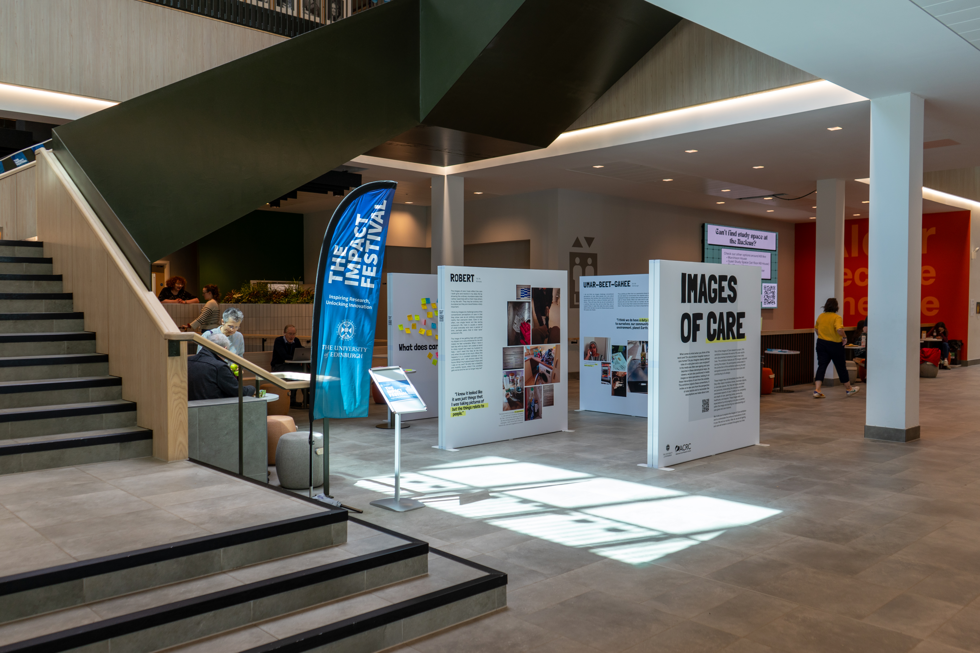
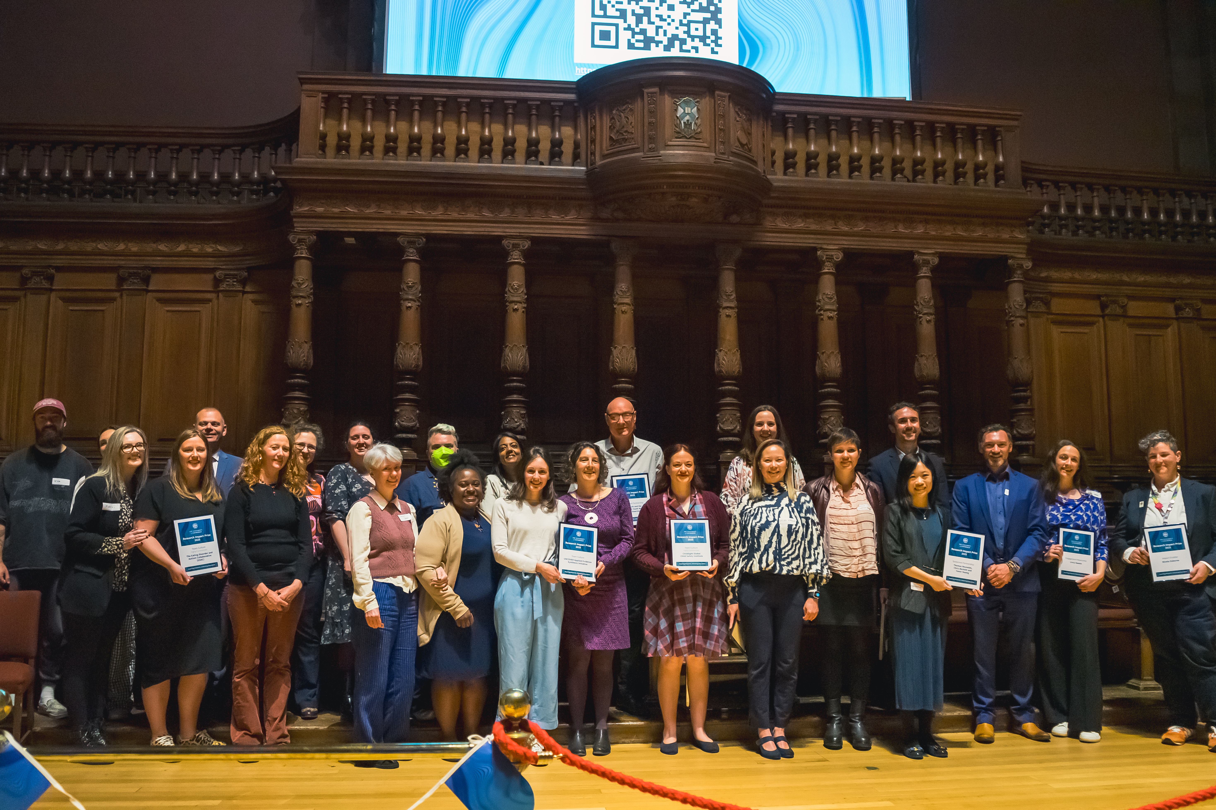
Benefits
Impact culture
New services and partnerships
REF impact case studies
Good return of investment
£3.6 for every £1 awarded
Exhibition space during the Impact Festival
Group of impact prize winners with certificates
Notes:
Impact culture
Capacity building – cohort of awardees (CMVM)
Potential for mentorship
Research Impact Prizes
New services and partnerships
New PPIE service piloted to support researchers with PPIE in underserved communities when preparing for new grant applications, filling a crucial gap in service provision
New international partnerships (e.g. Centre for Sustainable Agriculture in India) and engagement with Scottish parliamentary groups (e.g. cross-party group on arthritis and musculoskeletal conditions; cross-party event on women’s health)
REF impact case studies
84 awards have fed into ICS development since 2015.
Good return of investment
Over past 10 years, for every £1 we've spent we've seen £3.6 return via external award

Slide 7
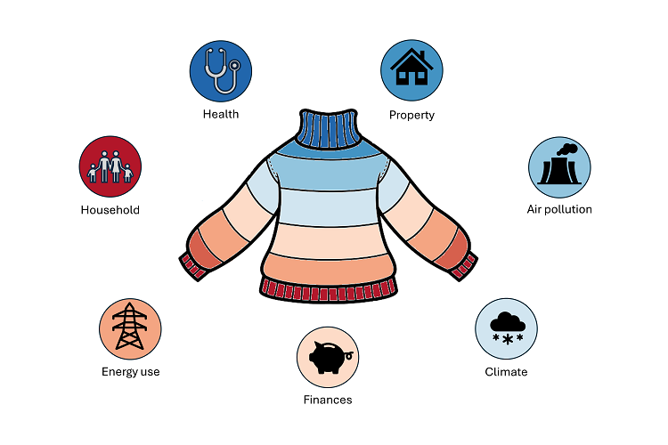
Case Study 1: Healthy homes, healthy kids
Link between housing and children’s respiratory health
“The Parent Group” with lived experience
  Co-designed the final research questions
  Co-produced a scientific animation
  Partnered with Media Education to obtain SCQF Level 5 Community Leadership qualification
Wellcome Trust fellowship
Policy and third sector engagement
Notes:
Olivia Swann idea to investigate the link between housing quality and poor respiratory health of children.
Quantitative study creating a dataset linking electronic health records with data on home energy use, smart meters, air pollution and climate.
Help design questions, use impact seed fund to engage with parents from hard-to-heat homes to understand key priorities.
➔ “Parent Group” (6 families) made up of diverse members from a variety of ethnicities, geographical locations, socio-economic and asylum-seeking backgrounds.
Codesigned the final research questions
Coproduced logo and scientific animation to raise awareness of the link between cold, damp homes and childhood chest infections
Partnered with Media Education to help members of the parent group to work towards an SCQF Level 5 Community Leadership qualification
WT fellowship → answer co-produced questions
Use outputs from engagement to work with policy makers and third sector organisations.
Some partners include: Scottish and UK Government (in particular Children and Families, Energy and Climate Change, Housing), Energy Saving Trust, Poverty Alliance, Public Health Scotland and others
Recently been appointed to the SG’s Fuel Poverty Advisory Panel for the next four years. In this role, she will help shape policies and programmes that tackle the root causes of fuel poverty, influencing how Scotland supports households struggling with energy costs and ensuring fairer access to affordable, sustainable heating

Slide 8
Case study 2: Transforming cultural identity and museum practice
Working with Naga community organisation to co-create an indigenous framework for a pedagogy of healing and reparations
  Co-produced a graphic novel
  Website to reach communities more widely
Working with the Pitt Rivers Museum to shape museum practice in relation to the management and repatriation of indigenous remains and artefacts.
Engaging with policy makers on UK (House of Lords) and international level (UN Commissioner on Human Rights) to exchange knowledge and expertise on international advocacy and human rights
  Recent report for HoL
Notes:
Arko is an expert in Highland Asia, particularly the Naga people who are recognised as Indigenous peoples based in the north-east of India and parts of Myanmar. Over the last 12 years he has worked with the Naga people and the Pitt Rivers Museum on projects related to the repatriation of ancestral remains and cultural artifacts, aiming to improve museum practice and empower communities.
The research has developed an indigenous pedagogy of healing and reparation, which forefronts Naga voices, reflects on the ethical and geopolitical complexities of repatriation and on the future of their ancestral remains in the PRM and other museums in Europe and beyond. This new framework is shaping museum practice in relation to management and repatriation of indigenous remains and artefacts. As a result, in June 2025 the PRM welcomed a delegation of elders and leaders to begin the repatriation process of a collection that has remained largely inaccessible to the Naga communities for over 150 years
The work has led to the development of Indigenous protocols regarding ancestral remains and two key resources – a graphic novel explaining the repatriation process to a general Naga public and a website that contains all the information on the various activities undertaken by RRaD. Through these resources, the research has shaped community identity, practice and knowledge of the past in Nagaland and public understanding of issues relating to the care of indigenous human remains more broadly.
Work began in 2014 with an initial seed fund investment of£5,000 and has continued to grow. Additional pots of moneyawarded in subsequent years totaling £42,000. This hastranslated into external funding worth more than £2 mil.

Slide 9
Activity: Innovation in small seed funding Discuss examples of
Doing things differently when managing small funds
Creative evaluation of funding schemes and how you have articulated their "value"
Contribution of seed funding to diverse, equitable and sustainable engagement and impact practices
Notes:
Remind people of Chatham House rules
Make the group discussion as inclusive as possible e.g. give everyone a voice; speak from the “I”
Use of post-it notes if people don’t want to contribute verbally
In your small groups (at table), consider small impact / KEI funding schemes you have run (or have wanted to run). Discuss some examples focussing on the following three areas:
Have you introduced innovation in your administration / managing of funding schemes?
How do you evaluate the value of the funding schemes? Any particularly creative / new approaches you want to share with others?
How have you included EDI and sustainability considerations into the running or your scheme?
If there are post-it notes, write down all your examples and ideas. At the end of 15 mins, we’ll ask one of you to give us 1 example of innovative practice.
Depending on where the discussion goes, we’ll explore writing up the findings in a blog or similar publication and will share this with ARMA attendees.
-------------------------------------------
Theatre style:
Options:
Depending on size of audience, we can also chat through each point as a room. Give a couple of mins to think through on your own and then we’ll invite examples from everyone in the audience. Post-its available if people don’t want to speak or we run out of time.
Ask people to talk in small groups to people around them – post-it notes (need to see how they are distributed) – Feedback in plenary
People can reflect on their own, or chat with the people nearby.

Slide 10
  “This experience has strengthened our desire for PPIE in future projects and has given us evidence to promote the value of PPIE with our academic and clinical colleagues, and with funders.”
Mid-career clinical researcher and paediatric consultant

