Slide 1


RESEARCH EVALUATION
How rankings drive university research strategies and what research managers can do about it
With Lizzie Gadd and James Wilson

Slide 2


EARLY INDICATIVE RESULTS
DO NOT RE-POST OR REPORT
Redaction: Lizzie Gadd’s slides have been removed from the ARMA 2026 slide decks, by the author’s request, as they contain unfinished work.
#ARMA2026

Slide 3
How university rankings measure research
A Research Evaluation Perspective
Observations and insights from the University of Bristol's Top 50 Strategy.
How university rankings differ from the Research Excellence Framework (REF).
The role (and limitations) of bibliometric data in university rankings.
#ARMA2026

Slide 4
REF vs Rankings
Two approaches to evaluating research institutions
Periodic research assessment system, grounded in peer review.
UK-based exercise, with ties to governmental funding.
Evaluates institutions across Outputs, Impact, and Environment profiles.
Annual league tables built on quantitative indicators.
International comparison, with ties to student recruitment.
Evaluates across Reputational, Institutional, and Bibliometric indicators.
#ARMA2026

Slide 5
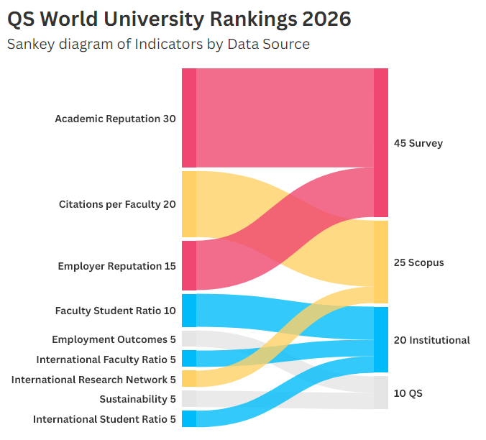
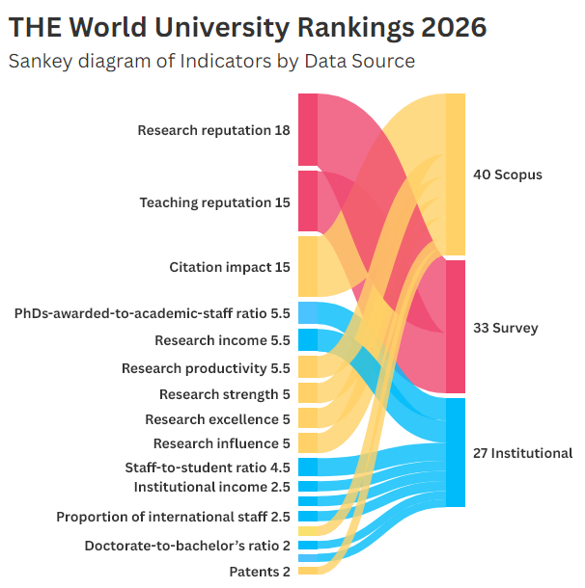

Slide 6
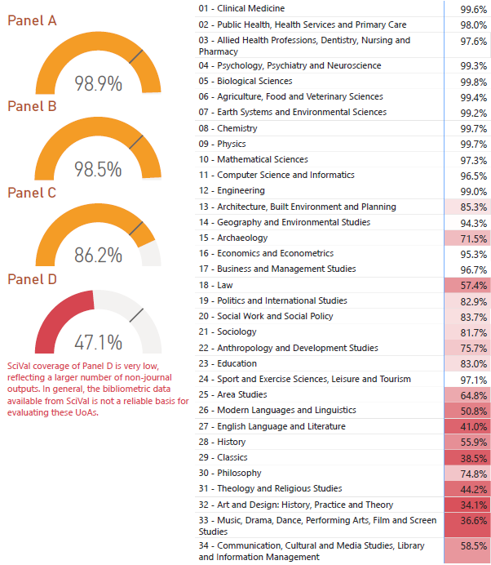
Content Coverage
Content coverage in Scopus – as with most citation databases – is skewed towards the hard sciences.
The REF 2021 Outputs dataset, which is publicly available, represents a benchmark for database accuracy.

Slide 7
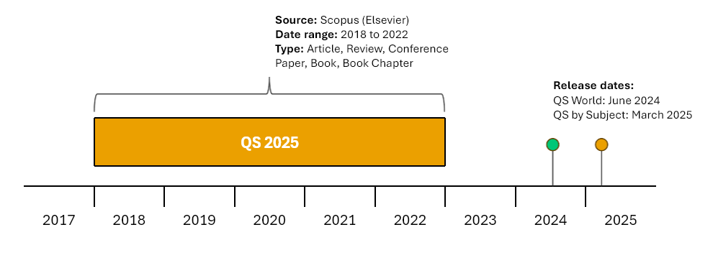
Ranking Lifecycles
The two main international university rankings – QS and THE – both score research outputs over a rolling five-year period.

Slide 8
Subject Areas
GENERAL CLAIM
University rankings cannot see your organisational structure, e.g., Faculties or Schools.
Subject areas are formed out of the All Science Journal Classification (ASJC) schema within Scopus.
Rankings score your institution's whole contribution to an ASJC subject area.

Slide 9
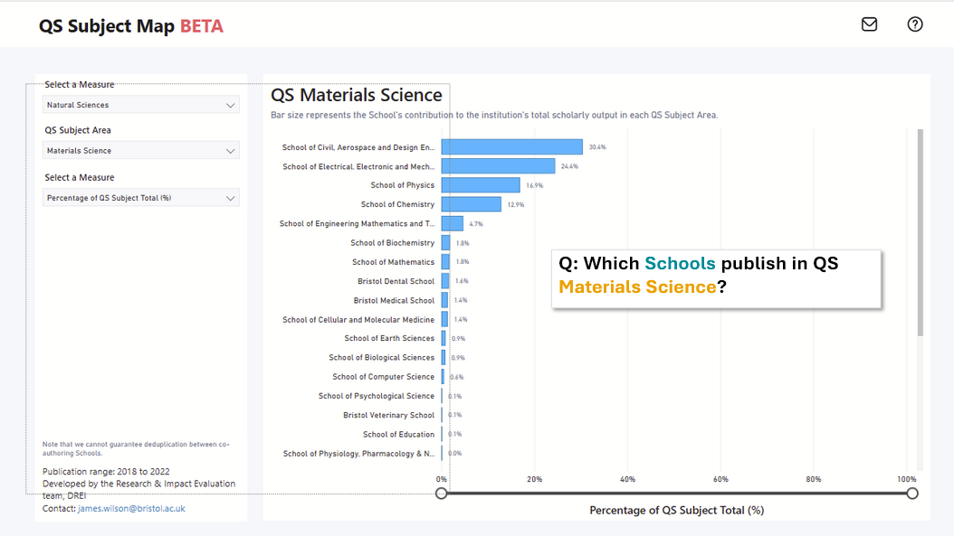

Slide 10
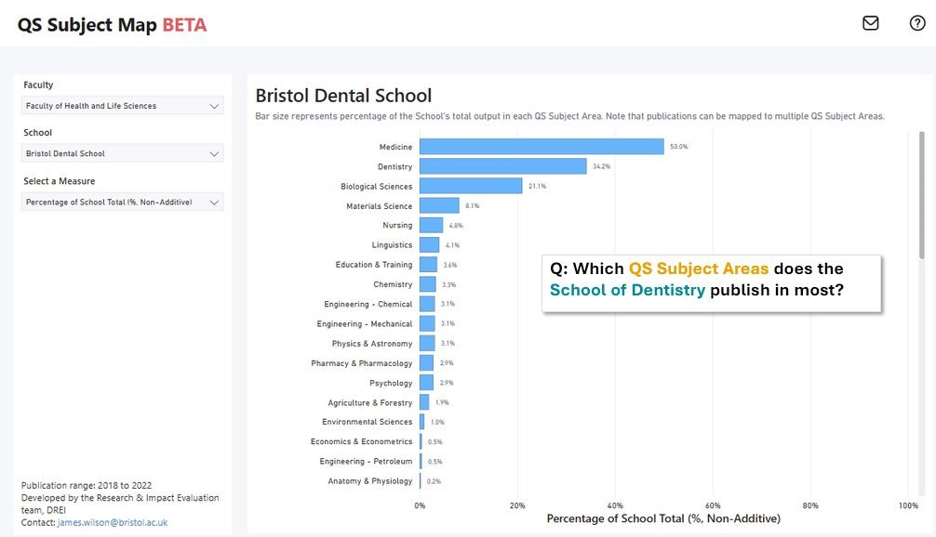

Slide 11
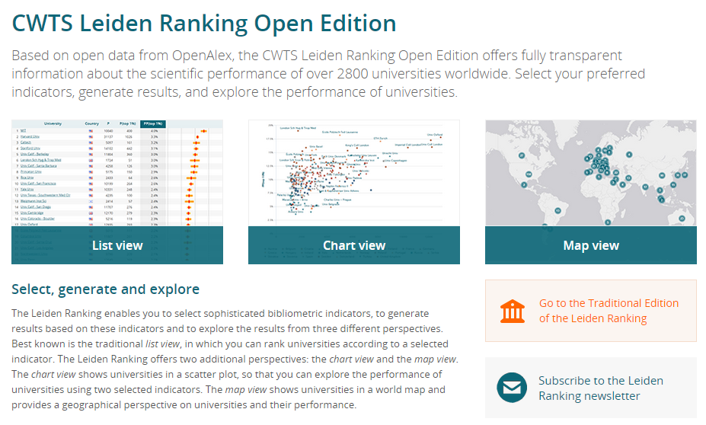
Recent Thoughts / Future Developments
Open and Transparent approaches to university rankings
University rankings are notoriously closed and opaque systems.
OpenAlex as a open source of bibliometric data.
CWTS Leiden Ranking Open Edition.
#ARMA2026

Slide 12

Thank you for listening.

