Slide 1


Session 2.3 - Research Development SIG
Dr Ying Chen (University of Southampton)
Dr Aygen Kurt Dickson (LSE)
Mr Adam Golberg (University of Nottingham)

Slide 2

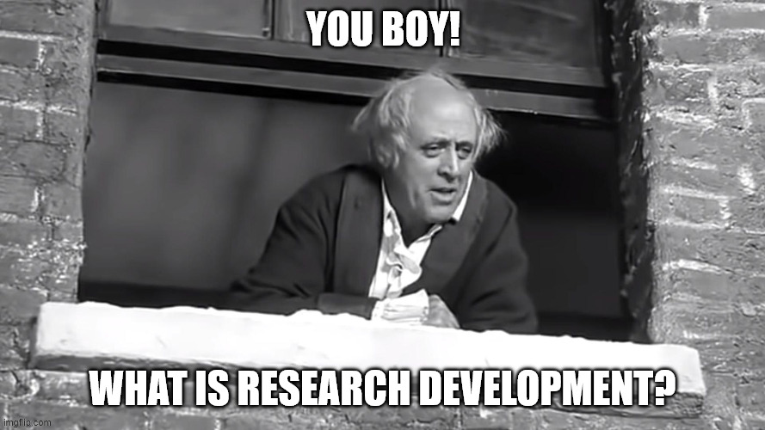

What’s going on? Who are you people?
What is a SIG?
An ARMA Special Interest Group
What is a Research Development?
“Research development is a set of strategic, proactive, catalytic, and capacity-building activities designed to facilitate individual faculty members, teams of researchers, and central research administrations in attracting external research funding, creating relationships, and developing and implementing strategies that increase institutional competitiveness.”
#ARMA2026

Slide 3
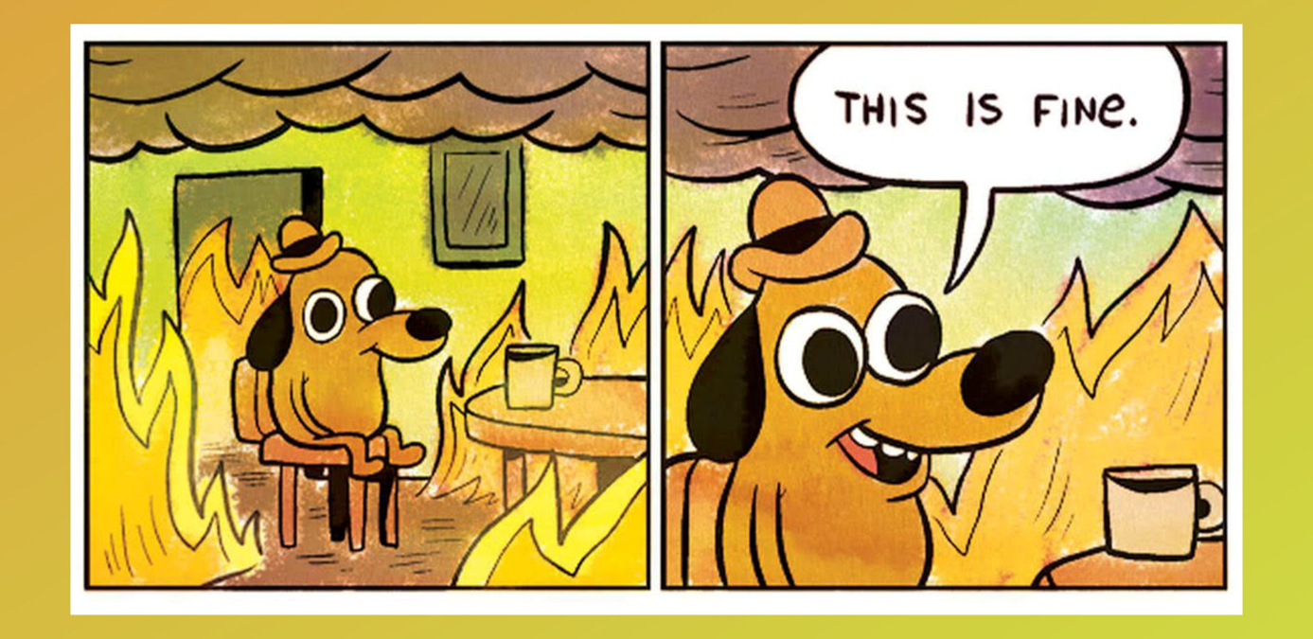
The sector right now….
Two panels from KC Green’s webcomic, Gunshow. ‘On Fire’ (2013)
#ARMA2026

Slide 4
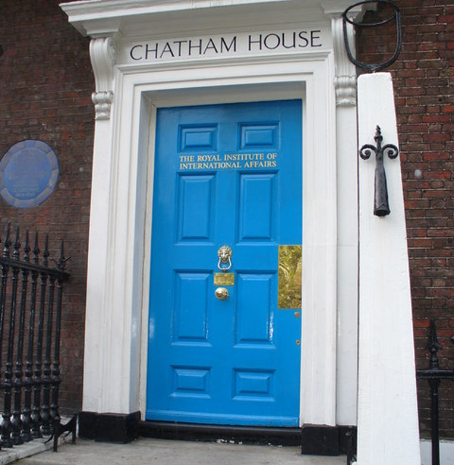
The Chatham House Rule
….“participants are free to use the information received, but neither the identity nor the affiliation of the speaker(s), nor that of any other participant, may be revealed”.
#ARMA2026

Slide 5
Session plan
Crowdsourced research development topics
  Long term strategic research development
  UKRI Buckets 2 and 3, Business Engagement
  Working with philanthropy and fundraising teams
  Demand management
  “Any other business”
  ??
Small groups – intros and icebreakers
  Discussions
Discussions, part 2
Sharing lightbulb moments
Future SIG plans
#ARMA2026

Slide 6
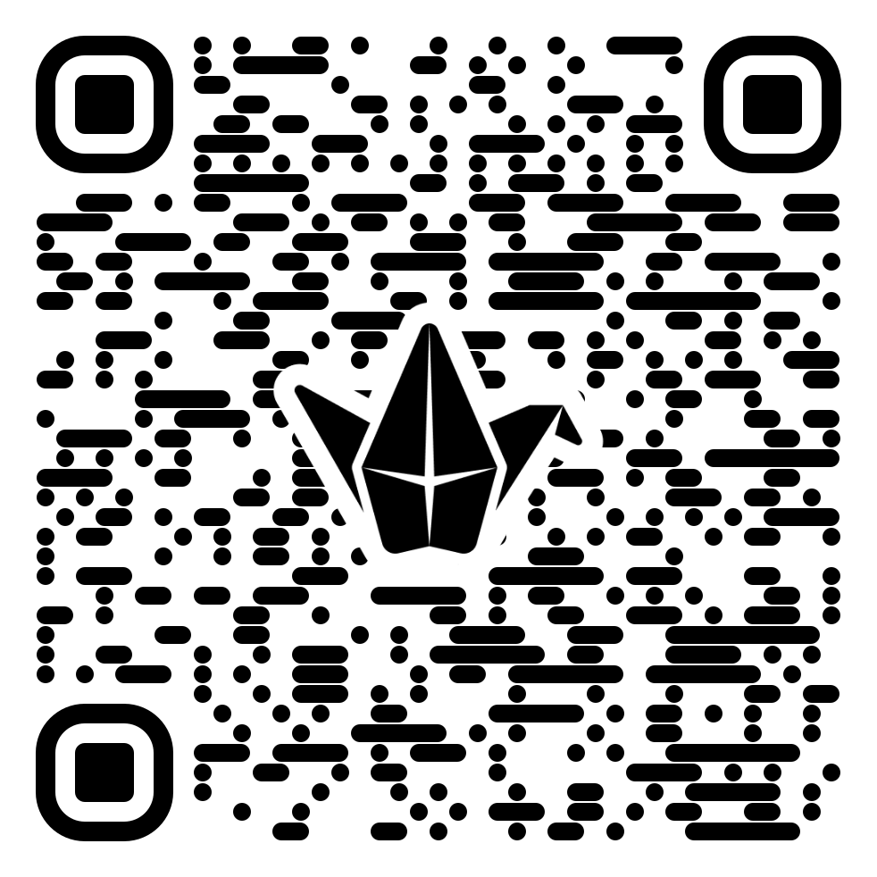
Padlet Link
You are very welcome to…
add key thoughts/insights
ignore the Padlet completely and focus on discussions
We will not…
“Go around the tables” and ask for a discussion summary
We will…
Offer the option of sharing one key insight
#ARMA2026

Slide 7
SIG Plans and Update
#ARMA2026

Slide 8

Thank you
Any questions?

Slide 9
#ARMA2026

