Slide 1



Embedding Equitable International Partnerships in UK Research Culture
Anna Williams and Eunice Hansen-Sackey
London School of Economics and Political Science (LSE)

Slide 2

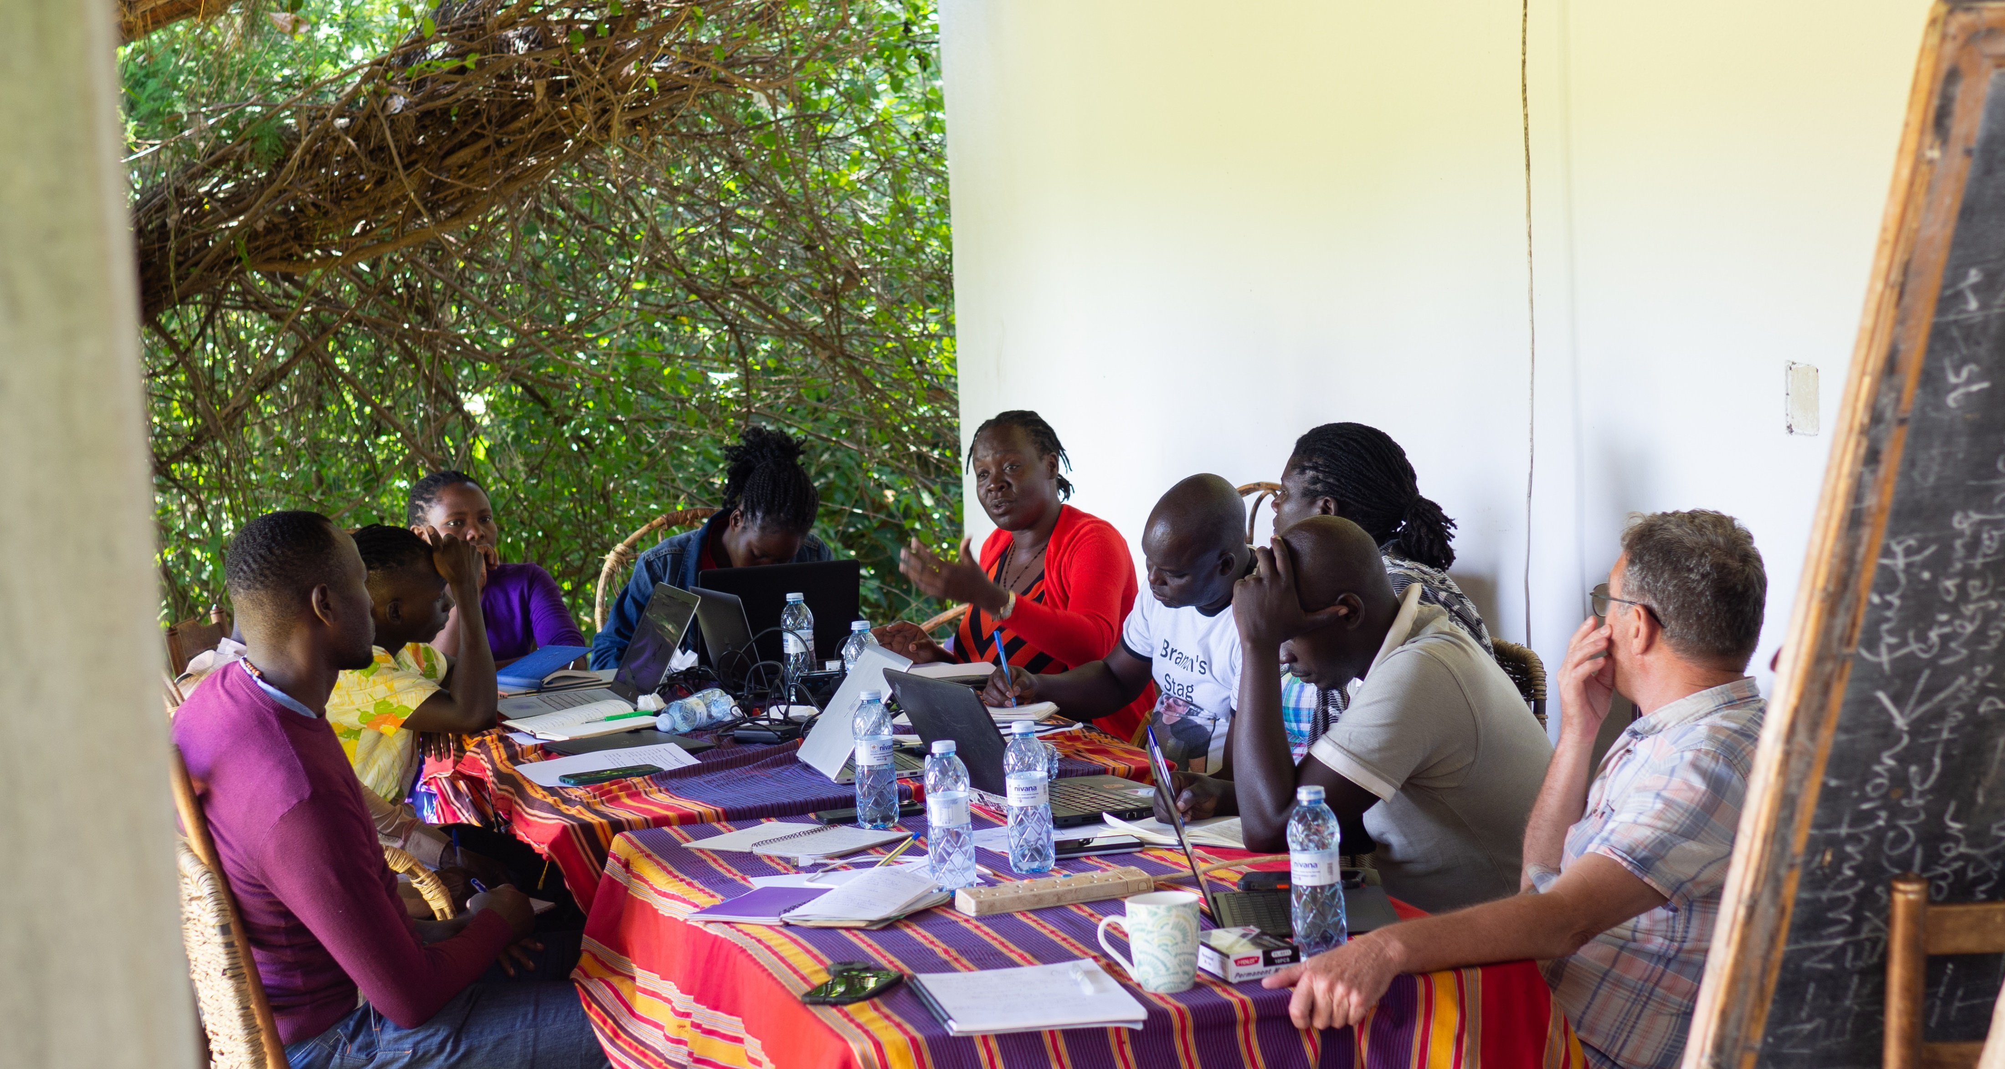


FLIA’s Context
Core mission to “put Africa at the heart of LSE”
Geographically-focused research institute
Frequently partnering with academic researchers, local/national/international NGOs, UN agencies, governments, activists, artists, and freelance researchers.
Who are we?
  Eunice – Research Grants Officer, focused on post-award management
  Anna – Research Programme Manager, focused on pre-award research development
FLIA Website
#ARMA2026
Notes:
Provide some context about FLIA and our role within LSE (particularly the Research Programme)
Advocacy across LSE regarding engagement with Africa?
Advancing research which situates lived experience and African knowledge as the core focus?

Slide 3

Goals
Discuss links between research culture strategies and meaningful equitable international research partnerships
Share experiences from our context
Reframe equitable research partnerships to go beyond "tick-box" exercises
#ARMA2026

Slide 4
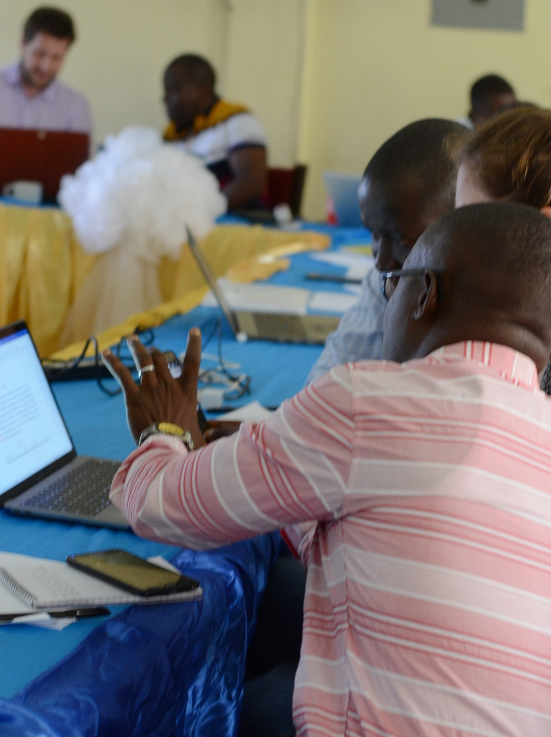
Why Equitable Research Partnerships Matter
International research collaboration can:
Expand knowledge and innovation
Address global challenges
Build mutual research capacity
Strengthen diplomatic and academic relationships
Advance practice of EDI principles in research both within UK institutions and internationally
Transform and advance disciplines with new knowledge generation
However, research partnerships are not always genuinely equitable.
In practice, who really has the power to design and implement big ideas at pre- and post-award?
Image: FLIA (2019) – Social Sciences Writing Workshop: University of Sierra Leone, LSE, LSHTM
#ARMA2026

Slide 5
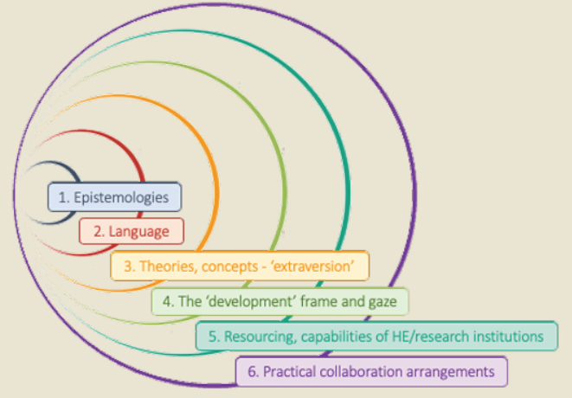
Challenges for Implementing Equitable Partnerships
Funding structures favouring UK leadership
“Rubber stamping” equitable engagement to meet funder requirements
Administrative complexity
Power imbalances in resources and infrastructure, knowledge ownership, and colonial legacies
Lack of meaningful inclusion of international collaborators at research design stages
Image source: “Uneven playing field in Africa – global production of scientific knowledge: multilayered power imbalances”, in: Africa Charter for Transformative Research Collaborations (pg. 5, 2023)
Sources: Presenter discussions with researchers and support staff; Building Equitable Partnerships in Africa (Raghuram et al 2024)
#ARMA2026
Notes:
Funding structure e.g. overheads.
Some of this comes from conversations we have had, others from various reports on equitable partnerships published by African universities. These challenges are all connected to the layers of inequality that can exist

Slide 6
“Academic cultures can be very colonial on whose voice is acknowledged” – FLIA-affiliated researcher
#ARMA2026
Notes:
Quote from researcher consulted for this presentation – informed by their experiences working in African organisations and UK HEI. Challenges with creating equitable research partnerships are linked to not only structural inequities (e.g. gaps in resources), but long-term colonial legacies which shape the norms and cultural legacies of academia.

Slide 7
“Research culture encompasses the behaviours, values, expectations, attitudes and norms of our research communities. It influences researchers’ career paths and determines the way that research is conducted and communicated.”
- The Royal Society, 2026
#ARMA2026
Notes:
Define research culture

Slide 8
What Does Research Culture Mean For Equitable Partnerships?
Features of equitable partnerships include:
And they are dependent on:
Shared decision-making and knowledge ownership
Fair distribution of resources
Recognition of all contributions
Mutual capacity strengthening
Respect for local knowledge and priorities
Equity doesn’t necessarily mean identical roles; it means fairness, transparency, and mutual benefit.
Institutional norms, values and legacies
Incentive structures
Leadership behaviour
Funding practices
Administrative processes
Cultural norms
Informed research management
Equitable partnerships are fundamentally a research culture issue
#ARMA2026
Notes:
Equitable partnerships require not just structural change, but shifts in norms, attitudes and values.

Slide 9
Example: LSE’s Research Culture Strategy and Implementation
Responsible Practice
Ensuring our research and research community uphold the highest professional standards of rigour, integrity, ethical behaviour, transparency and collegiality to fully recognise and value the contributions that all roles play in generating high quality research.
Supportive Environment
Ensuring the environment in which our research community works allows them to flourish, maximising the potential of colleagues at all career stages, and equitably supporting them to achieve their aspirations to attract and retain diverse talent.
Stimulating Ecosystem
Ensuring the research ecosystem at LSE encourages and facilitates interdisciplinary collaboration, citizenship, community-building, and innovative and creative thought leadership to deliver meaningful research, impact and influence.
#ARMA2026

Slide 10
Example: LSE’s Research Culture Strategy and Implementation
In practice
EDI principles in administrative processes, e.g. hiring practices
Breaking siloes by encouraging cross-departmental collaboration
Career development, coaching and training
Viewing professional support staff as key roles in the research culture ecosystem
But improvements still needed to:​
Incentivise and reward good research culture practice to encourage shifts in norms/attitudes​
Expand application of Research Culture Strategy beyond the institution; make international collaborations a core pillar​
#ARMA2026
Notes:
Understandings of research culture should be extended beyond the walls of the institution itself – they should apply to the way all researchers engage with collaborators and partners (academic and non-academic), and this approach could potentially embed meaningful change institutionally, culturally, and operationally.
LSE’s RC approach is underpinned by EDI principles especially in hiring practices, open access research, career development/coaching/training, and “breaking silos” by facilitating collaboration across LSE. This approach could inform equitable partnerships as well – especially through professionalisation of research management and embedding RM roles into project teams as key actors to support equitable partnerships

Slide 11
The Role of Research Professionals
Research grant development support
Due diligence processes
Facilitating equitable partnership agreements
Research governance design and implementation support
Partnership management and communications
Financial management
Logistical implementation incl. travel arrangements, contracting and invoice payments, and reporting
#ARMA2026
Notes:
Research grant development support – RMs are often closely involved in the grant development process, and teams can benefit from RMs acting as a convenor/coordinator impartial to the disciplinary or topic preferences across the team. The stage where the relationship is defined, to have a truly bilateral relationship in terms of discussing the proposal, designing work packages, distribution of responsibilities. UKRI new provisions for institutional overheads for international collaborators on OECD-DAC list – highlighting new reforms/rules on equitable partnerships for researchers

Slide 12
Practical steps for Research Managers
Supporting equitable partnerships principles embedded in research culture
Establishing ‘ways of working’ documents with project teams
Supporting co-leadership models at design and implementation
Finding creative solutions to some problems we can’t control
Maintaining transparent and consistent communication across project teams and collaborators – building trust and creating environments focused on wellbeing and safety
Proactively learning about common issues in the research locations and context-specific understandings of equitable partnerships
Working reflexively – continuously reflecting on the equity of research collaborations and where they can be improved
Engaging with long-term partnerships and networks
#ARMA2026
Notes:
These suggestions come from a mixture of our personal experiences in our roles, speaking with our researcher networks and learning their perspectives (UK and international), and learning from successes of other LSE colleagues. We aren’t necessarily suggesting that Research Managers should become experts in everything and be responsible entirely for equitable partnerships. Research culture strategies should also encourage RMs in different units/departments/institutions to engage with and learn from each other, ranging from dropping an email to ask about how to navigate a particular administrative issue, up to larger conferences such as ARMA increasingly including a focus on equitable partnerships (which is a feature theme this year)
Establishing ‘ways of working’ documents for project – outlining communication channels/methods, points of contact, responsibilities of team members
Creative solutions – document all of these to set precedents for particular solutions, creating new institutional memory
Proactively learning point – e.g. passport barriers and effectively supporting visas, contextual/cultural norms in the research locations, preferred communication (Zoom vs Teams),
Engaging with long-term partnerships – identifying funding opportunities, mobility opportunities, partnership management, internal advocacy

Slide 13
Practical steps for HE Institutions
Embedding equitable partnerships into research culture
Policy and Strategy
Integrate equitable international partnerships into research culture strategies
Global engagement strategies, e.g. investing in mutual staff mobility
Funding design
Establishing norms of co-creating research proposals
Budget transparency at pre- and post-award
Research Support and Career Development
Encouraging creative solutions to structural problems
Capacity-strengthening initiatives, incl. in PhD programmes
Incentivising equitable partnership engagement and contributions to research culture
Partnership development funding
Invest in ‘professionalisation’ of research management as knowledgeable actors in ecosystems
#ARMA2026
Notes:
Policy and strategy
Integrate equitable partnerships into RC strategies – by integrating into institutional RC strategies, this can create more consistent approaches to equitable partnerships across universities and support trust-building and positive reputations for UK universities (not just individual teams or departments/units). Also includes co-authorship policies, which are often linked to RC (as it is at LSE), this same approach should be taken to co-authorship with international partners as well
Global engagement strategies: staff mobility both ways, investment of funds in opportunities, including fundraising strategies – opportunity for mutual learning (academic and non-academic)
Incentivising: integrating partnership-building into hiring practices (academic and non-academic), PhD prizes in equitable partnerships, building partnership-building work and research culture practice into promotion criteria
2. Funding design
Co-creation of proposals: Institutions should identify the best fit for partnerships (comes back to breaking siloes); DigiAfrica (anonymised) example, finding the best units for geographically-focused calls
3. Research Support and Career Development
Encouraging creative solutions – creating environments for academic and PSS to bring alternative solutions to structural issues which can be considered “immovable”. This can also be linked to knowledge sharing and identifying staff (academic or PSS) with experience engaging with particular regions/countries/localities, and finding out what precedents might exist. Maintaining institutional memory of ways to support or overcome barriers
Capacity-strengthening initiatives – including widening access to organisational learning resources where needs might be identified; linked to global engagement strategies such as staff mobility. Starting at PhD level can ensure new generations of researchers are knowledgeable on equitable engagement principles, strategies for leading/contributing to international projects. Training and knowledge exchange on various solutions which have worked, cultural and contextual norms in various research locations. Creating networks of practice (e.g. ARC)
- Professionalisation of research management - e.g. build expertise in how to engage equitably with different locations and share knowledge within and between institutions

Slide 14


Case Study Examples
Research support staff embed themselves in projects as trusted point of contact
Exclusion of international collaborators from design stage
Emphasis on co-authorship and career development for international researchers (esp. freelance RAs)
Setting rules and requirements for some collaborators and not others
Consistent, transparent, and reflexive communication with all collaborators
#ARMA2026
Notes:
Post-award:
TJ project - Project conceptualised from partnership, implemented with partnership in mind, creating opportunities for not only team members but for stakeholders, removed barriers for travel for members of the group, all events hosted in locations, every team member wrote blog piece by end of the project providing publication opportunities (including members who were PhD candidates or freelance researchers without PhDs). Project manager was embedded within research team and attended workshops to provide closer support, incl. financial oversight to ensure barriers removed in practice during the events
Co-authorship (CPAID) and long-term career development support
Pre-award:
MH proposal (bad example), exclusion of African researchers in co-design stage, unsuccessful and feedback was reflective of unbalanced co-design approach
Wellcome Trust proposal (good example)
Possibly add GJS Hub?

Slide 15
Key Takeaways
Embedding equitable international partnerships into effective research practice requires:
Normative and cultural shifts in perceptions, attitudes and practice
Institutional and personal commitment
Changes to incentives and processes
Long-term relationship building and trust
Professionalisation of research management support
Strong research management support
Knowledge exchange within and between UK institutions, and internationally
Transparent communication
Factors which are directly linked to the creation of positive research cultures
#ARMA2026
Notes:
Challenges to equitable partnerships can be linked to not only structural factors, but cultural and normative legacies which can impact perceptions/perspectives, (mis)trust, “hidden” inequities, and create barriers for transformative/ambitious/impactful research. Research culture strategies can be overlaid with equitable partnerships to create more consistently equitable engagements not only between academic institutions, but also others with roles in the research/knowledge ecosystems including NGOs, activists, government, and communities.

Slide 16

Key Takeaways
How can research culture strategies support implementation of equitable international partnerships?
Recognising research professionals as advocates and implementors of equitable partnerships
Shift institutional norms, cultures and attitudes towards equitable partnerships and build institutional knowledge for sustainable long-term collaboration
Support "silo-breaking" knowledge exchange across academic and research professionals
Enhance accountability for engaging in meaningful equitable international partnerships to be sustainable in the long-term
#ARMA2026
Notes:
Challenges to equitable partnerships can be linked to not only structural factors, but cultural and normative legacies which can impact perceptions/perspectives, (mis)trust, “hidden” inequities, and create barriers for transformative/ambitious/impactful research.
Research culture strategies can be overlaid with equitable partnerships to create more consistently equitable engagements not only between academic institutions, but also others with roles in the research/knowledge ecosystems including NGOs, activists, government, and communities.

Slide 17

“What is one research culture practice that helps or hinders equitable international collaboration at your institution?
Join at menti.com - use code 3769 8903
#ARMA2026

Slide 18
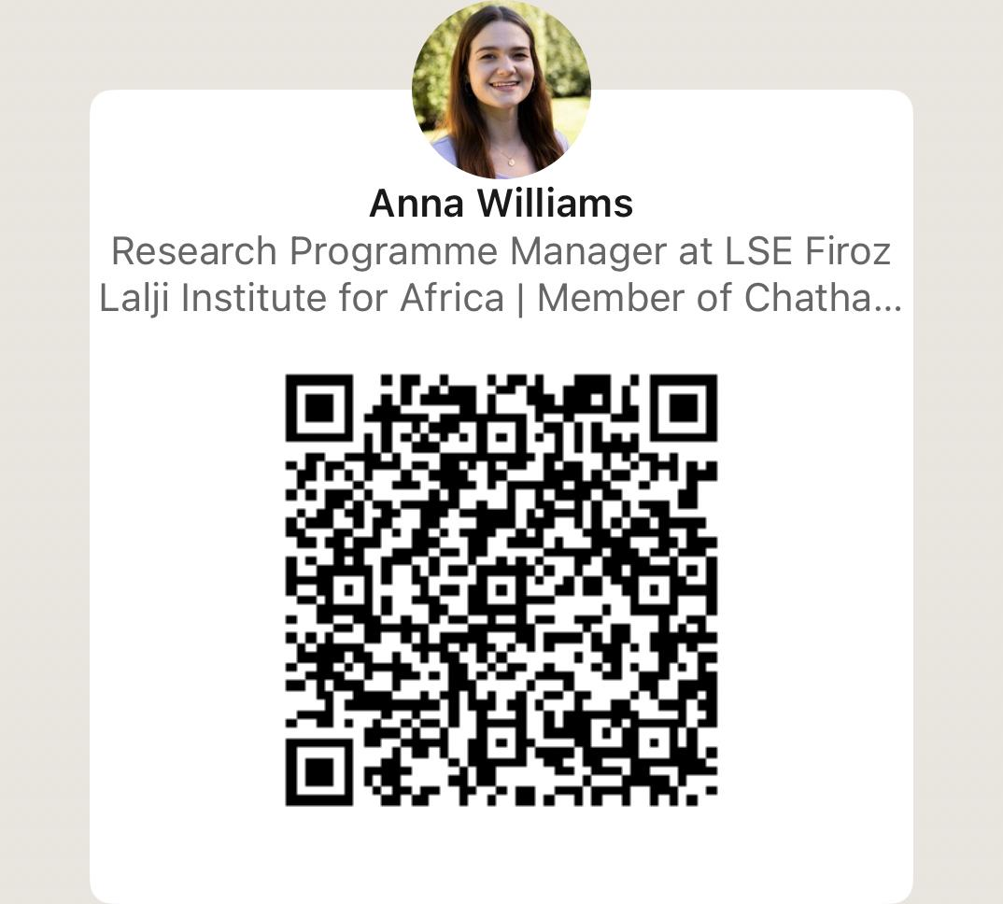
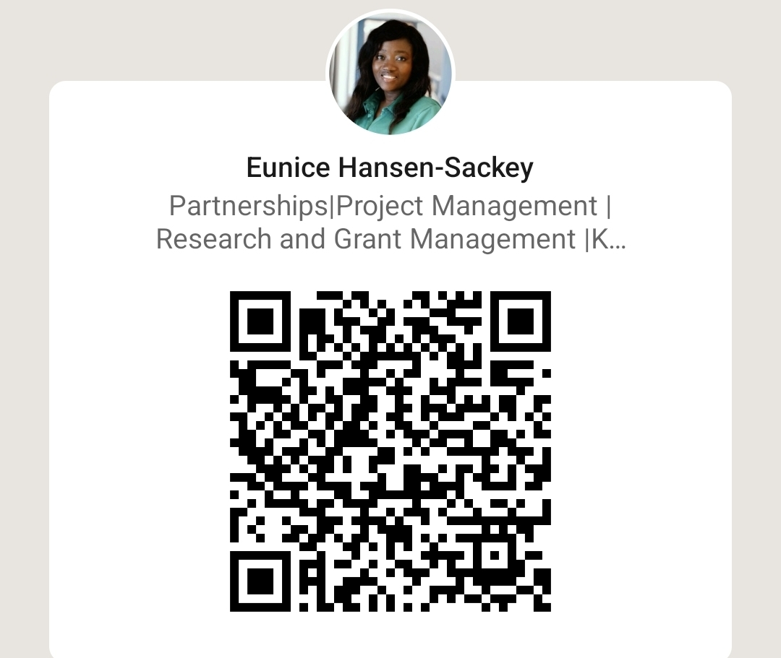
Let’s Connect
Anna Williams
Research Programme Manager
A.C.Williams1@lse.ac.uk
Eunice Hansen-Sackey
Research Grants Officer
E.Hansen-Sackey@lse.ac.uk
#ARMA2026

Slide 19

Thank you
Any questions?

Slide 20
Sources
Association of African Universities (AAU), African Research Universities Alliance (ARUA), African Academy of Sciences (AAS), Inter-University Council for Eastern Africa (IUCEA), Association of West African Universities (AWAU) , African Academy of Sciences (AAS), Perivoli Africa Research Centre (PARC) at University of Bristol, University of South Africa, University of Cape Town Institute for Humanities in Africa and CODESRIA (2023) Africa Charter for Transformative Research Collaborations. Available at: https://bpb-eu-w2.wpmucdn.com/blogs.bristol.ac.uk/dist/1/627/files/2023/07/Africa-Charter-for-Transformative-Collaborations.pdf
Raghuram , P., Cin, M., Gunter, A., Lekunze, M., Ong’eta, W., Schoeman, R. and van Vuuren, L. (2025). Building Equitable Partnerships in Africa. Available at: https://www.decolonising-education-for-peace-africa.org/sites/www.decolonising-education-for-peace-africa.org/files/Africa%20Report%20Building%20Equitable%20Partnerships%20V4%20WORD.pdf.
Aboderin, I., Fuh, D., Balcha Gebremariam, E., and Segalo, P. (2023). Beyond ‘equitable partnerships’: the imperative of transformative research collaborations with Africa. Global Social Challenges Journal 2, 2, 212-228, Available at: https://doi.org/10.1332/27523349Y2023D000000002
Royal Society. (2024). Research Culture | Royal Society. Available at: https://royalsociety.org/news-resources/projects/research-culture/.
London School of Economics. (2024). Research Culture at LSE. Available at: https://info.lse.ac.uk/staff/divisions/research-and-innovation/research-culture/Research-Culture-at-LSE.
Flint, A., Howard, G., Baidya, M., Wondim, T., Poudel, M., Nijhawan, A., Mulugeta, Y., and Sharma, S. (2022). Equity in Global North–South research partnerships: interrogating UK funding models. Global Social Challenges Journal 1, (1), pp. 76-93, Available at: https://doi.org/10.1332/VQIL8302
Moran, H., Karlin, L., Lauchlan, E., Rappaport, S.J., Bleasdale, B., Wild, L. and Dorr, J. (2020). Understanding Research Culture: What researchers think about the culture they work in. Wellcome Open Research, 5(1), pp.1–32. Available at: https://doi.org/10.12688/wellcomeopenres.15832.1
#ARMA2026

