Slide 1

The Digital Sustainability Card Game
A Tool for RMAs to Encourage Digital Sustainability in Project Design
DH
IE
UK
  James Baker
  University of Southampton
digitalhumanities-uk-ie.org

Slide 2
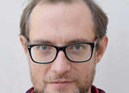
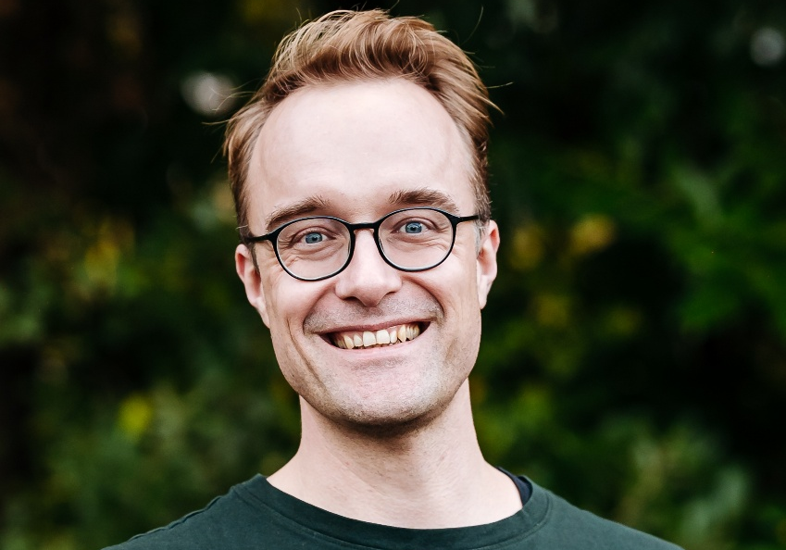
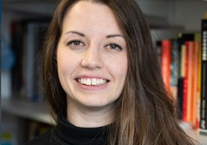
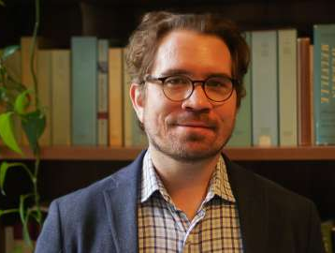

Who
James
Jo
Jo
Chris
Lisa
DH
IE
UK

Slide 3

Why
  Direct environmental impacts of digital technology
  Energy use — powering our devices, powering data centres and network infrastructure. If this is “dirty” energy, e.g. coal power, then there are carbon emissions, contributing to global warming
  Embodied carbon — carbon emissions associated with manufacturing devices, networks, data centres, etc.
  Tech metals and rare earth elements
  E-waste — processing e-waste can be harmful to workers and environment
  Water used for cooling some data centres
DH
IE
UK

Slide 4
Why
  But … let’s put that in context
  We’ll be talking about digital technology today, but let’s keep in mind that it is still a relatively small contributor to global warming.
  Good estimates are hard to come by, but digital technology might currently make up about 4-5% of our global carbon emissions.*
  Also digital technology enables us to do many things in more environmentally sustainable ways (videoconferencing vs. lots of travel).
* Freitag et al. (2021) estimated that in 2020 global emissions from Information Communication Technology (ICT) could be around 2.1%–3.9%. The same paper also estimated that if ICT emissions were to remain stable, and global emissions to decrease in line with 1.5 degrees, by 2024 ICT would be accounting for about 4.4% of the global carbon footprint. However, neither of these assumptions is a good reflection of the past five years: it is definitely time for a thorough reassessment.
DH
IE
UK

Slide 5
Why
  If it’s only a small contributor, why are we talking about it?
  Well, it’s not that small. It is in the same ballpark as aviation. It’s less than things like agriculture, construction, road transport.
  Digital technology has also been growing rapidly and projected to continue — closing digital divide, rise of AI, etc.
  Tech giants like Amazon, Google, Microsoft, Meta are also influential in shaping global net zero strategies more generally, and especially thinking on the role of technology in climate transition.
  Rebound effects can limit or undo efficiency gains.
DH
IE
UK

Slide 6
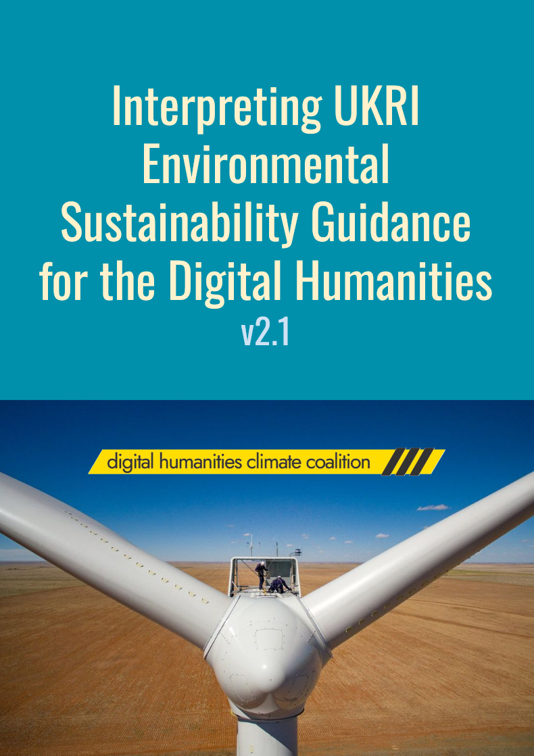
What
Little, H., Hayes, I., Baker, J., Otty, L., Walton, J. L., Ohge, C., Cummings, J., Dyer, M., Keinan-Schoonbaert, A., Kitcher, N., Mahoney, D., Sichani, A.-M., & Terras, M. (2026). Interpreting UKRI Environmental Sustainability Guidance for the Digital Humanities (v2.1). Digital Humanities Climate Coalition.
doi.org/10.5281/zenodo.19001739
DH
IE
UK

Slide 7
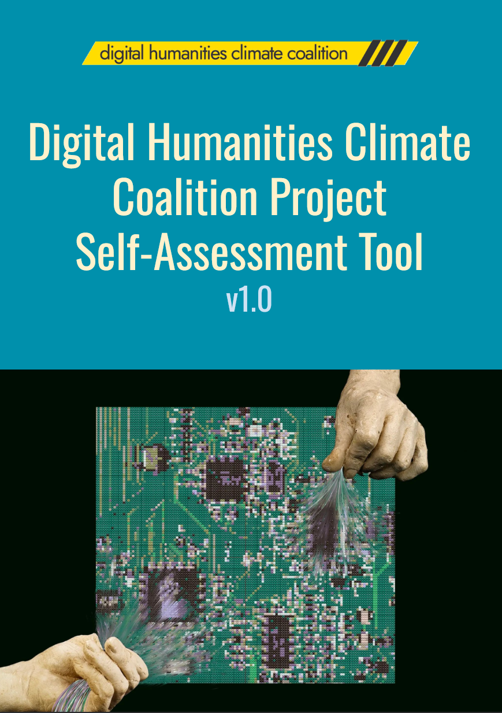
What
Baker, J., Otty, L., Walton, J. L., Ohge, C., Cummings, J., Dyer, M., Keinan-Schoonbaert, A., Kitcher, N., Mahoney, D., Sichani, A.-M., & Terras, M. (2026). DHCC Project Self-Assessment Tool (v1.0). Digital Humanities Climate Coalition.
doi.org/10.5281/zenodo.19004251
DH
IE
UK

Slide 8

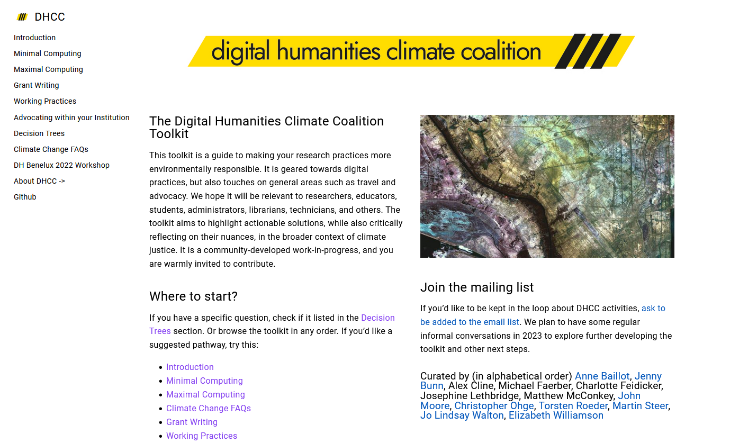
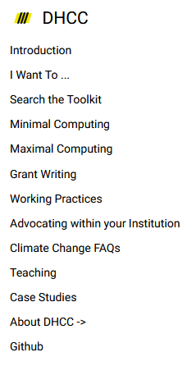

What
DH
IE
UK

Slide 9
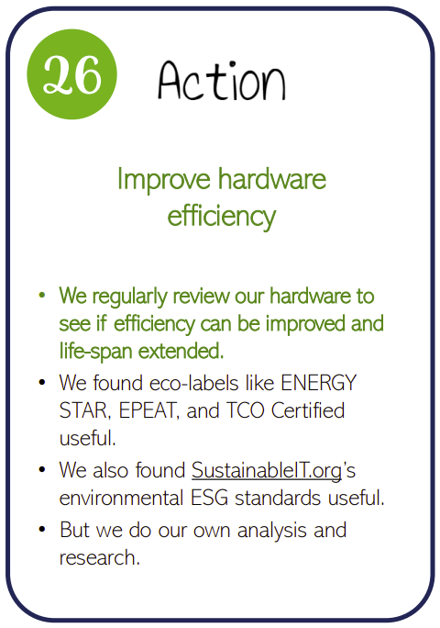
Digital Sustainability Game
  The game — we’ve created a card game to help teams and organisations learn about digital sustainability.
  The game — allows teams to roleplay possible Actions and how they align with possible future Events.
  Today — we use the brief break-out version of the game.
  Info — links to rules and cards can be found in the DHCC Toolkit.
DH
IE
UK

Slide 10
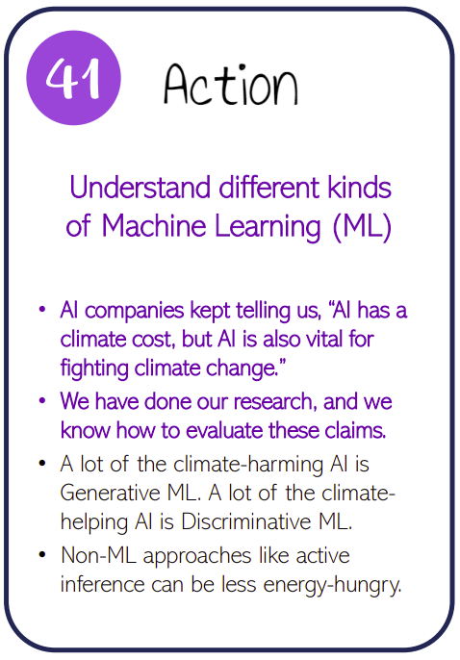
The Rules for Today
15 mins
  Familiarise — each table has 5 Action cards. Start by reading the title and top bullet point on each card.
  Arrange — place the cards on a matrix, one axis representing the imagined difficulty of implementing the action for a researcher or research team, and the other axis the imagined impact the action could have.
  Choose — once arranged, choose one or two cards and discuss what forms of advocacy would be needed to embed this action across your local context.
DH
IE
UK

Slide 11
5 mins
DH
IE
UK
  Reflections
  What did we learn?
digitalhumanities-uk-ie.org

Slide 12
DH
IE
UK
Thank you!
  James Baker
  University of Southampton
digitalhumanities-uk-ie.org

