Slide 1



Addressing the whole researcher in bid development:
a career-oriented approach
Chris Coey, University of Salford

Slide 2


The plan:
The role of bidding in the research career
Another way of looking at bidding
Some examples of practice
Possible benefits
Likely challenges
#ARMA2026

Slide 3
Why this idea, why now?
Research on research careers
Research development and grant writing
University Fellows and Researcher Development
If we think of researcher careers in the round, how does bidding (for example) emerge as a useful lens, with implications for our practice?
#ARMA2026

Slide 4
The challenge:
Researchers can experience bidding as…
An obligation
A disruption
Opportunistic and sporadic
…rather than as an integrated part of practice or strategic part of a career.
#ARMA2026

Slide 5

A Different Lens? Bid Writing as Inflection Point
A moment of identity reflection, deconstruction and reconstruction.
A moment in which a coherent vision of the future researcher is articulated.
A moment in which the institutional and external contexts become visible.
Leadership
Publications
Bid Submission
Networks
Impact
Networks
Impact
Publications
Leadership
The career lifecycle
Career – Identity - Context
#ARMA2026
Notes:
The bid is not the end point – it is a stage!

Slide 6
The ‘bid moment’ as an opportunity to encourage reflection : four examples from practice.
Example 1: cohorts, needs mapping and planning
Example 2: working with groups, strategies and visions
Example 3: 1-2-1s and a coaching approach
Example 4: follow-up conversations and learning from failure
#ARMA2026

Slide 7
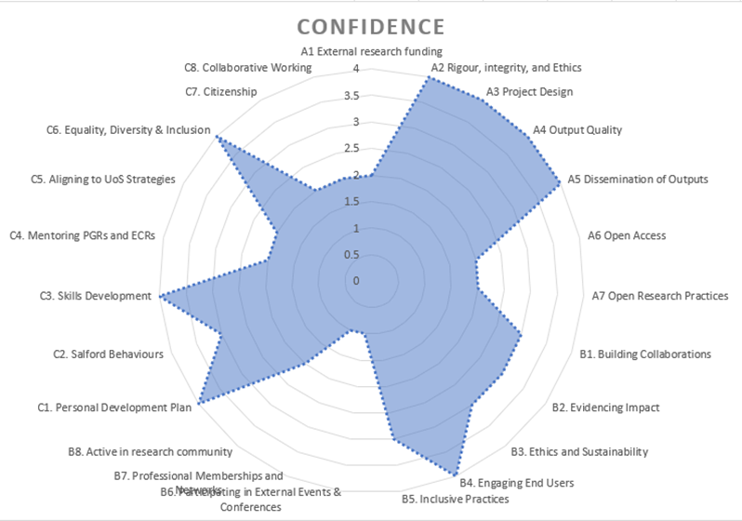
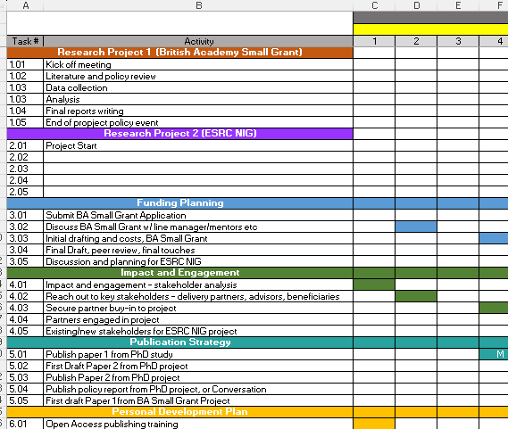
1. Cohorts: gaps, strategies and application
#ARMA2026

Slide 8
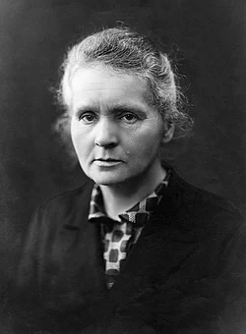


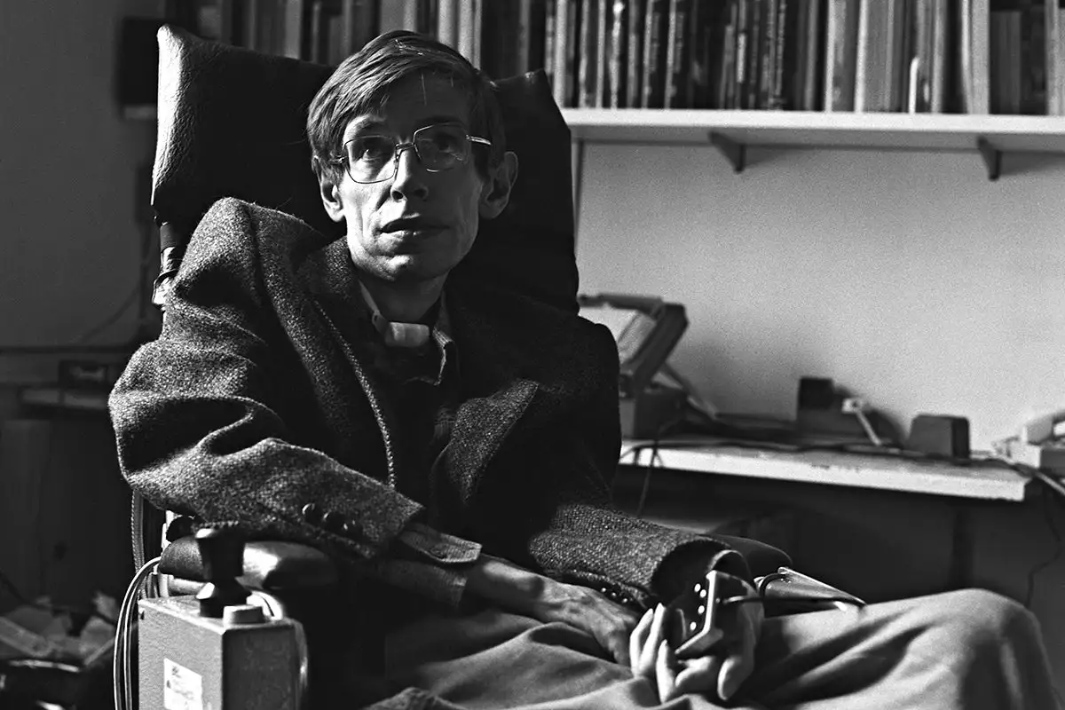

2. Working with groups: unpacking success.
What does a successful research leader look like?
?
#ARMA2026

Slide 9
Unpacking the pieces: identifying funding and its place
Innovation (theory, method, technical)
Stakeholder engagement
Visibility within discipline
Publications
Supervisions and mentorship
Research collaborations
Institutional leadership
Portfolio of research projects
Public profile
Funding
Real-world impact
#ARMA2026

Slide 10
3. 1-2-1 conversations: coaching and reflection
Two types of engagement:
Operational, content:
Understanding applications
Advising on what to write and where
Support in interpreting guidance
But… can we add a third, strategic, coaching type of question?
What have you done to get here?
What will you do next?
Who will you be in future as a research leader?
How does this bid help you get there?’
Rationalisation, concept testing:
Why this project?
Why this funder/scheme?
Why you? Why here? Why now?
Who cares?
#ARMA2026

Slide 11
4. 1-2-1 conversations: learning from failure
How do we follow up when a bid has been unsuccessful?
Often there’s a lack of funder feedback, but as professionals we have our own insights into individual researchers, their work and their bids
We can help tease out learning and other outcomes, which might include:
          Weaknesses in a bid or the way it was presented
          Insights into schemes and funders
          New connections and professional relationships
          New ideas about their own work
          Refined future plans
An opportunity to normalise bidding as part of the career journey, and normalise failure as constructive.
#ARMA2026

Slide 12
Why it Matters
Better conversations.
Better sense of research and researcher careers in context.
Better bidding/bids.
Better research culture.
But… challenges?
Time.
Timeliness.
Individual researcher.
Our own ability to see the bigger picture.
#ARMA2026

Slide 13
Final Thoughts
A bid is not an end point, but a single stage in a much longer career journey
A bid integrates multiple strands of a researcher’s identity
Research development conversations can encourage strategic thinking about career trajectories, identities and contexts
The questions we ask can contribute to researcher confidence and development, better bidding and more constructive cultures
#ARMA2026

Slide 14

Thank you
c.t.a.coey1@salford.ac.uk

