Slide 1


Equitable Partnerships for African Research Infrastructure and Capacity (EP for AfRICa)
Odile Masiá
University of Manchester

Slide 2


EP for AfRICa
International collaborations explored through the lens of research management
In 2024, the British Academy published a new call aimed at research offices: ODA Research Management Capacity Strengthening
This presentation will provide an overview of one of the awards: Equitable Partnerships for African Research Infrastructure and Capacity (PI Tshegofatso Seabi, University of Manchester)
The project brings together the University of Manchester, Addis Ababa University, Dar es Salaam University and Makerere University
#ARMA2026

Slide 3
An equitable partnership is a relationship where all
parties are valued, respected and have fair access to resources, opportunities and decision-making power
Dr. Hassan Iddy, senior lecturer, University of Dar es Salaam
#ARMA2026

Slide 4
Overview
Introduction
Collaborating partners
Project background
Project outline
What’s next
#ARMA2026

Slide 5



Introduction
Collaborative programme designed to strengthen research management capacity at the University of Manchester (UoM), Addis Ababa University (AAU), Makerere University (MU), and Mkwawa University College of Education (MUCE) affiliated to Dar es Salaam University
#ARMA2026

Slide 6
Collaborating partners
University of Manchester
Large Institution, multiple teams; UoM 2035 strategic ambition to work more effectively with global partners and collaborators
Addis Ababa University
One of the oldest and largest universities in Ethiopia, established in 1950, has vast experience of international collaborations
Makerere University
Established 100 years ago, it envisages repositioning itself to become a research-led university by 2030
Mkwawa University College of Education
Small and relatively young institution.
Recently began building research capacity and management function
#ARMA2026

Slide 7
Project background
Strengthening research management is increasingly recognised as a pillar of equitable international research collaboration
Despite growing research ambition and funding, some institutions have little or no dedicated resources for research management
Where systems do exist, misalignment between policies and processes across research functions often creates inefficiencies and barriers
These gaps affect the entire research lifecycle and can undermine collaboration
#ARMA2026

Slide 8
Project outline
Defining equitable partnerships
Identifying shared challenges
Understanding our respective institutional research infrastructures
Identifying opportunities for better engagement across research supportive roles
Delivery: in person workshops and virtual collaborative programme
#ARMA2026

Slide 9
What came out of the first workshop
The ambition to lead on applications responding to a mandate to be research led institutions
Best practice sharing on various research functions and areas of opportunity to cross learn
The importance of the full research life cycle approach
Acknowledged shared challenges in research support
#ARMA2026

Slide 10
Virtual collaborative programme
Various members of staff related to the topic join virtual sessions monthly to share best practice
Each organisation leads 3-4
Documented learnings from each discussion and refinement of topics in the toolkit
Best practice templates or frameworks are shared
#ARMA2026

Slide 11
What came out the virtual sessions
Time as resource is limited
Research managers/functions stretched thin
Dual roles for academics (researcher and research support)
Misalignment with research time allocation for researchers
Communication
Connectivity during virtual sessions
Language matters
Different forms of communication
#ARMA2026

Slide 12
What’s next
Final in person workshop in 2026
Launching toolkit
Embedding learnings within institutions
Expand knowledge to other partners/collaborators
Collaborative funding applications supported by the toolkit
#ARMA2026

Slide 13
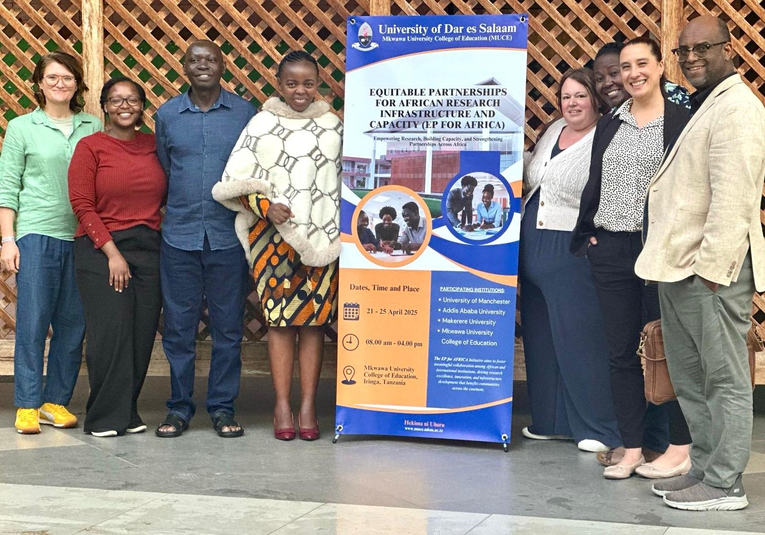
EPforAfrica@manchester.ac.uk
#ARMA2026

Slide 14

Thank you
Any questions?

