Slide 1

Streamlining REF2029 preparation and gathering impact evidence:
Using AI responsibly in research information management
Notes:
SCALE -- These slides are set up to standard size (ratio of 4:3). To change format please go to >> Page Set up >> change the ratio.

Slide 2

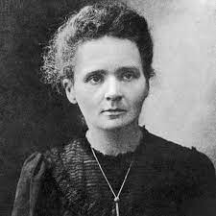

Who we are
Adrian Clark
Sales Manager (Figshare, Symplectic Elements)
Former librarian/research support professional
Shane Jackson
Product Specialist
Former Research Data Analyst (and REF veteran), University of Exeter UK

Slide 3
Familiar challenges
Managing output selections
Keeping track of impact evidence
Validating selections for output submissions
Quantifying impact
Supporting claims in environment statements

Slide 4
Digital Science’s AI tools can help
Extensive classification systems
Extraction of details like location, org type, document type
Generate prose from brief inputs
Parse text and PDFs, not just spreadsheets
Natural language summaries of information…

Slide 5
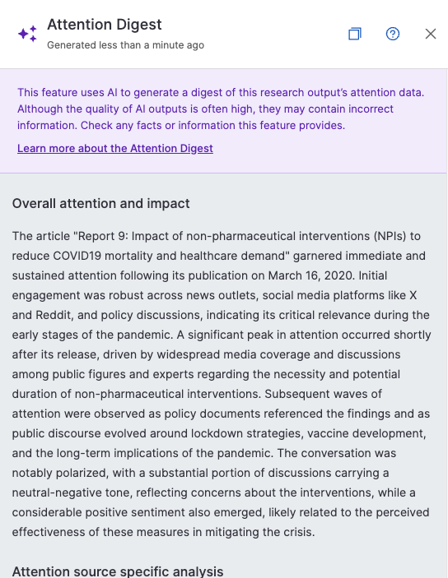
Impact digests

Slide 6








How do we do this?
164.3m
Publications
125m full text index
3.6m links
1.2m
Clinical
trials
703k links
27m links
2.3bn links
314.2m
Altmetric
data
points
29m links
179.3m
Patents
42k links
869k to funders
5.1m links
3.6m links
28m links
51m to funders
571m links
315k links
432k to funders
2.6m
Policy documents
8.2m
Grants
$3.4 trillion
in funding
72.5m
Datasets
28m links
29m to funders
Status: Apr 2026

Slide 7


Data enrichment
Incoming data
Dimensions enriched metadata
Enrichment
Institution identification
Organizations
Categorization
Classifications
Publications
Clinical trials
Concept
extraction
Concepts
Altmetric
Patents
Researcher
disambiguation
Researchers
References
Metrics
Datasets
Grants
Policy
docs
Reference extraction
Locations

Slide 8
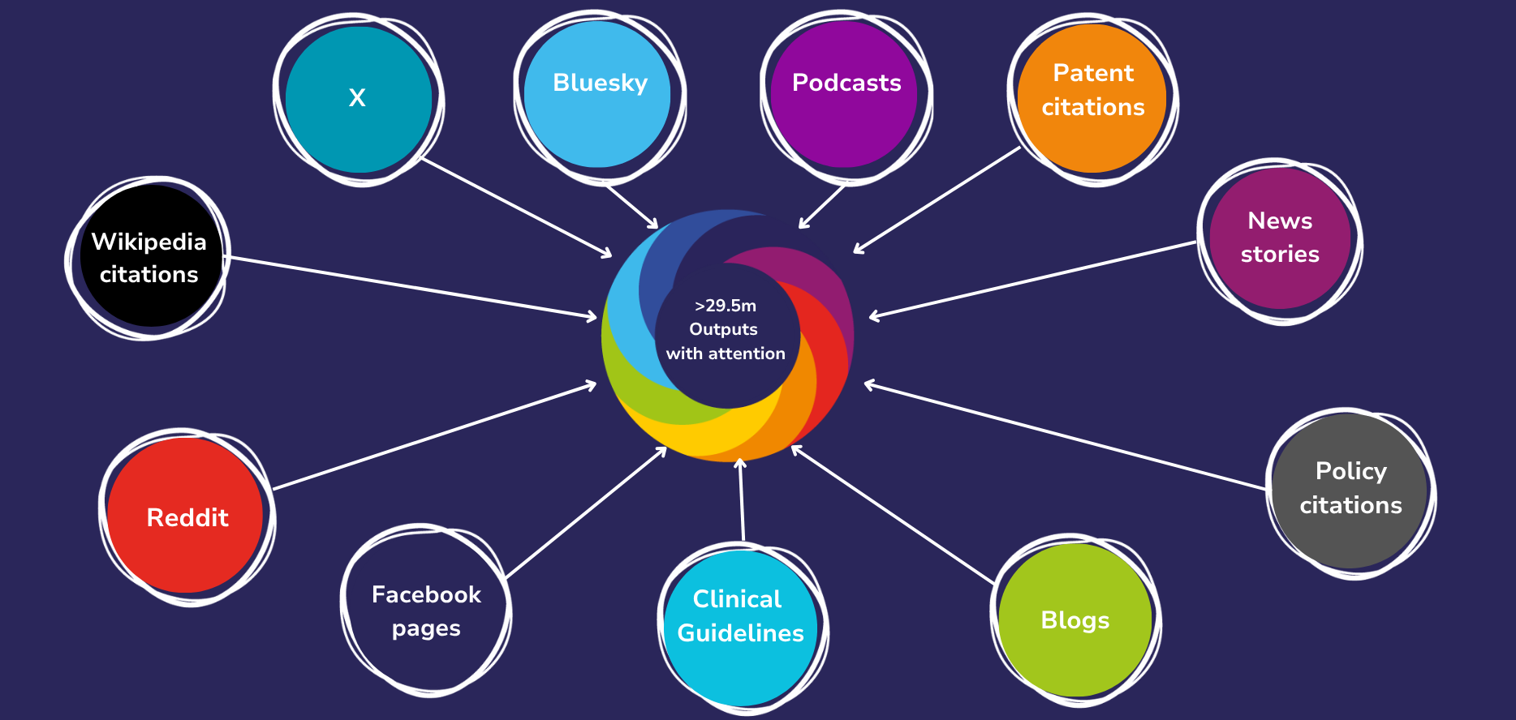

Slide 9
Let’s see it in action
Unit of Assessment sense-checking in Dimensions
Coverage of breadth of research
Evidence the benefit of partnerships across both platforms
Tracking policy citations in Altmetric; and summarising their significance

Slide 10
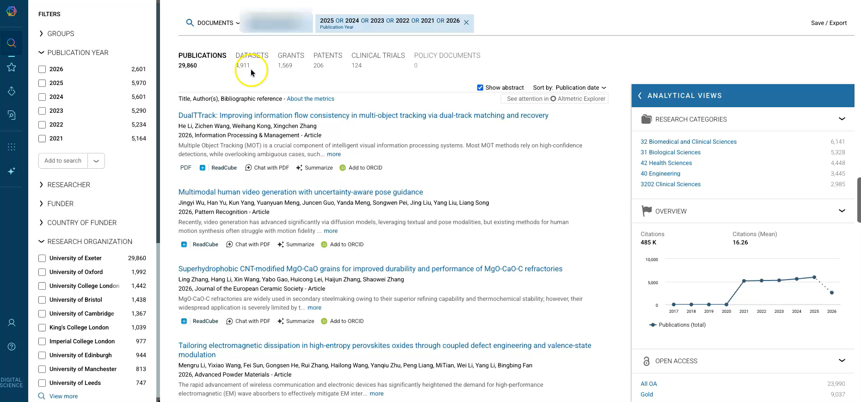
UoA sense-checking

Slide 11
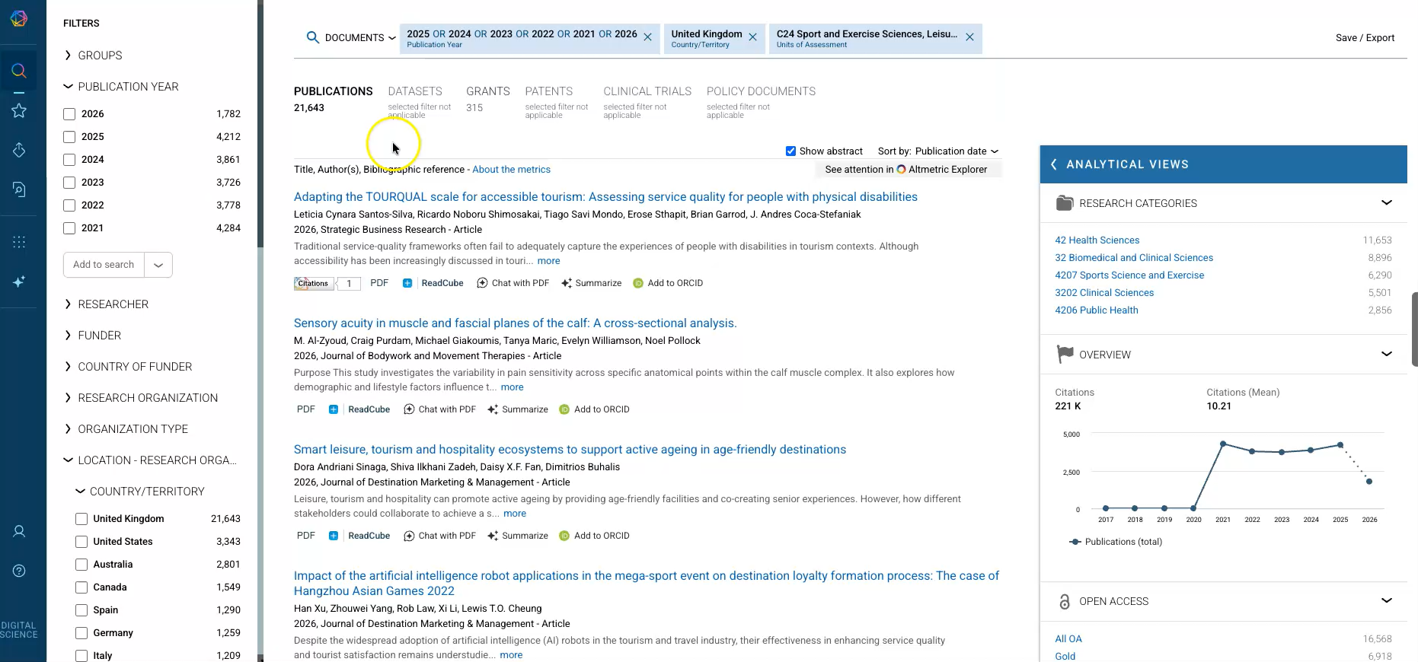
Coverage of breadth of research

Slide 12
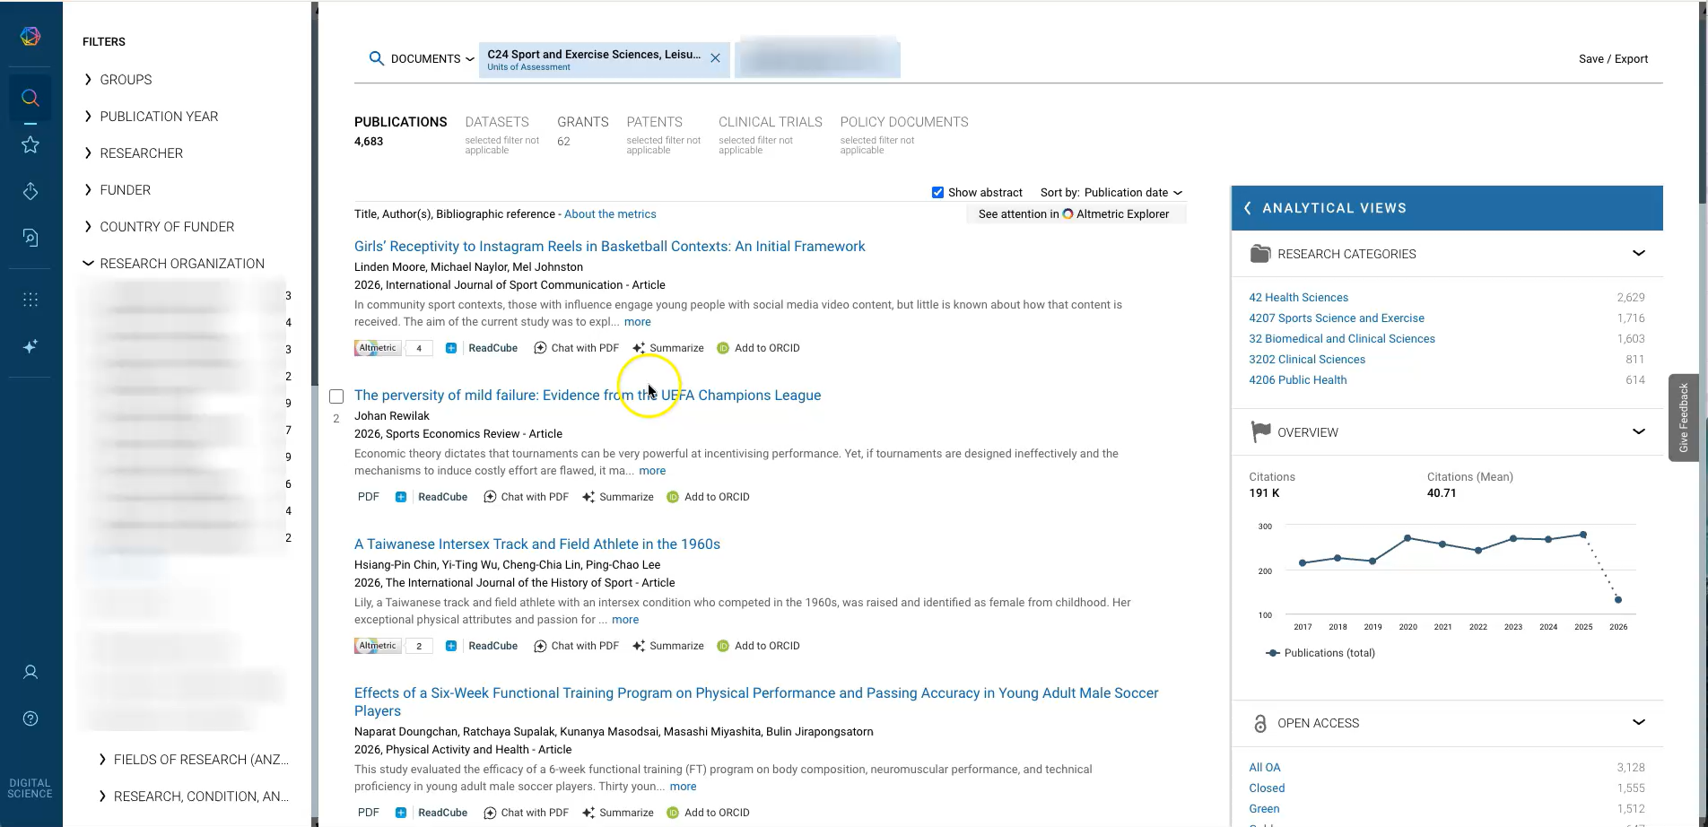
Evidence of partnerships and outcomes

Slide 13
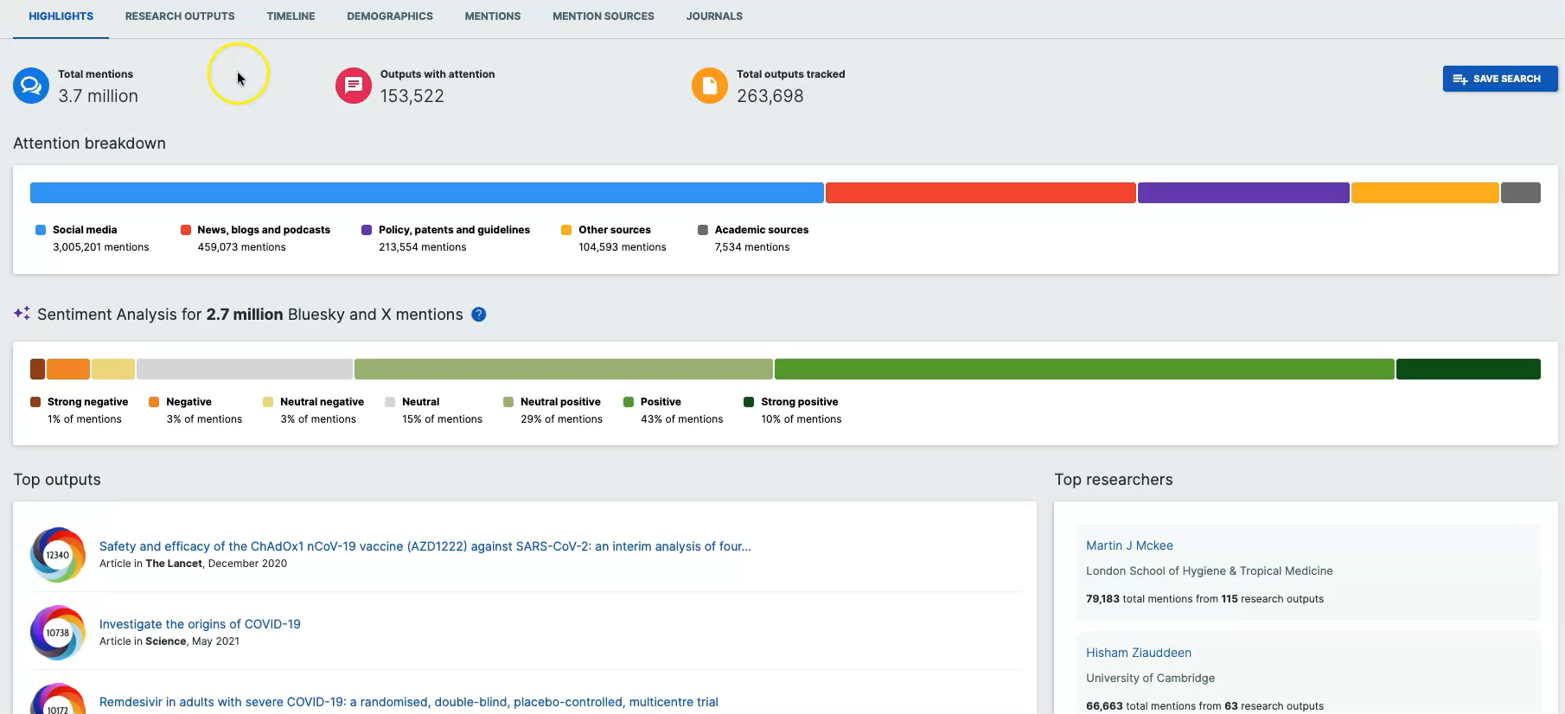
Tracking policy citations

Slide 14
Integration between systems
Dimensions and Altmetric play nicely together and with Elements
  Both have API and SQL database versions
Use Dimensions as a data source for Elements
Use HR, grants management and other systems to populate Elements
  …then use Elements to import your org structure to Altmetric
Benefits:
  Avoid duplication and complex mapping
  Easier dimensional modelling in reporting
  Confidence across tools

Slide 15

Working with structured data in your CRIS

Slide 16
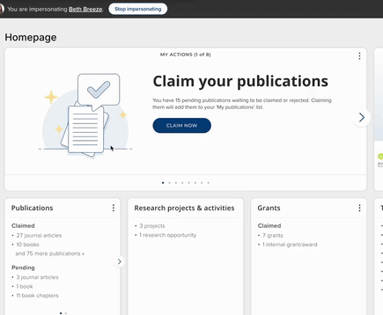
Automated Claiming

Slide 17
Automated Claiming challenges
Incomplete automated capture for non-STEM disciplines: Faculty in non-STEM fields often produce outputs that may not be able to automatically harvested, requiring additional manual effort to maintain complete and representative profiles.
Unstructured documentation of activities: Service and teaching details often exist only in CVs, making them hard to standardise.
Severe Information Gaps: Critical gaps in reporting, and institutional assessment emerge when automated claiming is the only data input method.

Slide 18
The Challenge
The Manual Entry Barrier

Slide 19
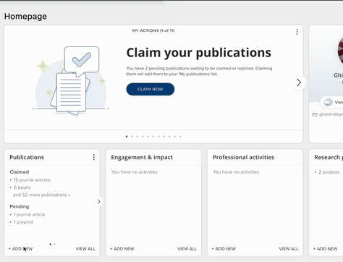
Manual Entry

Slide 20
Manual data entry challenges
Time-intensive profile maintenance: manually updating profiles across activities increases workload and is error prone, leading to slow adoption and incomplete data.
Reliance on administrative staff or delegates: institutions often depend on staff to manually maintain records, placing pressure on internal teams.
Some institutions report averages of 20 hours spent gathering, reviewing, and entering information to complete a profile for new faculty

Slide 21
These are universal challenges and a perfect match for an AI solution
Introducing Symplectic Elements’ AI-Assisted Profile Curation
Notes:
Elements uses AI to do this

Slide 22
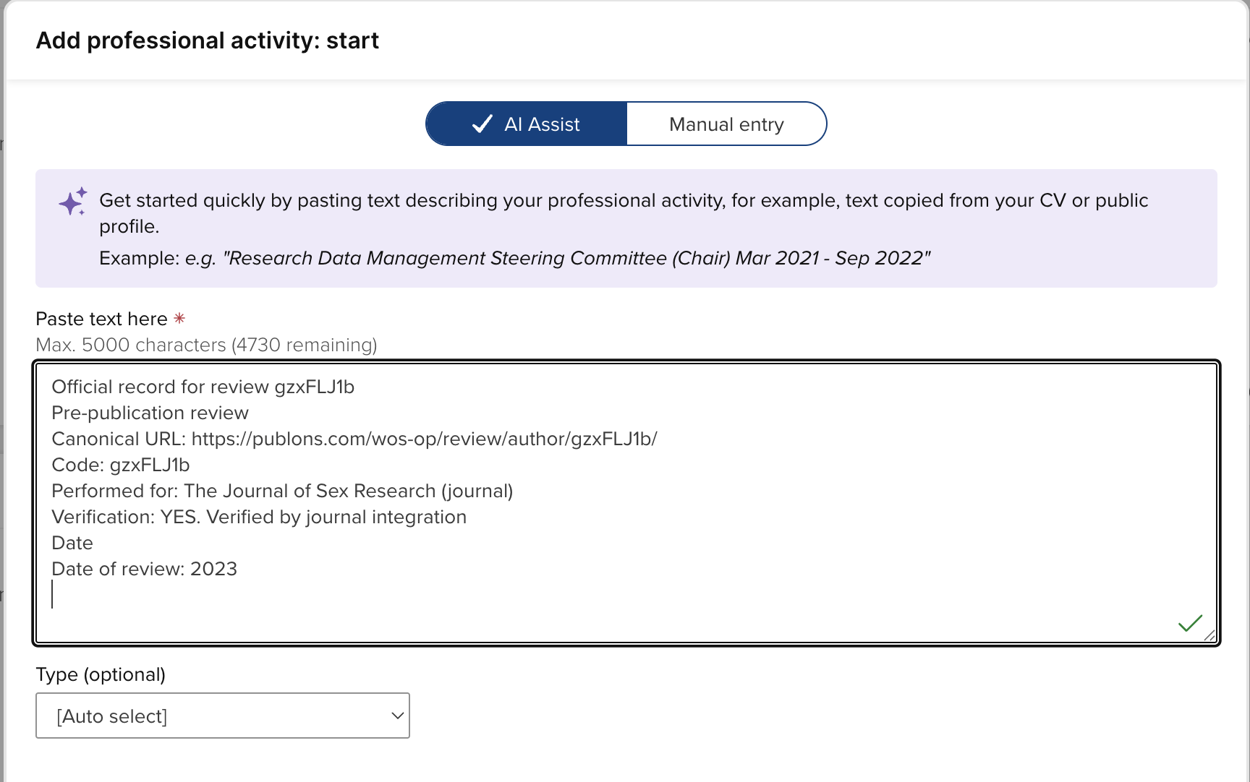
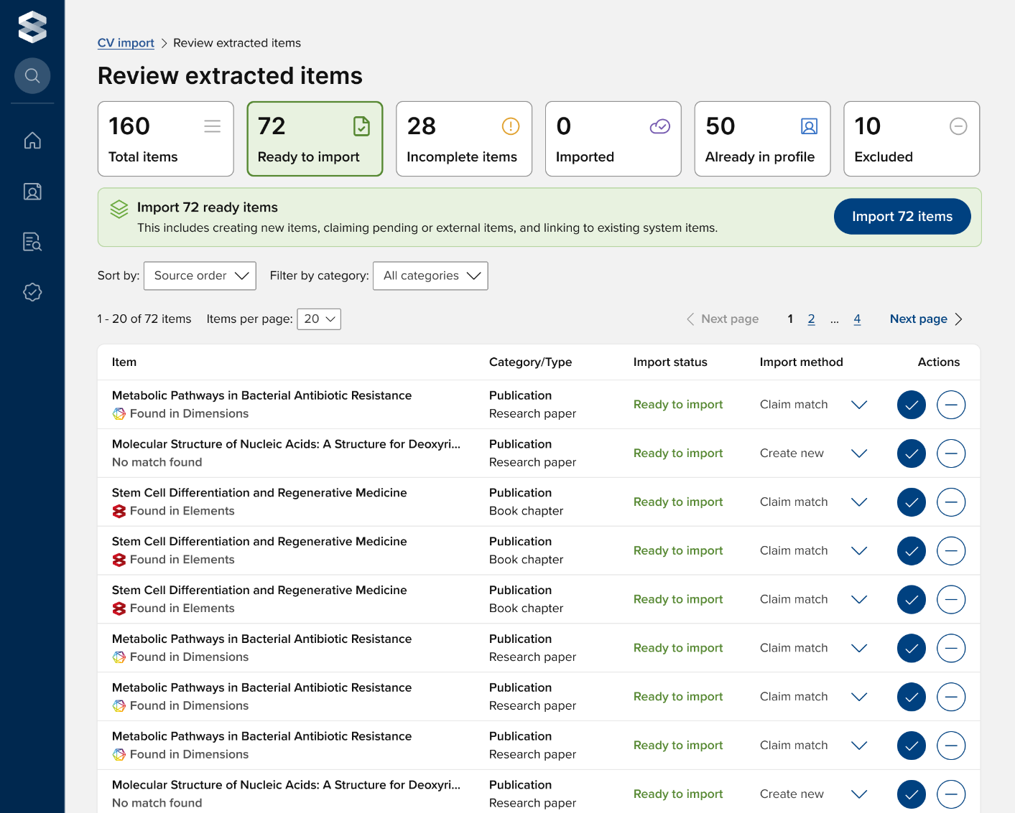
AI-Assisted Profile Curation
AI-assisted data entry
(single-item; text only)
AI-assisted CV import
(bulk import; PDF or text)
Notes:
TALK THROUGH AI ASSISTED DATA ENTRY AND DEMO AI ASSISTED CV IMPORT

Slide 23





AI-Assisted Profile Curation: Example Use Cases
Onboarding new faculty
AI-Assisted Profile curation helps University Administrators create complete profiles quickly for timely reporting, assessment, and discovery
Preparing for assessments
AI-Assisted Profile curation ensures profiles are richer with both traditional and non-traditional research outputs
Managing student workers
As a University Administrator, I need my student workers to curate faculty profiles in Elements faster amid tighter budgets and staffing

Slide 24
The Gains

Slide 25

Early feedback shows good results
"University of Oregon's experience using the AI-assisted entry tool has helped us implement the system quickly at the university, has particularly supported the data collection for faculty in our professional schools, and has encouraged faculty and administrator buy-in.”
Katy Krieger, Ph.D., Interim Director of Faculty Personnel and Policy, University of Oregon

Slide 26

A true end-to-end workflow from a raw CV document to a fully structured institutional researcher profile
AI-Assisted Profile Curation
Structured Research Data
Extracts metadata from documents into structured records, transforming unstructured CVs into high-quality research info.
Improved Data Integrity
Intelligent matching identifies existing records, preventing duplicates and maintaining clean institutional data.
Profiles are richer
Supports capture of publications, grants, and non-traditional outputs for a complete view of researcher contributions.
Seamless Experience
Fully embedded in Elements, working within existing workflows and governance without disruption.
Onboarding Velocity
Pre-populated records reduce manual effort, enabling faster faculty onboarding and profile completion.
Trusted & Governed
Secure processing with human-in-the-loop design principles through user review controls and confirmation steps.

Slide 27
Responsible AI

Slide 28
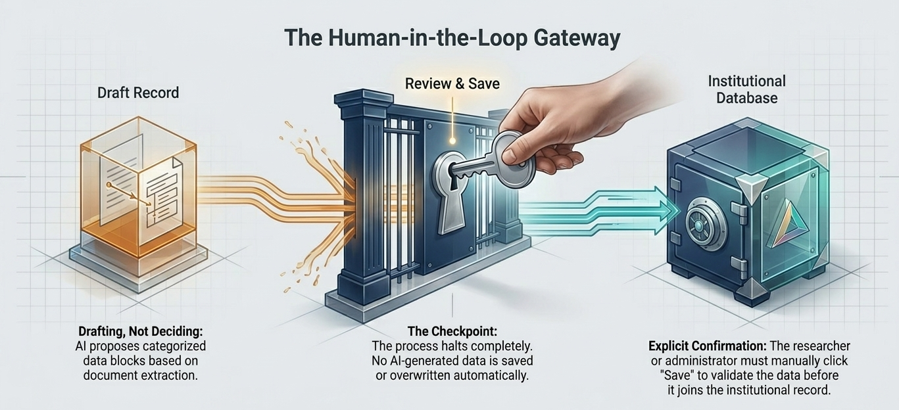
AI as a drafter, human as the decision-maker

Slide 29
Secure Processing
All data is processed securely to maintain the highest standards of safety.
Data Privacy
No information is used to train third-party models.
Responsible AI at Digital Science
Control & Consent
Institutional opt-in and individual opt-out options are available.
No Automation Risks
The AI never creates, modifies, or overwrites data automatically.
Sustainability
Considering the environmental and societal impact of AI technologies.
Informed Adoption
Institutions need to make informed decisions about adoption.

Slide 30
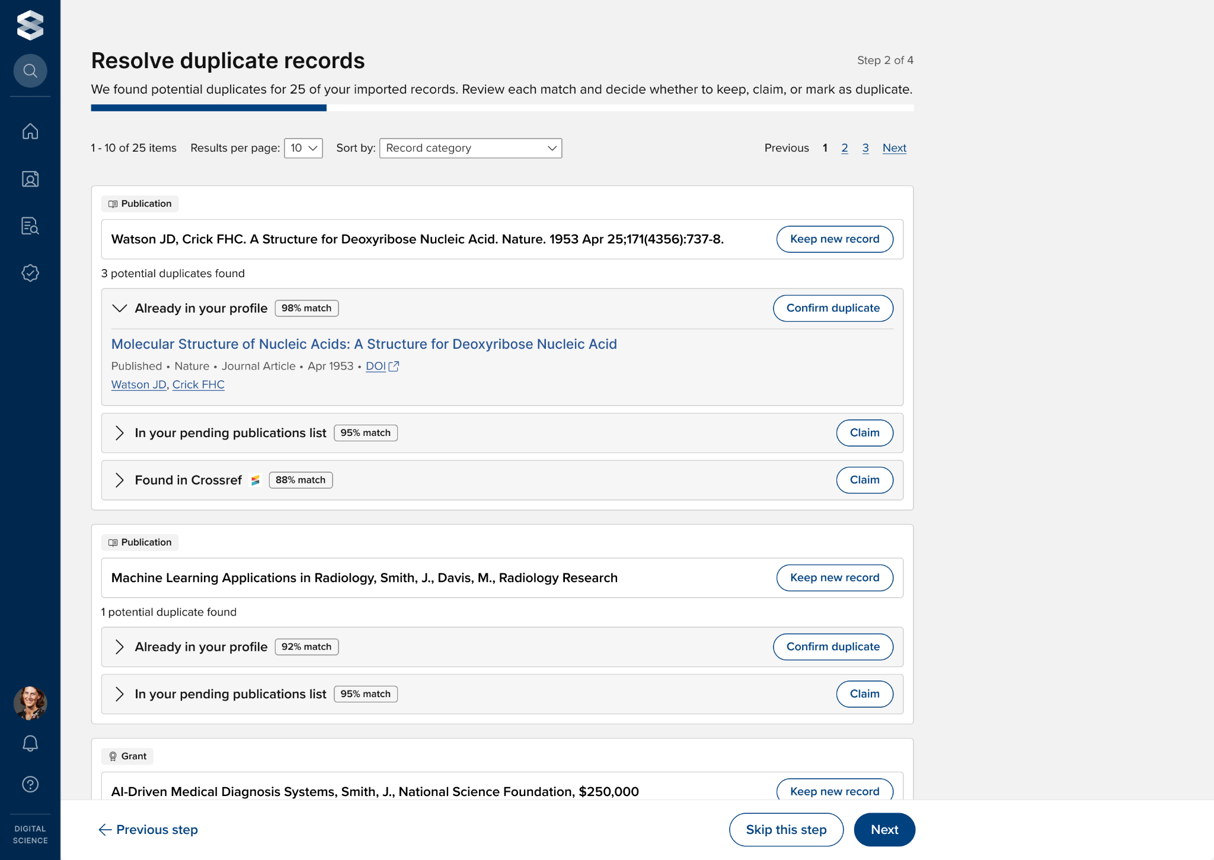
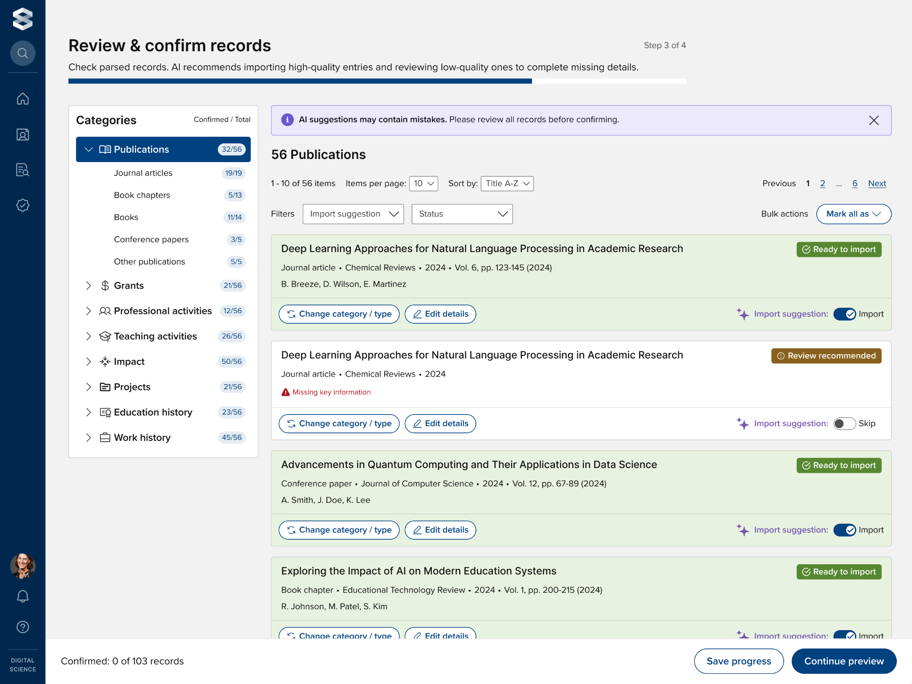
Human oversight remains crucial for bulk workflows
Interface designs highlighting manual verification steps within the automated CV import workflow

Slide 31
PACE Framework

Slide 32
PACE Dimension | The Question It Answers | REF 2029 Application | Digital Science Examples
Purpose-led adoption | Why are we using AI here? | Surfacing impact evidence, reducing equity gaps in profile completeness, improving metadata quality | CV import and AI data entry designed to close discipline gaps, not automate for its own sake
Accountability structures | Who reviews, owns, and can override AI output? | Defining human sign-off points in UoA selection, output metadata checking, SPRE narrative drafting | No data saved without explicit user confirmation; institutional opt-in/opt-out; category-level controls
Coverage and equity | Who does this AI serve and who does it miss? | Ensuring non-traditional outputs, arts/humanities, and early-career researchers are represented | Supports publications, grants, professional and teaching activities; designed for non-STEM disciplines
Evaluation and iteration | How do we know if it's working, and when do we revisit? | Benchmarking profile completeness pre/post adoption; assessing equity of UoA submissions at REF close | University of Oregon: faster onboarding, faculty buy-in, professional school adoption

Slide 33
PACE Dimension | Vendor Question
Purpose-led adoption | Which specific research output types and disciplines does your AI support, and where are the known gaps?
Accountability structures | Where does human review sit in the workflow, and is it possible to bypass it?
Accountability structures | What controls do institutions have to enable or disable AI features at a global or category level?
Coverage and equity | How does the tool handle non-traditional outputs such as policy reports, performances, or professional activities?
Coverage and equity | Is our data used to train or fine-tune any third-party models, and where is it processed?
Evaluation and iteration | What mechanisms exist for institutions to report AI errors, and how does the vendor act on that feedback?

Slide 34

Poll!
https://www.menti.com/al27okaggah5

Slide 35

Thank you!
Come see us at our exhibition stand

