Slide 1

Navigating complexity: A pragmatic best practice approach to supporting research cultures across a single University
Dr Sarah Masefield, Research Culture Manager
Research Culture & Researcher Development team

Slide 2



Problematic conflation klaxon
SPRE* and
research culture
are not synonymous
*Strategy, People and Research Environment

Slide 3
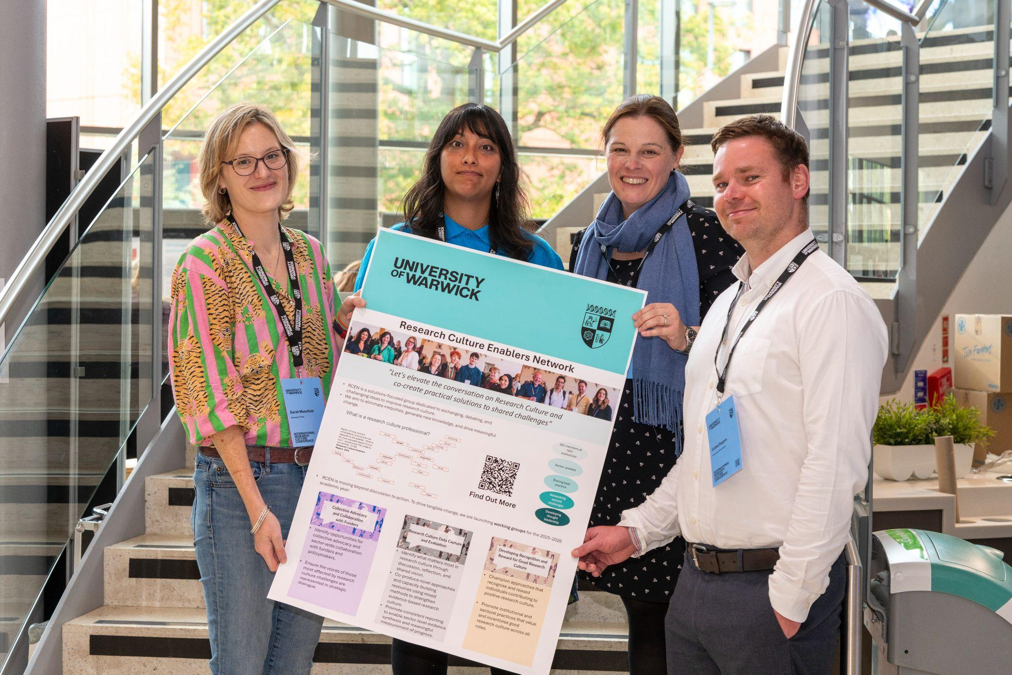
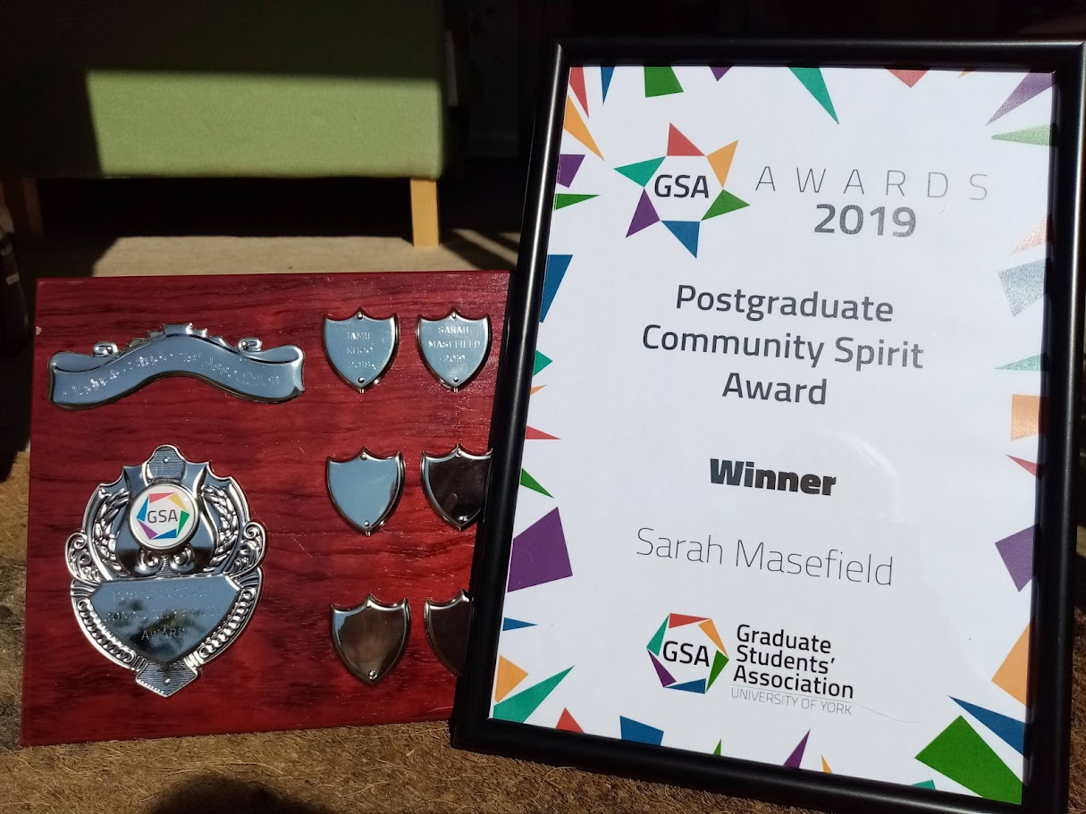
Me - for context
My background:
Clinical
Charity
Academia
Research Culture
Values:
Evidence-informed
Peer-support
Action-focused
Co-lead the RCEN Data Capture and Evaluation Working Group

Slide 4
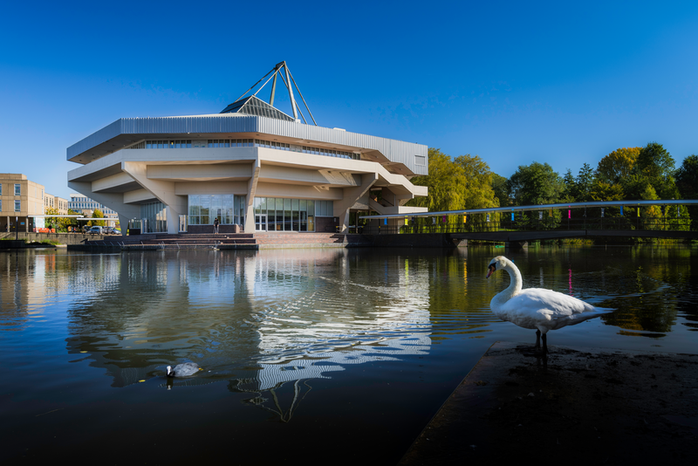
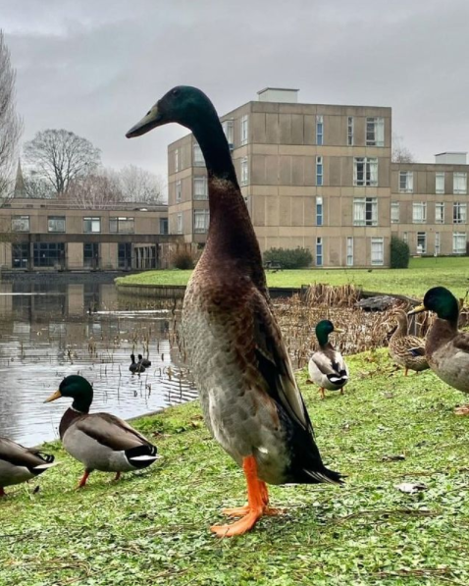
University of York context
Research intensive Russell Group (est. 1963)
REF 2021:
10th for research quality
12th for outputs & impact
11th place for research environment
‘Recognition of the support provided via
facilities, mentoring and career development’
Since 2021…adverse impact/changing practices:
2020 Covid-19
2024 financial challenges

Slide 5
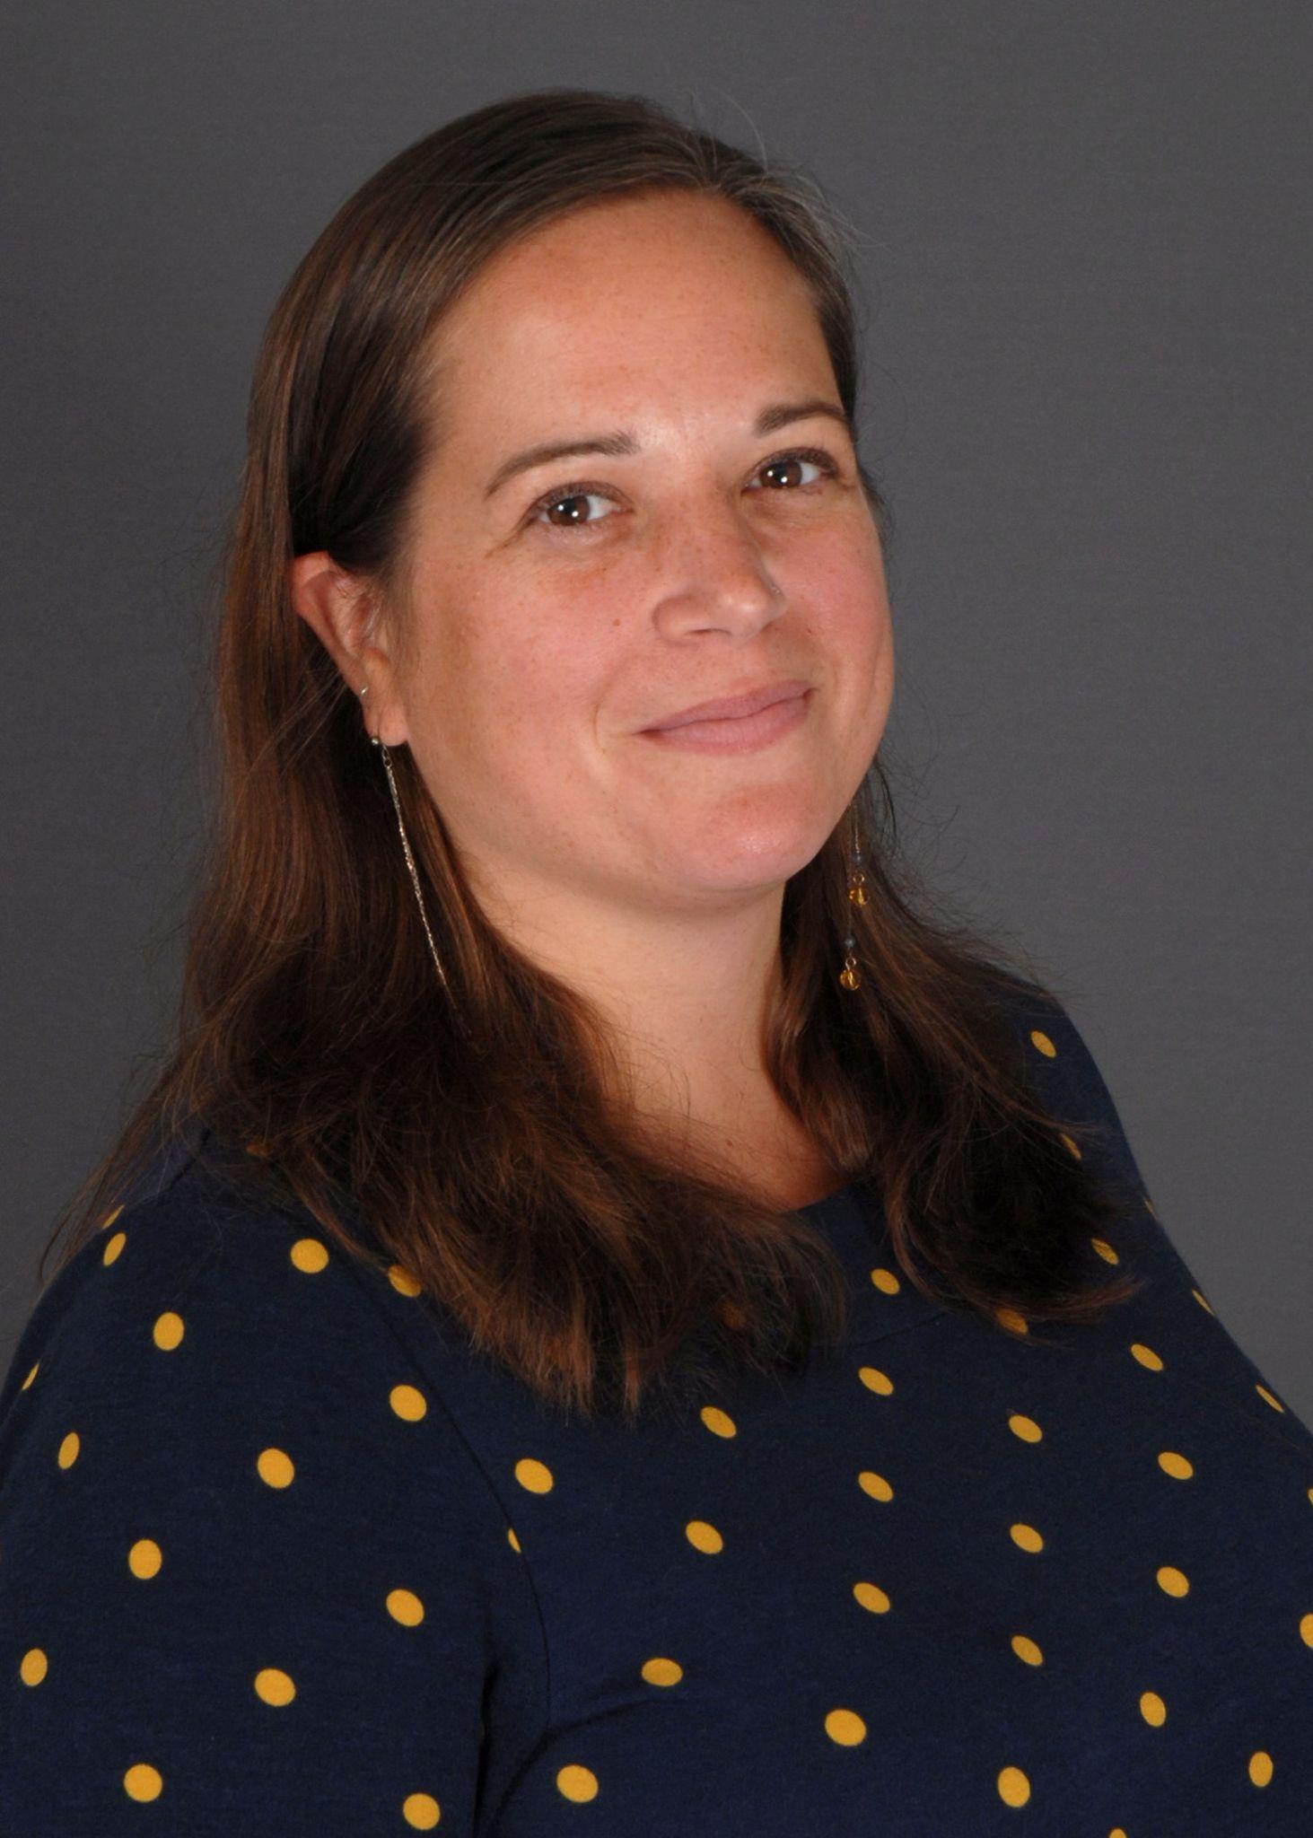
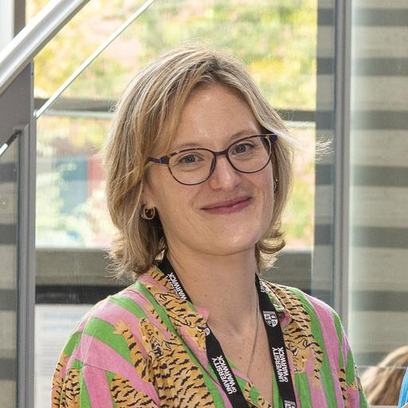

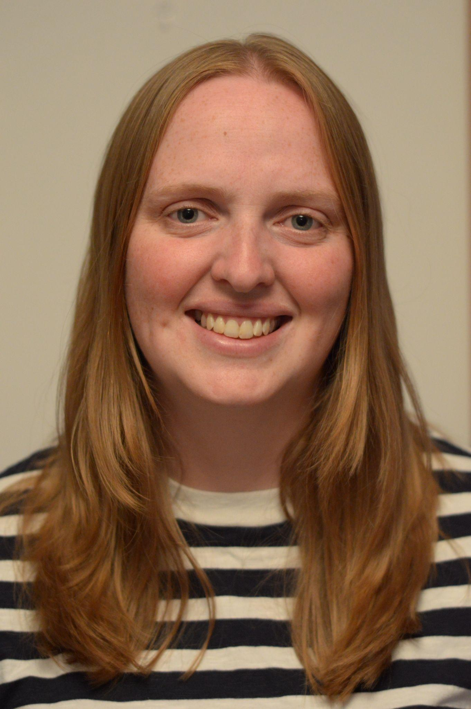
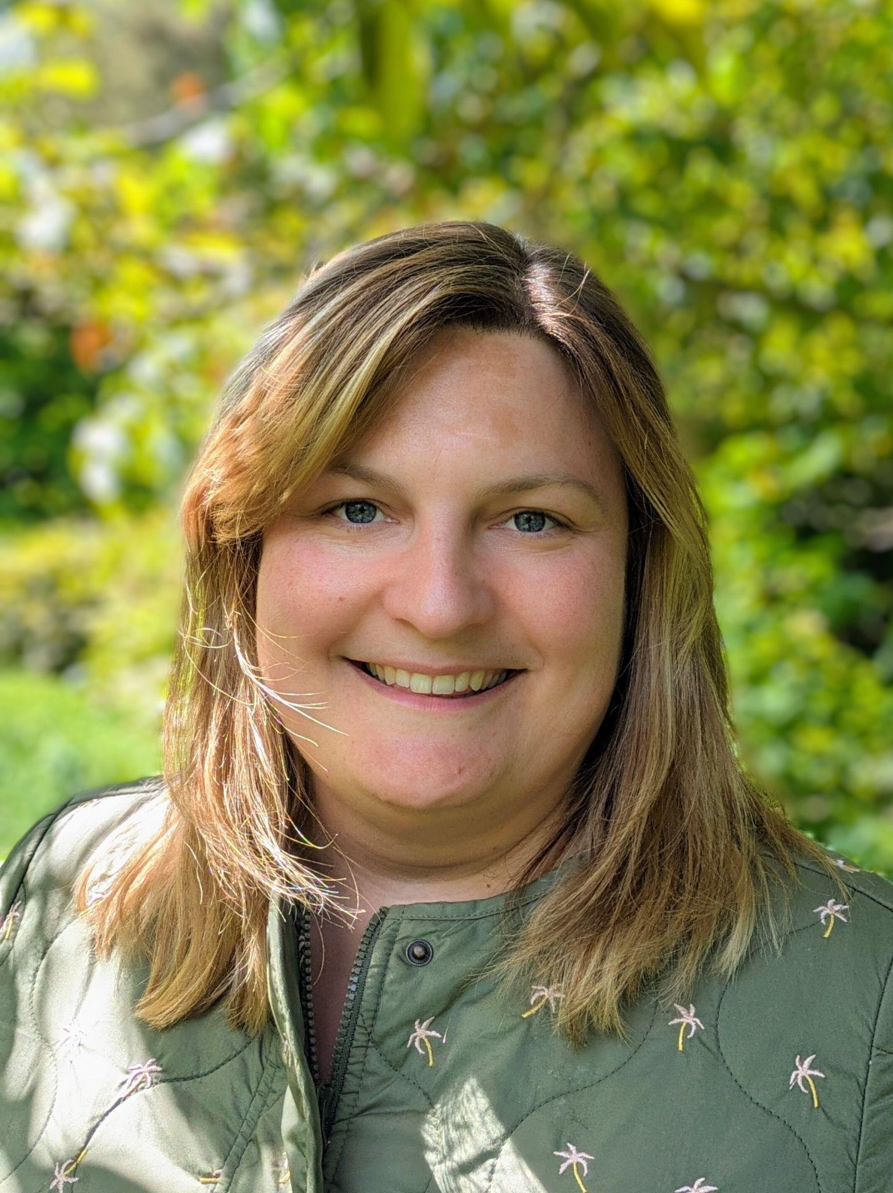

The Research Culture and Researcher Development Team
Megan McLoughlin,
Head of RC&RD
Sarah Masefield,
Research Culture Manager
Dominika Butler, Researcher Developer (PGRs)
Hazel Lawrence, Researcher Developer (ECRs)
Sarah Penny, Researcher Developer (Fellows)
Stewart Barker, Administration & Communications Manager
Connecting teams
Library, Archives & Learning Services
HR People & Organisational Development
York Graduate Research School
Next Generation
RSVP
Policy, Integrity and Performance team (PIP)
Public Involvement & Participatory Research
York Policy Engine (TYPE)
Research Communications

Slide 6
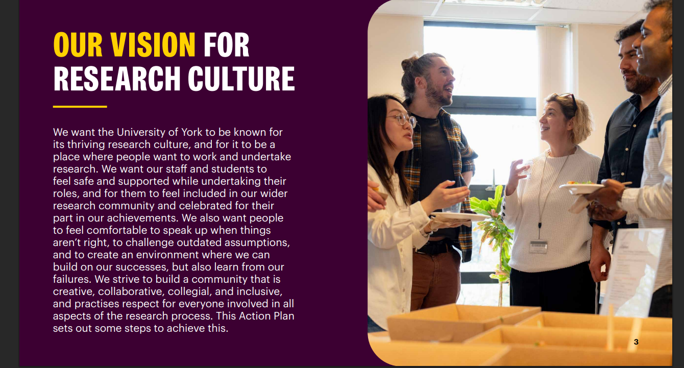
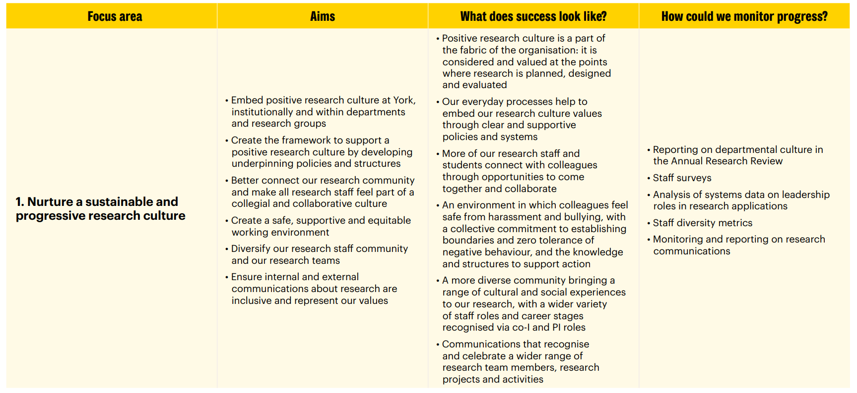
UoY research culture context
Alignment: UoY Research Strategy
Period: 2024-2030
Stakeholder engagement: Whole research community
Enablers: Enhancing Research Culture QR funding
2025/26 focus:
Establish support to help departments develop a strategic approach to research culture at department/School/UoA level
Individual & department participation in the PCE pilot
Mission - To be ‘a place where people want to work and undertake research’

Slide 7
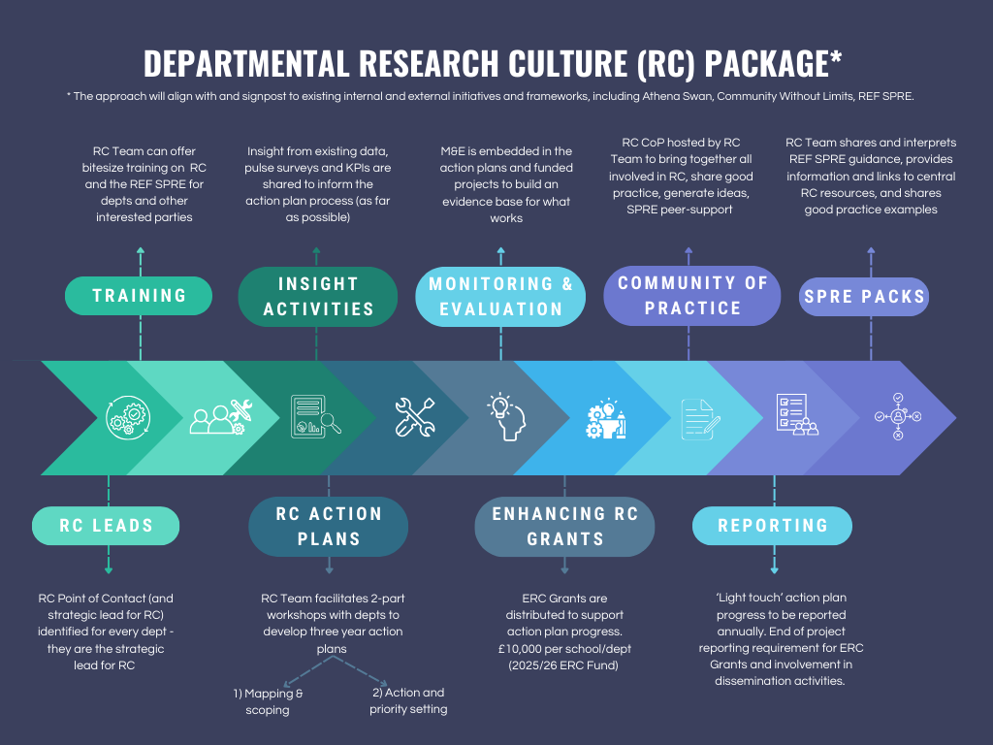

Slide 8
Research culture workshops
1: Mapping & scoping
2: Action & priority setting
Funding
2 hour workshop
Senior leadership attendance ++
To map existing activity against the focus areas of the RCAP
Output: A strengths and gaps summary - for action planning and SPRE

Slide 9
Theme 1: Nurture a sustainable and progressive research culture
PCE: Strategy
(& Inclusivity)
Strategic pressures/planning to be mindful of?
Areas | Leadership (for & by) | Late- career | Mid- career | ECR | PGR | PS | Other e.g. Technician | Minoritised groups
Connection & collegiality
Safe, supportive, and responsible working environment
Decolonising research structures/practices & promoting equitable global partnerships
Develop and share dept-level RC (awareness, visibility, expectations)
Diversify research staff community
Encourage and recognise good citizenship
Supportive spaces (collegiality, wellbeing, interdisciplinarity)
Inclusive communications & representation (committees)
Systems & support for informing and evidencing RC initiatives

Slide 10
Research culture workshops
1: Mapping & scoping
2: Action & priority setting
Funding
2 hour workshop
Same attendees + more staff representation
To set achievable outcome-focused actions and timescales for implementation
Output: 3 year RC action plan
Principles: non-judgemental; support not burden; facilitated not led; REF aware not driven

Slide 11
Outcome-focused action setting exercise
1) Generate ideas for possible actions to address the needs
2) Identify the potential impact of these - could consider short, medium and longer term impact
*We are not interested in operational concerns at this point*
1. Need/Priority area | 2. Outcome - what is the change you want to see? | 3. Activities - What can you do to achieve the outcome? | 4. Link to existing strategic initiative e.g. PRES/AS action plan, research strategy

Slide 12
Research Culture workshops
1: Mapping & scoping
2: Action & priority setting
Funding
Up to £10,000 for each school/department
Application stating:
  the research culture need/gap
  actions to address the gap
  how they’ll know if it's been successful (proportionate and appropriate M&E)
  estimated costing

Slide 13
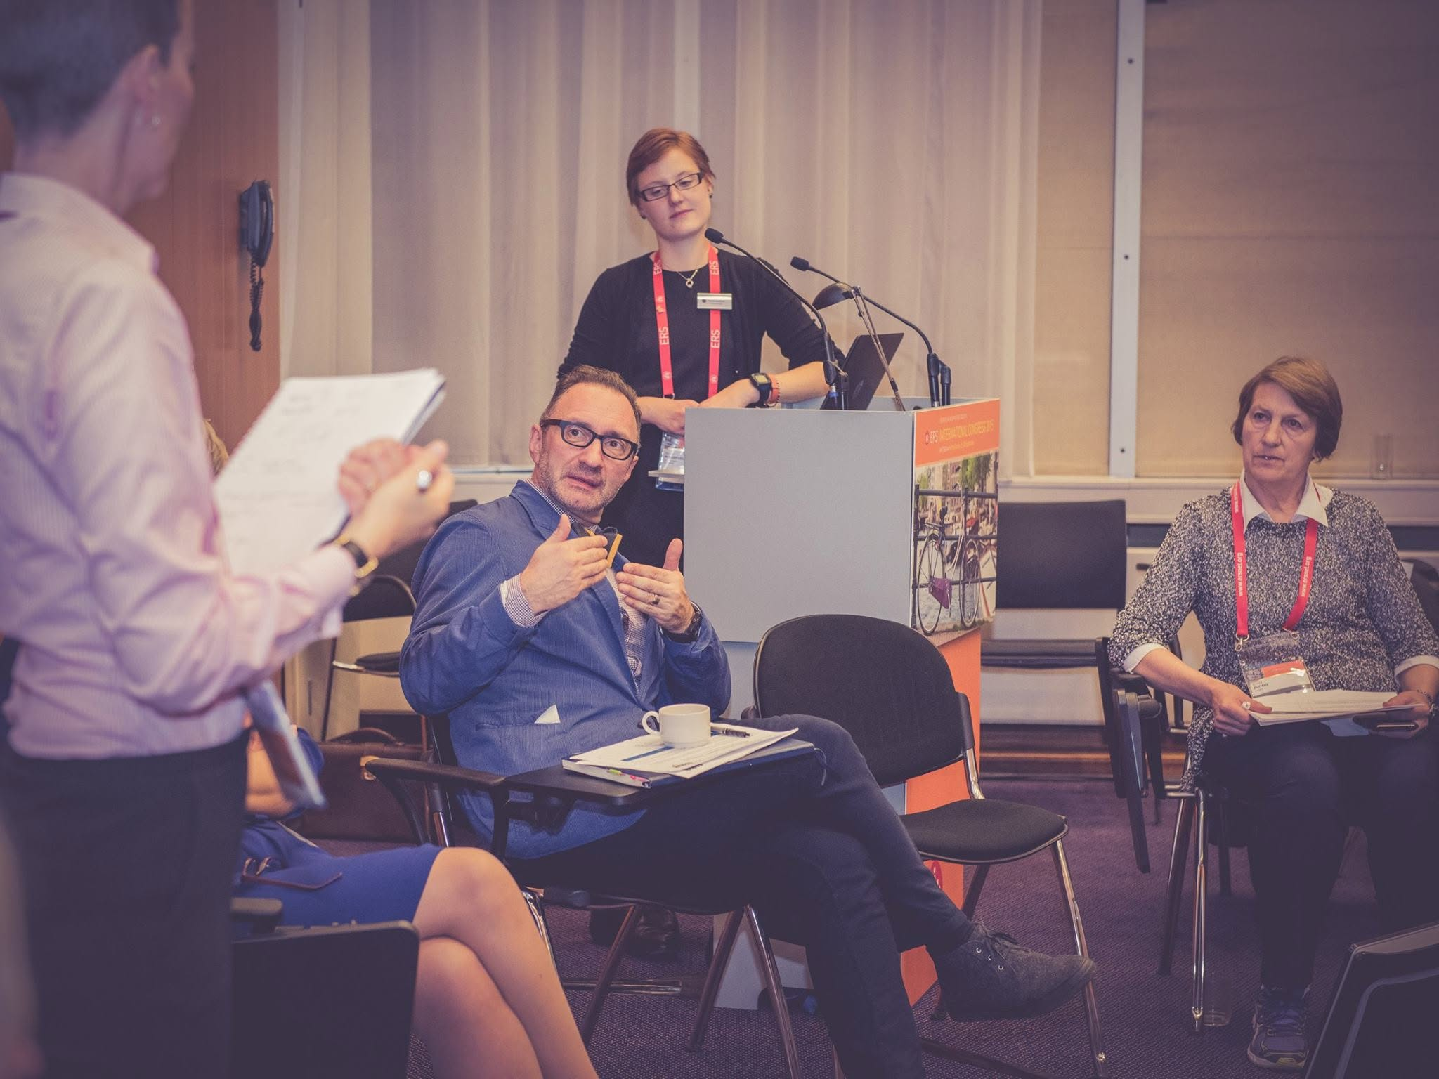
Objectives - For departments:
Space for reflection (inc. strategy documents)
Map existing RC activities, mechanisms and leadership
Scope their strengths and opportunities in diverse RC areas
Set realistic actions and timescales for implementation (including consideration of evidence and insight)

Slide 14
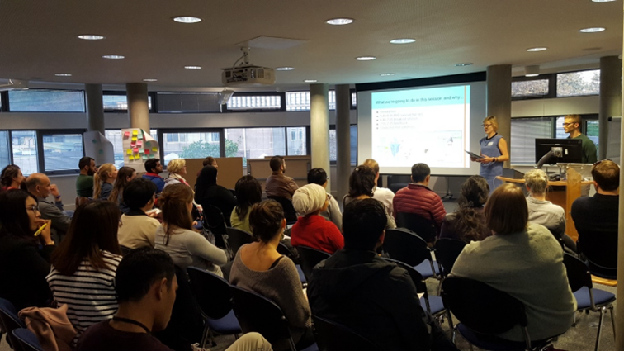
Objectives - Research Culture Team:
Increase and expand awareness of research culture and central support
Relationship and trust building (single point of contact)
Team visibility - ‘go to’ team for research culture and SPRE
Increase knowledge of good practice (to share)
Build insight into our research communities (to better serve them)

Slide 15
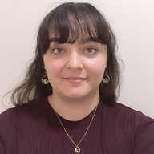
Workshop engagement
1 x facilitator; 1 x notetaker
18 x 2 hour in person workshops
4 x tailored workshops
Attendance: 4-40 (typical 10-15)
12 x 7-15 page reports
All 25 departments/schools awarded up to £10k
UoA2 workshop scheduled for June
Avoid dictation software!

Slide 16

Challenges/limitations
RC Leads as gatekeepers
Who’s in the room (and absent)?
  Invitation
  Engagement
  Psychological safety
Participants’ knowledge
Limited engagement with:
  Policies and guidance
  Equity lens
Trust & demoralisation

Slide 17
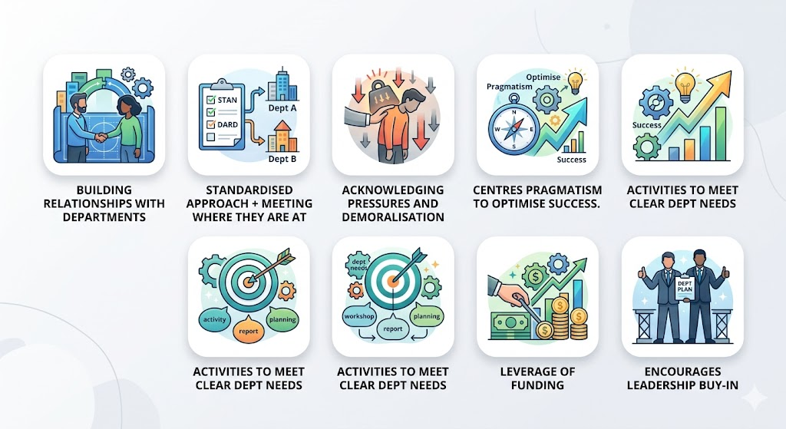
Strengths

Slide 18

Strengths of the approach - for REF
Establishes partnership between Units and central research culture support
Research culture audit and identification of concerns
Strategic alignment between institutional and with department priorities
SPRE education and springboard opportunity
(for Units and RC&RD team)
Provides:
a baseline
an activity log
proportionate evaluation

Slide 19
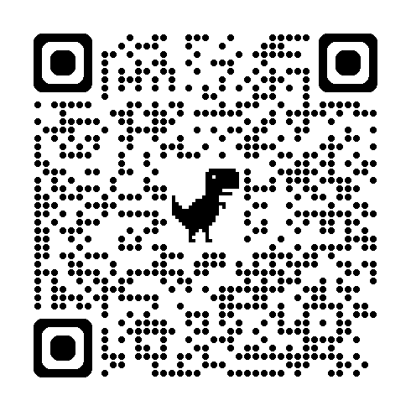
Stay in touch
Get in touch: sarah.masefield@york.ac.uk
Join the RCEN Data Capture and Evaluation Working Group
Next meeting: 25th June, 3-4.30
International Research Culture Conference:
Embedding evaluative thinking: An outcomes-focused approach to evidencing research culture impact.
Measuring Change: A Research Culture Data Capture and Evaluation Challenge-Led Workshop

