Slide 1










Joint funder alignment and insights on use of generative AI when applying for funding
Sue Russell, Wellcome
Lydia Fulford, UKRI
On behalf of the Research Funders’ Policy Group

Slide 2




Our session
Alignment and insights from Research Funders’ Policy Group
Group discussion: challenges & opportunities
#ARMA2026

Slide 3
Research Funders Policy Group (RFPG)
Who?
Informal funders’ group since 2019
Why?
Policy alignment
Reduce bureaucracy
Share practice / learning
Coordinate
Collaborate
Pool resources
#ARMA2026

Slide 4

RFPG initiatives
  Funding Policies Assurance Platform
  “Ask once” to multiple funders
  Tested with over 25 institutions
  Paper-based and system piloted
Annual Funder Symposium
Since 2024
Broader funders invited
2026 being planned
Gen AI
Expert review
Trusted Research
EDI
#ARMA2026

Slide 5

2023: Joint gen AI statement first published
Applying for funding and in assessment
Balanced benefits and risks
High-level principles as funders develop own policies / procedures
  Applicants: responsible use, best practice to acknowledge use
  Reviewers prohibited from use
Promote responsible gen AI use
Consistent messaging
#ARMA2026

Slide 6
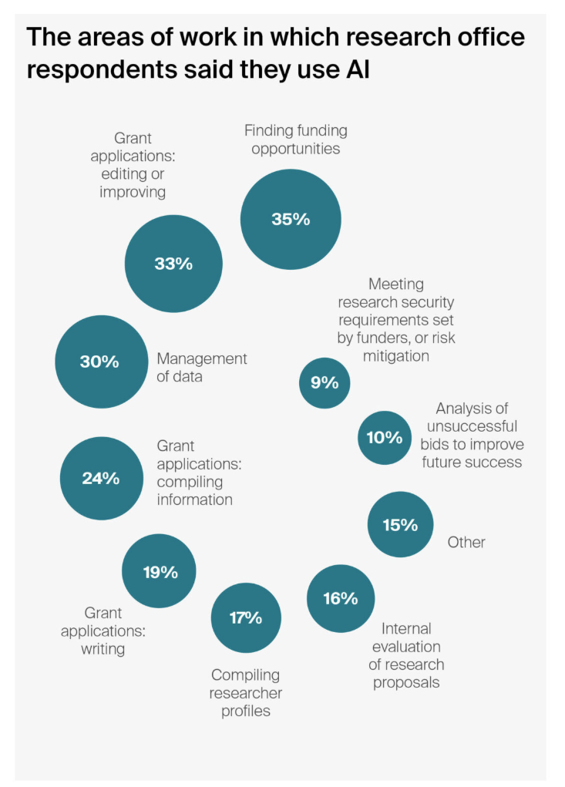
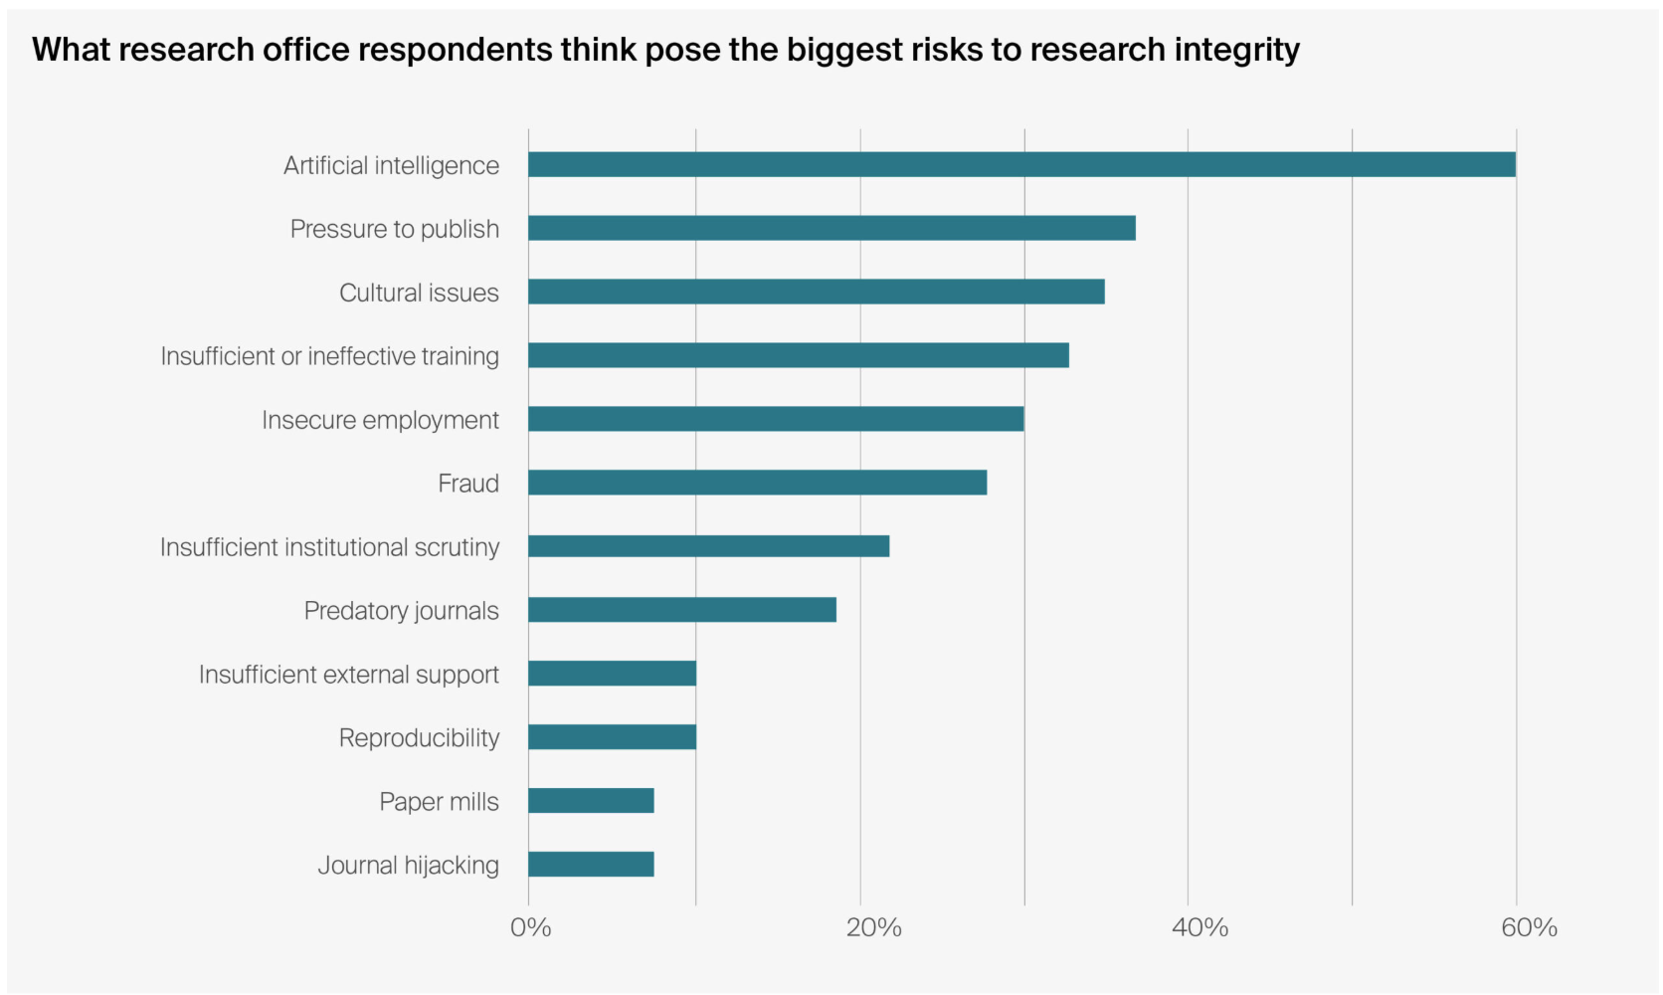
Research offices: increased use of gen AI
Research Professional 2025 survey: RPN’s Research Offices of the Future survey
#ARMA2026

Slide 7
Quick poll
#ARMA2026

Slide 8
2025/6: RFPG review to refine requirements
Our role as funders
Encourage innovation whilst mitigating risks
Maintain trust in funding process and decisions
Key considerations
Research system relies on trust
Hard to detect, police, prove use
What are our redlines?
#ARMA2026

Slide 9
Applicants: what do disclosures tell us?
Wellcome25%
Jan 2026
ECA
BHF
26%
YTD 2026
CRUK
16%
April 2026
Yes
used gen AI
How used
Language
Translation
Formatting
Reduce words
Refine ideas
Initial peer review
Compare literature sources
Align with funder requirements
Estimate costs
Tool(s)
ChatGPT, Co-Pilot, Gemini, Claude and others
#ARMA2026

Slide 10
Applicants: clarify acceptable use
Translation
Improve English
Formatting or word count
Assisting idea generation
Interpreting, analysing, summarising data / text
Comparing literature sources
Generating or refining code
Generating an abstract
#ARMA2026

Slide 11
Applicants: redlines for unacceptable use
Applicants must not:
Use where breaches research integrity expectations:
  Fabricating, falsifying, manipulating, duplicating, altering original data, images, results
  Plagiarising ideas, IP, work with no reference / permission
  Breaching data protection or IP rights
  Misrepresenting or falsifying information
  Faking citations or references
Generate entire application, or sections, without human involvement
#ARMA2026

Slide 12
Reviewers: clarify redlines
Reviewers must not:
Input funding application into gen AI tools
This breaches our confidentiality terms
Considerations
Funders’ role: confidentiality / protect IP
Avoid reviewers outsourcing to gen AI
Shouldn’t reviewers also benefit?
Reviewers using already?
Grey areas if relax prohibition
Unknown if reviewer gen AI tools are safe / secure
#ARMA2026

Slide 13



Funders: clarify use
Not to make funding decisions
May use to process applications
Not input confidential applications into publicly available gen AI tools
#ARMA2026

Slide 14





What might be next for individual funders?
Explore detection tools?
Prevent issues across research pipeline?
Increased gen AI contributing to rise in n° applications?
How to assess future applications?
#ARMA2026

Slide 15
Links
Joint Statement: Use of Gen AI
https://wellcome.org/about-us/positions-and-statements/joint-statement-generative-ai
Research Funders Policy Group
https://wellcome.org/research-funding/guidance/policies-grant-conditions/research-funders-policy-group
Updates coming soon!
See individual funder websites for detailed policies
#ARMA2026

Slide 16
Discussion
Think
What changes have you seen from increased use of gen AI tools?
What are your concerns about evolution of gen AI in next 5 years in applying/assessment?
Do
What is the role of research organisations and funders in ensuring validity of applications?
How could funders and research organisations work together to ensure responsible gen AI use?
#ARMA2026

Slide 17

Thank you

