Slide 1


Navigating Complexity: Pathways to Equitable International Research Partnerships
Strategies for fair and collaborative global research efforts
https://4sciences.co.uk

Slide 2



With thanks to
.. and to many colleagues working at the nexus of research excellence, research management & policy making.

Slide 3
FRAMING THE CHALLENGE OF EQUITABLE INTERNATIONAL COLLABORATION

Slide 4

Why equitable partnerships matter in today’s research landscape
Growth and Challenges of Collaboration
  Significant increase in international collaborations with a wider range of global partners¹
  Increasingly volatile funding environment with large dependency on project-based, competitive funding
Structural Inequities in Research
  Huge disparity in national investment in research & development² (% of GDP) impacting on research ecosystems
  Funding dependencies, institutional pressures, and governance reinforce power imbalances in research partnerships.
Impact of Inequity on Outcomes
  Inequitable partnerships risk inefficiencies, extraction of resources, and reduced scientific quality and societal impact.
Benefits of Equitable Partnerships
  Equitability fosters resilience, mutual benefits, and effective solutions respecting local knowledge and priorities.

Slide 5
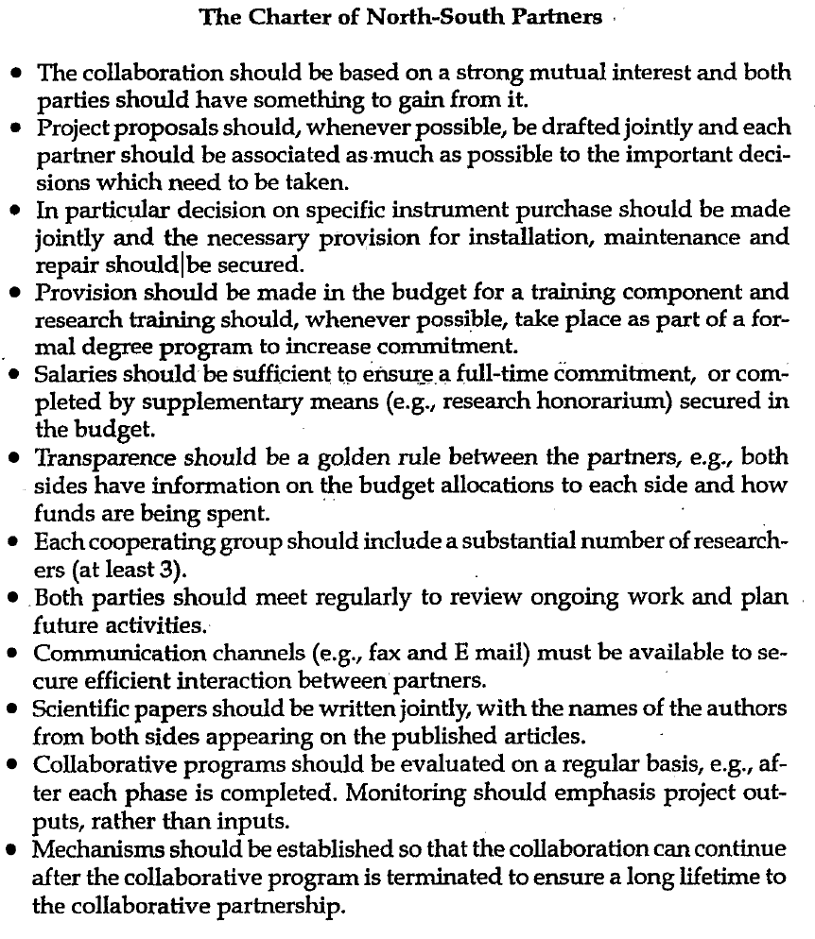
Approaches to N-S partnerships – 1994
Requirements for equitable partnerships:
Mutual interest and win-win
Joint project development
Joint decision-making
Training provision formalized in degree programmes
Sufficient research time through salary commitment
Transparency
Sufficient resourcing (researchers) of all partners
Regular meetings and communication
Joint publications
Regular project evaluations
Provision for continuation of collaboration
³ Gaillard, J. F. 1994. North-South research partnership: is collaboration possible between unequal partners? Knowledge and policy, 7, p.58.

Slide 6

Moving beyond a simplistic North-South framing
Limitations of North-South Framing
  Focusses on two entities:
    ‘the North’ and ‘the South’ (Fransman⁴ et al., 2021)
    Neglects stakeholder roles within the North and South or South-South activities
  Assumes joint objectives:
    BUT: Research excellence vs global challenges (SDGs) vs national priorities vs career development … (e.g. Oleksiyenko⁵, 2019)
  N-S partnership terminology is based on financial context:
    HIC vs LMIC
    Perception of the ‘weaker’ partner often based on ‘who has the money’
    Neglects other resources: Access to data, talent, expertise, reputation
    Focusses exclusively on Northern definitions of excellence⁶
Notes:
Diverse Stakeholders and Agendas
Research collaborations involve multiple actors with varying incentives such as career, reputation, funding, and national goals.
Risks of Binary Narratives
Binary framing risks reinforcing stereotypes and overlooks valuable leadership and capacity in Southern institutions.
Stakeholder-Centred Approaches
Equity requires managing complex stakeholder ecosystems with transparency in agendas, resources, and decision-making.

Slide 7
Evidence from the British Academy Global Initiative

Slide 8
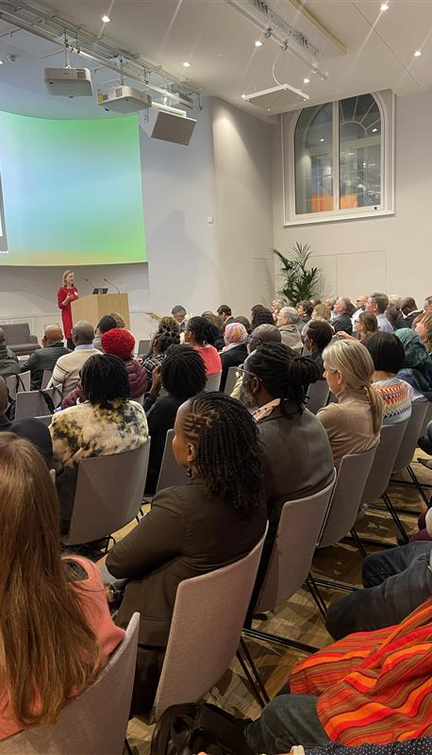
The British Academy programme: scope and approach
Programme Overview
  A 30-month initiative combining regional workshops and two major international conferences to explore equitability in research partnerships, supported by capacity strengthening activities and funding calls.
Participatory and Co-Creation Approach
  Brought together different stakeholders involved in research collaborations.
  Used a participatory approach to identify challenges and create practical pathways for equitable research collaborations.
Key Outputs and Impact
  Outputs include the Call to Action on Equitable Partnerships⁶, new funding designs, guidance and insights strengthening equitability.
Systemic Equity Focus
  The programme addresses equitability as a systemic issue across policy, funding, and institutional practices, while recognising the role of individuals.
See also: https://www.thebritishacademy.ac.uk/international/equitable-partnership-in-international-collaboration/

Slide 9
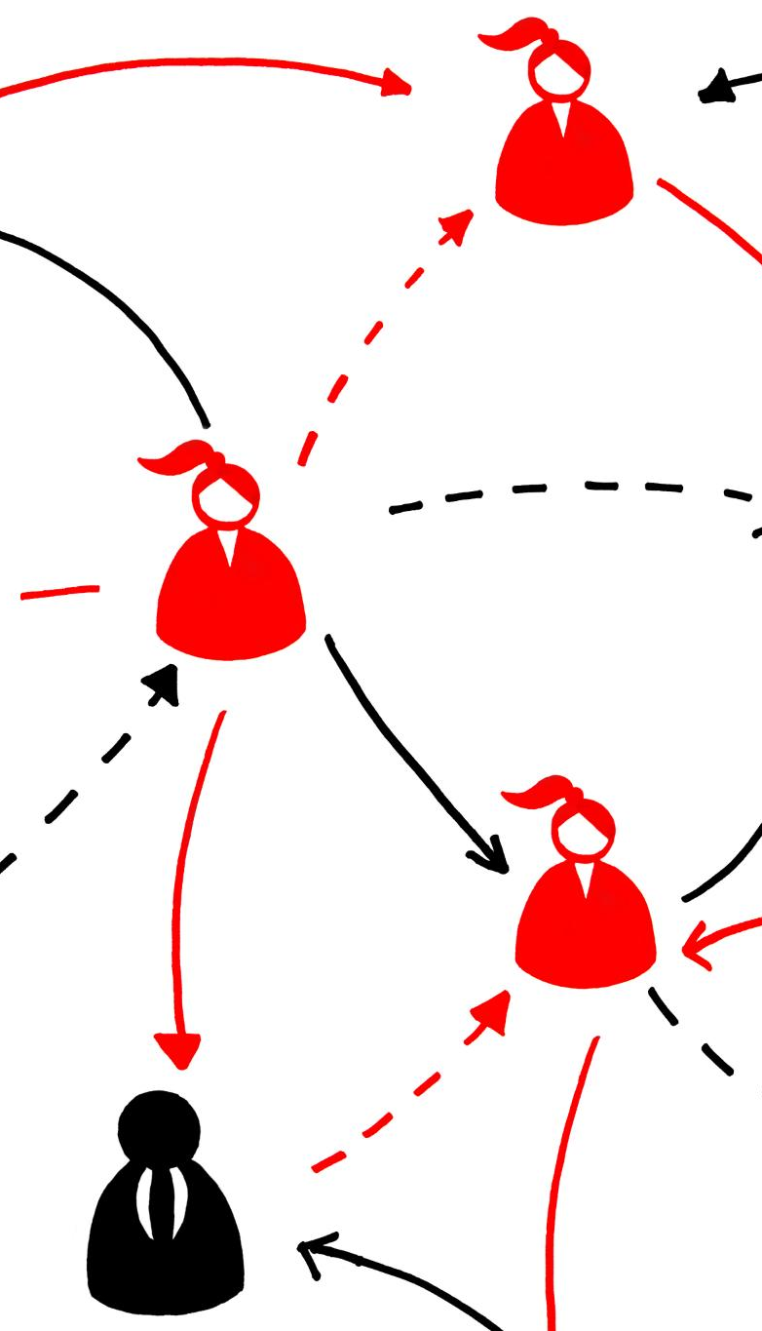
Recurring barriers identified across regions
Agenda Setting Challenges
  Funder priorities and lead institutions often shape research agendas, marginalising partner input and equitability.
Administrative and Financial Delays
  Misaligned contracting and financial processes cause delays and frustration across collaborating institutions.
Governance and Compliance Burdens
  Regulations often based on single national contexts create disproportionate burdens for international partners.
Capacity and Technology Gaps
  Unequal access to research management support and digital tools hinders equitable participation.

Slide 10
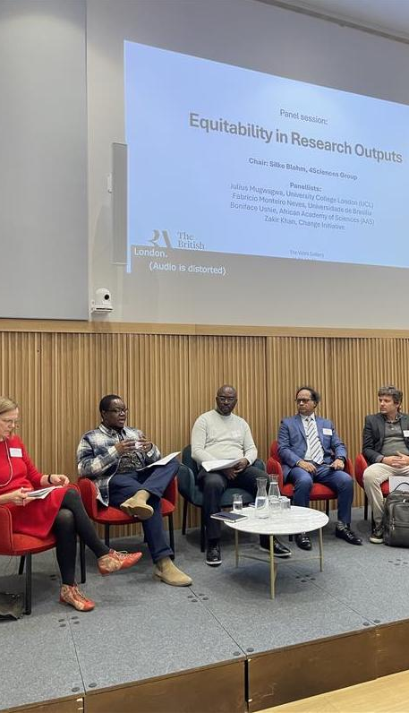
Where equitability is gained or lost:
Daily practices and systems
Equity in Daily Practices
  Equity is enacted or undermined through everyday practices like contracting and budget decisions impacting partners.
Impact of System Design
  System designs such as payment schedules and data control affect institutional stability and knowledge sharing.
Gap Between Commitment and Practice
  There is a notable divide between stated equitability commitments and actual implementation in organisational systems.
Operationalising Equity
  Focusing on how systems function in practice reveals leverage points to promote equitability effectively.

Slide 11
From Insight to Action: Practical Pathways Forward

Slide 12
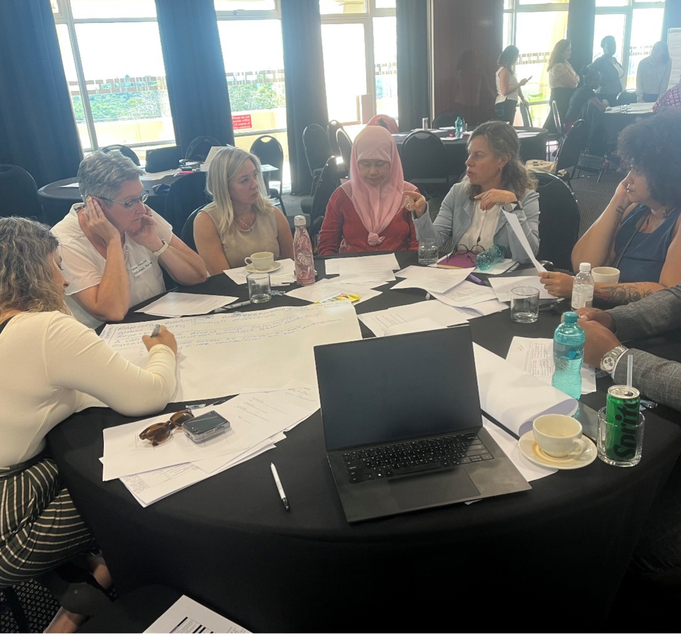
Key pressure points: systems, alignment, and technology
Administrative and Financial Systems
  Aligning processes across partners and adding inception phases can reduce delays and rebalance risk effectively.
Strategic Alignment and Co-Creation
  Early involvement of all stakeholders in agenda setting and impact planning fosters meaningful strategic alignment.
Technology and AI Opportunities
  Digital tools reduce barriers and boost efficiency but unequal access and expertise present risks to equity.
⁷ Reflections from the Research Management Capacity Strengthening workshop at the 2nd Equitable Partnership Conference, Pretoria, February 2026: https://www.sarima.co.za/news/stakeholder-news/reflections-from-the-research-management-capacity-strengthening-workshop/

Slide 13
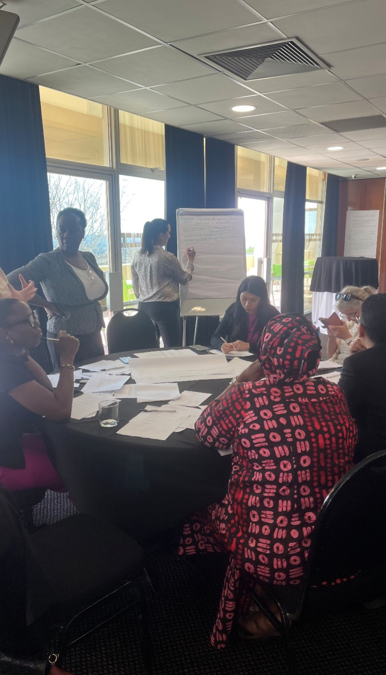
Research management as a strategic enabler of equitability
Critical Role in Equitable Partnerships
  Research management is essential for fostering equitable partnerships by bridging researchers, institutions, and funders effectively.
Protecting Researchers and Ensuring Transparency
  Empowered research managers reduce administrative burdens and maintain (financial) transparency to build trust among partners.
Strategic Function and Professional Development
  Recognising research management strategically involves investing in development and including managers in governance and partnership design.
Strengthening Capacity to Address Equity
  Building research management capacity helps institutions tackle equitability challenges in due diligence, reporting, and stakeholder engagement.

Slide 14
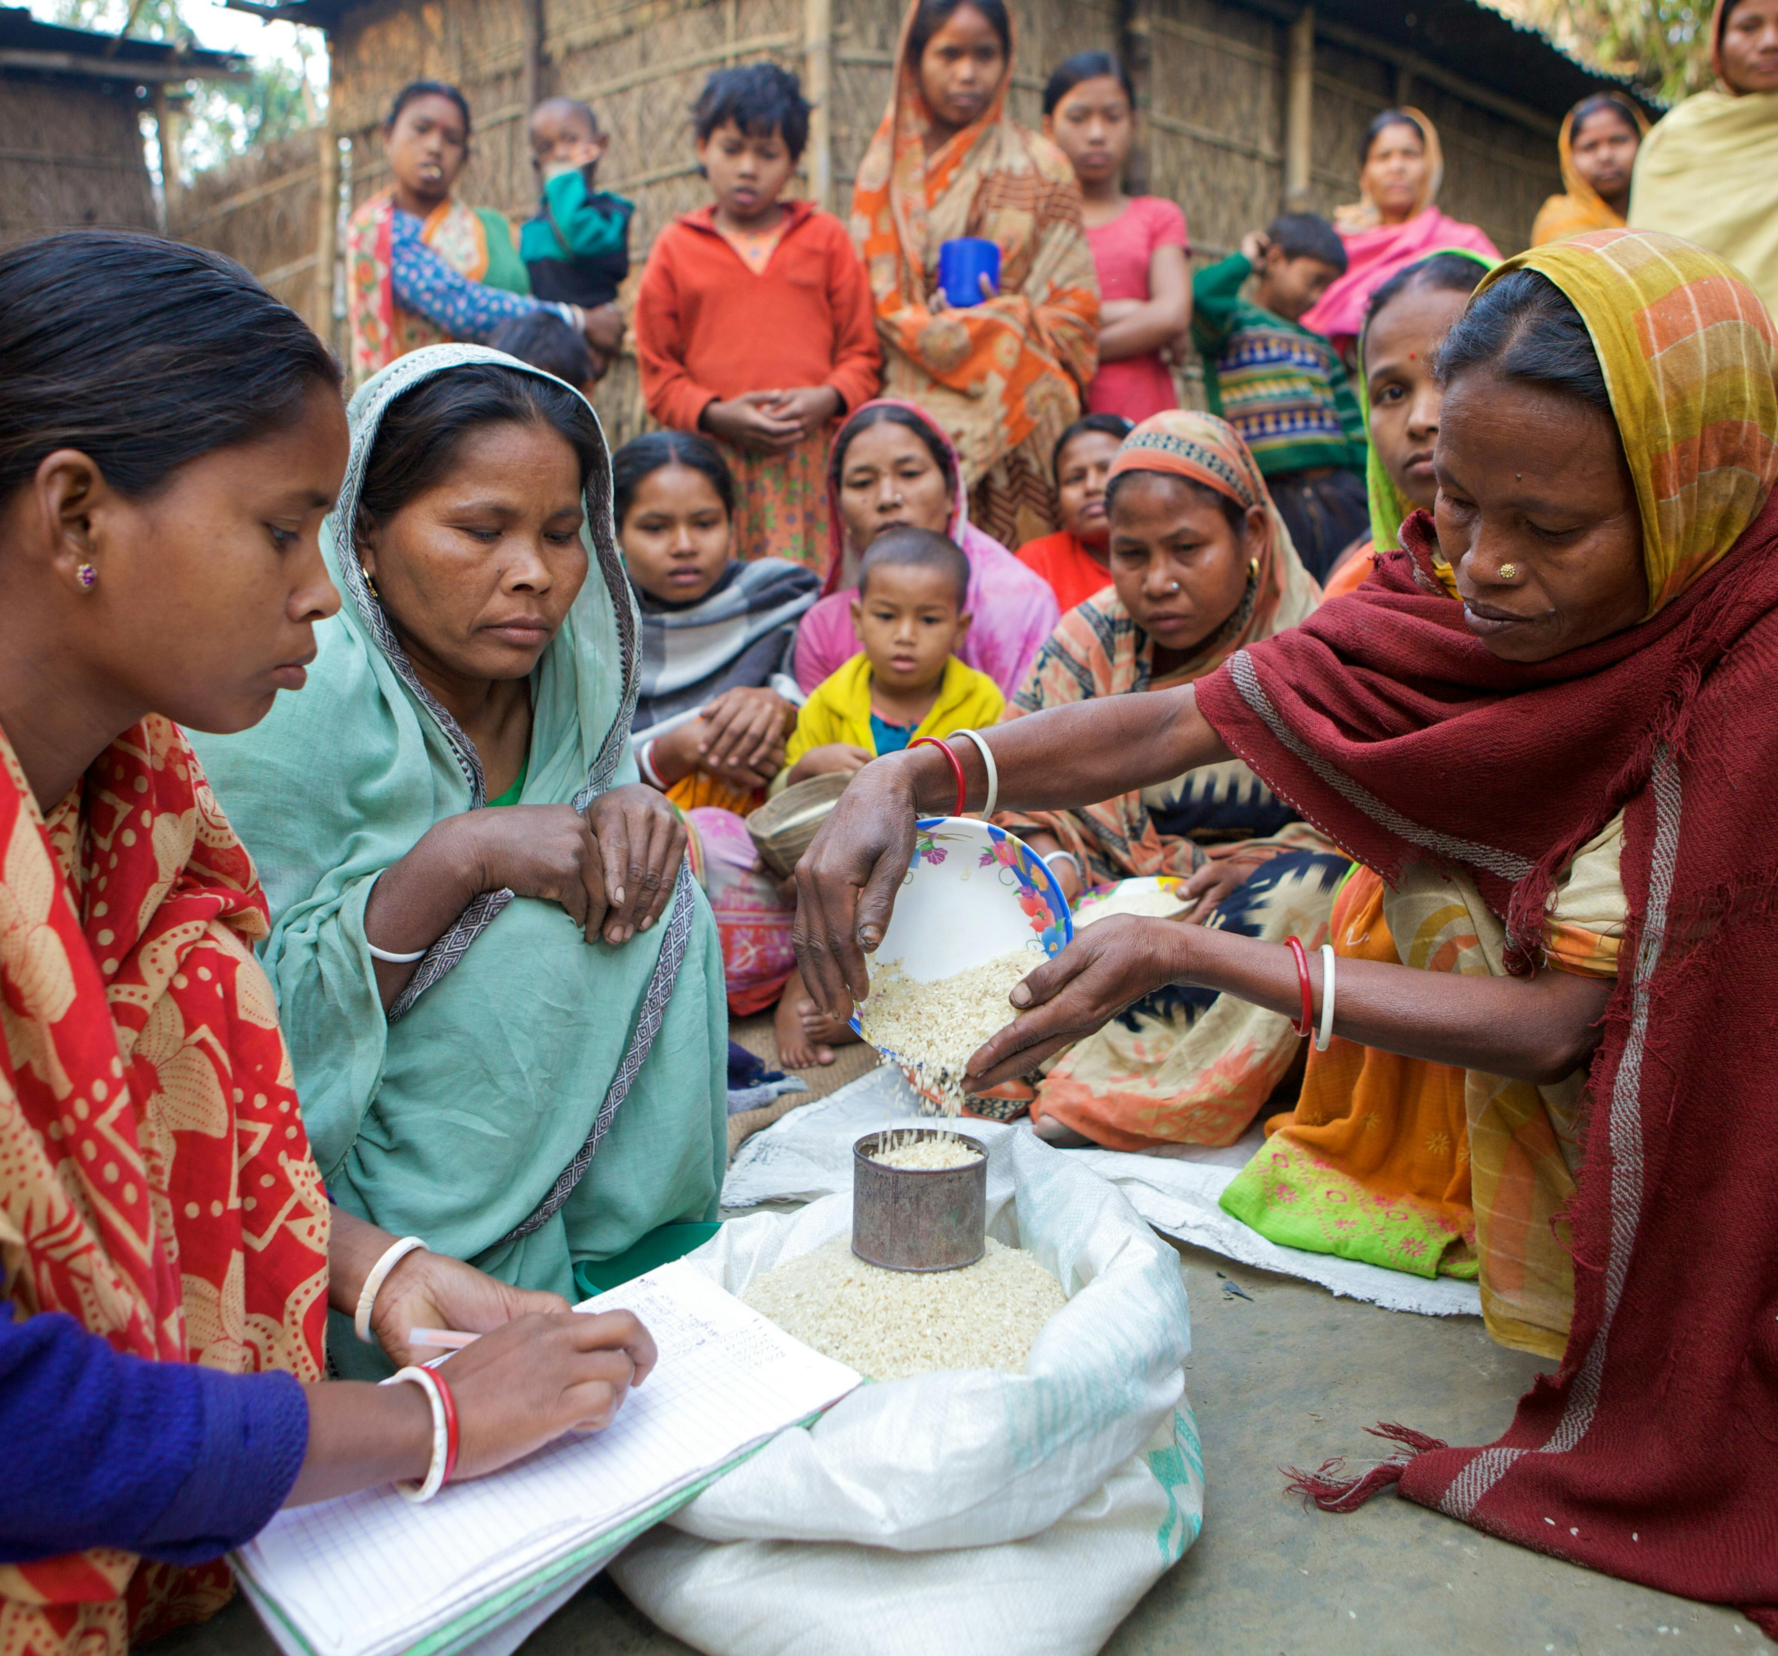
Trust, relationships, and the human dimension
Importance of Trust
  Trust is essential for navigating complexity, resolving misunderstandings, and sustaining long-term partnerships.
Building Mutual Understanding
  Mobility schemes, staff exchanges, and local networks effectively cultivate mutual understanding over time.
Role of Institutions and Funders
  Institutions must provide time, resources, and incentives that prioritize collaboration quality over speed or volume.

Slide 15

What needs to change: implications for funders and institutions
Funders' Support for Co-creation
  Funders should enable co-creation by providing seed funding and revising eligible costs like software licenses and infrastructure.
Institutional Policy Reflection
  Institutions must critically evaluate their policies to foster equitable collaboration and avoid one-size-fits-all partnership models.
Beyond Quantitative Indicators
  The system needs to develop qualitative evidence showing how research management and partnerships add real value.
Equitable Partnerships as Capability
  Equitable partnerships should be viewed as an organisational capability that can be designed, learned, and improved over time.
  → Stakeholders need to own their role in equitable partnerships
Notes:
Over-emphasising minimising institutional risk over enabling institutional strategy

Slide 16
“Equity doesn’t happen in the abstract. It happens, or fails, in our daily practices and systems that govern how research is funded, managed, and delivered. Equitable partnerships happen because and when people and systems make them possible.”
Research Management Capacity Strengthening Workshop, Pretoria, February 2026

Slide 17
Bibliography
¹ Gui, Q., Liu, C., Du, D., 2019. Globalization of science and international scientific collaboration: A network perspective
² Worldbank: https://data.worldbank.org/indicator/GB.XPD.RSDV.GD.ZS?end=2023&start=1996&type=shaded&view=chart , accessed 28.08.2025.
³ Gaillard, J. F. 1994. North-South research partnership: is collaboration possible between unequal partners? Knowledge and policy, 7, p.58.
⁴ Fransman, Jude et al. Beyond Partnerships: Embracing Complexity to Understand and Improve Research Collaboration for Global Development. Canadian Journal of Development Studies / Revue Canadienne d’études Du Développement 42, no. 3 (3 July 2021): 326–46. https://doi.org/10.1080/02255189.2021.1872507
⁵ Oleksiyenko, Anatoly V. Academic Collaborations in the Global Marketplace. Vol. 6. Knowledge Studies in Higher Education. Cham: Springer International Publishing, 2019. https://doi.org/10.1007/978-3-030-23141-5
⁶ See, for example, Ofir, Z., Schwandt, T., Duggan, C., McLean, R., 2016. Research Quality Plus: A Holistic Approach to Evaluating Research. International Development Research Centre. https://idl-bnc-idrc.dspacedirect.org/bitstream/handle/10625/56528/IDL-56528.pdf?sequence=2&isAllowed=y
⁷ Equitable Partnership in International Collaboration (EqPIC) – a Call to Action: https://www.thebritishacademy.ac.uk/international/equitable-partnership-in-international-collaboration/equitable-partnership-in-international-collaboration-eqpic-a-call-to-action/
⁸ Reflections from the Research Management Capacity Strengthening workshop: https://www.sarima.co.za/news/stakeholder-news/reflections-from-the-research-management-capacity-strengthening-workshop/

