Slide 1

Leading through turbulent times: managing teams through intense change
Pauline Muya
Director, Muya Research Management Ltd.
Email: paulinemuya01@gmail.com

Slide 2
Introduction
Over 30 years in research management, leading teams in multiple institutions
Navigated countless restructures and change programmes, including institutional merger
Worked across academic disciplines and research areas and led teams across the full research lifecycle
Extensive experience of research assessment including 5 RAE/REFs and seconded as Panel Adviser to Research England in REF 2021
Developed and delivered multiple training programmes for academic staff and research managers at all career stages
Run my own research management consultancy since 2019
ARMA veteran and former Deputy Chair/Board member

Slide 3

Case studies of leading teams through change
Birkbeck 2009-2011
Creation of Schools and incorporation of lifelong learning into relevant disciplines
Restructure was already underway when appointed, always playing catch up
Creation of new team, bringing people together from across the institution
Training and upskilling staff for new roles
Huge variability in ways of working and practices
Establishing new faculty level systems, budgets etc
Need to address some historic under-performance
High-performing researchers who needed support
Bespoke management development programme
Peer network
Senior institutional mentor

Slide 4

Case studies of leading teams through change
Institute of Education 2012-2015
Institutional merger with UCL, December 2014
Integrate relevant functions into UCL while maintaining business as usual
Building relationship with peers at UCL
Broader IOE roles didn’t map neatly into UCL more specialist structures and teams
Supporting team members as they navigated the realities of merger, some stayed, many left
Immense workload
Unpicking systems, policies and processes and implementing UCL methods
Personal job insecurity and family pressures
Support from external mentor

Slide 5

Senior leadership paints the picture
We are often given the vision and what the institution is trying to achieve
As leaders and managers, we may not always agree with the vision or the rationale but are still expected to deliver it and take our teams with us
Delivering the vision can be much harder than the big picture looks
The big picture is not always a true representation of what lies ahead
Planning each stage of the process is critical

Slide 6
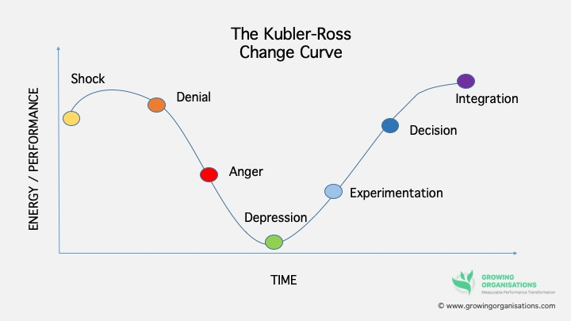
Reactions to Change

Slide 7
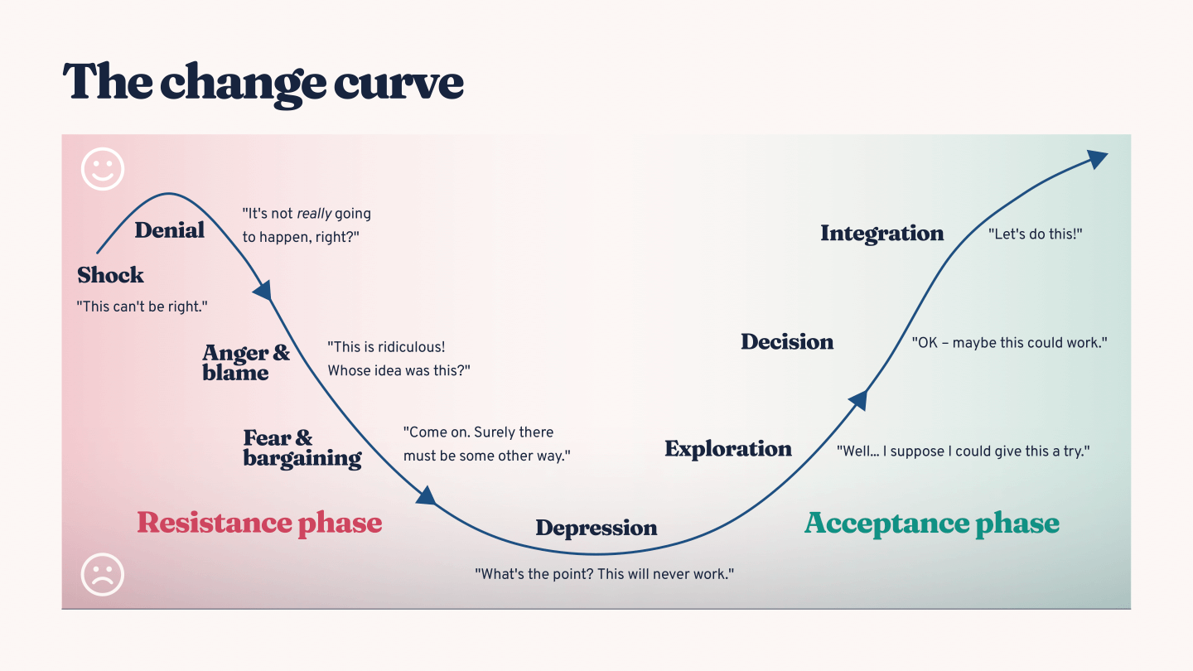

Slide 8

The responsibilities of leading
Navigating your personal “change curve” rapidly
Influencing upwards effectively
Retaining good morale
Being honest and authentic with those you lead
Retaining focus on business as usual
Being realistic about what is and is not possible
It’s ok to say “I don’t know”
Have a plan and some idea of how you are going to get there even if it changes constantly
Re-focus and adapt the plan as necessary
Listen to the team and take their suggestions on board where possible

Slide 9

Leadership
Leading can be lonely
Work in partnership with academic leaders
Ensure you have good peer support or mentors
Build your own resilience
Be realistic
None of this is meant to be easy
Know your own strengths and preferences: merger taught me that I am a builder and nurturer, not a dismantler
Know your team and reinforce their strengths
Help the team to reduce their weaknesses
Looking back, I know these were times of intense professional growth, however painful it was at the time

Slide 10

Delivering change can often feel more like this
When to be open and when to keep quiet
Sometimes the team doesn’t need to know immediately exactly what lies ahead
There is value in taking time to work through the immediate implications before speaking
Agreeing common messaging with peers can help
The truth or the rumour mill?

Slide 11

One step at a time
Working out the day-to-day priorities
Agreeing them with academic leaders and managers
Keeping the team focused on these concrete steps
Providing spaces where the team can come together, ask questions and seek guidance
Accepting that some won’t want to stay
Supporting the leavers and remainers
Still finding ways to celebrate the team and their achievements

Slide 12

We’ve been here before
It can feel like we are getting nowhere in an uphill struggle with no clear sight of the destination
Or the destination changes mid-journey
Taking time to re-focus and re-calibrate is essential
Accepting that this isn’t meant to be easy

Slide 13

Pause for reflection
Build in regular pauses to reflect on the road travelled
Re-adjust and re-set the direction when necessary
Accept that you won’t achieve everything you set out to
What is it that really matters?
Don’t allow work to take over, ensure you have good friends and family to support you

Slide 14

“Focus on what you can control”
Michelle Obama
On dealing with adversity
"Focus on what you can control. Be a good person every day. Vote. Read. Treat one another kindly. Follow the law. Don't tweet nasty stuff.”
On being authentic
“There's power in allowing yourself to be known and heard, in owning your unique story, in using your authentic voice. And there's grace in being willing to know and hear others.”
“For every door that's been opened to me, I've tried to open my door to others.”

Slide 15
We may not be in the same position as Michelle Obama, but
It’s easy to become over-whelmed
We can waste time and energy on what we can’t change or influence
If we can’t change the situation we can choose how we respond to it and how we treat those around us
As leaders and managers our words and actions carry more weight than we will ever realise
If we crumble and cease to function what happens to our teams?
What support mechanisms do we have/need to continue to function when everything is changing around us?

Slide 16

Your experiences
What are your reflections on living through change in your institution?
What was handled well?
What were the key lessons you learned?
Any questions that you would like to ask?

Slide 17
“Focus on what you can control”
Michelle Obama
On dealing with adversity
"Focus on what you can control. Be a good person every day. Vote. Read. Treat one another kindly. Follow the law. Don't tweet nasty stuff.”
On being authentic
“There's power in allowing yourself to be known and heard, in owning your unique story, in using your authentic voice. And there's grace in being willing to know and hear others.”
“For every door that's been opened to me, I've tried to open my door to others.”

Slide 18
Thank you
Thank you for being here and for listening
Take time to work out what support you need when navigating change
Take care of yourself and those you are leading
Feel free to contact me afterwards
paulinemuya01@gmail.com

