Slide 1


Policy Hackathon: Shaping the Next REF
What could research assessment look like in 2035?
ARMA REF SIG
Shelly Stringer, University of Oxford
Helen Young, University of Bristol
Tim Brooks, Anglia Ruskin University
Chris Browne, Queen’s University Belfast

Slide 2


Welcome
We will start at 3:55pm.
Please:
  Pick a REF experience sticker
  Find a table that broadly matches your sticker
  Introduce yourself to your table
  Choose a scribe and presenter
#ARMA2026

Slide 3
Agenda
Thanks to our panel:
3:45–3:55 Arrival, stickers and table grouping
3:55–4:05 Welcome, framing and instructions
4:05–4:35 Policy hackathon table task
4:35–4:50 Selected table pitches
4:50–5:00 Panel reflections and close
Rebecca Emmett
Head of Research Assessment Policy
Research England
June Faccini
Head of Higher Education Research & Knowledge Exchange
Department for the Economy NI
Oliver Wright
Senior Policy Officer, Investment and Research
Scottish Funding Council
#ARMA2026

Slide 4
The challenge
Your task
You are members of a national taskforce designing the UK’s next research assessment system for implementation in 2035, after REF 2029.
You are not deciding whether research assessment should exist. You are designing a model that is:
Credible // Fair // Deliverable
Your model must still support:
  allocation of public research funding
  accountability for public investment
  insight into the health and strength of the UK research system
#ARMA2026

Slide 5
How the hackathon works
30 minutes at your table
Part 1: Design your model — 20 minutes
Work through the handout:
  What should your model assess?
  How should assessment happen?
  What behaviours would it create?
  What would you retain, remove or improve?
  Would government fund it, institutions survive it, and researchers trust it?
Part 2: Prepare your pitch — 10 minutes
Your three-minute pitch should cover:
  Vision
  Model
  Problem solved
  Foundations needed before 2029
#ARMA2026

Slide 6
Pitch time
Each pitch has three minutes.
Please tell us:
  What is your vision for research assessment in 2035?
  What does your model assess?
  How does assessment work?
  What problem does it solve?
  What foundations need to be built before 2029?
Panel
Rebecca Emmett, Research England
June Faccini, Department for the Economy NI
Oliver Wright, Scottish Funding Council
#ARMA2026

Slide 7
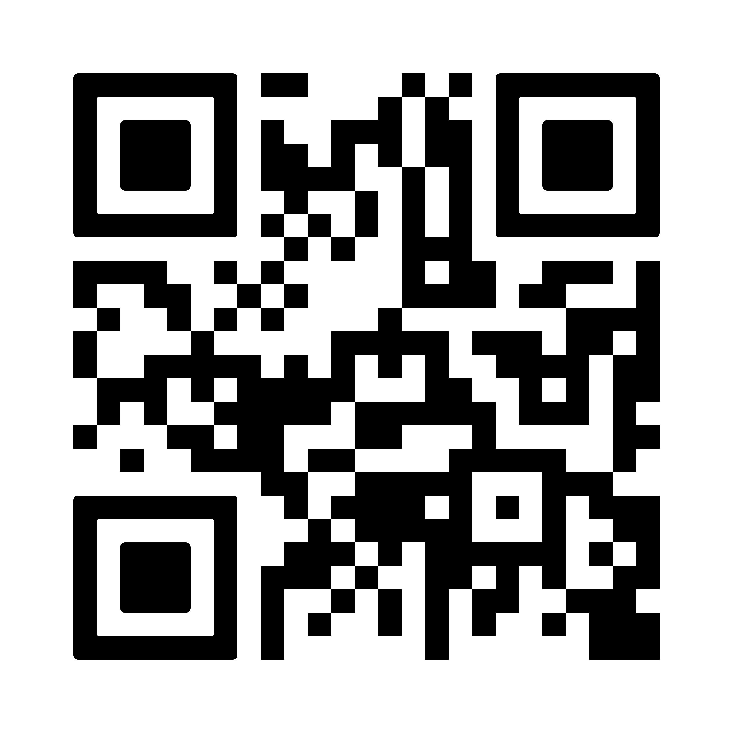
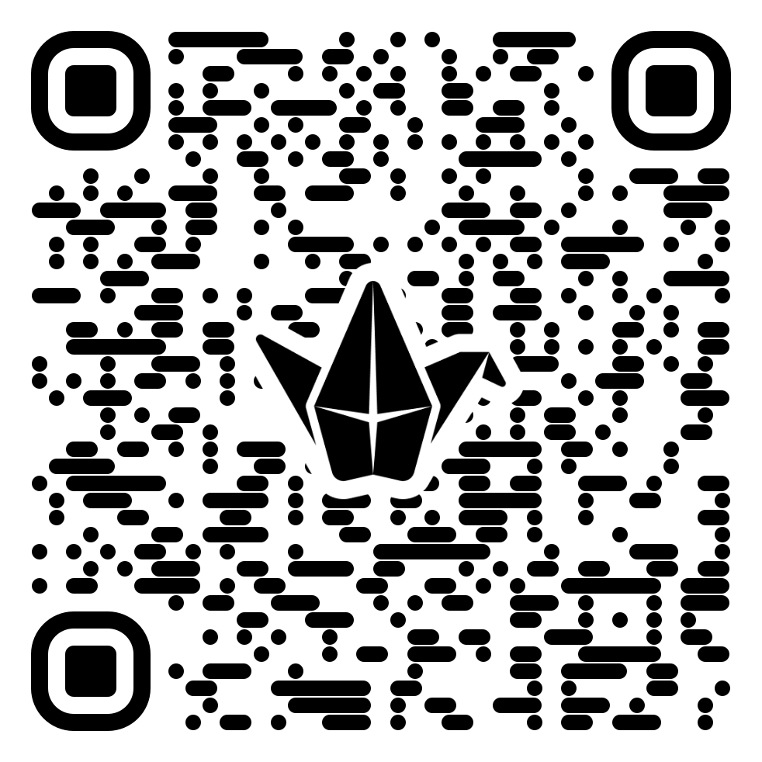
Continue the conversation…
Join us for the next REF SIG online drop-in on 24 June, 10:00-11:00
Reflections on the future of research assessment
Sign up here
Add to the Padlet here
#ARMA2026

Slide 8

Thank you
Any questions?

