Slide 1

The Efficiency Engine
Powering Post-Award Through Leaner, Smarter Workflows
Charles Shannon, Loughborough University
Rebecca Edwards, SOAS University of London
ARMA 2026 | Harrogate
Notes:
Presenter: Charles. Welcome everyone. This session is about practical ways post-award teams can work smarter under pressure. We are not suggesting that one system, one dashboard or one process will solve everything. The aim is to share useful ideas, explore common fears and collect practical solutions that can benefit the wider sector after today.

Slide 2

Today’s route
Why post-award efficiency matters now
Where time, income and value can leak from the process
What stops teams from innovating
Practical resources that can help
How systems, dashboards and AI can support earlier insight
What ideas we can share across the sector
Interactive outputs may inform a future article or Post-Award SIG sector resource.
Notes:
Presenter: Charles. Introduce the structure. This is intended to be interactive. We want to hear what is happening across the sector, including what people are worried about and what practical solutions are already being tested.

Slide 3
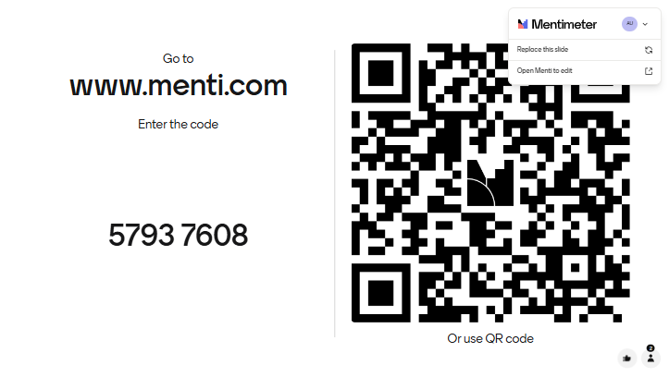
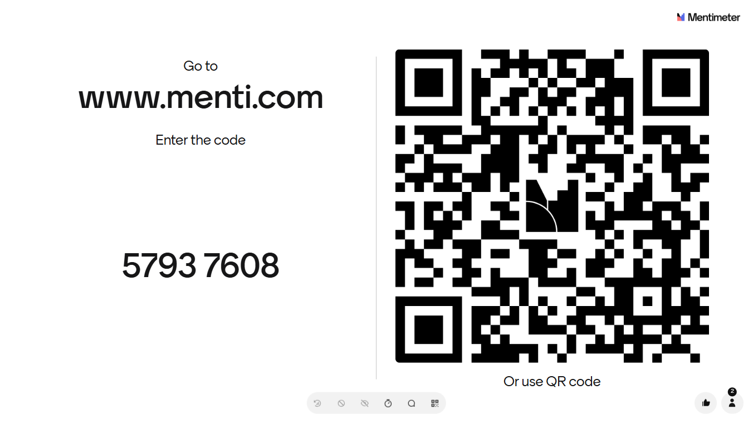
Notes:
Charles

Slide 4
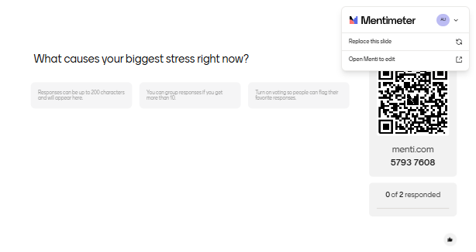
What keeps you awake night
Interactive outputs may inform a future article or Post-Award SIG sector resource.
Notes:
Presenter: Rebecca. Introduce the structure. This is intended to be interactive. We want to hear what is happening across the sector, including what people are worried about and what practical solutions are already being tested.

Slide 5
Why this matters now
The pressure
The risks
The opportunity
Larger and more complex portfolios
Constrained staffing and capacity
More scrutiny from funders
Wider compliance expectations
Delayed set-up and contracting
Weak forecasting
Late invoicing or claims
Rework, audit findings and income loss
Earlier risk visibility
Clearer ownership
Less reactive work
Better service to academics
How do we maintain strong compliance and service quality while reducing friction, rework and reactive pressure?
Notes:
Rebecca Post-award is no longer just about reporting expenditure after the event. It is about protecting research funding, enabling delivery, supporting academics and giving institutions confidence that risks are being managed. More funders are requiring assurance than ever before either by audit or additional information. Failure to provide sufficient assurance that we have sufficient controls can mean loss of income, further scrutiny or possible reputational damage.

Slide 6

“We do not lack data. We lack timely insight.”
Moving from retrospective reporting to earlier action
Notes:
Rebecca Traditional reporting remains necessary, but it is not enough. The opportunity is to use the information we already hold to identify risk earlier and act before options become limited. We will look at this in greater detail later

Slide 7
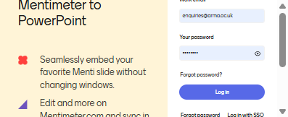
Case study: month 30 of 36
It is month 30 of a 36-month project. The research is progressing well, outputs are strong and the PI is confident.
Then the finance report arrives…
Only 45% of the budget has been spent.
Notes:
Rebecca
Prompts
Why we found out late (timing)
Whether it could have been spotted earlier (detection)
What we can still do (options)
What this reveals about our processes (learning)

Slide 8
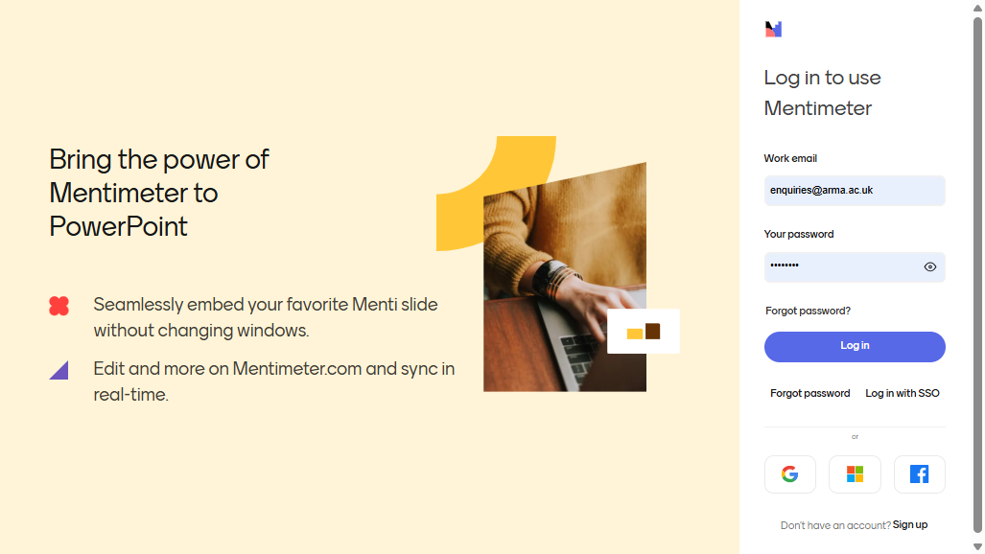
Notes:
Rebecca

Slide 9
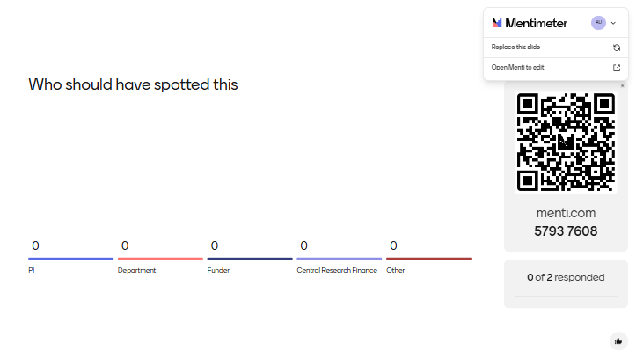
Notes:
Rebecca

Slide 10
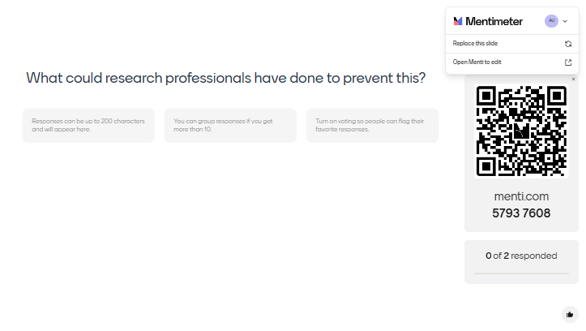
Notes:
Rebecca

Slide 11
Where does value leak?
Early lifecycle
During delivery
Close-out and assurance
Delayed award set-up
Missing documents
Slow contracting
Delayed recruitment
Weak forecasting
Late invoicing or claims
Poor PI engagement
Unclear ownership
Late close-out planning
Incomplete evidence
Ineligible or unsupported costs
Missed reprofile or extension options
Mentimeter: where does the greatest post-award value leak occur in your institution?
Notes:
Presenter: Rebecca. Financial leakage does not always mean direct loss. It can be lost time, missed income, unclaimed expenditure, poor cash flow, late decisions, inefficient administration or reputational risk.

Slide 12
What are we afraid of?
“If we automate this, something might go wrong.”
“If we move to risk-based review, we might miss something.”
“PIs will not engage.”
“The data is not good enough.”
“The system cannot do what we need.”
“We do not have time to improve the process.”
“Changing the process may create audit risk.”
Mentimeter word cloud: what is the biggest fear or barrier that stops post-award teams from working differently?
Notes:
Presenter: Rebecca. These fears are real and should not be dismissed. In compliance environments, people are understandably cautious. But the risk of not changing also needs to be considered.

Slide 13
From fear to fix
Fear
Possible fix
Automation may create errors
Automate reminders and prompts first, not final decisions
Risk-based review may miss issues
Use clear thresholds and escalation routes
PIs may not engage
Short award-start meetings and simple responsibility summaries
Data may not be trusted
Reconcile dashboard data to source systems
Staff have no capacity to improve
Start with one high-volume, high-friction process
Templates may reduce flexibility
Use mandatory core fields with optional local detail
Innovation can start with one controlled improvement — not a major system project.
Notes:
Presenter: Charles. A useful way to reduce resistance is to pair every fear with a practical control. Automation does not need to make eligibility decisions. It can simply remind people that a report is due or that an award is approaching its final six months.

Slide 14
Practical resources that can help
Simple templates
Smarter processes
Insight tools
Award-start checklist
PI responsibility summary
Close-out checklist
Funder rules FAQ
Risk-based review schedule
RACI / ownership map
Standard claims workflow
Escalation thresholds
Award health dashboard
Task list analysis
Portfolio risk view
AI prompt bank
The best resource is one that people actually use: simple, visible, owned and reviewed.
Notes:
Presenter: Charles This is where the session becomes practical. Not every solution needs to be expensive or technical. Some of the best improvements are checklists, clear role and responsibilities, thresholds and consistent ways of working.

Slide 15
Resource 1: award start-up checklist
Funding and budget
Delivery plan
Assurance
Award value and categories
Start and end dates
Reporting / claim deadlines
Restrictions and special conditions
Recruitment assumptions
Equipment and travel plans
Subcontracting or collaborators
PI responsibilities
Evidence storage
Ethics / due diligence
Trusted research risks
Escalation points
Use the start of the award to prevent downstream problems.
Notes:
Presenter: Charles. The start of the award is one of the best opportunities to prevent later problems. A simple award-start checklist can clarify expectations and reduce missing information.

Slide 16
Resource 2: PI responsibility summary
Improving PI engagement without overwhelming academics
What the PI is responsible for
What the department or school supports
What the post-award team manages
What needs approval before costs are incurred
When forecasts need to be reviewed
What evidence needs to be retained
What to do if plans change
Who to contact for help
This is not about transferring administration to academics. It is about making responsibilities clear enough that issues are identified before they become urgent.
Notes:
Presenter: Charles. Experience tells me that generally the post award team has very limited engagement with the PI and often only to discuss a problem, but sometimes we need to ask whether our expectations are clear enough. A short, practical PI responsibility summary can help avoid confusion and repeated queries. This might include regular reviews of expenditure for eligibility, ensuring timesheets are completed, reminding them to inform HR if staff change to name a few.

Slide 17
Resource 3: early-warning dashboard
Award status
Time and forecast
Operations
Award value vs Expenditure to date
Commitments
Remaining balance
Income vs Expenditure
% project elapsed
% budget spent
Forecast spend
3-2-1 end date/report date
Claims due
Start Certificates
Reports due
Overdue tasks
Recruitment status
A dashboard does not make the decision. It prompts the earlier conversation.
Notes:
Presenter: Charles. A dashboard does not need to be complicated to be useful. The key is to compare finance, time and activity. An award that is 75% through but only 40% spent may be fine if that was planned, but it should trigger a conversation and hopefully long before you reach this point. The information in these reports might help trigger early intervention or support e.g. noticing recruitment issues, ineligible expenditure, budget spend issues, parental leave, long-term absence, deliverables at risk of not being met, irregular expenditure or using the grant as a bank

Slide 18
Product options as enablers
Worktribe
Infonetica
Power BI
Local tools
Award records
Workflow and approvals
Task management
Lifecycle visibility
Post-award oversight
Risk visibility
Compliance support
Income protection
Dashboards
Trends and KPIs
Portfolio insight
Visual reporting
Excel
SharePoint / Teams
Forms / surveys
Document libraries
The product matters, but the operating model matters more.
Notes:
Presenter: Charles. We are not making a product recommendation. Different institutions will have different systems, budgets and levels of maturity. Products such as Worktribe, Infonetica and Power BI can support better post-award management, but they only create value when the data is reliable, ownership is clear and people act on the insight.

Slide 19
AI in post-award: calculate, collate, challenge
Calculate
Collate
Challenge
Generate or explain formulas
Support variance analysis
Build forecast models
Assist with dashboard measures
Summarise award documents
Pull together actions
Create evidence checklists
Summarise survey responses
Highlight unusual patterns
Suggest PI questions
Identify missing information
Prompt earlier review
AI should support professional judgement — not replace it.
Notes:
Presenter: Charles. AI is most useful when it helps organise and interrogate information we already have. It should not make final compliance decisions. It can help us calculate faster, collate information more consistently and challenge ourselves with better questions.

Slide 20
AI examples: calculations
Example prompts for Copilot or similar tools
Create a formula to calculate percentage of budget spent.
Flag awards where project elapsed is above 70% but spend is below 50%.
Calculate the forecast underspend based on current spend rate and remaining months.
Identify claims where payment lag is more than 90 days.
Create a Power BI / DAX measure for remaining balance including commitments.
Summarise the top five awards requiring management attention from this dashboard.
Control: calculations must remain visible, traceable and reconciled to source systems.
Notes:
Presenter: Rebecca. These examples show how AI can support everyday post-award work. The important control is that the output must be checked and calculations should remain visible and auditable in Excel, Power BI or the finance system.

Slide 21
AI examples: collating information
From documents
From conversations
From evidence
Summarise funder conditions
Extract deadlines
List restrictions
Create PI briefing notes
Summarise emails
Create action logs
Identify unresolved decisions
Draft follow-up messages
Create claim checklists
Find missing approvals
Group audit evidence
Summarise portfolio risks
Control: summaries should always be checked against the original source material.
Notes:
Presenter: Rebecca. AI could save a lot of time where information is spread across award letters, contracts, finance systems, HR records, emails, Teams conversations and funder portals. The control is always to validate the summary against the source material.

Slide 22
Responsible AI: controls matter
Risk
Control
Incorrect or overconfident output
Human review remains mandatory
Formula is wrong or unclear
Keep formulas visible and auditable
Funder terms misinterpreted
Specialist review of T&Cs
Data is incomplete
Reconcile to source systems
Confidential data is exposed
Use approved institutional tools and permissions
Output cannot be evidenced
Retain sources, assumptions and approvals
Staff over-rely on AI
Train users to challenge outputs
AI is useful when the data, workflow and accountability are clear.
Notes:
Presenter: Charles. AI can reduce repetitive work and help us see patterns, but it should not become an uncontrolled shortcut. It needs governance, training, clear use cases and appropriate data protection.

Slide 23
Three takeaways
1. Earlier insight protects income
2. Smarter workflows reduce pressure
3. Technology helps when ownership is clear
The sooner we see issues, the more options we have.
Efficiency is not just speed; it reduces rework, risk and avoidable escalation.
Systems, dashboards and AI add value when data, process and decision points are clear.
Final reflection: what is one improvement you could test in the next 30 days?
Notes:
Presenters: Charles and Rebecca. Emphasise that the most useful improvements often start small: one checklist, one dashboard view, one clearer PI email, one automated reminder or one better review point.

Slide 24
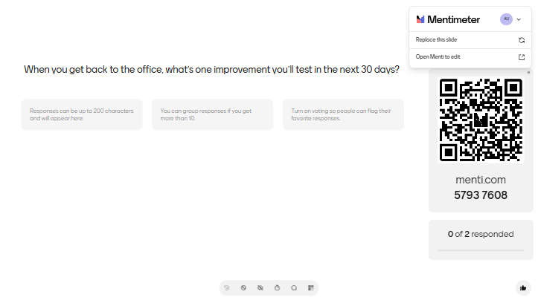
Notes:
Charles and Rebecca

Slide 25

Thank you
Any questions?
Charles Shannon and Rebecca Edwards
Notes:
Presenters: Charles and Rebecca. Thank the room for contributing. Encourage attendees to take away one practical action rather than trying to redesign everything at once.

Slide 26
“Resource appendix”
Optional take-away slides
Notes:
These slides are not for delivery unless time allows. Include them as resources after the main presentation.

Slide 27
Appendix: award-start checklist
Award documents received and stored
Budget agreed and coded correctly
Funder terms reviewed
Reporting dates recorded
Claim or invoicing schedule confirmed
PI responsibilities shared
Recruitment plan reviewed
Collaboration agreements identified
Ethics and due diligence confirmed
High-risk conditions escalated
Forecasting schedule agreed
Close-out date noted from the start
Notes:
Appendix resource slide.

Slide 28
Appendix: early-warning indicators
Award is more than 50% elapsed but less than 30% spent
Award is more than 75% elapsed but less than 60% spent
No staff costs after expected recruitment date
Equipment not purchased by planned date
Claims overdue
Income received does not align with expenditure
Significant spend in final three months
No recent PI forecast review
Repeated report extensions
Missing evidence for high-value costs
Notes:
Appendix resource slide.

Slide 29
Appendix: AI prompt bank
Summarise the key reporting obligations in this award agreement.
Create a checklist of evidence required for this claim.
Identify any unusual conditions in this funder agreement.
Draft a PI email explaining why the forecast needs updating.
Group these survey responses into five common themes.
Create an Excel formula to flag awards where spend is not aligned with elapsed time.
Suggest questions to ask the PI about this underspend.
Summarise this dashboard for a senior manager in five bullet points.
Draft a close-out action list for an award ending in six months.
Notes:
Appendix resource slide.

Slide 30
Appendix: 30-day improvement planner
Appendix: Tools
Question
Response
What is the process pain point?
https://www.worktribe.com/what-we-do/research-management/post-award/
https://www.infonetica.net/solutions/post-award
https://www.microsoft.com/en-us/power-platform/products/power-bi
https://www.office.com/
https://copilot.cloud.microsoft/
Why does it matter?
What small change could we test?
Who needs to be involved?
What data or evidence do we need?
What would success look like?
What is the first action next week?
Notes:
Appendix resource slide.

