Slide 1
What Nature Index authors think about the future of research
Simon Baker, Nature Index chief editor

Slide 2
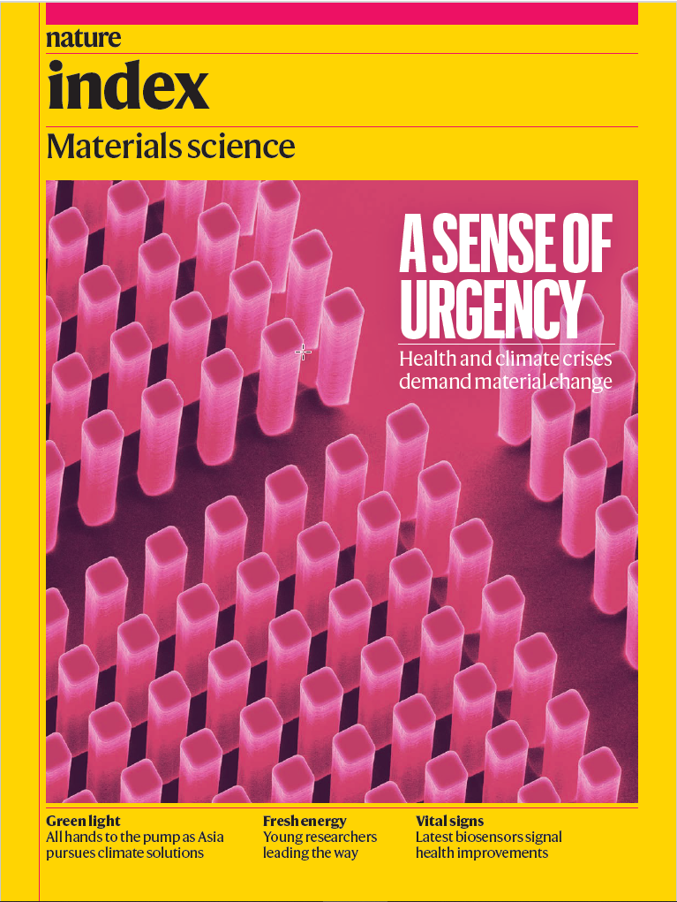
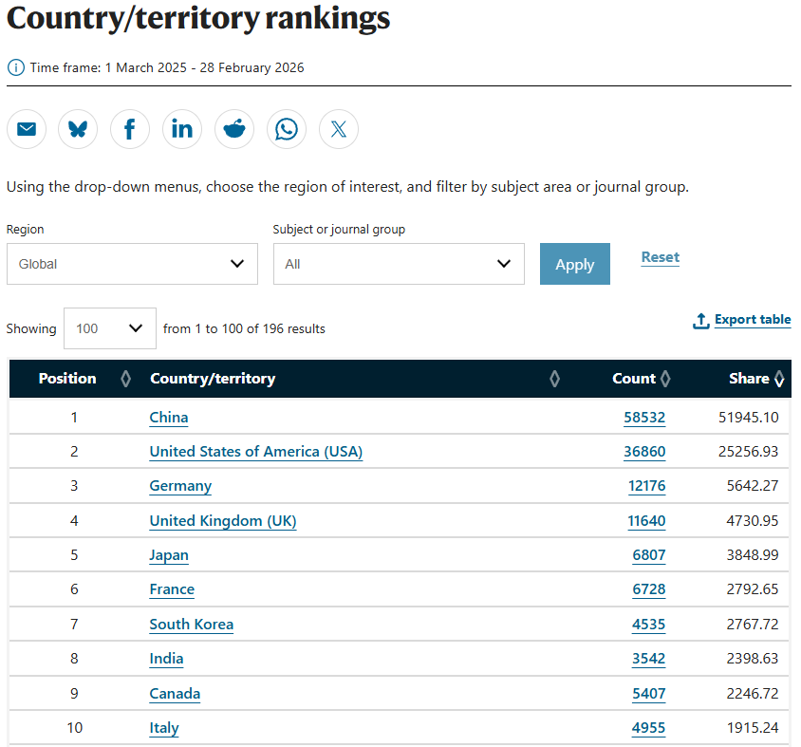
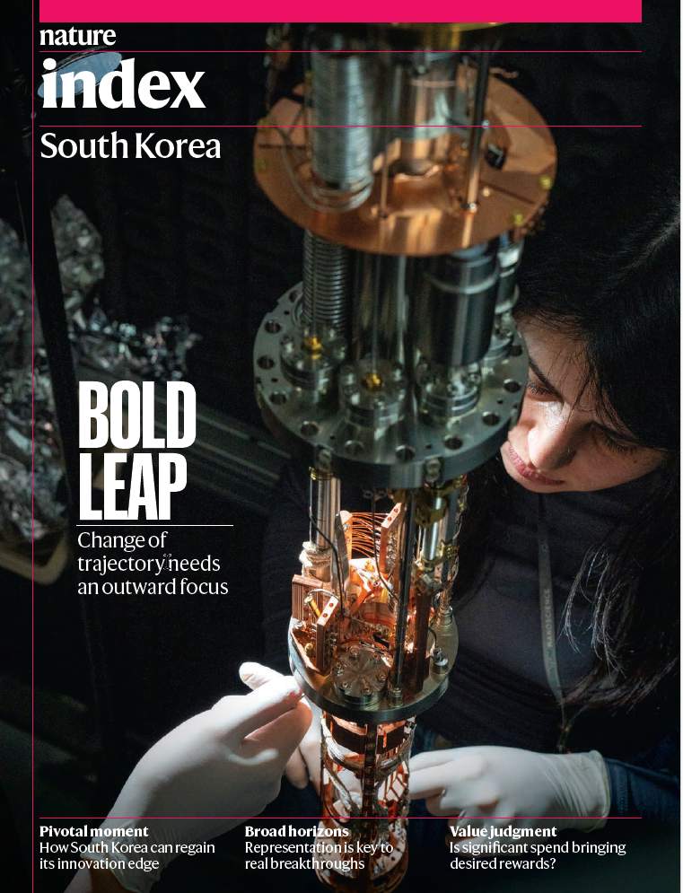
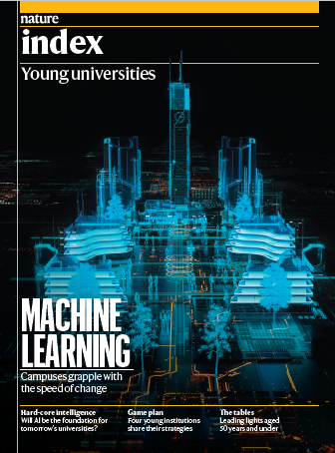
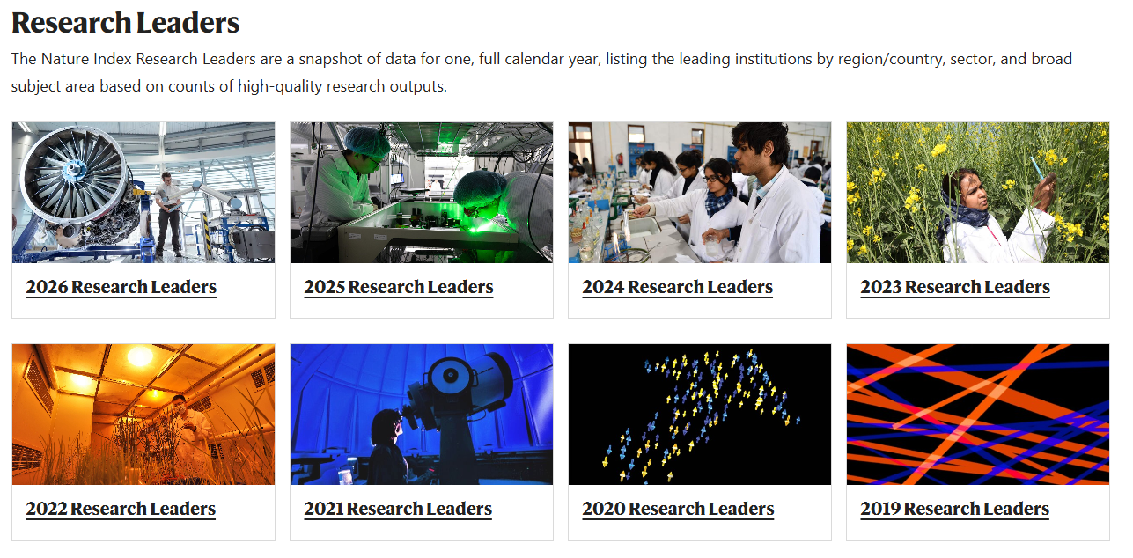
Nature Index: what is it?
Tracks author affiliations in 178 journals selected independently by research community as where scientists would want to publish their most significant work.
Data shared publicly from latest available 12 months, the last calendar year (Research Leaders) and supplement special issues (e.g. country/research area).

Slide 3
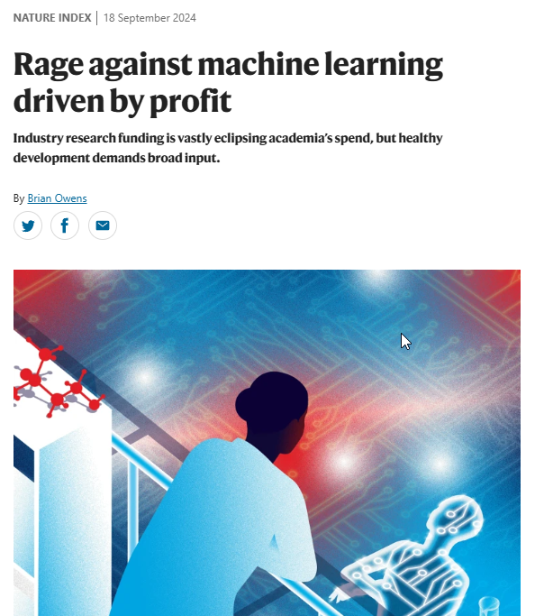
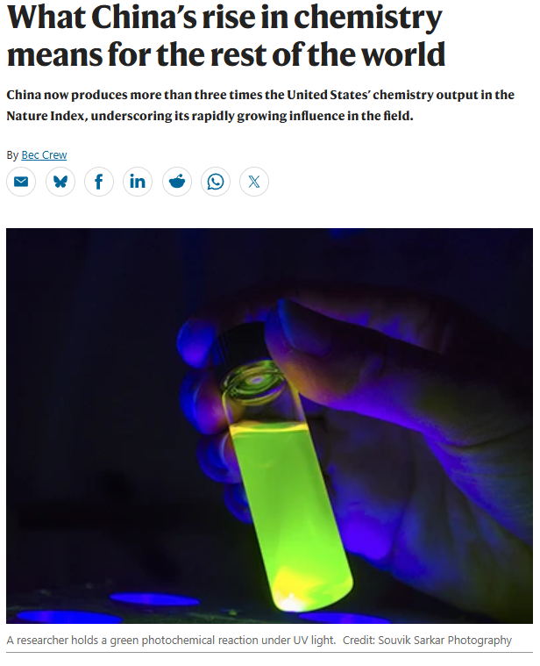
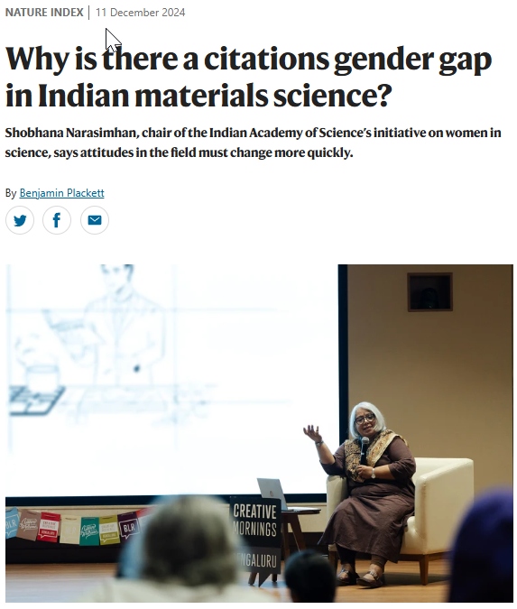
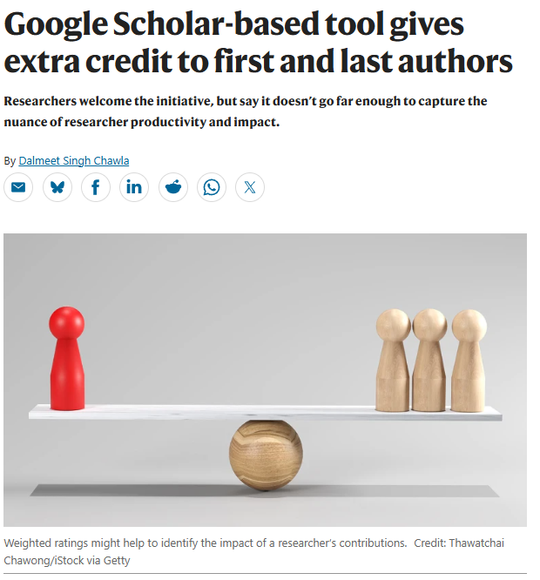
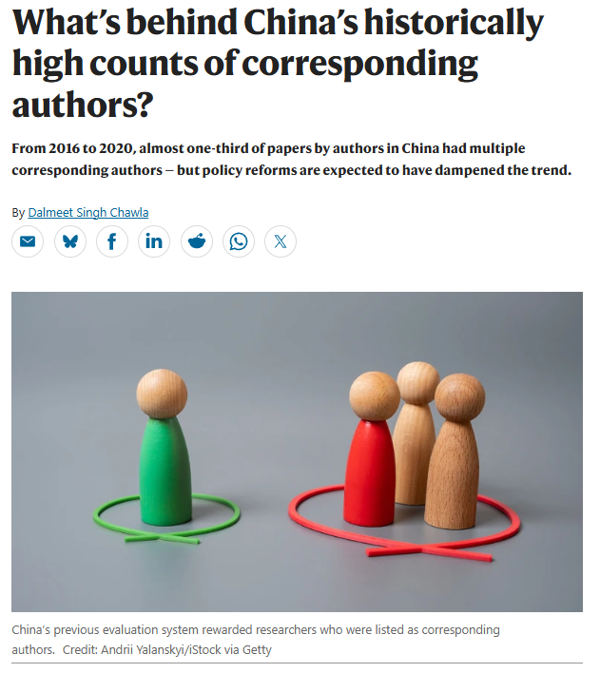
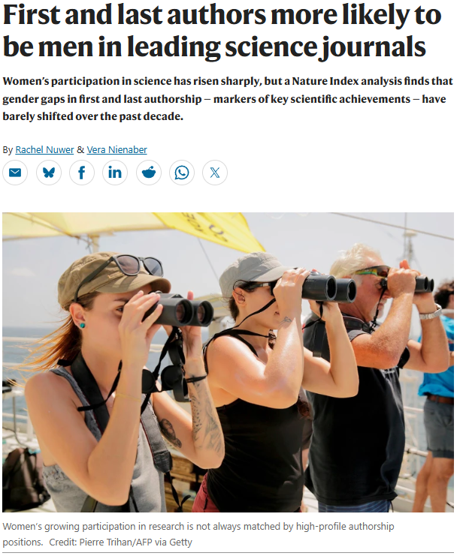
Our role as editors of Nature Index
NI data is starting point for looking at trends in science on a broader level.
Editors (Simon Baker and Bec Crew) have journalistic background in science, policy and education.
Several article formats including supplement features, data analyses and news stories, all editorially independent.

Slide 4
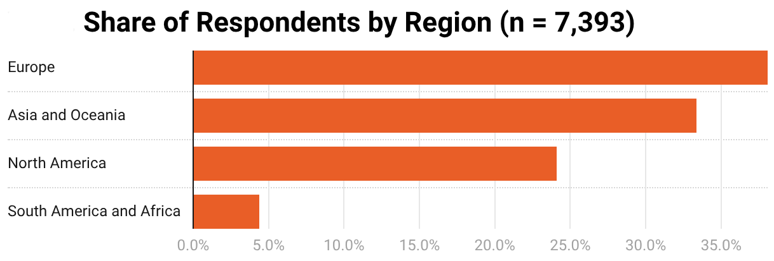
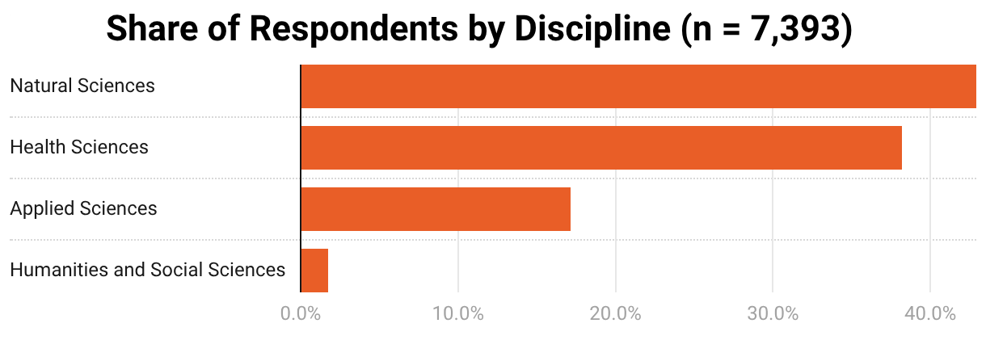
What was Nature Index ‘Research Leaders’ survey?
Almost 170k researchers — around a quarter of authors in NI journals in 2024 — invited to take part in June 2025.
Invitation sample adjusted to better reflect global demographics for researchers.
Total of 7,393 responses, of whom 6,030 completed the questionnaire in full.
Results analysed by location, discipline, gender (self-reported) and publication history (as proxy for seniority).
Some results for UK shared here exclusively (but beware of relatively small sample — 260 responses)
Notes:
So key point to make is that these are researchers who have published in influential journals (as chosen by science community) such as Nature, Science, Cell, Lancet etc.

Slide 5

What were Nature Index authors asked?
What is most associated with research achieving high academic, societal and economic impact.
Views on the direction of research funding in their discipline.
How much their research direction is influenced by their university and funders.
Satisfaction with their institution’s approach to DEI, leadership and governance, research integrity, research collaboration and training.
Notes:
Also about the discoveries and technologies that will be most significant in their field in the next decade, but not going into that data here.

Slide 6
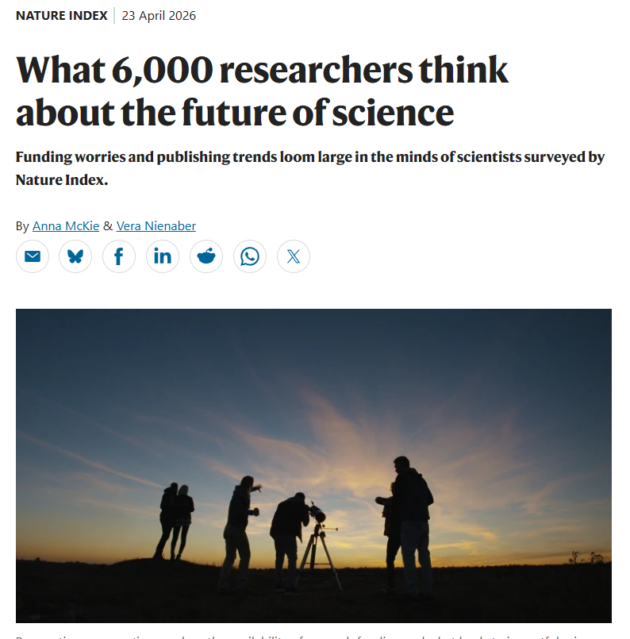

Key takeaways (shared in feature and white paper)
High-impact journals far less likely to be seen as a driver of academic impact than novelty and rigour: a view that strengthens among junior researchers.
Noticeable differences by gender on what researchers believe drives high academic impact.
Early career researchers are far more likely to be thinking about leaving academia entirely and report far less autonomy.
Perceived funding pressures are very different by region and discipline.
Notes:
Encourage them to read more here as too much data to go into here.

Slide 7
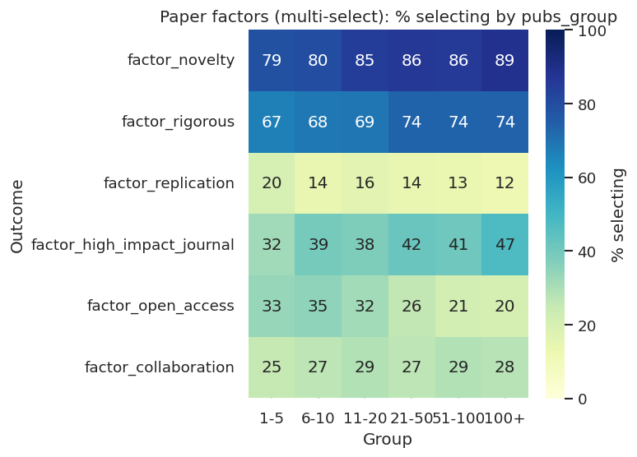
Views on impact by level of experience
Clear trend where rigour and novelty less likely to be chosen by junior researchers as factors driving academic impact.
It is the same for high-impact journals – ECRs seem to be far less likely to think this is important to achieve impact.
BUT replication and open access both more likely to be seen as key drivers of academic impact among more junior researchers.
Collaboration was selected by a similar proportion of researchers as a factor, whether senior or junior.
Notes:
Delving into this in more detail, although it is in the article. Explain chart a bit, what groups at the bottom mean.

Slide 8
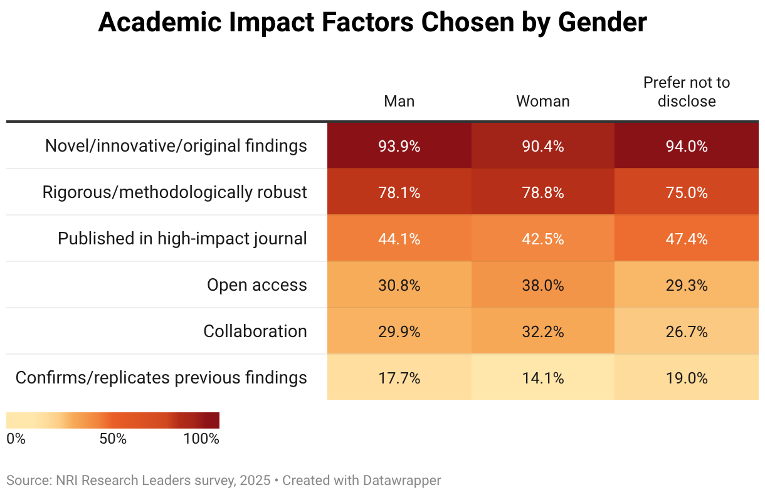
Drivers of impact by gender
Novelty chosen by slightly higher proportion of male researchers, but not a large gap (both higher than 90%). Rigour chosen by about the same proportion (almost 80%).
Open access seen as a key driver by a higher proportion of female researchers (38% v 31%).
Replication more likely to be chosen as a factor by male researchers (18% v 14%).
Some of these results might be linked to women being more likely to be ECRs, (male to female ratio was four times higher for the most senior researchers).
Notes:
1-5 group male/female ratio was 1.377 and 100+ was 5.543! Might need to explain “prefer not to disclose”.

Slide 9
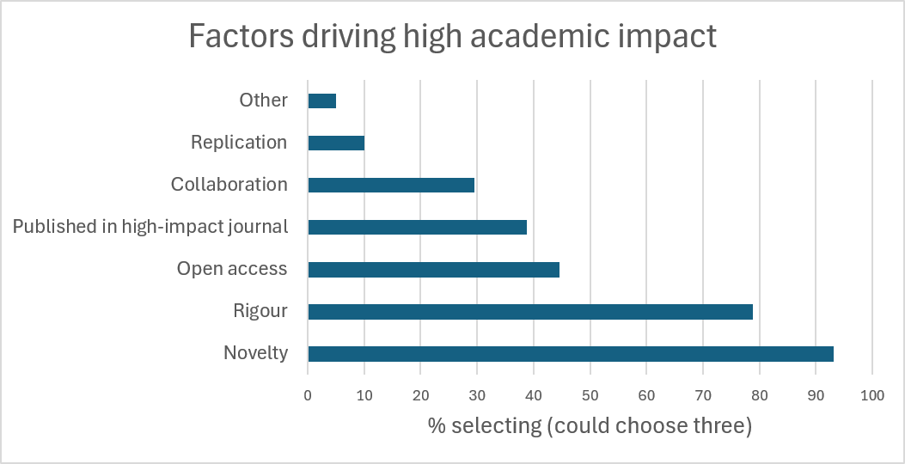
What about the UK and drivers of impact?
Novelty more likely to be chosen by UK researchers as driver of high academic impact compared with whole of Europe (93% v 85%).
Same with rigour (79% v 74%) and open access (45% v 37%).
Other factors, such as collaboration, journal impact and replication, had scores that were more similar to Europe as a whole.

Slide 10
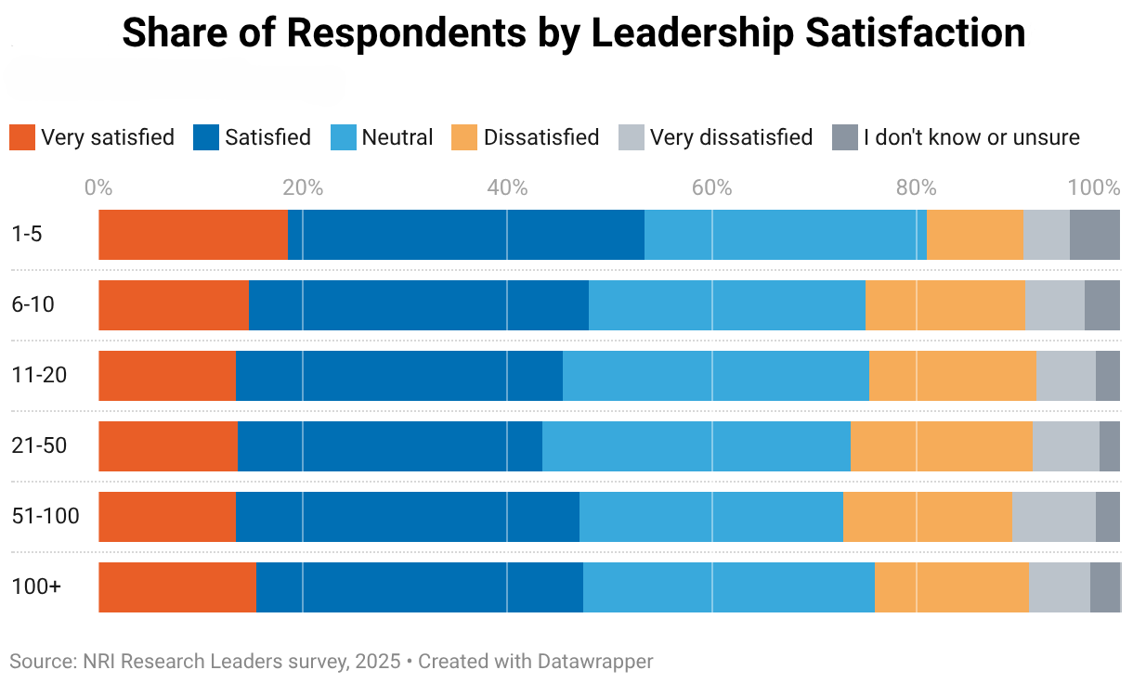
Views on research culture by experience (global)
Mid-career researchers were the most likely to express dissatisfaction and the least likely to report satisfaction with elements of their institution’s research culture.
The highest levels of satisfaction were reported by the least and most experienced researchers.
Global scores on institutional support for elements of research culture were very similar for both male and female researchers.
Chart shows satisfaction with institutional leadership, as an example, grouped by publication history in past 5 years
Notes:
Chart just shows satisfaction with institutional leadership

Slide 11
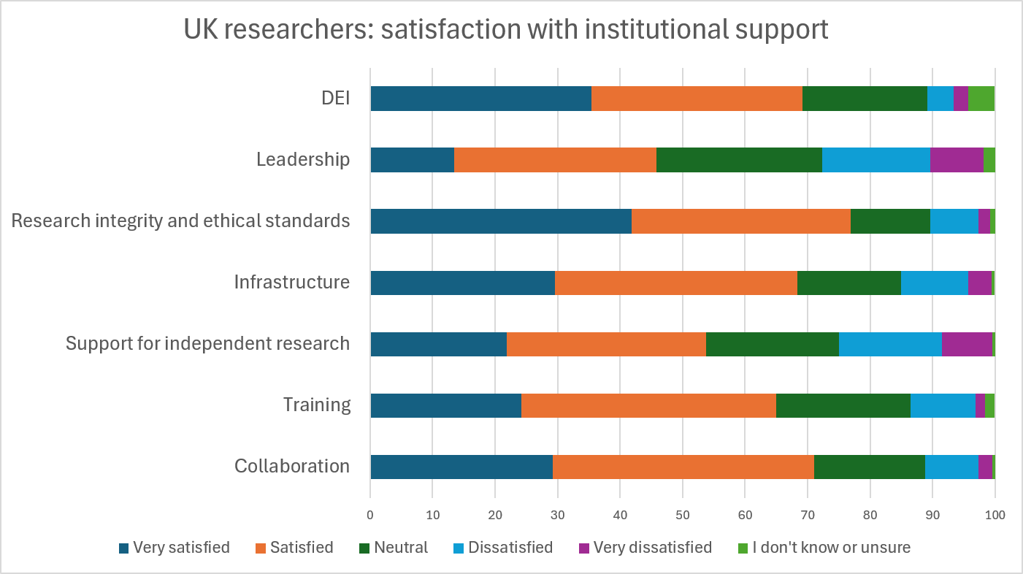
Differences in the view from UK researchers?
Much higher satisfaction with their institution’s support for DEI than globally. In the UK almost 70% were satisfied compared with around 60% globally.
One area where there seemed to be less satisfaction in UK was support for independent research. Almost a quarter were dissatisfied in the UK, compared with less than a fifth globally.
Other scores were broadly similar.
Notes:
Key slide as shows some interesting differences from UK-based researchers

Slide 12
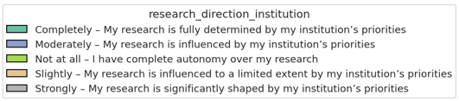
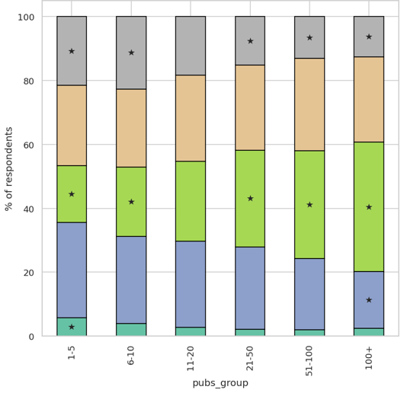
Drilling down on research autonomy...
A specific question in the survey asked: “To what extent is your research direction influenced by your institution’s priorities?”
Global results by researcher experience are stark: among respondents with only a few publications in the past 5 years, 27% said their research was determined completely or strongly by their institution, compared with 15% of those with 100+ publications.
One ECR told us for the Nature article: “Autonomy is important because that’s how we will grow as young postdocs and young scientists.”

Slide 13
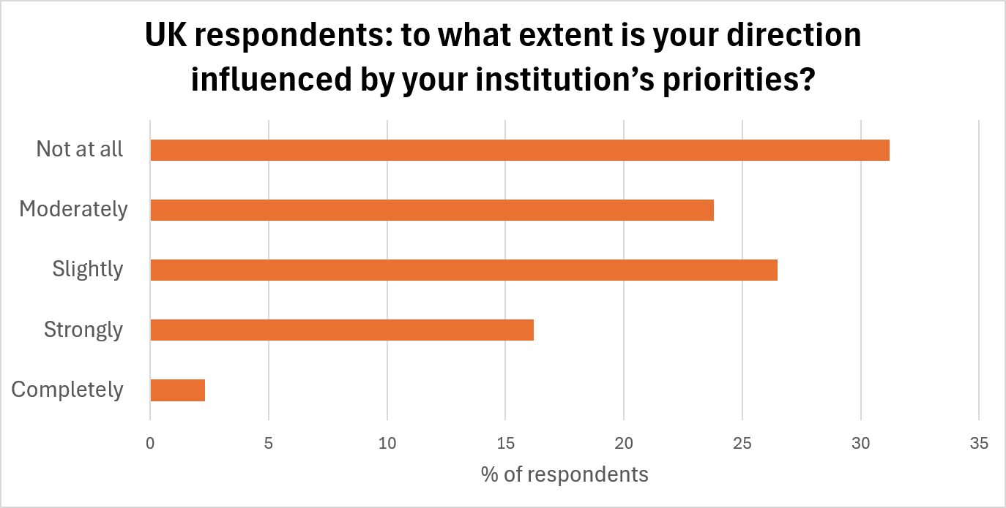
How about views on autonomy in the UK?
These were broadly similar to the results from Europe as whole: almost a fifth (19%) of UK respondents said their research was completely or strongly influenced by their institution.
Almost a third (31%) said that their institution had no bearing on their research direction at all, but global data suggest this is very likely driven by the view of senior researchers.

Slide 14
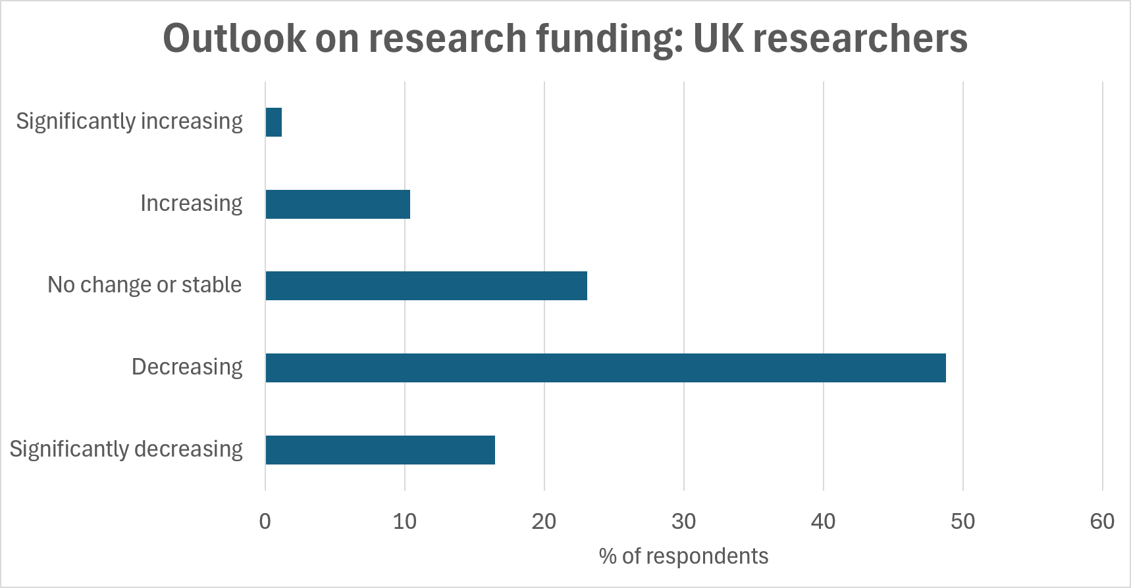
UK diverges on the outlook for research funding
Nature Index authors’ outlook on research funding in the UK was more similar to North America than the rest of Europe.
Almost two-thirds (65%) of UK researchers said they viewed funding as decreasing. This figure was 69% for North America and about 50% in Europe as a whole.

Slide 15
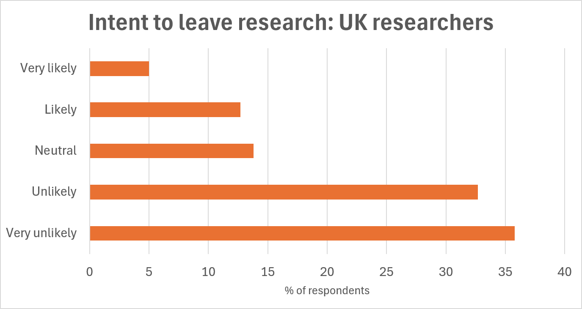
Why are these survey results important?
Almost a fifth of UK researchers say they intend to leave research entirely in the next two to three years.
This was a similar proportion to Europe as a whole, and North America, but it was much higher than other parts of the world (for example Asia/Oceania was 10%).
Acute pressure on ECRs: 22% of those with the least publishing experience said they were thinking of leaving.

Slide 16

Key messages for UK institutions?
Increasing funding for early career researchers is obviously very difficult in present environment, but could they have more autonomy?
Broad direction of institution’s research strategy can be important, but individual freedom to pursue research interests might be more important for retention.
Are there UK-specific constraints that explain these trends (eg REF) that might need a shift in policy to help ECRs?
Metrics like JIF are likely still used by institutions for research assessment (despite criticism) but it’s clear ECRs really value open-access publishing and replication efforts.

Slide 17
Thank you and please share your questions! nature.com/nature-index/ simon.baker@nature.com

