Slide 1

Good foundations: leveraging collaboration to support research environments to start right and grow sustainably
ARMA Conference 2026, Harrogate – 17 June 2026
Prof. Emma Bond, Pro-Vice-Chancellor Research & Knowledge Exchange, University of Suffolk
Rachel Persad, Head of Research Policy, GuildHE

Slide 2
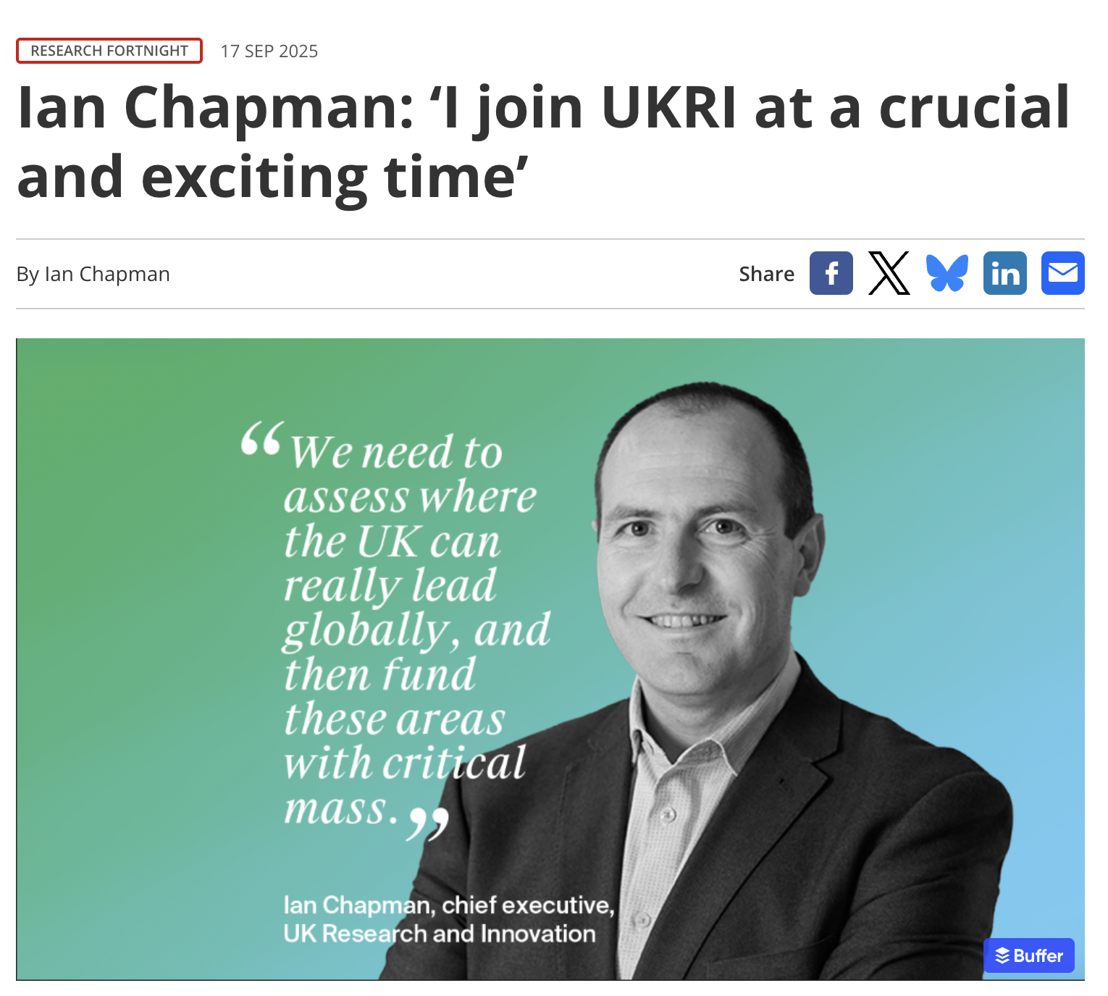
Setting the scene: Policy
Budget is growing - government confidence in R&I
Post-16 White Paper “specialisation and collaboration”
Efficiencies in HE
UKRI - New leadership (plus more to change)
https://www.researchprofessionalnews.com/rr-news-uk-views-of-the-uk-2025-september-ian-chapman-i-join-ukri-at-a-crucial-and-exciting-time/

Slide 3
Barriers and challenges for smaller research bases
Scale - Visibility and voice, limited time and resources
Specialist - Vital partners, engaged late in the day
Regulation - Disproportionate cost, negative effect on research sustainability
Infrastructure - Expensive and overly complex “like a 4x4 when all you need is a Mini”
QR Allocations - micro to small, and rapidly out-of-step with growth of research environment
Civic roles - Increasing expectations, who picks up the bill?

Slide 4

GuildHE Research - supporting sustainability
Affordable infrastructure
Consolidating research cultures
Visibility through advocacy
Starting right - introducing fundamentals

Slide 5


"The shared services have been invaluable in enabling the development of our research culture and access to vital services such as the impact tracker and repository. More importantly, GuildHE’s connection to key players has been invaluable in advocating for our part of the sector.”
Dr Joe Parslow, Rose Bruford College

Slide 6
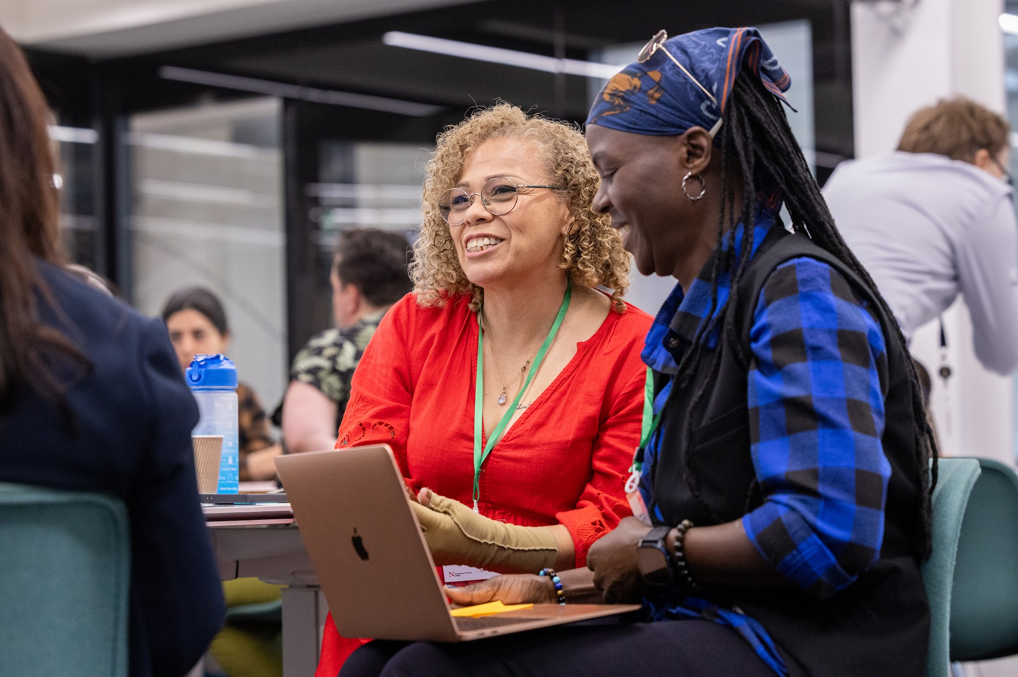
"Our PGR students value the UEA online training series. UEA and GuildHE working together is an exemplar of collaboration and support from the sector for small HEIs. The modules cover ground that we could not provide alone… access both consolidates our internal offer and strengthens it by offering diverse perspectives."
Prof Kate Adams, Leeds Trinity University
GuildHE Research - supporting sustainability
Affordable infrastructure
Consolidating research cultures
Visibility through advocacy
Starting right - introducing fundamentals

Slide 7
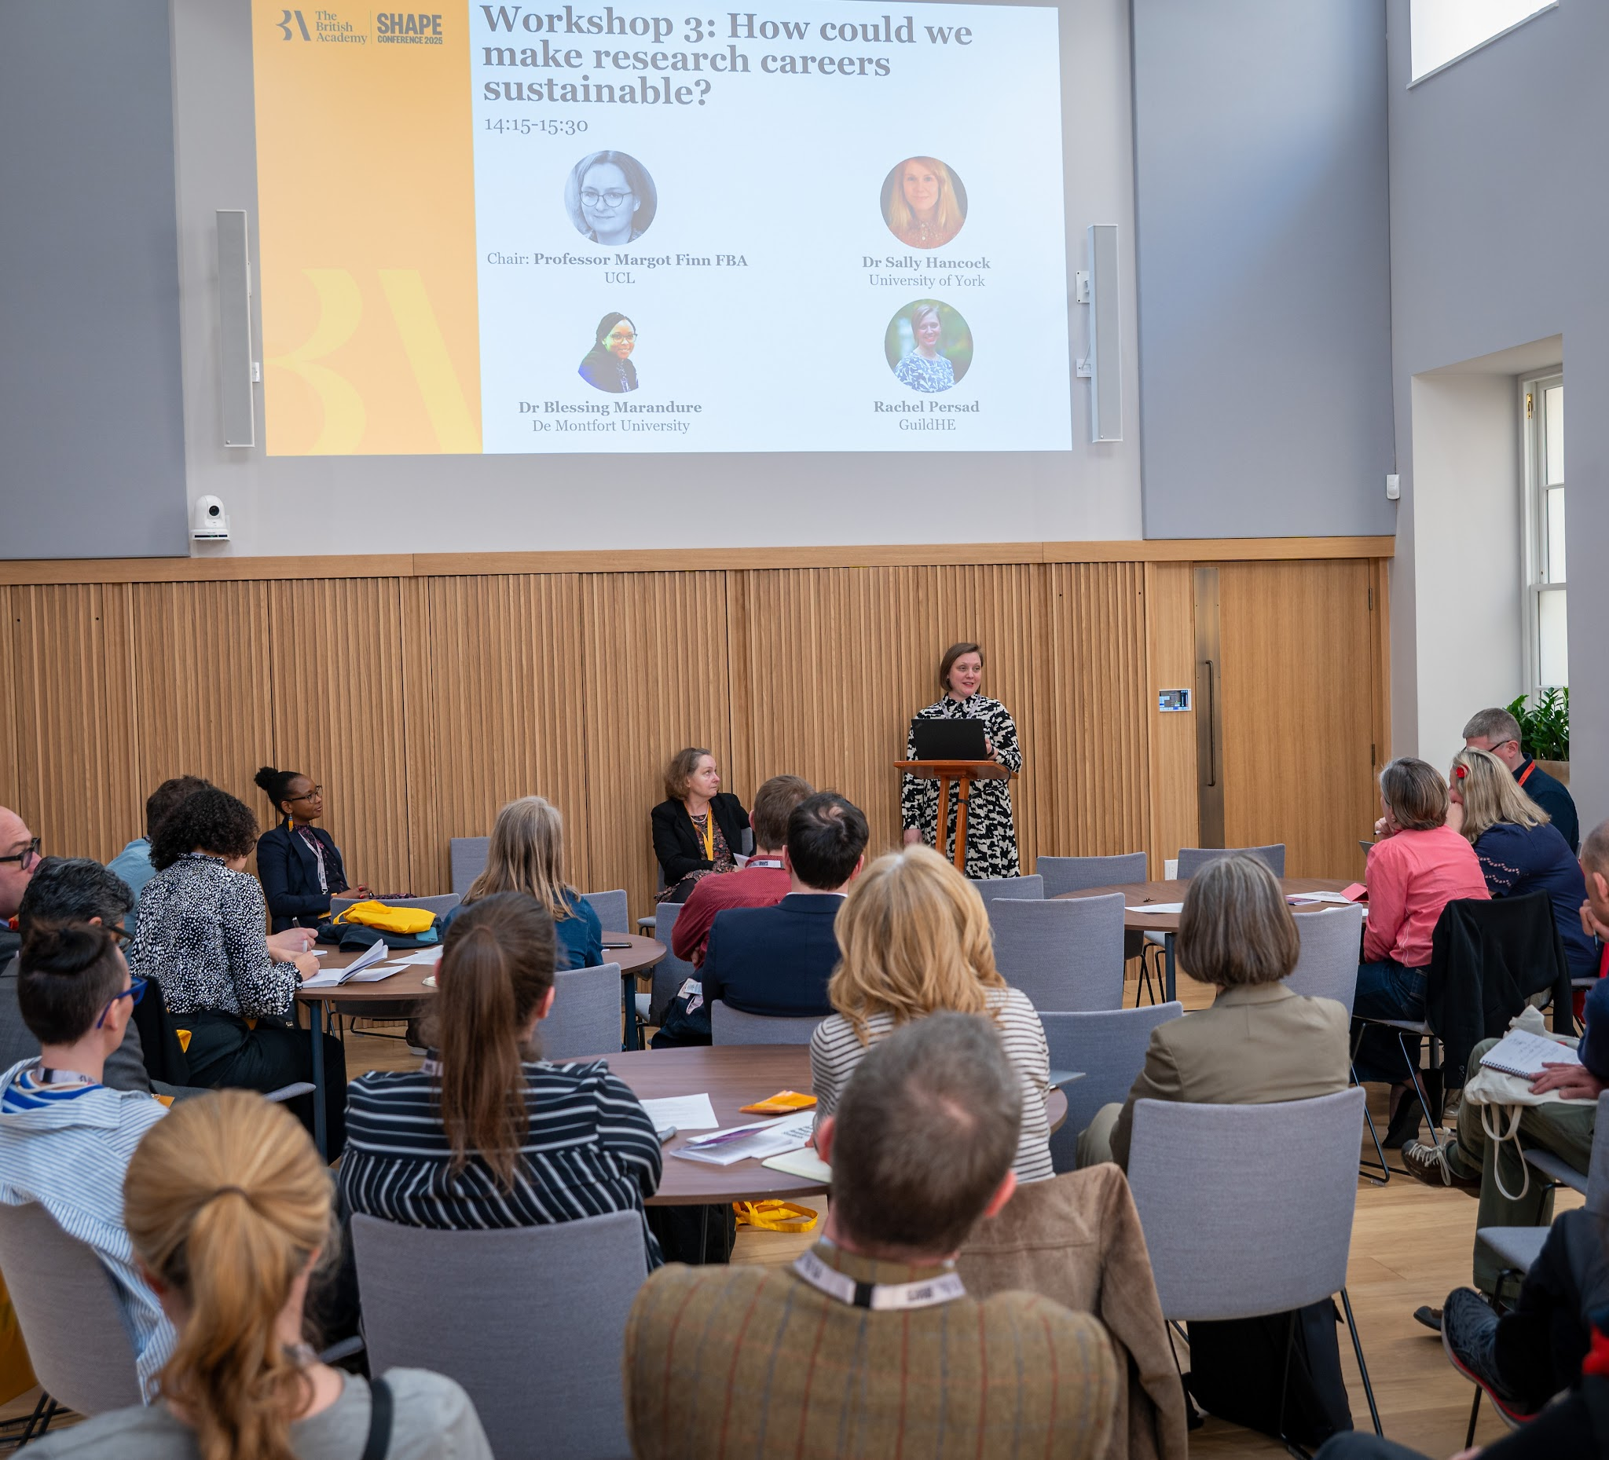
"GuildHE has introduced us to important bodies such as UKRIO and provides a forum for connecting with Research England/UKRI. It keeps us up to speed on key developments: we are a small team, and it fulfils a need to upskill knowledge across the university. It gives us a voice in the sector which we wouldn’t otherwise have."
Jennifer Wright, University of Law
GuildHE Research - supporting sustainability
Affordable infrastructure
Consolidating research cultures
Visibility through advocacy
Starting right - introducing fundamentals

Slide 8
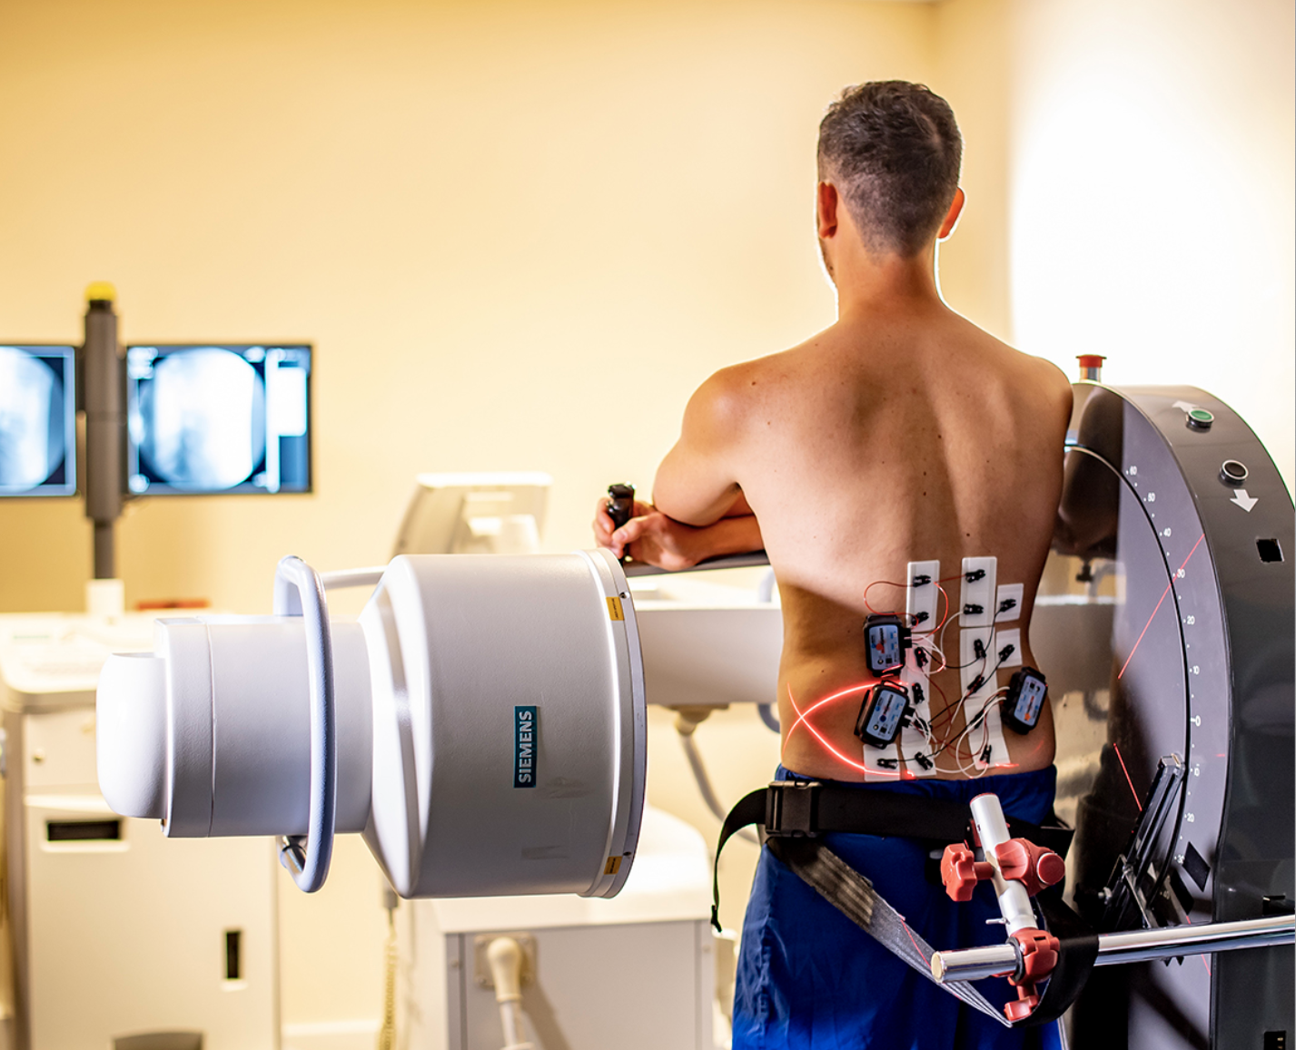

"HSU leads the National Centre for Chiropractic Research, and is a founding member of Wessex Health Partners, a regional partnership that includes universities of Southampton, Portsmouth and Bournemouth, 10 NHS organisations, NIHR+ infrastructure, and Health Innovation Wessex. GuildHE provides a platform through which specialist institutions like HSU can communicate the value of collaborative approaches to research." Dr Julie Northam, Health Sciences University
GuildHE Research - supporting sustainability
Affordable infrastructure
Consolidating research cultures
Visibility through advocacy
Starting right - introducing fundamentals

Slide 9

University of Suffolk

Slide 10
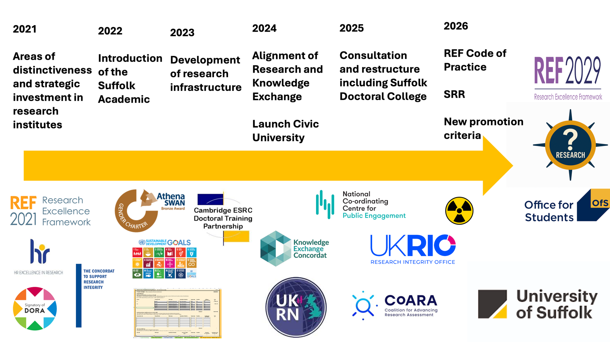

Slide 11
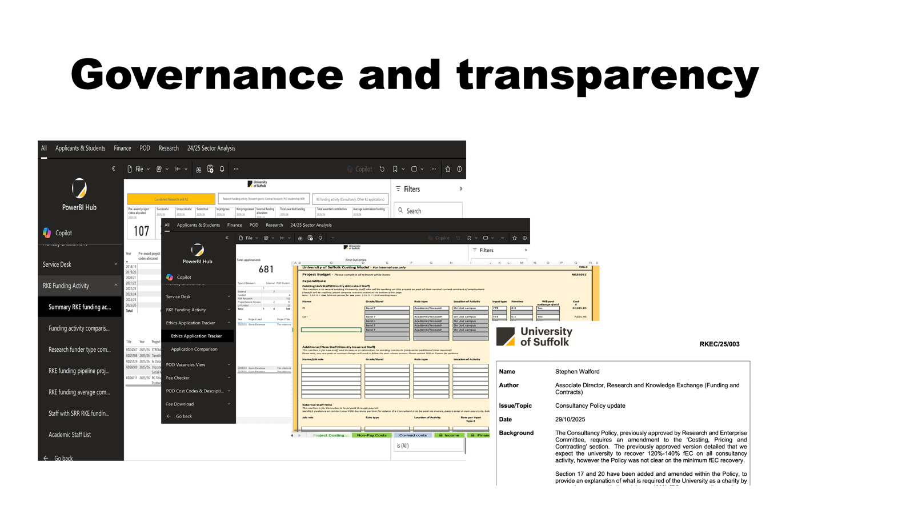

Slide 12
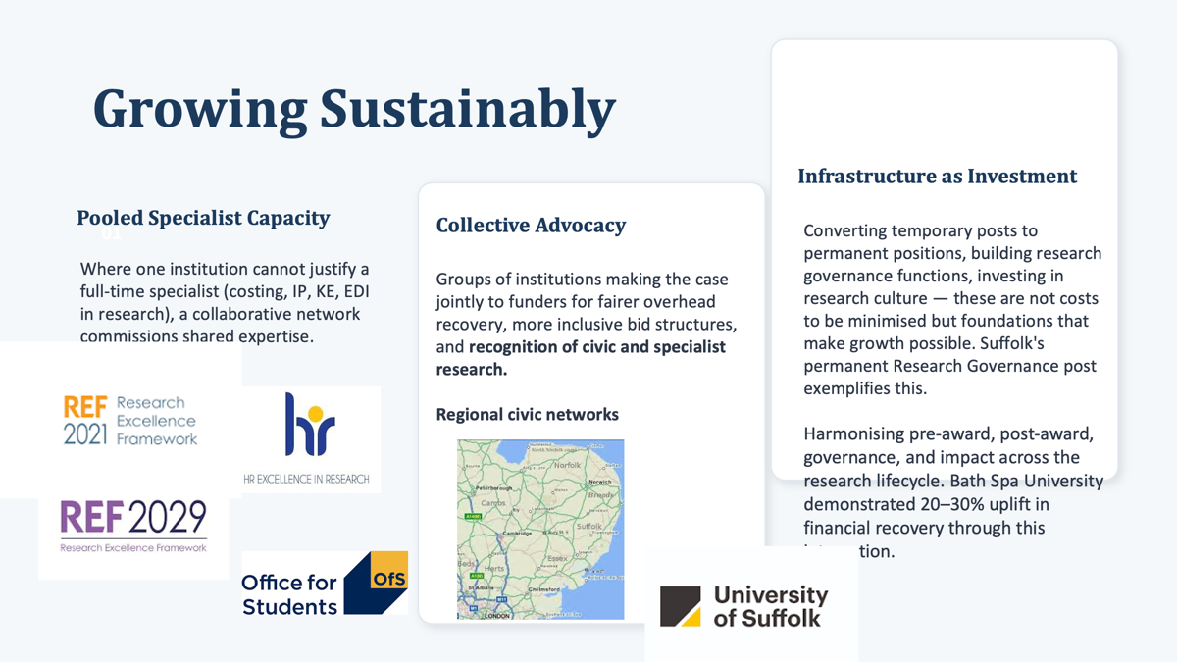

Slide 13
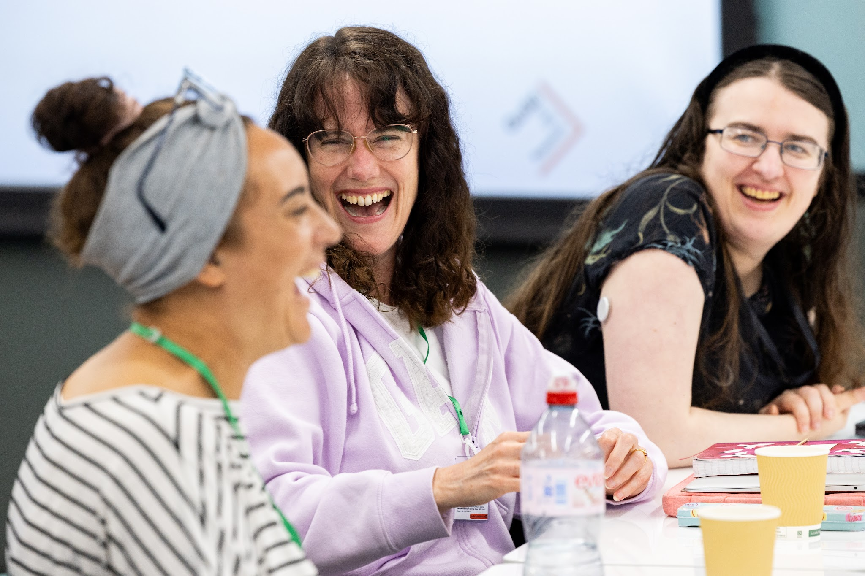
Thank you for listening
Contacts:
Rachel Persad, Head of Research Policy, GuildHE rachel.persad@guildhe.ac.uk
Prof. Emma Bond, Pro-Vice-Chancellor Research & Knowledge Exchange, University of Suffolk
e.bond@uos.ac.uk

