Slide 1


Strengthening engagement between funders and organisations: insights from Wellcome’s research funding survey
Sanja Vlaisavljevic, Funding Policies Manager, Wellcome
Kerry Garfitt, Senior Funding Policy Advisor, Wellcome

Slide 2
What we’ll cover
  Brief intro to Wellcome
  Purpose of our survey
  Survey design
  Key findings
  Next steps for Wellcome

Slide 3
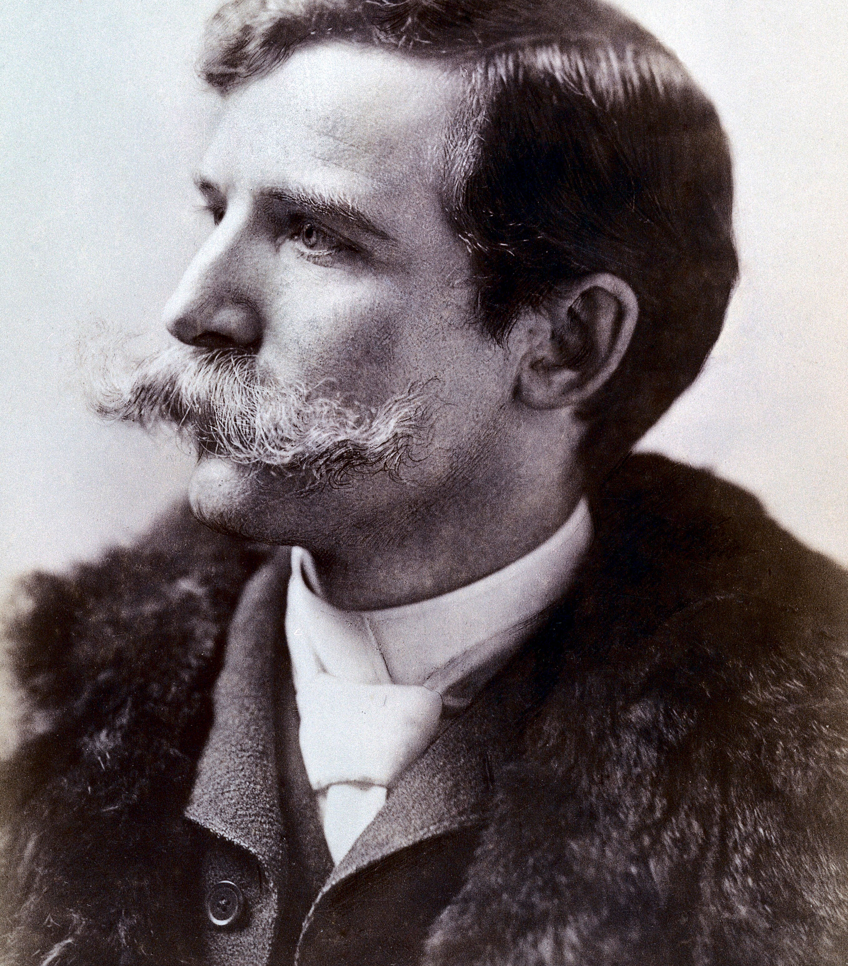
About Wellcome
UK charitable foundation
Global funder
A healthier future for everyone
Discovery and Solutions
Sir Henry Wellcome
  Photo credit: Wellcome Collection
Notes:
blue skies/open mode
challenge-led, Climate and Health, Infection Diseases, Mental Health

Slide 4





Role of funding policies
Enable high quality research
Ensure accountability
Protect from risk and harm
Influence change

Slide 5

Purpose of the survey
Gather feedback
Get information on how easily understood our funding policies are, and how we can communicate better
Understand local contexts and challenges
  Understand how they operate practically, particularly in a global context, and identify barriers to compliance
Broaden who we hear from
Capture a wider perspective that supports our global ambitions
  Foundation for action
  Inform future engagement and communication
Notes:
Sidenote: global policies review –also conducted/are conducting direct interviews with other funders and recipient organisations

Slide 6
Survey design

Slide 7

Scope and methodology
  Online survey, global audience
  Applied to Wellcome last 5 years
  Targeted organisational approvers
  Mix of quantitative and qualitative
  ​

Slide 8

What we asked
  Familiarity with policies
  Clarity of policies
  Ease of compliance
  Understanding of allowable costs
  Support needed to comply
  Navigating Wellcome’s application processes*
An image of a pencil and a questionnaire
Notes:
Research staff and applicants
We included questions on how organisations manage applications to Wellcome to understand better any barriers as part of a separate piece of work. We aren’t covering these questions today.

Slide 9
Survey snapshot
Invitations: 4000+
Response rate: 3%
Geographical spread: (55)
- UK, US and Kenya top
Type of organisations: (8)
- HEI, RIs and NGOs/non-profit top

Slide 10
Key Findings

Slide 11
FAMILIARITY
Respondents’ familiarity with policies, by funding status
Status | % of respondents
Unfunded unfamiliar | 15.3
Funded unfamiliar | 14.8
Unfunded familiar | 25.8
Funded familiar | 34.9
Notes:
The questions used a Likert scale of five options, two negative, two positive and one neutral. Respondents were able to answer not applicable or leave a question blank.
We’ve grouped the two negative and the neutral answers together to give us clarity on where answers genuinely are positive.
So the first thing we’ve looked at is the impact of getting funding on familiarity with our policies. As you can see, funding doesn’t really make a difference if you are unfamiliar with Wellcome policies – barely any difference between the 15.3% of unfunded respondents who said they were unfamiliar and the 14.8% of funded respondents who said the same.
The numbers do separate as you would expect for those who were familiar with those receiving funding distinctly more likely to be familiar with the policies than those who have not had funding. The remainder of the respondents answered not applicable to this question (for those of you eagle eyed enough to notice that this slide is not showing 100% of respondents.

Slide 12
Reasons for unfamiliarity
Notes:
There were four broad types of reason people gave for being unfamiliar with certain policies. The most common applied to our newest policies on Generative AI and Sex and Gender, which were that the respondents hadn’t seen them before – unsurprising as these were released in the last year or two when we contacted every organisation who had applied in the last five years. The next two reasons relate to being unfamiliar with Wellcome generally so either haven’t had funding yet or may have only recently starting applying for funding from us, or that the respondent wouldn’t expect to be familiar. The interest for me is in the feedback that the information is not readily available, and in the qualitative answers, it was pointed out that we don’t link to them from our funding opportunity pages, so that is something for us to take into account.

Slide 13
CLARITY
Policies respondents identified as least clear, by funding status
Funding status | Policies identified as least clear
Unfunded | Use of Generative AI in Applications
 | Open Access
 | Continuing Professional Development
Funded | Environmental Sustainability
 | Sex and Gender in Health Research
 | Continuing Professional Development

Slide 14
Why the policies aren’t clear
Keeping track of changes is difficult
IP policy is complex or of little relevance
There are too many policies
They aren’t linked on the scheme/call pages or on sample forms

Slide 15
COMPLIANCE – CAN YOU?
Policies respondents identified as most difficult to comply with, by funding status
Funding status | Policies identified as most difficult to comply with
Unfunded | Use of Generative AI in Applications
 | Data, materials and software management and sharing
 | Research misconduct
Funded | Environmental Sustainability
 | Continuing Professional Development
 | Data, materials and software management and sharing

Slide 16
Compliance challenges
Small teams find it difficult to ensure compliance
We don’t have all the policies you require in place
Context-related issues flagged, i.e., German organisations and multilaterals

Slide 17
COSTS
Understanding of allowable costs, by funding status

Slide 18
Reasons for not understanding costs

Slide 19
WHAT SUPPORT WOULD HELP?
Option | Times ranked 1st
FAQ/additional guidance | 38
Webinars | 22
In-person workshops | 18
Visits from Wellcome staff | 14
Online workshops | 13

Slide 20
HOW WOULD YOU LIKE TO BE INFORMED ABOUT POLICY UPDATES?
Option | Times ranked first
Direct communication from Wellcome’s Funding Policy team | 78
Wellcome website | 41
Wellcome’s Researcher Newsletter update [email] | 27
Webinar on online workshop | 18
Through sector bodies | 2

Slide 21
Next steps and engagement

Slide 22
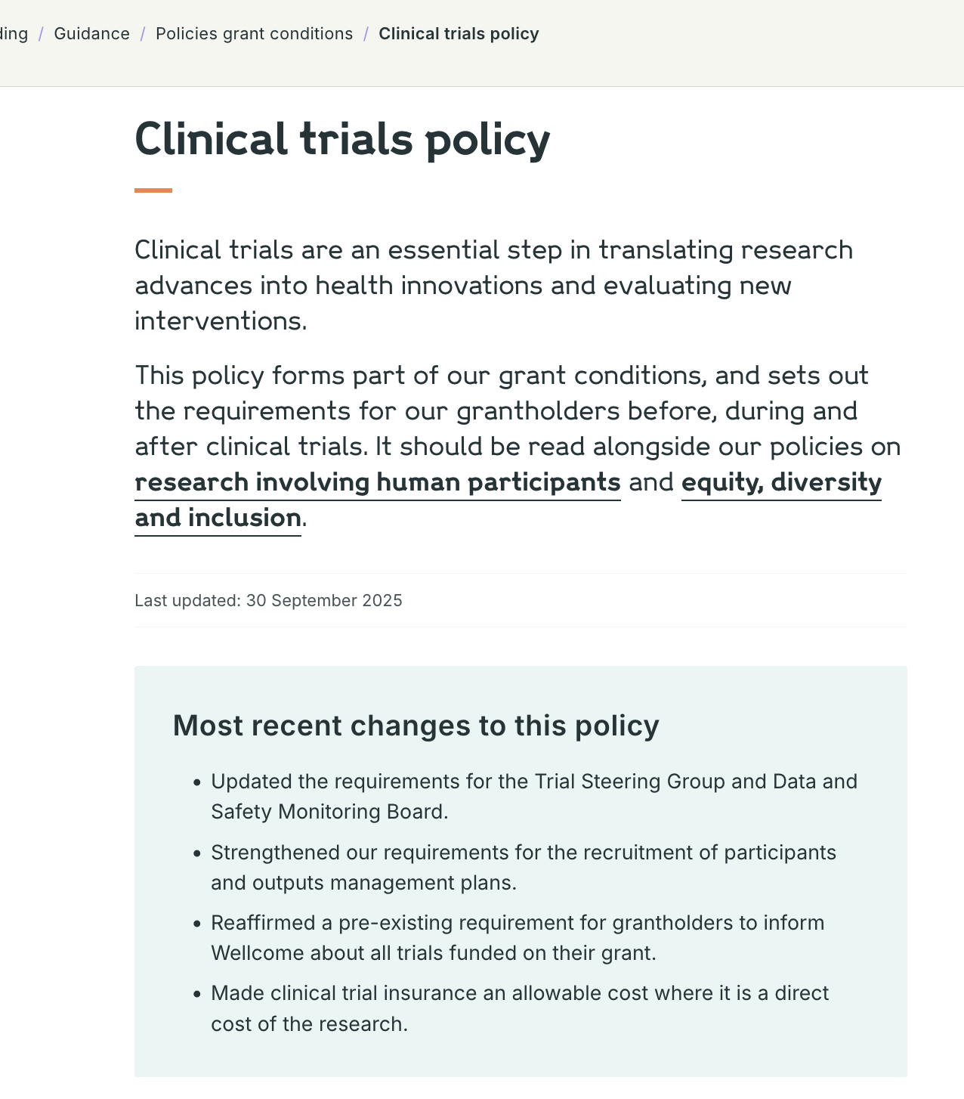
Actions we are taking
  Continuing to review survey findings
  Reviewing funding policies to enable compliance from a global context
  Highlighting recent policy updates on external webpage (like this)
  Considering what additional resources/support are helpful to meet our requirements
Screenshot of Wellcome’s Clinical Trials policy highlighting recent changes to policy

Slide 23
Thanks for listening
For more information, please contact:
S.Vlaisavljevic@wellcome.org
K.Garfitt@wellcome.org

