Slide 1
One Due Diligence Process to Rule Them All
Luke Postlethwaite, Head of Research Culture, Development & Environment
Rachael Gibson, Research Governance Manager
#ARMA2026

Slide 2
In the beginning
Disparate, inconsistent processes
Lacking central record
Lacking ownership or oversight
No monitoring
Increasing workload, reducing resource
Notes:
Gaps in processes and overlap in others. Duplication of effort with no clear gain of this in certain areas
Lots of local records, no agreed method of recording decisions or establishment of what information was needed to be valuable for unified due diligence
Ownership and oversight hadn’t been agreed. Instead, informal arrangements that had no standard baseline
Lack of formalised ongoing monitoring. Pre-award teams undertaking post-award work and the lacking standardised post-award process resulting in things being missed
Increasing demand on workload and what was needed for due diligence, not least research security, financial regulation

Slide 3
The Universal Approach
Research Development
Research Contracts
Research Operations
Academic
Finance
Research Governance
Library Research
(outputs)
Research Data Management
Notes:
We brought together the individuals/teams who needed to input
Mapped their engagements and touchpoints be involved in due diligence at different stages
There was significant variation in needs and definitions, demands arose at different stages fulfilling different purposes
On top of this there were increasing demands – research security, for example, requiring interconnectedness and a different perspective of due diligence and compliance
One option was to allow everyone to go their own way, determine their own needs, work on different datasets and definitions but as can see from mapping, this risked being resource heavy and impractical
It would be crucial to ensure provision of oversight for everyone whose work stream required it, without necessitating duplication of processes to facilitate basic oversight

Slide 4
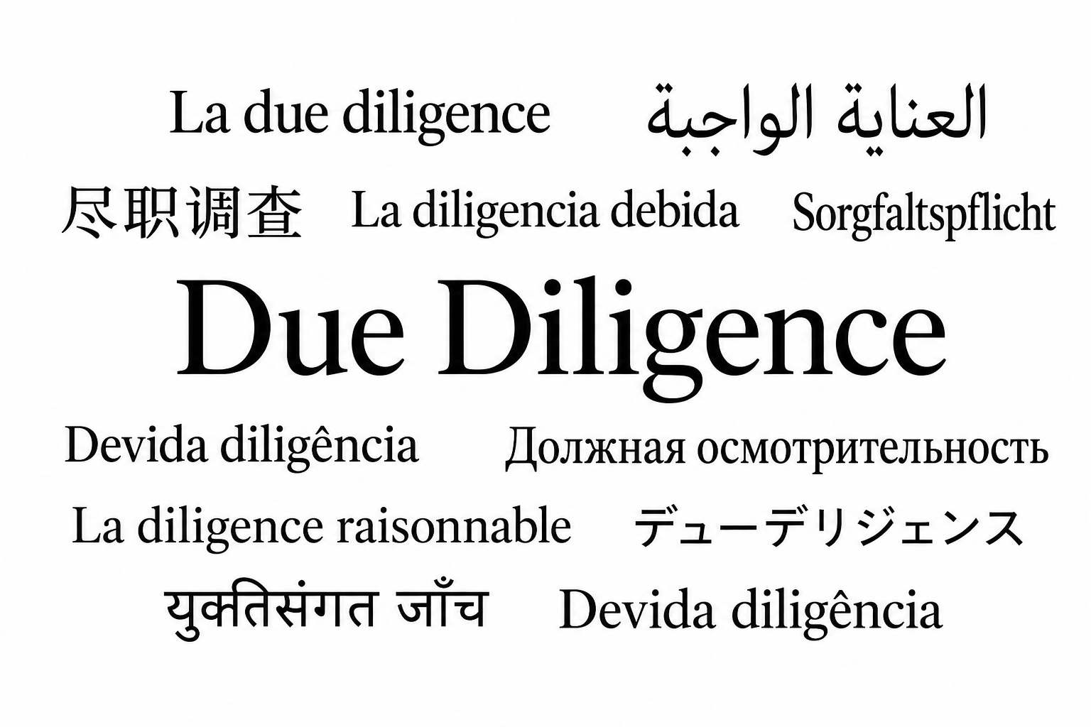
Finding a Common Language
AI
Notes:
Different teams, records, compliance needs. Needed to determine a common language.
Needed to identify actions that weren’t maximising efficiency because teams weren’t working towards a common goal.
Seeking to create efficiencies approaching this by first understanding what we were asking
What did we mean by DD? What did we mean by enhanced DD? And how did knowing the answer facilitate useful outcomes?

Slide 5
Where we stood and what we needed
Safeguarding the dignity, interests, rights, safety and welfare of those involved
Preserving the reputation of the University and the wider academic community
Complying with relevant legislation or institutional policies
Mitigating conflicts of interest
Protection of animal welfare, cultural heritage and the natural environment
Guiding principles
Efficiency
Good governance is a key value of a positive and functional research ecosystem
Positive research culture
Continued process improvement, enabling research and facilitating responsible and inclusive research
Reduction in bureaucracy
Notes:
You know you need a common language; how do you find it?
As a collective of research practitioners, we determined what we had to keep and what we needed to develop. This helped us find gaps in certain DD tasks.
We agreed our principles, aligning them to our ethics policy. We knew any change in governance had to be embedded in a positive research culture, and we also sought a reduction in bureaucracy. Once defined, alongside all those, we asked: what evidence was needed for which compliance matter?
Using these principles, we devised and trialled an DD initial process. It resulted in an improved record but an increase in time. This wasn’t where we needed to be.
Efficiency was a key driver. With shrinking resources and increasing demands, removal of any duplication of process and reduction in time to undertake a task was essential to achieve. Back to the drawing board.

Slide 6

Creating efficiencies and Upgrading the Approach
Integrated processes
Compliance
Systems investment
AI
Notes:
Needed to create efficiencies and pare back >> scrutinised each part of the process and asked, “is this part actually adding value or are we only doing something we’ve always done?”
Had invested in systems (Worktribe and Infonetica) that would allow us to work across teams and areas of need, each team providing its corresponding area of expertise, without duplicating, triplicating or crossing over
We recognised that making full and proper use of those systems and their existing data would facilitate integrated due diligence as a process and ultimately, improve compliance oversight
Everyone who needed to input would only input their part, everyone that needed to see could see some, or all, because we were working together, sequentially or in concurrently, as need dictated
We looked at creating efficiencies in repetitive tasks and embedding and kept returning to the conclusion that we should be embedding an AI tool

Slide 7
Including AI
AI
Operational principles
Trialling prompts, responses
Human
‘Thought partner’ approach
Improving efficiency
Verify
Collatable sources
Flexibility with tools
Inputting content
Preferential tools
Notes:
Reservations were only natural and we trialled routes and options. This came after developing our operational principles >> we have Principles of AI in research, Principles of AI in RKE operations, having developed those outside of a specified process allowed us to work from a standardised baseline n>> again, that common language as opposed to a bespoke route
For AI tool we agreed on standard text for the prompts. Was based on trial runs and this ensured confidence, alongside a recommendation but flexibility on which tool used.
It was and will remain essential to be very much alongside the human: as a thought partner. At this stage, there is no replacement for the human element.
Yes, there is the need to check the veracity of claims and sources – always ask for sources. Queried if this saves time - you would do this during manual DD and using AI is no different. Efficiency is created in speed of information collation and standardised questions.
Not to say there aren’t unintended risks and ethical dimensions. We are navigating the tension between governance frameworks and academic independence. We must mitigate the risk of over-regulation and information gaps.

Slide 8

Adoption and Culture Change
AI

Slide 9
Culture change
Burden
Most due diligence checks can now be completed in just a few minutes.
Collaboration
Shared ownership of content and systems has helped break down siloed working.
Consistency
More consistent advice and messaging provided to academics across the institution.
Embedded Due Diligence
Now part of everyday pre-award practice
Quality
Fewer post-award issues, reduced errors, and stronger management of emerging risks.
While significant progress has been made, adoption and buy-in remain uneven across some areas.
Building a culture of shared ownership remains an ongoing journey

Slide 10
Next Steps – Building Confidence and Capacity
Scalability
Outputs
Standards and Records
Readiness in records
Flexibility and Sustainability
Informal arrangements – inclusion and exclusion proportionality
Commercial Units
KE activity
Enhanced due diligence – nuance of geopolitics
AI literacy and workflow integrations
Compliance obligations – building confidence in consistency
Ongoing monitoring – fine-tuning and record renewals
AI enhancements
Cooperation
Compliance
Capacity
Notes:
Attention for next steps involves these focus areas. It’s very much on building confidence and capacity.
Scalability - culture change seen as rapid adoption in some areas and less in others. Well embedded in most pre-award processes, we’re expanding on post-award DD to Outputs in our repository (and this benefits research security operations), commercial units (where third parties, turnaround times and mitigations will differ and offer alternative challenges), similarly, with KE activity. Then there is also the need for ongoing AI literacy and the scalability here. Perhaps not as advanced as some institutions on an institution-wide approach to AI tools but locally to RKE operations we’ve made positive effort to embrace benefits and socialise risks. One future development is to start building in standard, repeatable processes to DD such as automated workflows, cyclical prompting routines.
An institution-wide approach allows us to collectively review the data and identify risk implications for institutional strategy and international engagement.
Standards and records – we’ve been live embedding and evaluating the model. Evaluation being seen in form in assurance of audit readiness in records (is it covering all variations on audits needs? Have we achieved that common language test?), testing process robustness and fine-tuning as we move through renewals of assessments.
Flexibility is needed for sustainability – proportionality is the simplest way to achieve this in short term. This means actions like capturing informal arrangements but reducing the extent of the checks and perhaps automating more in these areas. The process design had proportionate exclusions built in to reduce bureaucracy but this needs ongoing monitoring for robustness and efficacy. Geopolitics makes enhanced due diligence complex, for example. Can’t just set due diligence to done and walk away. So sustainability also comes in the form of building confidence in interpreting complex risk landscapes.
AI enhancements - have looked at how it can make an initial RAG rating. In fairly basic assessments, ty.pically the tool agrees but it doesn’t add sufficient value to justify removing the human element. The side-by-side works well
Have looked at making adjustments to support enhanced due diligence. This works when the questions are consistent but with enhanced there is greater nuance required as it needs additional context, so a work in progress and a weekend hobby.

Slide 11
Research-development@salford.ac.uk
Research-governance@salford.ac.uk
#ARMA2026

