Slide 1


Shift happen - small steps and shared effort
Dr Emily Ennis, Research Culture Manager
Soo Lincoln, Research Culture Advisor (Inclusivity)
University of Leeds
Notes:
Our presentation today will highlight the role of small tweaks to business-as-usual activities at Universities in effecting lasting research culture change.
These don’t replace the ambitious hearts-and-minds type work that are also essential in transforming research culture positively. And we’ll talk a bit about that. But they offer a valuable insight into what might be achievable as we enter into a new phrase of financial scarcity for research culture activities. We know, for example, that financial support from Research England is winding down; there is unlikely to be further funding for research culture initiatives coming from Wellcome Trust. But research culture will be part of SPRE assessments for REF2029 and they will be part of funding requirements from UKRI and beyond. So it’s important we reflect on the micro-initiatives that can drive change forwards in a system that isn’t always looking to change.
We will draw primarily on learnings from University of Leeds, contrasting big picture activities with smaller, more process-driven interventions, to demonstrate how research culture change can happen by "stealth" through micro-actions and connections that transform the research ecosystem.

Slide 2

Since 2022, we have invested £1.7 million to University community through open/targeted call funding schemes
Funded 153 projects, people, or initiatives, across all Faculties and Services
Nearly £400k for Research EDI (REDI) scheme, for 36 people, across 2024-25 and 2025-26
Notes:
Emily
Since 2022 we have been committed to using our funding from both University of Leeds and Research England to invest in our research cultures and communities.
These investments include:
[read slide]
These have been big splash items, focusing on grassroots initiatives, acknowledging that we – as a central team – cannot make one singular decision or do one singular action that makes research culture at Leeds more equitable, supportive, inclusive, or open. They justified and embedded our ongoing commitment to our Research Culture Strategy and to “putting our money where our mouth is” when it comes to effecting lasting change.
They acknowledge the importance of lived experience and community knowledge, something we would simply never have time to develop across multiple Schools, Faculties, and Services, even if we each bring our own set of experiences from these areas at Leeds or elsewhere.
They highlight the value of individuals and teams for making and sustaining positive research culture and they also, in the case of REDI, highlighted the need for targeted and sustained support for individuals most impacted by poor research cultures. We had the data to back us up on this one.
But, despite these large-scale investments, we were increasingly seeing that the system wasn’t adapted for change.

Slide 3

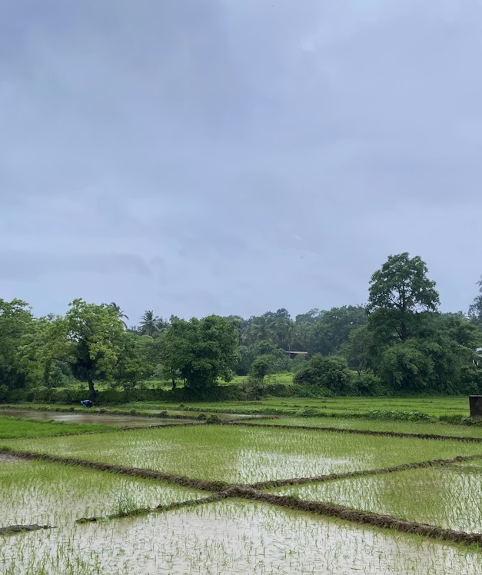
Not penetrating adjacent systems
Not fundees’ responsibility to effect systemic change
Something was missing..
Notes:
Soo
Something was missing….
We were routinely hearing that, despite investing in people and groups who knew both the research culture challenges and how to face them, crucially the systemic preparedness wasn’t there. People were building new initiatives for research culture that couldn’t be embedded - or - were trying to develop themselves (in the case of the REDI fund) in a system where structural barriers remain unsurpassable.
The limitations of the “big splash” method of research culture change were becoming clearer:
[**]
It’s never the fundees’ responsibility to effect systemic, or even local, change.
[**]
Targeted support of this kind does not necessarily penetrate adjacent systems or become embedded without additional work to make this happen.
You may have noticed we’re leaning into the water metaphors (…they may get a tad over-used today..) but it helps conceptualise our next steps upon realising the challenges with these big splash approaches, namely … we needed more focus on doing the institutional plumbing.

Slide 4


Institutional “plumbers”
Leaky systems are damaging
Both maintenance and emergency services are required
Pipes run through every room
Necessary for quality of life
Notes:
Emily
The idea of systems convening is very prevalent in research culture change spaces, and this is needed, especially for large-scale change. But what if systems themselves don’t work?
The concept of doing the plumbing work of institutional change is an idea Sara Ahmed discusses in her book, No is Not a Lonely Utterance. For her, the analogy invokes the idea of systems change being time- and labour-intensive, of being ongoing labour as well as one-off, and there is the implication, too, that with good plumbing everyone benefits (not just the plumbers).
For us, the idea of being the friendly institutional plumbers is the very spirit of collaboration for effective research culture change. We’ll describe shortly what sort of acts of plumbing we’ve been doing and how this embodies cultures of collaboration. But we first want to say a little bit more about why organisational change can and should be effected in this way.
[**]
Leaks are damaging:
lack of credibility;
damage the surrounding environment
[**]
Both maintenance and emergency service (say goodbye to costly repair bills!)
Micro-fixes/tightening the joints prevents the flood/burst pipes!
[**]
Pipes run through every room:
Too expensive/time consuming to “rip out” the whole system and start again → the system must remain operational at all times
[**]
Necessary for quality of life
Flushing things away while also providing nourishment → institutional plumbing guarantees we’re able to remove what doesn’t work and enhance what does!
So, with this in mind, what does culture change look like with this model?
We’re going to talk you through four of our approaches to collaboration that help us effect meaningful change in research culture at Leeds.

Slide 5





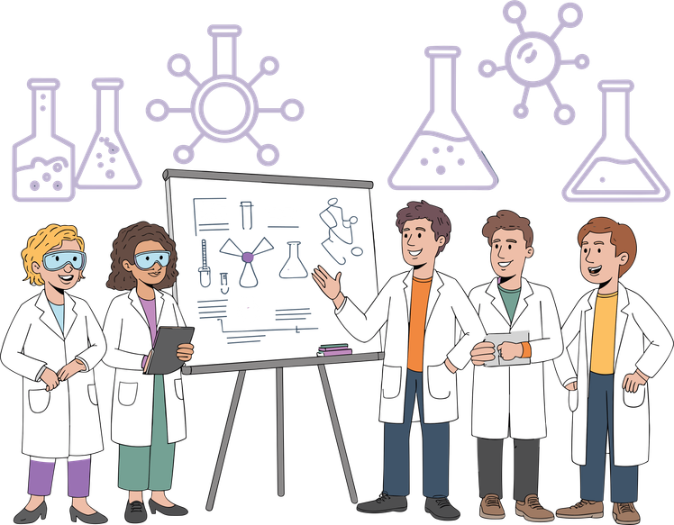
1. Targeted collaboration
Clear principles for content creation – prompts and principles
Research culture discourse in staff comms
Networking with faculty comms and interdisciplinary comms
Co-creation of RC central comms strategy
RC a 'golden thread' in central comms strategic objectives
Representing diverse research roles and diverse research activity
Notes:
Soo
The first approach is targeted collaboration
I’m going to talk for a few minutes about building relationships and making small but significant adjustments to how research is talked about at our institution.
[**]
This early collaboration was with the Leeds University central communications team; it worked really well and illustrates some key points nicely.
First a bit of background
One of our key research culture undertakings is the ‘diverse research activity’ project, the aim of which is to measure - and ultimately to influence- how well research culture is represented in university staff communications.
[**] Helpfully we had already worked closely with the Comms and Engagement team, during the co-creation of our research culture communications strategy, prior to our launch in 2023. So, this shared frame of reference was a good basis for working together.
[**]
The project itself involves searching every single research related communications article and capturing the frequency of over 160 key search terms.
We are particularly interested in capturing the diversity of both research roles and the diversity of types of research activities that were being communicated and celebrated in internal comms articles.
A comms team rep initially did the data capture, and we analysed this jointly.
[**]
This joint endeavour meant that people in their team gained a deeper insight into our research culture values and ambitions, allowing them to revisit content creation with this in mind. For example, we prompted them to bring out more under-represented roles such as technicians – and noted that articles don’t always need to have a photo of a professor, a Dean or the VC!
And we wanted them to ask more proactive questions in interviews about things like whole team contributions and non-traditional outputs. Although these are quite nuanced shifts in emphasis, we believe that they are stealthily changing the discourse around research.
[**]
Across a wider view, each Leeds faculty also has their own comms set up and there’s an interdisciplinary communications network too, so we met with everyone, discussing how, in the context of our findings, they can support research culture awareness at this local level as well, and sharing examples of good practice between ourselves.
We have continued the data capture and analysis for over two years now, continually updating the feedback loop with comms to evolve the quality of the content they produce, and sharing the findings across research leadership forums and other faculty comms roles.
[**]
A nice measure of the success of this collaboration is that in March last year, when the Communications and engagement team rolled out their own content strategy, they stated that research culture runs as a ‘golden thread’ through news planning, particularly with REF 2029 in mind.
We’ve since had further success in expanding this approach to both understanding and extending the influence of communications on research culture. University of Aberdeen requested the key words we are using as our search terms, and Bristol University are also exploring this within their own institution, with a view to automating the search for these using large language models. This points to us being able to have a sector-wide approach to influencing research communications but also speaks to the collaborative nature of working in the research culture space!

Slide 6

2. Systems, processes and policies
Enhancing digital infrastructure:
  Corporate Processes and Systems overhaul, Open Research Hub, intranet spaces
Training and support for staff who support research
Enabling research sustainability and supportive infrastructure:
  Emotionally Demanding research task and finish group
  Representatives from all relevant departments
  Methodical review of all related processes and policies, gap analysis
  Potential outputs/outcomes: creation of bespoke psychological training and support resources by Staff and Student wellbeing services, review of the PGR supervisory agreement and handbook, risk assessments, debrief protocols, incident reporting.
Notes:
[Soo]
2
The next approach we’re highlighting is systems, processes, and policies.
Going back to our plumbing analogy again for a moment - creating long-term, systems-level improvements means fixing the infrastructure, ensuring that the pipes connect, that they don’t leak, and that the water (or culture) flows in the right direction and with ease...
Some examples of our input into systems, processes, and policies:
[**]
We are on working groups enhancing the university’s digital infrastructure – for example the development of a new CPS system - which will cover training data, grant income data, and HR data
We supported the development and promotion of an open research hub with related resources
We are involved in user testing and re-testing of the Research and Innovation intranet spaces to ensure it effectively maps user experience for researchers and research professionals.
[**]
We’re closely involved in development and training resources aimed at staff who support research. For example, workshops rolling out good practice embedding equity and inclusion in research design and grant applications
We are developing training resources for decision makers in REF to ensure they make fair and equitable decisions.
We are also creating video resources for Principal Investigators who are supporting researchers through our redeployment process at Leeds at the end of projects. These video assets are being jointly produced by a senior HR professional who was seconded to the RC team for a spell.
[**]
And finally
This involves enabling sustainability and supportive infrastructures
To illustrate this last category, I’m going to talk through another example – this is a quite recent piece of work which is in its early stages, looking at emotionally demanding research.
The definition we are using for this is ‘research that demands a tremendous amount of mental, emotional, or physical energy and potentially affects or depletes the researcher’s health or well-being.
We have set up a T&F group the aim of which is firstly to understand the challenges involved in doing this kind of research, secondly to undertake a systematic review of all relevant processes and policies and eventually to influence improvements to these at the key intervention points.
The success of this project depends on having a very wide span of representation, and we worked hard to establish this, recruiting our 20+ reps from over 12 different roles and central departments across the institution including HR, H&S, ethics, research development managers and wellbeing services.
This breadth of representation means that we have staff in place at all the central key points to understand the relevant processes, identify gaps and to inform and implement improvements
Critically, these reps must have the power to enact progressive change, or at the least, enable it, by being advocates and smoothing the way for it in their specific sphere of influence
To illustrate,
Early actions agreed so far
the creation of bespoke psychological training and support resources
reviewing of the PGR supervisory agreement and handbook.
We’re also looking at
risk assessments
debrief protocols
incident reporting and escalation routes.
Eventually we’ll have a guidance and policies spanning the whole research cycle all in one place.
We are branching out regionally with this project too – having contacted similar initiatives across the White Rose consortium we plan to collaborate more closely in future to identify areas of alignment and potential cross-institution learning across the region.

Slide 7
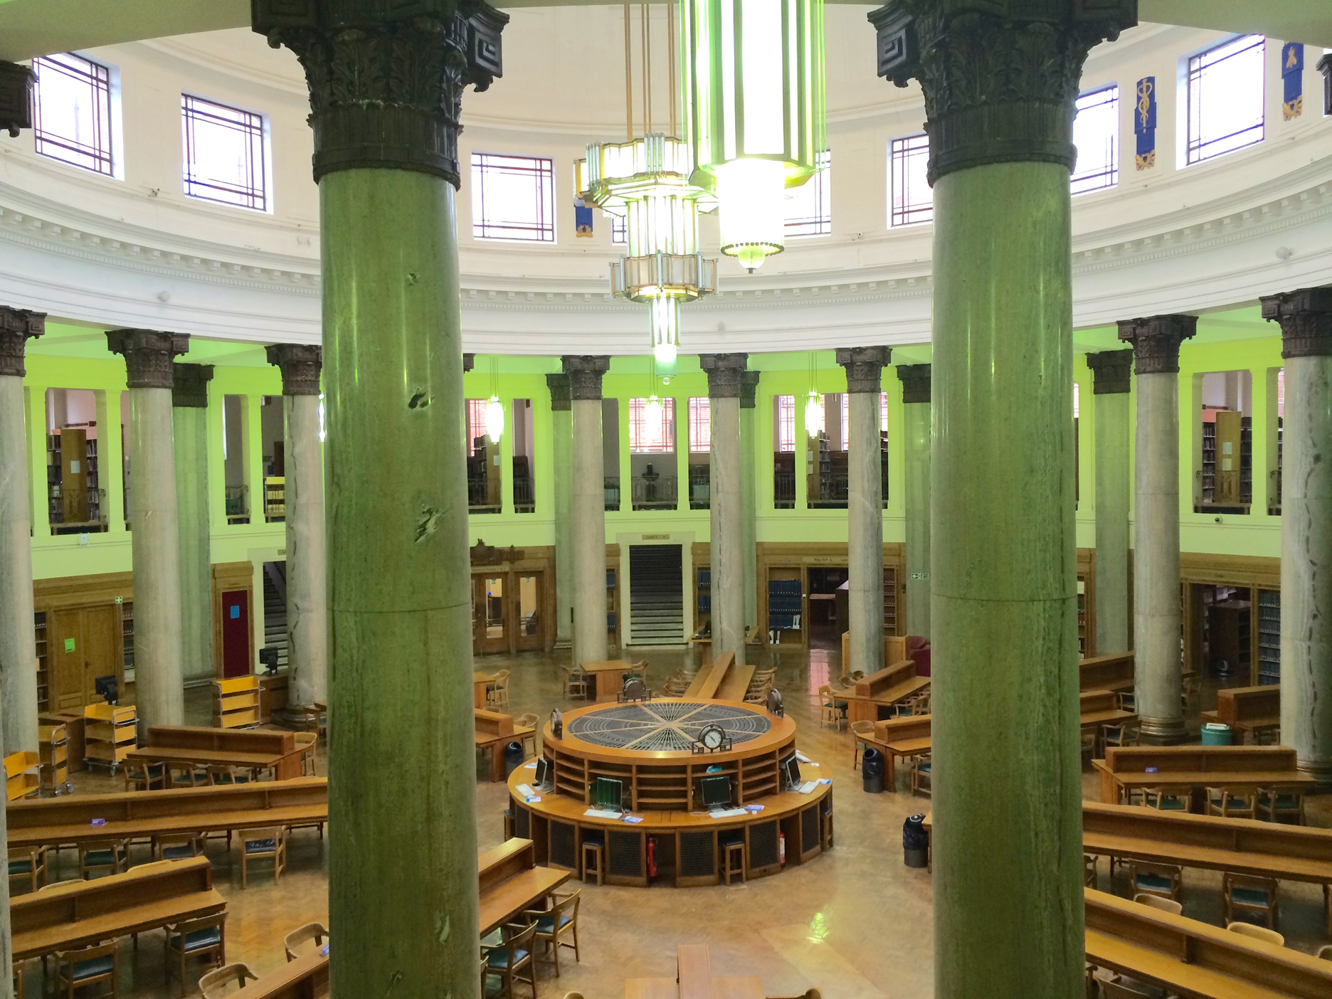
3. Cross-functional working
Open Research team
Supporting responsible research, research ethics, and research integrity
Researcher development and training
Notes:
Emily
3. Cross functional working
To build suitable and adaptive systems, processes, and policies, we need to be able to work closely with teams across the institution who have the required knowledge.
In these three examples here, we have built capacity – by providing time, money, energy, expertise – to create longer-term, more sustainable relationships where these services continue to operate largely independently of us, but with research culture enhancements.
[**]
With the Open Research team:
Invested in a role within the team for the last two year – funded by us, line managed/work coordinated by them
Grew additional capacity within that team, but also enabled research culture to be more firmly on the table
The Open Research Advisor was able to liaise directly with nearly 75 Directors of Research and Innovation as part of open research advocacy sessions. This exposed research culture issues, particularly around recognition of diverse research contributions and outputs, that we could then work collaboratively to tackle as RC/OR together
Even though role is coming to an end, we are working together on evergreen resources (OR checklists for different methodologies) and have jointly developed the Open Research strategic implementation plan that will cover the next few years.
[**]
Supporting responsible research, ethics, and integrity:
I already sit on UREC and we have a research ethics and integrity specialist in adjacent team
Over the last 6-9 months I have seconded someone in the RC team to do bespoke work on research integrity training and development provisions at Leeds, conducting extensive stakeholder engagement that will make any future processes more appropriate to Leeds research cultures.
[**]
Researcher development and training
As of 12 months ago, the RD team is now our adjacent team and we work side by side to tackle research culture issues both as a RC team and as a team focused on development and upskilling
Important outcome of this new relationship is the ability to embed some EDI and RC learnings within training and to embed training offerings in our approach to RC, ensuring we are using everything at our disposal to enhance RC at Leeds
One highlight is RD being able to provide training as part of REDI programme
While these relationships do involve investment, these investments are substantially lower costs than our “big splash” items, and result in long-term embedding of RC work in adjacent teams, and the work of said adjacent teams within our own work.
On the topic of hard won…

Slide 8

4. Seats at the table
Key Governance Groups:
  University Research Ethics Committee / Faculty Research Ethics Committee(s); REF Steering Group/REF Ops; Research Innovation Board; Technicians Commitment Steering Group
Key Reporting Methods:
  Annual Statement on Research Integrity; Researcher Development Concordat; University KPIs; Research Culture Strategy reports.
Notes:
Emily
4. Seats at the table/Participatory governance/institutional embedding (suggested by co-pilot)
Something culture change makers might shy away from is governance and reporting. Indeed, some of these structures are deeply-rooted in traditionalism, hierarchy, and privilege. But for us it’s about having a seat at the table, and ensuring that no decisions are made about us, without us.
As a team we sit on a variety of governance groups, and have a deep commitment to pre-established reporting networks. These include:
[read slide]
This allows us to have a say in how decisions are made within our institution and sector, including being a “critical friend” and providing new perspectives. Typically, where this can be presented as enhancing the integrity of research, or about building more efficient systems, people are receptive to having your input into these groups.
Inserting ourselves into governance and reporting functions also enables us to understand who’s got our backs and to provide key accountability. This doesn’t always mean who is in charge, but about understanding who our allies are in the decision-making process.
However, it’s important not to rely to heavily on the “individuals” within reporting structures: hence why it’s important to ensure your position in these groups/as part of reporting processes is consistent, recurring, and equitable. Reporting to a board is different to being on a board. While we have had the fortune of being at an institution where there is senior-level buy in to our work, a lot of that is dependent on personality, not structures. Getting that consistent seat at the table means that even if personnel changes, and allyships change, the system cannot fail because you, or your function, are represented. This mixture of allyship but safety net means that we both understand who our “faces” of RC are, while planning for what happens when those faces change. Remember: we’re only as good as our worst Yelp review!

Slide 9
Conclusions:
Building resilient systems embeds long-term change
Empathy is pivotal to culture change work, but we can’t always count on the right (most empathetic) person being in the right roles
Culture change is a collective effort (strategies from the top are always operationalised by large groups of people further down the line), but you still need the “face” to get the buy-in
Operational work can often be low- or no-cost
When the plumbing is working well, we don’t notice it – it just works, quietly, reliably, smoothly
Notes:
Both
Emily:
So, what have we learned?
Building resilient systems embeds long-term change.
To come back to our plumbing analogy:
There will come a time when you need a new bathroom or a new boiler, just as there are times in RC change where you need big, ambitious projects that move the dial forwards.
But if your plumbing system is faulty, a new boiler or a new bathroom will immediately fail.
Our focus in this talk has been on how we can build that resilient plumbing system in a way that can be responsive to the sector.
We have provided examples on collaborations with comms, on developments and enhancements of systems, processes, and policies, where cross-functional working can be effective, and how governance structures enable good decisions.
We know from experience that these can be effected in low- or no-cost ways.
But we also know, as indicated on my previous slide, you can’t always count on the right people being in the right places, even though we base a lot of our work in shared empathy and desire for change.
Soo:
What we also know is that culture change is a collective effort: Building a stronger system – rather than relying on individuals – has the greater opportunity for sustainability We’re focusing on taking the ego out of it! (But only if you have plumbers on call!)
Soo (closing line)
When the plumbing is working well, we don’t notice it – it just works, quietly, reliably, smoothly

