Slide 1


Building Transferable Research Capacity: Reflections from the RLUK–AHRC–ARMA Research Catalyst Cohort Programme
Eleanor Glenton, Durham University
William J Nixon, Research Libraries UK

Slide 2


Overview
Today’s talk will cover
Welcome and Background
Why the Research Catalyst Cohort (RCC)
The RCC within our wider research engagement programme
Transforming Roles
Durham Case Study
Transferability and Closing Reflections
#ARMA2026
Notes:
William

Slide 3
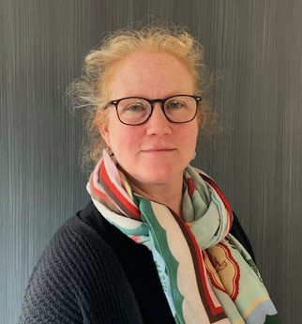
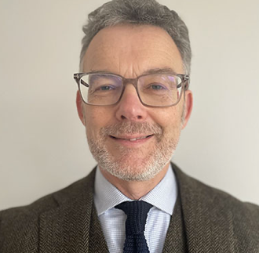

Welcome
Background
Who we are
Who helped us on this journey
Why this talk matters
Key Takeaways
  Research Catalyst Model
  Why this matters
  Transferability
#ARMA2026
Notes:
William and then Eleanor

Slide 4
Opening questions
In the Conference App
Does your institution support Library and Collection staff members to lead or participate in funded research?
If yes, does the L&C have the same access to research support as other units in your institution?
#ARMA2026
Notes:
Eleanor

Slide 5
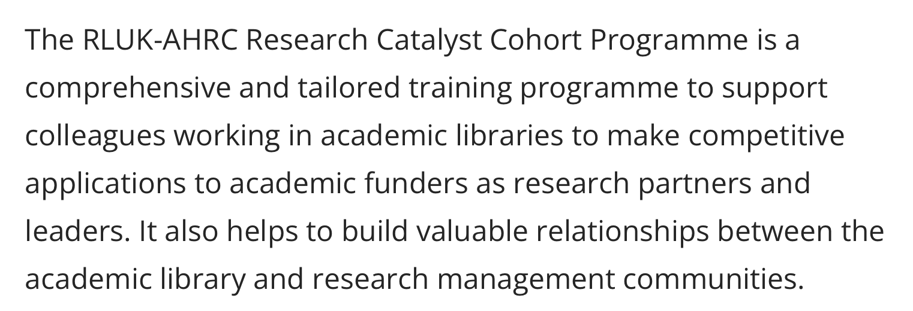
About the Research Catalyst Cohort
#ARMA2026
Notes:
Eleanor

Slide 6
Train the Trainer Model
Participants will be expected to actively share the learning and knowledge they acquire through the programme with colleagues, within and beyond their institution, and to be active advocates for the role of academic libraries as research partners and leaders.
Examples of ways in which participants might share their learning include:
Deliver or contribute to training events to their colleagues within their institution and/or external peers.
Publish blogs or thought pieces
Speak at conferences or events
Record or contribute to a podcast
Act as a mentor for colleagues interested in developing their own research capacity
#ARMA2026
Notes:
Eleanor

Slide 7

Why the Research Catalyst Cohort (RCC)
Context and Aims
Background to the RCC
RCC Snapshot – 3 Cohorts
Core Aims
RLUK/ARMA Partnership
Design of the Programme
Governance
#ARMA2026
Notes:
William

Slide 8
“Research is impossible without Libraries”
RLUK Strategy 2026-2030
#ARMA2026
Notes:
William

Slide 9


Libraries x Research
RLUK-AHRC Research Engagement
Introducing the REP
Supporting wider Research Culture
Building Capacity, Capability and Confidence
The Research Shift
#ARMA2026
Notes:
William

Slide 10
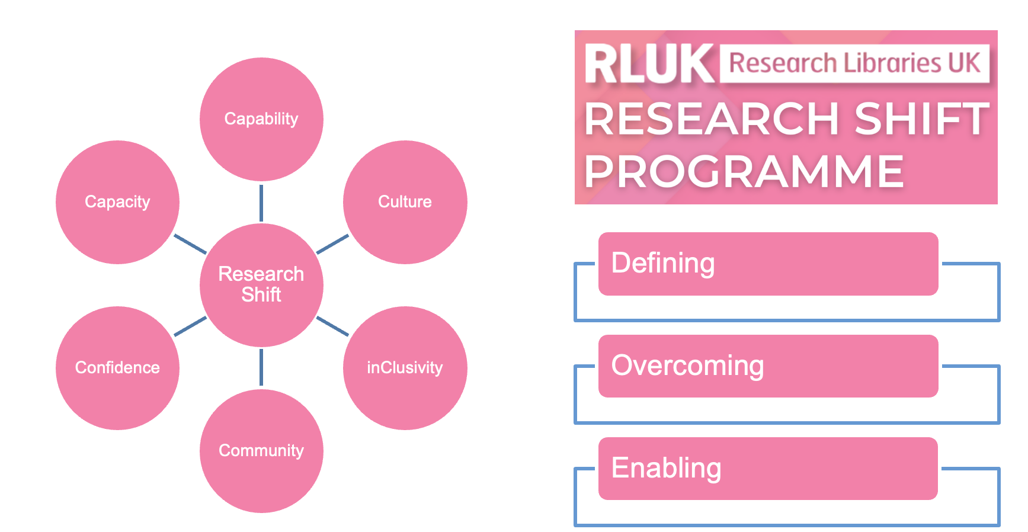
RLUK’s Research Shift
#ARMA2026
Notes:
William

Slide 11
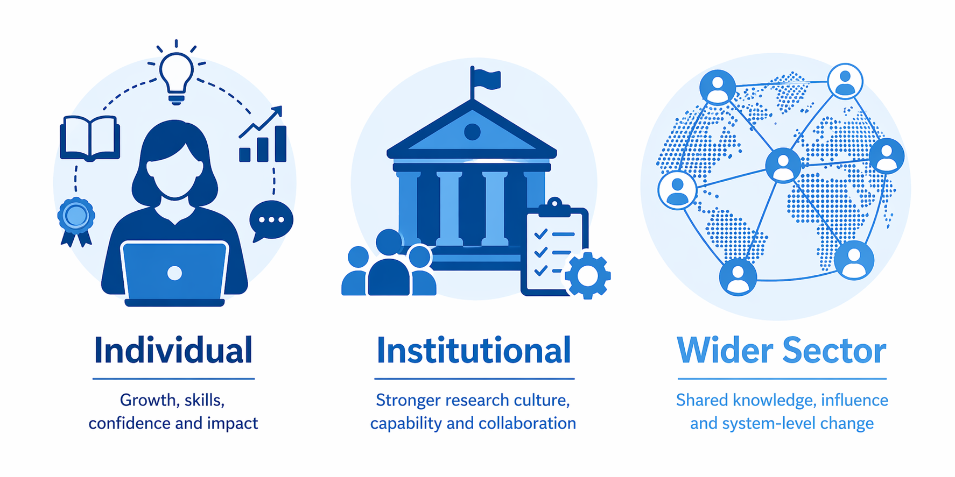
Transforming Roles
The Impact of the RCC
#ARMA2026
Notes:
William

Slide 12

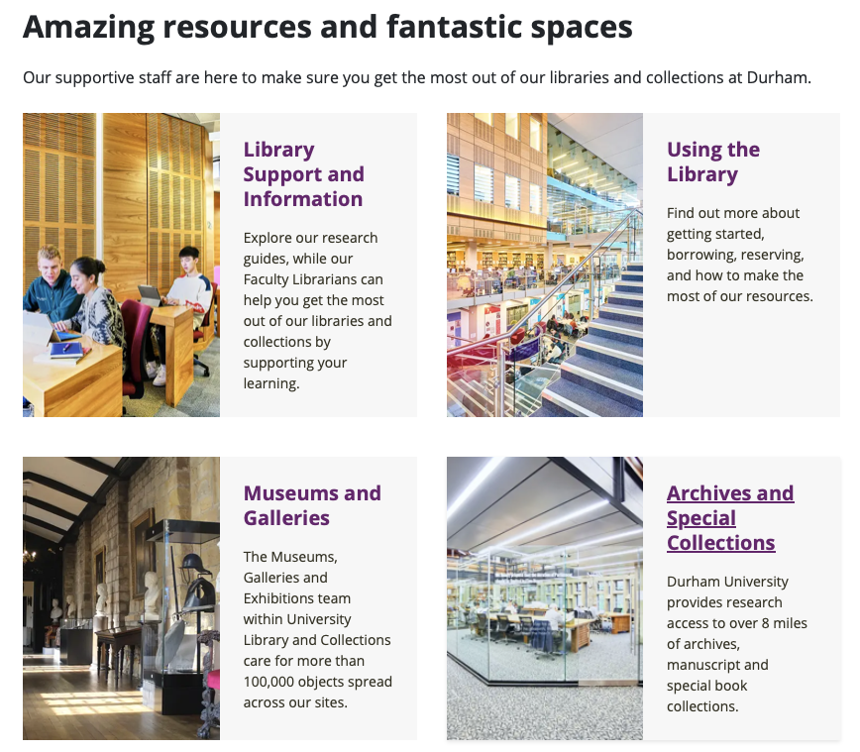
Case Study: Durham
Durham and Reflections
Context and Challenge
How the RCC Supported Practitioner Research Development
Our Outcomes and Learning
Partnership between Research and Innovation Services and Library
Support across the Research Lifecylce
#ARMA2026
Notes:
Eleanor

Slide 13



Case Study: Durham
Durham and Actions
Redefined roles
Establishment of internal research group​
Representation on internal groups
Visibility with funders
Part of wider discussions on research culture
#ARMA2026
Notes:
Eleanor

Slide 14

A Transferable Model
Closing Reflections
Why the RCC model is transferable
What you need for it to be a success
Why Partnerships are key
What you can do at your institution and across the sector
#ARMA2026
Notes:
Eleanor and then William

Slide 15

Thank you
Any questions?
Notes:
William

