Slide 1



Hidden REF
Assessing not traditionally submitted outputs (NTOs) for REF2029
James Baker, Gemma Derrick, Simon Hettrick

Slide 2
If we don't recognise everyone who is vital to research,
we limit our ability to conduct research

Slide 3
The last REF supported 22 categories of outputs
Authored book
Edited book
Chapter in book
Scholarly edition
Journal article
Conference contribution
Working paper
Artefact
Devices and products
Exhibition
Performance
Patent/Patent application
Composition
Design
Research report for external body
Confidential report for external body
Software
Website content
Digital or visual media
Data sets and databases
Translation
Other

Slide 4
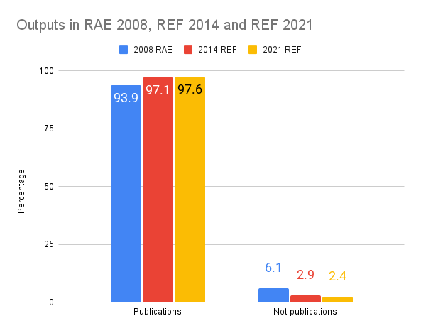
154,826
11
14
31
Journal articles submitted, but only…
Software outputs
Devices
Data outputs

Slide 5
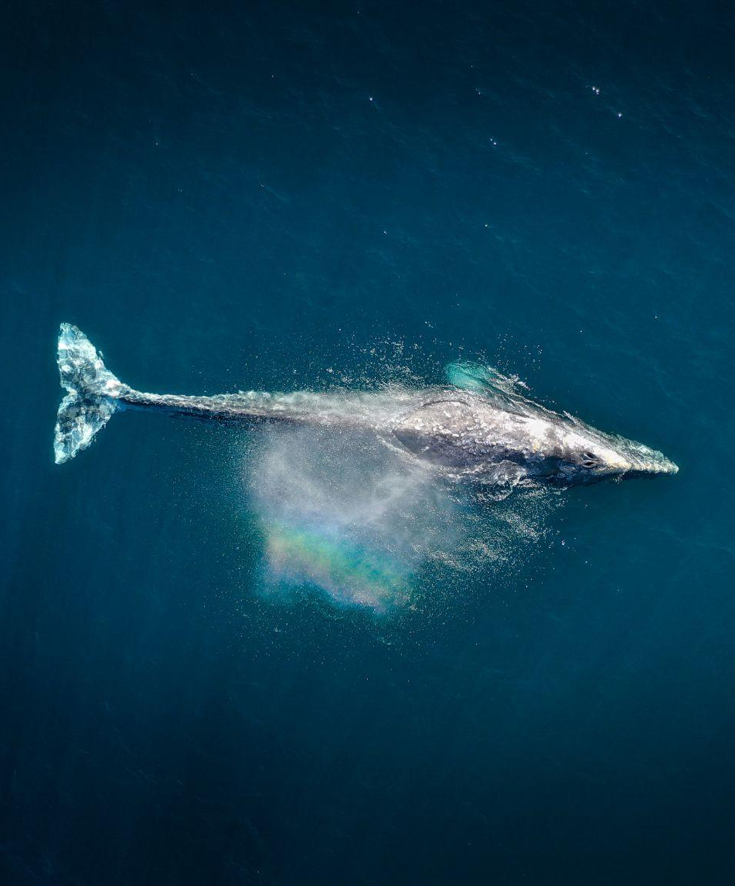
Publications are a blue whale
~ 120,000kg

Slide 6

Software is a Daschund
~ 7kg

Slide 7

What’s wrong with publications?!
Publications are, of course, vital to research, but….
Research culture tends to recognise only some of the people who are vital to research in publications
We have incentivised number of, and speed to, publication over reliability, reproducibility and openness
Recognising not-traditionally submitted outputs (NTOs) and all the people needed to conduct research (Hidden Roles) makes research more equitable and more effective.
Show me the incentive and I will show you the outcome
Charlie Munger

Slide 8
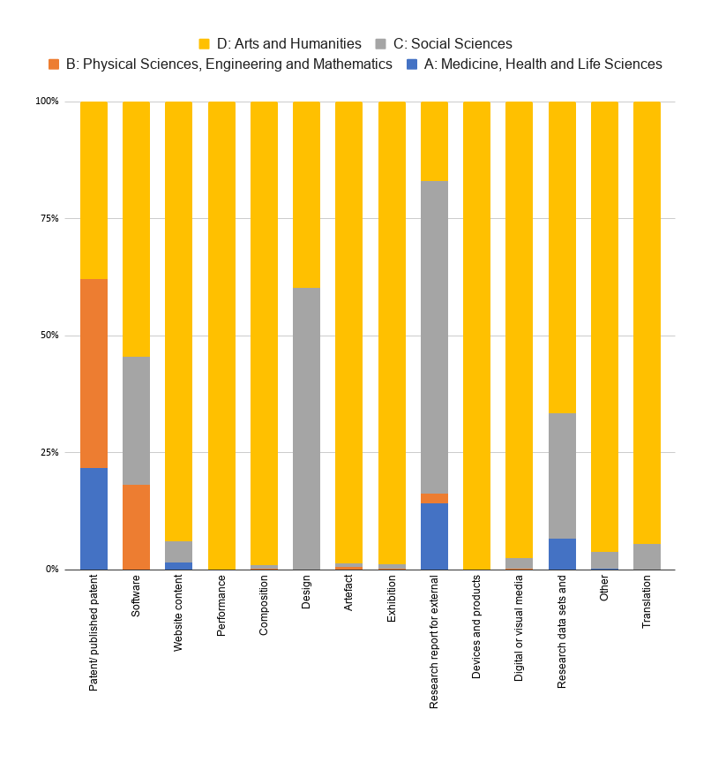
All outputs are equal!
An underpinning principle of the REF is that all forms of research output and research practice will be assessed on a fair and equal basis.
Sub-panels will not regard any particular form of output as of greater or lesser quality than another per se, and all subject matter will be assessed equally, without bias.
(CKU 5.6.7)

Slide 9

The Hidden REF
If we recognise all research outputs and everyone involved in their creation, we will make research more equitable and - importantly - more effective.
Launched in 2019 as a volunteer activity
Hidden REF competition in 2021, 2024 & 2026
The Festival of Hidden REF in 2023 & 2025
Funded in 2025 with a remit to improve culture around NTOs
NTO: Not traditionally submitted outputs
Hidden Roles: vital-but-unrecognised roles in research

Slide 10


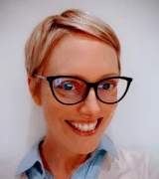











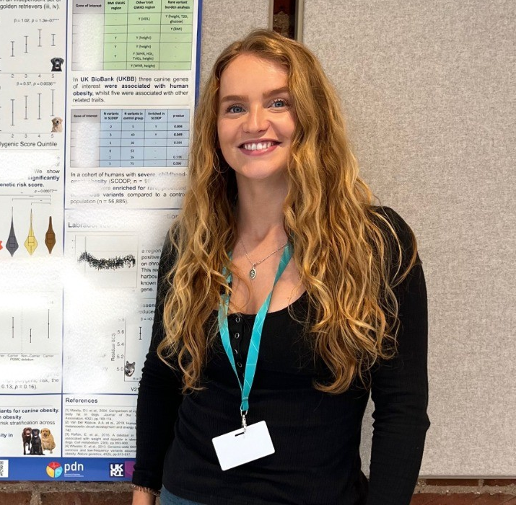
Committee
Alphabetically from top left: James Baker, Lyndsey Ballantyne, Gemma Derrick, Michael Donnay, Georgina Fletcher, Jude Fransman, Simon Hettrick, Emma Karoune, Simon Kerridge, Wioleta Kijewska, Veronica Ng, Tony Roche, Ben Thomas, Ola Thomson, Natalie Wallis

Slide 11































Slide 12
If we recognise everyone who is vital to research,
we advance our ability to conduct research

Slide 13
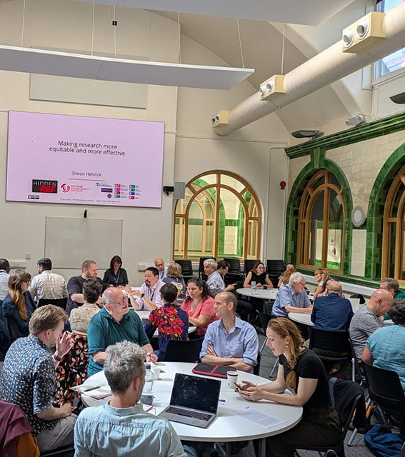

NTO Workshops
10 done, 10 more coming
Run on site at HEIs
Focus on attendees discussing the importance of NTOs, practicing assessing them against REF criteria, and working on overcoming challenges and concerns about NTO assessment
Gather data to inform policy recommendations
Email info@hidden-ref.org to request a workshop

Slide 14
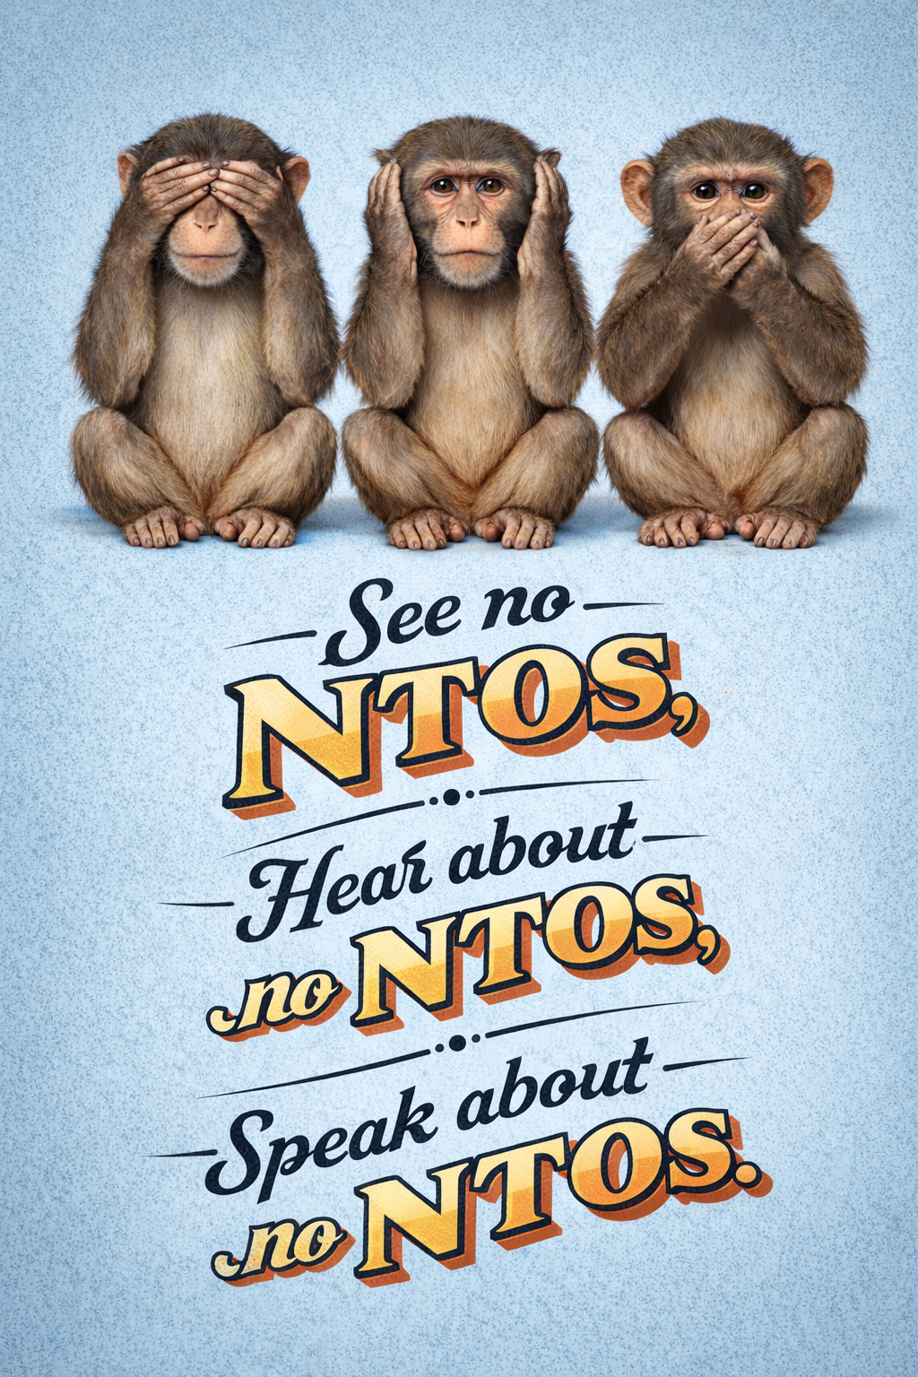
Why are we running NTO workshops?
NTOs are vital to research, and will only become more important: we must learn how to recognise and reward NTOs if we are to support all of research
If we can get this right, we will advance research across all disciplines
People tell us that they want to get experience of assessing NTOs
People specifically want guidance on how to assess NTOs within the REF guidelines

Slide 15
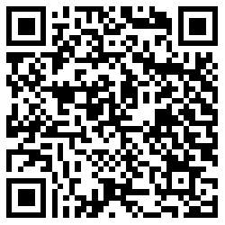
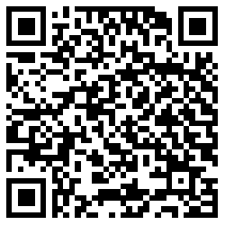
A flavour of our workshops
We’ve picked two REF2021 Panel B submissions: one composition, one piece of software.
Pick one, interact with it, and discuss in your group how you might evaluate Significance.
  “the extent to which the work has exerted, or is likely to exert, an influence on an academic field or practical applications”
Make notes about Originality and Rigour
Make notes about what information is missing
Identify any heuristics (rules of thumb) your group used to make scoring decisions.
~ 20 mins for this task
Composition
shorturl.at/S2oj4
Software
shorturl.at/sdNuh

Slide 16
Feedback from assessment
Report back on significance and notes on originality and rigour
Was any information missing from the NTO?
Were there any heuristics (rules of thumb) you used to make scoring decisions?

Slide 17
Wrap Up

Slide 18

Hidden REF Competition 2026
Launches May 2026
Submission deadline mid-September 2026
Award Ceremony November 2026
Lots of opportunities to get involved in assessing submissions
https://hidden-ref.org/hidden-ref-competition/

Slide 19

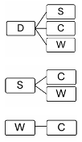
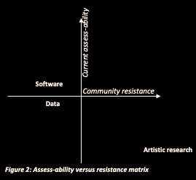
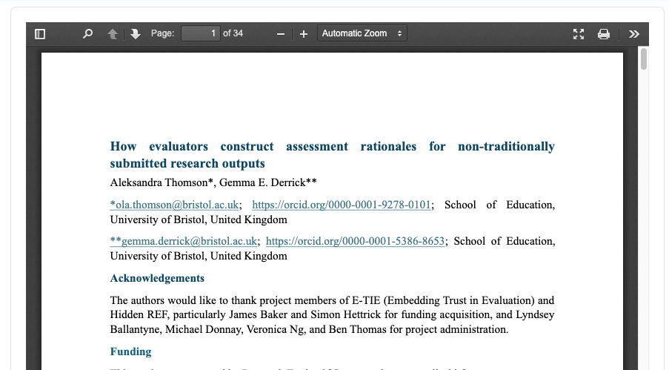

Evidence production
Uses the Hidden REF Competition, workshops and Festivals as basis for evidence creation of how NTO evaluation is currently constructed.
Rapid review: (n=95 documents): Mixed evidence on how to be done (NTO-specific), Unanimous that different approaches are necessary.
NTO-specific challenges in evaluation: Accessibility versus Resistance.
Think-aloud experiments (n=68, and growing). Problems attributing NTO value to criteria of Significance, Rigour and Originality
Challenges for NTO evaluators: Problems with Trust; Aesthetics; lack of formal guardrails; Presentation gap; and, Impact masquerading as tacit criterion.
All available in preprint, article, conference proceedings, policy briefs and discussed on the “What the REF!” podcast.

Slide 20

Expert Groups
Help us write output specific guidance on evaluating NTOs
We are collecting experts on different NTOs who will write short overviews of how to assess NTOs in relation to REF criteria
This guidance will help overcome one of the major barriers to how NTOs are valued
Sign up now!
  https://hidden-ref.org/expert-groups/

Slide 21
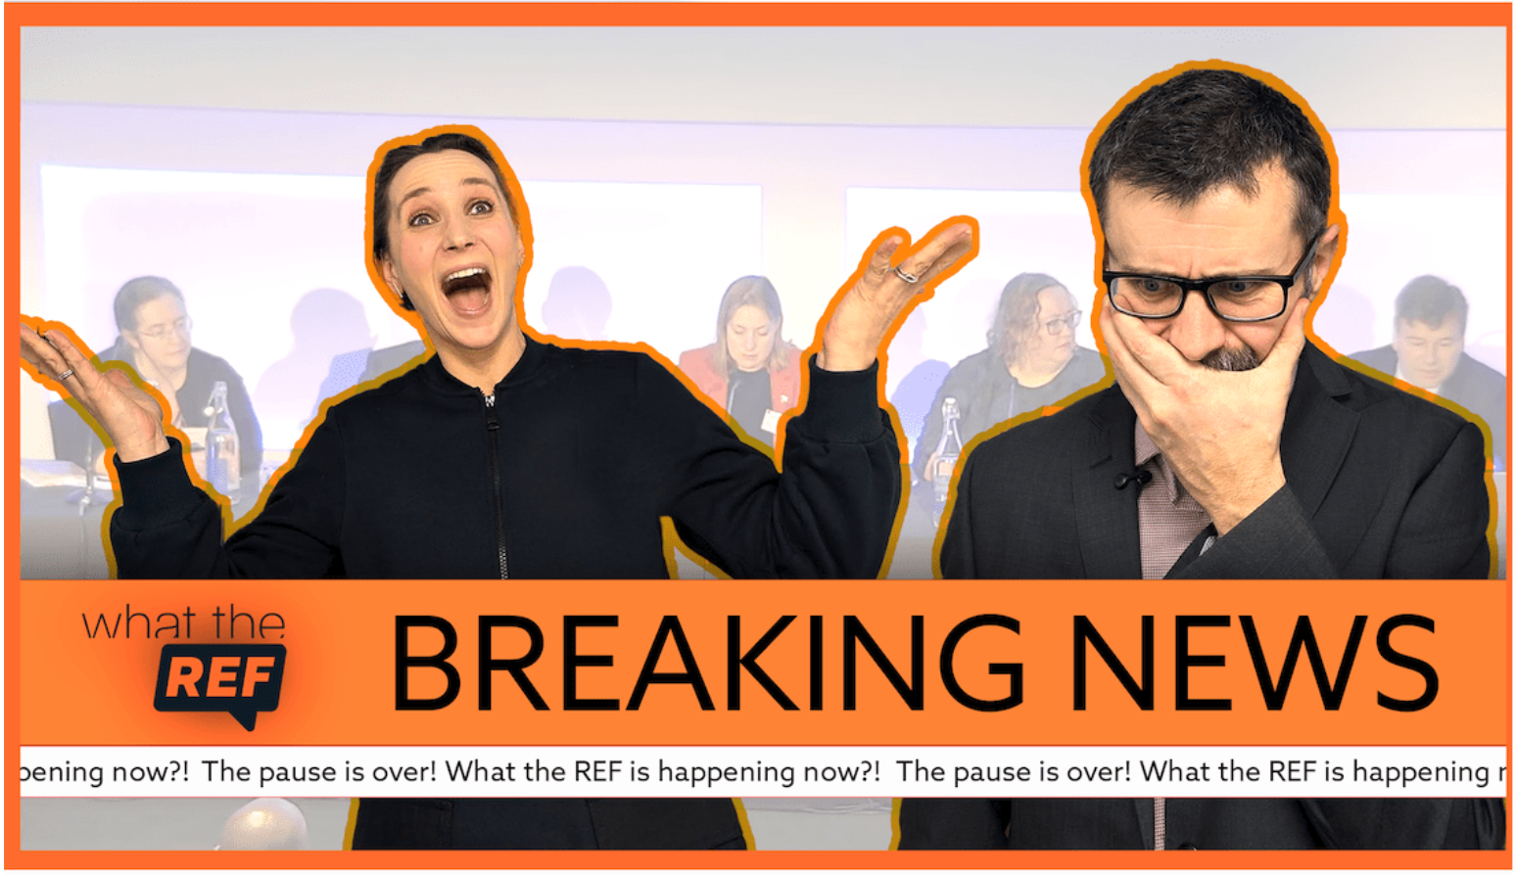

More about our work
What the REF?!
  https://www.youtube.com/@HiddenREFCampaign/podcasts
Community calls
  Every second month
  https://hidden-ref.org/resources/community-calls/

Slide 22
THANK YOU
Content is copyright the University of Southampton on behalf of the Hidden REF.
Slide template is courtesy of Slidesgo and includes icons, infographics & images by Freepik.
This presentation is CC-BY licensed, which enables reusers to distribute, remix, adapt, and build upon the material in any medium or format, so long as attribution is given to the creators as named in the credits.

