Slide 1


Understanding change: early insights from ARMA’s 2026 Research Culture Survey of the RMA Community
Dr Louise Stanley, University of St Andrews
Andrew Moss, Durham University
Dr Hayley Clissold, Wellcome Sanger Institute

Slide 2

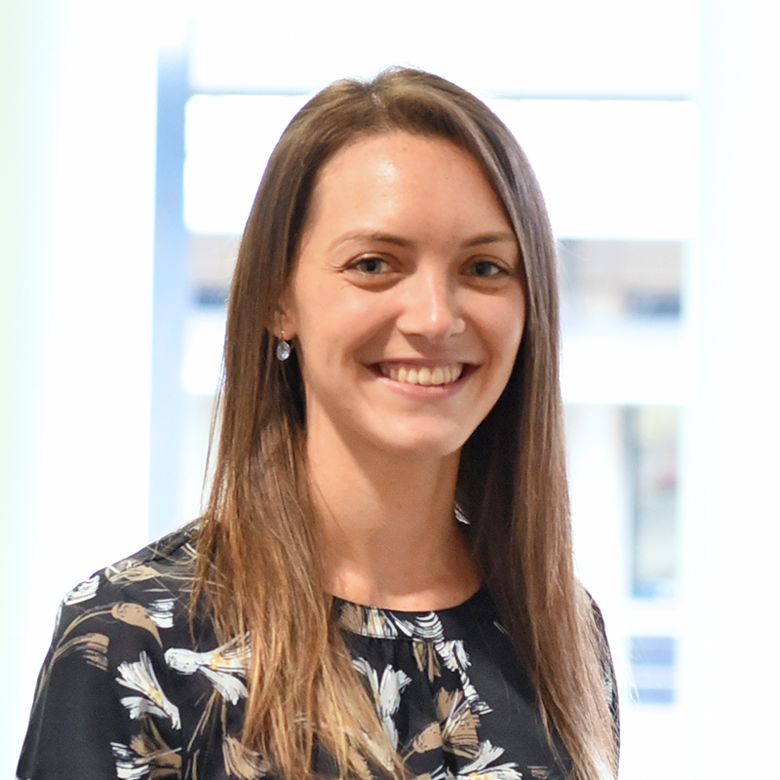
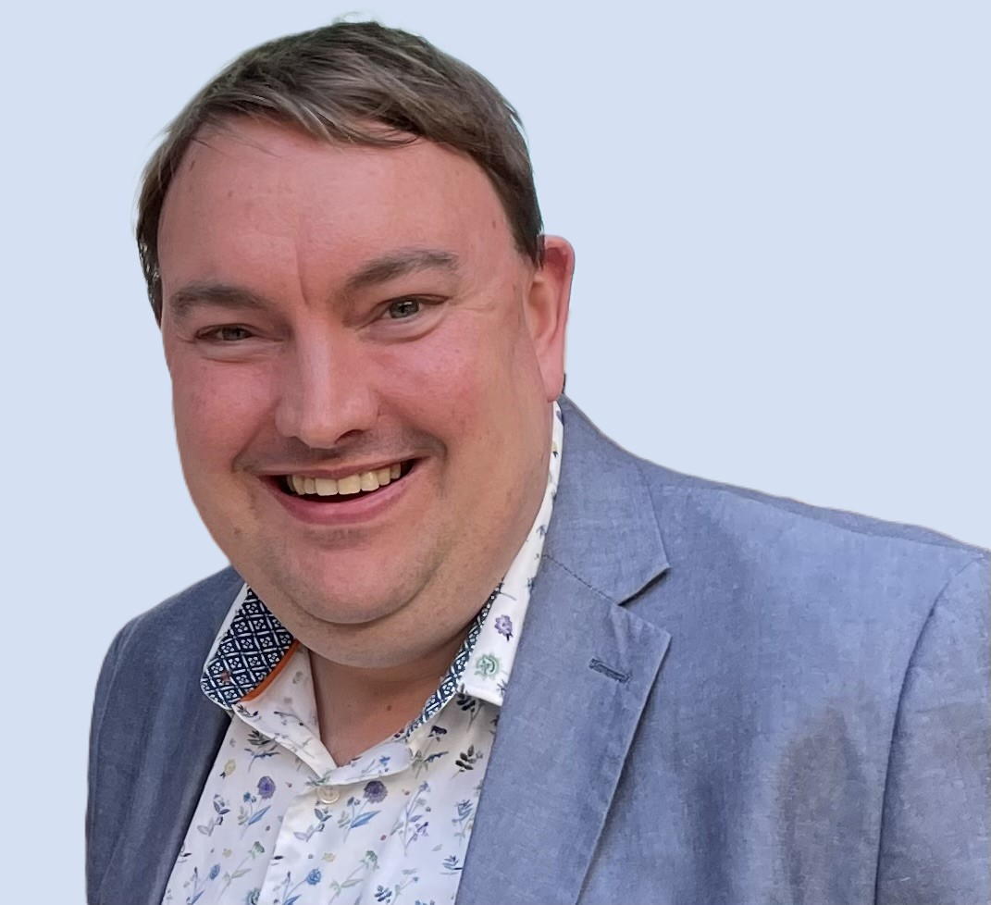
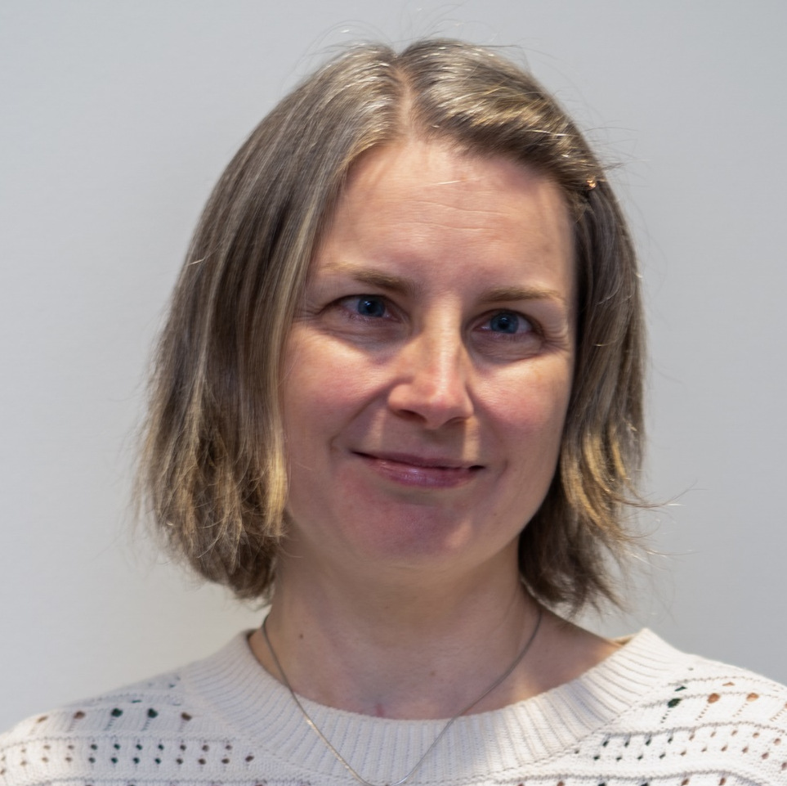


Introduction
ARMA Research and Innovation Culture Special Interest Group
The Research and & Innovation Culture SIG is open to all members with an interest in research and innovation culture and has a focus on both the operational aspects and strategic implications for institutions
It acts as a backbone of information, knowledge exchange and shared expertise that reflects the broader sector picture, as well as seeking to address gaps
Dr Hayley Clissold
Wellcome Sanger Institute
Andrew Moss
Durham University
Dr Louise Stanley
University of St Andrews
Dr Laura Stowe-Evans
University of Wales Trinity St. David
#ARMA2026
Notes:
Introduce the ARMA SIG – mission and purpose – introduce the speaks and also the panel that will come after the presentations

Slide 3
ARMA Research Culture Surveys
ARMA 2020 Survey was a landmark study focusing on the experiences of research managers, administrators, and support staff
Based on the Wellcome Trust What researchers think about the culture that they work in 2020 survey
ARMA 2026 Survey – led by ARMA working with the Research and Innovation Culture SIG
  Intended as key benchmark for developments in research culture
  ARMA's effort to make visible the range of perspectives of research culture within the research management community
2026 survey had similar questions to the 2020 survey to enable comparison across the two surveys
Data presented today is initial findings with a written report from ARMA to follow
#ARMA2026
Notes:
In the 2026 survey, some key elements that have come to the fore in the research and innovation ecosystem since 2020 may not be as prominent e.g. AI and Trusted Research. This isn't because we do not think that they are important to the research management community, but to facilitate better comparator data of the core elements from the 2020 data. It's also interesting to see if any of these new elements we raised by respondents in the free text comments to any of the sections.
Survey ran for a month in March 2026

Slide 4
ARMA Research Culture Survey 2026 – Backdrop
2020 survey was undertaken during the COVID-19 pandemic
UK R&D People and Culture Strategy was published in 2021
Significant investment in research culture through Research England (for English HEIs) and through other funding schemes (e.g. Wellcome)
New networks with focus on research and innovation culture, including at ARMA
Focussed attention on research culture in REF2029 decisions
New concordats created and published
Recent challenges surrounding organisations’ financial sustainability
#ARMA2026

Slide 5
2026 Survey Overview of Thematic Areas
Types of job role and employment information including contract types | Views on future career prospects | Support for career development and skills training | Awareness of research integrity and responsible research and innovation
Voluntary or citizenship roles | Attitudes toward bullying and harassment in the workplace | Impact of organisational leadership and strategy on research culture | Support for mental health and wellbeing
Descriptions of organisation, department and team research culture | Impact of equality, diversity and inclusion initiatives | Changes and improvements in organisational policies and research practices | Attitudes toward reward and recognition for RMAs
Attitudes to changes and developments in research culture over the last 5 years | Knowledge and understanding of concordats | Impact of research culture on individuals, teams, organisations and the public | What ARMA can do to improve working / research culture
#ARMA2026

Slide 6
Focus for this session
Who responded to the survey
Descriptions of research culture
Concordats
Careers
EDI
Research Leadership and Management
Reflections from the panel and RMAs
#ARMA2026

Slide 7
Respondents to the 2026 Survey

Slide 8
Who responded to the survey
Number of responses
2020 | 281
2026 | 469
67% increase
#ARMA2026

Slide 9
Who responded to the survey
Organisation type
Higher Education 2020 | 89.2%
Higher Education 2026 | 85.0%
Slight increased reach - broader range of organisations including funders and independent research organisations
#ARMA2026

Slide 10
Who responded to the survey
Selected Protected Characteristic Data
Gender - woman | 82.1%
Ethnicity - White English, Scottish, Welsh, Northern Irish or British or Other White background | 84.8%
Majority of responses from women of a white background
#ARMA2026

Slide 11
Who responded to the survey
North East
North West
West Midlands
South West 2.5 x up
#ARMA2026
Notes:
Significantly more respondents in the 2026 survey – by proportion the reach in the SW has increased 2.5x, drops in the proportion of respondents in the NE, NW and West Midlands.

Slide 12
Roles held by RMAs
Full-time versus part-time very similar to 2020 (82% FT, 16% PT)
Contract status also very similar to 2020 Permanent (75%) versus Fixed-term/open ended (subject to funding) (24%)
#ARMA2026

Slide 13
Time and role held in research management
#ARMA2026

Slide 14
Thank you to all respondents
#ARMA2026
Notes:
For the next slide – we have added comparator data to 2020 in some of the slides where appropriate, a greater comparison will be made in the final report

Slide 15
Descriptions of research culture in your organisation, department and team

Slide 16
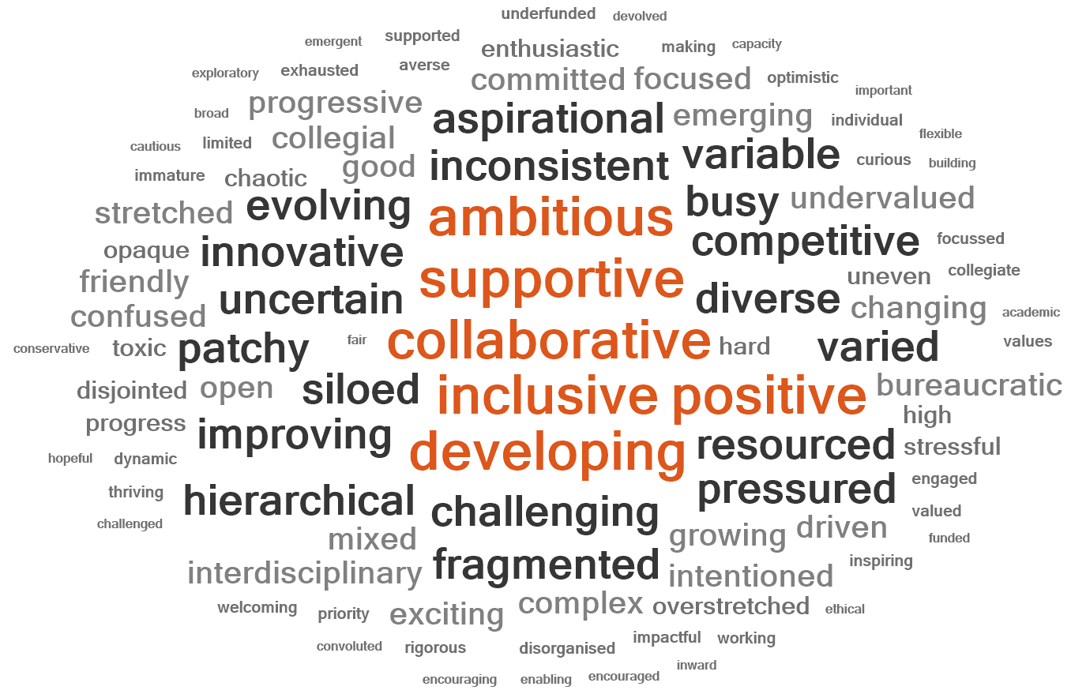
Which three words would you use to describe the current research culture in your organisation
1 = Collaborative
2 = Inclusive
3 = Supportive
#ARMA2026
Notes:
When asked what three words describe your current research current in your organisation it is really encouraging to see positive words coming through with the top three being collaborative, inclusive and supportive. These word clouds show the most frequently used words in red with the second level in black bold – it is here that we can start to see more 'negative' words such as patchy, uncertain, siloed, pressured etc coming through.

Slide 17
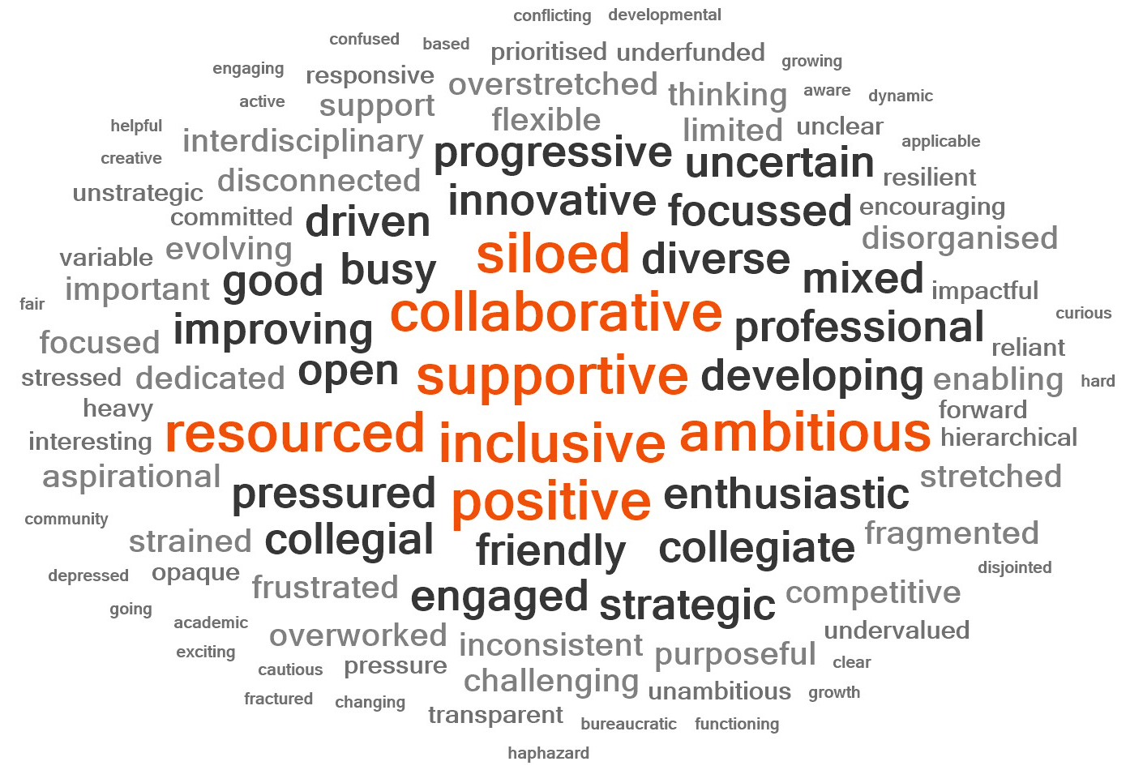
Which three words would you use to describe the current research culture in your department/unit
1 = Supportive
2 = Collaborative
3 = Inclusive
#ARMA2026
Notes:
Similar words are found at the departmental/unit level

Slide 18
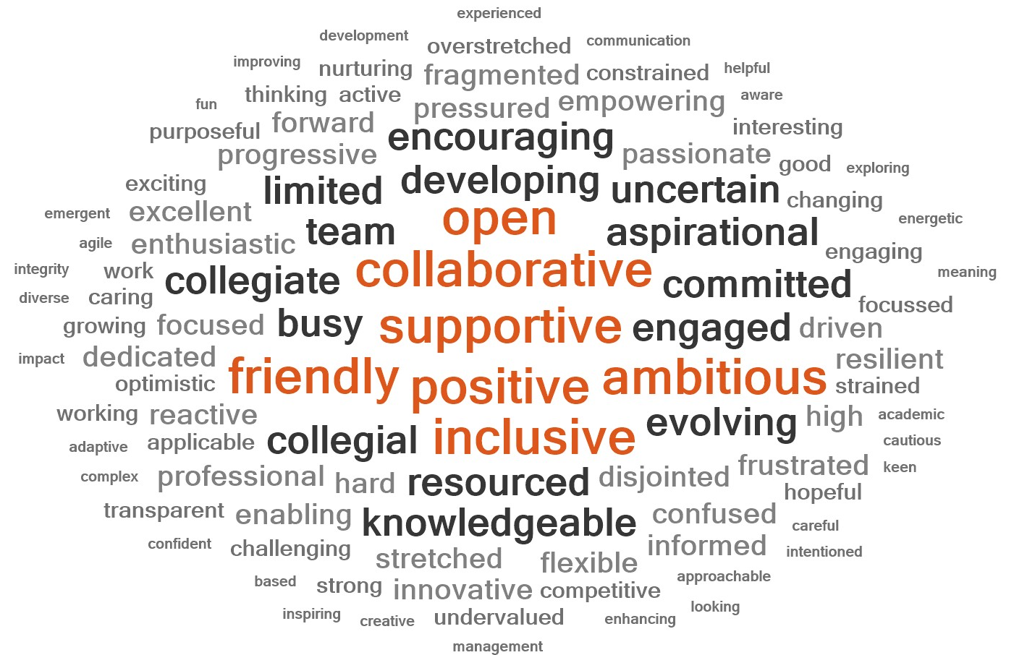
Which three words would you use to describe the current research culture in your team
1 = Supportive
2 = Collaborative
3 = Positive
#ARMA2026
Notes:
As well as in teams – with the second level (black bold) have fewer more negative words.

Slide 19
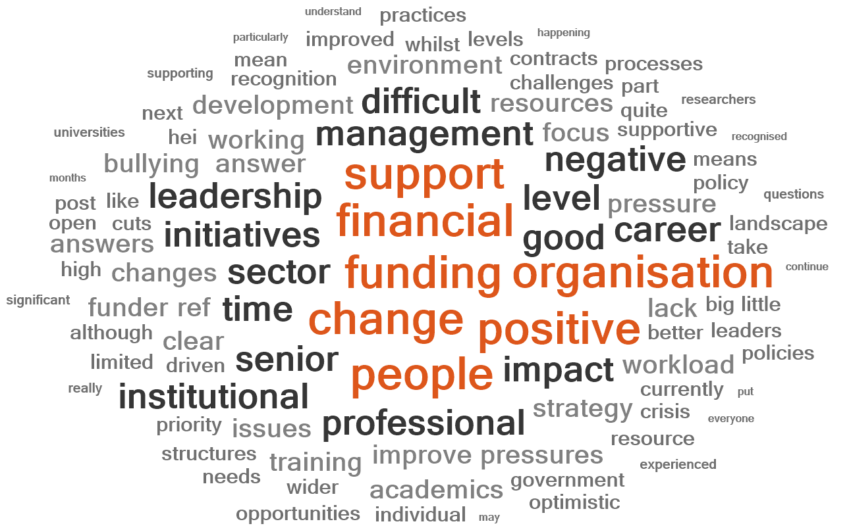
Keywords across the survey in narrative descriptors
1 = Funding
2 = Financial
3 = Change
4 = Support
5 = People
#ARMA2026
Notes:
When we look at the narratives provided across the entire survey the top words coming through are funding, financial, change, support and people – with the other words painting a picture about the current challenges in the HEI sector.

Slide 20
“There is a definite shift to acknowledge the importance of research adjacent staff roles in the
research process. It is still early days”
“Our research strategy, and research culture are cascaded throughout the organisation”
#ARMA2026

Slide 21
“the University and department have lots of different cultures - some great, some not so great”
“There is good practice across the organisation but still pockets of bad practice and behaviour”
#ARMA2026

Slide 22
Activity and perceived impact of research culture developments
#ARMA2026

Slide 23
“Some of the actions taken are having a positive impact, but which is then counter-balanced by
other things happening, particularly a constant climate of change and fear over jobs, funding,
etc, which reverse the positive effects that work on RC may have”
“I feel we were making progress, but the financial uncertainty of the sector has set things back,
as the future is uncertain and cuts have been made. There is a greater focus on financial gain
and not on research excellence, the pipeline of knowledge and impact.”
“….. positive effect is limited due to
the harsh landscape”
#ARMA2026

Slide 24
Concordats

Slide 25
The Influence of Concordats
How influential do you think external concordats have been in shaping changes to research culture in your organisation over the last 5 years?
#ARMA2026
Notes:
Over 60% of respondents feel that external concordats have had some or a lot of influence in shaping changes to research culture indicating that these do play a role in driving behaviours and actions.

Slide 26
Familiarity with Concordats
How familiar are you with the following?
For these concordats overall awareness and understanding lower than in 2020
Highest awareness for Open Research Data
A good understanding doesn’t go above 25%
#ARMA2026
Notes:
When looking at the subset of concordats shared here, which compares responses to those received in 2020 except for CoARA and Concordat for Environmental sustainability which are new – overall awareness is lower than in 2020 and having a good understanding doesn’t go above 25%.

Slide 27
Familiarity with Concordats
Much greater understanding and awareness for these areas
ORCiD, Researcher development concordat and DoRA reported to have a higher level of “good understanding” in 2026
Open Access Principles, ORCiD and Researcher Development all with > 80% awareness
How familiar are you with the following?
#ARMA2026
Notes:
When we look at the concordats shared here there is a much greater awareness and understanding. ORCiD, Researcher development concordat and DoRA are reported to have a higher level of “good understanding” in 2026 when compared to 2020. And for Open Access Principles, ORCiD and Researcher Development all with > 80% awareness.

Slide 28
"Whilst having funder or concordat driven requirements for improvements in research integrity or culture practices is great, actually committing resource to it is not a strength of many institutions"
"Compliance with all these different Concordats and commitments are only pushing RMAs to the brink. Being identified as non-compliant feels terrifying and is contributing to the pressure upon RMAs."
#ARMA2026

Slide 29
Careers

Slide 30
Attitudes to Career Development
#ARMA2026
Notes:
Around 50% of respondents think career development for all staff group has improved to some extent with around 20% thinking it has worsened. Encouraging to see that around 2/3 of line managers are supportive of and recognise diverse career pathways but this is perceived by respondents to be much lower by leaders of the organisation.

Slide 31
Skills, Knowledge and Contributions
#ARMA2026
Notes:
over 70% of respondents in 2026 agree or strongly agree that their skills, knowledge and experience are valued, 60% agree or strongly agree that their contributions are visible and appropriately credit.

Slide 32
Career Prospects
#ARMA2026
Notes:
However, when we look at career satisfaction only 30% are satisfied with their career prospects in RMA, a significantly drop compared to 2020- likely pointing to the current sectoral challenges. There also remains a significant % of respondents (34%) that are not aware of careers inside/outside of RMA that could utilise skills

Slide 33
Priorities for research culture improvement
“career development opportunities are a challenge - limited opportunities to progress”
“Lack of progression pathways for professional services”
#ARMA2026
Notes:
Given this information it is perhaps not surprising that when asked what areas should be prioritised over the next 3-5 years – career development was the option picked by most respondents. And this is echoed in some of the narrative responses shared here.

Slide 34
"There is limited ability for people to progress so there is resentment brewing around training and development activities that ultimately cannot lead to progression because there are fewer options to progress"
#ARMA2026

Slide 35
Equality, Diversity and Inclusion (EDI)

Slide 36
EDI in Organisations
How do you feel 'EDI and inclusive practices' have changed over the last 5 years in your organisation (in the context of support, training and/or practice)? (n=341)
How influential do you think 'EDI initiatives and practices' have been in shaping changes to research culture in your organisations over the last 5 years? (n=331)
#ARMA2026
Notes:
⅔ believe EDI practices have improved over the last 5 years, with only 5% believing it has worsened.
75% believe EDI initiatives and practices have been influential in changing research culture – with 15% believing they had been VERY influential.
These positive trends could be reflective of the growing awareness and recognition of inclusive and supportive research environments on research over recent years. And because there has been a greater emphasis from institutions, funders and other players across the sector to examine institutional practices and structures to improve EDI. So, this data here is quite encouraging in that it suggests that not only are improvements being made on EDI, but that its implementation has been effective and influential on local research cultures.

Slide 37
Treatment of Staff
I feel that my organisation treats all staff fairly regardless of protected characteristics (n=320)
#ARMA2026
Notes:
Around 60% agree that their organisation treats all staff fairly regardless of protected characteristics. Only 16% disagree.

Slide 38
Support for Underrepresented Groups
I feel that my organisation takes action to remove barriers and provide support for underrepresented groups (n=320)
Small improvements in sentiment towards removing barriers and providing support
#ARMA2026
Notes:
In terms of removing barriers and supporting those from underrepresented groups, small changes can be seen in the right direction.
52% agree that their organisation takes action to remove barriers and provide support for underrepresented groups. Up from 45% in 2020.
And similarly only 14% disagree with the statement – down from 19% in 2020.
While these are small changes, they look to be going in the right direction. And we should point out that the 2026 survey had significantly more respondents too.

Slide 39
Awareness of EDI policies
How familiar are you with your organisation's Equity, Diversity and Inclusion policies? (n=296)
Greater understanding of EDI policies
#ARMA2026
Notes:
We about familiarity with institutional EDI policies.
Familiarity of EDI policies has more or less remained the same at around 98%, but there has been an increase of 12 percentage points of those that have a good understanding of the detail of their EDI policies as opposed to just being aware of the policy existing.
Again, this data seems to be reflective of the improvements in awareness and engagement in EDI and inclusive practices.

Slide 40
Bullying and Harassment
How do you feel 'Bullying and harassment' have changed over the last 5 years in your organisation (in the context of support, training and/or practice)? (n=341)
One third respondents feel there have been improvements over the last 5 years
#ARMA2026
Notes:
Around one third feel that there have been improvements around bullying and harassment over the last 5 years. With only around 5% feeling that it has worsened.
This generally seems to be a positive trend, but there is a large amount – almost two thirds – who weren’t sure or had specified no change.

Slide 41
Bullying and Harassment
I am satisfied with the way my organisation/workplace handles performance issues, inappropriate behaviours, or integrity concerns (n=330)
Less satisfaction with how workplaces are handling issues
#ARMA2026
Notes:
However, we also asked whether respondents were satisfied with how their organisation handles performance issues, inappropriate behaviours and integrity concerns. And we see that there appears to be more discontent with how workplaces handle these issues.
You can see the 2020 data in blue and 2026 data in orange. And you can see that there is a reduction in those agreeing they were satisfied – down from 33% in 2020 to 21% in 2026. And also an increase in those who were dissatisfied with how their organisation handles issues – up from 35% in 2020 to 39% in 2026.

Slide 42
Bullying and harassment
#ARMA2026
Notes:
If we examine the 2026 data a bit more closely, we can see that there is greater confidence that line managers will appropriately deal with incidents of bullying, harassment and discrimination and that people feel organisations have policies and practices in place to deal with these issues.
BUT, there is much less confidence in organisations actually dealing with issues appropriately and swiftly.
Unfortunately, we don’t have comparison data to 2020 here, but it does suggest that more needs to be done to build confidence in staff about how incidents will be dealt with.

Slide 43
Bullying and harassment
An increase in witnessing and experiencing poor behaviours
#ARMA2026
Notes:
Finally, on bullying and harassment, this slide shows comparative data for those who have either witnessed or experienced either bullying, harassment or discrimination and also microaggressions in the workplace.
The 2020 data is in green and 2026 data is in purple. Unfortunately, you can see that for each of these areas, we have seen an increase in those witnessing and experiencing poor behaviours.
While this appears to be quite a negative trend, we should also note that since 2020, there has been more awareness and recognition of poor behaviours and some efforts underway to address these. So while this data might be indicating that behaviours have worsened or become more common, it may also be the case that there has been more confidence in reporting and recognising poor behaviours and hence why these numbers have increased.

Slide 44
Research Leadership and Management

Slide 45
Research Leadership and Management
How do you feel 'Research Leadership and Management' has changed over the last 5 years in your organisation (in the context of support, training and/or practice)? (n=341)
56%
respondents believe Research Leadership and Management Practice should be prioritised to improve research culture in the next 3-5 years (n=330)
#ARMA2026
Notes:
We asked respondents how they felt ‘Research leadership and management’ had changed over the past 5 years and around 41% felt there had been improvements, and only 17% felt it had worsened.
This suggests that there is still a fair way to go in improving leadership and management. And this is also reflected in the statistic where 56% of respondents felt that leadership and management practices should be prioritised over the next 3-5 years in order to improve research culture. And that was one of the highest rated priority areas after career development.

Slide 46
Organisational Strategy and Research Culture
How influential do you think 'Organisational Strategy and Leadership' have been in shaping changes to research culture in your organisation over the last 5 years? (n=341)
#ARMA2026
Notes:
We also asked how influential ‘Organisational strategy and leadership’ had been in shaping changes to research culture. And we can see from the green segments here that 65% of respondents felt it was influential and around one fifth felt it hadn’t been influential at all.

Slide 47
"We need to call out the bad stuff - and celebrate the good stuff. All to often leadership and management practice are enabling or sending the signal that bad stuff is allowed to happen, rewarded even, without a shred of accountability"
#ARMA2026
Notes:
If we move on to look at some quotes related to this, we can see that more is needed from leadership and management to lead by example and send the right signals for positive behaviours.

Slide 48
"The challenge here is that working across a large institution I know that not everyone has the same experiences. There absolutely are good leadership and management practices in some areas, mine included but that this doesn't always translate across the institution, there are inconsistencies that need to be addressed"
#ARMA2026
Notes:
And that there are often inconsistencies across institutions – pockets of good practice, but also pockets of bad practice.

Slide 49
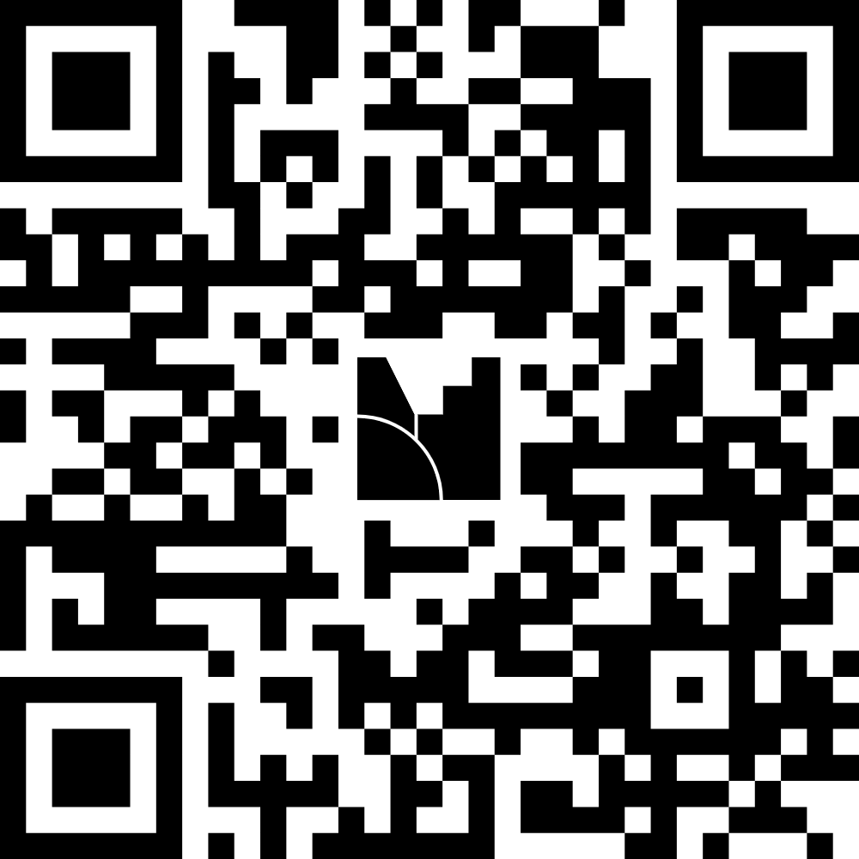
Reflections on results shared
Audience Poll – Mentimeter
Please share any initial reflections that you may have on the initial results shared, before we proceed into the panel discussion.
More than one response can be made
#ARMA2026

Slide 50

Panel Session
Hillary Noone, Research and Innovation Culture Lead, UKRI
Bryony Wakefield, Executive Director of Research Management and Innovation,
Kings College London
Lorna Wilson, Chair of ARMA and Managing Director of Research and Innovation Services, Durham University

