Slide 1

Qualifications information session
Katherine Carlyon (ARMA)
James Dunphy (ARMA)
Camelia Dijkstra (Director of Qualifications)

Slide 2

Programme
Welcome and introductions
Programme content
Programme delivery
Benefits
Key information
Questions

Slide 3
Introductions

Slide 4
Programme content

Slide 5
ARMA Qualifications
A modern qualification designed to support your growth, strengthen your practice and prepare you for the future of research management
What they are and who they are for?
A professional qualification aimed at Research Administrators and Managers.
Developed in consultation with some of the UK’s leading practitioners in research management
Accredited by Awards for Training and Higher Education (ATHE) and regulated by OFQUAL.
Certificate in Research Management Foundation
An introductory level qualification for those starting their career in research administration
It covers a broad range of topics required for an overall understanding of research management
Certificate in Research Management Advanced
The Advanced certificate has been designed to provide an insight into the technical and professional skills needed in research management today.
A deep dive into the skills, roles and activities required for the profession and supports students to develop a higher-level view of the issues
Notes:
Katherine –
Mention units for each
Mention how the content is currently being reviewed for currency and relevance

Slide 6
What you will get from the new ARMA qualifications programme
A programme built for today’s research managers
A fully refreshed qualification, reflecting current and emerging challenges across the research management profession
Simplified Learning Outcomes
  Clear, simple learning outcomes make the programme easy to navigate and more manageable alongside work and personal commitments.
  Learning you can use immediately
  Assessments focus on authentic workplace tasks – such as business cases, risk assessments and governance reviews – not abstract theory
Future-ready Curriculum
  Integration of equality, sustainability, digital transformation, and AI prepares learners for modern research management.
  Clear links to your professional development
  The qualification is aligned to ARMA’s Professional Development Framework, helping you evidence your skills and career development clearly and confidently

Slide 7
Certificates at a glance:
Feature​ | CRM Foundation (Level 3) | CRM Advanced (Level 5)
Learning Model​ | Self‑led, work‑based learning​ | Self‑led, work‑based learning​
Support Provided​ | Live webinars, discussion webinars, assignment support sessions, presenters, assessors, peers, critical friend​ | Live webinars, discussion webinars, assignment support sessions, presenters, assessors, peers, critical friend​
Structure​ | 5 mandatory units​ | 4 mandatory units + 2 optional units​
Interaction​ | Learning Management System + online webinars + 1 face to face event​ | Learning Management System + online webinars + 1 face to face event​​
Accreditation​ | ATHE accredited; OFQUAL regulated​ | ATHE accredited; OFQUAL regulated​
Total Qualification Time​ | 240 hours​ | 180 hours​

Slide 8
CRM Foundation Units
Each certificate is made up of units. The units bring together concepts of learning into coherent groupings.
Unit Title | Summary
Unit 1: Understanding Research Policy | Provides an overview of UK and international research policy, how they intersect, and how to identify and communicate relevant policy information.
Unit 2: Understanding Research Funding | Explains how to cost research funding proposals, the importance of cost recovery, and how to support colleagues through the costing process.
Unit 3: Supporting a Research Project and Portfolio Management | Covers key features of research projects and portfolios, roles in supporting colleagues, and the functions of audit and reporting.
Unit 4: Research Environment | Explores what makes a healthy, ethical, inclusive and well‑governed research environment and the learner’s role in supporting it.
Unit 5: Research Impact and Engagement | Develops understanding of research impact, outputs and engagement, why they matter, and how they are evaluated.

Slide 9
CRM Advanced units (mandatory)
Unit | Summary
Managing Research Policy and Strategy | Designed to help students develop knowledge and skills in relation to strategy and policy
EDI in Research Environment | Designed to help students understand, explain and evaluate the importance of equality and diversity in research management
Research Governance | Designed to help students understand the role of good governance in research management
Managing a Funding Portfolio | Designed to help the student gain the knowledge and skills to evaluate and expand the funding policy of their organisation in order to identify and plan new funding opportunities

Slide 10
Advanced units (optional)
Unit | Summary
Delivering Results: People, Systems and Processes | Designed to help students build their skills and understanding of how people, systems and processes must work together to deliver an efficient and effective service
Managing Collaborations | Designed to help students gain the knowledge and understanding they need to support successful collaboration. These might be with similar organisations in their own country or overseas, or they might be partnerships with different types of organisation, such as industry partners.
Data For Decision Making | Designed to help the student develop knowledge and understanding in working with data to provide useful management information

Slide 11
Progamme delivery

Slide 12
The Qualifications Programme
Unit webinars are delivered live from November in chronological order approx. 6 – 8 weeks apart throughout the first year. These are followed by a live question and answer session to help students reflect and come prepared to talk about their assignments.
Each session is 90 – 120 minutes, and where possible are scheduled between 09:30 – 11:30 or 13:00 – 15:00 Monday to Thursday. The webinar schedules will be sent to you in October
You can review the recordings saved to the qualifications resource hub or re-attend the next cohort’s webinars in your second year

Slide 13
Qualifications Critical Friend Support – key to success
Identify a qualifications critical friend – think about who will be able to give support and encouragement and possibly help you in your professional development
Share your handbook and online resources
Agree a schedule that will work between you and your critical friend and meet as regularly as possible
Get in touch if you have any questions or queries

Slide 14
Assessments
Each unit is assessed by an assignment/work related task (max of 2500 words)
Full guidance is provided at The Assignment Guidance webinar
Details about each assignment are included in the learning management system
Your critical friend can help with your assignment by proof reading and giving feedback. You can also talk to your cohort, your work colleagues and your line manager
Assignments are marked by ARMA members with expertise in their unit(s), who are trained as assessors
Assignments can have one of two marks: pass or refer (exceptionally, they can fail)*
Constructive feedback should help you improve where needed AND contribute to your professional development

Slide 15
Benefits

Slide 16
Benefits for you
🎓 Accredited Learning: OFQUAL-regulated qualifications with ATHE accreditation and certificate
📚 Professional Development: Comprehensive curriculum, reflective assignments applied to your own context, with expert feedback
🤝 Peer Support: Engage with assessors, colleagues, other students and a critical friend
⏱️ Flexibility: Self-led, work-based learning with both recorded and live webinars
🚀 Career Progression: Builds skills in research management and leadership and opportunities to share successes.

Slide 17
Benefits for your organisation
🧠 Enhanced Capability: Staff gain accredited training in research management.
📈 Improved Performance: Work-based learning directly benefits organisational outcomes.
🤝 Internal Collaboration: Encourages peer support, line manager engagement, and knowledge sharing.
🏅 External Recognition: OFQUAL-regulated qualifications enhance institutional/team credibility.
💡 Talent Development: Supports career progression and staff retention.
💷 Cost and Time Effective: Flexible pricing and webinar access support busy time constrained teams.

Slide 18
The Qualifications Programme – *extra benefits
Face to face option for first unit to enable networking with your community and cohort
Each session has a follow up Q and A session to aid reflective discussions and support with assessment
New one stop shop online learning management system
Prices frozen at 2025 rates
Cost includes 1 free online Training and Development workshop of your choice (subject to availability)
Personalised support
Designed by the sector, delivered by the sector

Slide 19
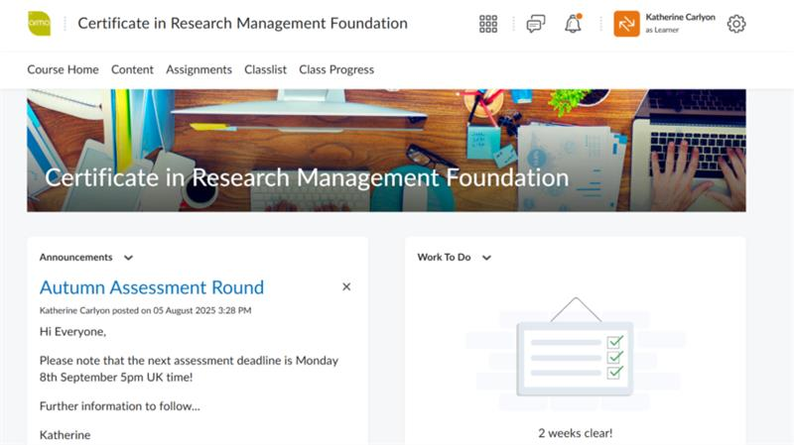
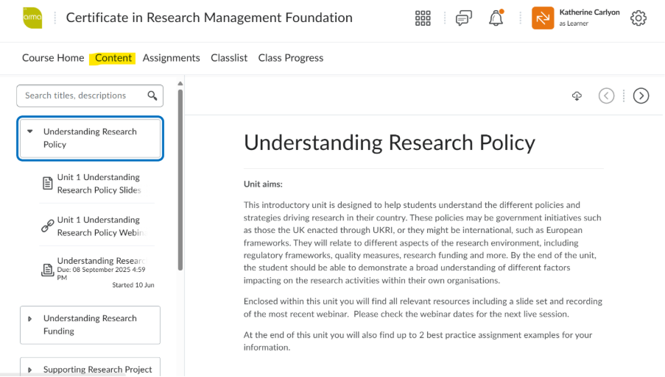
D2L Brightspace

Slide 20
Key details

Slide 21
What does it cost
Prices for 2026 Registration
Foundation Online | £1215
Advanced Online | £1317
Foundation Online Monthly* | £101.25
Advanced Online Monthly* | £109.75
*paid in 12 monthly instalments over the first year
Don’t forget to factor in your membership fees*!
*click membership fees link to join

Slide 22
Registration deadline
Thursday 15th October
If you need support writing a business case to secure funding, please contact us: qualifications@arma.ac.uk

Slide 23
ARMA Qualifications:
A modern qualification designed to support your growth, strengthen your practice and prepare you for the future of research management

Slide 24
Thank you and questions

Slide 25
Guest speaker:

Slide 26

Contacts
Qualifications email: qualifications@arma.ac.uk
Katherine Carlyon: katherine.carlyon@arma.ac.uk
Other ARMA enquiries: enquiries@arma.ac.uk

