Slide 1



Shaping the Future: Co-creating Recognition and Pathways for Research Professionals
Steph Bales, Teesside University
Dan King, Research Consulting Ltd.
Professor Alis Oancea, University of Oxford
Dr Isabella von Holstein, King’s College London

Slide 2











What is Research Professional Futures?
Research Professional Futures (RPF) is a £4.5m UK‑wide programme funded through the Research England Development (RED) Fund from 1st January 2026 to 31st December 2029.
The project aims to reshape how research is delivered in the UK by focusing on the visibility, recognition, training, and career pathways for the diverse community of research professionals who are essential to research excellence.
It will co-create a strategic blueprint with the sector to enable institutions to translate the findings and outputs of the RPF project into organisational change.

Slide 3

Who are Research Professionals?
•Research Development Manager
•Research Culture lead
•Programme Manager (PRISM)
•Research Insights Analyst
•Research Integrity Manager
•Commercialisation Manager
•Research Librarian
•Director of Research Office
We are all here for the research.

Slide 4

What is a Research Professional?
Join at:
vevox.app
ID:
163-050-458

Slide 5
Change Screen to Vevox Presenter View
https://warwickuni.display.vevox.com#/present/922984/VL61XE7JI5K3FMIL6K6C

Slide 6




What is the problem and why now?
Lack of Strategy
Missing evidence on effective RP role design and resourcing
Untapped Expertise
The added value of RPs is underused across the research system
Accidental Careers
Lack of structured professionalisation and development for RPs
Cultural Divide
Limited mutual understanding hinders teamwork and delivery

Slide 7
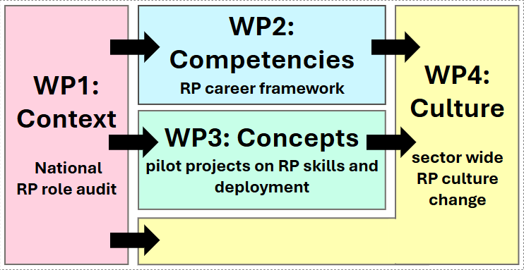

Work Packages & Objectives
Work package 1:
Context
To audit and analyse the current landscape of RP roles and develop a shared vision for their future.
Work package 2:
To develop and implement the first unifying, sector-wide framework of core skills, behaviours, and career pathways for RPs.
Competencies
Work package 3:
To pilot new institutional and regional initiatives that enhance and futureproof RP roles, including exploring the potential of emerging technologies and shared service models.
Concepts
Work package 4:
To co-create a practical, strategic ‘RP Blueprint’ to embed lasting change.
Culture

Slide 8
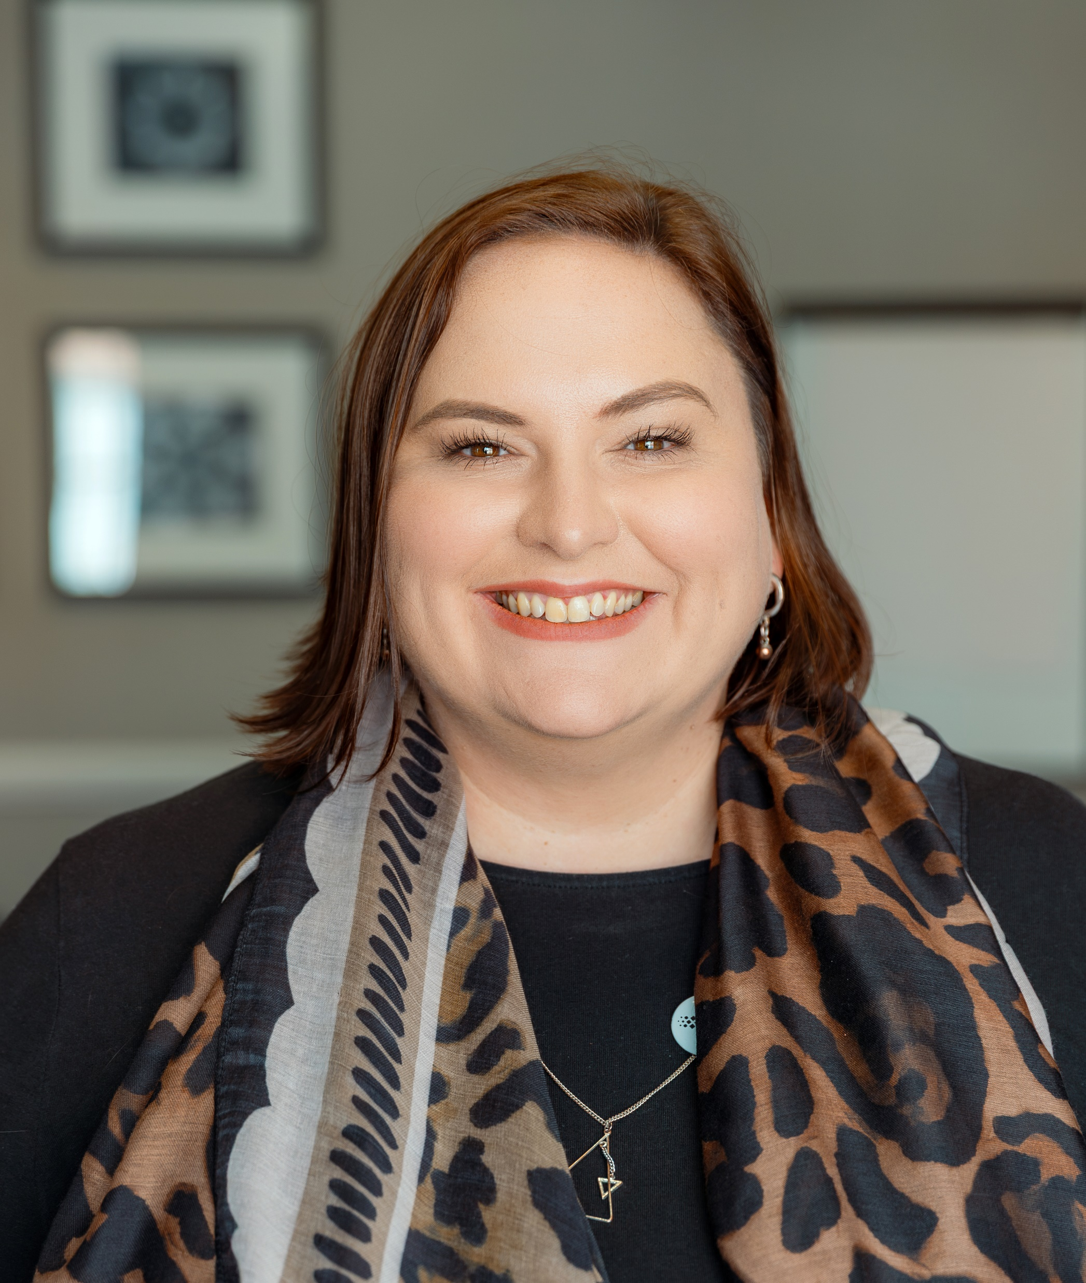
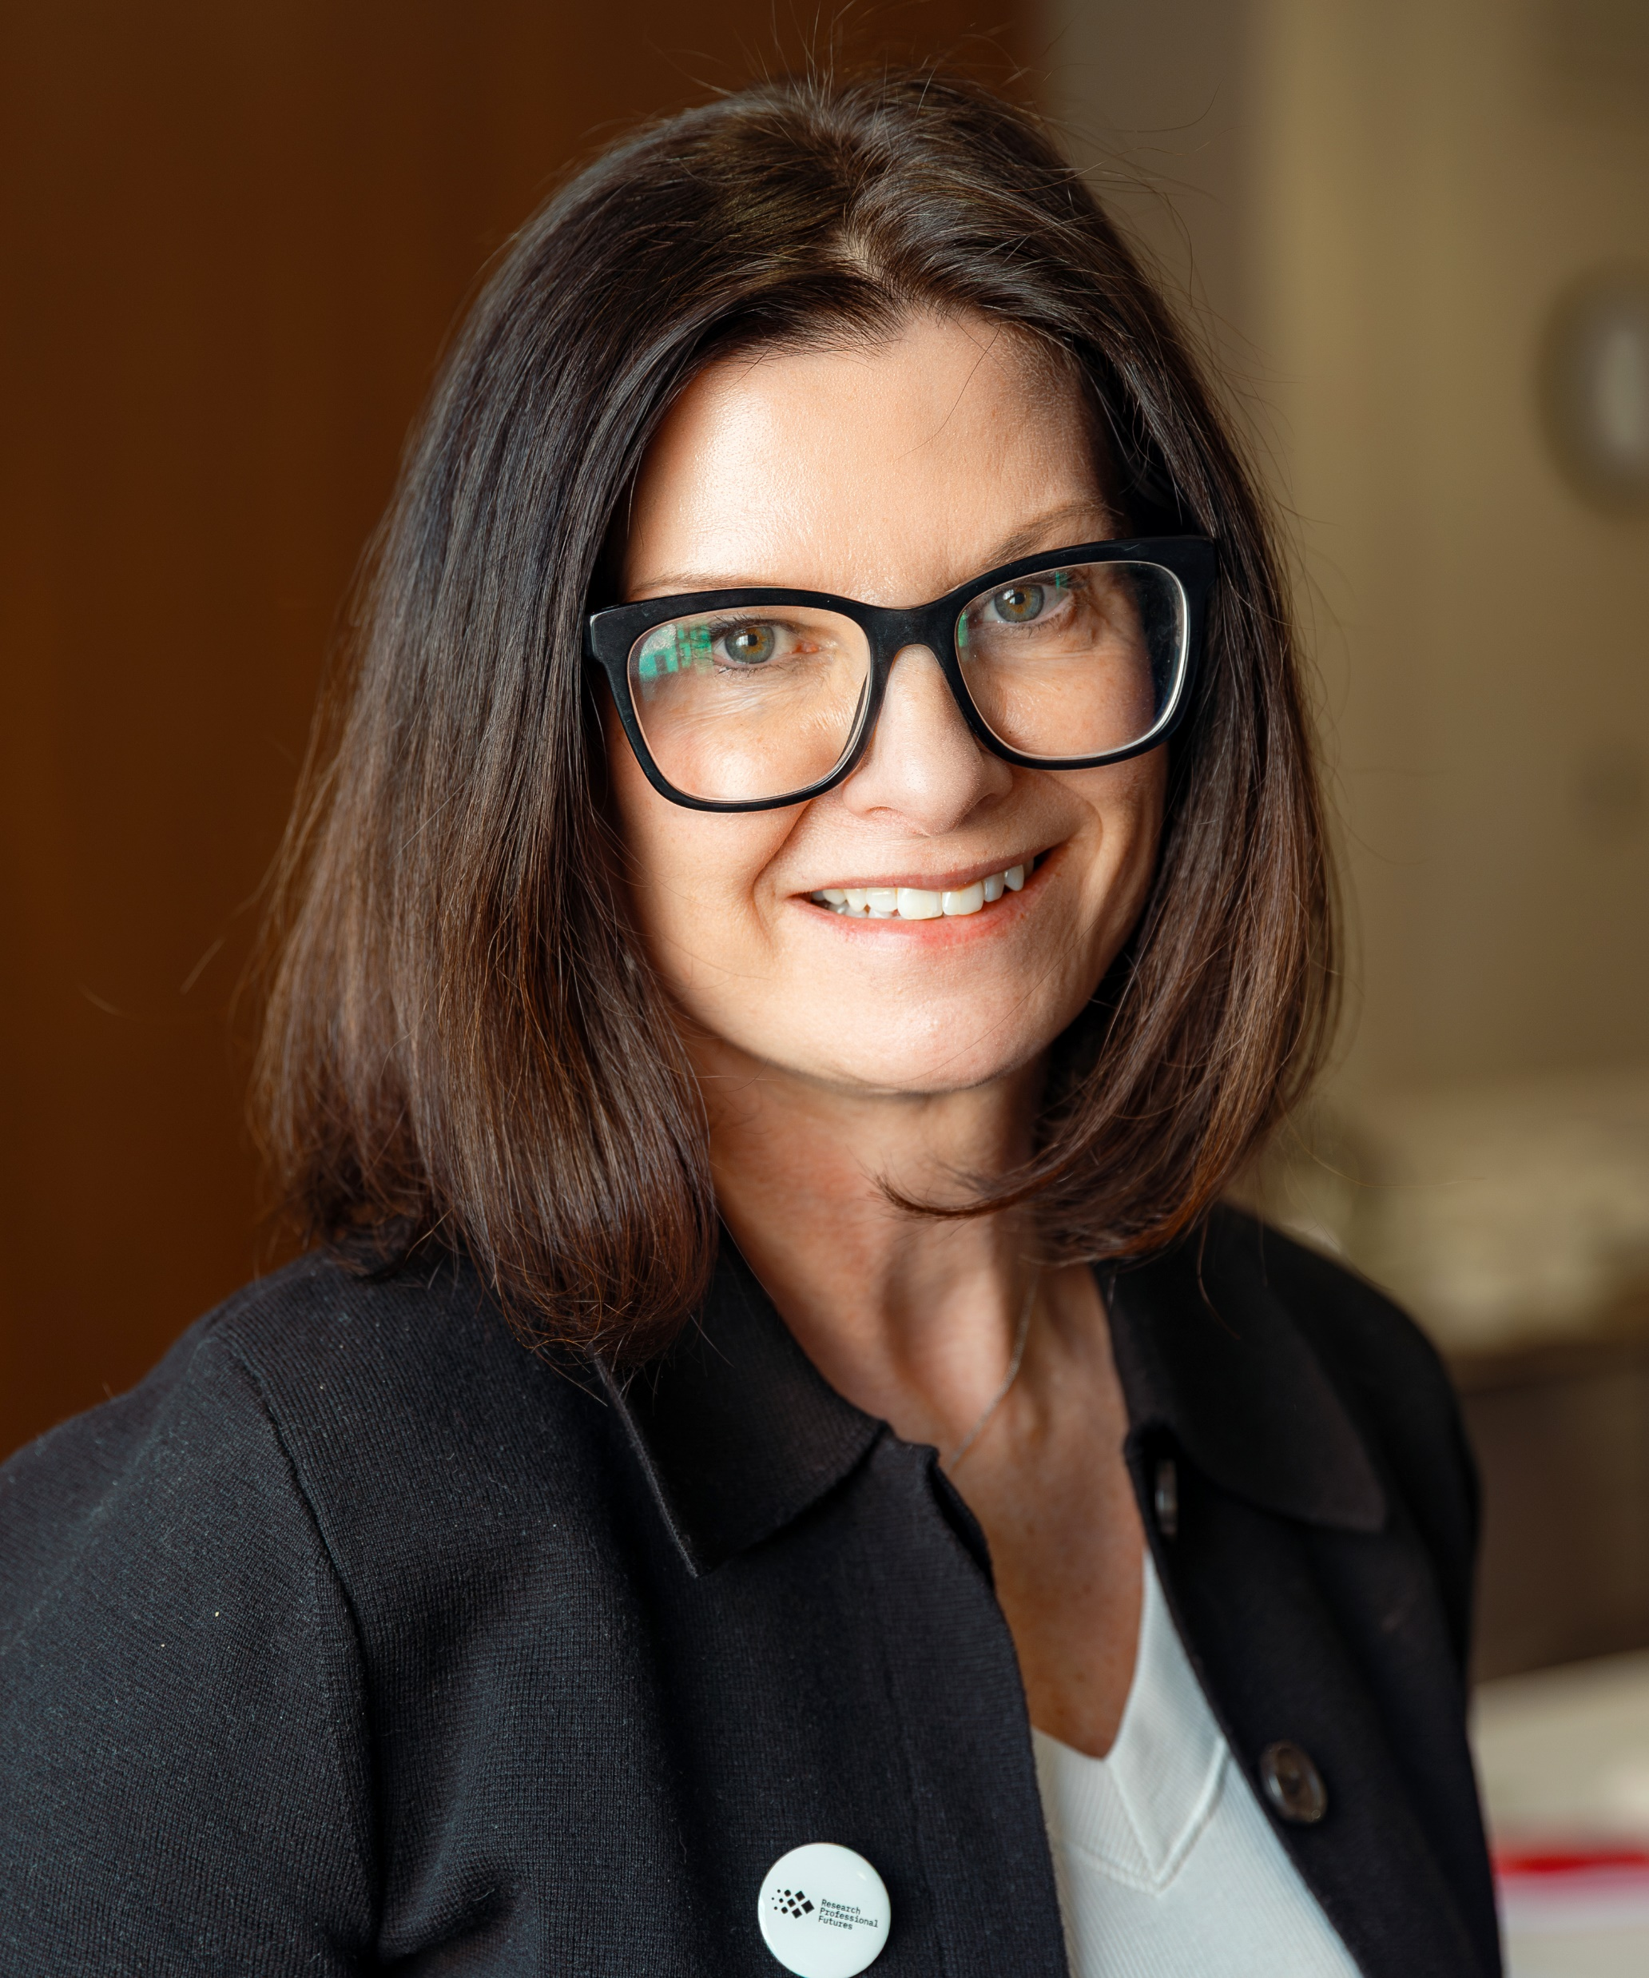
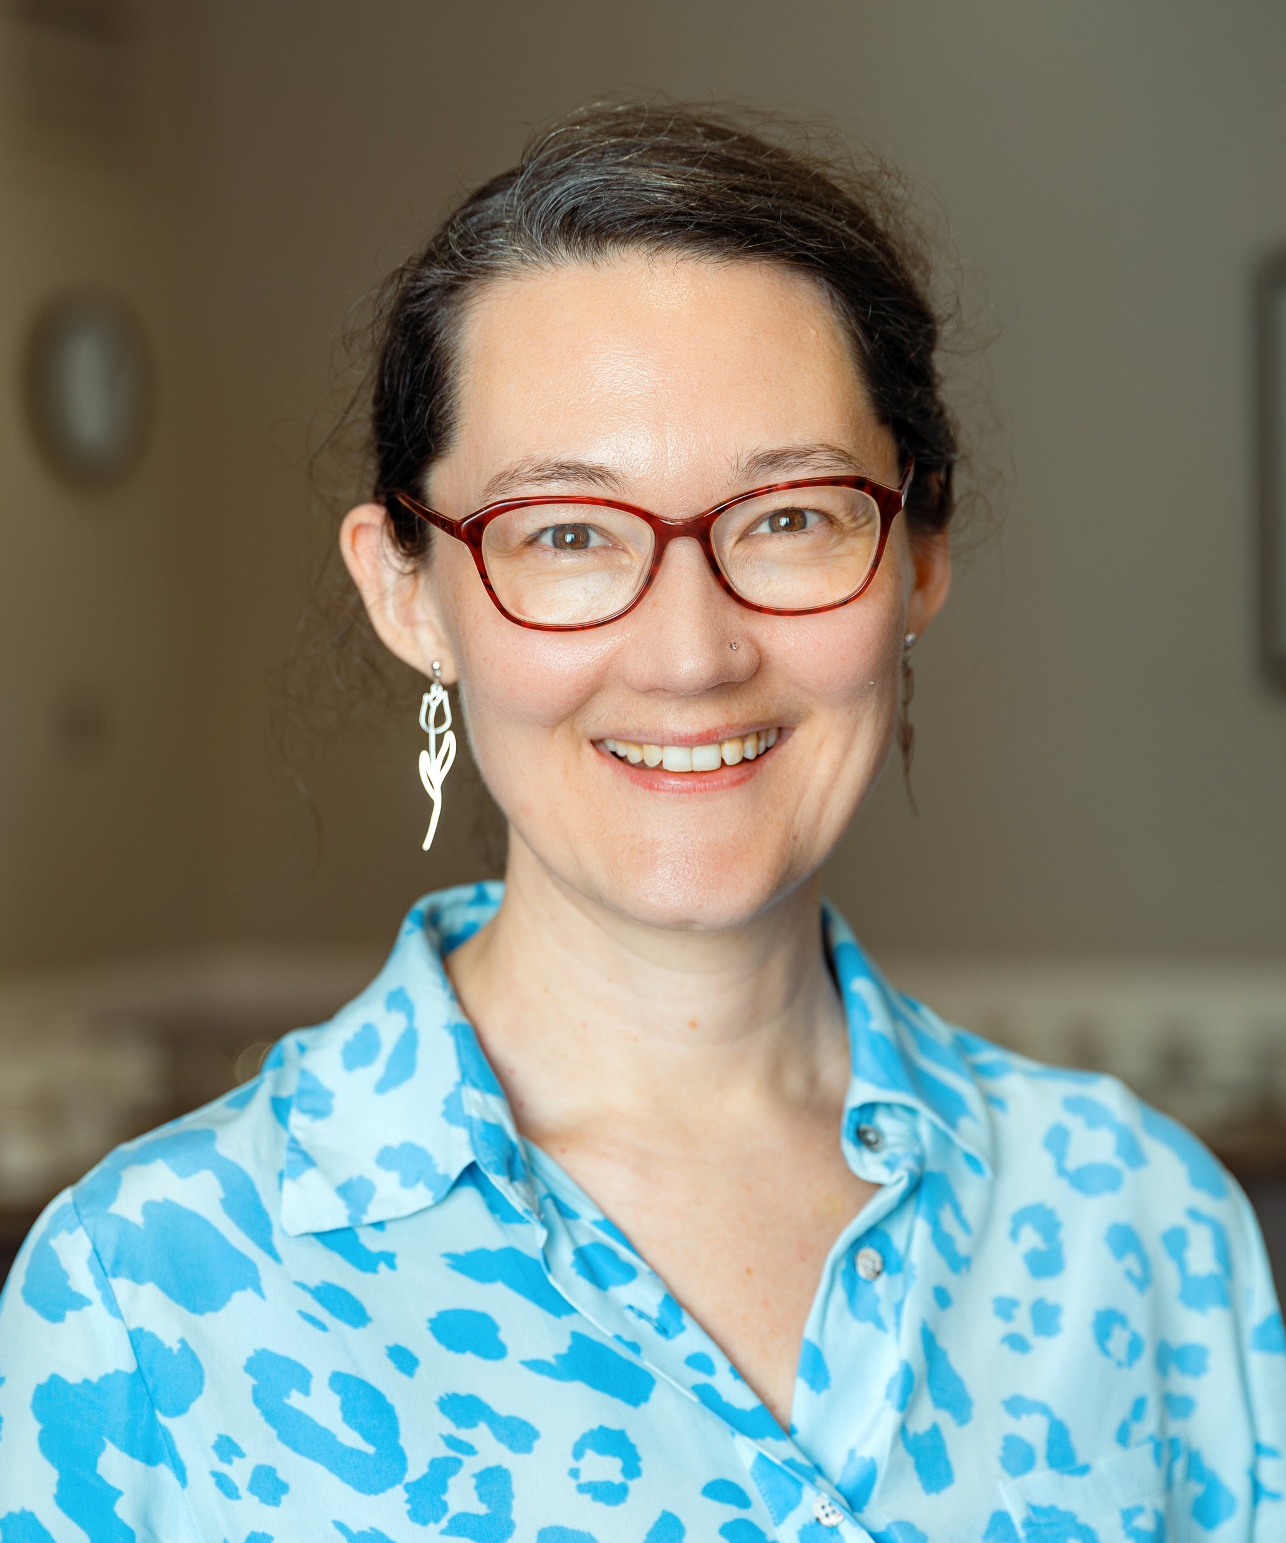
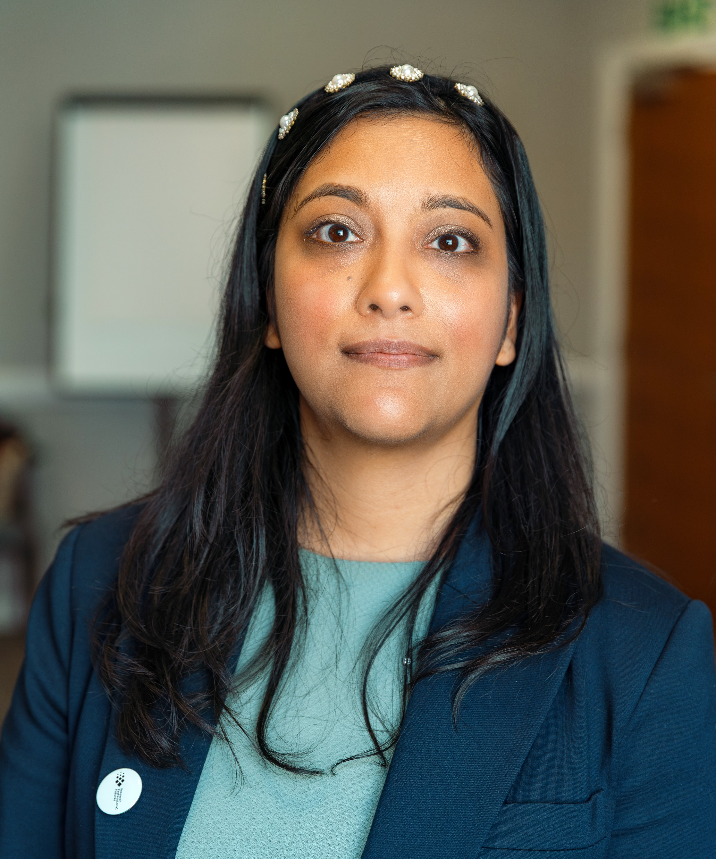




RPF Leadership Team
Lorna Wilson
WP1 Lead
Steph Bales
WP2 Lead
Isabella von Holstein
WP3 Lead
Rika Nair
WP4 Lead

Slide 9
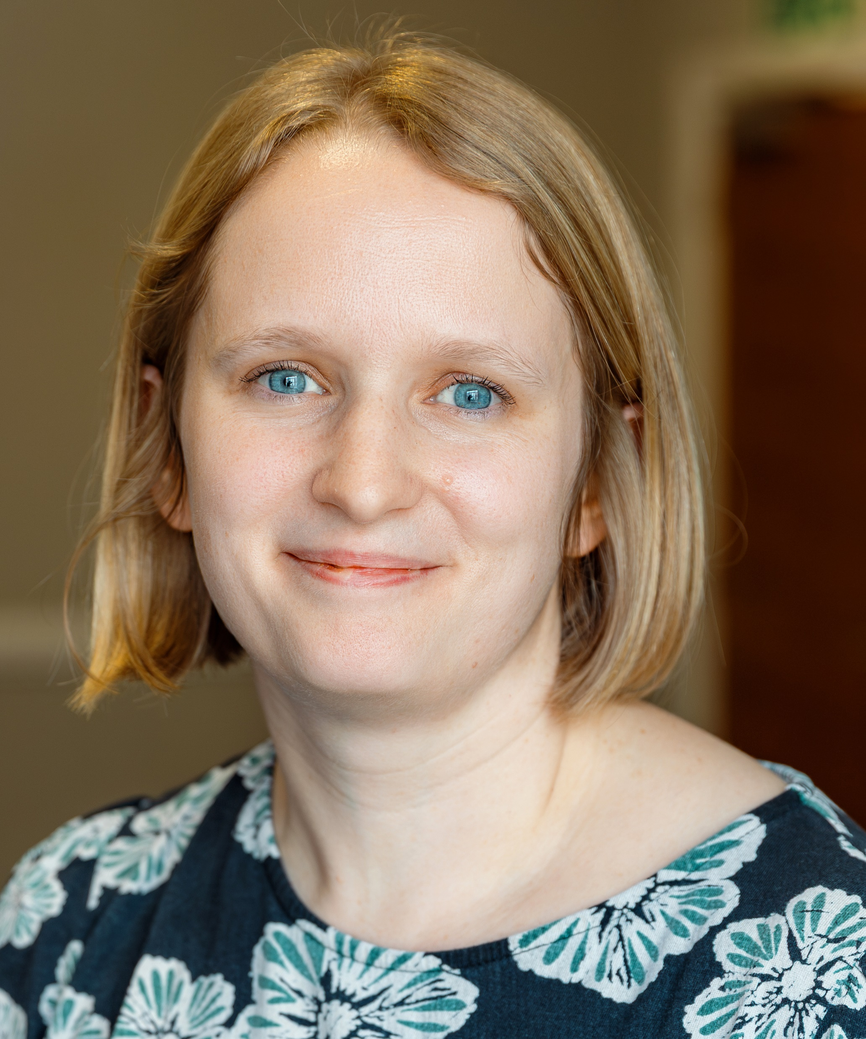
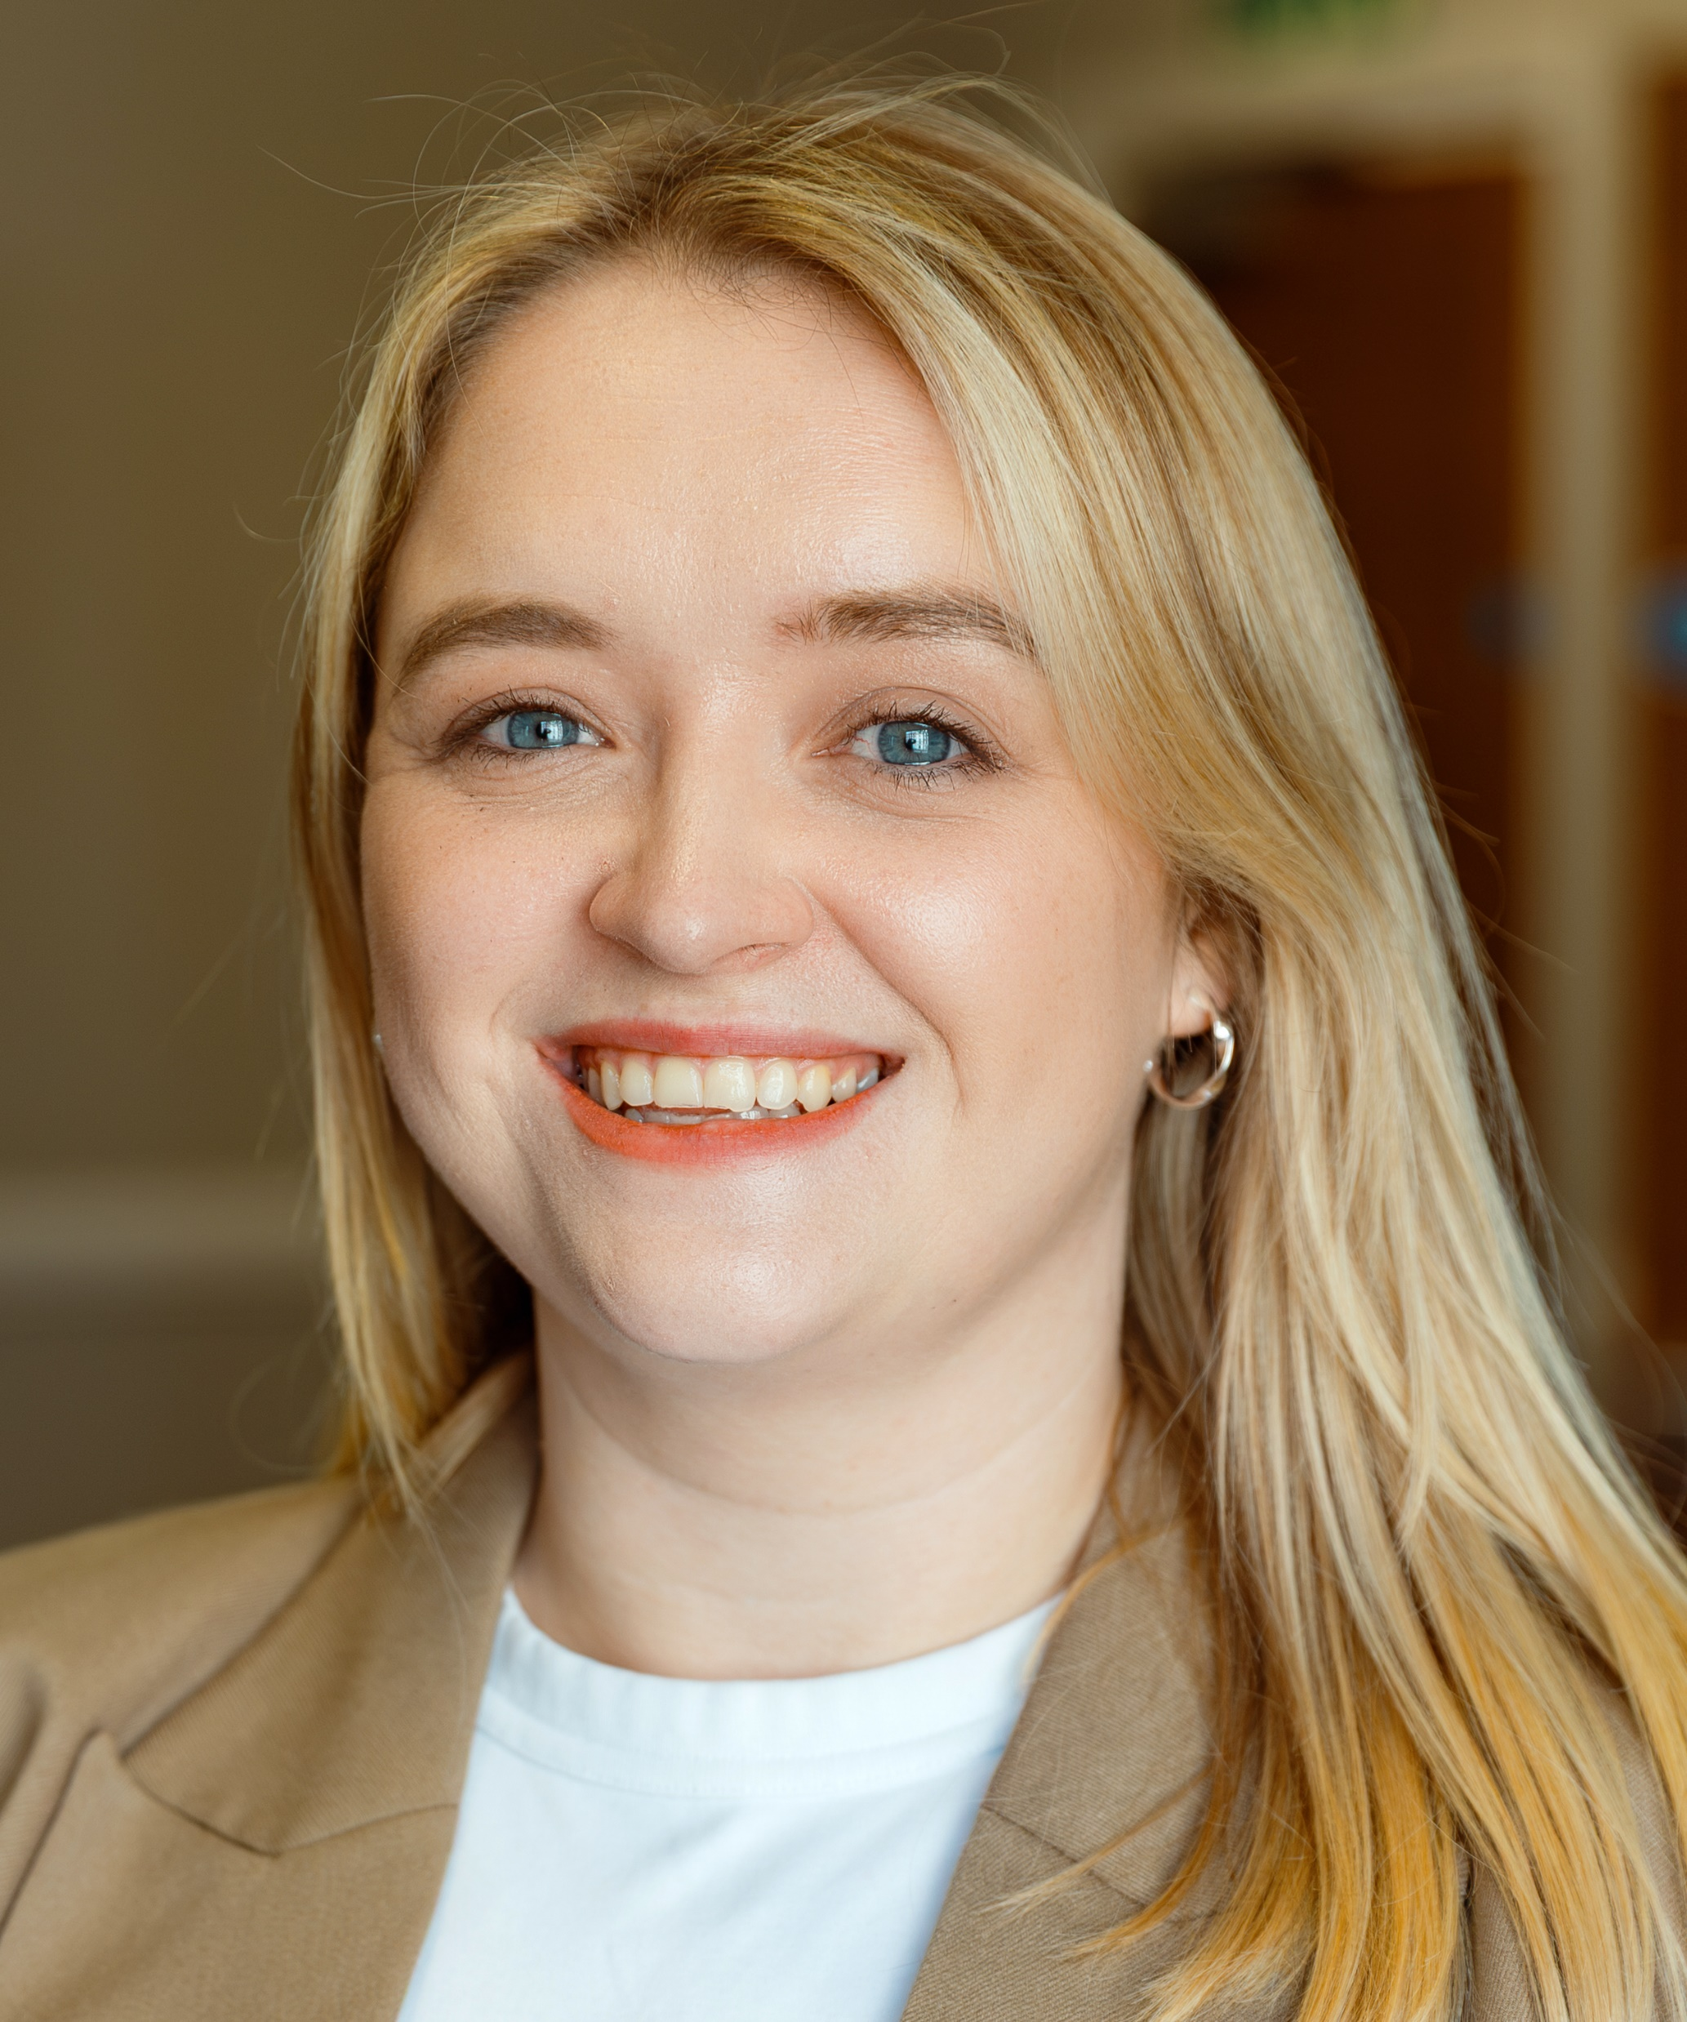
RPF Project Team
Karen O’Riordan
RPF Project Officer
Katie Reynolds
RPF Research Culture Manager

Slide 10


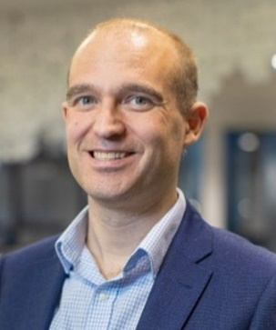
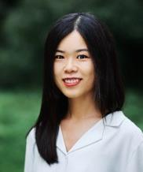
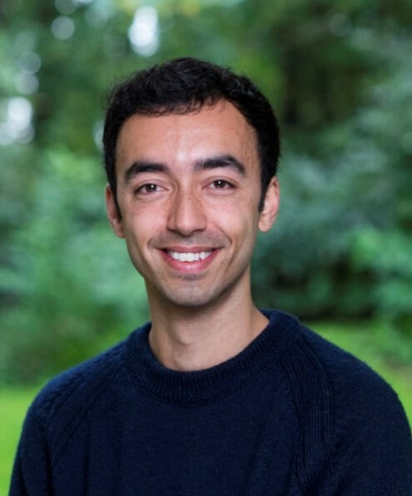
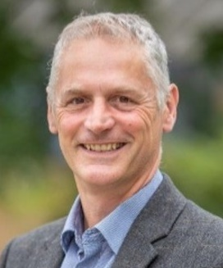
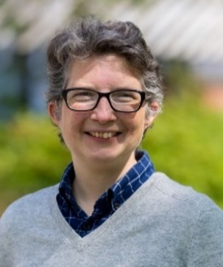

Key Delivery Partners
Prof Alis Oancea
Dr Jess Pilgrim-Brown
Rob Johnson
Dr Xin Xu
Dr Ben Hart
Dan King
Angharad Roberts
University of Oxford
Research Consulting Ltd.

Slide 11

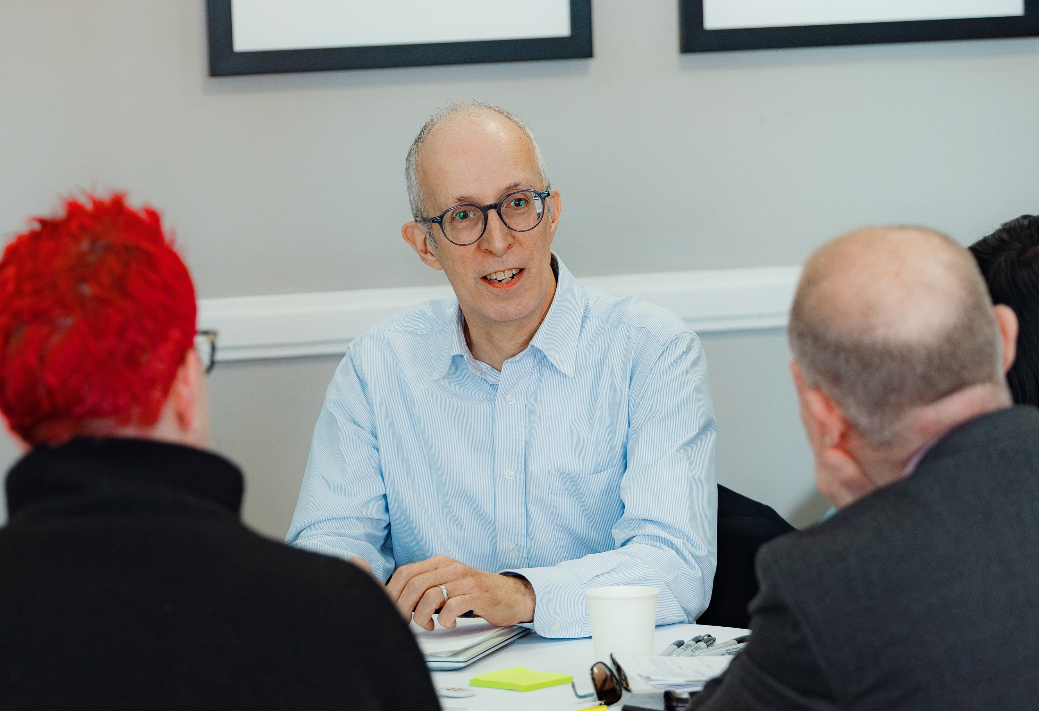

RPF National Commission
SHAPE DIRECTION
TEST INSIGHTS
SECTOR INFLUENCE
... A Critical Friend

Slide 12
Year 1 Project Plan

Slide 13
Interactive Activity
Join at:
vevox.app
ID:
163-050-458

Slide 14
Change Screen to Vevox Presenter View
https://warwickuni.display.vevox.com#/present/922984/VL61XE7JI5K3FMIL6K6C

Slide 15
WP1 Quantitative research elements
Surveys, job advert analysis and underpinning RP role typology
Dan King, Research Consulting

Slide 16
Describing the landscape of Research Professional roles
Current work is focusing on context (WP1) leading into competencies (WP2).
Exploring:
characteristics of the current landscape of RP roles;
current competencies, roles, services and demographics of RPs in UK HEIs;
career pathways and experience; and
skills and expertise which the research sector will need from RPs in the future.
Drafting an initial typology of Research Professional roles, as an enabling framework for data collection (qualitative and quantitative).
Gathering and analysing quantitative data including:
Job advert data (8 years)
Individual survey of Research Professionals (now live!)
Institutional survey of HEIs

Slide 17
Drafting an initial typology of Research Professional roles
The typology is used in the surveys and there is also an opportunity to comment on this in this session: Is there anything we have missed? Is there a better way of grouping these roles?
1 | Research funding and research business development
2 | Research environment, culture and researcher development
3 | Research systems, infrastructure, and management
4 | Library, collection and research information services
5 | Research strategy, policy and planning
6 | Knowledge exchange, impact and commercialisation
7 | Research compliance, governance and regulatory requirements
8 | Managing research portfolios: applications, awards, projects and income
9 | Research project, programme and centre management
10 | Clinical and NHS-linked research management
11 | Research communications and marketing
Comments and suggestions to angharad.roberts@research-consulting.com

Slide 18
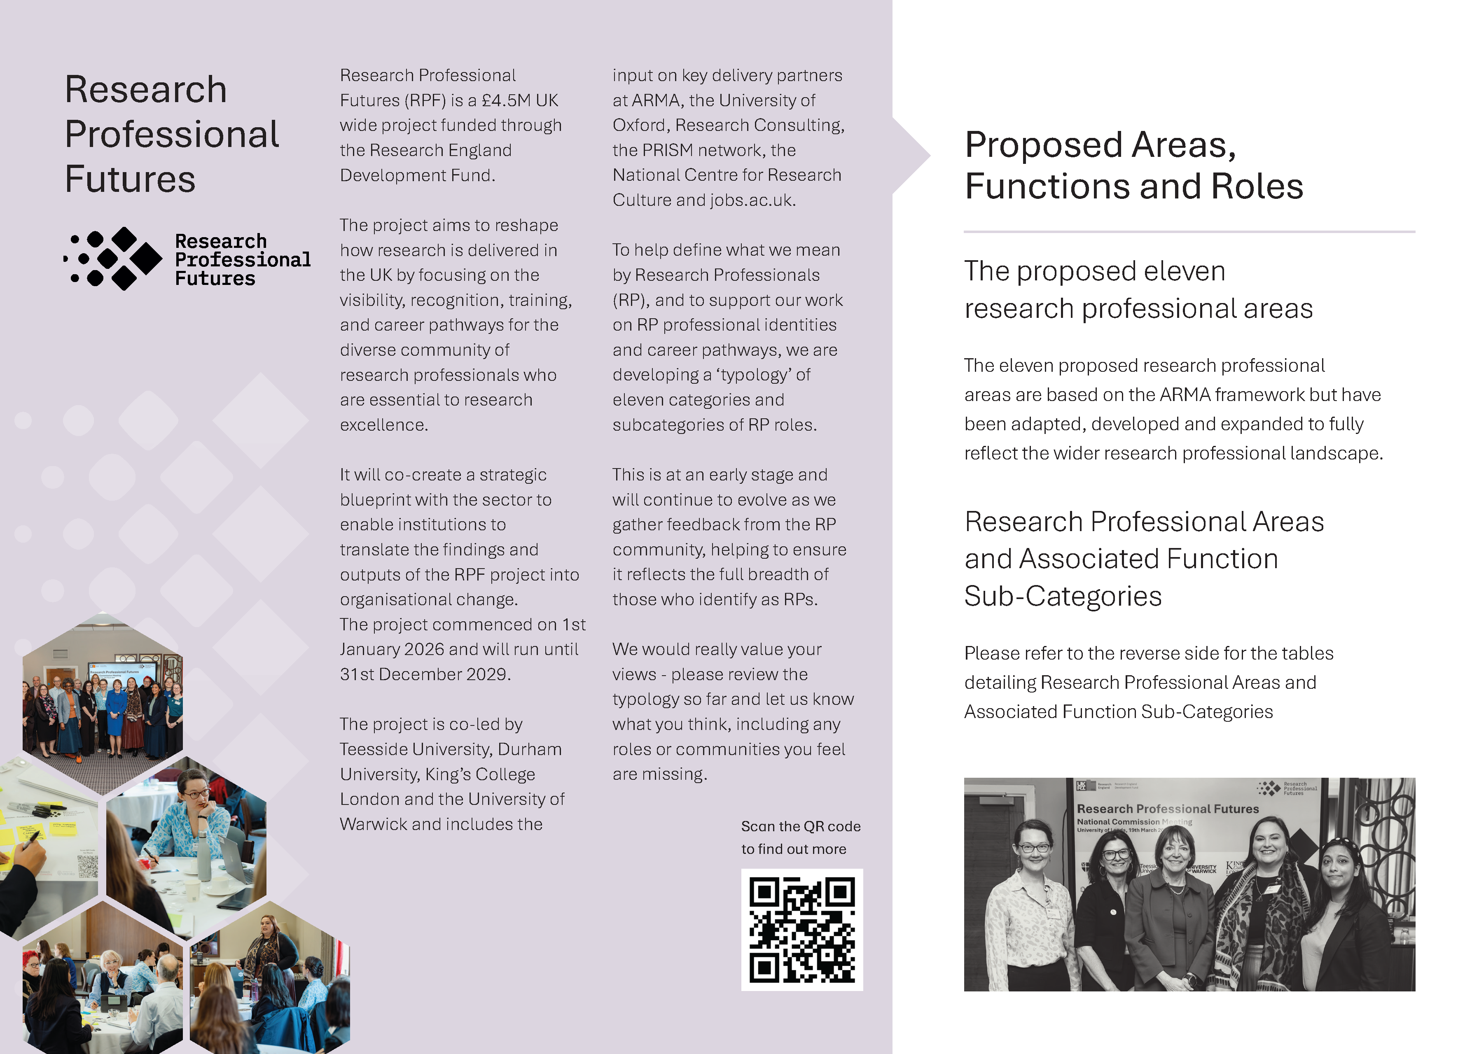
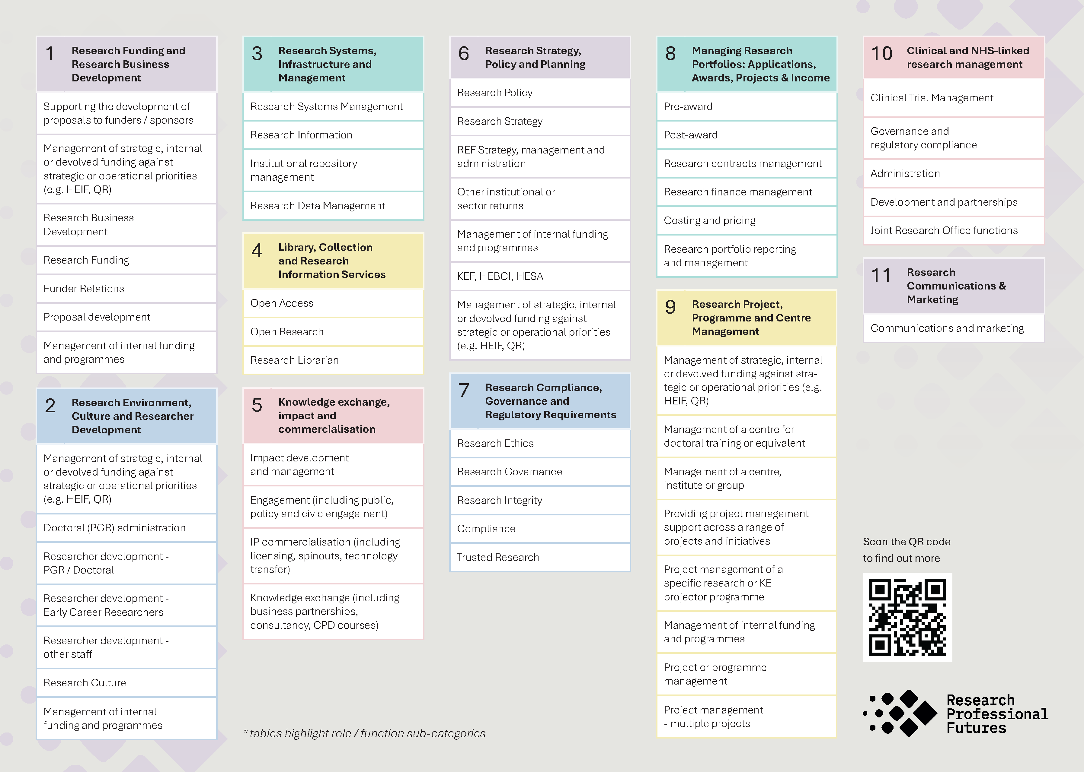
Drafting an initial typology of Research Professional roles
Handouts are available explaining this further. See us on the RP Futures stand to discuss further.
Comments and suggestions to angharad.roberts@research-consulting.com

Slide 19
Drafting an initial typology of Research Professional roles
Notes:
Individual roles not bounded by these, people may have roles requiring work across several. Leaders and Heads of team would have responsibilities across whole areas.

Slide 20

Individual survey now open: take part and share your views!
The individual survey is designed to capture information about the career pathways, perceptions and experiences of Research Professionals in Higher Education Institutions in the UK.
The survey asks individuals about
Current or most recent Research Professional roles
Areas of Research Professional activity, based on the draft typology
Experience, background and pathway into Research Professional roles
Skills and networks
Environment, culture and Research Professionals
Benefit and impact of Research Professional roles
Aspirations for the future
Challenges and opportunities for the next five years
Demographic information
Notes:
Share your experiences and input into the RPF project.

Slide 21
Institutional survey - launching later this summer
The institutional survey aims to develop an authoritative picture of the RP landscape across the sector.
Key objective: mapping the current landscape of RP roles in institutions.
The heart of the survey is the collection of quantitative data about RP roles and functions – contributing to sector-level understanding.
Survey elements:
Contextual information: indicators of scale
The central functions where RPs are employed
Where RPS are employed in departments, schools or Faculties
  Selected “departmental” submissions (up to three)
  Considering disciplinary differences and the nature of RP roles outside central functions
Views on future trends and anticipated changes.
Notes:
To maximise engagement and reduce potential survey burden, qualitative questions have been kept to a minimum.
Participation can provide a useful benefit to institutions as a prompt for gathering data internally which can be used by the institutions for organisational and strategic planning (including REF 2029 Strategy, People and Research Environment).
Participating institutions will be offered early sight of survey findings, with indications of alignment or variation between their institutional response and the wider sector.

Slide 22

RPF 2026-2029
Research components - University of Oxford team
Research team:
Prof Alis Oancea Dr Jess Pilgrim-Brown Dr Xin Xu Dr Ben Hart

Slide 23

Aims
Methods
Evidence base for programme activities and outputs and to extend and integrate knowledge of research professions
Sector-wide participatory input and validation for RPF, including co-production of the PDF
Support change through research and evaluation processes and insights
Academic engagement via different channels
Two systematic reviews of research literature
100 interviews
60 focus group participants
3 cycles of Delphi expert surveys
10 co-production workshops
Support for institutional pilots
Evaluation of institutional pilots

Slide 24
Research Questions
WP1
WP3
8. How can institutional and regional initiatives enhance and futureproof RP roles and provide community support for emerging RP groups?​
9. How may the onset of AI contribute to RP’s work? What constitutes responsible AI use in RP activity?
What are RPs' experiences in their roles and careers?
What are the short- and medium-term professional needs of RPs across the sector?
What do RPs collectively identify as short- and medium-term priorities for change?​
WP2
WP4
4. What training and professional development provision is available to RPs, and where are the gaps?​
5-6. What are the practices and competencies through which RPs add value to research? What are the key competencies for a PDF?
7. What are the short- and medium-term priorities for training and PD?​
10. How do RPs, senior leaders, funders and researchers describe and experience enabling factors and barriers to full recognition of RP roles? What contextual factors mediate it?
11. How may lasting change be embedded in the sector?

Slide 25
Qualitative interviews, focus groups and co-production workshops
Interviews (WP1)
c.100 interviews with RPs May 2026 - April 2027
Focus Groups (WP1)
c. 60 participants
Co-production (WP2)
c. 50 participants
2 workshops per region (two regions in England, devolved nations)
2 rounds each (co-design, validation)
12 conducted so far
Participants: all job roles, types, career stages and expertise
October 2026 - June 2027
10 FG: range of job roles and specialisms; geographies; environments; professional networks
Additional data: participants to provide (optionally) career timeline, photo of their workspace, daily timeline and job description
Included: FG with emerging roles; one FG with academics

Slide 26
Delphi study (WP1-3)
30 expert panel members with extensive sector experience. Aiming for sector-wide consensus:
Cycle One (June 2026-March 2027)
Definition of RPs
Challenges and Needs
Cycle Two (April 2027-December 2027)
Key competencies
Training priorities
Recognition
Future priorities
Cycle Three (February 2028-January 2029)
Role of AI in the work of RPs
The impact of AI on the sector

Slide 27
Emerging insights

Slide 28
Systematic literature review (definitions, needs & priorities )​
26309 studies from Web of Science, Scopus, ProQuest and OpenAlex from 2010-2026.
5594 duplicates auto-detected in Covidence
247 duplicates manually detected
10589 studies irrelevant
Final screening (9879) ongoing
Domains in which RP roles operate
Search terms
Keywords derived from RQs (e.g., development, careers, experiences)
Job titles (using initial typology)

Slide 29
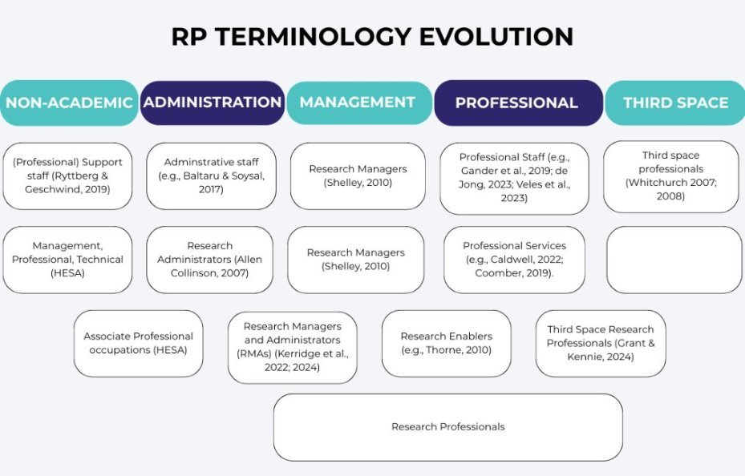

Slide 30
Interviews: Terminology and professional identity
Target: 100 interviews (25+75)
Current: 12/25 interviews conducted so far in Phase 1 (including 3 pilot interviews).
First phase participants from ARMA members (through the ARMA research culture survey).
Participants had different interpretations of the term 'Research Professional', including who is an RP and what roles fall under 'RP'
Different degrees of association with the term 'research professional' (personal professional identity)
Perception that 'RP' may include researchers and academic staff

Slide 31
Emerging insights: Terminology and professional identity
"It's a term that I would like to see more people using...I think we should be claiming that professional role." RP in RKEI role.
"Research Professional seems as good a term as any... research support...is perhaps a slightly better one....I sometime think of myself as a research manager, research administrator, I suppose." RP in Senior Research and Innovation role.
"I'm not sure it's one that resonates with me that much... the one that's coming up more for me now is Knowledge Mobiliser. I think particularly for those of us that work in and around impact, we see ourselves as kind of a bit more outward facing and Research Professional feels a little bit...insular." RP in Senior Impact role.

Slide 32
Emerging insights: Careers, pathways, and recognition
Often coming into the sector with other specific specialisms, sometimes from other industries
Sometimes difficult to progress in current role (lack of opportunities, lack of hands-on training/secondments)
Questions about recognition and acknowledgement of work in a way that it is appropriate and meaningful

Slide 33
Emerging insights: Entering the sector & identity
"So I did my PhD... I did a postdoc...there I was doing research... I made a very painful decision to come back to the U.K. and... there was no way I was going to just come back and be an academic...So, I did an MBA.“ RP working in RKEI
"And [in] my previous career, I worked in financial services regulation, and I worked with accountants and actuaries, and I actually was, I started my first real job was at [large financial services firm]“ Research Centre Manager
"...my professional background is actually in international development. So, I spent 10 years working for [large NGO] and other NGOs in the UK and other countries. And then when I came back from [there I was] in communications... so I was always in communications [previously]" Research Facilitator
"I did biological sciences and then after that I went and worked in the NHS for a year in the lab. Yes, I worked in a hospital lab... So yeah, working in R&D, I was lab based" Research Development Manager
" I did a gap year [after school] in an office as a sort of office admin. And then...went to University...Walked out with a 2:1, which was surprising considering how terrible my A levels were...four months after I left a friend had just got a promotion and she said, oh, actually they're looking for a temp if you start Monday...I turned up on Monday, became a temp. I was working for the Research Centre as... a research centre administrator.“ Research Operations Manager

Slide 34
Emerging insights: Professional development
"There's things that we could do in sort of getting people ready. …There's things that we could do around... secondments and working with others. We've just moved into … a larger research and innovation directorate. So I wonder if between that, there could be some job swaps and stuff and sort of, yeah, opportunities for doing a bit of work at a higher grade“ RP Research Development Manager
“Basically the best we can offer you is … rolling out courses to give you other skills.“ RP in RKEI

Slide 35
Emerging insights: Career progression
"...there's no career pathway.... If you're an academic, you start as a lecturer, senior lecturer, associate professor, professor, etc. [Here] there is no scale. In some universities, you might have a research development manager, you might have a senior research development manager. But if you want to progress any further, then you just have to wait until the director leaves and you apply for that role. There's very little progression within that.
We had an exercise at [HEI] one or two years ago about the progression of professional services staff in general, and they found no answer. It was basically the best we can offer you is either rolling out courses to give you other skills or you have a sideways moves... into another department. So, there they decided not to introduce a careers progression framework.“ RP in RKEI
"

Slide 36
Emerging insights: Career progression
"...that's actually been said by our HR director. You know, if you want to progress as a professional services [member of staff], you [have to] go somewhere else."
RP in a Research Innovation role
"If you're career minded and want to progress, you have to be prepared to move around a lot"
RP in a Senior Research Support role
"I think the thing about the recognition in general terms - that gets me - is the way in which the career progressional ladders work in the professional services side of things, that you get to the top of the grade you're on and that's it. You know, there isn't any opportunity to, or it's very difficult to jump to the next grade“ RP in a Senior Research and Innovation role

Slide 37
Emerging insights: Recognition and reward
"Crediting is a really tricky one because it's still a formal sort of arrangement to credit researchers' names in papers. And I don't think that crediting sort of professionals in papers is at all the way forward and it's kind of impossible to do.
We have to think of other ways to do that though...one thing I really like is that we have sort of a ceremony for like awards and the VC has that sort of like VC awards ceremony, which is a nice way of crediting the work.“ Research Partnership Manager
"...we have an annual Research and KE Awards ceremony, which is part of an annual conference that we run. And that's where professional services staff can be put up for awards in various different areas. .., and then for that, you get money to go towards training. To be honest, I thought just having money would have been nice, but it has to go towards training. So, there's that forum. But beyond that, there's not a great deal really“ Research Professional in KEI
"I feel like, if we can't receive a sort of financial bonus, there should be some reward in at least...professional development, you know." Research Operations Manager

Slide 38
Engagement Activity
Join at:
vevox.app
ID:
163-050-458

Slide 39
Change Screen to Vevox Presenter View
https://warwickuni.display.vevox.com#/present/922984/VL61XE7JI5K3FMIL6K6C

Slide 40
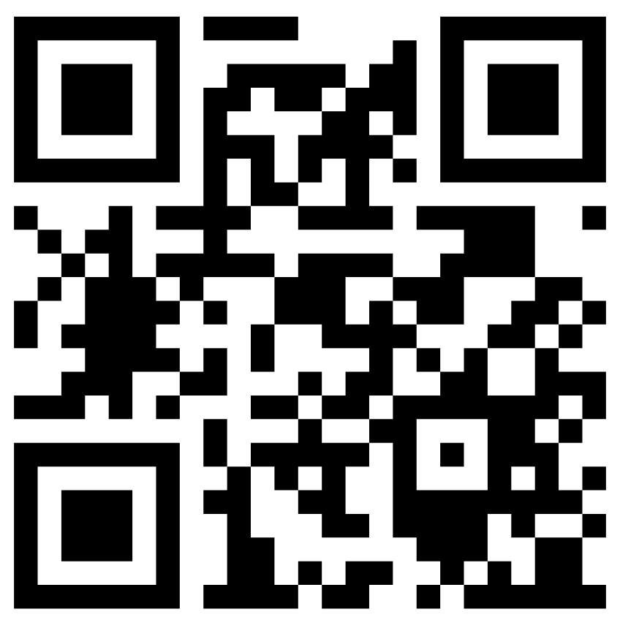



Questions?
Want to get involved?
Scan our QR code to visit our website and join our mailing list.
rpfutures.co.uk

