Slide 1






Community Labs
Building inclusive interdisciplinary research communities through structured collaboration​
Co-Presenters
Dr Anouska Nithyanandan
Head of Research Development, , London School of Economics and Political Science
Miss Liberty Gibson
Senior Research Development Manager, London School of Economics and Political Science
Ms Lucy Brownsdon
Director, Centre for Facilitation
ARMA 2026: Session 1.1 - Funding Development and Delivery
Notes:
1 minute
Good morning/afternoon and thank the audience.
Introduce presenters briefly and explain that the presentation focuses on:
a challenge many universities currently face
how the Community Lab model emerged in response
what has been learned so far
practical approaches others may be able to adapt within their own institutions
Key framing: Universities increasingly encourage interdisciplinary collaboration, but the conditions needed for meaningful collaboration are often not intentionally designed
This presentation explores how we attempted to address that challenge through developing this new Community Lab model.

Slide 2


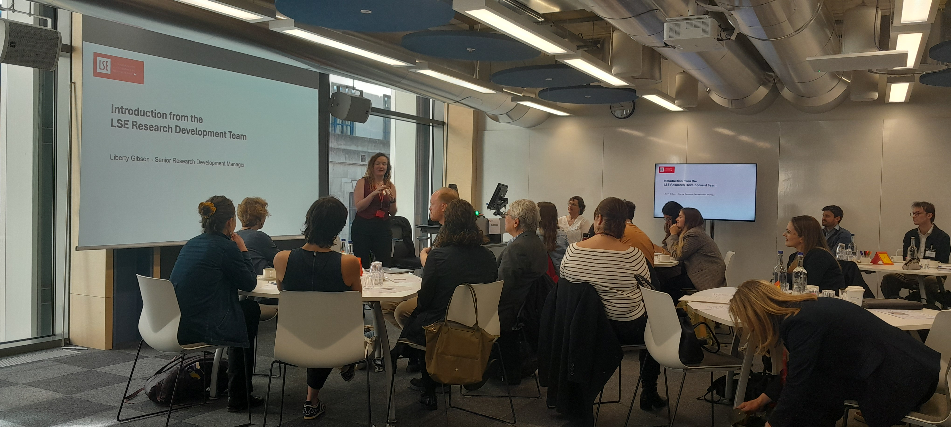
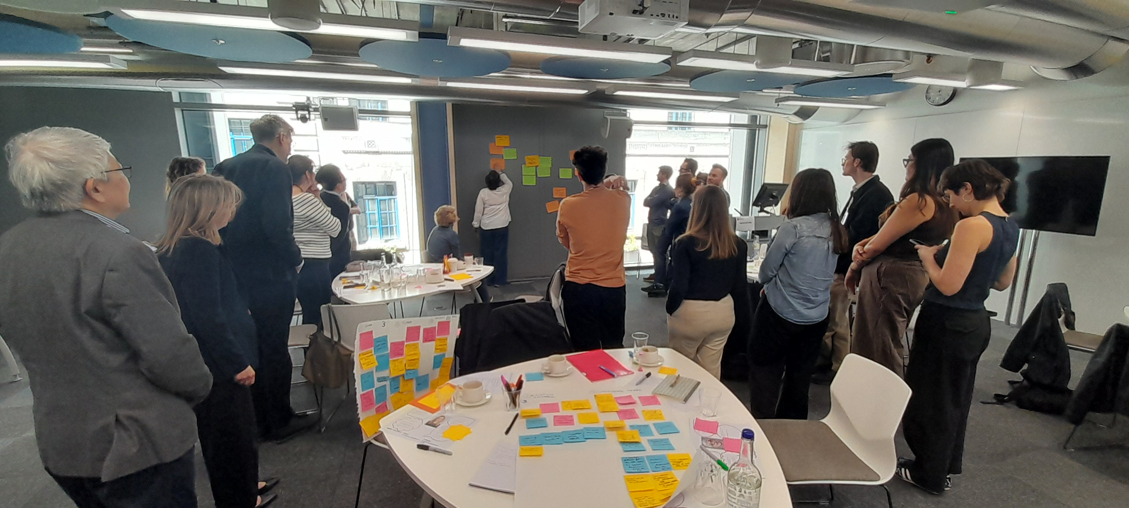
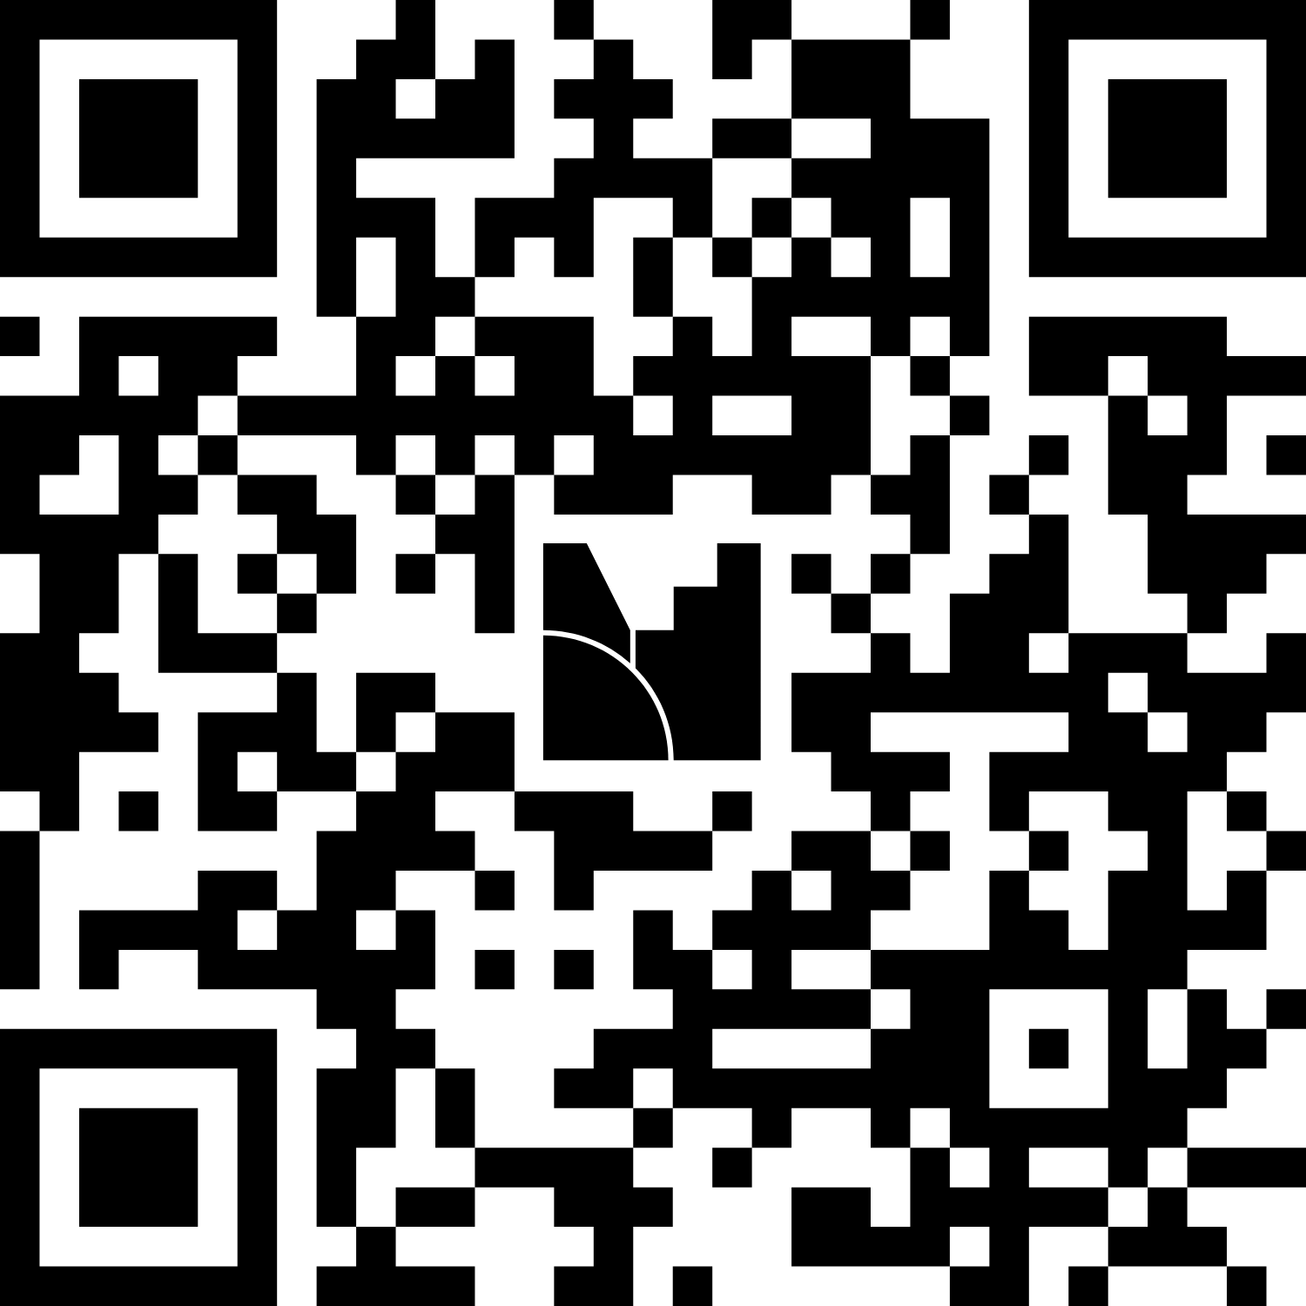
The challenge of enabling interdisciplinary research
  Menti meter/Word cloud question:
  How will greater interdisciplinary collaboration most transform your institution?
The Times and The Sunday Times Good University Guide ranked LSE University of the Year 2025 and the top university in the UK for 2025 and 2026.
Institutional challenge | Collaborative challenge | Strategic challenge
siloed working | trust takes time | ideas struggle to progress
fragmented expertise | difficult to initiate collaboration | unclear pathways to funding
disconnected support structures | uneven participation and confidence | limited sustained community-building
Opportunity: Intentional institutional infrastructure | Opportunity: Design environments that support trust-building and inclusive participation | Opportunity: Pathway to readiness to compete for challenge-led funding opportunities
Participation info for slide https://www.menti.com Use code 3842 0916
Notes:
4 minutes
Invite participants to contribute to the word cloud.
Use live responses to connect with shared institutional experiences.
Key points:
The challenge was not a lack of expertise or willingness
Collaboration is often expected but not actively supported
Institutions frequently rely on informal networks and existing relationships
Professional services are often involved too late in the process
Key reflection: For us, the issue was not collaboration itself, but the absence of intentional structures that support trust-building, inclusive dialogue and sustained interdisciplinary engagement. The Community Lab model emerged as a response to these structural and relational challenges.

Slide 3
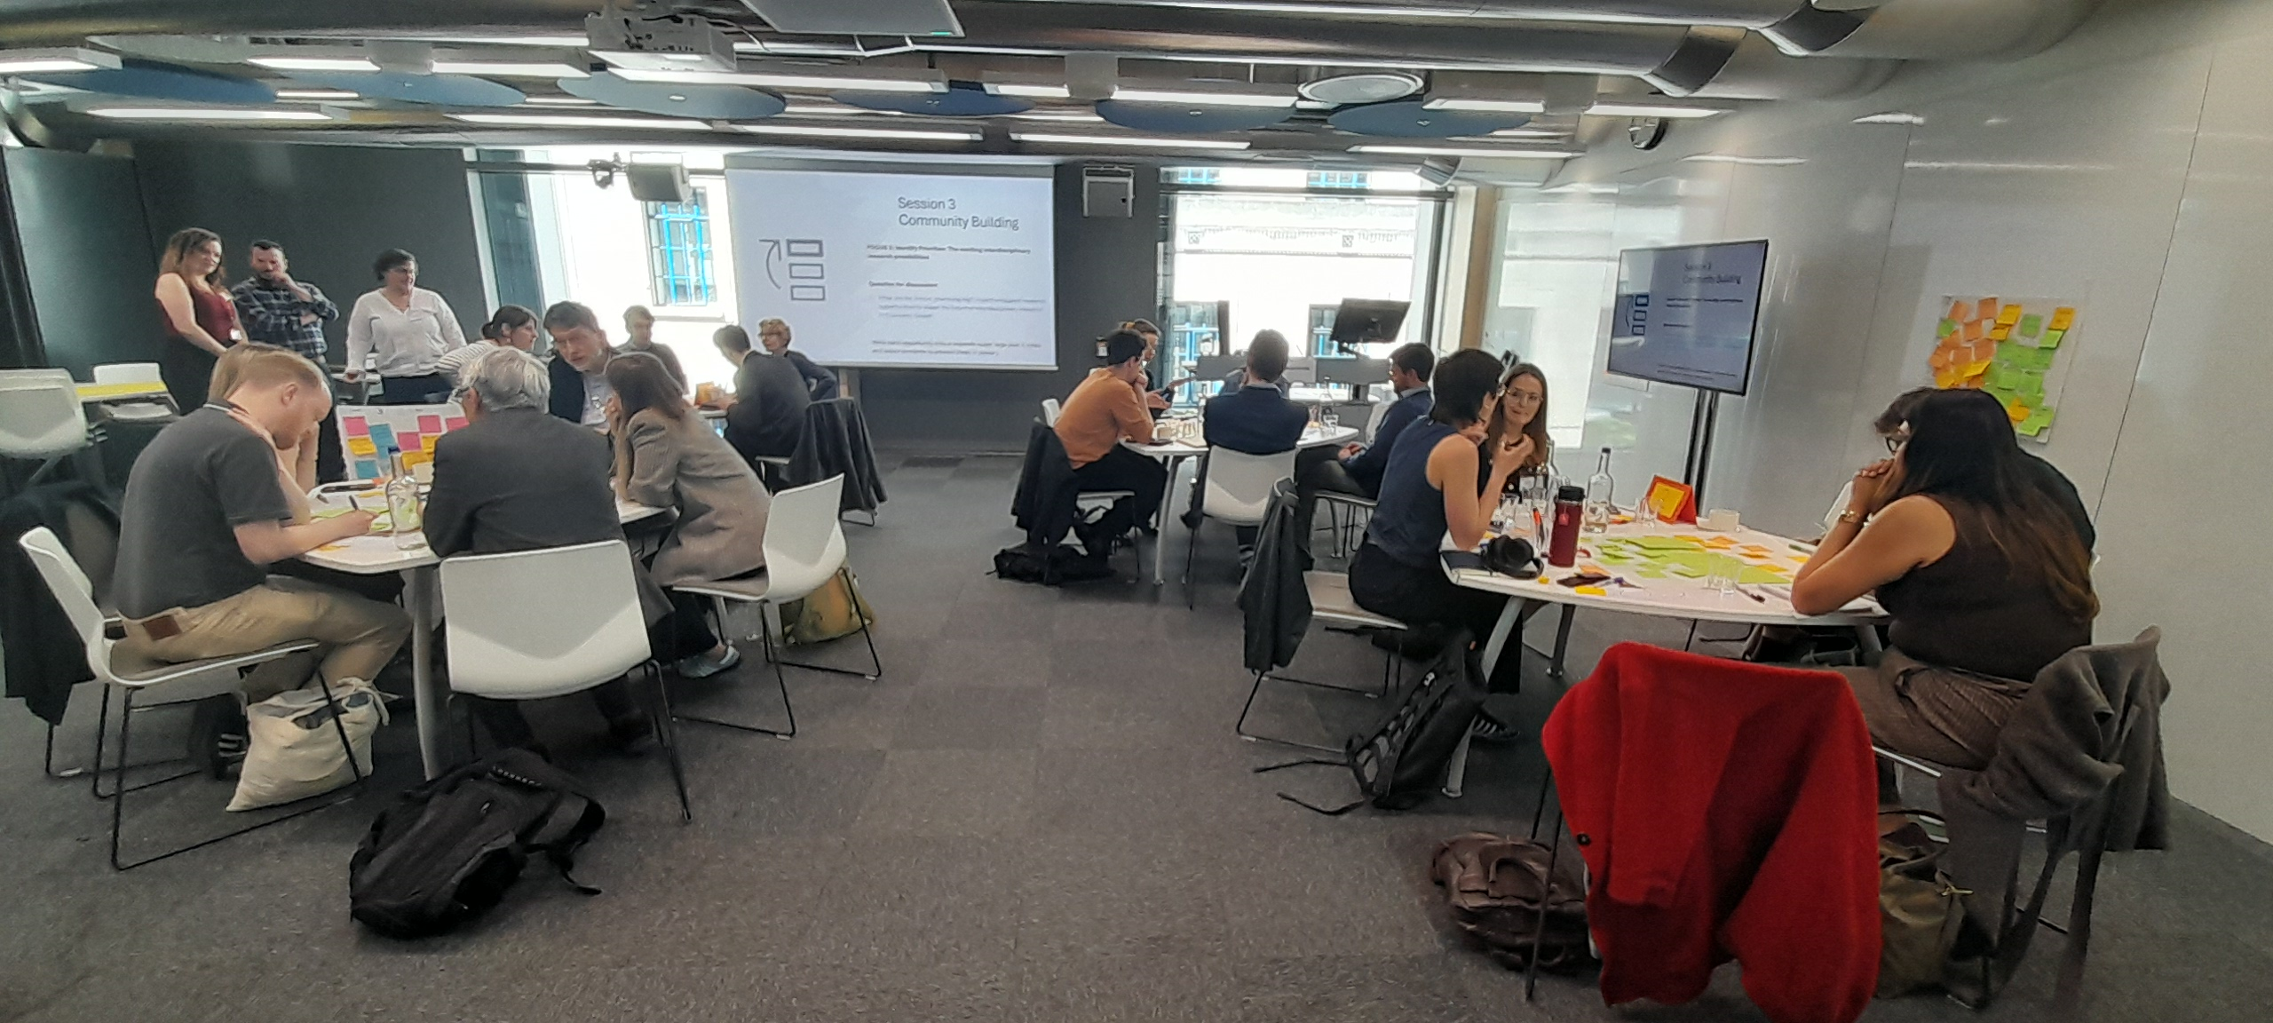
The Community Lab Model
Intentional convening
Facilitated interdisciplinary dialogue
Collaborative idea development
Funding and community pathways
Academic lead
Facilitators
Professional services support
External partners
All relevant to theme
Skills and knowledge mapping
Gaps = Opportunities
Spotting untapped opportunities for novel research
Inclusive participation
Cross-professional collaboration
Observers and networking
External facilitation
Sustained follow-up​
Digital space
Connection with broader networks
Provide R&I ‘menu of support’ to drive follow through
Notes:
3 minutes

Slide 4
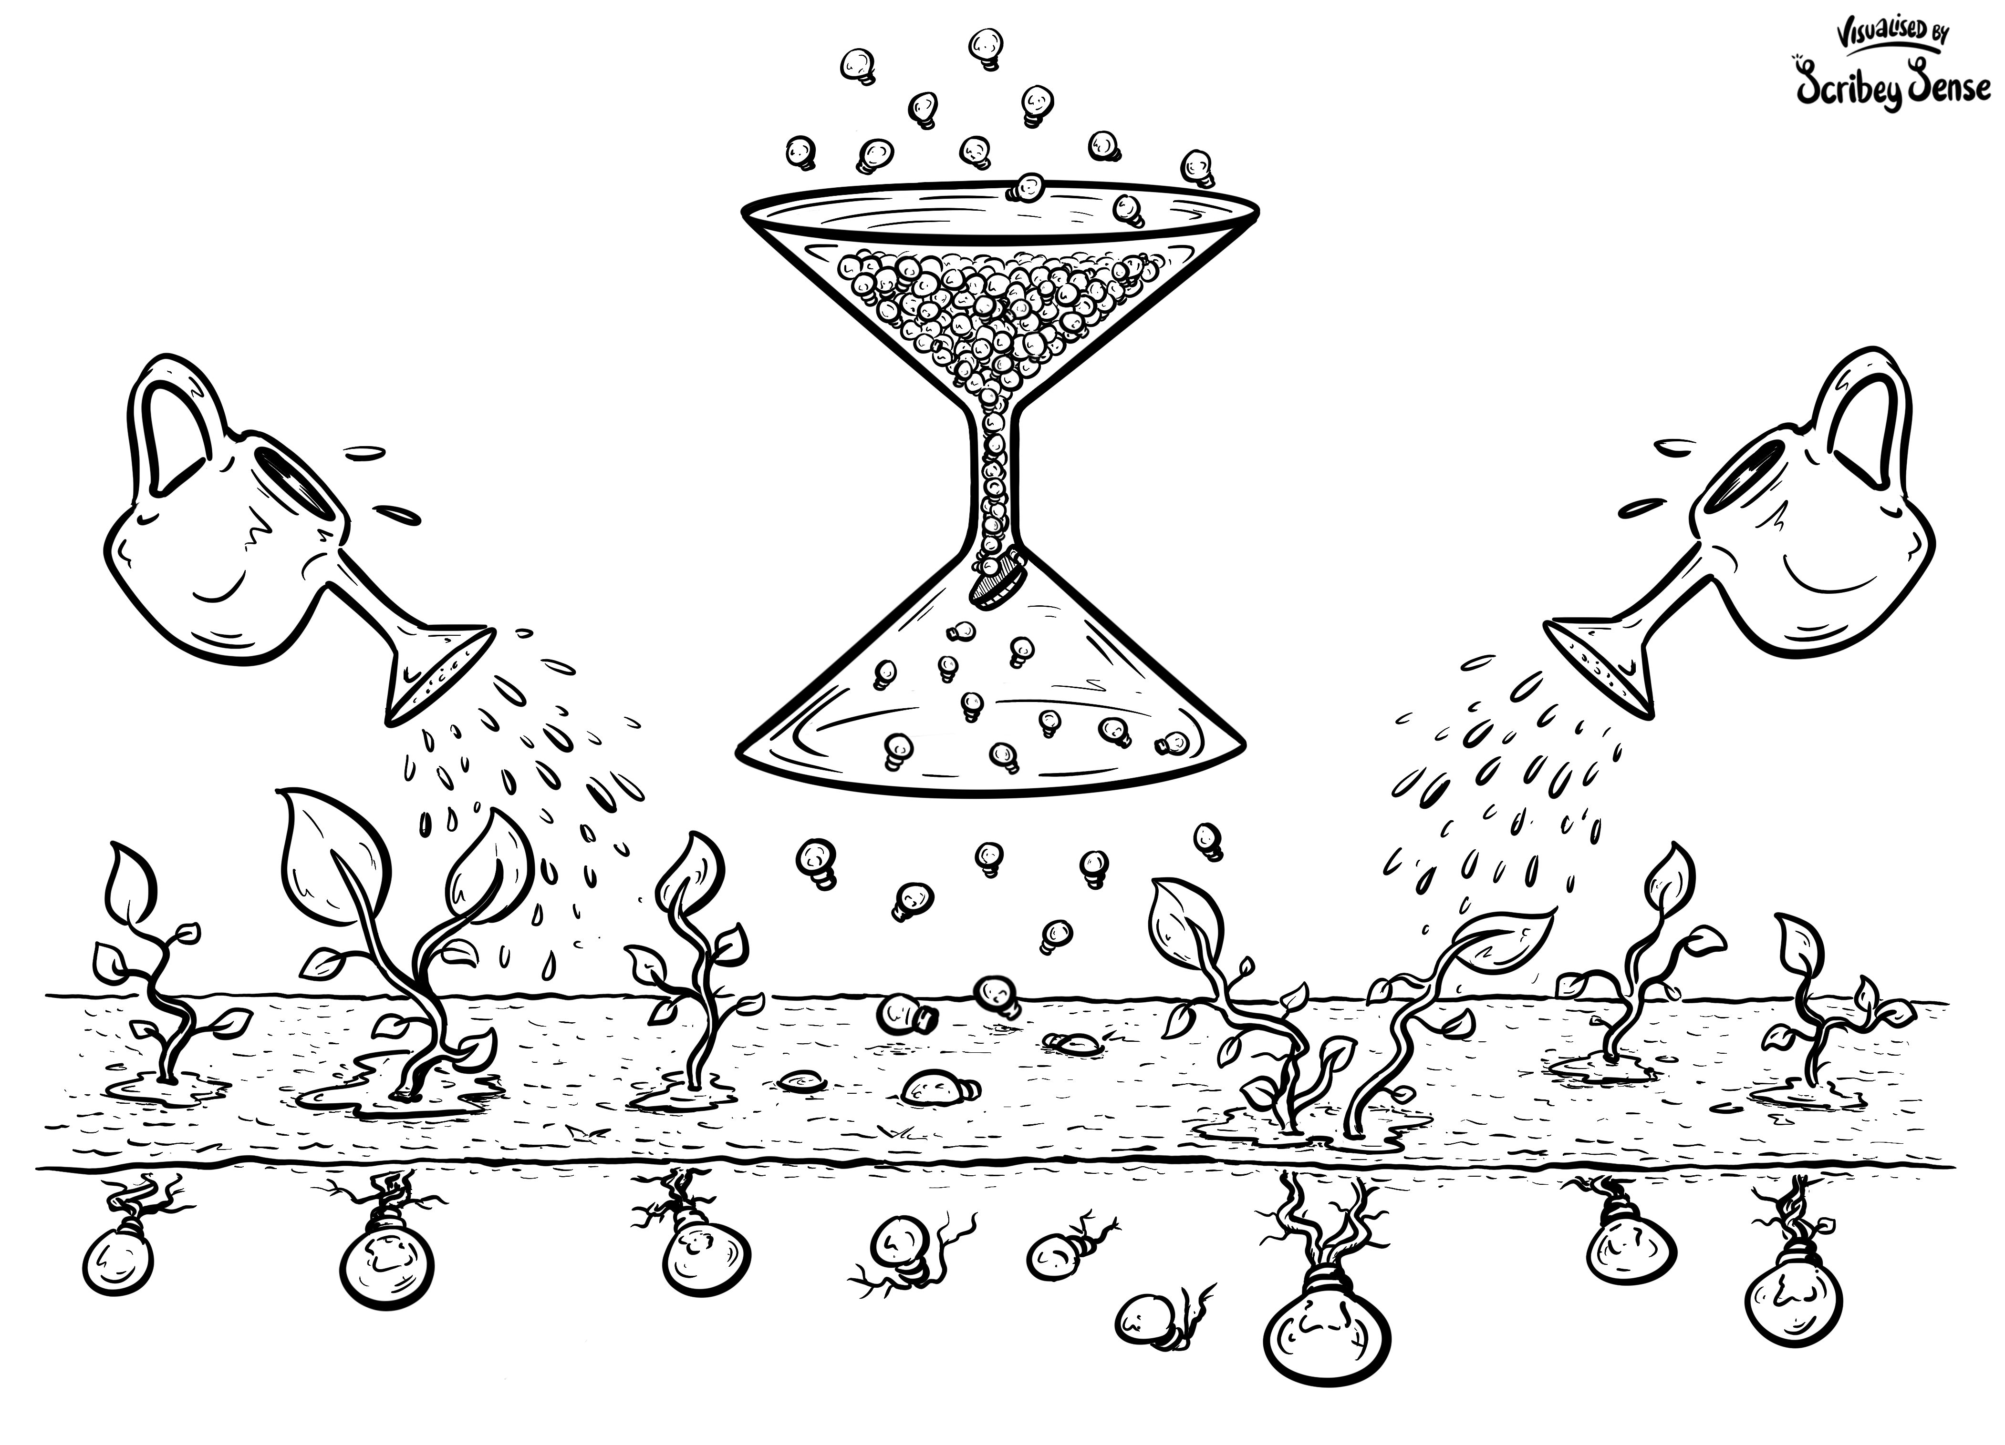
The Model and Key Contributions of External Facilitation
From disciplinary knowledge to viable interdisciplinary research
Explore the theme, transition from disciplinary knowledge into interdisciplinary understanding
Identify untapped opportunities for ambitious, impactful novel research
Develop intellectual content for each novel research opportunity.
Key Contributions of External Facilitation
Purposeful collaborative design
Structured pathways to outcome
Inclusive participation
Focus and Engagement
Notes:
Thank you Liberty will give a little more context to the Community Lab Model and the key contributions of external facilitation
MODEL/ILLUSTRATION
Together LSE and Centre for Facilitation created a three-phase model to help participants progress from disciplinary knowledge to contributing to viable interdisciplinary research.
Looking at the funnel at the top:
participants work in in small interdisciplinary groups – structured questions help groups focus conversations and transition…….from disciplinary knowledge and vision…….To understanding the theme challenges……. To recognizing untapped interdisciplinary research opportunities
The stem of the funnel:
Where we bring together the untapped research opportunities identified by each small group…….Ideas are combined which encourages more ambitious, imnovative and impactful research directions to emerge.
The funnel opening encompassing the ground:
The most promising research opportunities are cultivated through interdisciplinary collaboration. We look to distil robust intellectual content……..identify novel research concepts and form collaborations. Theopportunitites take root and grow.
KEY CONTRIBUTORS OF EXTERNAL FACILITATION
Purposeful collaborative design – joining up facilitators, Theme Lead and Professional Services expertise to create a theme relevant workshop
Structured Pathway to outcomes - designing an agenda that flows (the ‘what and why’) and the ‘how’ - the methodology and the carefully crafted questions to keep conversations engaging and productive
Inclusive Participation – its’ essential that diverse voices contribute equally……. which means that an environment for listening has to be fostered. This is a key consideration in both the design and theCommunity Lab where facilitators closely observe the room and temporarily join a group if we feel we can add value.
Focus and Engagement – it’s the facilitators role to set clear expectations…….maintain momentum…….navigate complexity…..respond to the unexpected……. and driving groups towards clear next steps.
I will now hand back to Liberty
4 minutes

Slide 5
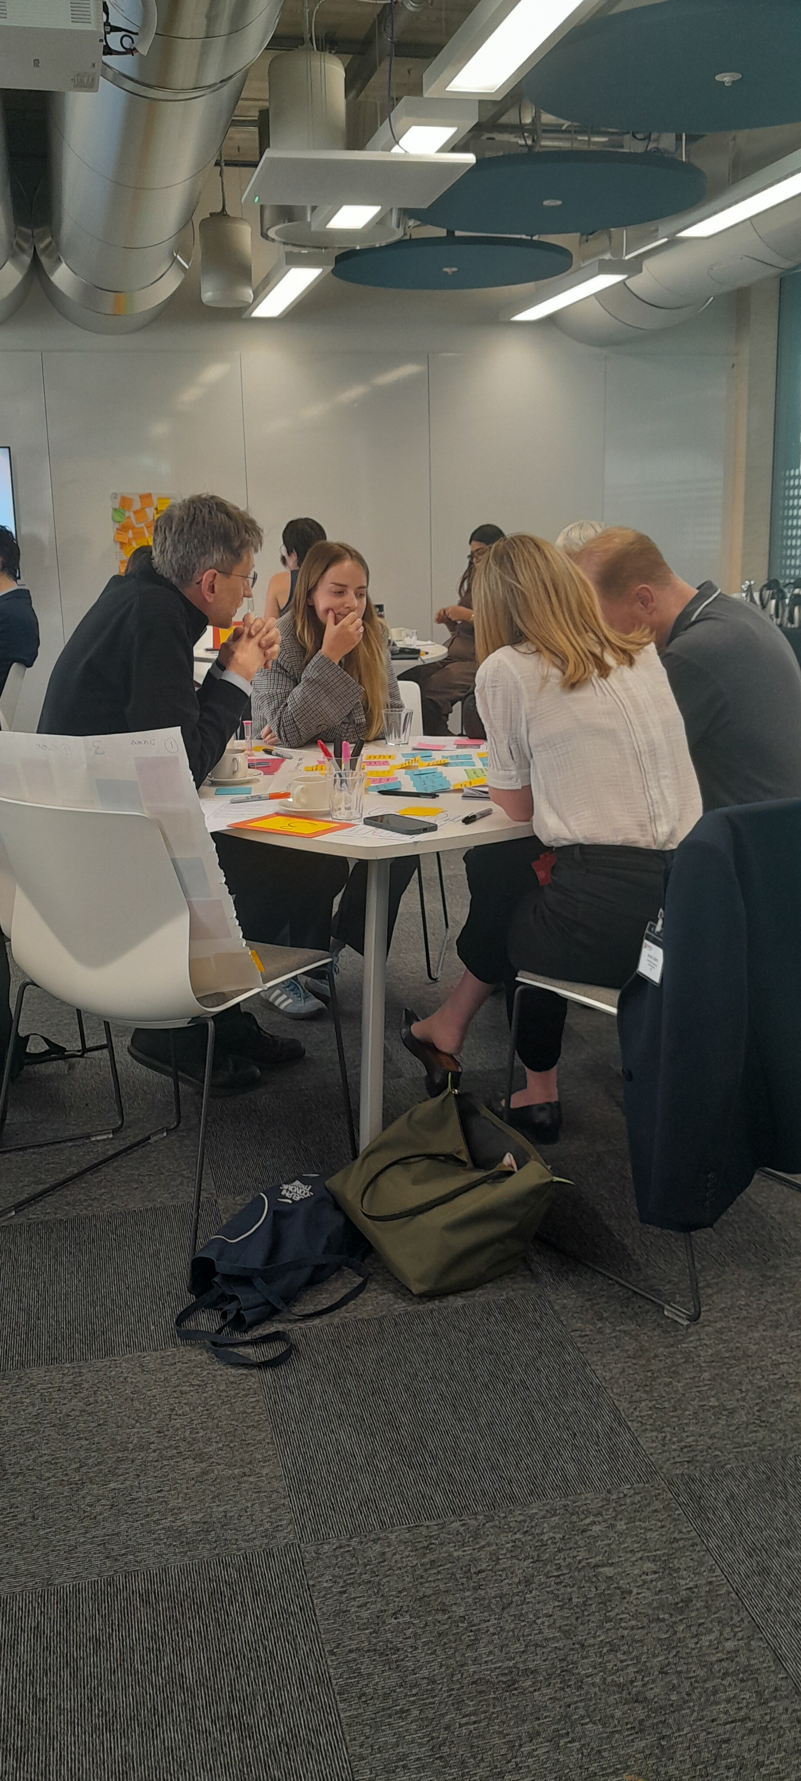
Early outcomes and emerging impact
Metrics:
No. of participants
No. of academic units represented
No. external partners
No of interdisciplinary project concepts developed
No. of funding applications submitted
Feedback from Labs:
“The structure made interdisciplinary conversations feel accessible and productive.”
“easy to connect with other researchers”
“structured and clear”
All feedback responses so far stated ‘agreed’ or ‘strongly agreed’ that the Lab supported cross‑disciplinary conversations.
Additional outcomes:
Stronger institutional insight into emerging areas
New interdisciplinary relationships
Clearer support pathways
Increased visibility of professional services expertise
More labs driving more interdisciplinary topics
Notes:
1.5 minutes

Slide 6
Framework to apply Community Labs to your own institutional context
1. Identify the Purpose
2. Design
4. Facilitate
Start with identifying the genuine interdisciplinary challenge
Design intentionally for trust and inclusion
Involve professional services from the beginning
Use structured facilitation rather than informal networking
Develop clear follow-up pathways before the event
3. Collaborate
5. Pathways
Key Takeaways
The model is intentionally practical and adaptable across institutional contexts
Treat collaboration as an ongoing process, not a one-off intervention
Relationships, trust and facilitation were just as important as research expertise
Notes:
1.5 minutes

Slide 7
Final thoughts for the session and Q&A
Final Reflection: Interdisciplinary collaboration depends not only on expertise and funding, but on intentionally designed environments that support trust, participation and sustained community-building
Let’s collaborate! We welcome opportunities to continue conversations and cross-institutional activities on this - do connect with us here at ARMA 2026 and afterwards:
Presenter contact details:
Dr Anouska Nithyanandan – Head of Research Development, LSE a.nithyanandan@lse.ac.uk
Miss Liberty Gibson – Senior Research Development Manager, LSE l.gibson4@lse.ac.uk
Ms Lucy Brownsdon – Director, Centre of Facilitation lucybrownsdon@centreforfacilitation.com
We are also on LinkedIn
Thank you for listening
Notes:
30 seconds

