Slide 1


ARMA EDI Advisory Board Session -
From Principles to Practice: Lessons from Co-Designed EDI Interventions in Research Management
Lizzie Ranson, Durham University
Jessica Johnson, Royal Holloway, University of London

Slide 2



Agenda
Introduction to the ARMA Equality, Diversity and Inclusion (EDI) Advisory Group
EDI in research and innovation – lessons learnt from two institutional/personal perspectives
Conclusion
AI image by Roman Tiraspolsky; Adobe Stock Standard Licence
#ARMA2026
Notes:
Lizzie

Slide 3
Introduction to the ARMA EDI Advisory Group
Remit
What we do in practice
ARMA EDI Progress: Advise on EDI considerations and practice across ARMA strategy, policy and member engagement
External engagement: Leverage our sector leadership and lived experience to embed EDI across research policy
ARMA Member experience: Reviewing ARMA EDI data and issues raised and embedded inclusivity for ARMA events
Established in 2019
Advisory capacity on EDI considerations across ARMA operations
Direct feed into ARMA Board
Diverse membership – career stage, institution type, job role, EDI lived experience
#ARMA2026
Notes:
Lizzie

Slide 4
ARMA EDI Advisory Group Membership
Sophie Collet (Bristol) – Group Chair (ex-officio) & ARMA Deputy Chair
Alasdair Cameron - ARMA CEO
Lennie Foster (Loughborough)
Jess Johnson (Royal Holloway, University of London)
Mani Nayaranan (Queen’s University Belfast)
Julie Northam (AECC University College)
Lizzie Ranson (Durham)
Natalie Wall (King’s College London) - ARMA Global Majority Special Interest Group Chair
→ Contact the group via Jo Somerville at ARMA, or reach out to any individual members
#ARMA2026
Notes:
Jess

Slide 5
EDI in Research and Innovation – Two institutional perspectives
Greater importance placed on EDI and research culture than ever before (REF2029, QR Research Culture funding etc.), but sector-wide challenges remain
Solutions will sit at multiple levels and collaboration and sharing best practice are increasingly important
This session brings together two complementary perspectives on EDI and learnt lessons:
1) EDI in applications toolkit (Lizzie/Durham)
2) The micro-level (Jess/Royal Holloway)
#ARMA2026
Notes:
Jess

Slide 6


Part 1: The Intervention Project
“Structural changes are needed to ensure selection processes are fully supportive and inclusive of under-represented individuals”
#ARMA2026

Slide 7




EDI In Application Processes Toolkit
Why?
Need for structural change​ in processes to move towards an inclusion culture
Addressing increasing administrative burden through efficiency
Who?
PS + Academic co-leads with EDI intervention experience
How?
£££ Durham EDI Fund (PVC EDI) + Research Culture Fund + Impact Acceleration Account
→ employed part-time research assistant & student intern
#ARMA2026

Slide 8
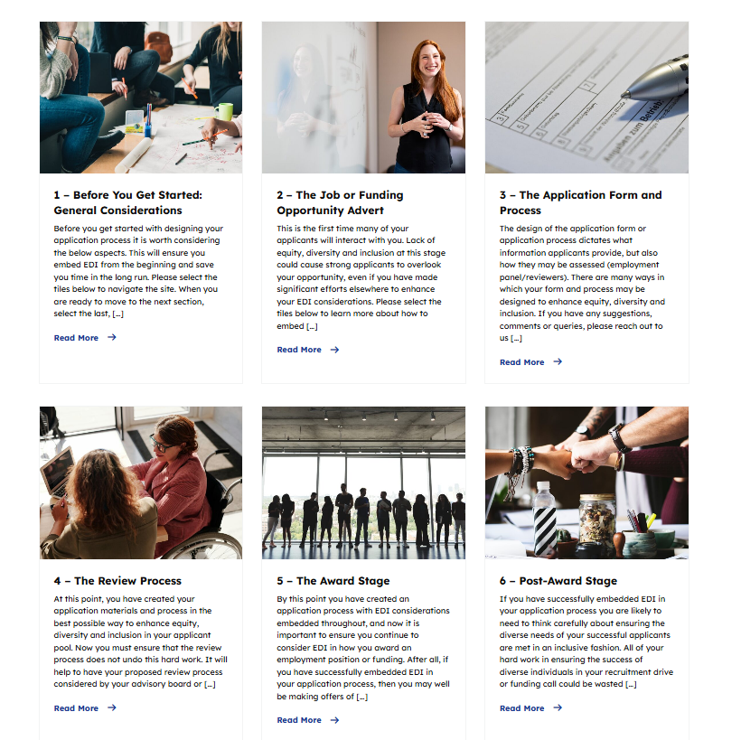
EDI In Application Processes Toolkit
What?
https://editoolkit.webspace.durham.ac.uk/
Step-by-step guide
Embeds EDI considerations and best practice into application processes -
e.g. internal funding, internal demand management, citizenship roles, jobs
Extensive practical tools and resources
#ARMA2026

Slide 9

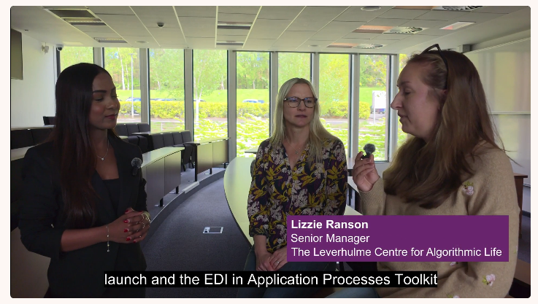

EDI In Application Processes Toolkit
Launched Jan 2026
Endorsed by Durham UEC
EDI Fund spotlight video
User feedback
Living resource
Impact so far:
“I'm using the EDI toolkit to update our processes and have finally got buy in for anonymous applications - so a huge thank you from me for the toolkit and inspiration!”
edi.toolkit@durham.ac.uk
#ARMA2026

Slide 10

Part 2: The Micro-Lens
“A strategy is only realised through everyday decisions, practices and behaviours.”
“By anchoring EDI into everyday practice […], organisations can secure long-term success in an increasingly diverse world.”
(Alyson Malach, Equality and Diversity UK)
#ARMA2026

Slide 11

What this means for EDI at research institutions
The local: Importance of balancing institutional research strategy and policy with practical allyship and action – top-down and bottom-up.
Individual research support professionals play a key part in translating, delivering and challenging institutional practice.
Inclusion is shaped not just by policies, but through individual interactions and events.
So what does this look like in practice...?
AI image
#ARMA2026
Notes:
Strategies live and breathe through those ‘on the ground’.

Slide 12
My experience of embedding EDI and allyship in everyday research support
In my roles as Research Facilitation Officer/Development Manager (Surrey/Royal Holloway)
Reflection: ‘EDI sabbatical’ – mini project into EDI and underrepresentation in engineering and physical sciences
Connection: co-launched and chaired Surrey’s first Women’s Network; collaboration with other EDI networks, e.g. Women’s Engineering Society
Action: My own action: Embedding EDI and responsible assessment into internal panels; diversifying internal and external reviewer colleges; individual allyship
#ARMA2026

Slide 13
My experience of embedding EDI and allyship in everyday research support continued
Internal and external lobbying: EDI recruitment targets for internal major fellowship scheme; liaising with funders for more inclusive processes
Responsive Mode: The landscape will keep changing. What issues are we encountering in the everyday?
Lobbying for disability inclusion, e.g. for EU brokerage events.
Challenging institutional policies on maternity cover payments.
#ARMA2026

Slide 14
Connecting policy to practice – four types of action
What can you do?
Reflection: Build your awareness through active listening and learning
Connection: Build resilience and engagement by using or growing your networks, including staff EDI networks
Action: Embed your EDI processes and learning into day-to-day research and innovation support
Responsive Mode: How are things working out in practice? Be vigilant, get feedback and step in where barriers arise.
#ARMA2026

Slide 15
Amplifying the voice of change
We believe that EDI in research is best promoted through a mix of both strategic and micro-level approaches
Best practice sharing at all levels is crucial for change - please reach out to the ARMA EDI Advisory Board with ideas / concerns / case studies / questions…
Contact details:
Jo Somerville, ARMA EDI Advisory Board secretary, jo.somerville@arma.ac.uk
Jess Johnson, Research Development Manager for Arts, Humanities and Social Sciences; Royal Holloway, University of London, jessica.johnson@rhul.ac.uk
Lizzie Ranson, Senior Manager, Leverhulme Centre for Algorithmic Life, Durham University, elizabeth.a.ranson@durham.ac.uk
Thank you
#ARMA2026
Notes:
Jess

Slide 16

Thank you
Any questions?

