Slide 1



From Administrator to Investigator: How Research Managers Can Lead Metascience Studies
Dr Christopher Daley, Head of R&I Evidence and Analysis, LSE

Slide 2
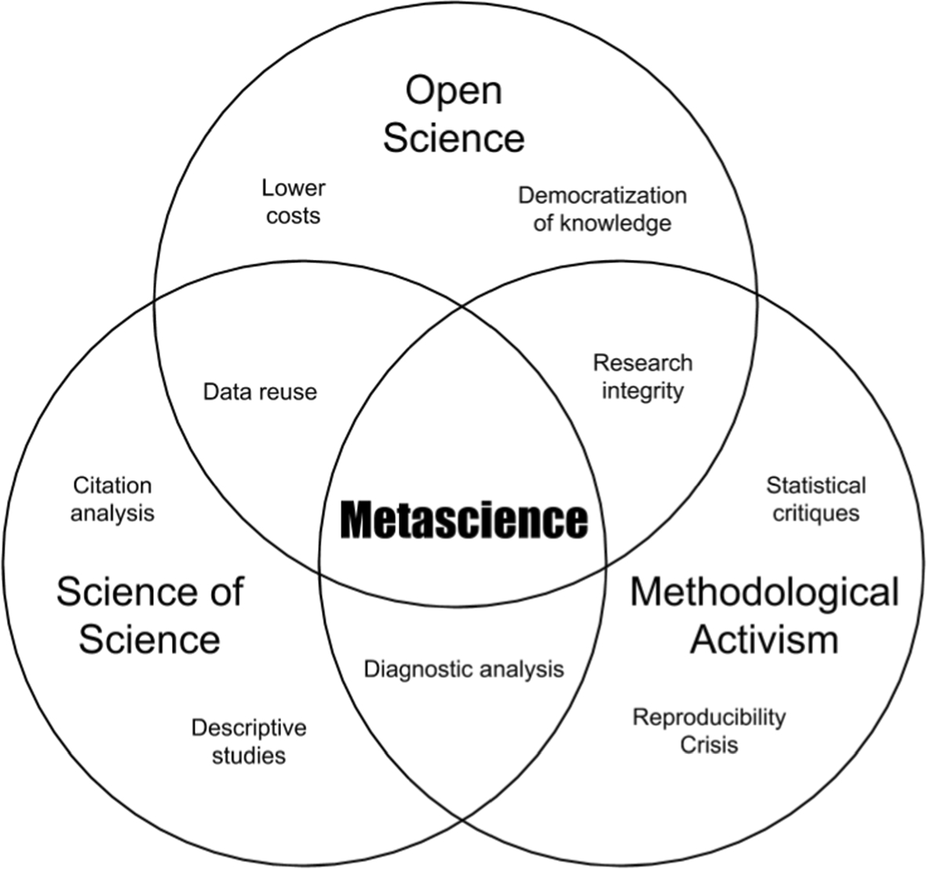

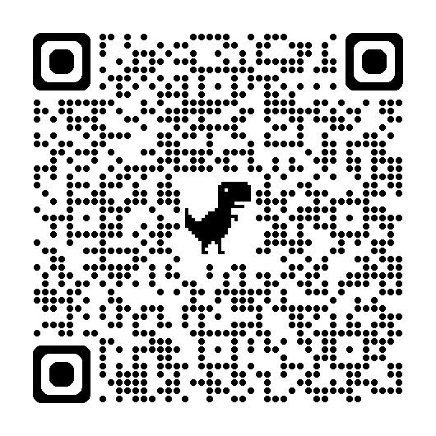
What is metascience?
Broadly defined: “application of robust methods to the analysis of research systems, cultures and decision-making” (Wilsdon et al, 2025).
Synonyms/competing terms: metaresearch, science-of-science, research-on-research.
Image: Peterson and Panofsky (2023)

Slide 3
“…rather than a strictly intellectual movement, metascience has both intellectual and policy dimensions. Thus, it represents what Epstein (2008:21) has referred to as a “hybrid coalition” in which experts, bureaucrats, and policymakers are drawn together”.
Peterson, D., Panofsky, A (2023). Metascience as a Scientific Social Movement. Minerva 61, 147–174 (p.152). Online

Slide 4
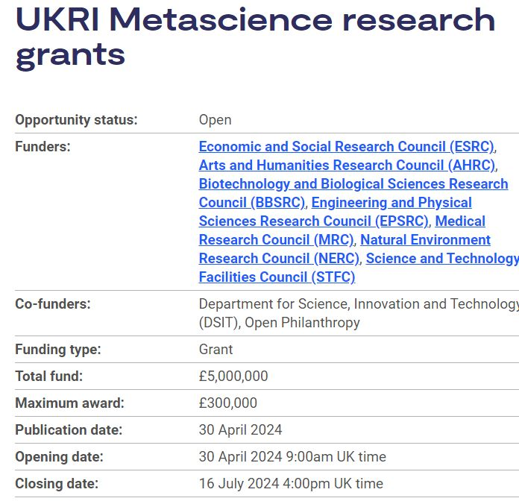
The Role of Research Managers within Metascientific Studies
“Within the burgeoning metascience community, there are two characteristic groups:
Researchers using rigorous social scientific methods (for example, experiments and qualitative, or quantitative, data analysis) to study the social practice of science itself.
A community of practice united by an interest in designing, implementing, and evaluating innovative modes of science funding and delivery.”

Slide 5
Research Managers as Practitioner Metascientists
When we think about the areas covered by metascience, we can see that they often align directly with the work of RMAs who may even be undertaking a form of practice-focused metascience in their own institutions.
Area | Example activities
Policy analysis and insights | Interpreting government/funder policies to understand what they may mean for specific groups or organisations
Evaluation and monitoring | Examining the effectiveness and impact of internal R&I funding schemes, assessing institutional research cultures, evaluating research security risks
Providing the evidence base for strategic decision-making | Supplying empirical information to support strategic initiatives (grant application and award data, impact activity, mock REF exercises)
Evidence based advocacy | Producing reports which demonstrate the value of particular disciplines/approaches
Institutional planning | Horizon scanning to support investment strategies, reporting on research strengths and gaps
Open science advocacy | Library scholarly communication teams and bibliometric analysis

Slide 6
Academic rigor and methodologies
Operational expertise
Notes:
The ultimate aim would then be for transformative projects which combined rigorous academic methodologies with operational expertise to significantly enhance the R&I landscape.

Slide 7
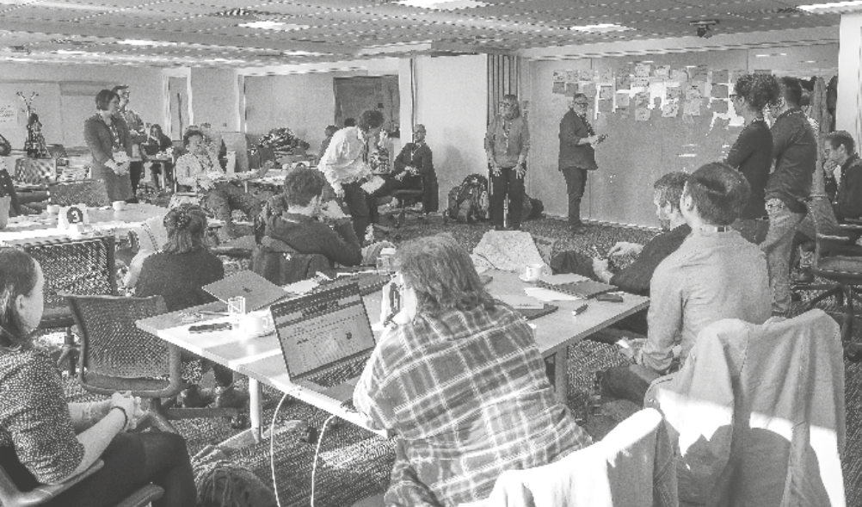

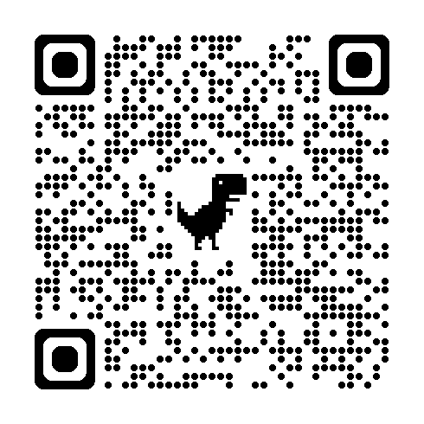
Experiences from the 2025 UKRI Data for Metascience Sandpit
Organised by the UK Metascience Unit which is a joint DSIT/UKRI initiative
Held in February 2025 over 4 days (2 in Swindon, 2 online)
28 participants, heavily skewed towards academics
Participants were provided with access to UKRI administrative grant data throughout the sandpit
Stakeholder speakers included: Molly Morgan-Jones (British Academy), Charlotte Deane (EPSRC), Sophie Collett (ARMA), Ben Johnson (former government adviser).
Total funding available: £1 million
Notes:
Talk about the structure – two days with lots of interactive work, ideation sessions etc. Then two days preparing pitches. Final day concluded with pitches to a panel to determine whether you would make it through to full funding application.

Slide 8
Research Manager-Led Project
What is unique about responsive mode funding?
PROJECT SUMMARY
PROJECT TEAM
DURATION & VALUE
Investigates and maps the unique aspects of responsive mode grants compared to other funding modes, analysing their size, outputs, diversity, and impacts to inform future funding strategies and policy decisions.
Dr Christopher Daley PI, LSE
Dr Rosa Filgueira Co-I, Edinburgh
Dr Xavier McNally Research Officer, LSE
Dr Laura Moran RA, Edinburgh
Spyro Nita RA, Edinburgh
£200,000
12 months

Slide 9
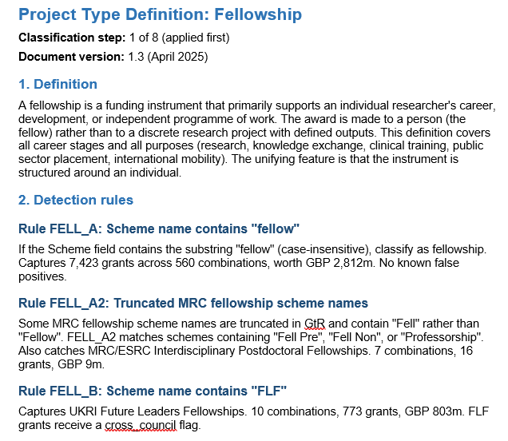
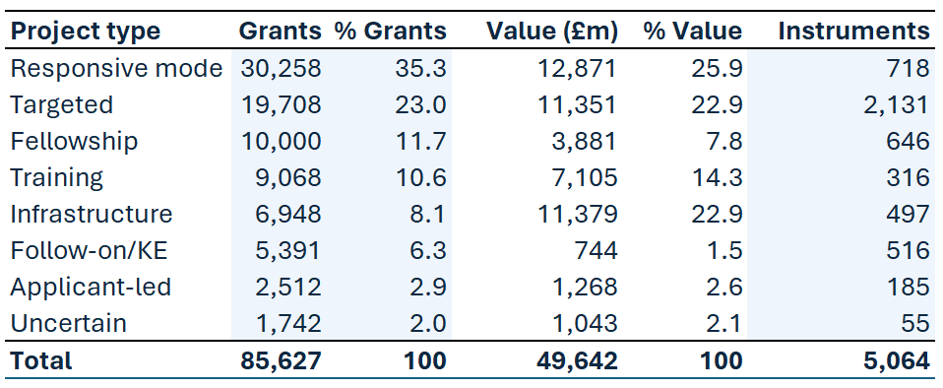
Research Manager-Led Project
Our project involved developing a robust classification system for the different types of funding instruments within UKRI’s portfolio. This was done to combat inconsistencies in naming conventions across councils in UKRI’s historical administrative data.

Slide 10
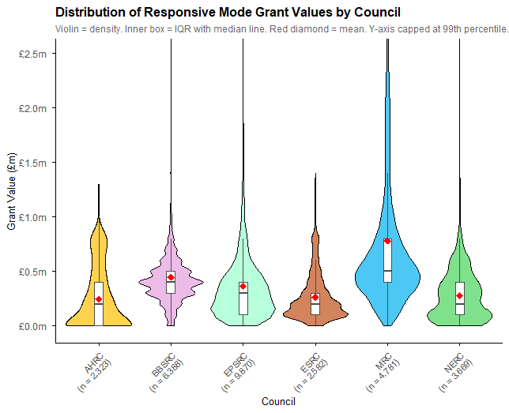
Research Manager-Led Project

Slide 11
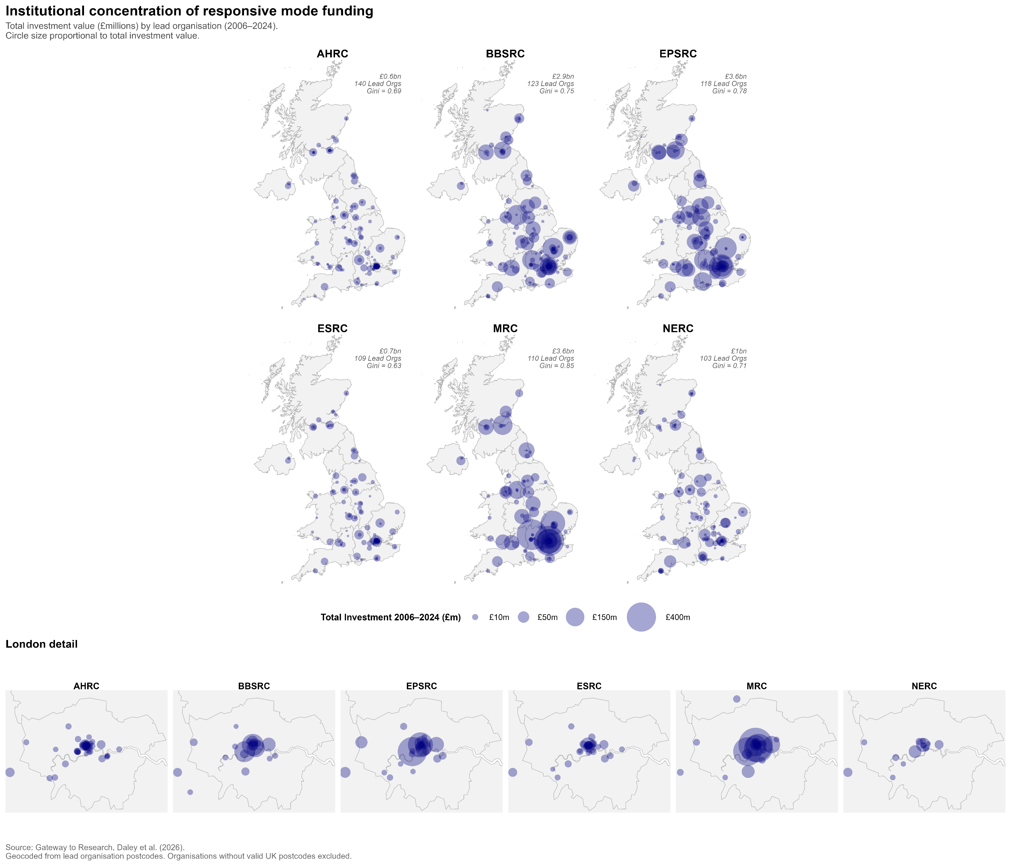
Research Manager-Led Project
Notes:
Lead organisations in London alone (£2.8bn) received more responsive mode funding over the study period (2006-2024) than those in Scotland, Wales, and Northern Ireland combined (£2bn). However, London and the South East is the location of approximately a 1/3rd of all UK universities.

Slide 12
Little recognition of metascience in career pathways
Lack of time/resource in the role for research
Recognising Barriers
Visibility and proactive inclusion in metascience narrative
Jobs focused on service delivery
Culture of undervaluing practitioner insights
Unclear avenues for dissemination
Collated from survey data collected by the ARMA Metaresearch SIG in May/June 2025

Slide 13
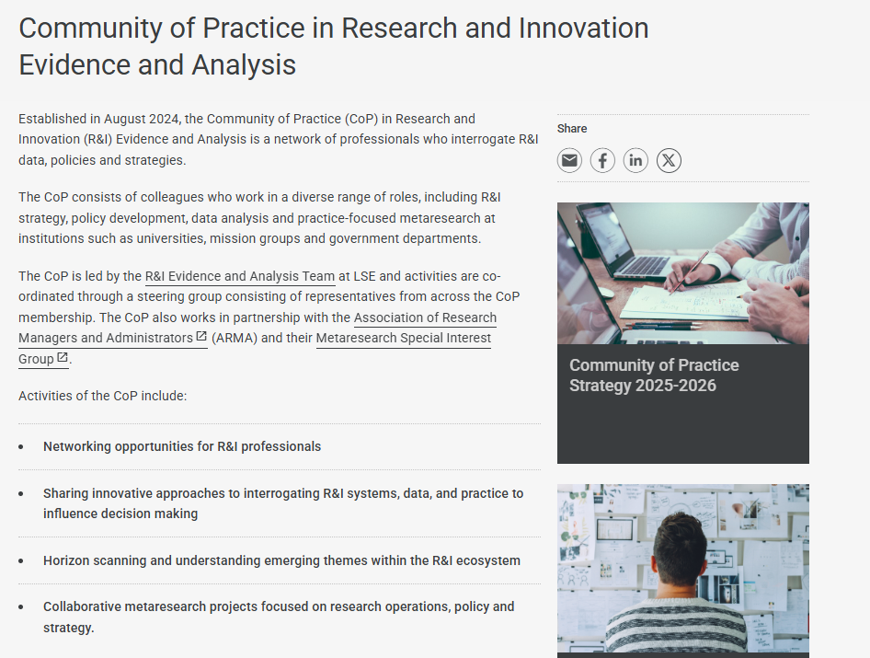
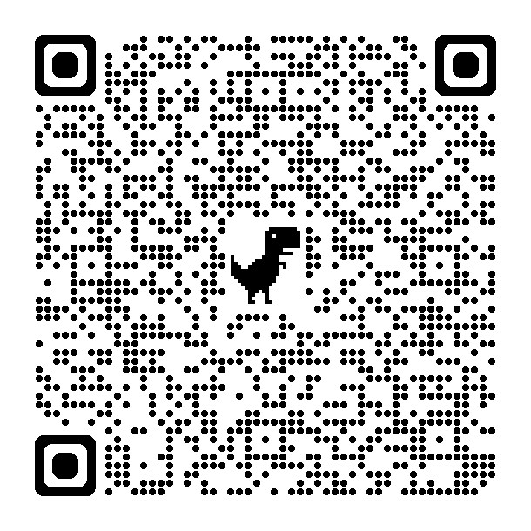

How to Get Involved
Think about the ways metascience work can compliment your role.
Look at grant funding, which may help overcome time barriers (e.g. by costing in RA/postdoc support).
Are there academics at your institution who are interested in this area, or other RMAs? Potential to form local institutional groups.
Engage with the UK Metascience Unit and wider metascience community (e.g. conferences, seminars).
Engage with the ARMA Metaresearch SIG and projects such as Research Professional Futures.

