Slide 1


From Spreadsheets to Sustainability: Building the Foundations for Financially Resilient Research
Who Wants to Fill In Spreadsheets?
Transforming Multi-Partner Innovation Funding
Carl Samuel and Steve Hall
Newcastle University
Notes:
How we created a platform that transformed how we handled multi-partner innovation funding

Slide 2

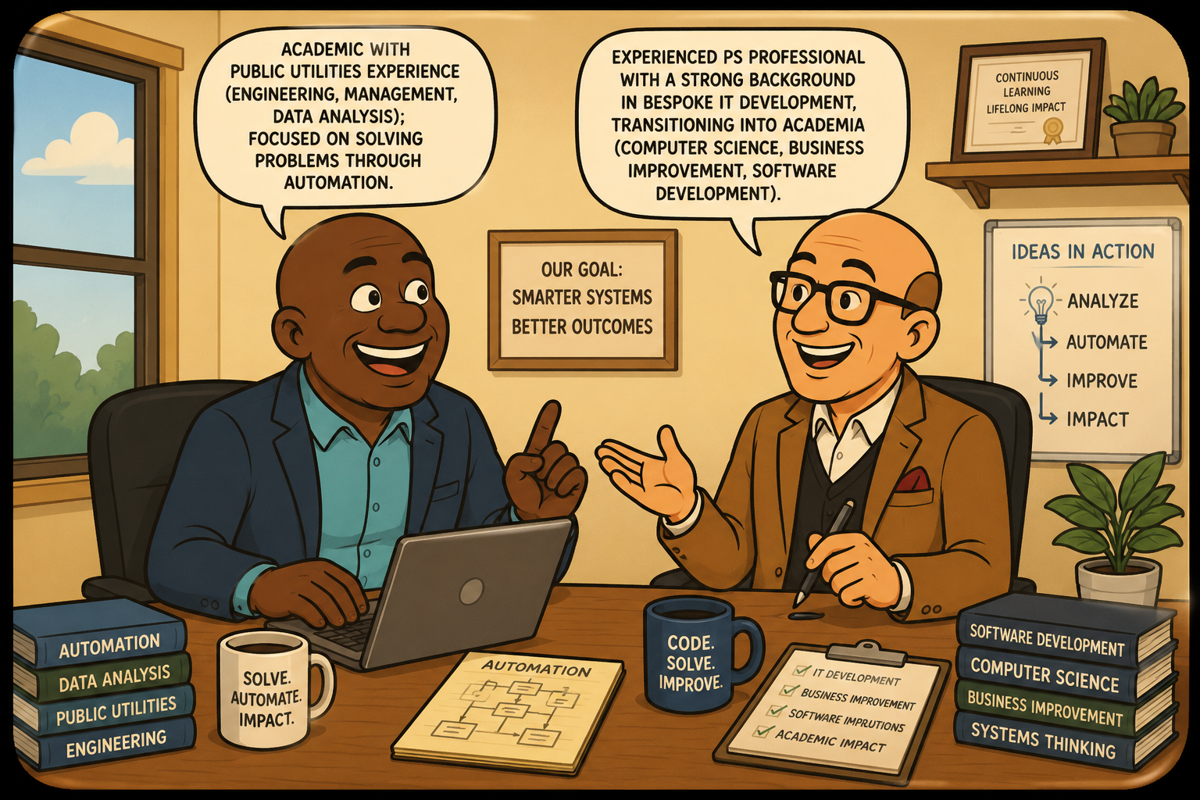

Introductions
Carl Samuel:
Academic with public utilities experience (engineering, management, data analysis); focused on solving problems through automation.
Steve Hall:
Experienced PS professional with a strong background in bespoke IT development, transitioning into academia (Computer Science, business process improvement, software development).
Mutual interests:
  Business process improvement
  IT based solutions
  Whingeing about how things could be better AND discussing application-specific solutions
#ARMA2026
Notes:
Introductions (Carl and Steve)
Mutual interests
Spreadsheets versus relational databases
Both have their uses and should be deployed accordingly

Slide 3

How Efficient Are Our Funding Management Processes?
How do you currently manage and report project funding allocations?
Do you use different management or reporting processes for different funders?
Approximately how many hours per week do you spend on project funding management activities?
How long does it typically take to complete a periodic report for a funder?
#ARMA2026
Notes:
Steve and I found that an enormous amount of time was being spent to generate simple reports for funders and that some pre and post award processes could be automated.
Because your time is important we would like to find out about how much time you spend processing , managing and reporting on grant funding i.e. impact accelerator grant funding and the like?
We plan to analyse this data later with the view of attempting to quantify the time/effort saved using our system as opposed to the manual system.
Can we have the poll now please?
Q1: How do you currently manage and report project funding allocations?
a. Paper or email-based processes with manual reporting
b. Spreadsheet-based management (e.g. Excel) with manual reporting
c. Dedicated or proprietary software for funding management and reporting
Q2: Do you use different management or reporting processes for different funders?
a. Yes
b. No
c. We currently work with only one funder
Q3: Approximately how many hours per week do you spend on project funding management activities?
a. 1–8 hours
b. 9–16 hours
c. 17–24 hours
d. 25–32 hours
e. 33–40 hours
Q4: How long does it typically take to complete a periodic report for a funder?
a. 1–3 days
b. 3–5 days
c. 1–2 weeks
d. 3–4 weeks
e. More than 1 month

Slide 4
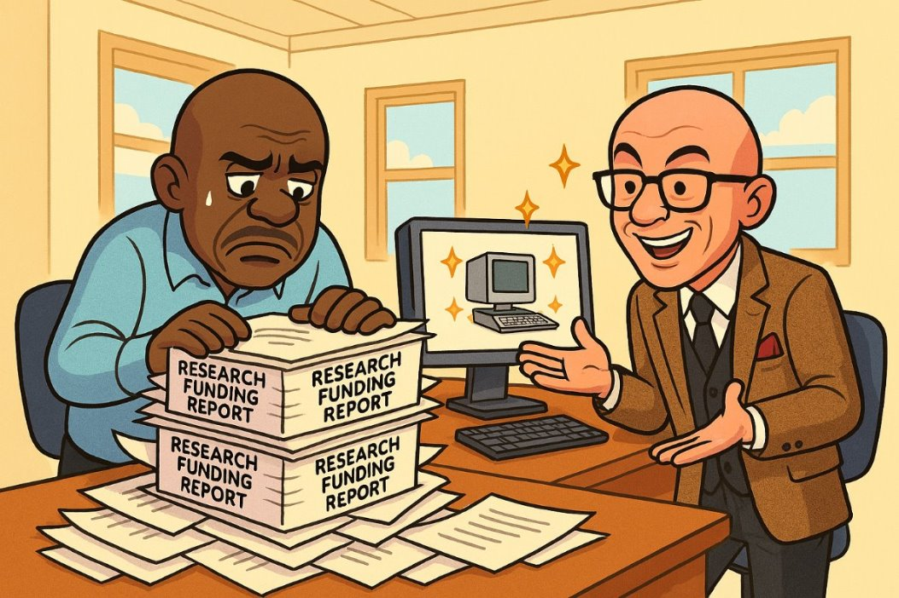
The Backstory
From Fragmented Reporting to Structured Data
Managed £3M EPSRC IAA reporting (56 projects) using Word forms and Excel, leading to inconsistent data capture and poor alignment with UKRI requirements
Manual portfolio reporting took months, limiting scalability and delaying ad‑hoc insights (e.g. net zero projects)
UKRI harmonisation increased demand for standardised, consistent individual and aggregated metrics
#ARMA2026
Notes:
Our experience covers a period from 2020 to present day
Initially, reporting was extremely time-intensive—reviewing project applications written in MS Word and follow-up reports manually to extract usable data to be later analysed in MS Excel.
For example processing 56 projects scalable platform took 2–3 months using Word and Excel, and the results were often inconsistent due to different interpretations of KPIs.
Metrics were difficult to standardise, requiring manual judgement and making the process error-prone and hard to scale, making reporting challenging.
The challenge grew as 2 years on, I had 105 projects to process, and increasing expectations for consistent, cross-faculty reporting.
I therefore designed and implemented structured fillable pdf forms based on a database paradigm, that was processed using R-based scripts (Prototype 1) which reduced reporting time to just 2 weeks—demonstrating clear efficiency gains and the need for a.

Slide 5

“Easy to use, have a metrics library, facilitate automation, have memory and be scalable”
#ARMA2026
Notes:
In early 2024 Steve and I determined that a more refined platform should be “Easy to use, have a metrics library, facilitate automation, have memory and be scalable”
Some design requirements of our platform included:
A simple, intuitive user interface with reliable, repeatable reporting (current & historical)
Needed to be deployed quickly
A customisable KPI library, tailored to the expectations of internal and external stakeholders
Validate metrics with non-experts to ensure resulting reports will be clearly understood by all audiences
A warning that poor or unclear metrics lead to an unfit design → start with what the reporting objectives are first
A design that has a modular “bolt-on” functionality without disrupting existing data structures (ability to adding more tables/columns (fields if required).
This feature was subsequently validated through the successful implementation of the NESCA (2025) and more recently, GBC grant (2026).

Slide 6
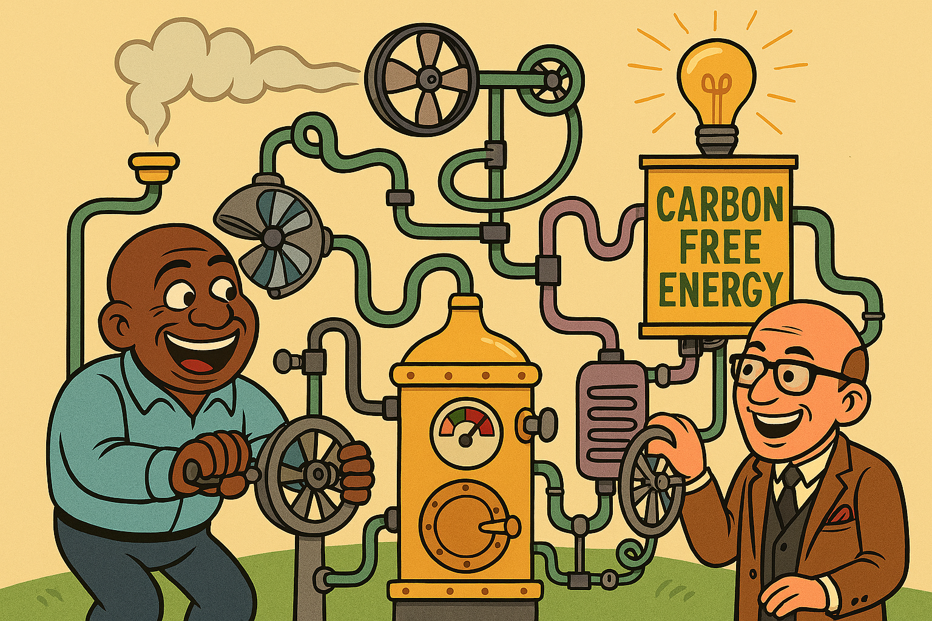
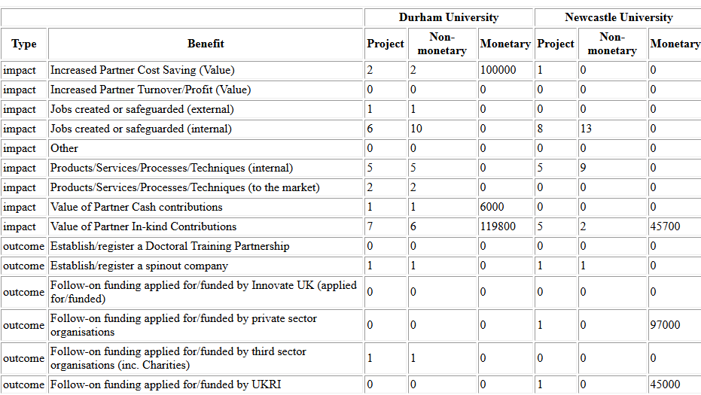
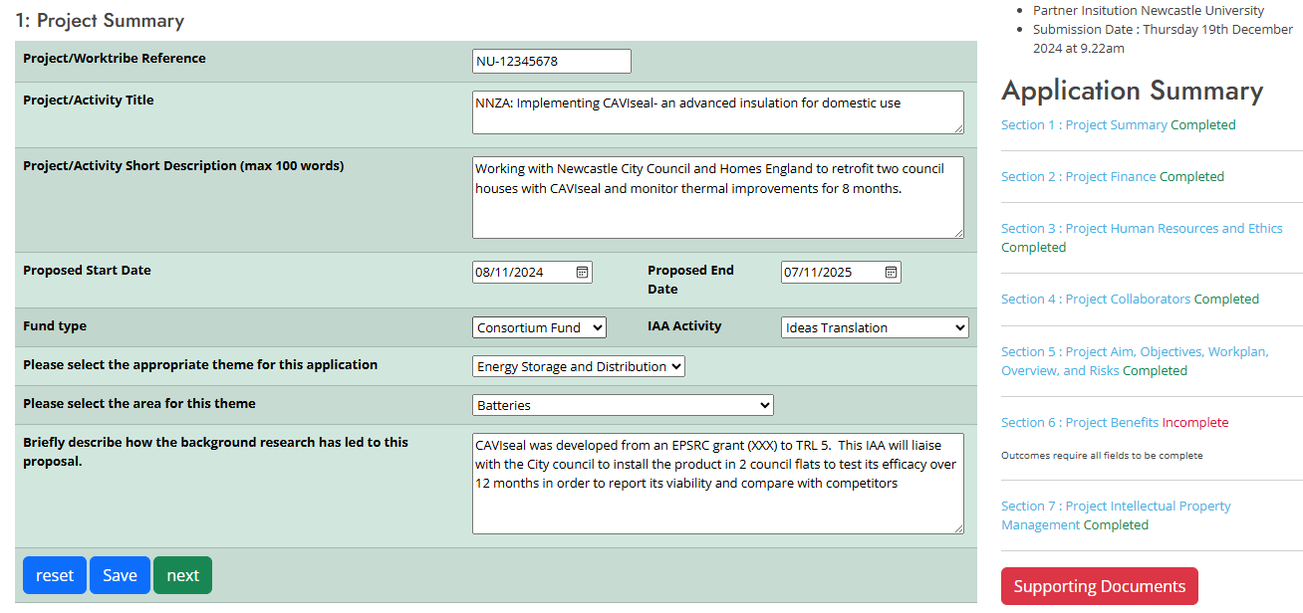
Prototype 3: The Northern Net Zero Accelerator Grant Platform
The NNZA is a UKRI‑funded impact accelerator translating net‑zero research into place‑based impact across the North East, Teesside, and Humber. Six partner universities involved- led by Newcastle University (www.nnza.ac.uk)
Key Features
Application and review at scale
Comprehensive data capture: Records project HR roles (PIs, CoIs, PDRAs, TTOs, technicians) and collaborator information
Cross‑institutional reporting: Rapid collation of KPIs across all six partners
Customisable reporting
#ARMA2026
Notes:
Platform Evolution & NNZA Delivery
Recalling the prototyping journey:
P1: Relational database + R for EPSRC reporting
P2: Enhanced forms to capture richer data
P3: Scalable, database-driven solution for NNZA (define the NNZA)
NNZA scale & complexity:
6 universities, 250+ academics
4 workstreams, 11 funding schemes, multiple KPIs- based on a user-defined library- must be compiled across all awarded projects from all six university partners
Key Capabilities
Processes high volumes of applications with peer review
Customisable fields, KPIs, and full audit trail
Captures detailed project roles and collaborator data
Enables rapid, cross-institution reporting and insights
Supports tailored reporting for all stakeholders
So much data created –what on earth can we do?

Slide 7



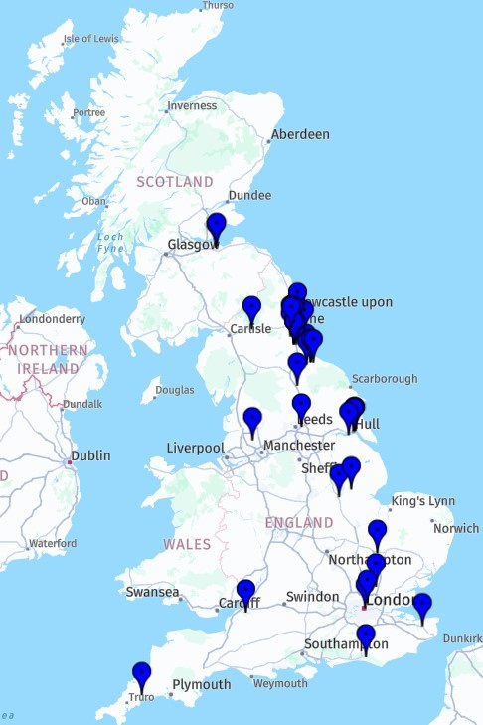
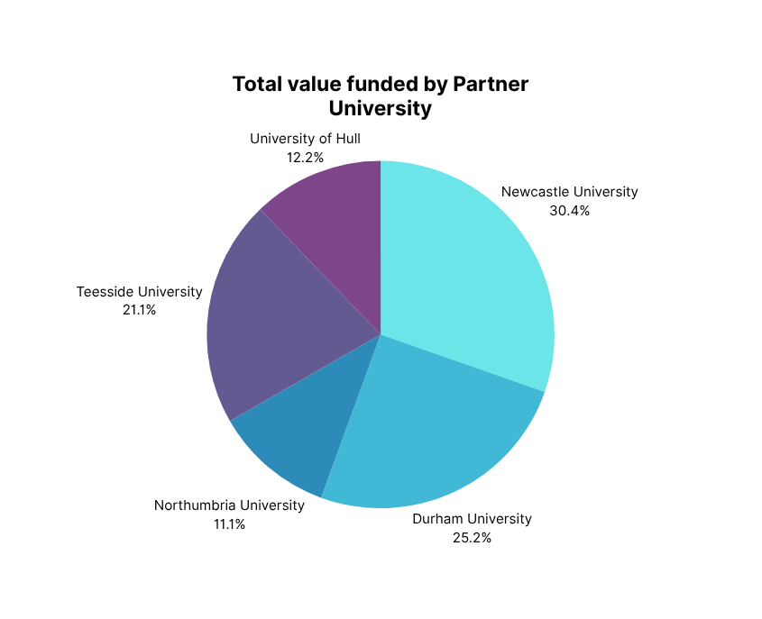


NNZA Projects Workstream at a Glance
Collaborators of funded projects
Platform Activity
Applications Submitted
Total Value
  253 registered on the application platform
    Newcastle University- 66
    Teesside University - 50
    Sunderland University - 32
    Durham University - 39
    Northumbria University -40
    University of Hull - 26
  A Peer Review College of 74 (70 academics and 4 non-HEI members)
    over 236 proposal reviews submitted to date
  With decision- 48/86 successful
    Commercialising Innovation- 14
    Fostering Partnerships - 10
    Ideas translation - 24
  Over 40 collaborators
  Application success rate by scheme:
    Commercialising Innovation- 67%
    Fostering Partnerships - 43%
    Ideas translation - 67%
  Proportion of funded applications by theme
    Energy Storage /Distribution-10%
    Integration: End Use Sectors- 50%
    Low Carbon Energy - 40%
£2,037k (funded applications)
~£330k (Currently awaiting decision by the NNZA FAP)
  Ideas Translation
55% increase
Winner of Newcastle University’s
2026 Engagement and Place Award
Engaging for Economic Benefit
Notes:
Just a taste of what information we can provide fairly quickly.
I now hand over to Steve who will speak about his experience regarding this engagement.

Slide 8

Requirements Gathering or Specifying
Has got to be an iterative process
Dealing with IT developer isn't just listing your requirements
Start at 'then end' and work backwards to the initial input stage
The developer will create a better system if they understand how and the why
Remember 'none functional' requirements such as GDPR, legal requirements, system availability, future support etc.
#ARMA2026
Notes:
"One meeting will not a system make!"
Requirements gathering by a developer tends to be led by the developer
Both parties will need to know exactly where you want to go so that the path there can be mapped properly
In this project requirements were identified together with the process owner giving:
Better understanding of overall system deliverables (in this case reporting)
A chance to develop the interface for better user experience
Allow both parties to suggest/estimate on future developments and therefore design the database so that 'add –ons' can be easily implemented
The Developer will have lots of experience, use their knowledge but remember they need your knowledge to do a 'proper job'

Slide 9

Take Home Points
Key Lessons & Success Factors
Delivered through informal collaboration across roles, driven by shared interest
Existing skills already within HEIs – enable staff to innovate
Success depends on inclusive, cross-team collaboration
Ongoing Development Mindset
Design is never “finished” – continuous improvement is essential
Success drives demand – stakeholder expectations will grow
Be prepared to evolve and expand the solution continuously
#ARMA2026
Notes:
This work came from informal collaboration, with people stepping beyond defined roles due to shared interest.
The key point is that the skills already exist within universities—staff just need the space to innovate.
Collaboration across teams was essential to making the solution practical and effective.
We also learned that design is never finished—once it works, it quickly needs to evolve.
And as soon as you deliver value, demand increases—so ongoing development should always be expected- That should always be considered as a good thing!!

Slide 10

Thank you
Any questions?
Contact Information: Carl Samuel
Email: carl.samuel@newcastle.ac.uk

