Slide 1


Session 3.5 – Research Impact
Part 1 Developing Facilitating and Sustaining Effective Place based Partnerships
Stephanie Bales/Caragh Dewis/Liz Ogilvie
Part 2 Measuring impact
Dr Bridget Sealey
Notes:
Steph -
Context ‘why’ to the challenge at Teeside -move from a transactional grant giving culture to a value driven transformational partnerships increasing value of partnerships in place
Caragh
Model
What changed at the workshop
Steph chip in

Slide 2
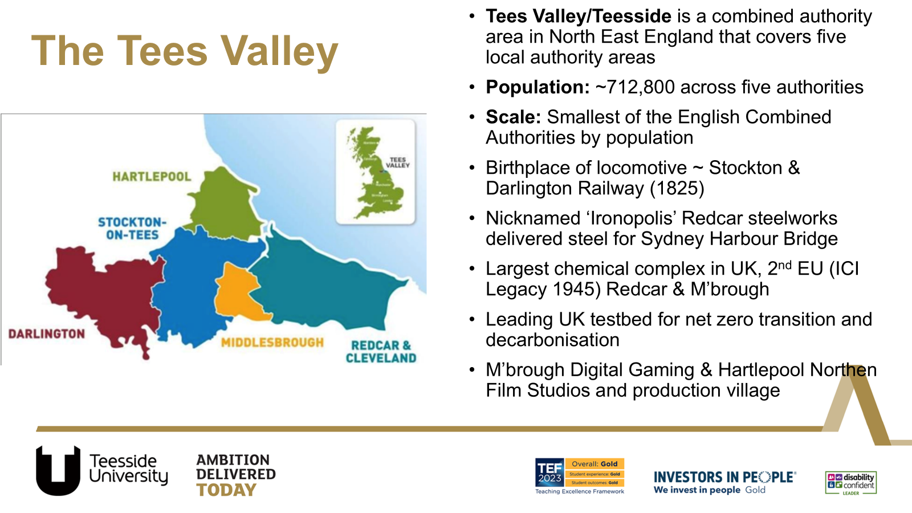

Slide 3
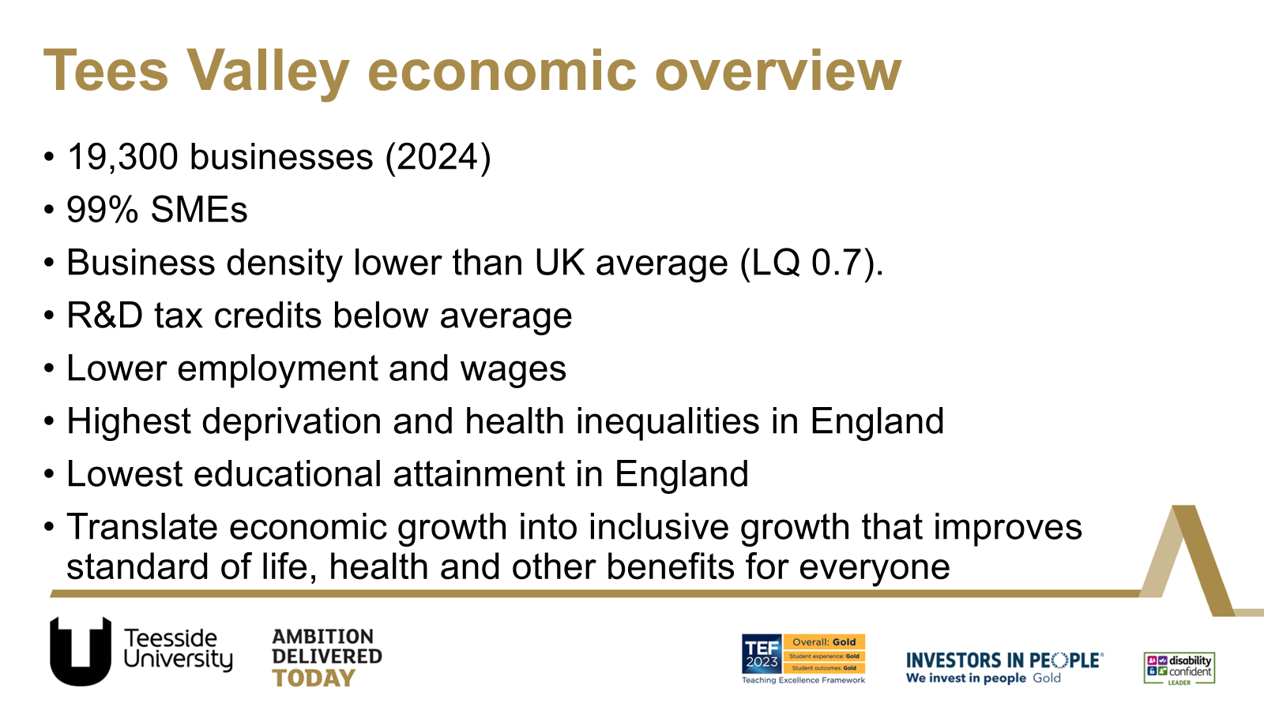

Slide 4
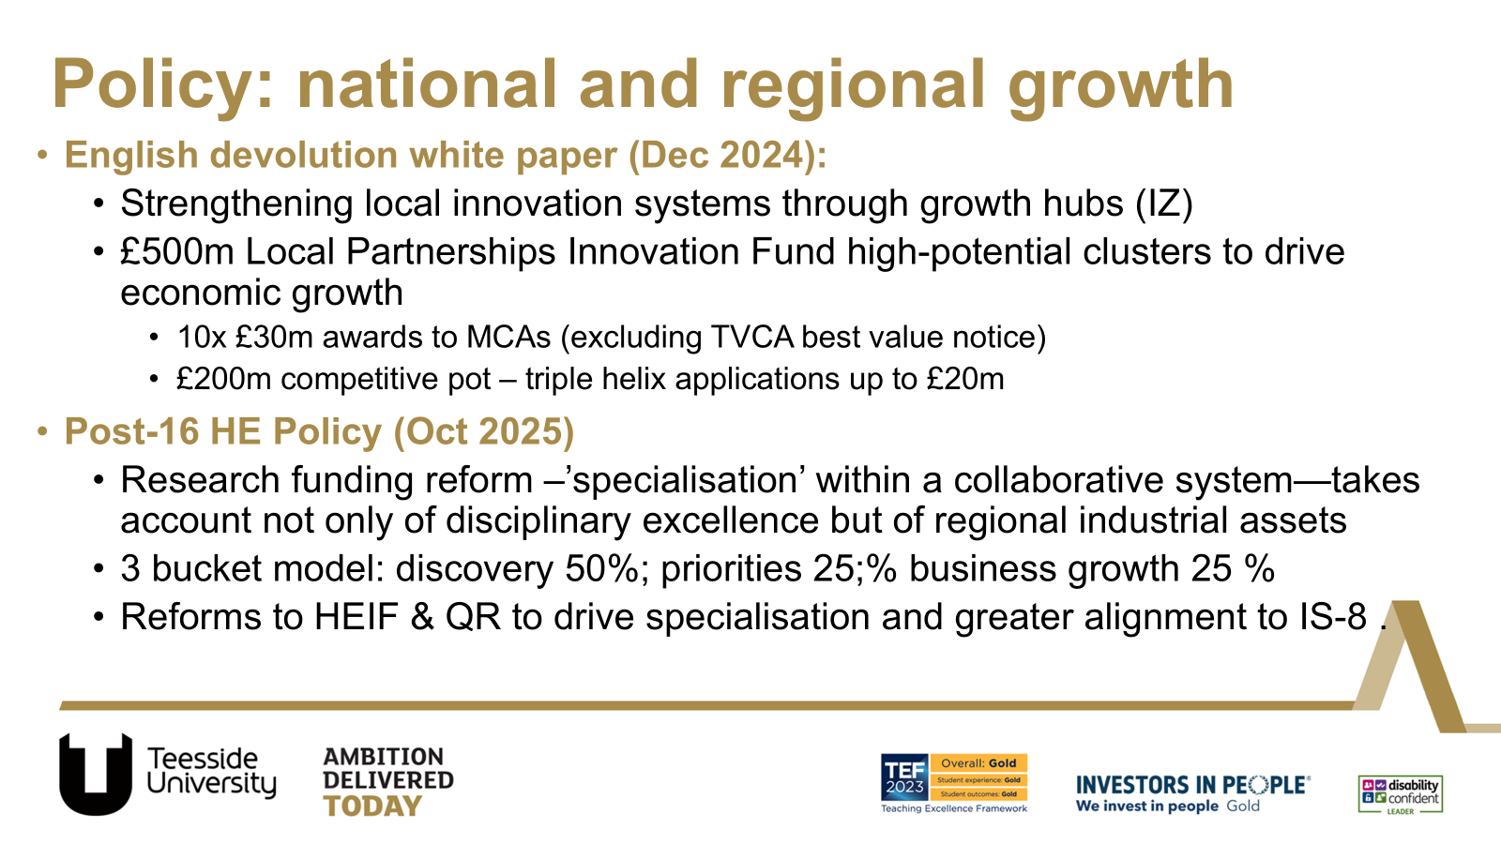

Slide 5
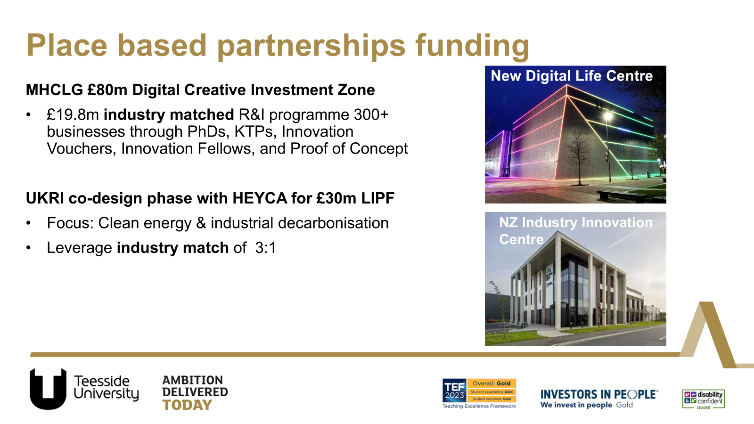

Slide 6
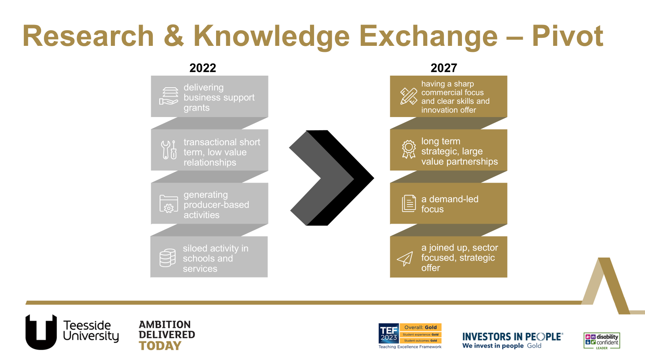

Slide 7
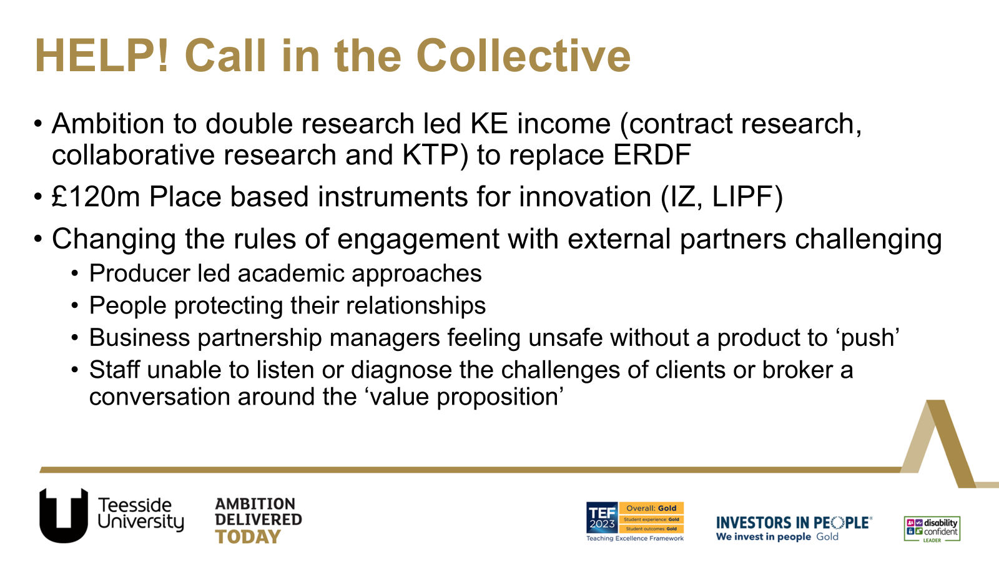

Slide 8
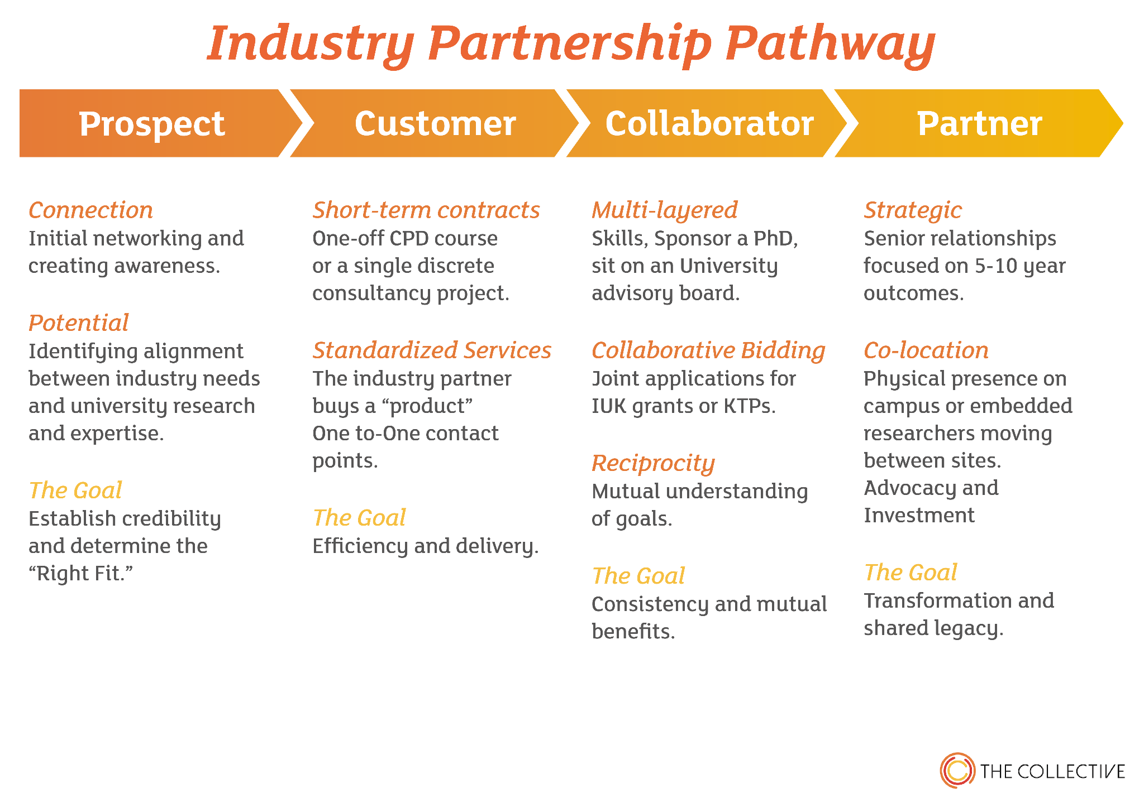



Slide 9




Partnership Pathway Pyramid
Transformational
STRATEGIC PARTNER Exclusive – few
Increasing value added
COLLABORATOR Selective – several
Increasing depth
and breadth of
relationship
Increasing trust and integration
CUSTOMER
Moderate – many
PROSPECT
Broad Base
Transactional

Slide 10
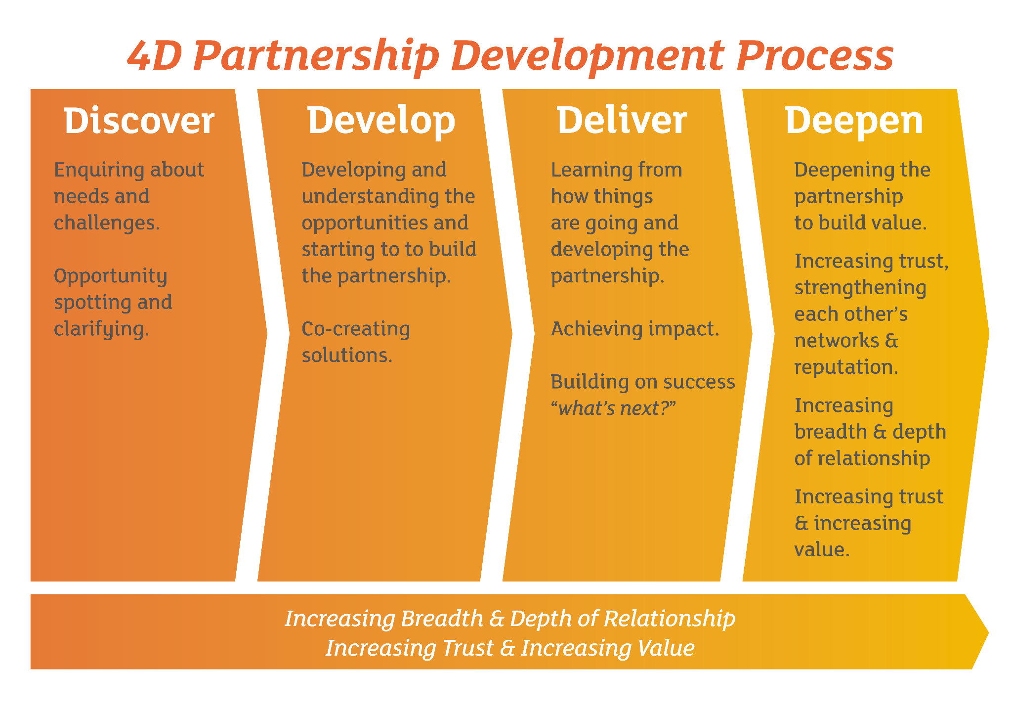

Slide 11
Pairs Discussion
Reflecting on the Teesside story and the models we have presented today…
How relevant is this model for you and your work?
How might you use this model?

