Slide 1


Squaring the Circle: Is Sustainable Research Finance Possible?
Dr Rebecca Edwards
Head of Research and Knowledge Exchange Development and Delivery
SOAS, University of London
Charles Shannon
Head of Research And Innovation Operations
Loughborough University
Presenting on behalf of the ARMA Task and Finish Group on Research Finance Sustainability

Slide 2

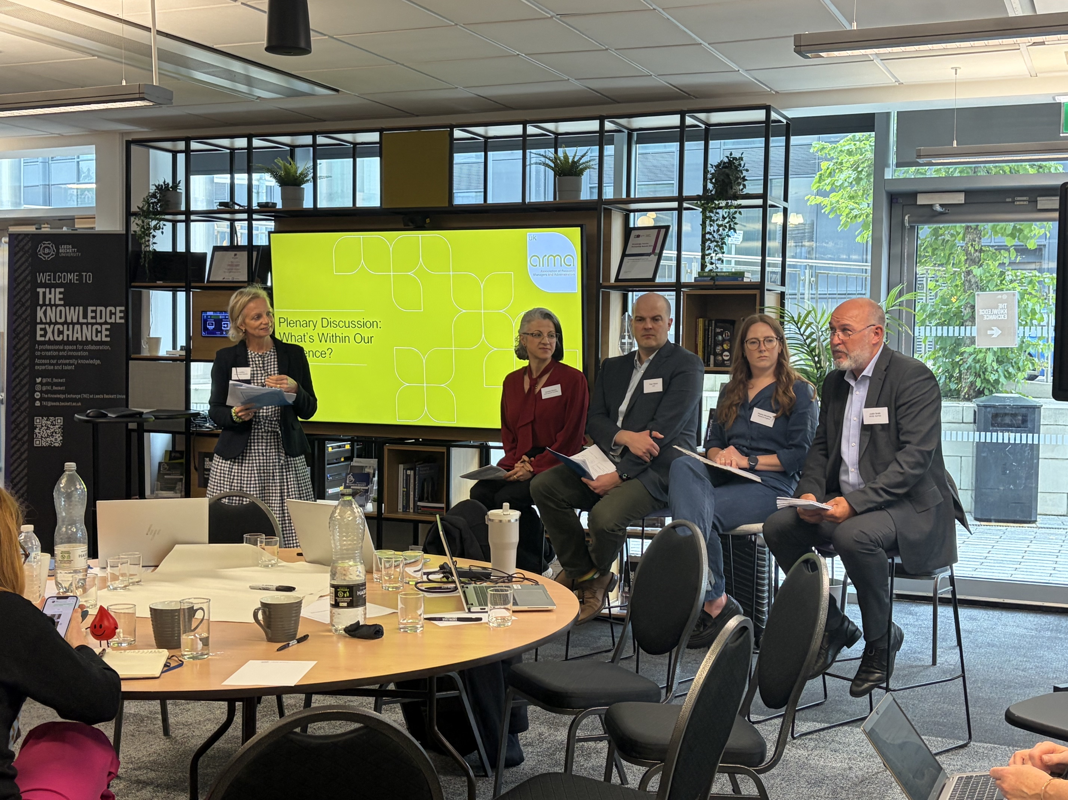

Context: About the Task and Finish Group
Summer 2024, ARMA survey of research financial sustainability revealed:
  Signs of strain changing approach
  Change approached to external funding
  Impacts on research culture
Need for action: creation of the Task and Finish Group
Have collated further survey data and insights from two workshops
Supported by Research England, report to be published later this year
#ARMA2026
Notes:
BECCA:
Welcome, and thank you for attending this session
We are here today, to give you an update on cross sector work, exploring the impact of the current financial pressures on the UK University sector on research activity
Back in summer 2024, ARMA surveyed its membership to understand the impact of the financial pressures on universities in relation to externally funded research -
This revealed some concerning trends, including signs of strain on the sector
Resulting in changing behaviours in the approach – e.g. on support for certain ECR funding schemes
Which indicated concerns re research culture which may impact national capability research
Coupled with work undertaken by other interest groups, and national data indicating declining recovery rates on research, this indicated a need for further action across our professional body
For example, most recently Universities UK survey shows worsening picture but more optimism about future backing for research - there has been a 12 percentage point leap in the number of UK universities reporting cutbacks to research

Slide 3
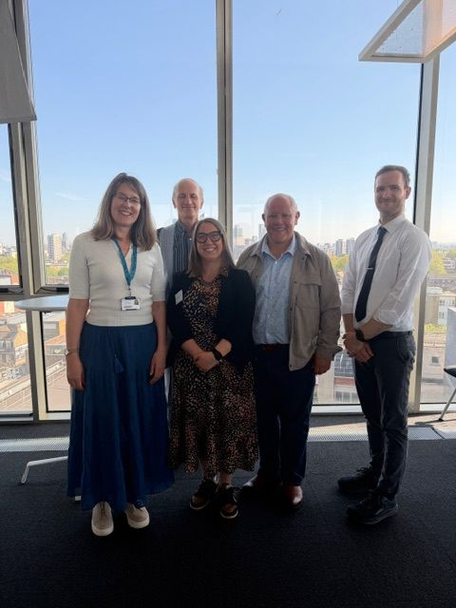
Context: About the Task and Finish Group
Chair: Bryony Butland – Director of Research and Innovation, Queen Mary University London
Rebecca Edwards - Head of RKE Development & Delivery, SOAS
Camelia Dijkstra - Director, Research and Knowledge Exchange Services, Leeds Beckett University
Clare E. Edwards – Head of Research and Partnership Development, University of Leicester
Angus Bell – Head of Research Development, Brunel University
Charles Shannon - Head of Research and Innovation Operations, Loughborough University
Alex Morrison – Research Grants Programme Manager, Bournemouth University
#ARMA2026
Notes:
BECCA:
The Task and Finish Group was established to consider the growing financial pressures affecting research delivery across the higher education sector.
Its purpose was to identify practical actions to support the long-term sustainability of the UK research base.
The group brought together insight from research management, research finance, current academic research wider professional services colleagues.
We’ve been exploring how current funding models, institutional pressures and increasing operational requirements are shaping behaviours across the research lifecycle.
The group aimed to move beyond describing the problem, and to identify where funders, institutions, ARMA and sector bodies can work together.
Our approach recognises that research sustainability is a shared responsibility across the system.
Our insight has been formed from an additional survey of membership, two participatory workshops funded by Research England and our collective experience.
Our aim has been to articulate actions which are needed to ensure research is financially sustainable and excellence is maintained during these financially pressured times.
So what did this deeper dive across our professional reveal?

Slide 4

Key findings from the evidence: 1. Financial sustainability and strategic value of research
Financial pressures across higher education are already changing behaviours across the research lifecycle.
Action is needed now to ensure financial constraint does not erode the UK’s research capability, reputation or attractiveness.
Research is too often framed as a financial “loss” without understanding value
Financial pressure is affecting research culture, particularly for early and mid-career researchers.
Reduced institutional capacity and discretionary funding mean there is less scope to invest in pipeline development, mentoring, pump-priming and routes into external funding.
#ARMA2026
Notes:
CHARLES
Financial pressures across higher education are already changing behaviours across the research lifecycle.
Action is needed now to ensure financial constraint does not erode the UK’s research capability, reputation or attractiveness.
Research is too often framed as a financial “loss” without understanding value
Financial pressure is affecting research culture, particularly for early and mid-career researchers.
Reduced institutional capacity and discretionary funding mean there is less scope to invest in pipeline development, mentoring, pump-priming and routes into external funding.

Slide 5

Key findings from the evidence: 2. Research finance, post-award delivery and professional services capacity
Research finance is a specialist area, but it is not always well understood, valued or used effectively by wider university professional services, funders or academics.
Need to raise awareness of research finance as a strategic capability, including through engagement with other professional bodies such as BUFDG.
Post-award activity is becoming increasingly complex and burdensome.
Post-award work remains under-recognised, despite being central to financial sustainability, compliance, delivery confidence and researcher experience.
Professional services capacity is being squeezed at the same time as funder requirements are increasing.
This creates a risk that delivery capacity is weakened precisely when the system needs it most.
#ARMA2026
Notes:
CHARLES:
Research finance is a specialist area, but it is not always well understood, valued or used effectively by wider university professional services, funders or academics.
Need to raise awareness of research finance as a strategic capability, including through engagement with other professional bodies such as BUFDG.
Post-award activity is becoming increasingly complex and burdensome.
Post-award work remains under-recognised, despite being central to financial sustainability, compliance, delivery confidence and researcher experience.
Professional services capacity is being squeezed at the same time as funder requirements are increasing.
This creates a risk that delivery capacity is weakened precisely when the system needs it most.

Slide 6
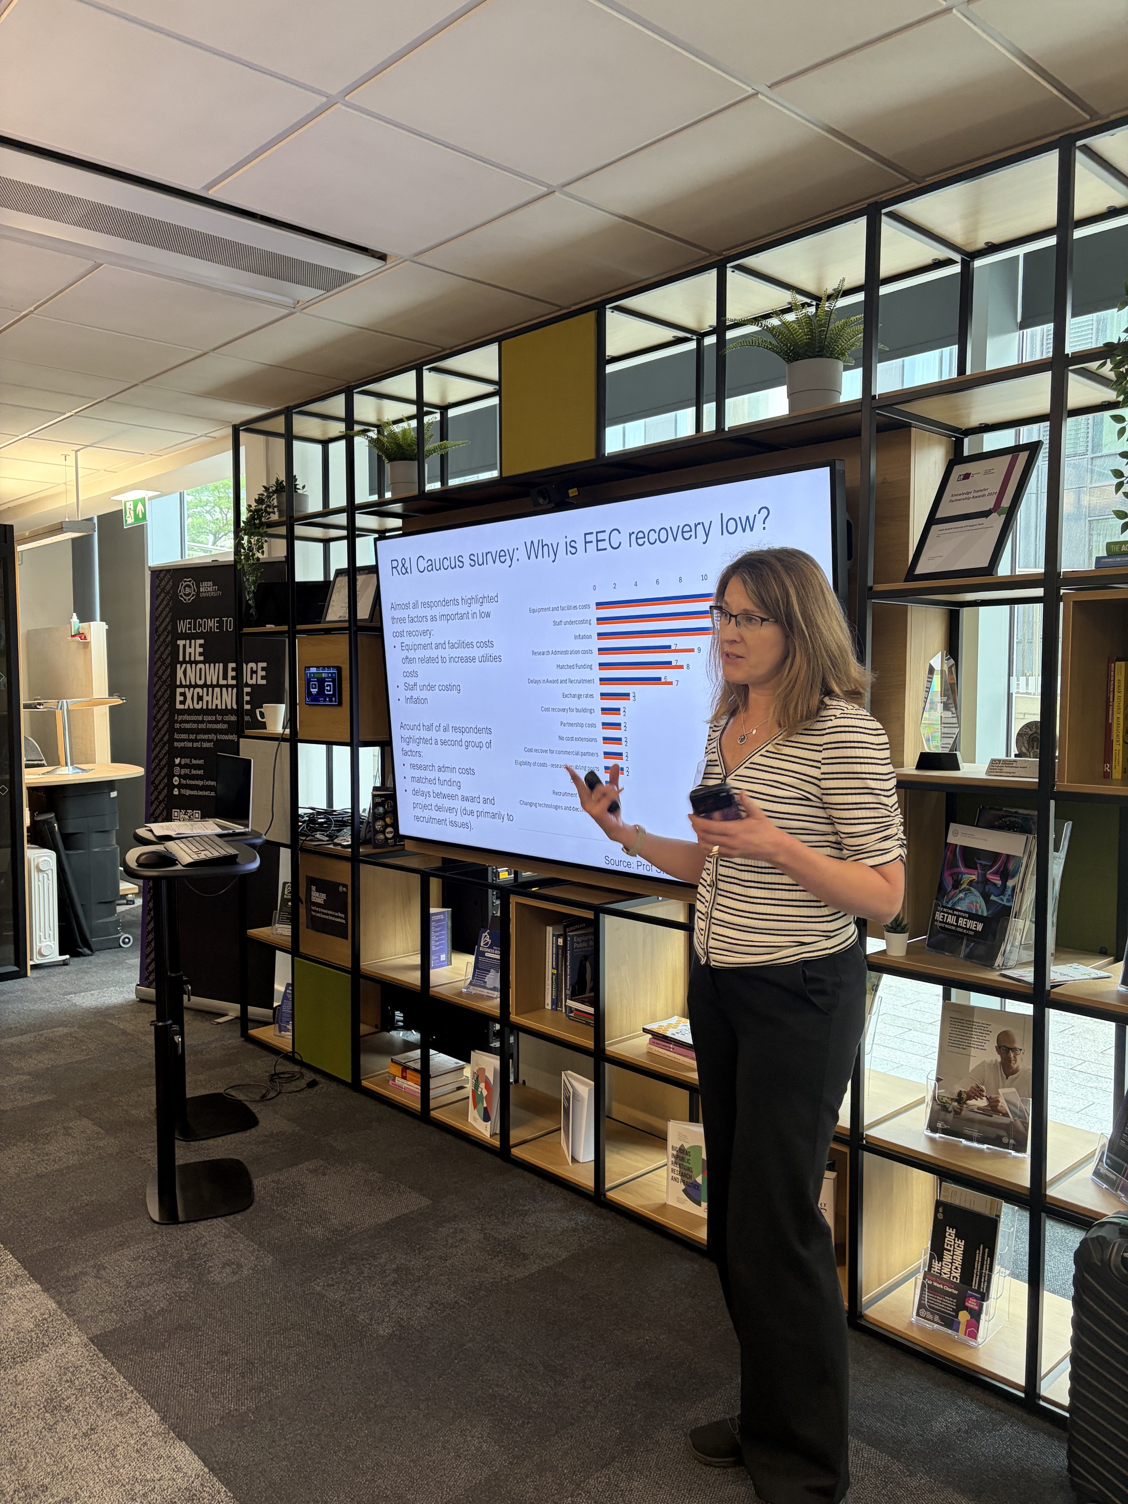
Key findings from the evidence: 3. Sector influence, funder engagement and ARMA’s collective role
Funder engagement on research funding policy and operations could be strengthened.
This needs to be distinct from engagement with researchers on research topics and funding priorities.
The people who make funding work in practice should be more systematically involved in the design, implementation and review of funding mechanisms.
There is strong appetite for ARMA to provide a collective voice for the profession.
There is also appetite for ARMA to develop practical resources and support sector-wide influence on the conditions needed for sustainable research delivery.
#ARMA2026
Notes:
CHARLES:
Funder engagement on research funding policy and operations could be strengthened.
This needs to be distinct from engagement with researchers on research topics and funding priorities.
The people who make funding work in practice should be more systematically involved in the design, implementation and review of funding mechanisms.
There is strong appetite for ARMA to provide a collective voice for the profession.
There is also appetite for ARMA to develop practical resources and support sector-wide influence on the conditions needed for sustainable research delivery.

Slide 7

Recommendations for funders: Design for sustainability
Engage research finance and professional services colleagues in scheme design and review.
Assess how funding models influence institutional behaviour and research culture.
Harmonise audit, assurance, terms and reporting requirements across funders.
Reduce delays between funding decisions, grant offers and project start dates.
Increase recovery of the full economic cost of research.
Recognise and fund the real costs of delivery, including project management, compliance, reporting, partnerships, assurance and impact.
Build review points into grant management
Reduce cumulative reporting burdens across accountability frameworks.
Work collectively with the sector to improve efficiency and avoid duplication.
#ARMA2026
Notes:
BECCA
Overall, this paints a challenging picture
Now face a crossroads – whether this continues, or whether agree and progress actions that can ensure research becomes more financially sustainable – or we take action
Emerging from the task and finish insights are recommended actions for funders, institutions and ARMA.
To funders:
Engage research finance and professional services colleagues in scheme design and review.
Assess how funding models influence institutional behaviour and research culture.
Harmonise audit, assurance, terms and reporting requirements across funders.
Reduce delays between funding decisions, grant offers and project start dates.
Increase recovery of the full economic cost of research.
Recognise and fund the real costs of delivery, including project management, compliance, reporting, partnerships, assurance and impact.
Build review points into grant management e.g. to take into account inflation
Reduce cumulative reporting burdens across accountability frameworks.
Work collectively with the sector to improve efficiency and avoid duplication

Slide 8
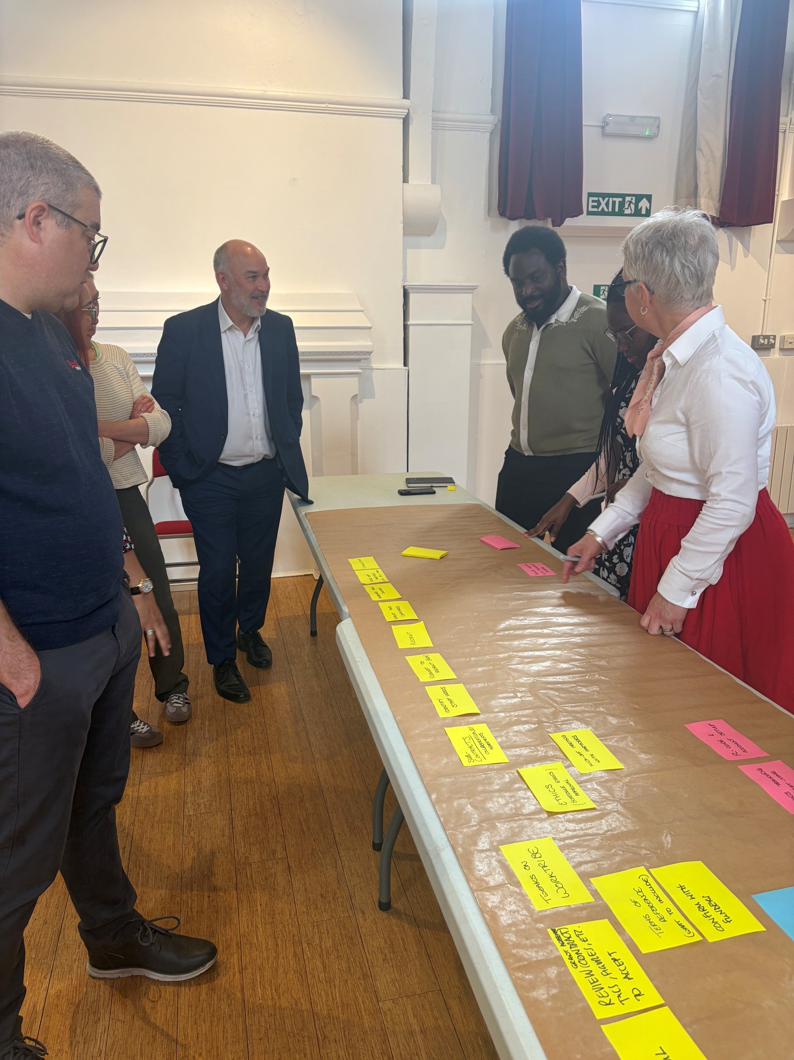
Recommendations for institutions: Recognise research sustainability as a strategic capability
Treat research sustainability as a strategic capability (not just operational)
Strengthen joined-up working across professional services
Build research finance understanding and confidence across the institution.
Articulate the wider value of research beyond award income
Protect delivery capacity as well as income-generation capacity.
Ensure professional infrastructure is in place to manage risk, compliance, funder relationships and partner delivery.
Reduce disproportionate internal bureaucracy, duplicate checks and unnecessary approvals.
Take a proportionate approach to low-risk contracts, approvals and negotiations.
Continue investing in research culture and routes into funding for early and mid-career researchers
Recognise that weakening early and mid-career support risks damaging the future research pipeline.
#ARMA2026
Notes:
BECCA
Treat research sustainability as a strategic capability (not just operational) > draw on the expertise of those colleagues who understand how it works
Strengthen joined-up working across professional services
Build research finance understanding and confidence across the institution.
Articulate the wider value of research beyond award income
Protect delivery capacity as well as income-generation capacity.
Ensure professional infrastructure is in place to manage risk, compliance, funder relationships and partner delivery.
Reduce disproportionate internal bureaucracy, duplicate checks and unnecessary approvals.
Take a proportionate approach to low-risk contracts, approvals and negotiations.
Continue investing in research culture and routes into funding for early and mid-career researchers
Recognise that weakening early and mid-career support risks damaging the future research pipeline.

Slide 9
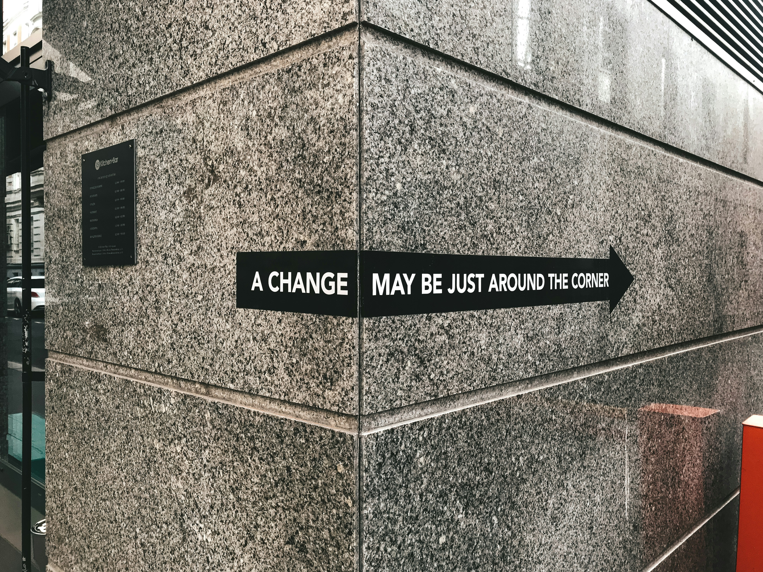
Recommendations for ARMA: Enable action for our professional community
Create shared tools, training and resources to help the sector communicate research finance sustainability clearly.
Develop funder-facing good practice principles on proportionate, realistic and sustainable funding processes.
Work with BUFDG and other professional bodies to build common language across research, finance and professional services.
Amplify insight from the profession so research managers’ experience informs sector policy and funder practice.
Keep the work moving through follow-up engagement, case studies and practical outputs.
#ARMA2026
Notes:
BECCA:
Create shared tools, training and resources to help the sector communicate research finance sustainability clearly.
Develop funder-facing good practice principles on proportionate, realistic and sustainable funding processes.
Work with BUFDG and other professional bodies to build common language across research, finance and professional services.
Amplify insight from the profession so research managers’ experience informs sector policy and funder practice.
Keep the work moving through follow-up engagement, case studies and practical outputs.

Slide 10

Next steps
“UK research and innovation is a national asset” (UUK, 2025 report on why does university research matter) - will that always be the case?
Much that we can do to enable the financial sustainability of research
Producing a full report from this work to be published later in the year with recommendations
Including next steps for cross sector collaboration
Get in touch if you’d like to be involved or would you like to share your insights/perspective
#ARMA2026
Notes:
BECCA
Research and innovation in the UK is world leading – but there is a risk with pressures on universities – this won’t always be a case, owing to short term decision making over realizing the long-term impact
What our task and finish group is highlight is that there is much we can – and arguably must – do ensure research is financially sustainable during unprecedent financial pressures on the sector
We are currently writing the report for Research England – which will detail next steps
If you are interested in being part of the solution – and squaring the circle - please reach out

Slide 11

Thank you to all that have inputting into the Task and Finish Group and to Research England for their support for this initiative

